Slide 1
Term Project Final Software Demo
CCP
Sneh Koul, Bob Anderson, John Adam, Nicholas Shawhan
4/19/2018

Slide 2
Motivation
Topic:
Course Scheduling Application
Why?
Course scheduling is a problem faced by many in the educational arena
Overwhelmed by the fact of what exactly would be a good course schedule
Don’t have straightforward information about workload, homework difficulty, and compatible of classes
How?
We cover all Computer Science class

Slide 3
Methodology
Through our web application we have made the course scheduling process easier for students in the educational arena by emphasizing the idea of synergy between classes.
Project environment:
Django Web Application Framework
Languages: Python, HTML, CSS
SQLite

Slide 4
What We’ve Done for Milestone 1
Functionalities:
Server setup:
Django with nginx and uwsgi

Slide 5
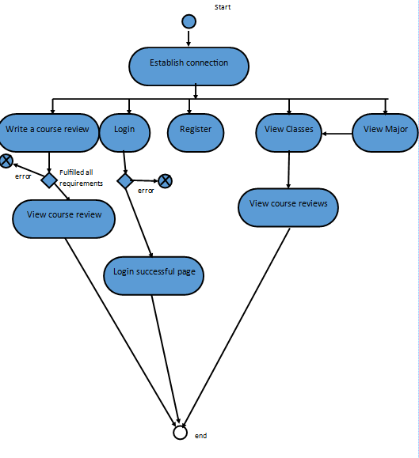
The Activity Diagram for Course Scheduling Application

Slide 6
What We’ve Done for Milestone 2
Functionalities
Homepage
Description of What we offer
Links established to other functionalities provided by our application

Slide 7
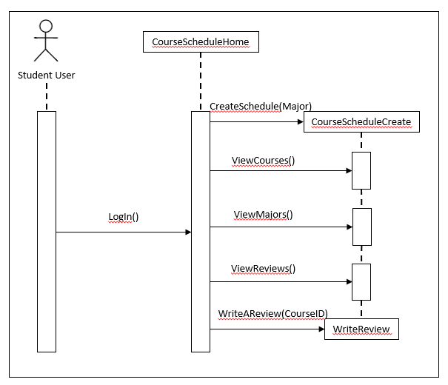
The Sequence Diagram for Course Scheduling Application

Slide 8
What We’ve Done for Milestone 3
Functionalities
Models and DB population
Associated tables developed: courseLinks, Majors, Courses
Populating the database with associated courses, majors, prerequisites, and more.

Slide 9
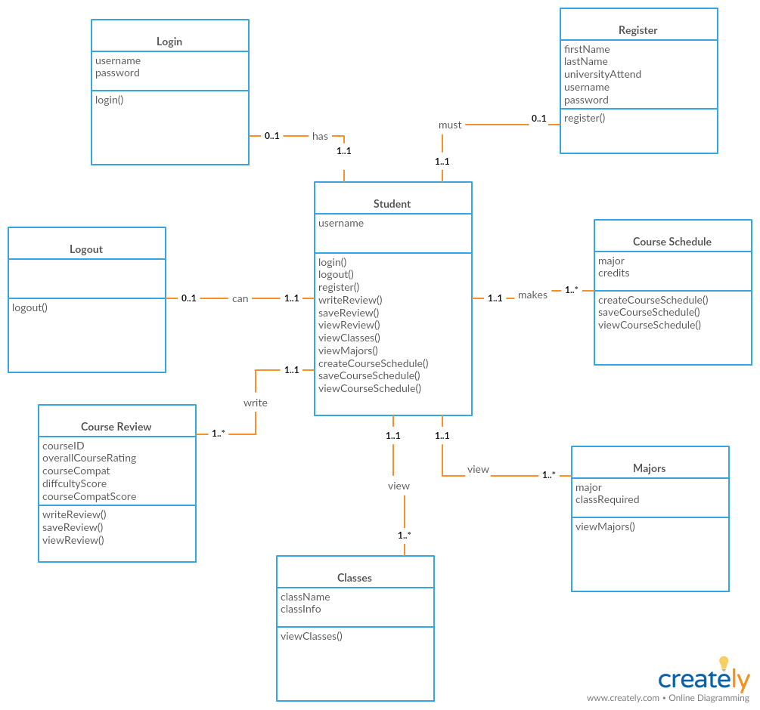
The Class Diagram for Course Scheduling Application

Slide 10
What We’ve Done for Milestone 4
Functionalities
Course Review
Developed course review form highlighting the aspects of difficulty and compatibility of courses.
Ability to review forms based on specified major.

Slide 11
The Class Diagram for Course Scheduling Application

Slide 12
What We’ve Done for Milestone 5
Functionalities
Course Schedule
Developing an algorithm being able to course review form input to generate a flowing course schedule for a student

Slide 13
The Sequence Diagram for Course Scheduling Application

Slide 14
What We’ve Done for Milestone 6
Functionalities
Additional Majors/Additional functionalities added
Implemented course schedule generation for Bioinformatics and Computer Science
Login, Register, Logout, Mission Statement, View Classes and Majors base on a major specified.

Slide 15
The Class Diagram for Course Scheduling Application

Slide 16
Demo
Step 1
Show how you test your application’s features using the automated testing frameworks, Selenium and JUnit. Should implement at least 10 JUnit test cases.
Demonstrate how all your application features works in the web browser. Bring your laptop and adapter for the demo, if necessary.
Step 2
Show the actual data set updated in DB tables using the terminal (or tool) on the Amazon AWS server.
Please prepare to show updated DB tables in class.
Step 3
https://github.com/teamsofteng/ccp2018
https://trello.com/b/frxXBSfr/ccp-software-engineering

Slide 17
What We’ve Learned
Issues and challenges
Interaction of Django with databases
Algorithm

Slide 18
Summary!!! :)
Problem: Hard to develop a compatible course schedule for students
Motivation: Many students are overwhelmed by the fact of what exactly would be a good course schedule...are these classes to hard together??
Proposed solution: Developed an course scheduling application that with help with determining a compatible course schedule based of off previous reviews requirements of classes

