Slide 1
CHALO KISAAN
Team: Squash Members: Om Bhojane Mihir Amin

Slide 2
1. Problem Definition
Agrotourism, as it stands today, faces several challenges that hinder its full potential:
Limited Pre-Visit Experience: Customers(users) often lack the means to explore farms virtually before visiting, resulting in uncertain expectations and potentially disappointing experiences.
Generic Agrotourism Offerings: The industry primarily offers standard agrotourism packages without customization, leaving tourists with limited choices and a lack of personalization.
Lack of Sustainability Focus: Many agrotourism experiences do not emphasize eco-friendly practices or educate visitors about sustainable farming methods.
Short-Term Engagement: Visitors typically engage with farms briefly, missing out on the opportunity for deeper immersion and understanding of rural life.
Limited Farmer-Tourist Interaction: Communication between agrotourists and farmers is often minimal, preventing tourists from gaining valuable insights and building lasting connections.
Addressing these issues is crucial for revolutionizing agrotourism and creating a more enriching experience for both tourists and farmers.

Slide 3
2. Solution
• Booking Appointments : Customers(users) can easily book appointments with farmers, and farmers receive instant SMS notifications containing appointment details
• Discover Hidden Gems : Find underrated and unique places to visit in your selected area, enhancing your agrotourism adventure.
• Government Scheme Information : Farmers can access simplified information about government schemes and easily apply for the support they need.
• Weather Calendar : Farmers can view a weather calendar to better plan their farming activities, ensuring optimal conditions for their crops
• Local Communities : Farmers can interact with other farmers, gardeners and discuss about their issues, access important advisories with the help of Chat application and Group announcements. Farmers will be more open-minded results stress free farming innovation

Slide 4
3. Tech Stack
• Front End : Flutter
• Backend : GCP, APIs, Firebase, SQLite

Slide 5
4. How unique is our Solution?
• Comprehensive Agrotourism Ecosystem: Chalo Kissan doesn't merely offer isolated features; it provides a holistic ecosystem that redefines agrotourism. From pre-visit exploration to post-visit engagement, our app covers every aspect of the agrotourism journey, making it a one-stop solution for tourists and farmers alike.
• Chalo Kissan's Weather Calendar provides localized weather forecasts and trends, allowing farmers to plan their agricultural activities with precision. What sets it apart is its customized nature; it's designed specifically for the needs of farmers, helping them make informed decisions regarding planting, harvesting, and other critical tasks.
• Chalo Kissan simplifies complex government agricultural schemes, making them easily understandable for farmers. We break down bureaucratic jargon and provide step-by-step guidance, ensuring that even small-scale farmers can access and benefit from these schemes without hassle.This innovation not only saves time but also increases the likelihood of farmers successfully accessing the support they need.
• Chalo Kissan's Hidden Gems feature is distinctive in its focus on curating local, off-the-beaten-path experiences for customers(users). We go beyond the popular tourist spots to highlight under-rated tourism attraction places. This uniqueness lies in our commitment to showcasing the authentic and less-explored aspects of agrotourism, offering tourists a deeper, more meaningful experience.

Slide 6
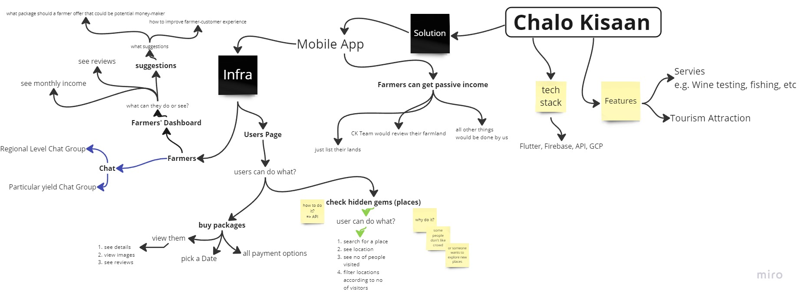
5. Architecture of our Idea

