Slide 1
Antechamber Contamination

Slide 2
Glovebox
Top_Cylinder_Before_Cleaning
Swipe
Laboratory
Swipe
Laboratory
Glovebox

Slide 3
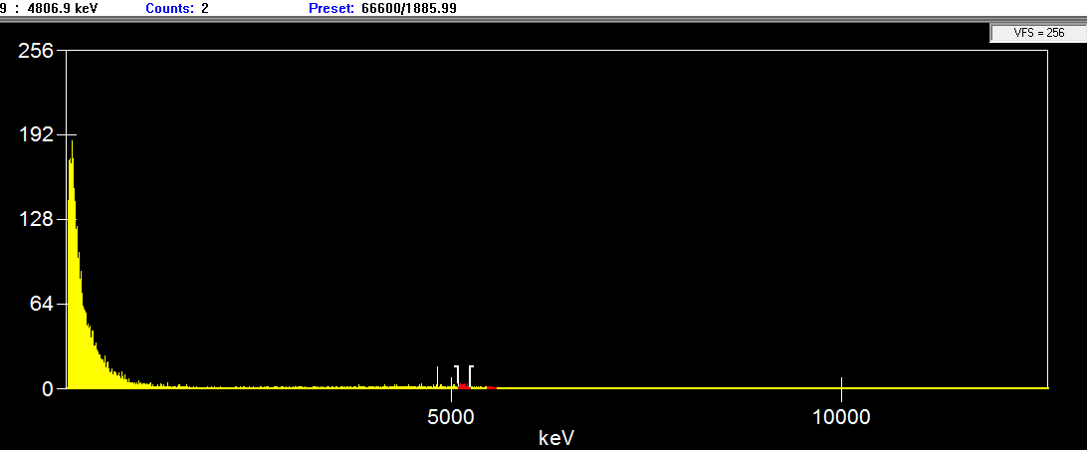

Slide 4
Glovebox
Top_Cylinder_After_Cleaning
Swipe
Laboratory
Swipe
Laboratory
Glovebox

Slide 5
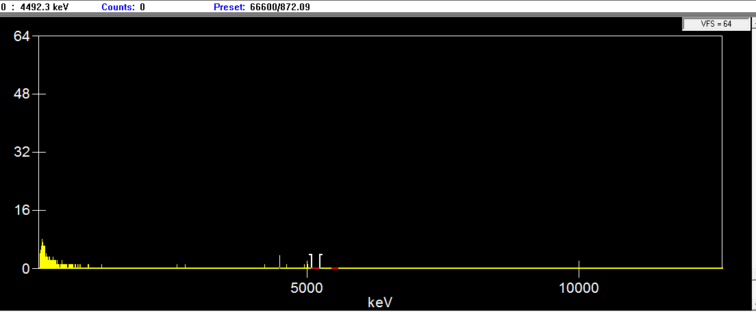

Slide 6
Glovebox
Inner Cylinder antechamber
Before cleaning
Swipe
Laboratory
Laboratory
Swipe
Glovebox

Slide 7
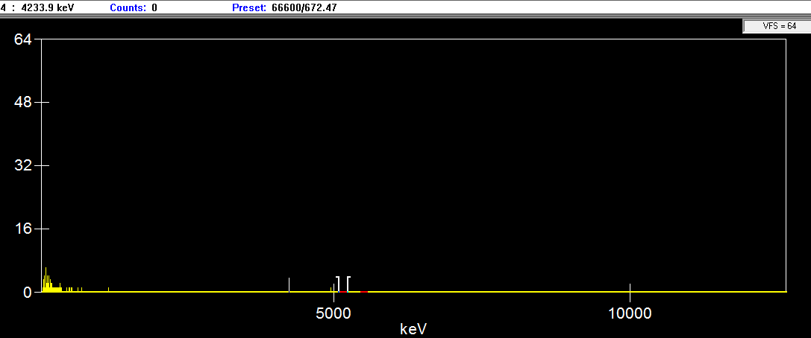

Slide 8
Glovebox
Vacuum inlet before cleaning
Swipe
Laboratory
Swipe
Laboratory
Glovebox

Slide 9
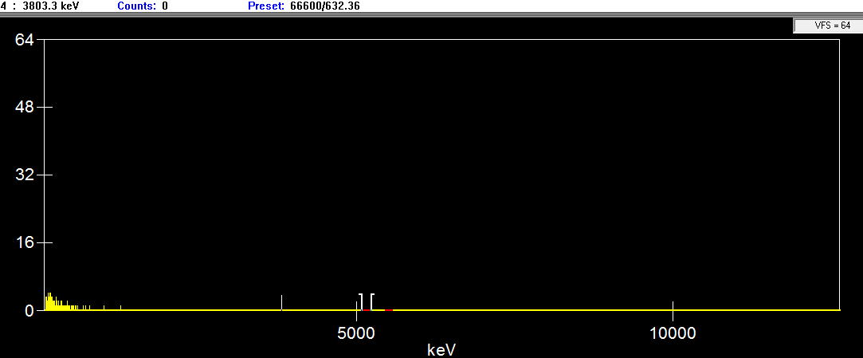

Slide 10
Glovebox
Tray_Entire_Region
Laboratory
Laboratory
Glovebox

Slide 11
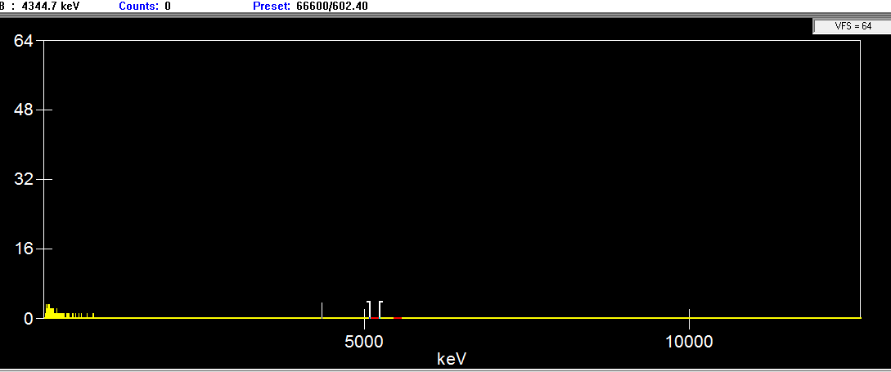

Slide 12
Glovebox
Left Right Mid plane
Swipe
Swipe
Laboratory
Laboratory
Swipe
Glovebox

Slide 13
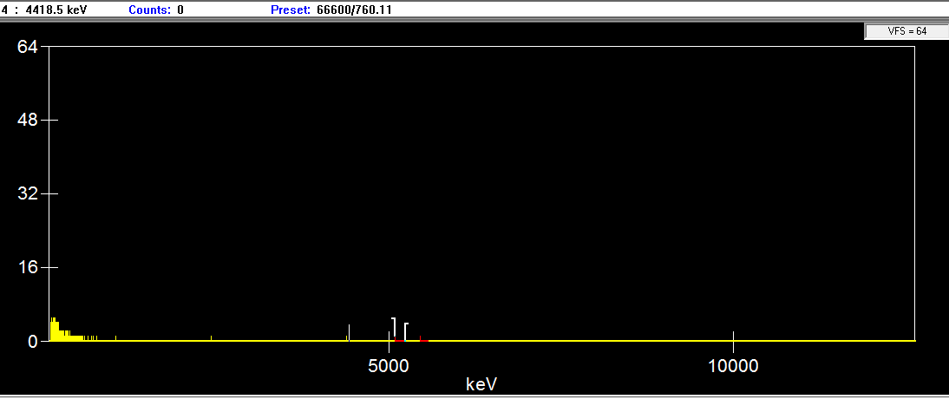

Slide 14
Glovebox
Swipe
Bottom Back portion
Of cylinder
Laboratory
Laboratory
Glovebox
Swipe

Slide 15
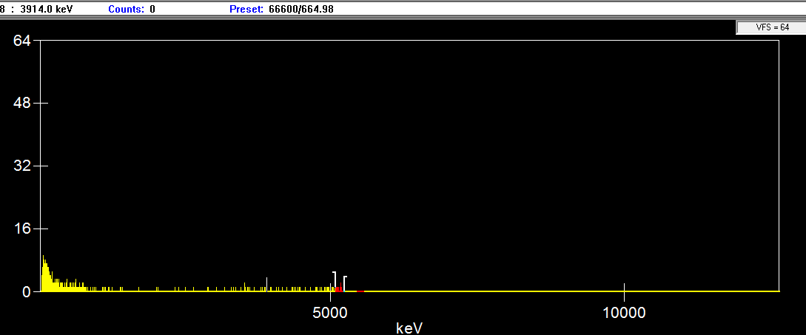

Slide 16
Glovebox
Back of Antechamber
Top portion of
cylinder
Swipe
Laboratory
Swipe
Laboratory
Glovebox

Slide 17
