Slide 1
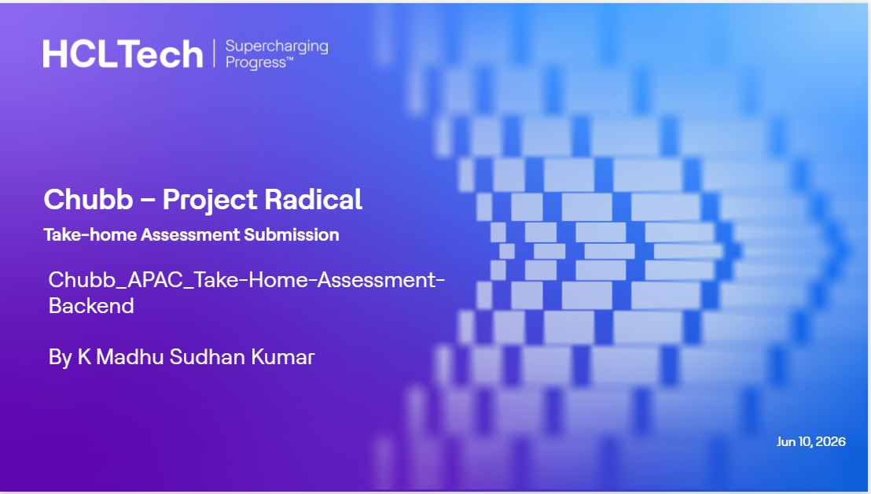
Classification: Internal

Slide 2
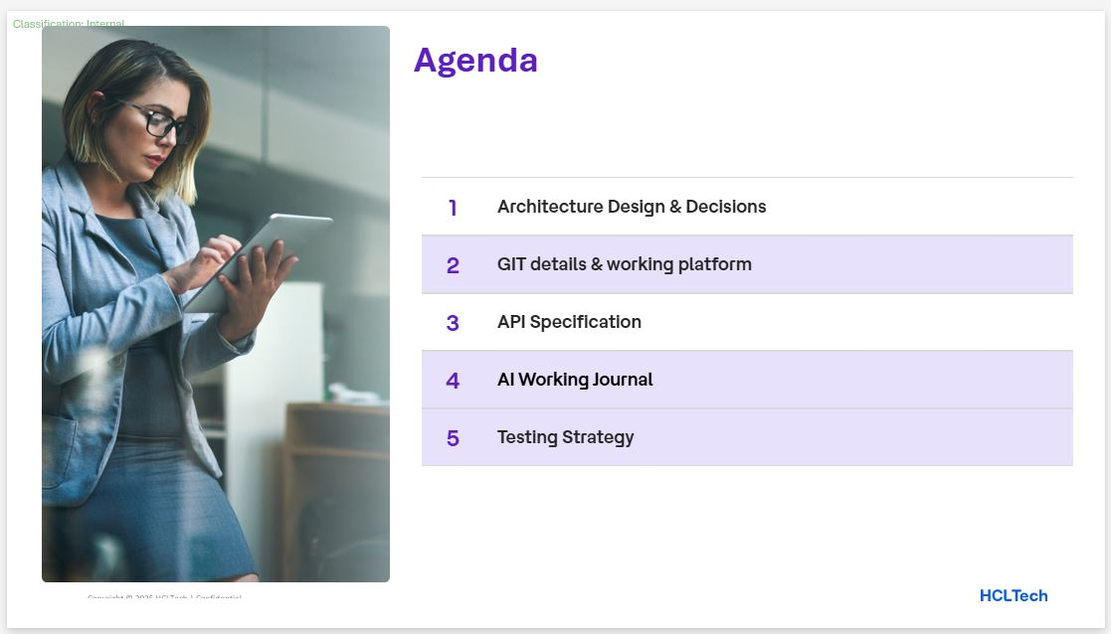

Slide 3
Classification: Internal
Architecture Design & Decisions
Layered Clean Architecture with a framework-free domain core; dependencies point inward (api → service → domain; infrastructure → domain).
Strict boundaries — DTOs never leave api; JPA entities never leave infrastructure; only domain models cross layers, each via a dedicated mapper.
Read flow — Entity → EntityToDomain → domain Policy → DomainToResponseDto → ResponseDto.
Dynamic filtering via JPA Specifications, composed null-safely from a PolicySearchCriteria domain object; absent filters become no-op predicates.
Display vs. stored values — enums stored by constant name (ACTIVE, ACCIDENT_AND_HEALTH), surfaced as display values (Active, A&H) via a WebMvcConfigurer.
Flyway owns the schema — ddl-auto=validate fails fast on drift; constructor injection only keeps components immutable and unit-testable.
Contract-first — OpenAPI authored up front; 250 realistic APAC policies auto-seeded into an empty database for an out-of-the-box demo.

Slide 4
Classification: Internal
GIT details & working platform
Repository — https://github.com/madhurrscs/policy-overview-bff (working branch: dev; PR target: main).
Build & tooling — Java 21 (LTS), Spring Boot 3.4.5, Maven with committed wrapper (mvnw / mvnw.cmd), Lombok.
Runtime stack — Spring Web, Data JPA, Validation, Actuator; PostgreSQL; Flyway migrations; springdoc-openapi (Swagger UI).
Local platform — Docker Compose provisions postgres:18 (database : policydb, port : 5432) with a persistent volume and a pg_isready healthcheck.
Run locally — docker compose up -d, then ./mvnw spring-boot:run → http://localhost:8080 (API /api/v1, Swagger /swagger-ui.html).
Configuration externalized — datasource via env vars (.env committed as .env.example) with safe local defaults.
History — 7 conventional commits: contract+schema → entity/repository+seed → API implementation → exception handling, tests & Docker → finalize.

Slide 5
Classification: Internal
API Specification
Contract-first OpenAPI 3.0.3 (policies-api.yaml); base path /api/v1; served live via Swagger UI and /v3/api-docs.
GET /policies — paginated, sorted, multi-field filtered, free-text searchable; returns PagedPolicies (content, page, size, totalElements, totalPages).
GET /policies/{id} — single policy by UUID; 404 when not found (PolicyNotFoundException).
PATCH /policies/flag — bulk flag policies for review; returns flaggedCount and a message.
GET /policies/summary — counts by status, total premium by line of business, and an expiring-soon count.
Filters — status, lineOfBusiness, region, effectiveDateFrom/To, search; enums accept display values (status=Active, lineOfBusiness=A&H).
Standard ErrorResponse model (timestamp, status, error, message, path); documented 400 / 404 / 503 responses.

Slide 6
Classification: Internal
AI Working Journal
Built end-to-end with AI assistance under explicit project rules in .claude/rules (architecture, code-style, logging, testing); ai-journal.md records each step and trade-off.
Scaffolding — Spring Boot 3.4.5 / Java 21 Maven project, layered package skeleton, Flyway baseline migration.
Contract-first — authored the OpenAPI contract, then aligned migration, JPA entity, domain model and DTOs to the full 14-field Policy schema.
Persistence — PolicyEntity + repository (JpaSpecificationExecutor); seeder split into PolicySampleDataFactory for SRP and complexity < 4 (EnumMap over switches).
Filtering & service — framework-free PolicySearchCriteria, null-safe PolicySpecification, service layer with EntityToDomain mapper.
Global exception handling — @RestControllerAdvice maps NotFound→404, validation→400, catch-all→500; SLF4J parameterized logs (method/path/correlationId), no sensitive data.
Key decisions & follow-ups — pinned Spring Boot 3.4.5, stored-vs-display enums, Lombok/Byte Buddy overrides for newer JDKs; open: correlation-ID filter, 503 mapping, @WebMvcTest.

Slide 7
Classification: Internal
Testing Strategy
Two-tier strategy per .claude/rules/testing.md — unit tests for service / mappers / specification plus database integration tests; 32 @Test cases across 7 classes.
Unit (JUnit 5 + Mockito) — PolicyServiceImplTest (6), PolicySpecificationTest (10), GlobalExceptionHandlerTest (6), DomainToResponseDtoTest (2), EntityToDomainTest (1).
Happy + failure paths, AAA pattern, repositories and Criteria API mocked; runnable without Docker.
Integration (Testcontainers) — PolicySpecificationIntegrationTest (6) spins up a real PostgreSQL via @ServiceConnection to validate filtering and search against a live DB.
Conventions — naming nameOfTheTest_whatIsTested_outcome; JUnit assertions throughout.
Execution — ./mvnw test runs the full suite (integration needs Docker); -Dtest=... targets the unit-only set.
Build robustness — Byte Buddy and Lombok versions overridden so Mockito mocking and annotation processing work on newer JDKs.

Slide 8

Classification: Internal

