Slide 1


數位語音處理概論
Introduction to Digital Speech Processing
8.0 Search Algorithms for Speech Recognition
References: 1. 12.1-12.5 of Huang, or 2. 7.2-7.6 of Becchetti, or 3. 5.1-5.7, 6.1-6.5 of Jelinek
4. “ Progress in Dynamic Programming Search for LVCSR
(Large Vocabulary Continuous Speech Recognition)”,
Proceedings of the IEEE, Aug 2000
授課教師：國立臺灣大學 電機工程學系 李琳山 教授
【本著作除另有註明外，採取創用CC「姓名標示－非商業性－相同方式分享」臺灣3.0版授權釋出】

Slide 2


Basic Approach for Large Vocabulary Speech Recognition
A Simplified Block Diagram
Example Input Sentence
this is speech
Acoustic Models
(th-ih-s-ih-z-s-p-ih-ch)
Lexicon (th-ih-s) → this
(ih-z) → is
(s-p-iy-ch) → speech
Language Model (this) – (is) – (speech)
P(this) P(is | this) P(speech | this is)
P(w_{i}|w_{i-1}) bi-gram language model
P(w_{i}|w_{i-1},w_{i-2}) tri-gram language model,etc
Input Speech
Front-end
Signal Processing
Feature
Vectors
Linguistic Decoding
and
Search Algorithm
Output
Sentence
Speech
Corpora
Acoustic
Model
Training
Acoustic
Models
Language
Model
Language
Model
Construction
Text
Corpora
Lexicon
2

Slide 3
DTW and Dynamic Programming
Dynamic Time Warping (DTW)
well accepted pre-HMM approach
find an optimal path for matching two templates with different length
good for small-vocabulary isolated-word recognition even today
Test Template [y_{j}, j=1,2,...N] and Reference Template [x_{i}, i=1,2,..M]
warping both templates to a common length L
warping functions: f_{x}(m)= i, f_{y}(m)= j, m=1,2,...L
endpoint constraints: f_{x}(1)= f_{y}(1)= 1, f_{x}(L)=M, f_{y}(L)= N
monotonic constraints: f_{x}(m+1) ≥ f_{x}(m), f_{y}(m+1) ≥ f_{y}(m)
matching pair: for every m, m: index for matching pairs
recursive relationship:
global constraints/local constraints
lack of a good approach to train a good reference pattern
Dynamic Programming
replacing the problem by a smaller sub-problem and formulating an iterative procedure
Reference: 4.7 up to 4.7.3 of Rabiner and Juang
3

Slide 4
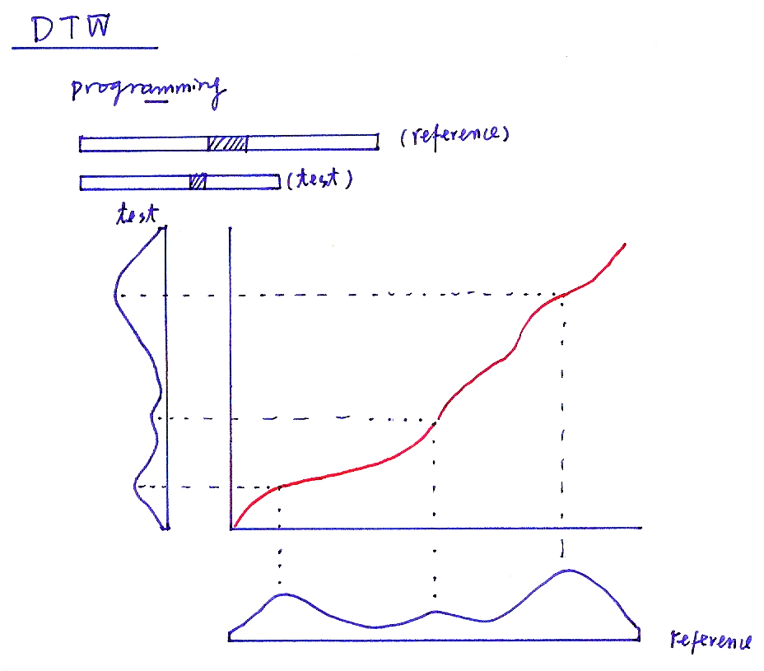
DTW
programming
(reference)
(test)
test
reference
4

Slide 5
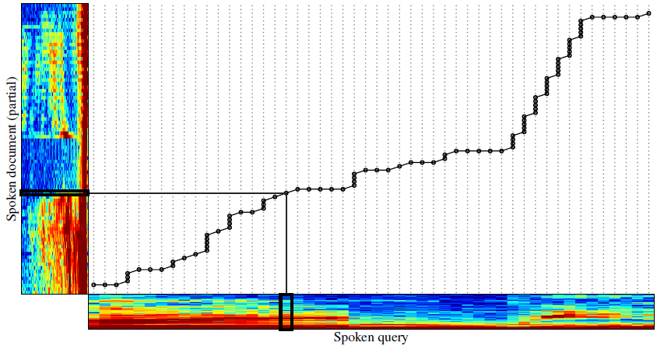
DTW
5

Slide 6
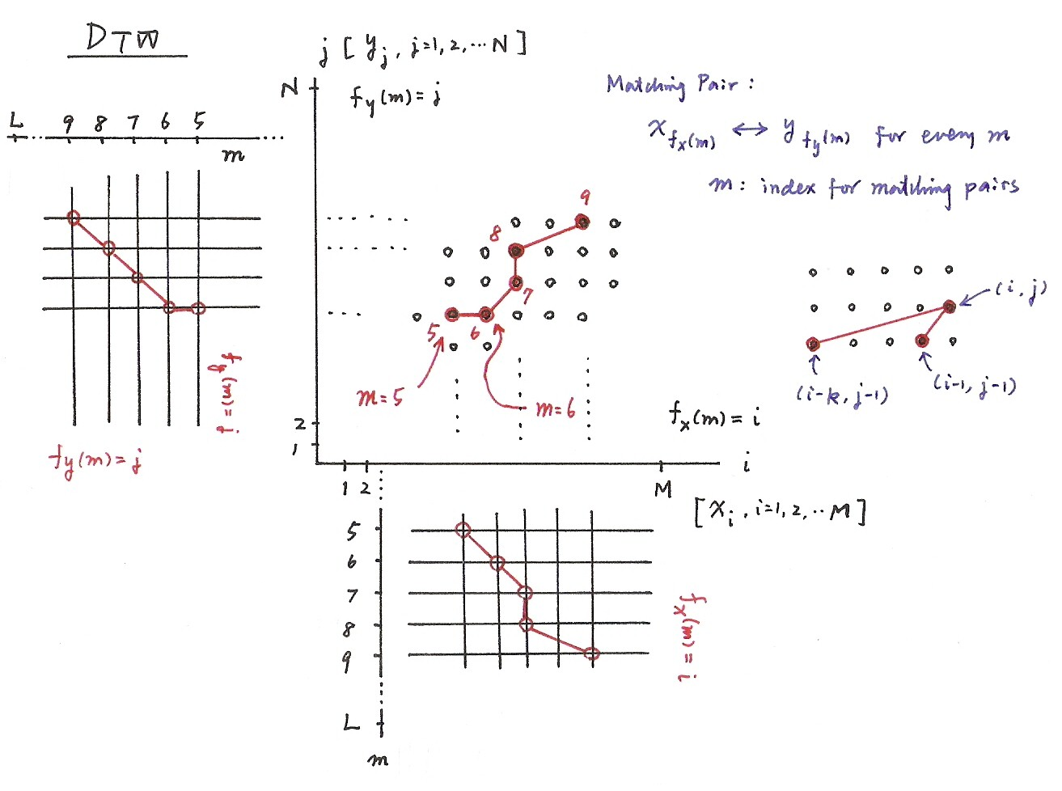
DTW
f_{x}(m)= i, f_{y}(m)= j, m=1,2,...L
f_{x}(1)= f_{y}(1)= 1, f_{x}(L)=M, f_{y}(L)= N
f_{x}(m+1) ≥ f_{x}(m), f_{y}(m+1) ≥ f_{y}(m)
accumulated minimum distance
6

Slide 7
7

Slide 8
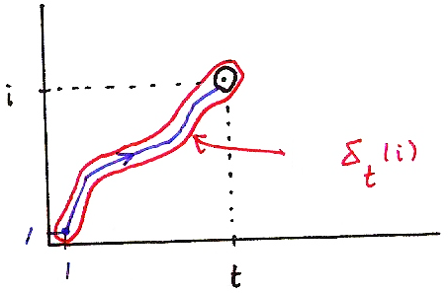
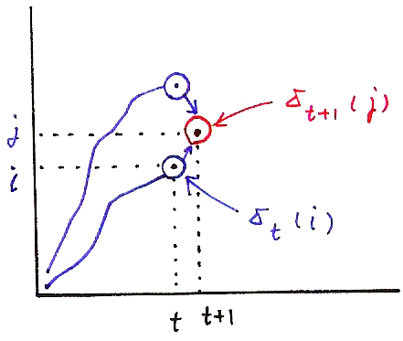
Viterbi Algorithm (P.21 of 4.0)
δ_{t+1}( j) = max [δ_{t}(i)a_{ij}] • b_{j}(o_{t+1})
i
i
δ_{t+1}(j)
j
δ_{t}(i)
i
δ_{t}(i)
1
1
t
δ_{t}(i) = max P[q₁,q₂,…q_{t-1}, q_{t} = i, o₁,o₂,…,o_{t} |λ]
t
t+1
q₁,q₂,…q _{t-1}
8

Slide 9
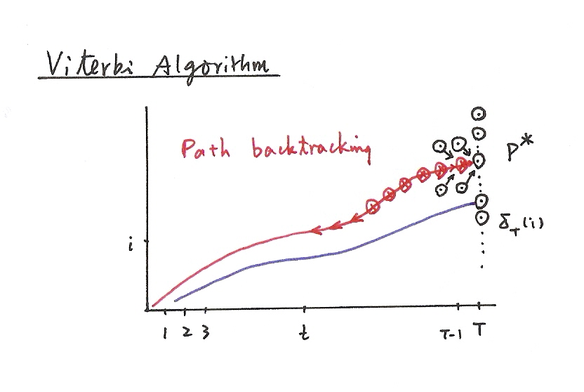
Viterbi Algorithm (P.22 of 4.0)
9

Slide 10
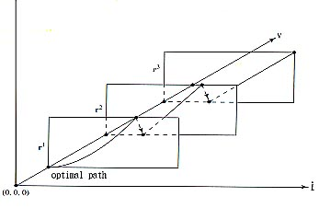
Continuous Speech Recognition Example: Digit String Recognition― One-stage Search
Unknown Number of Digits
No Lexicon/Language Model Constraints
Search over a 3-dim Grid
0
1
0
1
9
9
9
2
0
1
t
Switched to the First State of the Next Model at the End of the Previous Model
May Result with Substitution, Deletion and Insertion
10

Slide 11
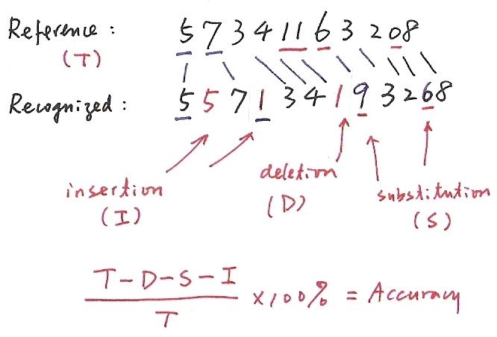
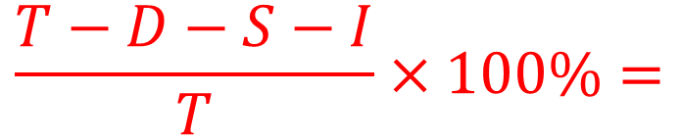
Recognition Errors
Reference:
(T)
Aligned
Recognized:
insertion
(I)
deletion
(D)
substitution
(S)
$$\frac{T−D−S−I}{T}×100\%=$$
Accuracy
11

Slide 12
Continuous Speech Recognition Example: Digit String Recognition ― Level-Building
Known Number of Digits
No Lexicon/Language Model Constraints
Higher Computation Complexity, No Deletion/Insertion
0
1
.
9
0
1
.
9
0
1
.
9
0
1
.
9
State
01...9
number of levels = number of digits in an utterance
automatic transition from the last state of the previous model to the first state of the next model
01...9
01...9
01...9
t
12

Slide 13
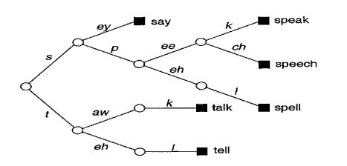
Time (Frame)- Synchronous Viterbi Search for Large-Vocabulary Continuous Speech Recognition
MAP Principle
An Approximation
the word sequence with the highest probability for the most probable state sequence usually has approximately the highest probability for all state sequences
Viterbi search, a sub-optimal approach
Viterbi Search―Dynamic Programming
replacing the problem by a smaller sub-problem and formulating an iterative procedure
time (frame)- synchronous: the best score at time t is updated from all states at time t-1
Tree Lexicon as the Basic Working Structure
from
HMM
from Language Model
each arc is an HMM (phoneme, tri-phone, etc.)
each leaf node is a word
search processes for a segment of utterance through some common units for different words can be shared
search space constrained by the lexicon
the same tree copy reproduced at each leaf node in principle
13

Slide 14
Basic Problem 2 for HMM (P.24 of 4.0)
․Application Example of Viterbi Algorithm
- Isolated word recognition
.
.
.
observation
1
≤
i
≤
n
1
≤
i
≤
n
Basic Problem 1
Forward Algorithm
(for all paths)
Basic Problem 2
Viterbi Algorithm
(for a single best path)
The model with the highest probability for the most probable path
usually also has the highest probability for all possible paths.
14

Slide 15
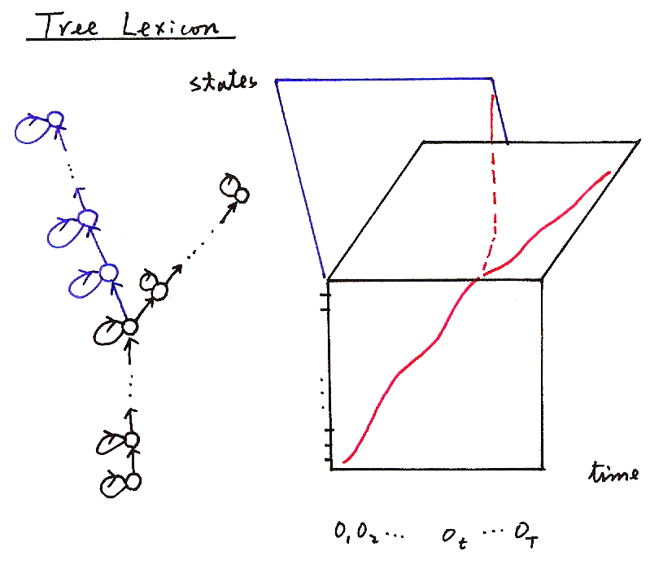
Tree Lexicon
states
time
o₁ o₂ …. o_{t} …. o_{T}
15

Slide 16
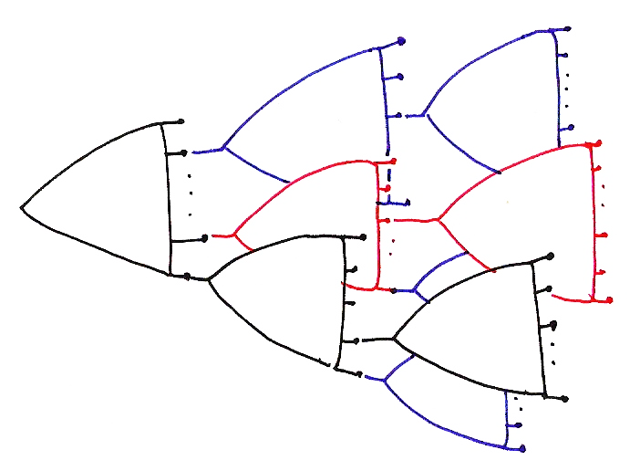
16

Slide 17
Time (Frame)- Synchronous Viterbi Search for Large –Vocabulary Continuous Speech Recognition
Define Key Parameters
D (t, q_{t}, w) : objective function for the best partial path ending at time t in state q_{t} for the word w
h (t, q_{t}, w) : backtrack pointer for the previous state at the pervious time when the best partial path
ends at time t in state q_{t} for the word w
Intra-word Transition―HMM only, no Language Model
Inter-word Transition―Language Model only, no HMM (bi-gram as an example)
17

Slide 18
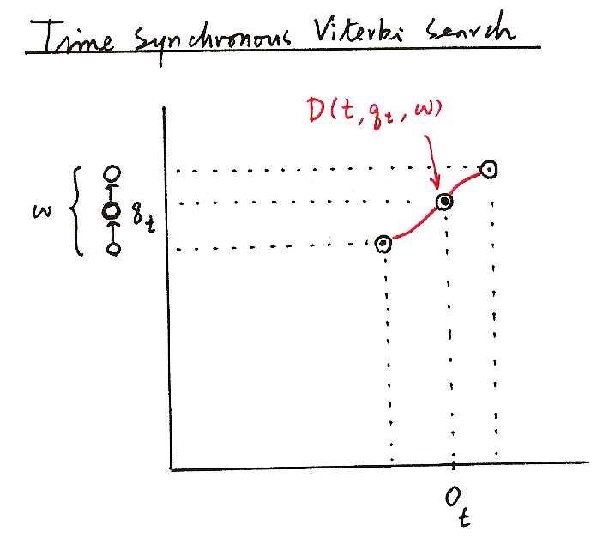
Time Synchronous Viterbi Search
D (t, q_{t} , w)
w
q_{t}
_{ot}
18

Slide 19
Viterbi Algorithm (P.21 of 4.0)
δ_{t+1}( j) = max [δ_{t}(i)a_{ij}] • b_{j}(o_{t+1})
i
i
δ_{t+1}(j)
j
δ_{t}(i)
i
δ_{t}(i)
1
1
t
δ_{t}(i) = max P[q₁,q₂,…q_{t-1}, q_{t} = i, o₁,o₂,…,o_{t} |λ]
t
t+1
q₁,q₂,…q _{t-1}
19

Slide 20
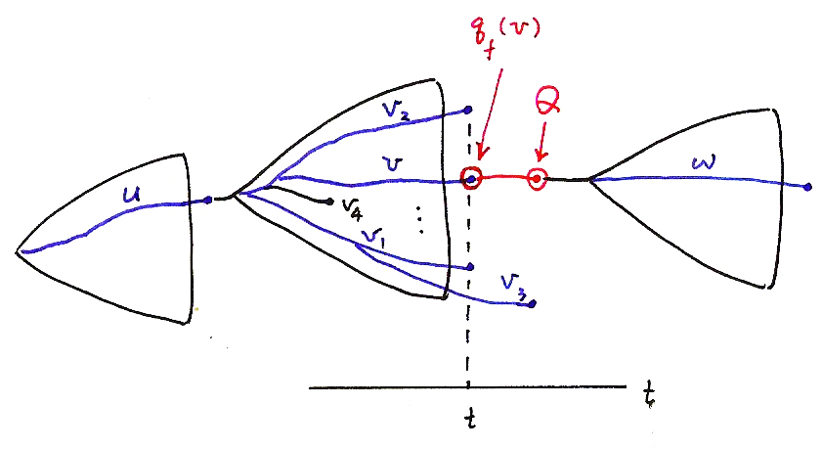
q_{f} (v)
Q
t
t
20

Slide 21
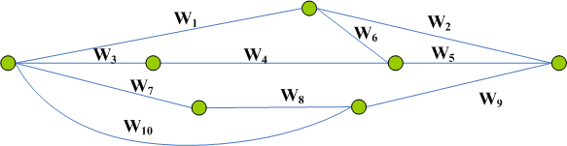
Time (Frame)- Synchronous Viterbi Search for Large-Vocabulary Continuous Speech Recognition
Beam Search
at each time t only a subset of promising paths are kept
example 1: define a beam width L (i.e. keeping only L paths at each time)
example 2: define a threshold Th (i.e. all paths with D< D_{max,t}-Th are deleted)
very helpful in reducing the search space
Two-pass Search (or Multi-pass Search)
use less knowledge or less constraints (e.g. acoustic model with less context dependency or language model with lower order) in the first stage, while more knowledge or more constraints in rescoring in the second path
search space significantly reduced by decoupling the complicated search process into simpler processes
N-best List and Word Graph (Lattice)
W₁ W₂
W₁ W₆ W₅
W₃ W₄ W₅
W₇ W₈ W₉
W₁₀ W₉
similarly constructed with dynamic programming iterations
N-best
List
X
N-best List or
Word Graph
Generation
Rescoring
W
Word
Graph
Time
21

Slide 22
Some Search Algorithm Fundamentals
An Example – a city traveling problem
8.5
3
3
2.8
C
E
3
S: starting
G: goal
to find the minimum distance path
3
A
5.7
4
5
G
S
5
10
2
B
4
D
F
3.0
10.3
7.0
Search Tree(Graph)
Blind Search Algorithms
Depth-first Search: pick up an arbitrary alternative and proceed
Breath-first Search: consider all nodes on the same level before going to the next level
no sense about where the goal is
3
S
2
A
6
B
6
7
6
B
C
A
D
11
11
D
11
F
9
E
C
E
9
C
16
E
G
12
G
14
14
Heuristic Search
Best-first Search
based on some knowledge, or “heuristic information”
f(n) = g(n)+h*(n)
g(n): distance up to node n
h*(n): heuristic estimate for the remaining distance up to G
heuristic pruning
S
11.5
A
h*(n):
straight-line distance
11.7
11.8
C
E
12.0
G
22

Slide 23
Heuristic Search: Another Example
Problem: Find a path with the highest score from root node “A” to some leaf node (one of “L1”,”L2”,”L3”,”L4”)
A
4
3
2
B
C
D
3
4
8
3
Node g(n) h*(n) f(n)
A 0 15 15
B 4 9 13
C 3 12 15
D 2 5 7
E 7 4 11
F 7 2 9
G 11 3 14
L1 9 0 9
L2 8 0 8
L3 12 0 12
L4 5 0 5
E
F
G
L4
2
1
1
L1
L2
L3
List of Candidate Steps
Top | Candidate List
A(15) | A(15)
C(15) | C(15), B(13), D(7)
G(14) | G (14), B(13), F(9), D(7)
B(13) | B(13), L3(12), F(9), D(7)
L3(12) | L3 (12), E(11), F(9), D(7)
23

Slide 24
A* Search and Speech Recognition
Admissibility
a search algorithm is admissible if it is guaranteed that the first solution found is optimal, if one exists (for example, beam search is NOT admissible)
It can be shown
the heuristic search is admissible if
for all n with a highest-score problem
A* search when the above is satisfied
Procedure
Keep a list of next-step candidates, and proceed with the one with the highest f(n) (for a highest-score problem)
A* search in Speech Recognition
example 1: use of weak constraints in the first pass to generate heuristic estimates in multi-pass search
example 2: estimated average score per frame as the heuristic information
24

Slide 25

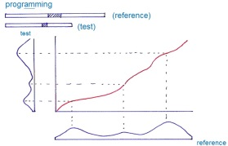
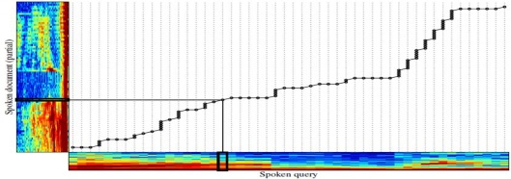
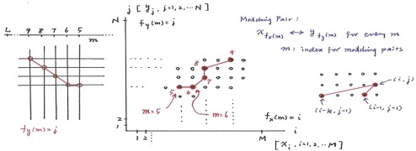
版權聲明
頁碼 | 作品 | 版權標示 | 作者/來源
2 |  |  | 國立臺灣大學電機工程學系 李琳山 教授 本作品採用創用CC「姓名標示-非商業性-相同方式分享3.0臺灣」許可協議。
4 |  |  | 國立臺灣大學電機工程學系 李琳山 教授 本作品採用創用CC「姓名標示-非商業性-相同方式分享3.0臺灣」許可協議。
5 |  |  | 國立臺灣大學電機工程學系 李琳山 教授 本作品採用創用CC「姓名標示-非商業性-相同方式分享3.0臺灣」許可協議。
6 |  |  | 國立臺灣大學電機工程學系 李琳山 教授 本作品採用創用CC「姓名標示-非商業性-相同方式分享3.0臺灣」許可協議。
25

Slide 26
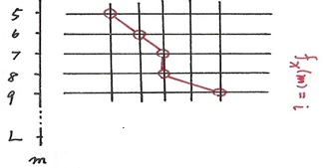
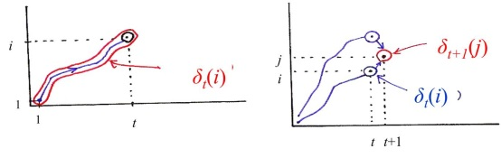
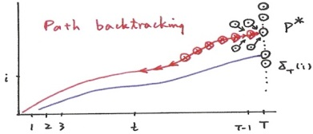
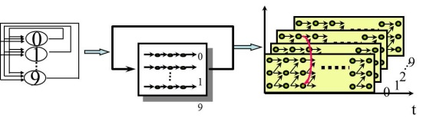
版權聲明
頁碼 | 作品 | 版權標示 | 作者/來源
6 |  |  | 國立臺灣大學電機工程學系 李琳山 教授 本作品採用創用CC「姓名標示-非商業性-相同方式分享3.0臺灣」許可協議。
8,19 |  |  | 國立臺灣大學電機工程學系 李琳山 教授 本作品採用創用CC「姓名標示-非商業性-相同方式分享3.0臺灣」許可協議。
9 |  |  | 國立臺灣大學電機工程學系 李琳山 教授 本作品採用創用CC「姓名標示-非商業性-相同方式分享3.0臺灣」許可協議。
10 |  |  | 國立臺灣大學電機工程學系 李琳山 教授 本作品採用創用CC「姓名標示-非商業性-相同方式分享3.0臺灣」許可協議。
26

Slide 27
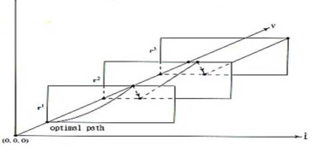

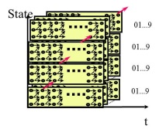
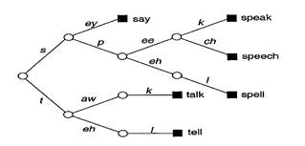
版權聲明
頁碼 | 作品 | 版權標示 | 作者/來源
10 |  |  | 國立臺灣大學電機工程學系 李琳山 教授 本作品採用創用CC「姓名標示-非商業性-相同方式分享3.0臺灣」許可協議。
12 |  |  | 國立臺灣大學電機工程學系 李琳山 教授 本作品採用創用CC「姓名標示-非商業性-相同方式分享3.0臺灣」許可協議。
12 |  |  | 國立臺灣大學電機工程學系 李琳山 教授 本作品採用創用CC「姓名標示-非商業性-相同方式分享3.0臺灣」許可協議。
13 |  |  | 國立臺灣大學電機工程學系 李琳山 教授 本作品採用創用CC「姓名標示-非商業性-相同方式分享3.0臺灣」許可協議。
27

Slide 28
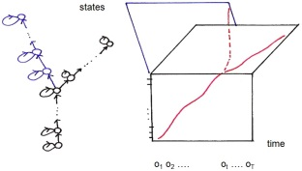
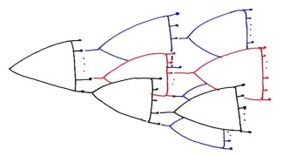
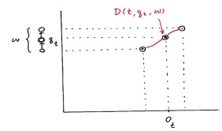
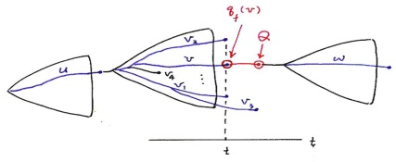
版權聲明
頁碼 | 作品 | 版權標示 | 作者/來源
15 |  |  | 國立臺灣大學電機工程學系 李琳山 教授 本作品採用創用CC「姓名標示-非商業性-相同方式分享3.0臺灣」許可協議。
16 |  |  | 國立臺灣大學電機工程學系 李琳山 教授 本作品採用創用CC「姓名標示-非商業性-相同方式分享3.0臺灣」許可協議。
18 |  |  | 國立臺灣大學電機工程學系 李琳山 教授 本作品採用創用CC「姓名標示-非商業性-相同方式分享3.0臺灣」許可協議。
20 |  |  | 國立臺灣大學電機工程學系 李琳山 教授 本作品採用創用CC「姓名標示-非商業性-相同方式分享3.0臺灣」許可協議。
28

Slide 29

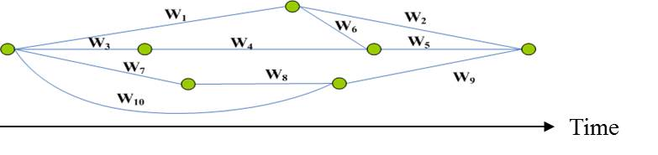
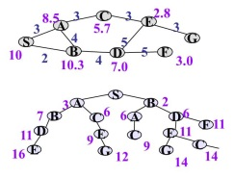
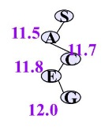
版權聲明
頁碼 | 作品 | 版權標示 | 作者/來源
21 |  |  | 國立臺灣大學電機工程學系 李琳山 教授 本作品採用創用CC「姓名標示-非商業性-相同方式分享3.0臺灣」許可協議。
21 |  |  | 國立臺灣大學電機工程學系 李琳山 教授 本作品採用創用CC「姓名標示-非商業性-相同方式分享3.0臺灣」許可協議。
22 |  |  | 國立臺灣大學電機工程學系 李琳山 教授 本作品採用創用CC「姓名標示-非商業性-相同方式分享3.0臺灣」許可協議。
22 |  |  | 國立臺灣大學電機工程學系 李琳山 教授 本作品採用創用CC「姓名標示-非商業性-相同方式分享3.0臺灣」許可協議。
29

Slide 30
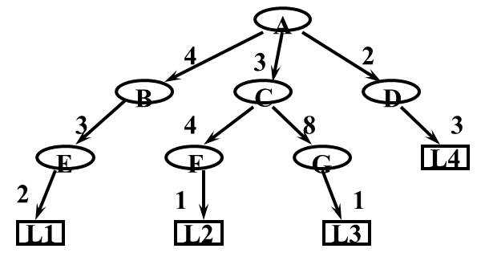
版權聲明
頁碼 | 作品 | 版權標示 | 作者/來源
23 |  |  | 國立臺灣大學電機工程學系 李琳山 教授 本作品採用創用CC「姓名標示-非商業性-相同方式分享3.0臺灣」許可協議。
30

