Slide 1


數位語音處理概論
Introduction to Digital Speech Processing
5.0 Acoustic Modeling
References: 1. 2.2, 3.4.1, 4.5, 9.1~ 9.4 of Huang
2. “ Predicting Unseen Triphones with Senones”,
IEEE Trans. on Speech & Audio Processing, Nov 1996
授課教師：國立臺灣大學 電機工程學系 李琳山 教授
【本著作除另有註明外，採取創用CC「姓名標示－非商業性－相同方式分享」臺灣3.0版授權釋出】

Slide 2
Unit Selection for HMMs
Possible Candidates
phrases, words, syllables, phonemes.....
Phoneme
the minimum units of speech sound in a language which can serve to distinguish one word from the other
e.g. b at / p at , b a d / b e d
phone : a phoneme’s acoustic realization
the same phoneme may have many different realizations
e.g. sa t / me t er
Coarticulation and Context Dependency
context: right/left neighboring units
coarticulation: sound production changed because of the neighboring units
right-context-dependent (RCD)/left-context-dependent (LCD)/ both
intraword/interword context dependency
For Mandarin Chinese
character/syllable mapping relation
syllable: Initial (聲母) / Final (韻母) / tone (聲調)
tea it ㄅㄢ
two at ㄅㄨ
target ㄅㄧ
2

Slide 3
Unit Selection Principles
Primary Considerations
accuracy: accurately representing the acoustic realizations
trainability: feasible to obtain enough data to estimate the model parameters
generalizability: any new word can be derived from a predefined unit inventory
Examples
words: accurate if enough data available, trainable for small vocabulary, NOT generalizable
phoneme : trainable, generalizable
difficult to be accurate due to context dependency
syllable: 50 in Japanese, 1300 in Mandarin Chinese, over 30000 in English
Triphone
a phoneme model taking into consideration both left and right neighboring phonemes
(60)³→ 216,000
very good generalizability, balance between accuracy/ trainability by parameter-sharing techniques
3

Slide 4
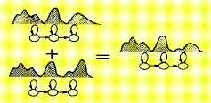
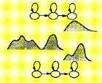

Sharing of Parameters and Training Data for Triphones
Sharing at Model Level
Sharing at State Level
Generalized Triphone
Shared Distribution Model (SDM)
clustering similar triphones and merging them together
those states with quite different distributions do not have to be merged
4

Slide 5
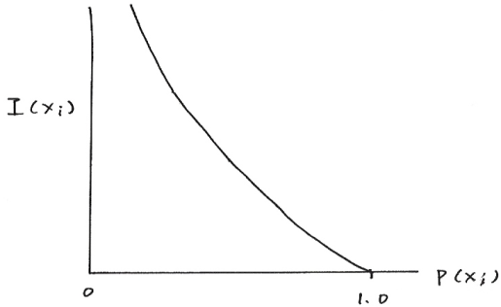
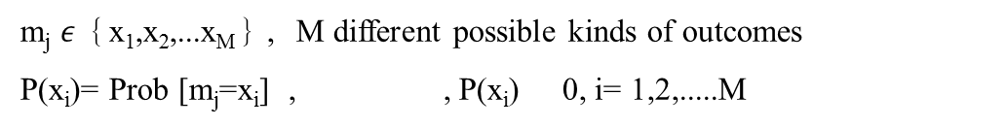
Some Fundamentals in Information Theory
Quantity of Information Carried by an Event (or a Random Variable)
Assume an information source: output a random variable m_{j} at time j
Define I(x_{i})= quantity of information carried by the event m_{j}= x_{i}
Desired properties:
1. I(x_{i}) 0
2. I(x_{i}) = 0
3. I(x_{i}) > I(x_{j}) , if P(x_{i}) < P(x_{j})
4.Information quantities are additive
I(x_{i}) = bits (of information)
H(S) = entropy of the source = average quantity of information out of the source each time
=
= the average quantity of information carried by each random variable
U = m₁m₂m₃m_{4.....,}m_{j}: the j^{-th} event, a random variable
S
m_{j} $ε$｛x₁,x₂,...x_{M}｝, M different possible kinds of outcomes
P(x_{i})= Prob [m_{j}=x_{i}] , , P(x_{i}) 0, i= 1,2,.....M
I(x_{i})
P(x_{i})
0
1.0
5

Slide 6
Fundamentals in Information Theory
M=2, {x₁, x₂} = {0, 1}
→U = 110100101011001……
P(0)=P(1)=½
U = 111111111……
P(1)=1, P(0)=0
U = 10111111111011111111……
P(1) ≈ 1, P(0) ≈ 0
S
M=4, {x₁, x_{2,} x₃, x₄} = {00, 01, 10, 11}
→U = 01 00 10 11 01……
S
6

Slide 7
Some Fundamentals in Information Theory
Examples
M = 2, {x₁, x₂}= {0,1}, P(0)= P(1)=
I(0) = I(1) = 1 bit (of information), H(S)= 1 bit (of information)
U=01101101001010110……
↑
This binary digit carries exactly 1 bit of information
M =4, {x₁, x₂, x₃, x₄}={00, 01, 10, 11}, P(x₁)= P(x₂)= P(x₃)= P(x₄)=
I(x₁)= I(x₂)= I(x₃)= I(x₄)= 2 bits (of information),
H(S)= 2 bits (of information)
U=01 00 01 11 10 10 11……
↑
This symbol (represented by two binary digits) carries exactly 2 bits of information
M = 2, {x₁, x₂}= {0,1}, P(0)= , P(1)=
I(0)= 2 bits (of information), I(1)= 0.42 bits (of information)
H(S)= 0.81 bits (of information)
U=11101111100111110……
↑ ↑
This binary digit carries This binary digit carries
0.42 bit of information 2 bits of information
7

Slide 8
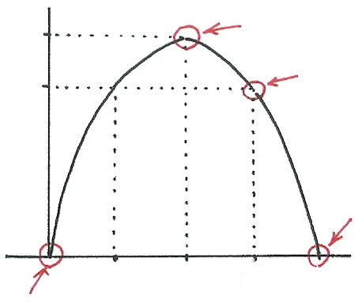




Fundamentals in Information Theory
M=2, { x₁, x₂ } = { 0, 1 }, P(1)=p, P(0)=1-p
H(S)=-[ plog p + (1-p) log (1-p) ]
1.0
$$U=101100101001010011⋯$$
$$U=111011110111⋯$$
0.81
H(S)
(bits)
$$U=1111111⋯$$
0
p
0
0.25
0.5
0.75
1.0
$$U=0000000⋯$$
Binary Entropy Function
8

Slide 9
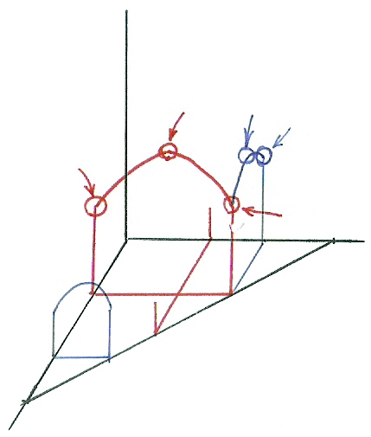
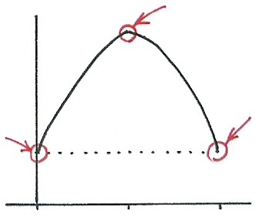













Fundamentals in Information Theory
M=3,{x₁, x_{2,} x₃} = {0, 1, 2}
P(0) = p, P(1) = q, P(2) = 1-p-q
[p, q, 1-p-q]
H(S)=-[ plog p + (1-p-q) log (1-p-q) + qlog q ]
$$[ \frac{1}{3},\frac{1}{3},\frac{1}{3} ]$$
$$[ \frac{1}{6},\frac{2}{3},\frac{1}{6} ]$$
$$[p,\frac{1−p}{2},\frac{1−p}{2}]$$
$$[ 0,\frac{2}{3},\frac{1}{3} ]$$
$$[ \frac{1}{3},0,\frac{2}{3} ]$$
p fixed
H(S)
(bits)
$$[ \frac{1}{3},\frac{2}{3}, 0 ]$$
0
$$q$$
$$[p,0, 1−p]$$
$$[p,1−p,0]$$
1.0
$$[ 0.8,0,0.2 ]$$
q
1.0
0
$$\frac{1−p}{2}$$
$$1−p$$
9
$$p$$

Slide 10
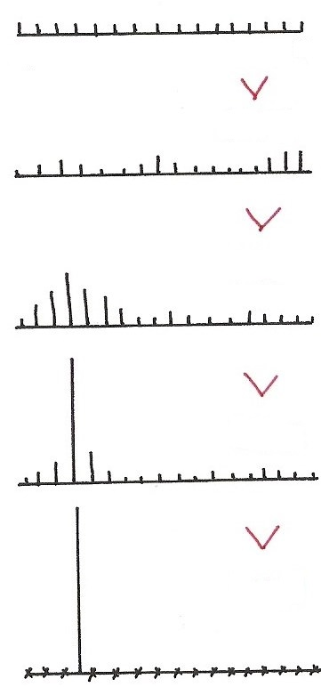








Fundamentals in Information Theory
$$P(x_{i})$$
$$H(S)$$
所帶Information 量最大
亂度最大，最random
不確定性最大
$$x_{1}$$
$$x_{M}$$
$$H(S)$$
It can be shown
$$H(S)$$
, M: number of different symbols
equality when
P(x_{j})= 1, some j
P(x_{k})=0, k≠ j
equality when
P(x_{i})= , all i
$$H(S)$$
一個 distribution
集中或分散的程度
$$H(S)$$
H(S)：Entropy
確定性最大，最不random
純度最高
10

Slide 11
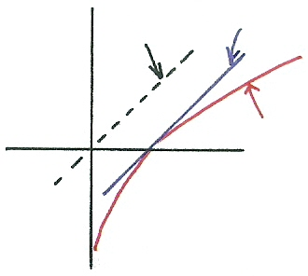



Some Fundamentals in Information Theory
Jensen’s Inequality
q(x_{i}): another probability distribution, q(x_{i}) ≥ 0,
equality when p(x_{i})= q(x_{i}), all i
proof: log x≤ x-1, equality when x=1
replacing p(x_{i}) by q(x_{i}), the entropy is increased
using an incorrectly estimated distribution giving higher degree of uncertainty
Kullback-Leibler(KL) distance (KL Divergence)
difference in quantity of information (or extra degree of uncertainty) when p(x) replaced by q(x), a measure of distance between two probability distributions, asymmetric
Cross-Entropy (Relative Entropy)
Continuous Distribution Versions
$$y=x$$
$$x−1$$
$$\log{x}$$
11

Slide 12
Classification and Regression Trees (CART)
An Efficient Approach of Representing/Predicting the Structure of A Set of Data — trained by a set of training data
A Simple Example
dividing a group of people into 5 height classes without knowing the heights:
Tall(T), Medium-tall(t), Medium(M), Medium-short(s),Short(S)
several observable data available for each person: age, gender, occupation....(but not the height)
based on a set of questions about the available data
Y
1
N
2
Age > 12 ?
Occupation= professional basketball player ?
Milk Consumption > 5 quarts per week ?
gender = male ?
Y
N
S
T
3
Y
N
t
4
Y
N
M
s
question: how to design the tree to make it most efficient?
12

Slide 13
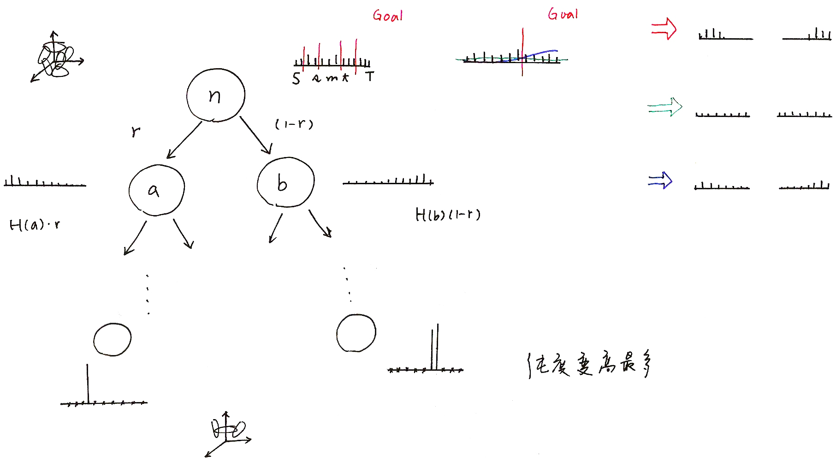



Node Splitting
Goal
Goal
S s M t T
$$(1−r)$$
$$H(a)⋅r$$
$$H(b)(1−r)$$
純度變高最多
13

Slide 14
Splitting Criteria for the Decision Tree
Assume a Node n is to be split into nodes a and b
weighted entropy
₌
: percentage of data samples for class i at node n
p(n): prior probability of n, percentage of samples at node n out of total number of samples
entropy reduction for the split for a question q
choosing the best question for the split at each node
q* =
It can be shown
weighting by number of samples also taking into considerations the reliability of the statistics
Entropy of the Tree T
the tree-growing (splitting) process repeatedly reduces
n
n
n
a
b
arg max
q
n
n
n
a
b
a(x): distribution in node a, b(x) distribution in node b
n(x): distribution in node n , : cross entropy
n
terminal n
14

Slide 15
Training Triphone Models with Decision Trees
Construct a tree for each state of each base phoneme (including all possible context dependency)
e.g. 50 phonemes, 5 states each HMM
5*50=250 trees
Develop a set of questions from phonetic knowledge
Grow the tree starting from the root node with all available training data
Some stop criteria determine the final structure of the trees
e.g. minimum entropy reduction, minimum number of samples in each leaf node
For any unseen triphone, traversal across the tree by answering the questions leading to the most appropriate state distribution
The Gaussion mixture distribution for each state of a phoneme model for contexts with similar linguistic properties are “tied” together, sharing the same training data and parameters
The classification is both data-driven and linguistic-knowledge-driven
Further approaches such as tree pruning and composite questions
(e.g. )
15

Slide 16
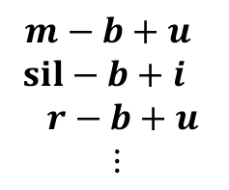
Training Tri-phone Models with Decision Trees
An Example: “( _ ‒ ) b ( +_ )”
12
yes
no
30
sil-b+u
a-b+u
o-b+u
y-b+u
Y-b+u
32
46
42
U-b+u
u-b+u
24
i-b+u
Example Questions:
12: Is left context a vowel?
24: Is left context a back-vowel?
30: Is left context a low-vowel?
32: Is left context a rounded-vowel?
e-b+u
r-b+u
50
N-b+u
M-b+u
E-b+u
16

Slide 17
Phonetic Structure of Mandarin Syllables
17

Slide 18
Phonetic Structure of Mandarin Syllables
巴 拔 把 霸 吧：5 syllables, 1 base-syllable
ㄕ ㄐ ㄇ ㄒ ㄐ ㄉ 聲母(INITIAL’s) 空聲母
ㄨ ㄧ ㄚ ㄧ ㄩ ㄨ 韻母(FINAL’s) 空韻母
ㄢ ㄝ ㄢ
-n ：ㄣ ㄢ
-ng：ㄥ ㄤ
Same RCD INITIAL’S
ㄅ ㄅ ㄅ ㄅ
ㄚ ㄢ ㄠ ㄤ
ㄚ ㄚ ㄚ
ㄣ ㄨ ㄥ
(艾,宜,烏,于)
(制,尺,時,日,
紫,次,思)
Medials
Tone：聲調
4 Lexical tones 字調
1 Neutral tone 輕聲
Nasal ending
18

Slide 19
Subsyllabic Units Considering Mandarin Syllable Structures
Considering Phonetic Structure of Mandarin Syllables
INITIAL / FINAL’s
Phone(me)-like-units / phonemes
Different Degrees of Context Dependency
intra-syllable only
intra-syllable plus inter-syllable
right context dependent only
both right and left context dependent
Examples :
113 right-context-dependent (RCD) INITIAL’s extended from 22 INITIAL’s plus 37 context independent FINAL’s: 150 intrasyllable RCD INITIAL/FINAL’s
33 phone(me)-like-units extended to 145 intra-syllable right-context-dependent phone(me)-like-units, or 481 with both intra/inter-syllable context dependency
At least 4,600 triphones with intra/inter-syllable context dependency
19

Slide 20
Comparison of Acoustic Models Based on Different Sets of Units
Typical Example Results
INITIAL/FIANL (IF) better than phone for small training set
Context Dependent (CD) better than Context Independent (CI)
Right CD (RCD) better than Left CD (LCD)
Inter-syllable Modeling is Better
Triphone is better
Approaches in Training Triphone Models are Important
Quinphone (2 context units on both sides considered) are even better
20

Slide 21
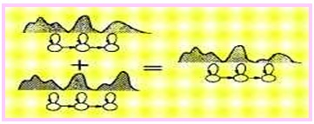
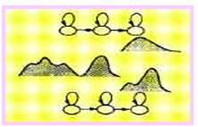
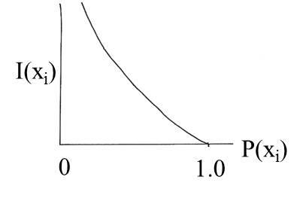
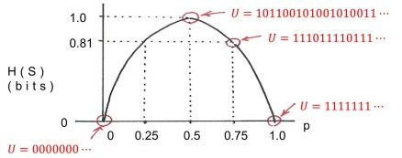
版權聲明
頁碼 | 作品 | 版權標示 | 作者/來源
4 |  |  | 國立臺灣大學電機工程學系 李琳山 教授 本作品採用創用CC「姓名標示-非商業性-相同方式分享3.0臺灣」許可協議。
4 |  |  | 國立臺灣大學電機工程學系 李琳山 教授 本作品採用創用CC「姓名標示-非商業性-相同方式分享3.0臺灣」許可協議。
5 |  |  | 國立臺灣大學電機工程學系 李琳山 教授 本作品採用創用CC「姓名標示-非商業性-相同方式分享3.0臺灣」許可協議。
8 |  |  | 國立臺灣大學電機工程學系 李琳山 教授 本作品採用創用CC「姓名標示-非商業性-相同方式分享3.0臺灣」許可協議。
21

Slide 22
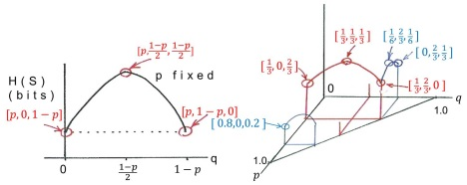
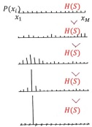
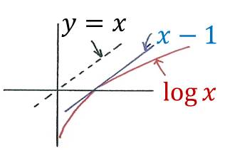
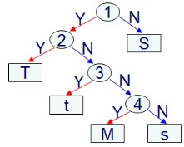
版權聲明
頁碼 | 作品 | 版權標示 | 作者/來源
9 |  |  | 國立臺灣大學電機工程學系 李琳山 教授 本作品採用創用CC「姓名標示-非商業性-相同方式分享3.0臺灣」許可協議。
10 |  |  | 國立臺灣大學電機工程學系 李琳山 教授 本作品採用創用CC「姓名標示-非商業性-相同方式分享3.0臺灣」許可協議。
11 |  |  | 國立臺灣大學電機工程學系 李琳山 教授 本作品採用創用CC「姓名標示-非商業性-相同方式分享3.0臺灣」許可協議。
12 |  |  | 國立臺灣大學電機工程學系 李琳山 教授 本作品採用創用CC「姓名標示-非商業性-相同方式分享3.0臺灣」許可協議。
22

Slide 23
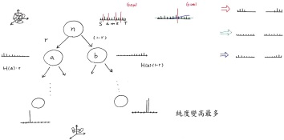
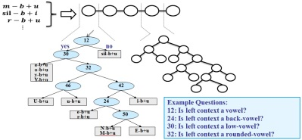
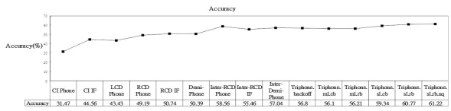
版權聲明
頁碼 | 作品 | 版權標示 | 作者/來源
13 |  |  | 國立臺灣大學電機工程學系 李琳山 教授 本作品採用創用CC「姓名標示-非商業性-相同方式分享3.0臺灣」許可協議。
16 |  |  | 國立臺灣大學電機工程學系 李琳山 教授 本作品採用創用CC「姓名標示-非商業性-相同方式分享3.0臺灣」許可協議。
20 |  |  | 國立臺灣大學電機工程學系 李琳山 教授 本作品採用創用CC「姓名標示-非商業性-相同方式分享3.0臺灣」許可協議。
23

