Slide 1

數位語音處理概論
Introduction to Digital Speech Processing
13.0 Speaker Variabilities: Adaption and Recognition
授課教師：國立臺灣大學 電機工程學系 李琳山 教授
【本著作除另有註明外，採取創用CC「姓名標示－非商業性－相同方式分享」臺灣3.0版授權釋出】

Slide 2
References: 1. 9.6 of Huang
2. “ Maximum A Posteriori Estimation for Multivariate Gaussian
Mixture Observations of Markov Chains”, IEEE Trans. on
Speech and Audio Processing, April 1994
3. “ Maximum Likelihood Linear Regression for Speaker
Adaptation of Continuous Density Hidden Markov
Models”, Computer Speech and Language, Vol.9 ,1995
4. Jolliffe, “ Principal Component Analysis ”, Springer-Verlag, 1986
5. “ Rapid Speaker Adaptation in Eigenvoice Space”, IEEE Trans. on
Speech and Audio Processing, Nov 2000
6. “ Cluster Adaptive Training of Hidden Markov Models”, IEEE
Trans. on Speech and Audio Processing, July 2000
7. “ A Compact Model for Speaker-adaptive Training”, International
Conference on Spoken Language Processing, 1996
8. “ A Tutorial on Text-independent Speaker Verification”, EURASIP
Journal on Applied Signal Processing 2004
9. “An Overview of Text-independent Speaker Recognition: from
Features to Supervectors”, Speech Communication, Jan 2010

Slide 3
Speaker Dependent/Independent/Adaptation
Speaker Dependent (SD)
trained with and used for 1 speaker only, requiring huge quantity of training data, best accuracy
practically infeasible
Multi-speaker
trained for a (small) group of speakers
Speaker Independent (SI)
trained from large number of speakers, each speaker with limited quantity of data
good for all speakers, but with relatively lower accuracy
Speaker Adaptation (SA)
started with speaker independent models, adapted to a specific user with limited quantity of data (adaptation data)
technically achievable and practically feasible
Supervised/Unsupervised Adaptation
supervised: text (transcription) of the adaptation data is known
unsupervised: text (transcription) of the adaptation data is unknown, based on recognition results with speaker-independent models, may be performed iteratively
Batch/Incremental/On-line Adaptation
batch: based on a whole set of adaptation data
incremental/on-line: adapted step-by-step with iterative re-estimation of models
e.g. first adapted based on first 3 utterances, then adapted based on next 3 utterances or first 6 utterances,...

Slide 4
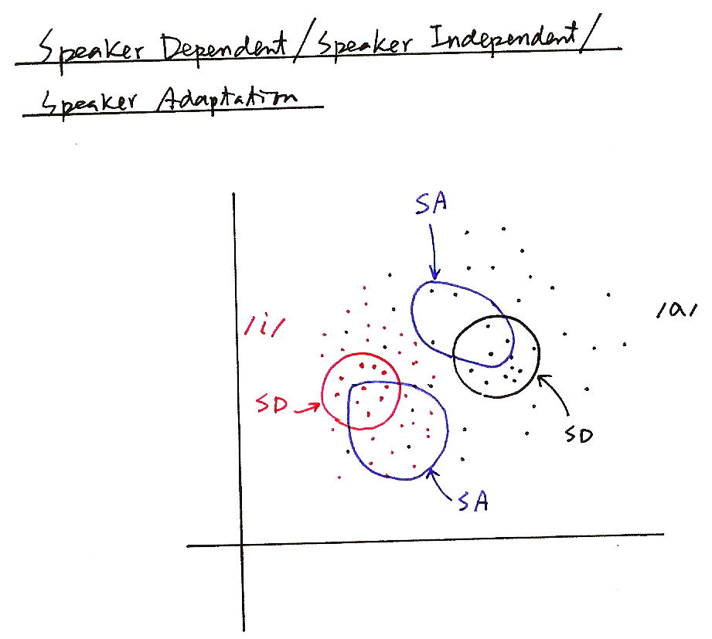
Speaker Dependent/Independent/Adaptation
SA
/a/
/i/
SD
SD
SA

Slide 5
MAP (Maximum A Posteriori) Adaptation
Given Speaker-independent Model set Λ={λ_{i}=(A_{i}, B_{i}, π_{i}), i=1, 2,...M} and A set of Adaptation Data O = (o₁, o₂,...o_{t},...o_{T}) for A Specific Speaker
With Some Assumptions on the Prior Knowledge Prob [Λ] and some Derivation (EM Theory)
example adaptation formula
a weighted sum shifting μ_{jk} towards those directions of o_{t} (in j-th state and k-th Gaussian)
larger τ_{jk} implies less shift
Only Those Models with Adaptation Data will be Modified, Unseen Models remain Unchanged — MAP Principle
good with larger quantity of adaptation data
poor performance with limited quantity of adaptation data
arg max
Λ
τ_{jk}: a parameter having to do the prior knowledge about μ_{jk}
may have to do with number of samples used to trainμ_{jk}

Slide 6
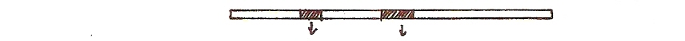
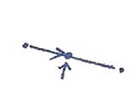
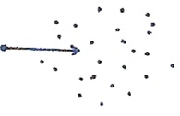
MAP Adaptation
$$λ_{i}$$
$$λ_{j}$$
$$\frac{a\overset{⃑}{v}+b\overset{⃑}{o}}{a+b}$$
$$=λ\overset{⃑}{v}+(1−λ)\overset{⃑}{o}$$
$$\frac{a\overset{⃑}{v}+( Σb_{i})\overset{⃑}{o}}{a+( Σb_{i})}$$
$$i$$
$$i$$
$$\frac{a\overset{⃑}{v}+( Σb_{t}{\overset{⃑}{o}}_{t}) }{a+( Σb_{t})}$$
$$\overline{v}$$
$$t$$
$$\overset{⃑}{o}$$
$$t$$
$${\overset{⃑}{o}}_{t}$$
$$\overset{⃑}{v}$$

Slide 7
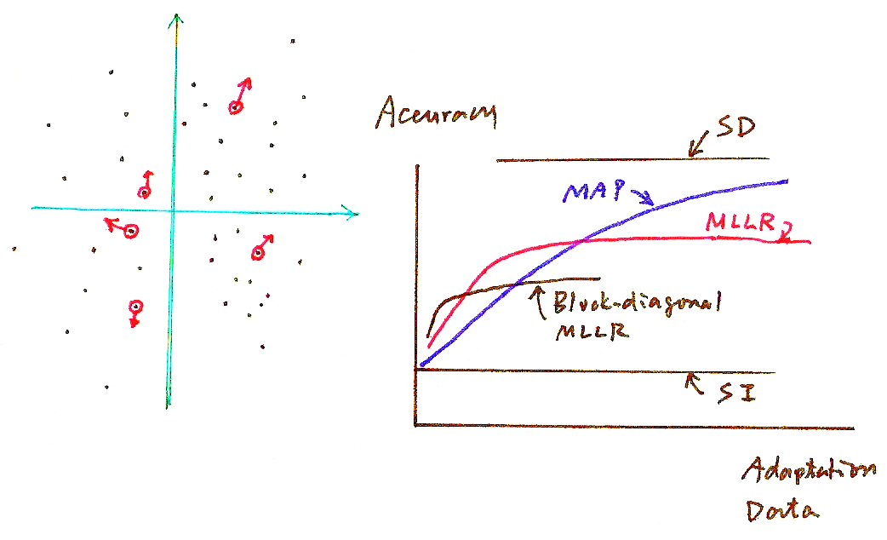
MAP Adaptation
Accuracy
SD
MAP
MLLR
Block-diagonal MLLR
SI
Adaptation Data

Slide 8
Maximum Likelihood Linear Regression (MLLR)
Divide the Gaussians (or Models) into Classes C₁, C₂,...C_{L}, and Define Transformation-based Adaptation for each Class
linear regression with parameters A, b estimated by maximum likelihood criterion
All Gaussians in the same class up-dated with the same A_{i}, b_{i}: parameter sharing, adaptation data sharing
unseen Gaussians (or models) can be adapted as well
A_{i} can be full matrices, or reduced to diagonal or block-diagonal to have less parameters to be estimated
faster adaptation with much less adaptation data needed, but saturated at lower accuracy with more adaptation data due to the less precise modeling
Clustering the Gaussians (or Models) into L Classes
too many classes requires more adaptation data, too less classes becomes less accurate
basic principle: Gaussian (or models) with similar properties and “ just enough” data form a class
data-driven (e.g. by Gaussian distances) primarily, knowledge driven helpful
Tree-structured Classes
the node including minimum number of Gaussians (or models) but with adequate adaptation data is a class
dynamically adjusting the classes as more adaptation data are observed

Slide 9
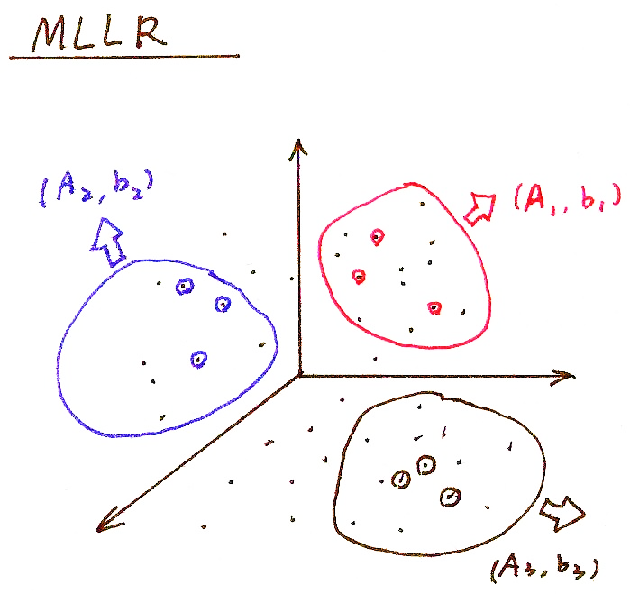
MLLR
(A₂, b₂)
(A₁, b₁)
(A₃, b₃)

Slide 10
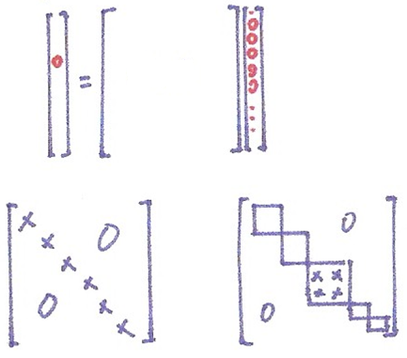
MLLR
$$\vec{y}=A\vec{x}$$
Full
Diagonal
Block-diagonal

Slide 11

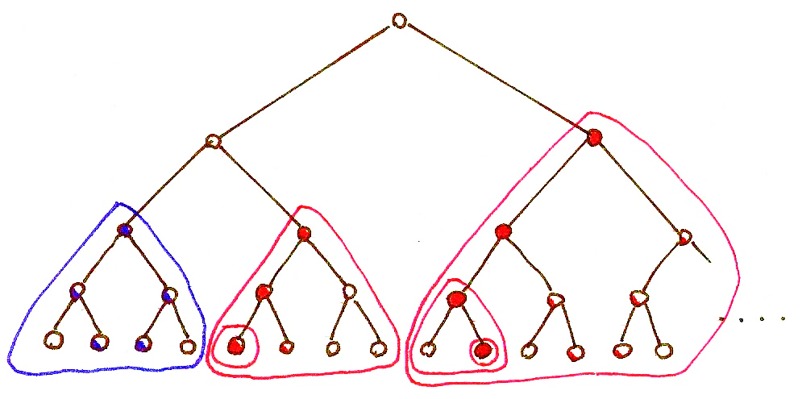
MLLR

Slide 12
Principal Component Analysis (PCA)
Problem Definition:
for a zero mean random vector x with dimensionality N, x∈R^{N}, E(x)=0, iteratively find a set of k (k≤N) orthonormal basis vectors {e₁, e₂,…, e_{k}} so that (1) var (e₁^{T} x)=max (x has maximum variance when projected on e₁ ) (2) var (e_{i}^{T} x)=max, subject to e_{i}⊥ e_{i-1} ⊥…… ⊥e₁ , 2≤ i ≤k (x has next maximum variance when projected on e₂ , etc.)
Solution: {e₁, e₂,…, e_{k}} are the eigenvectors of the covariance matrix Σ for x corresponding to the largest k eigenvalues
new random vector y ∈R^{k} : the projection of x onto the subspace spanned by A=[e₁ e_{2 ……} e_{k}], y=A^{T}x
a subspace with dimensionality k≤N such that when projected onto this subspace, y is “closest” to x in terms of its “randomness” for a given k
var (e_{i}^{T} x) is the eigenvalue associated with e_{i}
Proof
var (e₁^{T} x) = e₁^{T} E (x x^{T})e₁ = e₁^{T}Σe₁ = max, subject to |e₁|²=1
using Lagrange multiplier
J(e₁)= e₁^{T} E (x x^{T})e₁ -λ(|e₁|²⁻1) ,
⇒ E (xx^{T}) e₁ = λ₁e₁ , var(e₁^{T} x) = λ₁= max
similar for e₂ with an extra constraint e₂^{T}e₁ = 0, etc.
J(e₁)
e₁
$$Aυ=u$$
$$Aυ=λυ$$
= 0
eigenvector
eigenvalue

Slide 13
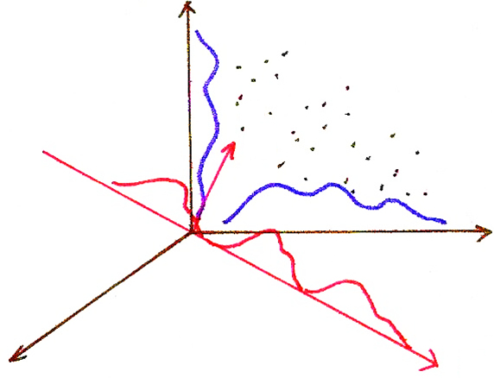
PCA
$$x_{2}$$
$${\vec{e}}_{2}$$
$$x_{1}$$
$${\vec{e}}_{1}$$

Slide 14

PCA
$$\left[⋯ e_{1k}^{T} ⋯\right]\left[\begin{aligned}⋮ \\ x_{k} \\ ⋮\end{aligned}\right]={\vec{e}}_{1}⋅\vec{x}$$
$=\left|{\vec{e}}_{1}\right|\left|\vec{x}\right| \cos{θ}$
$$∥$$
1
$$\vec{y}=A^{T}\vec{x}=\left[ \begin{aligned}{\vec{e }}_{1}^{T} \\ {\vec{e }}_{2}^{T} \\ ⋮ \\ {\vec{e }}_{k}^{T}\end{aligned} \right] \vec{x}$$

Slide 15
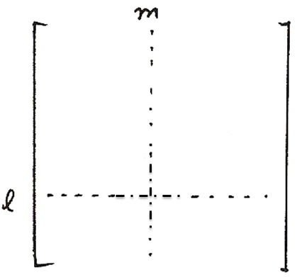
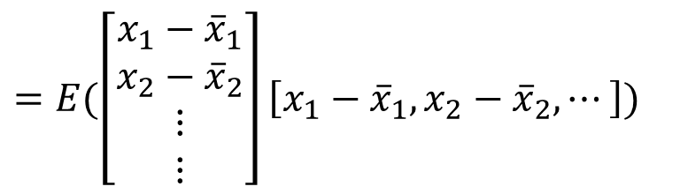



Basic Problem 3 (P.35 of 4.0)

Slide 16
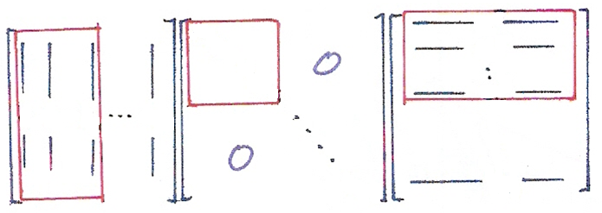
PCA
$$≈ Σ$$
$$= Σ$$
$$=E\left[x x^{T}\right]$$
$$=E[(x−\overline{x}){(x−\overline{x})}^{T}]$$
$$λ_{1}$$
$${\vec{e}}_{1}^{T}$$
$$λ_{2}$$
$${\vec{e}}_{2}^{T}$$
$$⋱$$
$$λ_{k}$$
$${\vec{e}}_{k}^{T}$$
$${\vec{e}}_{1}{\vec{e}}_{2} {\vec{e}}_{k}{ \vec{e}}_{N}$$
$$⋯$$
$$⋮$$
$$λ_{N}$$
$${\vec{e}}_{N}^{T}$$
$$\sum{{\vec{e}}_{i}}=λ_{i} {\vec{e}}_{i}$$
eigenvalue
eigenvector
$$Aυ=u$$
$$Aυ=λυ$$
eigenvector
eigenvalue

Slide 17
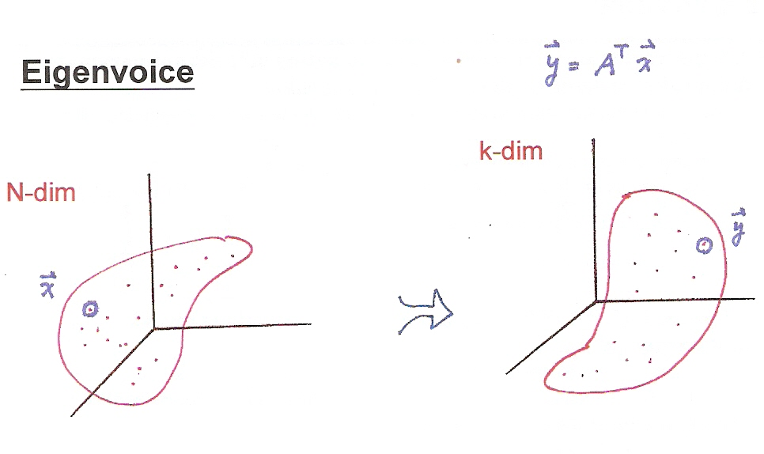
PCA
$$\vec{y}=A^{T}\vec{x}$$
k-dim
N-dim
$$\vec{y}$$
$$\vec{x}$$

Slide 18
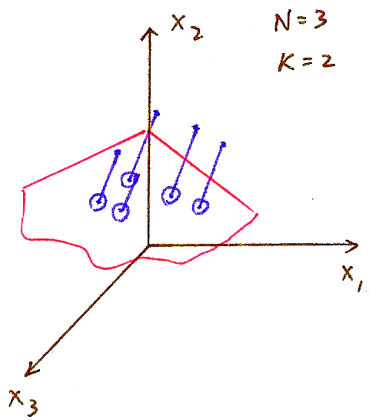
PCA
N=3
k=2

Slide 19
Eigenvoice
A Supervector x constructed by concatenating all relevant parameters for the speaker specific model of a training speaker
concatenating the mean vectors of Gaussians in the speaker-dependent phone models
concatenating the columns of A, b in MLLR approach
x has dimensionality N (N = 5,000×3×8×40 = 4,800,000 for example)
SD model mean parameters (m)
transformation parameters (A, b)
A total of L (L = 1,000 for example) training speakers gives L supervectors x₁,x₂,...x_{L}
x₁, x₂, x₃..... x_{L} are samples of the random vector x
each training speaker is a point (or vector) in the space of dimensionality N
Principal Component Analysis (PCA)
x'= x-E(x) , Σ= E(x' x'^{T}) ,
{e₁,e₂ ,.....e_{k}}: eigenvectors with maximum eigenvalues λ₁> λ₂... > λ_{k}
k is chosen such that λ_{j}, j>k is small enough (k=50 for example)

Slide 20
Eigenvoice
Principal Component Analysis (PCA)
x'= x-E(x) , Σ= E(x' x'^{T}),
{e₁,e₂ ,.....e_{k}}: eigenvectors with maximum eigenvalues λ₁> λ₂... > λ_{k}
k is chosen such that λ_{j}, j>k is small enough (k=50 for example)
Eigenvoice Space: spanned by {e₁,e₂ ,.....e_{k}}
each point (or vector) in this space represents a whole set of tri-phone model parameters
{e₁,e₂ ,.....e_{k}} represents the most important characteristics of speakers extracted from huge quantity of training data by large number of training speakers
each new speaker as a point (or vector)
in this space,
a_{i} estimated by maximum likelihood
principle (EM algorithm)
Features and Limitations
only a small number of parameters a₁...a_{k} is needed to specify the characteristics of a new speaker
rapid adaptation requiring only very limited quantity of training data
performance saturated at lower accuracy (because too few free parameters)
high computation/memory/training data requirements
Training Speaker 1
Training Speaker 2
New Speaker
New Speaker

Slide 21
Speaker Adaptive Training (SAT) and Cluster Adaptive Training (CAT)
Speaker Adaptive Training (SAT)
trying to decompose the phonetic variation and speaker variation
removing the speaker variation among training speakers as much as possible
obtaining a “compact” speaker-independent model for further adaptation
y=Ax+b in MLLR can be used in removing the speaker variation
Clustering Adaptive Training (CAT)
dividing training speakers into R clusters by speaker clustering techniques
obtaining mean models for all clusters(may include a mean-bias for the “compact” model in SAT)
models for a new speaker is interpolated from the mean vectors
Speaker Adaptive Training (SAT)
Training Speakers
Cluster Adaptive Training (CAT)
cluster
mean 1
a₁
Speaker 1
L
Training Speakers
A₁, b₁
MAP
“Compact” Speaker - independent model
cluster
mean 2
a₂
Speaker 2
A₂, b₂
MLLR
Σ
a_{R}
mean for a new speaker
A_{L}, b_{L}
cluster
mean R
Speaker L
1
mean-bias
, m_{i}: cluster mean i, m_{b}: mean-bias

Slide 22
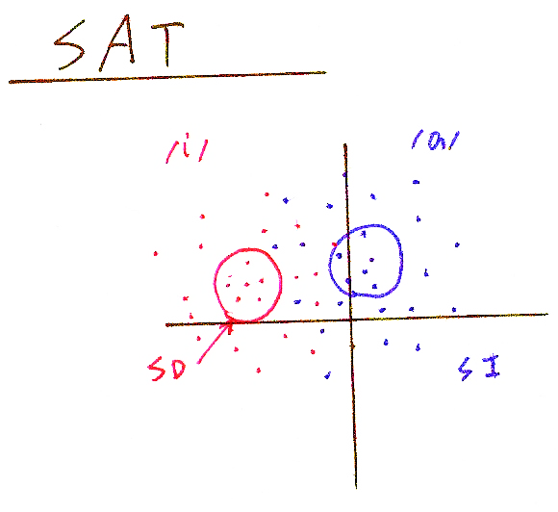
SAT
/i/
/a/
SD
SI
$$\vec{y}=A\vec{x}+\vec{b}$$
$\vec{x}=A^{−1}$ $\vec{y}−A^{−1}\vec{b}$

Slide 23
Speaker Recognition/Verification
To recognize the speakers rather than the content of the speech
phonetic variation/speaker variation
speaker identification: to identify the speaker from a group of speakers
speaker verification: to verify if the speaker is as claimed
Gaussian Mixture Model (GMM)
λ_{i}={(w_{j}, μ_{j}, Σ_{j},), j=1,2,...M} for speaker i
for O = o₁o₂ ...o_{t} ...o_{T} ,
maximum likelihood principle
Feature Parameters
those carrying speaker characteristics preferred
MFCC
MLLR coefficients A_{i},b_{i}, eigenvoice coefficients a_{i}, CAT coefficients a_{i}
Speaker Verification
text dependent: higher accuracy but easily broken
text independent
likelihood ratio test
speech recognition based verification

Slide 24
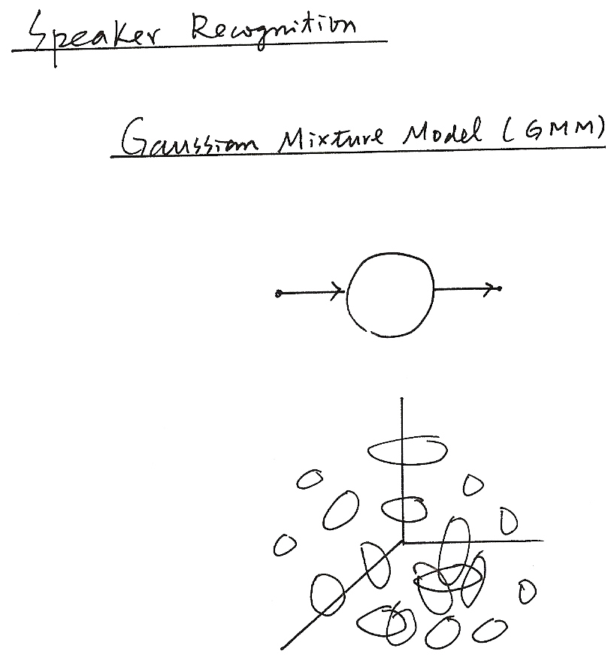
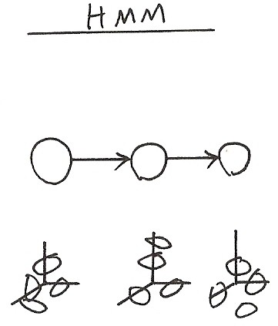
Speaker Recognition
Gaussian Mixture Model (GMM)
HMM

Slide 25
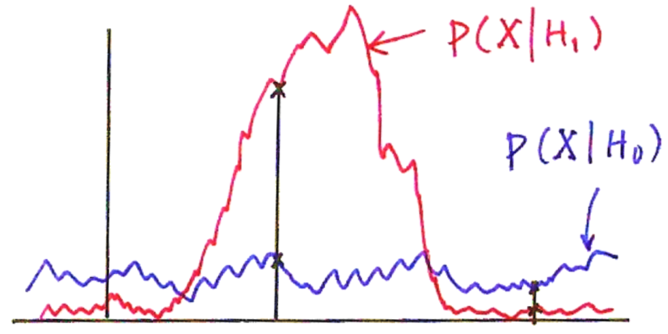
Likelihood Ratio Test
Detection Theory― Hypothesis Testing/Likelihood Ratio Test
2 Hypotheses: H₀, H₁ with prior probabilities: P(H₀),P(H₁)
observation: X with probabilistic law: P(X H₀), P(X H₁)
MAP principle
choose H₀ if P(H₀ X)> P(H₁ X)
choose H₁ if P(H₁ X)> P(H₀ X)
Likelihood Ratio Test
P (H_{i} X) = P(X H_{i}) P (H_{i})/P(X), i=0,1
H₀
>
H₀
<
>
1
H₁
<
likelihood ratio-Likelihood Ratio Test
H₁
P(X| H₁)
P(X| H₀)
X
x₂
x₁
Type I error: missing (false rejection)
Type II error: false alarm (false detection)
false alarm rate, false rejection rate, detection rate, recall rate, precision rate
Th: a threshold value adjusted by balancing among different performance rates

Slide 26
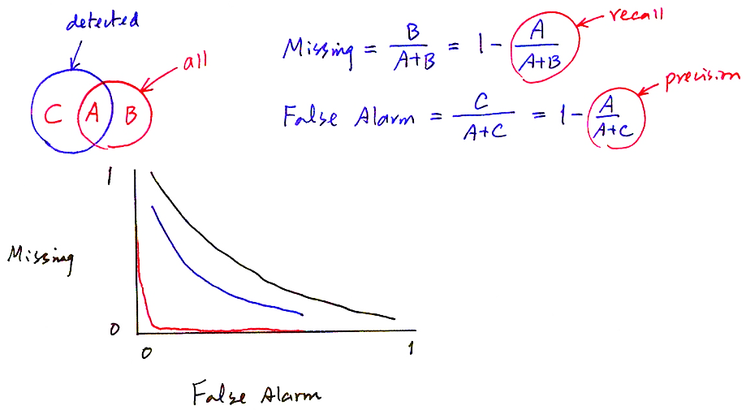
Receiver Operating Characteristics (ROC) Curve
detected
recall
Missing rate$=\frac{B}{A+B}=1−\frac{A}{A+B}$
all
precision
False Alarm rate$=\frac{C}{A+C}=1−\frac{A}{A+C}$
1
Missing
0
0
1
False Alarm

Slide 27
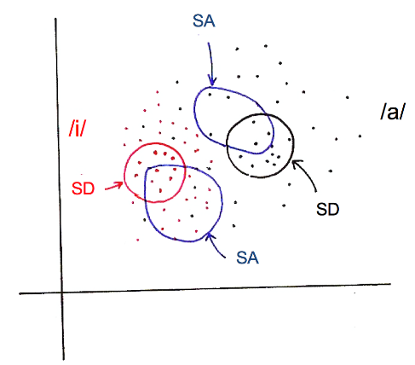
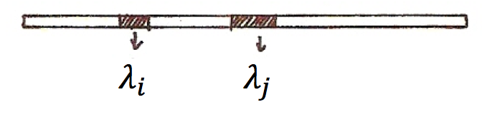
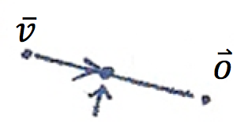
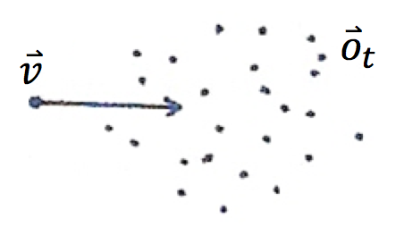
版權聲明
頁碼 | 作品 | 版權標示 | 作者 / 來源
4 |  |  | 國立臺灣大學電機工程學系李琳山 教授。 本作品採用創用CC「姓名標示-非商業性-相同方式分享3.0臺灣」許可協議。
6 |  |  | 國立臺灣大學電機工程學系李琳山 教授。 本作品採用創用CC「姓名標示-非商業性-相同方式分享3.0臺灣」許可協議。
6 |  |  | 國立臺灣大學電機工程學系李琳山 教授。 本作品採用創用CC「姓名標示-非商業性-相同方式分享3.0臺灣」許可協議。
6 |  |  | 國立臺灣大學電機工程學系李琳山 教授。 本作品採用創用CC「姓名標示-非商業性-相同方式分享3.0臺灣」許可協議。

Slide 28
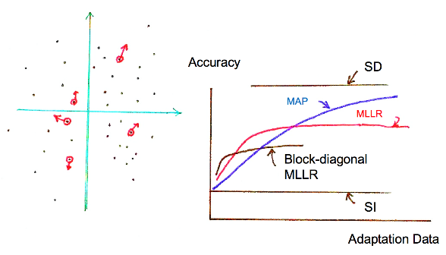
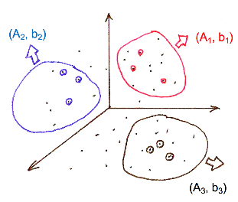
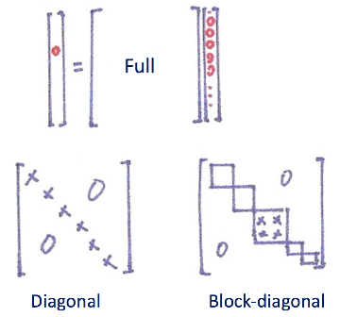
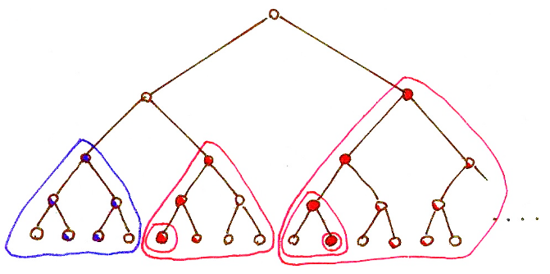
版權聲明
頁碼 | 作品 | 版權標示 | 作者 / 來源
7 |  |  | 國立臺灣大學電機工程學系李琳山 教授。 本作品採用創用CC「姓名標示-非商業性-相同方式分享3.0臺灣」許可協議。
9 |  |  | 國立臺灣大學電機工程學系李琳山 教授。 本作品採用創用CC「姓名標示-非商業性-相同方式分享3.0臺灣」許可協議。
10 |  |  | 國立臺灣大學電機工程學系李琳山 教授。 本作品採用創用CC「姓名標示-非商業性-相同方式分享3.0臺灣」許可協議。
11 |  |  | 國立臺灣大學電機工程學系李琳山 教授。 本作品採用創用CC「姓名標示-非商業性-相同方式分享3.0臺灣」許可協議。

Slide 29
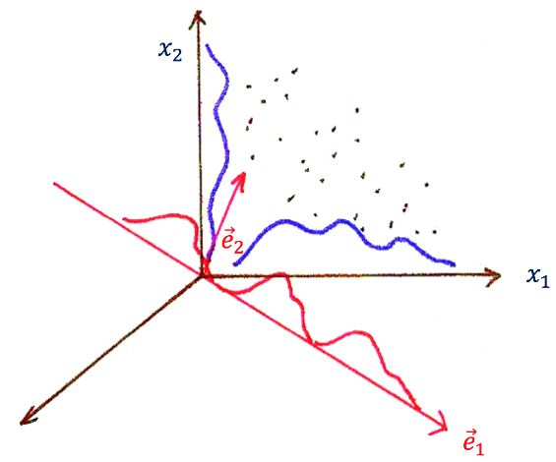
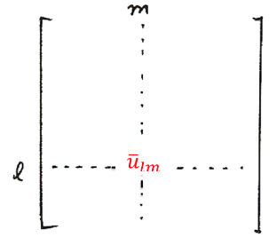
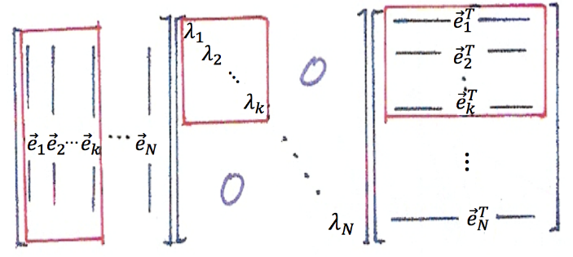
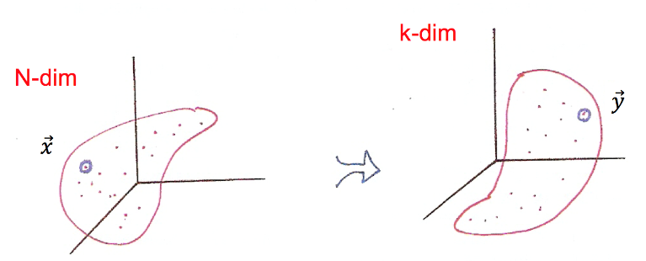
版權聲明
頁碼 | 作品 | 版權標示 | 作者 / 來源
13 |  |  | 國立臺灣大學電機工程學系李琳山 教授。 本作品採用創用CC「姓名標示-非商業性-相同方式分享3.0臺灣」許可協議。
15 |  |  | 國立臺灣大學電機工程學系李琳山 教授。 本作品採用創用CC「姓名標示-非商業性-相同方式分享3.0臺灣」許可協議。
16 |  |  | 國立臺灣大學電機工程學系李琳山 教授。 本作品採用創用CC「姓名標示-非商業性-相同方式分享3.0臺灣」許可協議。
17 |  |  | 國立臺灣大學電機工程學系李琳山 教授。 本作品採用創用CC「姓名標示-非商業性-相同方式分享3.0臺灣」許可協議。

Slide 30
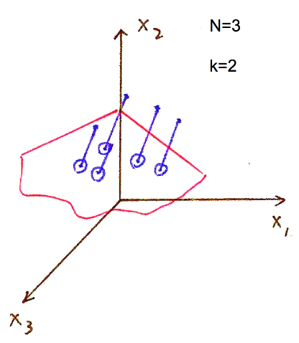
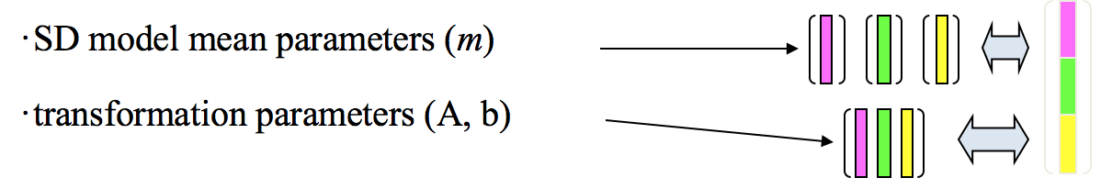
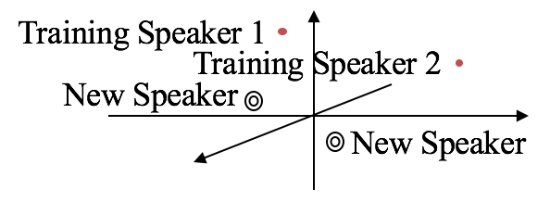
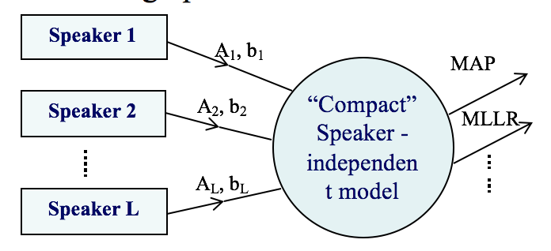
版權聲明
頁碼 | 作品 | 版權標示 | 作者 / 來源
18 |  |  | 國立臺灣大學電機工程學系李琳山 教授。 本作品採用創用CC「姓名標示-非商業性-相同方式分享3.0臺灣」許可協議。
19 |  |  | 國立臺灣大學電機工程學系李琳山 教授。 本作品採用創用CC「姓名標示-非商業性-相同方式分享3.0臺灣」許可協議。
20 |  |  | 國立臺灣大學電機工程學系李琳山 教授。 本作品採用創用CC「姓名標示-非商業性-相同方式分享3.0臺灣」許可協議。
21 |  |  | 國立臺灣大學電機工程學系李琳山 教授。 本作品採用創用CC「姓名標示-非商業性-相同方式分享3.0臺灣」許可協議。

Slide 31
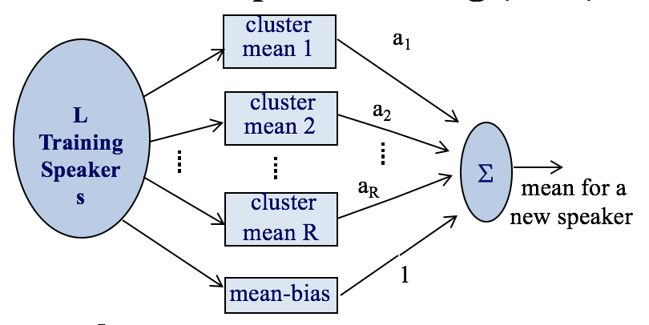
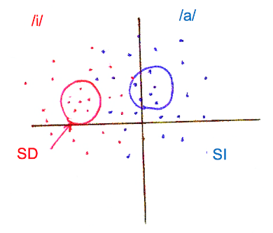
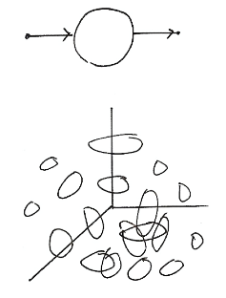
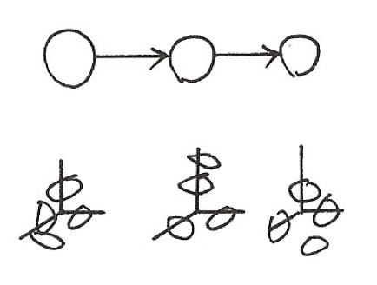
版權聲明
頁碼 | 作品 | 版權標示 | 作者 / 來源
21 |  |  | 國立臺灣大學電機工程學系李琳山 教授。 本作品採用創用CC「姓名標示-非商業性-相同方式分享3.0臺灣」許可協議。
22 |  |  | 國立臺灣大學電機工程學系李琳山 教授。 本作品採用創用CC「姓名標示-非商業性-相同方式分享3.0臺灣」許可協議。
24 |  |  | 國立臺灣大學電機工程學系李琳山 教授。 本作品採用創用CC「姓名標示-非商業性-相同方式分享3.0臺灣」許可協議。
24 |  |  | 國立臺灣大學電機工程學系李琳山 教授。 本作品採用創用CC「姓名標示-非商業性-相同方式分享3.0臺灣」許可協議。

Slide 32
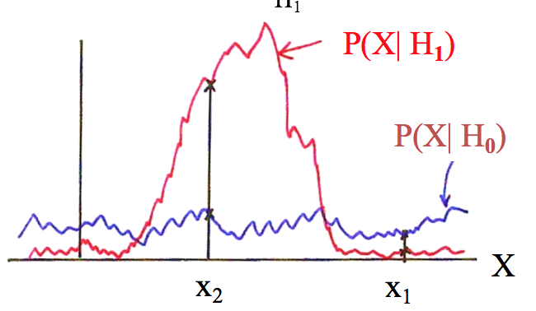
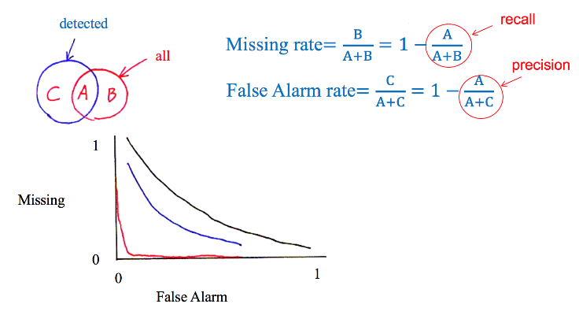
版權聲明
頁碼 | 作品 | 版權標示 | 作者 / 來源
25 |  |  | 國立臺灣大學電機工程學系李琳山 教授。 本作品採用創用CC「姓名標示-非商業性-相同方式分享3.0臺灣」許可協議。
26 |  |  | 國立臺灣大學電機工程學系李琳山 教授。 本作品採用創用CC「姓名標示-非商業性-相同方式分享3.0臺灣」許可協議。

