Slide 1

數位語音處理概論
Introduction to Digital Speech Processing
16.0 Some Fundamental Principles: EM Algorithm
授課教師：國立臺灣大學 電機工程學系 李琳山 教授
【本著作除另有註明外，採取創用CC「姓名標示－非商業性－相同方式分享」臺灣3.0版授權釋出】

Slide 2
References: 1. 4.3.2, 4.4.2 of Huang, or 9.1-9.3 of Jelinek
2. 6.4.3 of Rabiner and Juang
3. http://www.stanford .edu/class/cs229/materials.html
4.http://melodi.ee.washington.edu/people/bilmes/mypapers/em.pdf
5.http://www.academia.edu/2785880/A_note_on_EM_algorithm_for_probabilistic_latent_semantic_analysis

Slide 3
EM (Expectation and Maximization) Algorithm
Goal estimating the parameters for some probabilistic models based on some criteria
Parameter Estimation Principles given some observations
X=[x₁, x₂, ……, x_{N}]:
Maximum Likelihood (ML) Principle find the model parameter set θ such that the likelihood function is maximized, P(X |θ)= max.
For example, if θ ={μ,Σ} is the parameters of a normal distribution, and X is i.i.d, then the ML estimate of θ ={μ,Σ} can be shown to be
the Maximum A Posteriori (MAP) Principle
Find the model parameter θ so that the A Posterior probability is maximized
i.e. P(θ |X)= P(X |θ) P(θ)/ P(X)= max
⇒ P(X |θ) P(θ) = max

Slide 4
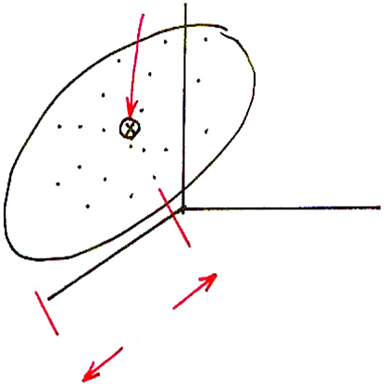


Parameter Estimation
$$μ$$
$$Σ$$

Slide 5
EM ( Expectation and Maximization) Algorithm
Why EM?
In some cases the evaluation of the objective function (e.g. likelihood function) depends on some intermediate variables (latent data) which are not observable (e.g. the state sequence for HMM parameter training)
direct estimation of the desired parameters without such latent data is impossible or difficult e.g. to estimate {A,B, π} for HMM without knowing the state sequence

Slide 6
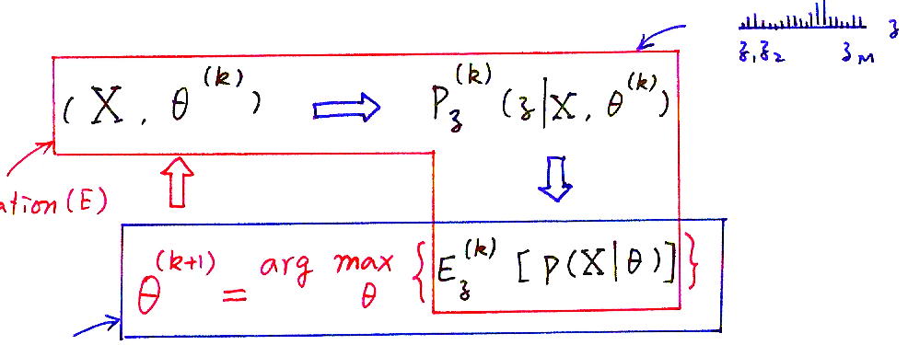
EM ( Expectation and Maximization) Algorithm
Iteractive Procedure with Two Steps in Each Iteration:
E (Expectation): expectation of the objective function with respect to a distribution (values and probabilities) of the latent data based on the current estimates of the desired parameters conditioned on the given observations
M (Maximization): generating a new set of estimates of the desired parameters by maximizing the objective function (e.g. according to ML or MAP)
the objective function increased after each iteration, eventually converged
X：available data
θ^{(k)} ：k-th estimate of the parameter set θ
z：latent data
(X, θ^{(k)})
P_{z}^{(k)}(z|X, θ^{(k)})
Expectation(E)
{
E_{z}^{(k)}[P(X|θ)]
}
θ^{(k+1)} =
arg max
θ
Maximization(M)
P(X|θ)：objective function

Slide 7
EM Algorithm: An example
A
B
output
(RGG)
Observed data : O : “ball sequence”: RGG
Latent data : q : “bottle sequence”: AAB
Parameter to be estimated : λ={P(A),P(B),P(R|A),P(G|A), P(R|B), P(G|B)}
First, randomly assigned λ⁽⁰⁾={P⁽⁰⁾(A),P⁽⁰⁾(B),P⁽⁰⁾(R|A),P⁽⁰⁾(G|A), P⁽⁰⁾(R|B), P ⁽⁰⁾(G|B)} for example : {P⁽⁰⁾(A)=0.4,P⁽⁰⁾(B)=0.6,P⁽⁰⁾(R|A)=0.5,P⁽⁰⁾(G|A) =0.5, P⁽⁰⁾(R|B) =0.5, P ⁽⁰⁾(G|B) =0.5}
Expectation Step : find the expectation of logP(O| λ) 8 possible state sequences q_{i} :{AAA},{BBB},{AAB},{BBA},{ABA},{BAB},{ABB},{BAA}
Maximization Step : findλ⁽¹⁾ to maximize the expectation function E_{q}(logP(O|λ))
Iterations : λ⁽⁰⁾➔ λ⁽¹⁾ ➔ λ⁽²⁾ ➔....
For example, when q_{i} = {AAB}

Slide 8
EM Algorithm
In Each Iteration (assuming logP(x |θ) is the objective function)
E step: expressing the log-likelihood logP(x|θ) in terms of the distribution of the latent data conditioned on [x, θ^{(k)}]
M step: find a way to maximized the above function, such that the above function increases monotonically, i.e., logP(x|θ^{(k+1)})≥logP(x|θ^{(k)})
The Conditions for each Iteration to Proceed based on the Criterion
x : observed (incomplete) data, z : latent data, {x, z} : complete data

Slide 9
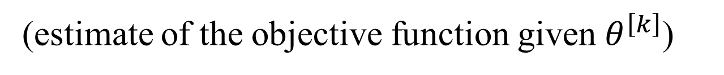
EM Algorithm
For the EM Iterations to Proceed based on the Criterion:
to make sure logP(x|θ^{[k+1]}) ≥ logP(x|θ^{[k]})
H(θ^{[k+1]},θ^{[k]}) ≤H(θ^{[k]},θ^{[k]}) due to Jenson’s Inequality
the only requirement is to have θ^{[k+1]} such that Q(θ^{[k+1]},θ^{[k]}) -Q(θ^{[k]},θ^{[k]}) ≥ 0
E-step: to estimate Q(θ,θ^{[k]}): auxiliary function (increase in this function means increase in objective function, maximizing this function may be easier), the expectation of the objective function in terms of the distribution of the latent data conditioned on (x,θ^{[k]})
M-step: θ^{[k+1]} = Q(θ,θ^{[k]})
(estimate of the objective function given $θ^{\left[k\right]}$)
arg max
θ

Slide 10
Example: Use of EM Algorithm in Solving Problem 3 of HMM
Observed data : observations O, latent data : state sequence q
The probability of the complete data is P(O,q|λ)= P(O|q,λ)P(q|λ)
E-Step : Q(λ, λ^{[k]})=E[log P(O,q|λ)|O, λ^{[k]}]= Σ_{q} P(q|O,λ^{[k]})log[P(O,q|λ)]
λ^{[k]}: k-th estimate of λ (known), λ: unknown parameter to be estimated
M-Step :
Find λ ^{[k+1]} such that λ ^{[k+1]} =arg max_{λ}Q(λ, λ^{[k]})
Given the Various Constraints (e.g. ), It can be shown
the above maximization leads to the formulas obtained previously

Slide 11
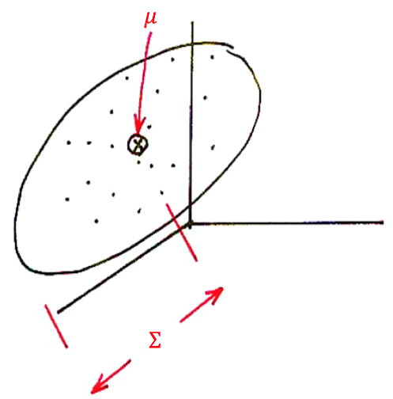
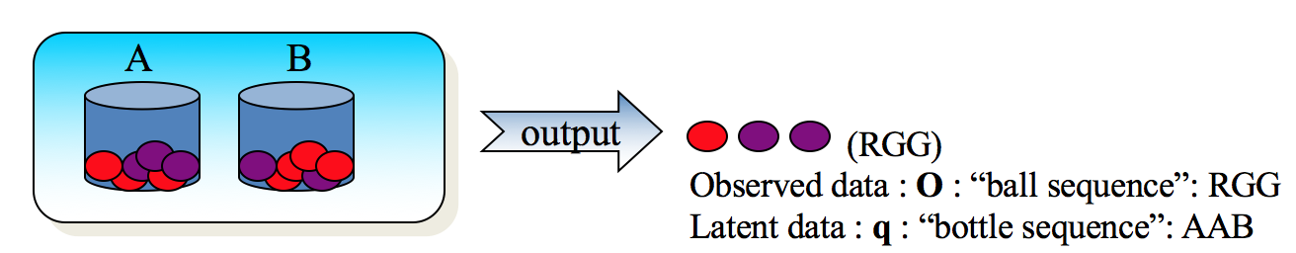
版權聲明
頁碼 | 作品 | 版權標示 | 作者 / 來源
4 |  |  | 國立臺灣大學電機工程學系李琳山 教授。 本作品採用創用CC「姓名標示-非商業性-相同方式分享3.0臺灣」許可協議。
7 |  |  | 國立臺灣大學電機工程學系李琳山 教授。 本作品採用創用CC「姓名標示-非商業性-相同方式分享3.0臺灣」許可協議。

