Slide 1


數位語音處理概論
Introduction to Digital Speech Processing
17.0 Spoken Dialogues
References: 1. 11.1 - 11.2.1, Chapter 17 of Huang
2. “Conversational Interfaces: Advances and Challenges”, Proceedings of the IEEE, Aug 2000
3. “The AT&T spoken language understanding system”, IEEE Trans. on Speech and Audio Processing, vol.14, no.1, pp.213-222, 2006
4. “Talking to machine” in ICSLP, 2002
5. “A telephone-based conversational interface for weather information” IEEE Trans. On Speech and Audio Processing, vol. 8,
no. 1, pp. 85-96, 2000.
6. “Spoken Language Understanding”, IEEE Signal Processing Magazine, vol.22, no. 5, pp. 16-31, 2005
7. “Spoken Language Understanding”, IEEE Signal Processing Magazine, May 2008
授課教師：國立臺灣大學 電機工程學系 李琳山 教授
【本著作除另有註明外，採取創用CC「姓名標示－非商業性－相同方式分享」臺灣3.0版授權釋出】

Slide 2

Spoken Dialogue Systems
Almost all human-network interactions can be made by spoken dialogue
Speech understanding, speech synthesis, dialogue management, discourse analysis
System/user/mixed initiatives
Reliability/efficiency, dialogue modeling/flow control
Transaction success rate/average dialogue turns
Sentence Generation
and Speech Synthesis
Internet
Users
Output Speech
Response to the user
Discourse Analysis
Dialogue
Manager
Databases
Networks
User’s Intention
Input Speech
Dialogue Server
Speech Recognition and Understanding
2

Slide 3
Key Processes in A Spoken Dialogue
A Basic Formulation
goal: the system takes the right actions after each dialogue turn and complete the task successfully finally
Three Key Elements
speech recognition and understanding: converting X_{n} to some semantic interpretation F_{n}
discourse analysis: converting S_{n-1} to S_{n}, the new discourse semantics (dialogue state), given all possible F_{n}
dialogue management: select the most suitable action A_{n} given the discourse semantics
(dialogue state) S_{n}
X_{n}: speech input from the user in the n-th dialogue turn
S_{n}: discourse semantics (dialogue state) at the n-th dialogue turn
A_{n}: action (response, actions, etc.) of the system (computer, hand-held device, network server, etc.) after the n-th dialogue turn
by dialogue management
by discourse analysis
by speech recognition and understanding
F_{n}: semantic interpretation of the input speech X_{n}
3

Slide 4
Dialogue Structure
Turns
an uninterrupted stream of speech(one or several utterances/sentences) from one participant in a dialogue
speaking turn: conveys new information
back-channel turn: acknowledgement and so on(e.g. O. K.)
Initiative-Response Pair
a turn may include both a response and an initiative
system initiative: the system always leads the interaction flow
user initiative: the user decides how to proceed
mixed initiative: both acceptable to some degree
Speech Acts(Dialogue Acts)
goal or intention carried by the speech regardless of the detailed linguistic form
forward looking acts
conversation opening(e.g. May I help you?), offer(e.g. There are three flights to Taipei…), assert(e.g. I’ll leave on Tuesday), reassert(e.g. No, I said Tuesday), information request(e.g. When does it depart?), etc.
backward looking acts
accept(e.g. Yes), accept-part(e.g. O.K., but economy class), reject(e.g. No), signal not clear(e.g. What did you say?), etc.
speech acts ↔ linguistic forms : a many-to-many mapping
e.g. “O.K.” ⎯ request for confirmation, confirmation
task dependent/independent
helpful in analysis, modeling, training, system design, etc.
Sub-dialogues
e.g. “asking for destination”, “asking for departure time”, …..
4

Slide 5
Language Understanding for Limited Domain
Semantic Frames ⎯ An Example for Semantic Representation
a semantic class defined by an entity and a number of attributes(or slots)
e.g. [Flight]:
[Airline] → (United)
[Origin] → (San Francisco)
[Destination] → (Boston)
[Date] → (May 18)
[Flight No] → (2306)
“slot-and-filler” structure
Sentence Parsing with Context-free Grammar (CFG) for Language Understanding
S
Grammar(Rewrite Rules)
S → NP VP
NP → N
VP → V-cluster PP
V-cluster → (would like to) V
V → fly| go
PP → Prep NP
N → Boston | I
Prep → to
NP
VP
V-cluster
PP
N
(would like to)
V
Prep
NP
N
I
would like to
fly
to
Boston
5
extension to Probabilistic CFG, integration with N-gram(local relation without semantics), etc.

Slide 6
Robust Parsing for Speech Understanding
Problems for Sentence Parsing with CFG
ungrammatical utterances
speech recognition errors (substitutions, deletions, insertions)
spontaneous speech problems: um–, cough, hesitation, repetition, repair, etc.
unnecessary details, irrelevant words, greetings, unlimited number of linguistic forms for a given act
e.g. to Boston
I’m going to Boston, I need be to at Boston Tomorrow
um– just a minute– I wish to – I wish to – go to Boston
Robust Parsing as an Example Approach
small grammars for particular items in a very limited domain, others handled as fillers
e.g. Destination→ Prep CityName
Prep → to |for| at
CityName → Boston |Los Angeles|...
different small grammars may operate simultaneously
keyword spotting helpful
concept N-gram may be helpful
Speech Understanding
two-stage: speech recognition (or keyword spotting) followed by semantic parsing (e.g. robust parsing)
single-stage: integrated into a single stage
Prob(c_{i}|c_{i-1}), c_{i}: concept
CityName (Boston,...)
direction (to, for...)
similar to class-based N-gram
6

Slide 7
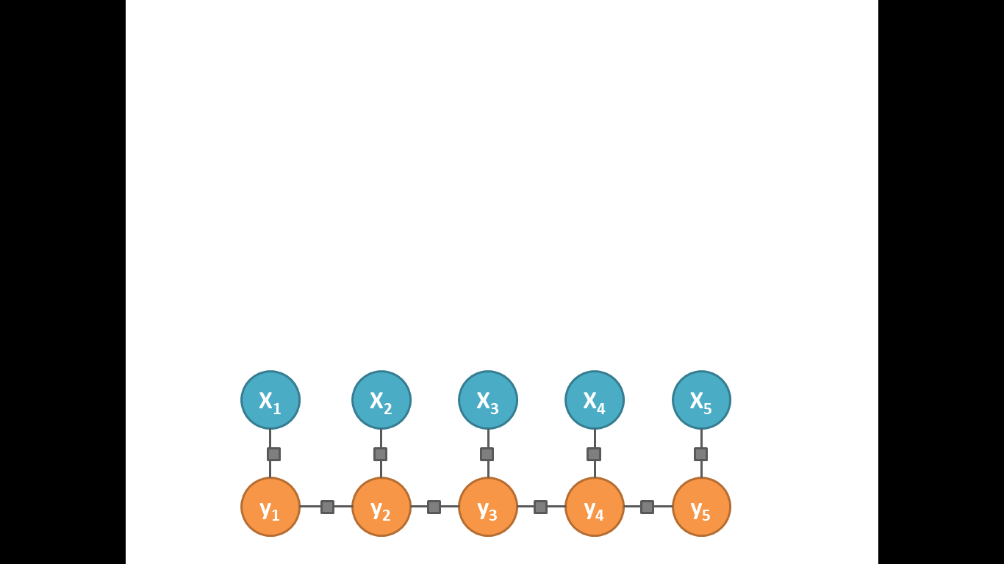
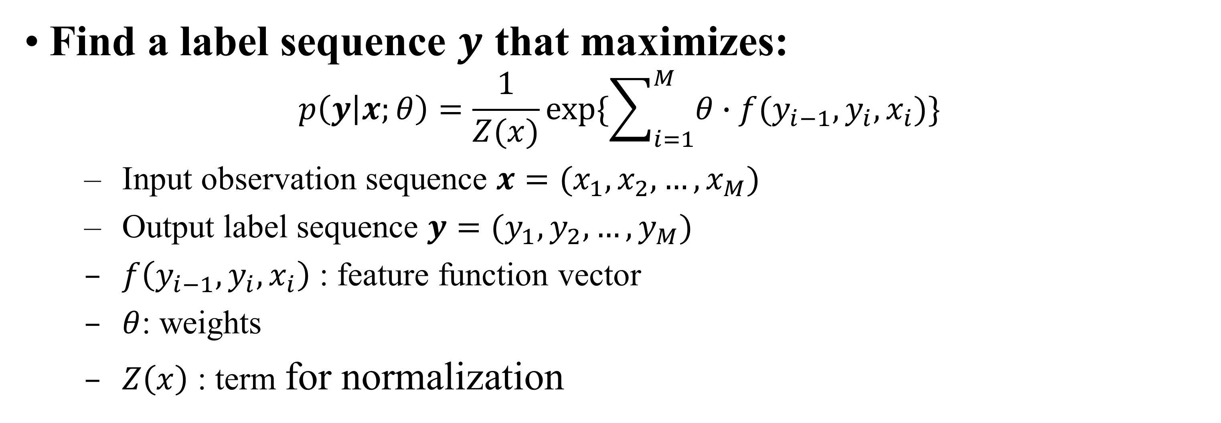
Conditional Random Field (CRF)
Find a label sequence $y$ that maximizes:
$$p\left(y | x;θ\right)=\frac{1}{Z(x)}exp⁡\{\sum_{i=1}^{M}{θ∙f(y_{i−1},y_{i},x_{i})}\}$$
Input observation sequence $x=(x_{1}, x_{2},…, x_{M})$
Output label sequence $y=(y_{1},y_{2},…,y_{M})$
$f\left(y_{i−1},y_{i},x_{i}\right)$ : feature function vector
$θ$: weights
$Z\left(x\right)$ : term for normalization
Observed
variables
Target
variables
7

Slide 8
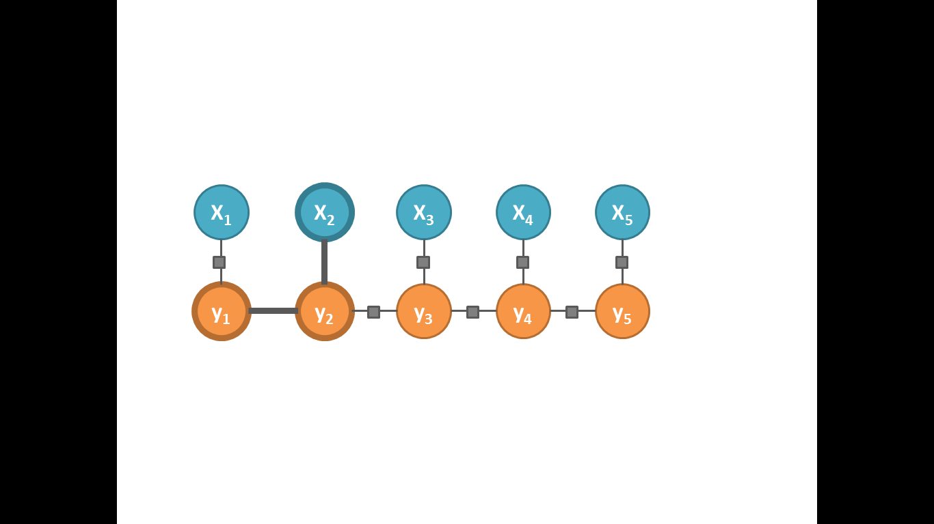

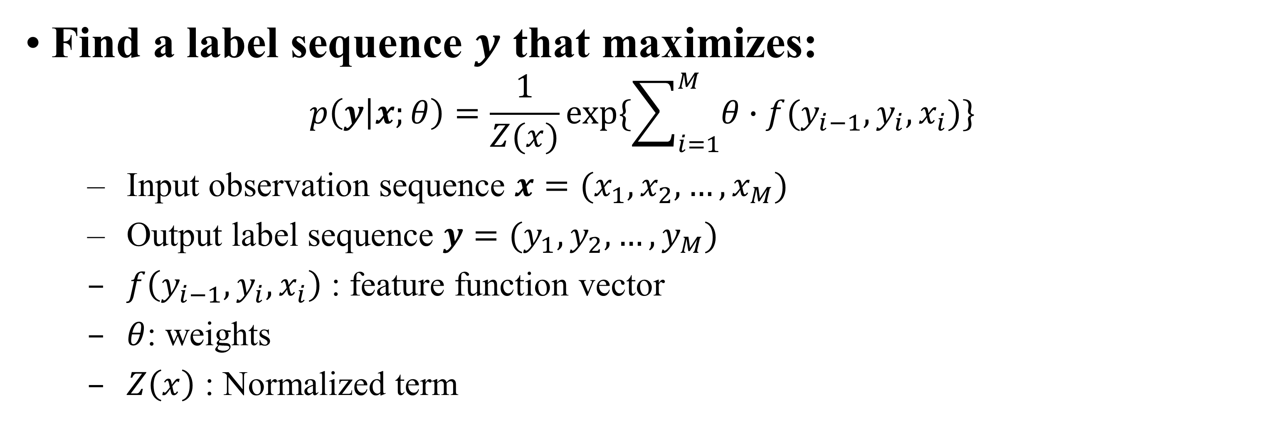

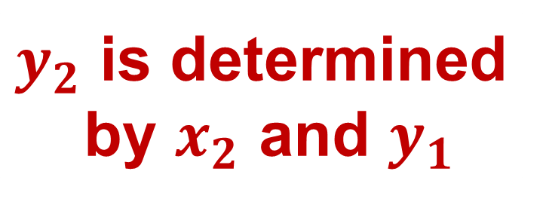

Conditional Random Field (CRF)
Find a label sequence $y$ that maximizes:
$$p\left(y | x;θ\right)=\frac{1}{Z(x)}exp⁡\{\sum_{i=1}^{M}{θ∙f(y_{i−1},y_{i},x_{i})}\}$$
Input observation sequence $x=(x_{1}, x_{2},…, x_{M})$
Output label sequence $y=(y_{1},y_{2},…,y_{M})$
$f\left(y_{i−1},y_{i},x_{i}\right)$ : feature function vector
$θ$: weights
$Z\left(x\right)$ : Normalized term
$$φ(x_{i},y_{i})φ(y_{i},y_{i−1})$$
$y_{2}$ is determined by $x_{2}$ and $y_{1}$
Observed
variables
$$φ(x_{i},y_{i})$$
Target
variables
$$φ(y_{i},y_{i−1})$$
8

Slide 9
Example
POS Tagging
Input sequence: natural language sentence
Ex: “Amy ate lunch at KFC”
Output sequence: POS tagging
Possible POS tagging: NOUN, VERB, ADJECTIVE, ADVERB, PREPOSITION…
Ex: “Amy(NOUN) ate(VERB) lunch(NOUN) at(PREPOSITION) KFC(NOUN)”
9

Slide 10
Example
POS Tagging
POS_{i} is determined by the word_{i} and POS_{i-1}
Input word
Amy
ate
lunch
at
KFC
output
POS₁
POS₂
POS₃
POS₄
POS₅
10

Slide 11
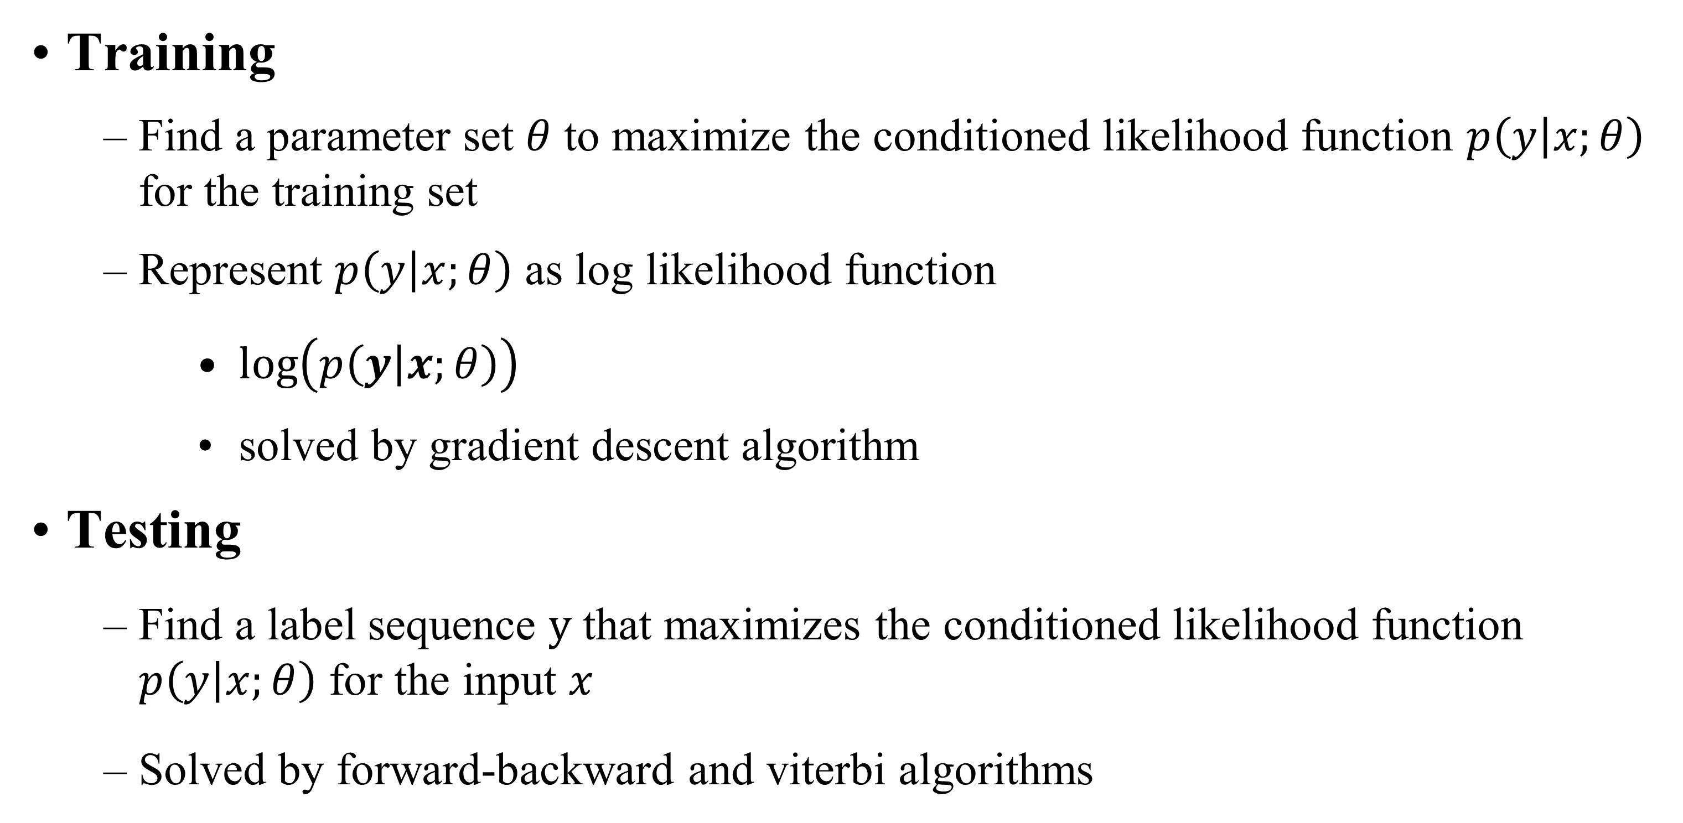
Training/Testing of CRF
Training
Find a parameter set $θ$ to maximize the conditioned likelihood function $p\left(y | x;θ\right)$ for the training set
Represent $p\left(y | x;θ\right)$ as log likelihood function
$\log\left(p\left(y | x;θ\right)\right)$
solved by gradient descent algorithm
Testing
Find a label sequence $y$ that maximizes the conditioned likelihood function $p\left(y | x;θ\right)$ for the input $x$
Solved by forward-backward and viterbi algorithms
11

Slide 12
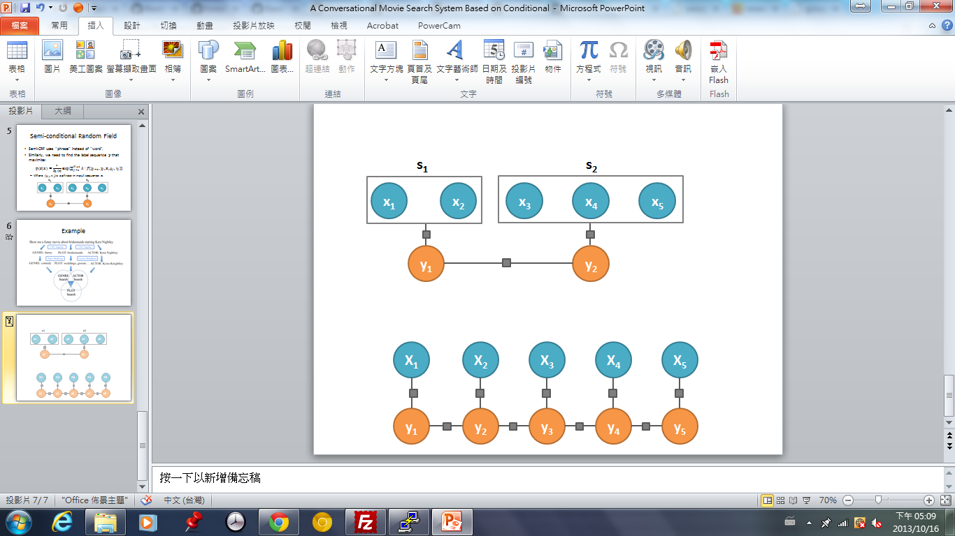
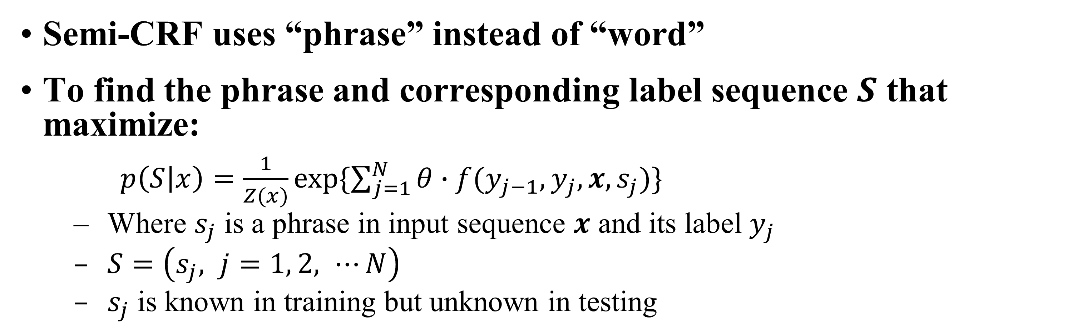
Semi-conditional Random Field (Semi-CRF)
Semi-CRF uses “phrase” instead of “word”
To find the phrase and corresponding label sequence $S$ that maximize:
$p\left(S | x\right)=\frac{1}{Z(x)}exp⁡\{\sum_{j=1}^{N}{θ∙f(y_{j−1},y_{j},x,s_{j})}\}$
Where $s_{j}$ is a phrase in input sequence $x$ and its label $y_{j}$
$S=\left(s_{j}, j=1, 2, ⋯N\right)$
$s_{j}$ is known in training but unknown in testing
12

Slide 13
Example
Slot filling
Input sequence: natural language sentence
Ex: Funny movie about bridesmaid starring Keira Knightley
Output sequence: slot sequence
GENRE, PLOT, ACTOR
Ex: [Funny](GENRE) movie about [bridesmaid](PLOT) starring [Keira Knightley](ACTOR)
13

Slide 14
Discourse Analysis and Dialogue Management
Discourse Analysis
conversion from relative expressions(e.g. tomorrow, next week, he, it…) to real objects
automatic inference: deciding on missing information based on available knowledge(e.g. “how many flights in the morning? ” implies the destination/origin previously mentioned)
inconsistency/ambiguity detection (e.g. need clarification by confirmation)
example approach: maintaining/updating the dialogue states(or semantic slots)
Dialogue Management
controlling the dialogue flow, interacting with the user, generating the next action
e.g. asking for incomplete information, confirmation, clarify inconsistency, filling up the empty slots one-by-one towards the completion of the task, optimizing the accuracy/efficiency/user friendliness of the dialogue
dialogue grammar: finite state machines as an example
no
Subdialogue:
Conversation Opening
Subdialogue:
Asking for Destination
Subdialogue:
Asking for Departure Time
Departure
Time
filled up
Destination
filled up
yes
yes
no
plan-based dialogue management as another example
challenging for mixed-initiative dialogues
Performance Measure
internal: word error rate, slot accuracy (for understanding), etc.
overall: average success rate (for accuracy), average number of turns (for efficiency), etc.
14

Slide 15
Dialogue Management
Example Approach – MDP-based
Example Task: flight booking
The information the system needs to know:
The departure city
The arrival city
Define the state as (DEPARTURE,ARRIVAL)
There are totally four states:
(?,?), (KNOWN,?), (?,KNOWN), (KNOWN,KNOWN)
15

Slide 16
Flight Booking with MDP (1/5)
S2
S1
(KNOWN,?)
(?,?)
Sf
(KNOWN,KNOWN)
The state is decided by the information the system knows.
16

Slide 17
Flight Booking with MDP (1/5)
A1: ask DEPARTURE city
S2
S1
A2: ask ARRIVAL city
A3: confirm
A4: return flight list
Sf
The state is decided by the information the system knows.
A set of available actions is also defined.
17

Slide 18
Flight Booking with MDP (2/5)
A1: ask DEPARTURE city
A1
S2
S1
(?,?)
Sf
Assume the system is at state S1 and takes action A1.
18

Slide 19
Flight Booking with MDP (2/5)
A1: ask DEPARTURE city
A1
S2
S1
(?,?)
Sf
Assume the system is at state S1 and takes action A1.
User response will cause the state to transit.
19

Slide 20
Flight Booking with MDP (3/5)
A1: ask DEPARTURE city
A1
0.7
S2
S1
0.2
Response: From Taipei.
(?,?)
0.1
Response: From Taipei to Boston.
Sf
Response: What did you say?
The transition is probabilistic based on user response and recognition results (with errors).
20

Slide 21
Flight Booking with MDP (3/5)
A1: ask DEPARTURE city
A1
0.7
+5
S2
S1
+10
0.2
(?,?)
0.1
-5
Sf
The transition is probabilistic based on user response and recognition results (with errors).
A reward associated with each transition.
21

Slide 22
Flight Booking with MDP (4/5)
A2: ask ARRIVAL city
A2
S2
S1
(KNOWN,?)
Sf
The interaction continues.
22

Slide 23
Flight Booking with MDP (4/5)
A2: ask ARRIVAL city
A2
S2
S1
(KNOWN,?)
Sf
The interaction continues.
23

Slide 24
Flight Booking with MDP (4/5)
S2
S1
Sf
(KNOWN,KNOWN)
The interaction continues.
When the final state is reached, the task is completed and result is returned.
24

Slide 25

Flight Booking with MDP (5/5)
A1
A2
S2
S1
+5
(?,?)
+5
Sf
For the overall dialogue session, the goal is to maximize the total reward
R = R1 + … + Rn = 5 + 5
Dialogue optimized by choosing a right action given each state (policy).
Learned by Reinforcement Learning.
Improved as Partially Observable MDP (POMDP)
25

Slide 26
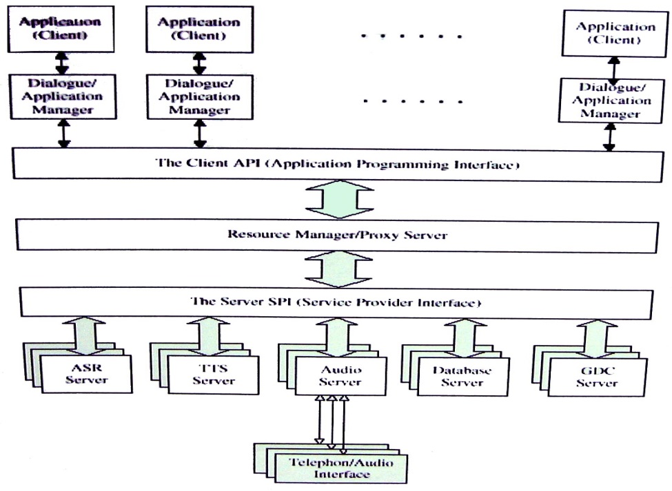
Client-Server Architecture
Galaxy, MIT
Integration Platform, AT& T
Application (Client)
Application (Client)
Application (Client)
HLT Server
Dialogue/ Application Manager
Dialogue/ Application Manager
Dialogue/ Application Manager
The Client API (Application Programming Interface)
Network
Hub
Client
Resource Manager/Proxy Server)
Domain Server
The Server SPI (Server Provider Interface)
ASR Server
TTS Server
Audio Server
Database Server
GDC Server
Telephone/Audio Interface
Domain Dependent/Independent Servers Shared by Different Applications/Clients
reducing computation requirements at user (client) by allocating most load at server
higher portability to different tasks
26

Slide 27
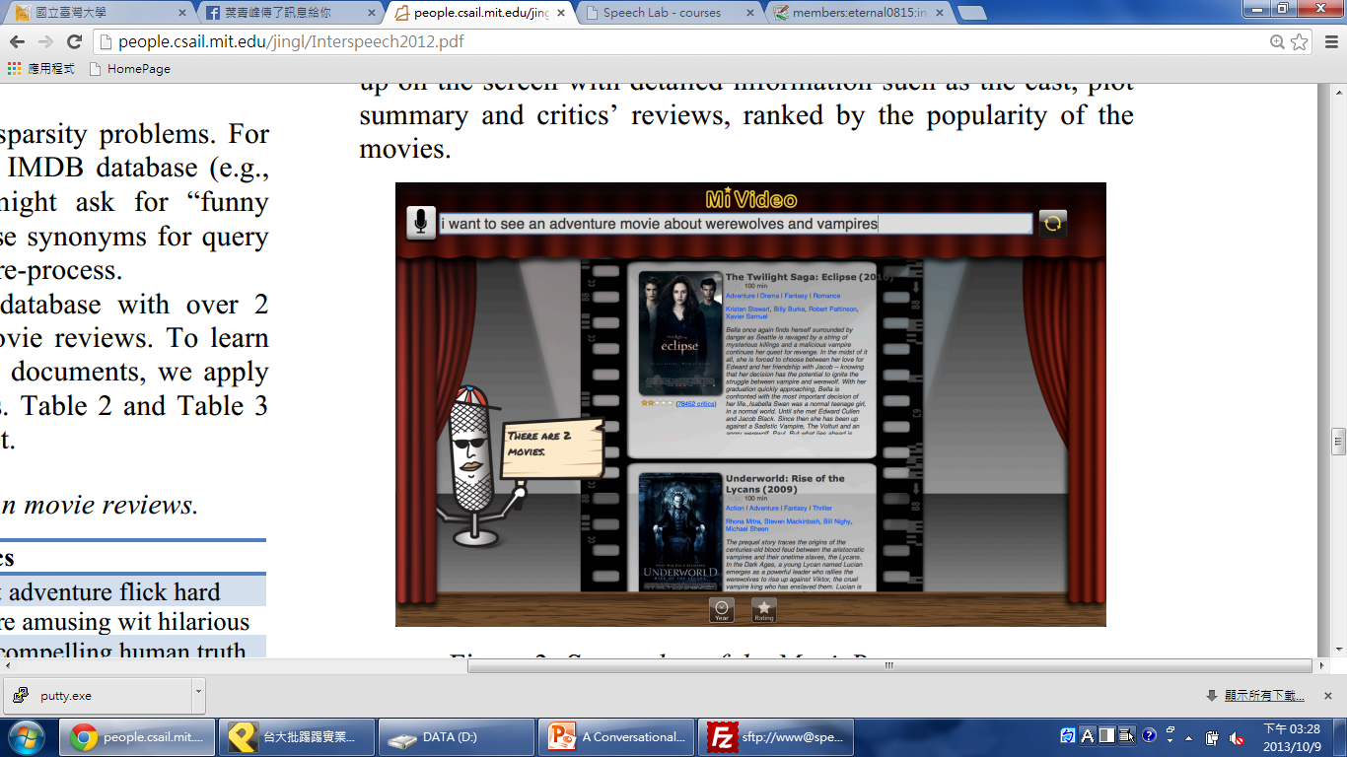
An Example: Movie Browser
Voice Command
Recognition results
Retrieved movies
27

Slide 28

Flowchart
USER
database
Query utterances
TURKER
indexing
Search Engine
annotations
Speech
Synthesis
Speech
recognizer
Dialogue and Discourse
CRF model
28

Slide 29
Semi-CRF for Slot Filling
Input data: user’s query for searching movie
Ex: Show me the scary movie
Output: label the input sentence with “GENRE”, “PLOT” and “ACTOR”
Topic modeling
Data sparsity → difficult to match terms exactly
Ex. “funny” and “comedy”
Use Latent Dirichlet Allocation (LDA) for topic modeling
Handling misspelling
Convert query terms to standard phonemes
Search by pronunciations instead of spellings
29

Slide 30
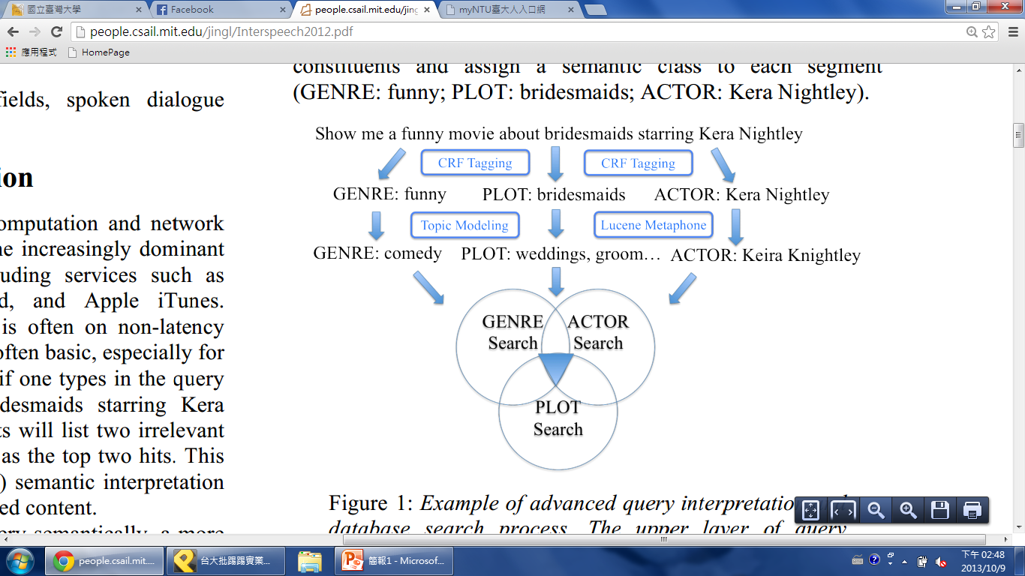
Example
30

Slide 31
References for CRF
References:
Jingjing Liu, Scott Cyphers, Panupong Pasupat, Ian Mcgraw, and Jim Glass, A Conversational Movie Search System Based on Conditional Random Fields , Interspeech, 2012
J. Lafferty, A. McCallum, and F. Pereira. Conditional random fields: Probabilistic models for segmenting and labeling sequence data, In Proc. of ICML, pp.282-289, 2001
Wallach, H.M., Conditional random fields: An introduction, Technical report MS-CIS-04-21, University of Pennsylvania 2004
Sutton, C., McCallum, A., An Introduction to Conditional Random Fields for Relational Learning, In Introduction to Statistical Relational Learning 2006
31

Slide 32
References for CRF
References:
Sunita Sarawagi, William W. Cohen: Semi-Markov Conditional Random Fields for Information Extraction. NIPS 2004
Bishan Yang and Claire Cardie, Extracting Opinion Expressions with semi-Markov Conditional Random Fields, EMNLP-CoNLL 2012
Toolkits:
CRF++ (http://crfpp.googlecode.com/svn/trunk/doc/index.html)
CRFsuite (http://www.chokkan.org/software/crfsuite/)
32

Slide 33
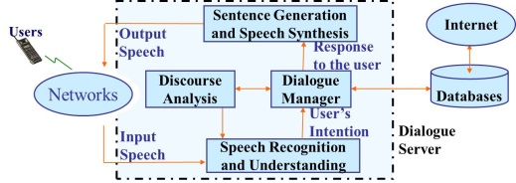
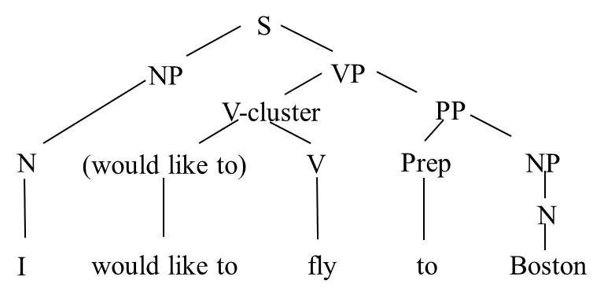
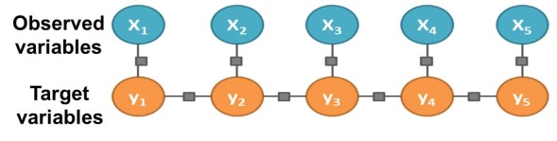
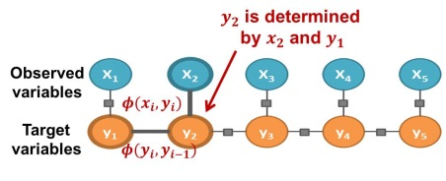
版權聲明
頁碼 | 作品 | 版權標示 | 作者/來源
2 |  |  | 國立臺灣大學電機工程學系 李琳山 教授 本作品採用創用CC「姓名標示-非商業性-相同方式分享3.0臺灣」許可協議。
5 |  |  | 國立臺灣大學電機工程學系 李琳山 教授 本作品採用創用CC「姓名標示-非商業性-相同方式分享3.0臺灣」許可協議。
7 |  |  | 國立臺灣大學電機工程學系 李琳山 教授 本作品採用創用CC「姓名標示-非商業性-相同方式分享3.0臺灣」許可協議。
8 |  |  | 國立臺灣大學電機工程學系 李琳山 教授 本作品採用創用CC「姓名標示-非商業性-相同方式分享3.0臺灣」許可協議。
33

Slide 34
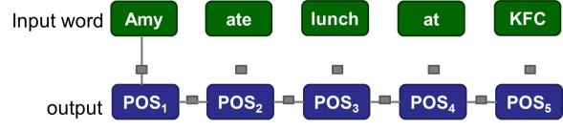
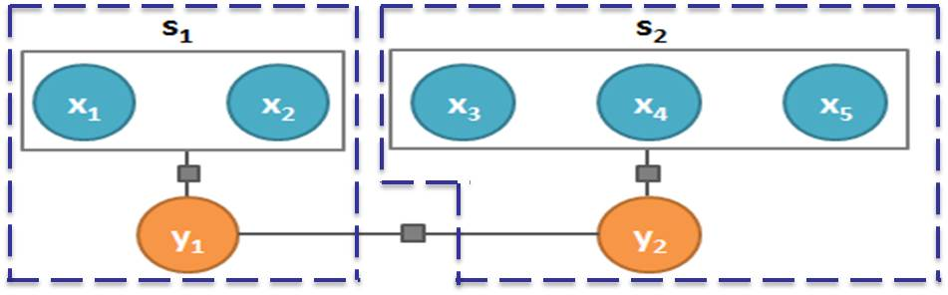
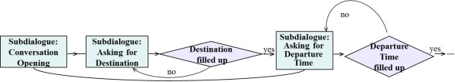
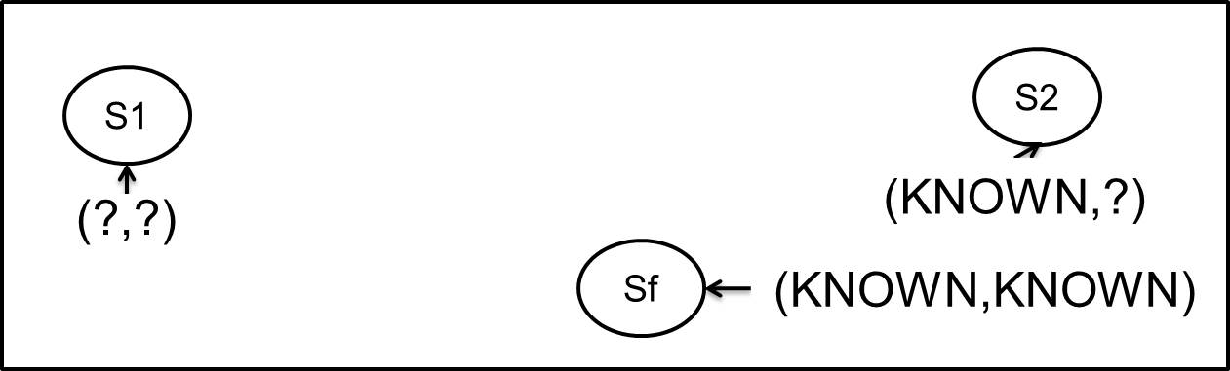
版權聲明
頁碼 | 作品 | 版權標示 | 作者/來源
10 |  |  | 國立臺灣大學電機工程學系 李琳山 教授 本作品採用創用CC「姓名標示-非商業性-相同方式分享3.0臺灣」許可協議。
12 |  |  | 國立臺灣大學電機工程學系 李琳山 教授 本作品採用創用CC「姓名標示-非商業性-相同方式分享3.0臺灣」許可協議。
14 |  |  | 國立臺灣大學電機工程學系 李琳山 教授 本作品採用創用CC「姓名標示-非商業性-相同方式分享3.0臺灣」許可協議。
16 |  |  | 國立臺灣大學電機工程學系 李琳山 教授 本作品採用創用CC「姓名標示-非商業性-相同方式分享3.0臺灣」許可協議。
34

Slide 35
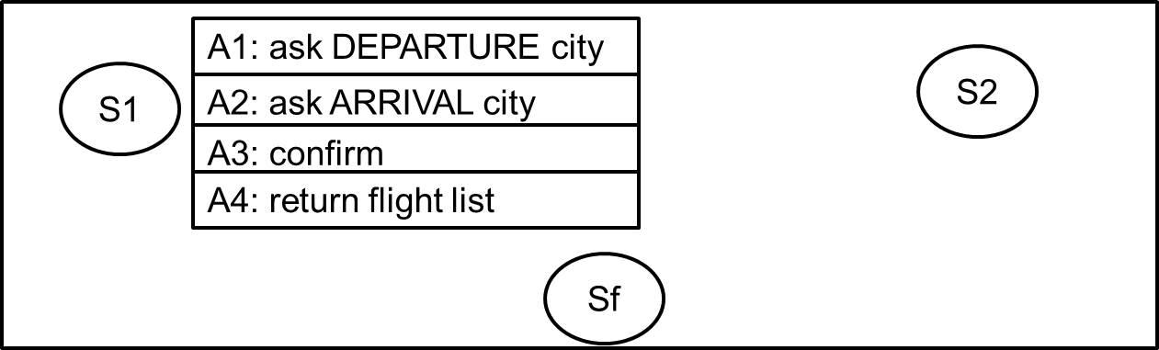
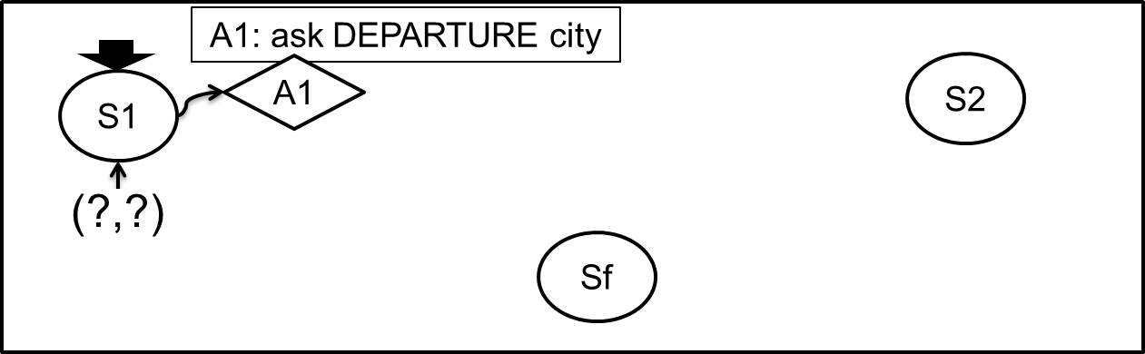
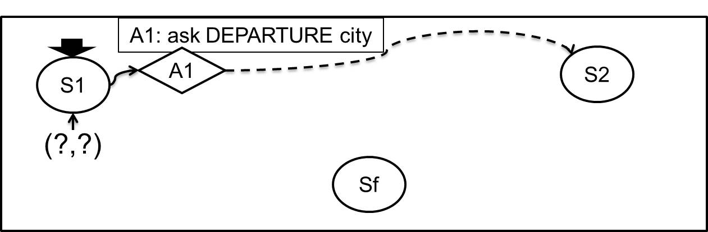
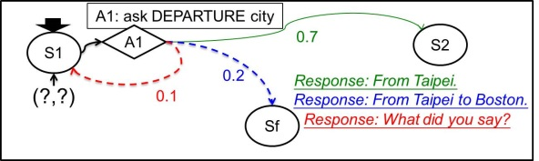
版權聲明
頁碼 | 作品 | 版權標示 | 作者/來源
17 |  |  | 國立臺灣大學電機工程學系 李琳山 教授 本作品採用創用CC「姓名標示-非商業性-相同方式分享3.0臺灣」許可協議。
18 |  |  | 國立臺灣大學電機工程學系 李琳山 教授 本作品採用創用CC「姓名標示-非商業性-相同方式分享3.0臺灣」許可協議。
19 |  |  | 國立臺灣大學電機工程學系 李琳山 教授 本作品採用創用CC「姓名標示-非商業性-相同方式分享3.0臺灣」許可協議。
20 |  |  | 國立臺灣大學電機工程學系 李琳山 教授 本作品採用創用CC「姓名標示-非商業性-相同方式分享3.0臺灣」許可協議。
35

Slide 36
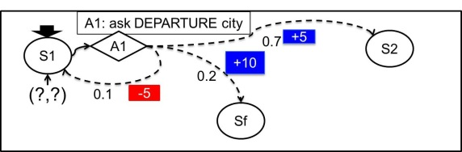
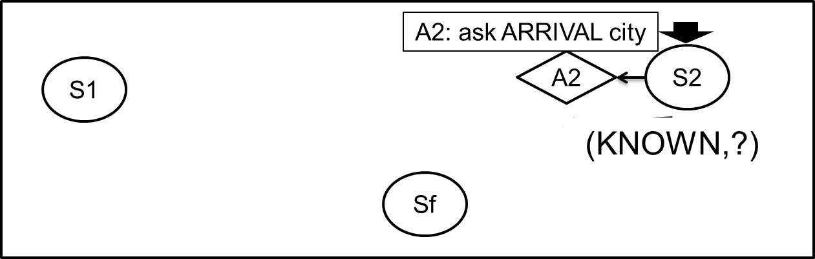
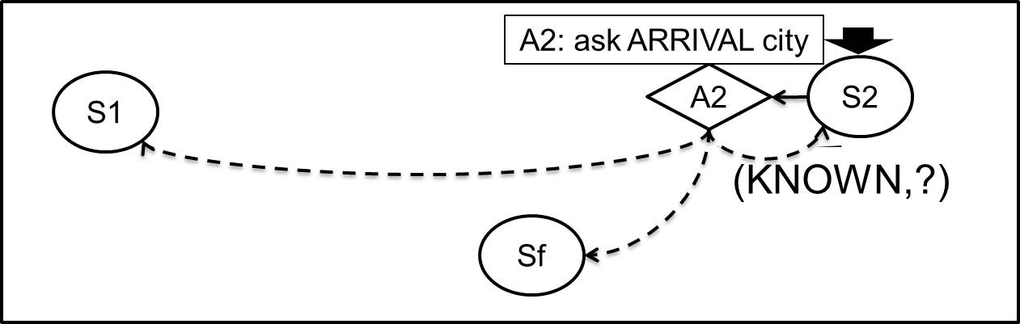
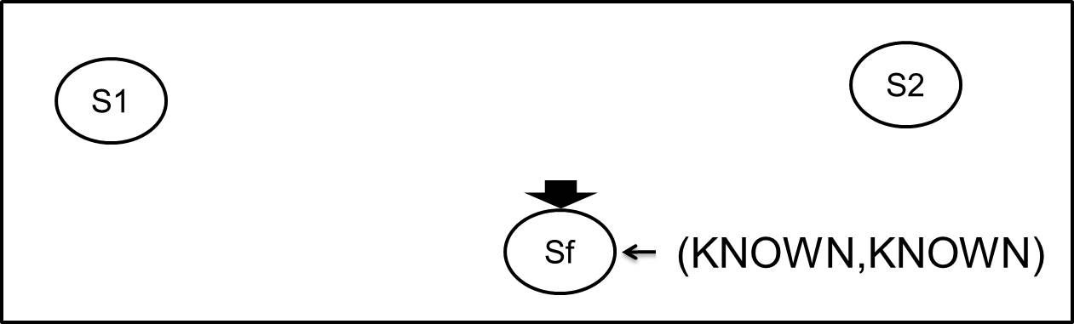
版權聲明
頁碼 | 作品 | 版權標示 | 作者/來源
21 |  |  | 國立臺灣大學電機工程學系 李琳山 教授 本作品採用創用CC「姓名標示-非商業性-相同方式分享3.0臺灣」許可協議。
22 |  |  | 國立臺灣大學電機工程學系 李琳山 教授 本作品採用創用CC「姓名標示-非商業性-相同方式分享3.0臺灣」許可協議。
23 |  |  | 國立臺灣大學電機工程學系 李琳山 教授 本作品採用創用CC「姓名標示-非商業性-相同方式分享3.0臺灣」許可協議。
24 |  |  | 國立臺灣大學電機工程學系 李琳山 教授 本作品採用創用CC「姓名標示-非商業性-相同方式分享3.0臺灣」許可協議。
36

Slide 37
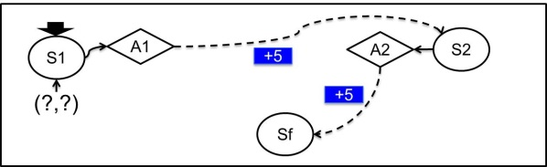
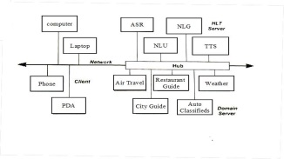
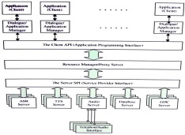
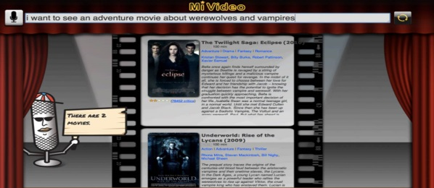
版權聲明
頁碼 | 作品 | 版權標示 | 作者/來源
25 |  |  | 國立臺灣大學電機工程學系 李琳山 教授 本作品採用創用CC「姓名標示-非商業性-相同方式分享3.0臺灣」許可協議。
26 |  |  | 國立臺灣大學電機工程學系 李琳山 教授 本作品採用創用CC「姓名標示-非商業性-相同方式分享3.0臺灣」許可協議。
26 |  |  | 國立臺灣大學電機工程學系 李琳山 教授 本作品採用創用CC「姓名標示-非商業性-相同方式分享3.0臺灣」許可協議。
27,28 |  |  | A Conversational Movie Search System Based on Conditional Random Fields, Interspeech, 2012/ 作者：Jingjing Liu, Scott Cyphers, Panupong Pasupat, Ian Mcgraw, and Jim Glass 瀏覽日期：2016.12.1。本作品依據著作權法第46、52、65條合理使用。
37

Slide 38
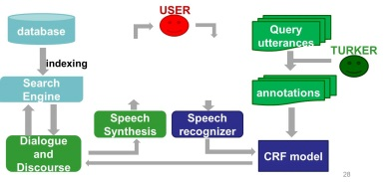
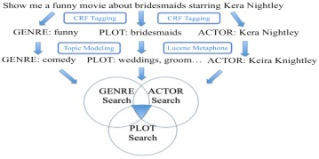
版權聲明
頁碼 | 作品 | 版權標示 | 作者/來源
28 |  |  | 國立臺灣大學電機工程學系 李琳山 教授 本作品採用創用CC「姓名標示-非商業性-相同方式分享3.0臺灣」許可協議。
30 |  |  | 國立臺灣大學電機工程學系 李琳山 教授 本作品採用創用CC「姓名標示-非商業性-相同方式分享3.0臺灣」許可協議。
38

