Slide 1


SSMA for ISRO
HackOut’24
Securing space mission Anomalies
Presented by: team ynx

Slide 2
Table of Contents
Problem Statement
Why SSMA?
Do you know?
Technical Approach
User Flow
Rough Action Plan

Slide 3
Problem Statement
The lack of a centralized database on past space mission failures hinders our ability to learn from mistakes and secure the success of future missions.
Major concern:
There is currently no comprehensive, searchable database of past space mission failures that details the causes and lessons learned, which is crucial for informing and improving future space missions.
Aim:
“Learning from past mistakes and securing future.”
Back to ToC

Slide 4
Why SSMA?
Establishes a Centralized resource consolidating past space mission failures.
Crucial for Informed decision making to avoid repeated mistakes.
Improves mission success rate and reduces the risk of future failures.
Future enhanced collaboration with data including space launchers and customer satellites.
Reduces research time and costs, enhancing Time and Cost efficiency in predicting space launch failures.
Lays the groundwork for AI Integration in future mission analysis.
Back to ToC

Slide 5
Basic, Unexpected yet Failed.
Do you know?
INSAT-1A failed after 18 months due to overheating. Better thermal controls might have prevented it.
Vikram lander of Chandrayaan-2 lost communication before landing. More testing might have avoided the crash.
GSAT-5P was destroyed due to a rocket booster failure. Rigorous testing could have prevented it.
IRNSS-1H failed to reach orbit because the rocket’s heat shield didn’t separate. Better checks might have helped.
Back to ToC

Slide 6
Technical Approach
Frontend(HTML, CSS & JS):Structure the website with HTML. Style it using CSS to ensure responsiveness on all devices.
Backend(Node.js & Express):Set up a server using Node.js and Express to handle API requests and database interactions.
Database(MongoDB): Use MongoDB to store mission data, including key-value pairs. Employ Mongoose for defining schemas and managing database operations.
API Integration: Extend an existing API by adding new data relevant to space missions.
Deployment: Test locally using Node.js and MongoDB. Deploy on platforms like GitHub
Back to ToC

Slide 7
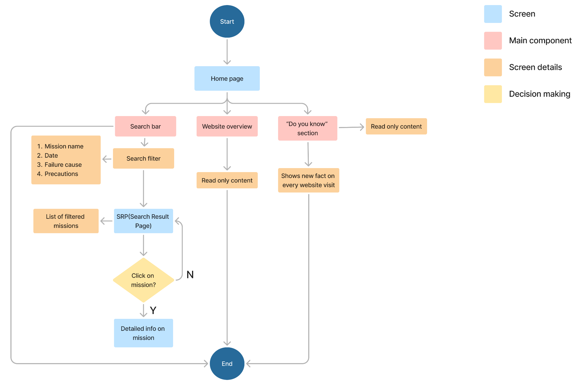
Back to ToC

Slide 8
Rough Action Plan
Day 2:
Finalize & Present
Polish UI, final testing.
Prepare and submit presentation.
Tonight:
Extend API
Set up environment and plan.
Explore and extend the API.
Test and debug.
Day 1:
Integrate & Build
Set up backend (Node.js, MongoDB).
Develop responsive HTML/CSS pages.
Integrate frontend with API.
Test and document.
Back to ToC

Slide 9
Thank You

