Slide 1

HouseTab Mobile App
Jacob Neuman
Om Patel
Michael Telakowicz

Slide 2

Problem
Household expenses can be hard to track, especially in a large household
All roommates are buying different things for the house
Manually tracking all the finances can cause mistakes
It's difficult to visualize who is spending what

Slide 3
Solution
HouseTab handles all house expenses in one easy to use app
It keeps a running balance of all expenses, handles automatic splitting, and adds visual guide on how much people spend

Slide 4
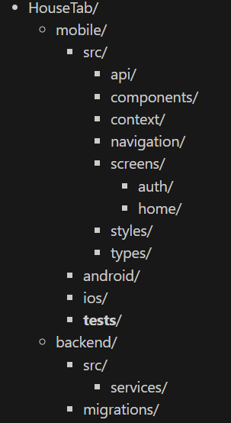
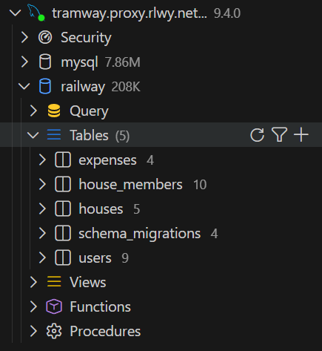
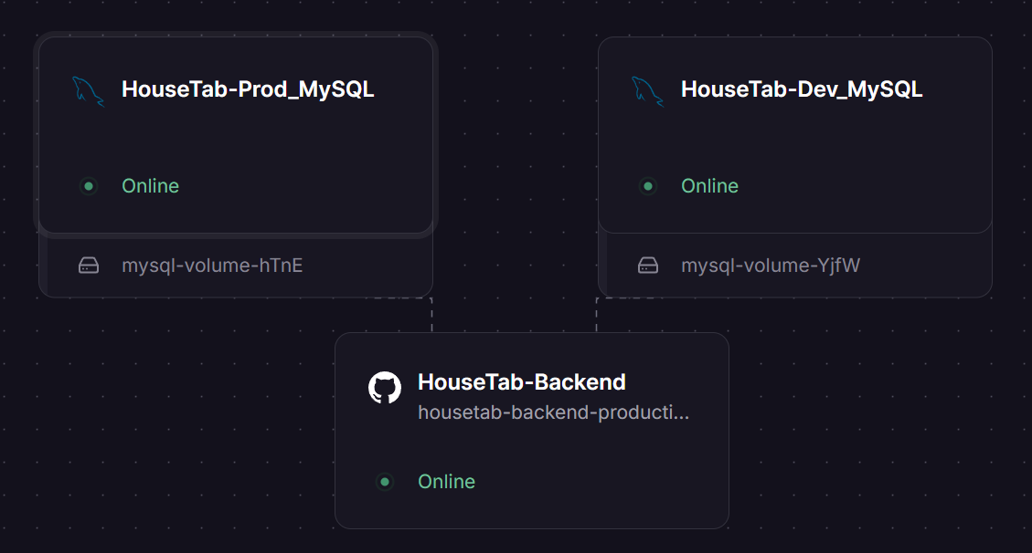
Tech Stack
Frontend: React Native, Java (Android), Swift (iOS)
Backend: Node.js + Express
Database: MySQL
Uses a migration system in backend to handle updates
Cloud: Railway
Auto deploys Backend based on GitHub

Slide 5
Progress Since Initial Demo
Expenses are stored in the back end and saved after logging out
Styling is consistent now across all tabs (log in, houses, expenses)
Work on publishing to the Play Store
Configuring settings
Creating a private policy
Adding a webpage to delete accounts
Getting screenshots and generating descriptions

Slide 6
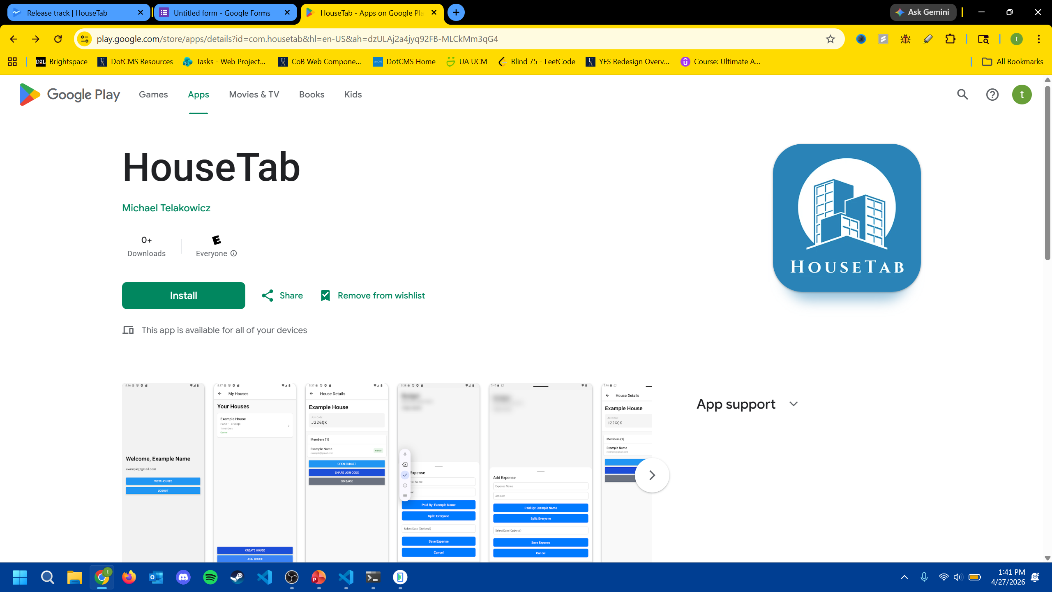
Publishing
Apple Store
Deciding if we want to continue with publishing due to the increased price and harder to support
Play Store
Currently: Sent our first version of our app to review (est. 1 week)
Next: Need to get 12 testers for a period of 14 days before we can publish
Railway
Cost: $5 a month + extra depending on use up to a limit of $25

Slide 7
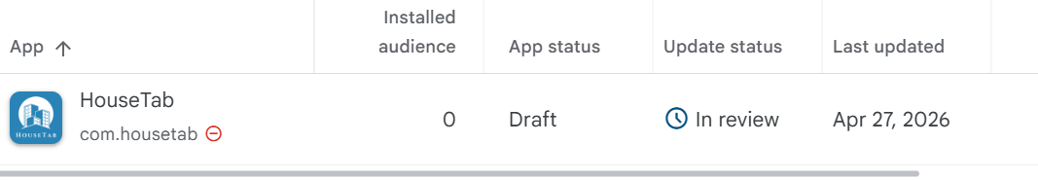
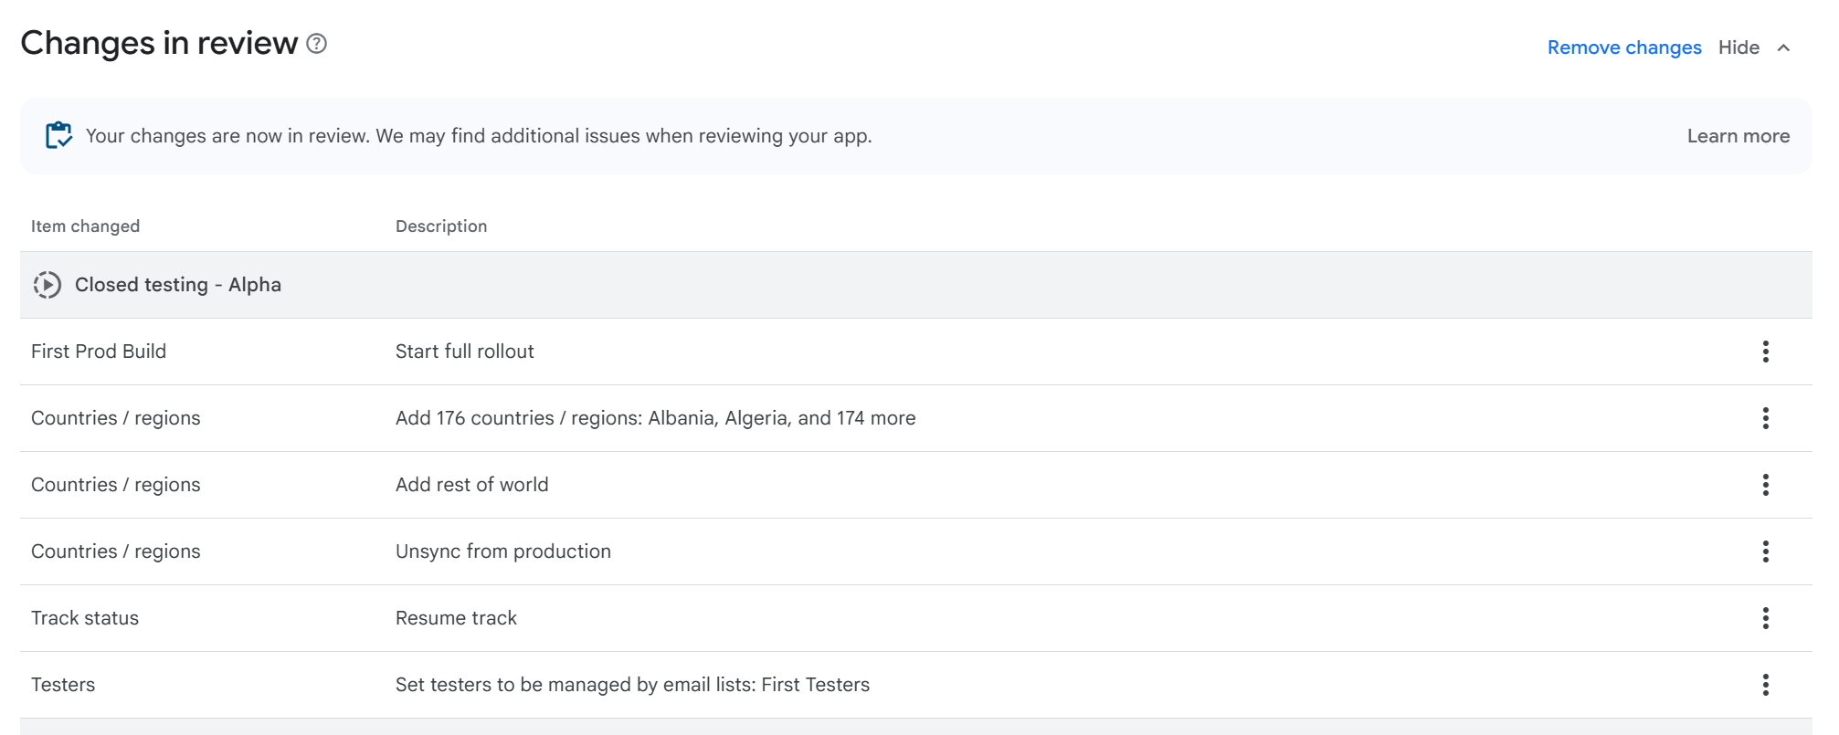
Possible Future Work
Production build published on the Google Play Store and Apple App Store - Google Play is a one-time $25 fee - Apple charges a $100 yearly fee
Third-party payment integration (Venmo, Cash App)
Scan feature to analyze receipts
Recurring payments to be scheduled automatically

