Slide 1
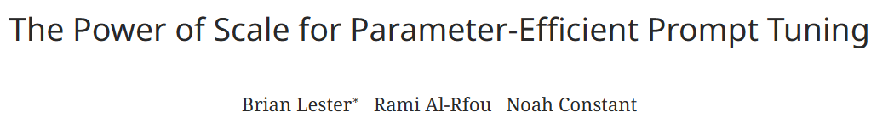

Slide 2
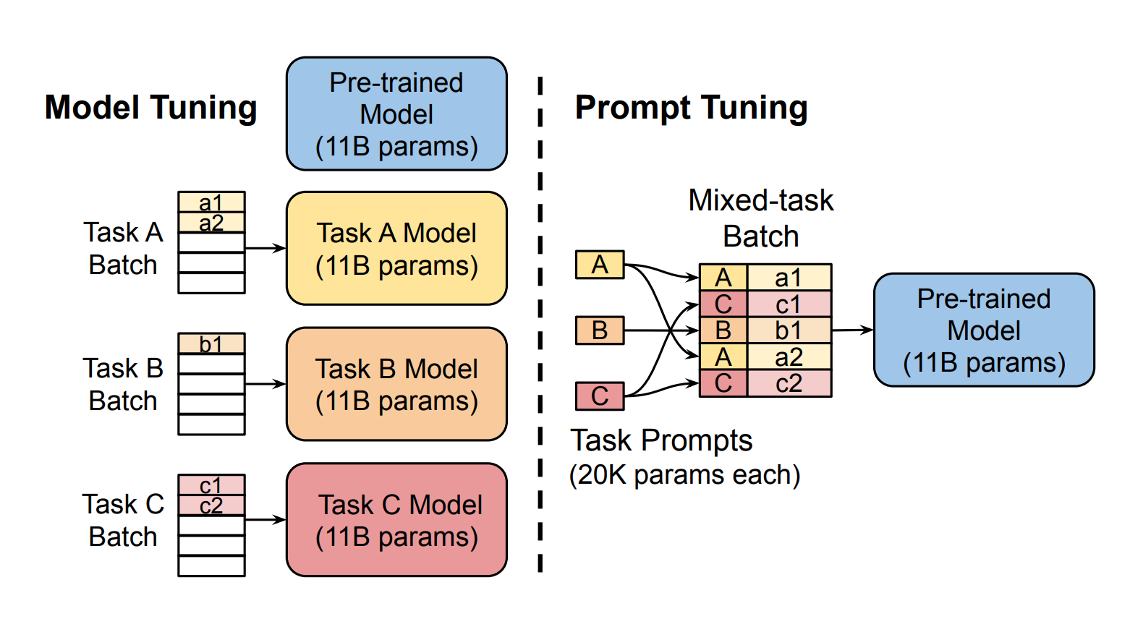
History
The idea of Freezing
Model Tuning (Fine-tuning): GPT and BERT (update all parameters)
Prompt Design: GPT-3 (freeze model, adapt via handcrafted prompts)

Slide 3
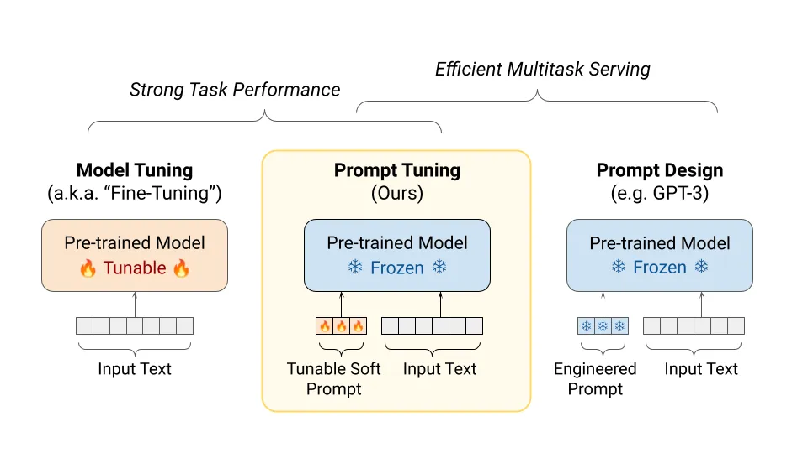

Slide 4
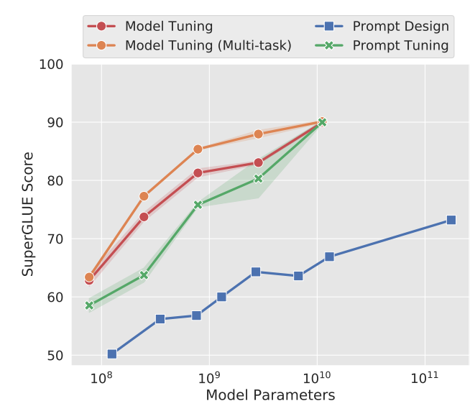
Prompt Tuning
Freeze the entire pre-trained model, do not change its weights
Learn only k tunable tokens per downstream task
Prepending those tokens to the input text forming a soft prompt.
Example Token
[ P1, P2, …, P20, Input_1, Input_2, … Input_n ], matrix of 20 * 768 (vector size = embedding dimension of model.

Slide 5
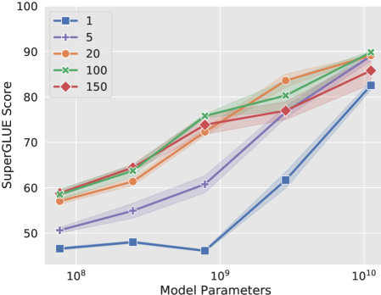
Ablation-Prompt Length
Increasing prompt length beyond 1 token generally gives large improvement for most model sizes.
XXL model still does reasonably well even with single token prompt.

Slide 6
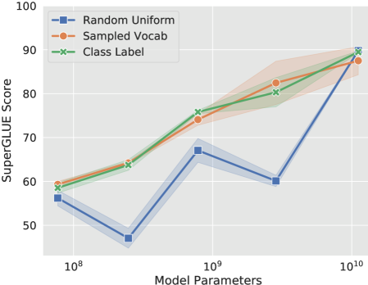
Ablation-Prompt Initialization
Class Label initialization tends to perform best, especially in smaller and midsize models.
Sampling vocab is middle ground.
Differences in initialization diminish for XXL model.

Slide 7
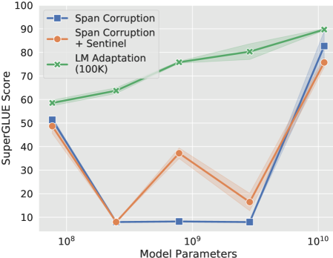
Ablation: Pre-training Objective
LM adaptions give higher performance across model sizes.
Adding sentinel to downstream targets while using span corruption yields little benefit.
XXL models are more robust. Even non-ideal settings produce good results.

Slide 8
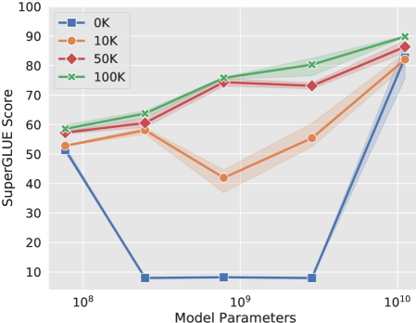
Ablation-LM Adaptation Steps
More adaptation steps equals better performance, but up to a point.
There is a diminishing return, which the XXL model gets smaller gains.

Slide 9
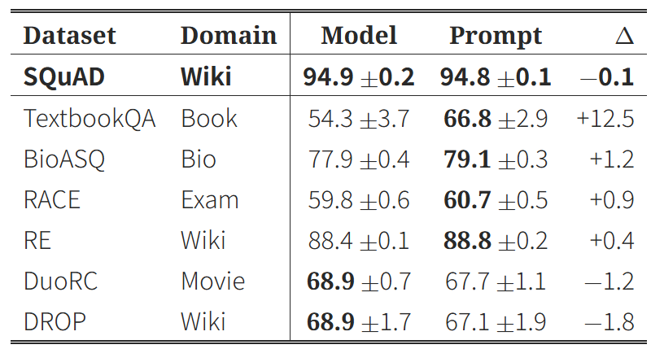
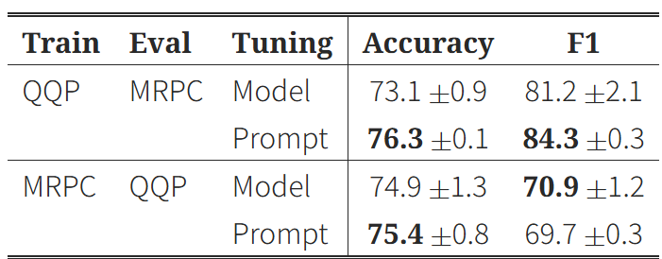
Domain Transfer
Prompt tuning tends to outperform model tuning under domain shift, particularly when the shift is large.
Zero-shot Domain Transfer in Question Answering
Training: SQuAD
Testing: Out of domain datasets from MRQA 2019.
Zero-shot Domain Transfer in Paraphrase Detection
Training: Transfer Tested between community Q&A pairs and MRPC, which is news sentence pairs.
Examine both transfer directions.

Slide 10
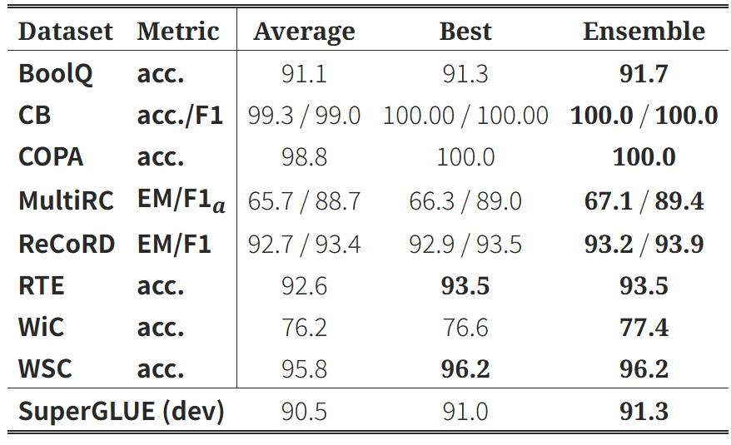
Prompt Ensembling
Ensembling gives gains over both average and the best individual prompt. Less storage cost than ensembling full models.

Slide 11
Interpretability
Nearest neighbor analyses Learned prompt tokens cluster semantically.
Class label initialization tends to preserve class label embeddings.

Slide 12
Summary
Scaling Effect
Small models: prompt tuning lags behind full model tuning.
Large models (billions of parameters): performance gap disappears, prompt tuning matches full fine-tuning.
Efficiency
Performance
Prompt-tuned small models can rival much larger GPT-3 models.

Slide 13
Summary - Takeaway
Good with domain shifts
Boosted performance through prompt resembling
Potential interpretability of task behavior

Slide 14
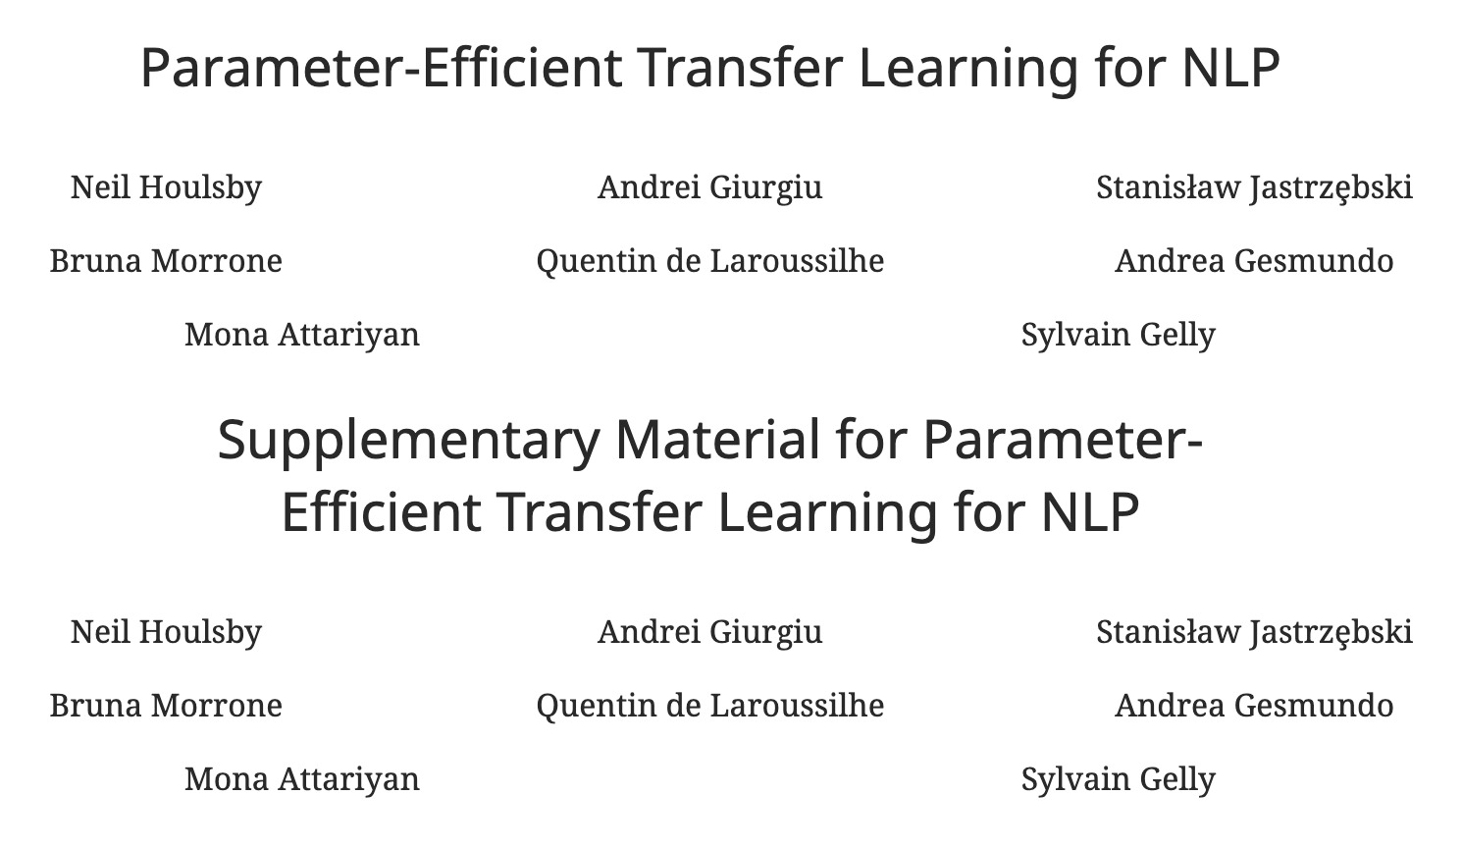
Jiayue Zhao

Slide 15
Background & Motivation
Method: Adapters
Experiments & Results
Contributions & Limitations
Conclusion

Slide 16
Background & Motivation
Pretrained models (e.g., BERT) → strong performance but expensive to fine-tune
Each new task requires training & storing the full model
Need parameter-efficient transfer learning alternatives
Goal: reduce cost while retaining accuracy

Slide 17
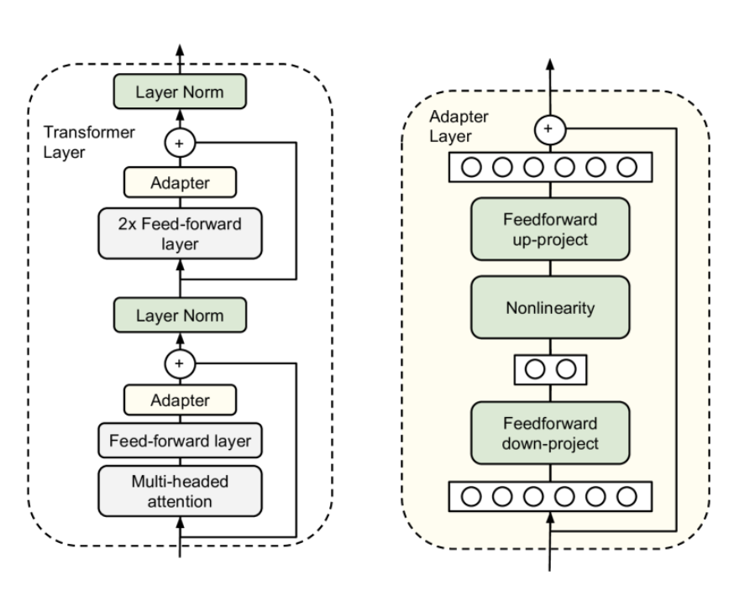
Method: Adapters
Part 1：Where to Insert Adapters
Part 2：How AdaptersWork

Slide 18
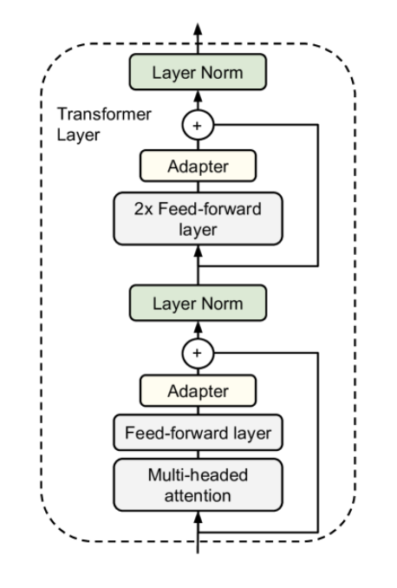
Method (Part 1): Where Adapters are Inserted
Inserted after attention + feed-forward layers
Only adapters + layer norms + classifier are trained
Pretrained model parameters frozen

Slide 19
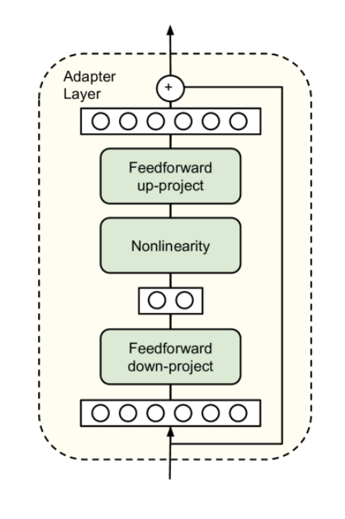
Method (Part 2): Adapter Architecture
Down-project: reduce dimensionality (bottleneck)
Nonlinearity
Up-project: restore dimensionality
Very few parameters compared to full layer

Slide 20
Intuition
Pretrained model provides general language knowledge
Adapters act as small task-specific “plugins”
Enable efficient transfer across many different tasks

Slide 21
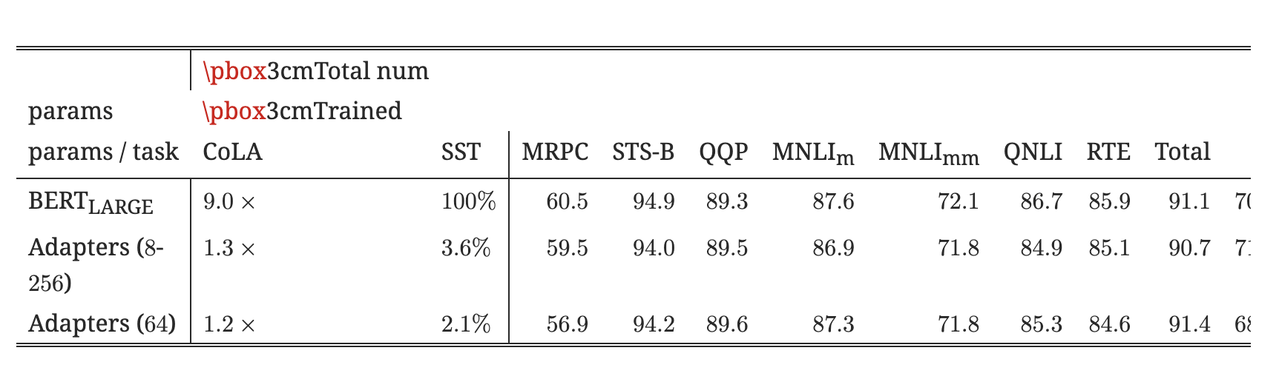
Experiments & Results
GLUE Benchmark
Adapters achieve accuracy within 0.4% of full fine-tuning
Require only 2–3% trainable parameters per task
Comparable performance, much lower cost

Slide 22
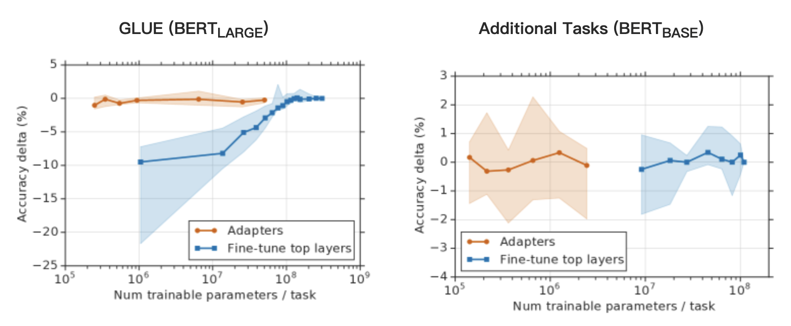
Experiments & Results
Efficiency
Adapters: near full accuracy with far fewer parameters
Top-layers fine-tuning: poor when parameters are limited
Adapters clearly more parameter-efficient

Slide 23
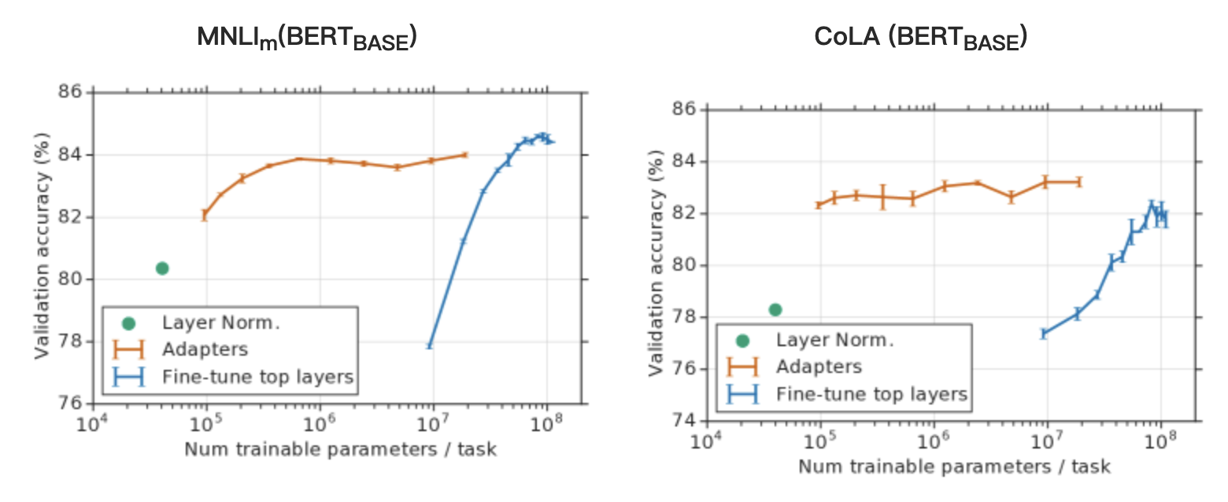
Experiments & Results
Robustness
Tested adapter placement across Transformer layers
Performance stable regardless of where adapters are inserted
Shows method is robust and flexible

Slide 24
Experiments & Results
Parameter/Performance Trade-off
Investigated different adapter sizes (bottleneck dimension m)
m = reduced hidden size in adapter (e.g., 64, 128, 256)
Trade-off: smaller m → fewer parameters, but potential drop in performance
Results: even with small m (e.g., 64), adapters achieve strong accuracy
Demonstrates adapters remain effective across parameter scales

Slide 25
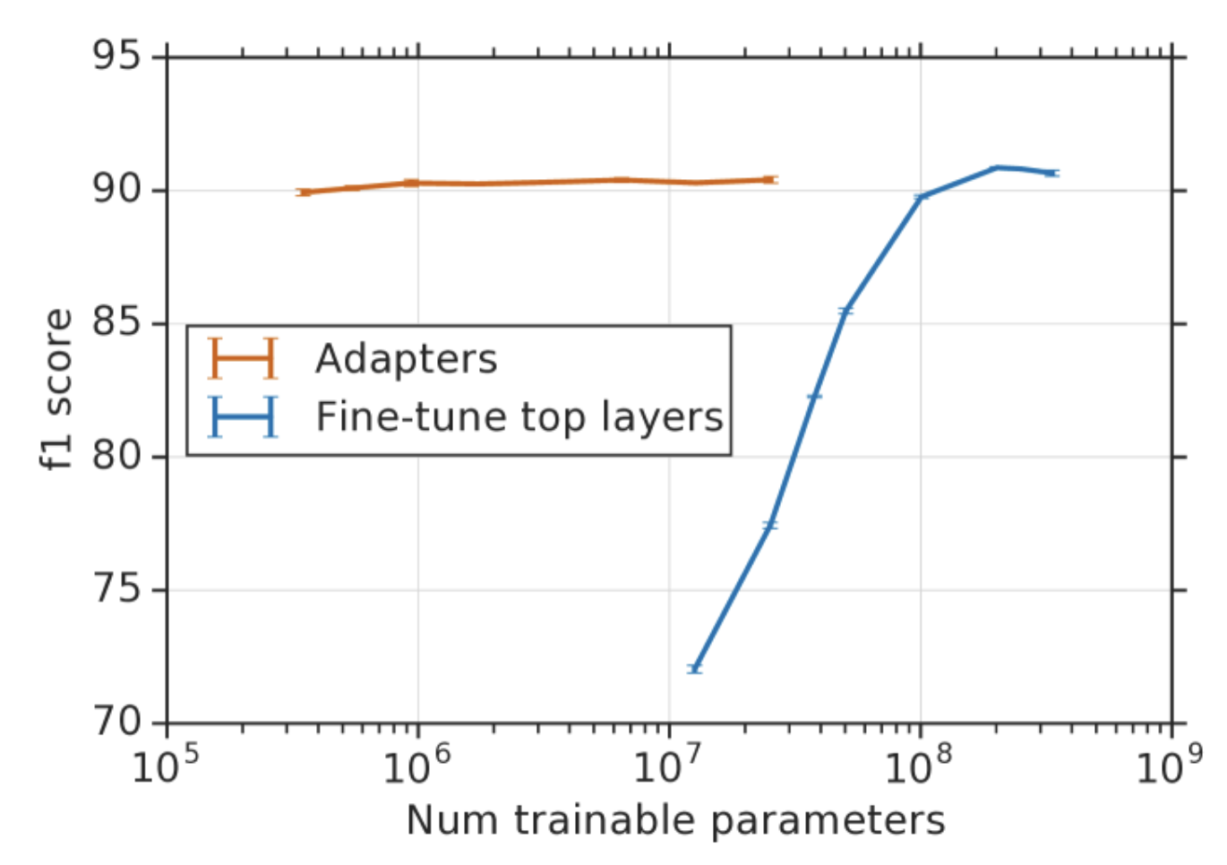
Experiments & Results
SQuAD Extractive Question Answering
Tested adapters on the SQuAD v1.1 dataset (reading comprehension)
Compared with full fine-tuning
Adapters achieve near-identical F1 and EM scores while training ~3% parameters
Confirms effectiveness beyond GLUE → generalizable to QA tasks

Slide 26
Experiments & Results
Analysis & Discussion
Placement: inserting adapters in both attention & feed-forward layers works best
Training cost: faster to train than full fine-tuning due to fewer parameters
Robustness: stable performance across tasks and adapter configurations
Limitation: inference still runs full model; each task requires an adapter

Slide 27
Contributions & Limitations
First to systematically study adapters for NLP
Showed near full fine-tuning accuracy with only ~3% parameters
Inference still requires the full model
Each task needs a separate adapter

Slide 28
​
Summary
Adapters = small & efficient
2–3% parameters ≈ full fine-tuning
Efficient / stable / flexible
Great for multi-task transfer

Slide 29
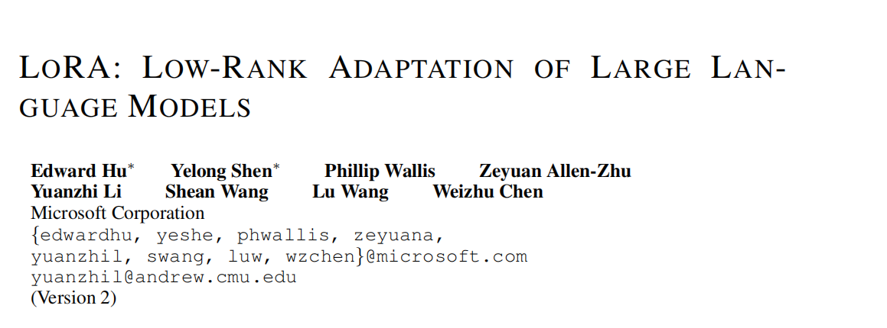

Slide 30
Topic & Challenge
Existing Solution
LoRA-Proposed Solution
Experimental Step&Key Result
Related Work
Conclusion&Future Work
Agenda

Slide 31
Topic & Challenge
Topic: Adapting large-scale pre-trained language models (e.g., GPT-3) to downstream tasks.
Challenge: Full fine-tuning(Traditional way to adapt) requires retraining all parameters (175B for GPT-3), which is costly to store and deploy.

Slide 32
2. Existing Solution and Limitation
Adapter layers:
Add sequential modules → cause extra inference latency, especially in online/small-batch scenarios.
Prefix tuning:
Hard to optimize;
Reduces effective sequence length;
Performance unstable.
Conclusion: Existing methods are inefficient or quality-limited in large-scale, latency-sensitive settings.
All in all, exsiting solution ain't good enough

Slide 33
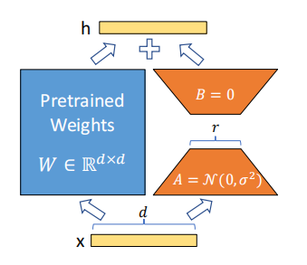
3.LoRA — Proposed Solution
3.1 LOW-RANK-PARAMETRIZED UPDATE MATRICES
h =W₀x+ ΔWx=W₀x+BAx (*)
W₀ : The original weight matrix from the pretrained model. It is frozen during fine-tuning and does not get updated. Dimensions: W₀ ∈R^{d×k}
x: The input vector.
ΔW=BA: The LoRA-generated update term used to adapt the model to a new task.
B∈R^{d×r}: low-rank matrix.
A∈R^{r×k}: low-rank matrix.
r≪min(d,k)
much smaller——> low-rank decomposition——> efficient and lightly

Slide 34
3.1 Comparision: LoRA vs Full-Fine-Tuning
Given an input vector x∈R^{k} , and a weight matrix W∈R^{d×k}, the linear output is:
h=Wx
Parameter Update:
W ← W−η⋅∇_{W} L(Wx,y)
Where:
η is the learning rate
L(Wx,y)
is the loss function (e.g., cross-entropy)
y is the target label
In Full-Fine-Tuning, the whole W need to be updated(W₀included)

Slide 35
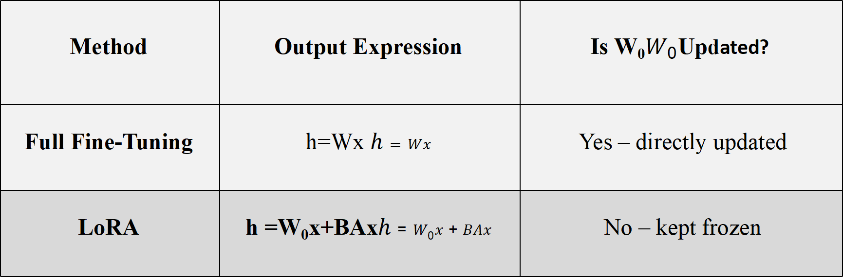
3.1 Comparision: LoRA vs Full-Fine-Tuning
Method | Output Expression | Is W₀$W_{0}$Updated?
Full Fine-Tuning | h=Wx $h=Wx$ | Yes – directly updated
LoRA | h =W₀x+BAx$h=W_{0}x+BAx$ | No – kept frozen
In LoRA, only the small matrices A and B need to be trained, while the original weight matrix W₀ remains frozen.

Slide 36
3.2 Apply LoRA To Transformer
In principle, we can apply LoRA to any subset of weight matrices in a neural network to reduce the number of trainable parameters.
In the Transformer architecture, there are four weight matrices in the self-attention module (W_{q}, W_{k}, W_{v}, W_{o}) and two in the MLP module.
However, in this research, researchers limit their study on self-attention module for both simplicity and parameter-efficiency

Slide 37
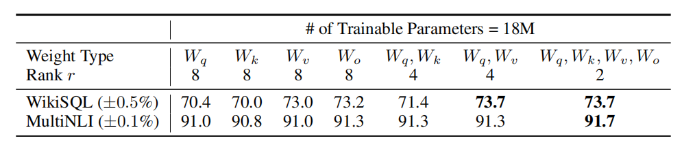
3.3 Apply LoRA To Transformer
Which weight matrix in transformer should we apply LoRA to?
Validation accuracy on WikiSQL and MultiNLI after applying LoRA to different types of attention weights in GPT-3, given the same number of trainable parameters.
Note that putting all the parameters in ∆W_{q} or ∆W_{k} results in significantly lower performance, while adapting both W_{q} and W_{v} yields the best result.

Slide 38
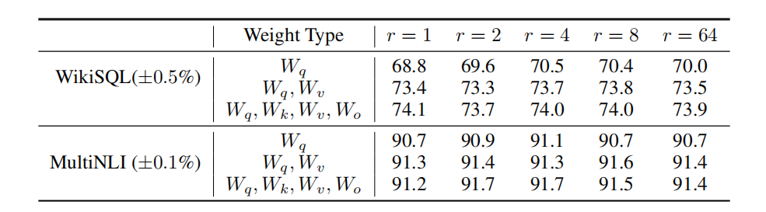
3.3 Apply LoRA To Transformer
What is the optimal rank r for LoRA?
Researchers Validation accuracy on WikiSQL and MultiNLI with different rank r.
LoRA doesn't really sensitive to r because LoRA already performs competitively with a very small r.

Slide 39
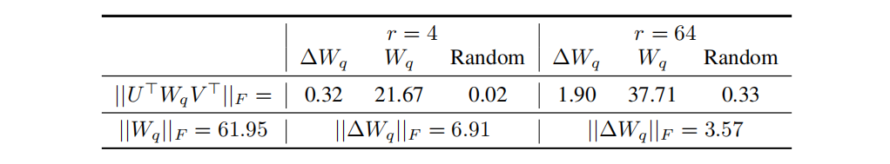
3.3 Apply LoRA To Transformer
How does the adaption Matrix ∆W compare to W ?
First, ∆W has a stronger correlation with W compared to a random matrix, indicating that ∆W amplifies some features that are already in W.
Secondly, instead of repeating the top singular directions of W, ∆W only amplifies directions that are not emphasized in W.

Slide 40
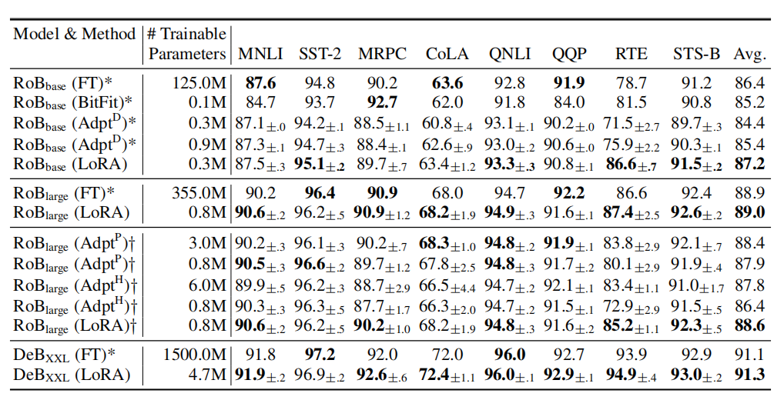
4.Experimental Step & Key Result
Step1&2&3: Applyting different pre-training method on different scale model, starting from small and expanding to much larger, seeing the performance of LoRA and comparing to other methods.
Key Result:
LoRA perform really competitively on GLUEbenchmark in different scale model
More parameter( higher rank), LoRA tend to perform well and finally go beyond FT

Slide 41
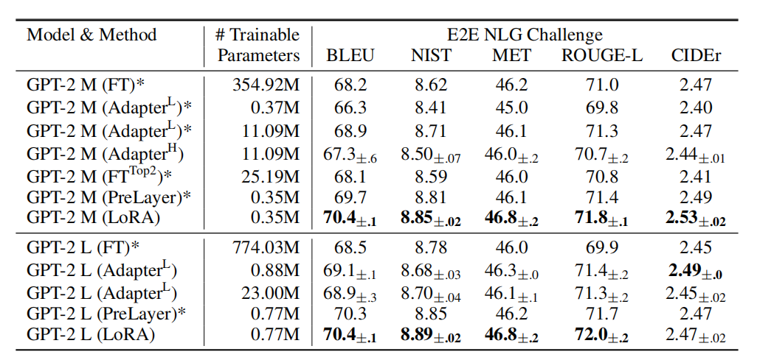
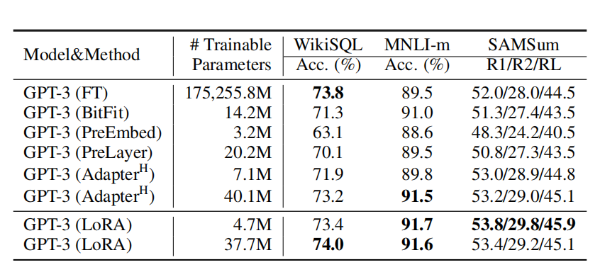
4.Experimental Step & Key Result
Step4&5: answering if LoRA still prevails on NLG models, such as GPT-2 medium and large; and as a final test for LoRA, researchers scale up to GPT-3 with 175 billion parameters and see how LoRA matches.
Key Result:
LoRA performs better than prior approaches, including full fine-tuning.
LoRA matches or exceeds the fine-tuning baseline on GPT-3

Slide 42
5. Related Work
Transformer Language Models. Transformer language models revolutionized NLP by combining large-scale pretraining with task-specific fine-tuning, with larger models like GPT-3 continuously pushing performance boundaries.
Prompt Engineering and Fine-Tuning.While prompt engineering offers a lightweight way to adapt GPT-3 via careful input design, full fine-tuning—though more effective—is often infeasible for very large models due to computational constraints.
Parameter-Efficient Adaptation. LoRA builds on the idea of adapter-based fine-tuning using a low-rank bottleneck, but differs by avoiding inference-time overhead. Unlike prompt tuning methods, it does not consume sequence length and has stronger scalability potential.
Low-Rank Structures in Deep Learning. Low-rank structures are deeply rooted in both empirical practices and theoretical studies of machine learning. LoRA uniquely leverages this by applying low-rank updates to frozen pre-trained models for efficient downstream adaptation—something not explored in prior work.

Slide 43
6. Conclusion and Future Work
Conclusion
Proposed LoRA: freeze pretrained weights, train low-rank matrices.
Achieves near/full FT performance with 0.01% trainable params.
No additional inference latency; easy task switching.
Validated across RoBERTa, DeBERTa, GPT-2, GPT-3.
Future Work
Combine LoRA with other efficient tuning methods.
Deeper understanding of why LoRA works.
Systematic selection of which layers/matrices to adapt.
Explore rank deficiency in pretrained weights.

Slide 44
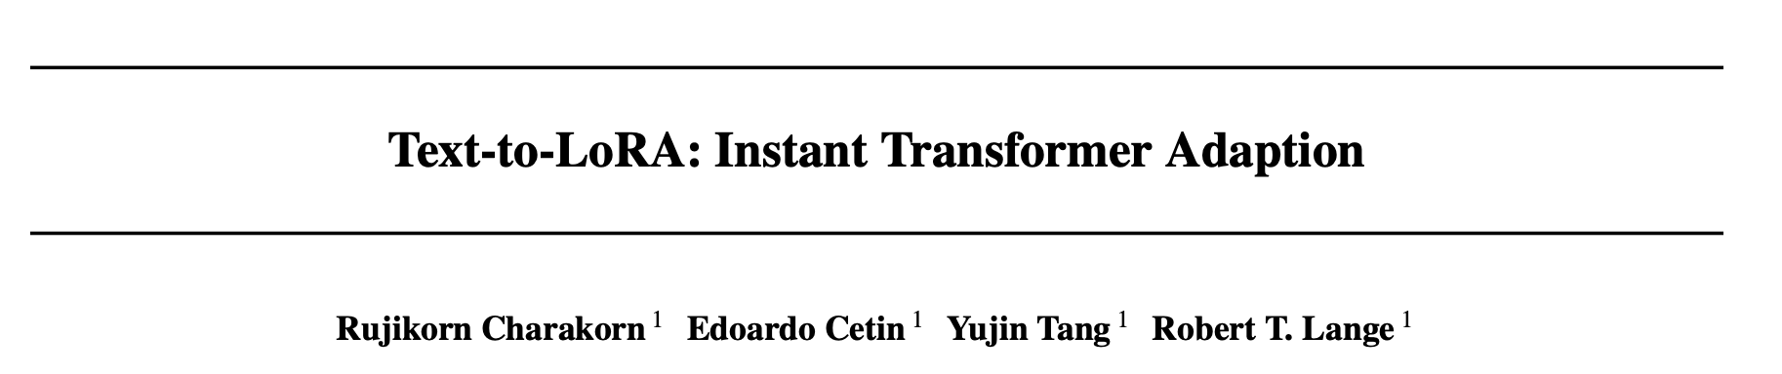
Text-to-LoRA: Instant Transformer Adaption
All group member

Slide 45
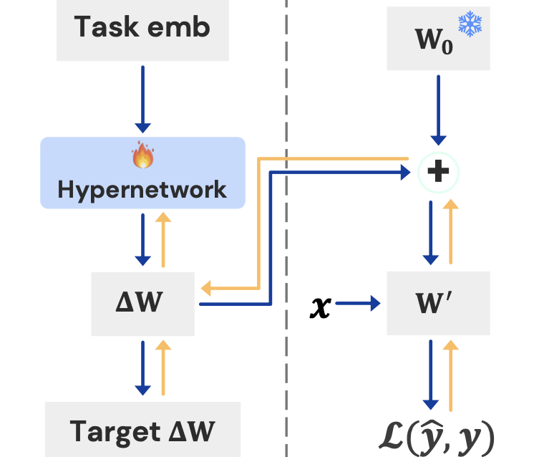
Introduction — Motivation
Fine-tuning = expensive + slow
Need separate LoRA per task
Idea: Text-to-LoRA (T2L)
Input: task description in natural language
Hypernetwork instantly generates LoRA weights
Add to frozen base model → fast task adaptation

Slide 46
Preliminaries
Supervised Fine-Tuning (SFT)
LoRA (Low-Rank Adaptation)
Hypernetwork

Slide 47
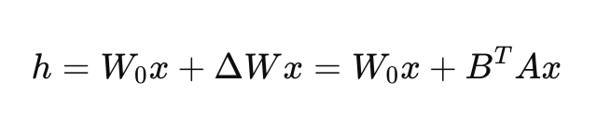
Preliminaries -LoRA
Freeze base model weights
Add trainable low-rank matrices (ΔW = BAx)
Efficient fine-tuning with fewer parameters

Slide 48
Preliminaries-Hypernetwork
Task description
Task embedding
Hypernetwork
LoRA weights
Base model
A neural network that generates parameters for another model
Input: task description embedding
Output: LoRA weights for the base model
Enables task-specific adaptation in a single forward pass

Slide 49
Motivation and Setup
LoRA adapters are effective but costly to fine-tune and store individually.
The Goal: Use a hypernetwork thay, given a task description in natural language, generates LoRA weights directly.

Slide 50

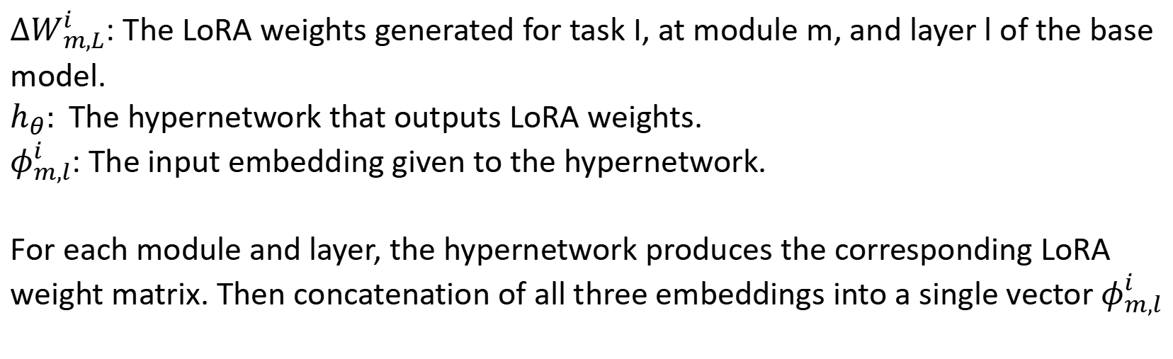
LoRA WEIGHTS
$ΔW_{m,L}^{i}$: The LoRA weights generated for task I, at module m, and layer l of the base model.
$h_{θ}:$The hypernetwork that outputs LoRA weights.
$φ_{m,l}^{i}$: The input embedding given to the hypernetwork.
For each module and layer, the hypernetwork produces the corresponding LoRA weight matrix. Then concatenation of all three embeddings into a single vector $φ_{m,l}^{i}$

Slide 51
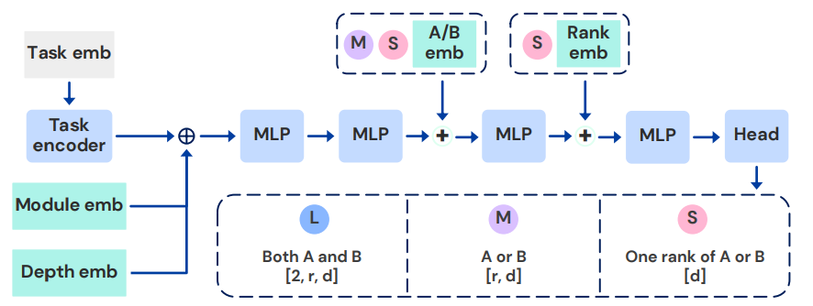
Architectures (L,M,S)
L (Large): Outputs both LoRA matrices 𝐴,𝐵 together. Highest parameter count, best performance.
M (Medium): Shared output layer for 𝐴 or 𝐵. Smaller than L, but still effective.
S (Small): Outputs only one rank at a time. Most parameter-efficient, with strong inductive biases.

Slide 52

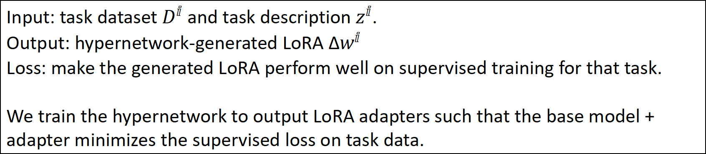
Training Objective for T2L
.
Input: task dataset $D^{ⅈ}$ and task description $z^{ⅈ}$.
Output: hypernetwork-generated LoRA Δ$w^{ⅈ}$
Loss: make the generated LoRA perform well on supervised training for that task.
We train the hypernetwork to output LoRA adapters such that the base model + adapter minimizes the supervised loss on task data.

Slide 53

Training Methods
Reconstruction Training
Train T2L to recreate existing LoRAs.
Pros: Simple, leverages existing LoRA libraries.
Cons: Poor generalization to unseen tasks.
Supervised Fine-Tuning
Train directly on task datasets with descriptions.
Pros: Learns implicit clustering, better zero-shot generalization.
Cons: Requires more training data.

Slide 54
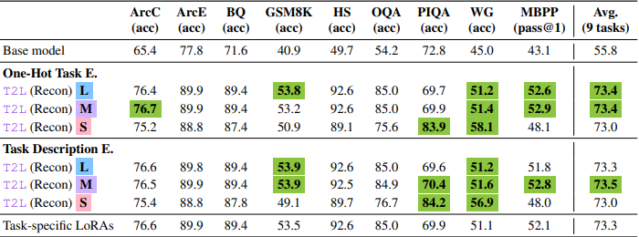
Experiments – LoRA Compression
Setup: Mistral-7B-Instruct as base model; LoRAs rank=8.
Result: T2L can compress LoRAs and match (sometimes exceed) the performance of individually trained LoRAs.
Observation: Compression acts like regularization—sometimes improves generalization (e.g., PIQA, WG)

Slide 55
Experiments - Zero-Shot LoRA Generation
Setup: T2L trained with 479 tasks from SNI dataset.
Result: Generates LoRAs for unseen tasks just from descriptions.
Performance: Beats multi-task LoRA baselines and approaches task-specific LoRA performance.
Example: T2L (L) achieved 73.9 avg. vs Multi-task LoRA 71.9

Slide 56
Takeaways
T2L = Hypernetwork + Task Descriptions → LoRAs.
Trade-offs: Larger architectures (L) = better performance; smaller ones (S) = efficiency.
Three contributions
Compress many LoRAs into one model.
Generate new LoRAs from text descriptions (zero-shot).
Achieve competitive results with efficient training.

Slide 57
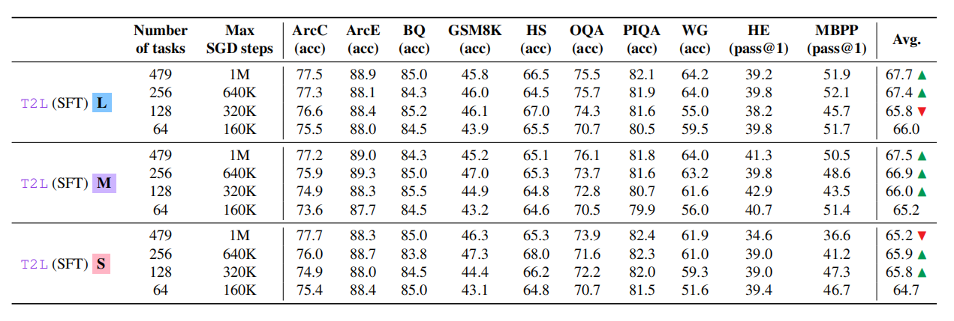
Ablations and Analyses
Does Increasing Training Compute Proportional to the Number of Training Tasks effect the performance of T2L?
Researchers explores the scalability of T2L by increasing the number of training tasks while proportionally increasing the compute budget, finding that generally, the performance improves while increasing task but it has limited capicity

Slide 58
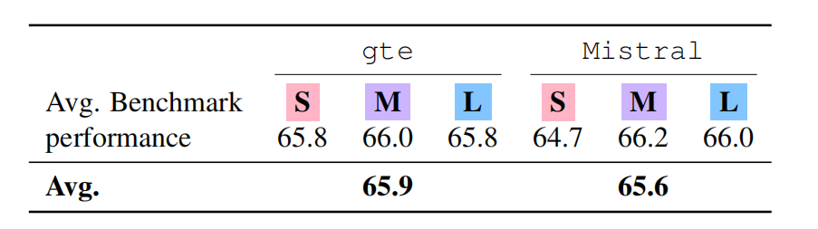
Ablations and Analyses
Does the choice of text embedding model affect the quality of LoRA generated by T2L?
Researchers compare 2 embedding model: gte-large-en-v1.5 and Mistral-7B-Instruct
Conclusion:
Both models yield high-quality LoRA adapters with similar performance.
T2L is robust to the choice of task embedding model, showing good generalization capabilities.

Slide 59
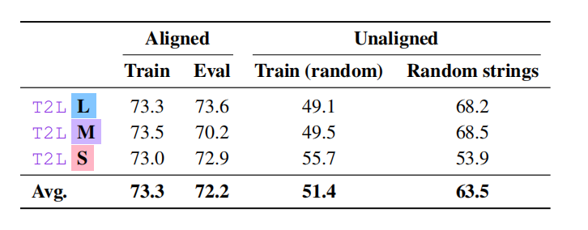
Ablations and Analyses
Does the quality or alignment of task descriptions affect the LoRA performance generated by T2L?
Researchers use 4 types of task descriptions in training:
Train – Original descriptions used in training
Eval – New, unseen descriptions for the same task
Train (random) – Descriptions from other tasks
Random strings – Completely unrelated/random text
Conclusion:
T2L requires semantically aligned task descriptions to perform well.

Slide 60
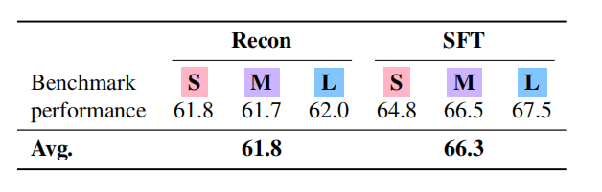
Ablations and Analyses
two training strategies SFT and Reconstruction which one leads to better zero-shot performance?
SFT perform better obviously
Why?
Because pre-trained LoRA adapters for similar tasks may lie in very different parameter spaces, making them harder to compress reliably.

Slide 61
Related Work
Hypernetworks: Used in multi-task and continual learning, but typically rely on task IDs and lack zero-shot ability.
Zero-shot adaptation: Prior works like Hyperdecoders and Gisting are less flexible.
Contribution: First to achieve text-based LoRA generation and cross-task generalization.

Slide 62
Discussion & Limitations
Discussion:
Task descriptions generated automatically by GPT-4o mini to ensure quality.
Approach is extendable to multimodal models (e.g., vision-language).
Potential: train T2L with small models, transfer to larger models.
Limitations:
Only outputs LoRA as the adaptation space.
Compression could be improved further.
Zero-shot performance still below dedicated single-task LoRAs.

Slide 63
Conclusion
T2L provides plug-and-play, low-cost adaptation using only natural language descriptions.
Unifies LoRA compression and zero-shot task generation.
Represents a step toward more automated and universal adaptation of large models.

