Slide 1
AROMATIQUE BRAND
Second-order Co-occurrence for
Interaction-Free Perfume Recommendation
A recommender engine inside a customer chatbot for an Indonesian perfume brand
Azam Azri Ahmad • Master of Information Technology – Gadjah Mada University
Notes:
Open with the partnership: this is a joint research project with Aromatique, an Indonesian perfume brand. Your part is the recommender engine.

Slide 2





A content-based recommender for Aromatique, built for small, interaction-free data
This work builds the recommendation engine that sits inside a customer-facing chatbot for Aromatique, an Indonesian perfume brand.
OBJECT
PARTNER
Perfume
Aromatique
DATA
SETTING
Small
Interaction-free
What we built
2 / 14
Notes:
Position the work in one breath: content-based recommender, perfume domain, small data, no user interactions. The four chips summarise the whole setting.

Slide 3
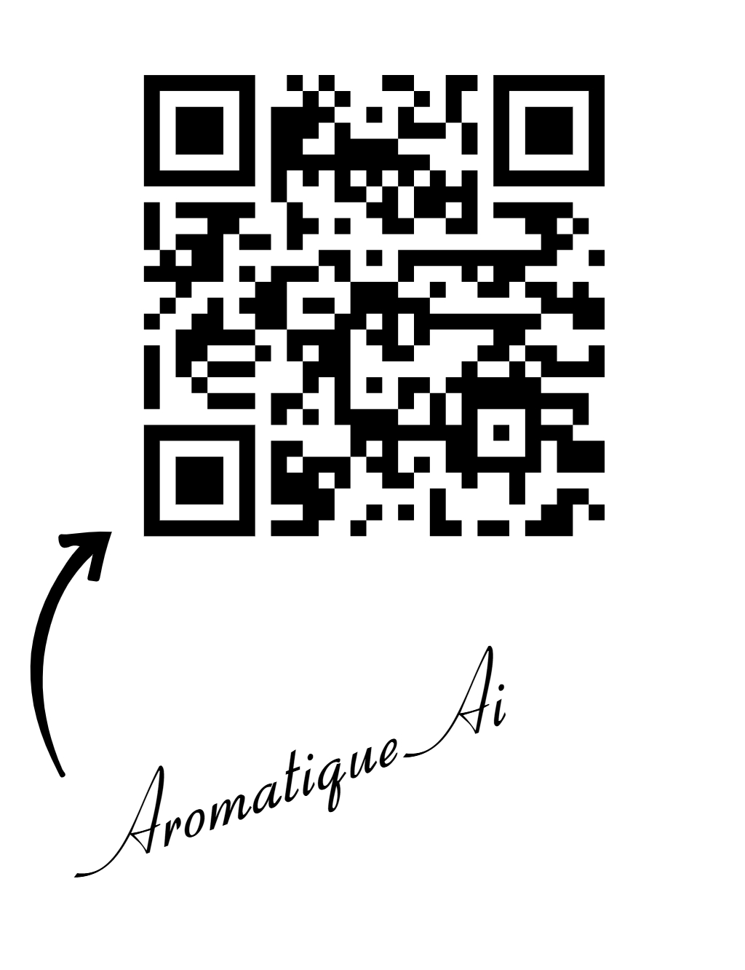
Notes:
Position the work in one breath: content-based recommender, perfume domain, small data, no user interactions. The four chips summarise the whole setting.

Slide 4





At peak hours few staff can't serve many customers, so the recommender lives in a chatbot
Aromatique runs branches across many Indonesian cities and provinces. At peak hours a few staff cannot serve the crowd — a bottleneck. A joint project pairs a colleague's chatbot (HCI) with this recommender: a waiting customer types a preference (e.g. “a perfume for school”) and gets the Top-3 relevant products.
→
→
→
Customer
Chatbot
Recommender
Top-3 products
waiting at peak hours
types a free preference
this work
relevant Aromatique picks
3 / 14
Notes:
Tell the origin story: many branches, peak-hour bottleneck, few staff. Colleague builds the chatbot (HCI); you build the recommender inside it. Walk the flow left to right; give the 'perfume for school' example.

Slide 5




Existing perfume recommenders rank by single-accord similarity over note text
Fannisa et al., 2025 (journal)
TF-IDF content-based filter beats a Word2Vec variant
Lutan, 2025
Survey: subjectivity and sparse sensory data are the core obstacles
Nurmuthia et al., 2025
Ranking by cosine and Jaccard over note descriptions
All content-based, single-accord similarity — and none carry user interactions.
Related work
4 / 14
Notes:
These are the existing perfume recommenders. Lead with the journal result (Fannisa). They are all content-based, single-accord, note-text, no interactions.

Slide 6




Yet three gaps remain — and the strongest methods can't even run here
Order-1
Needs interactions
Complex overfits
Accords treated independently; co-occurrence helps, but problem in intraction-free.
Graph / KG recommenders learn from a user–item signal the data lacks.
On small, imbalanced data, flexible and neural models lose to simple baselines.
Hao, IP&M 2024 (Q1)
Zhang, IEEE TKDE 2023 (Q1)
Ma, ACM TOIS 2022 (Q1)
Lyu, IEEE TKDE 2023 (Q1)
Ahlmann-Eltze, Nat. Methods 2025 (Q1)
Rather, AI Review 2024 (Q1)
Research gaps
5 / 14
Notes:
The gap slide. All three claims are backed by Q1 journals. Stress gap 2: the strongest recommenders need interactions the data does not have, so they cannot even run.

Slide 7


We propose second order co-occurrence — matching accord pairs, not single notes
Why not order-1?
Single accords overlap too much, so look-alikes are hard to separate.
Why co-occurrence?
Which accords appear together is a signature; rare pairs separate the right product.
Why not embeddings?
Word2Vec / SBERT / node2vec blur exact rare pairs into latent vectors and overfit small data.
Notes:
State the proposal as three short answers. Why not order-1, why co-occurrence, why not embeddings. End on parameter-free by design.

Slide 8


Each perfume becomes a rarity-weighted set of accords and accord-pairs
→
→
→
Preference
Accords + pairs
Cosine match
Top-3 + reasons
free user text → accords
rarity-weighted tokens
vs 340 products
ranked recommendations
One cosine score splits cleanly into an order-1 (single-accord) part and an order-2 (accord-pair) part — and the pairs become the explanation.
How it works
7 / 14
Notes:
Explain the pipeline without math: preference becomes accords and accord-pairs, matched by one cosine, returns Top-3 with reasons.

Slide 9




A three-source firewall makes the evaluation non-circular
The main risk is leakage: features secretly carrying the answer. Keeping the three sources independent prevents it.
Item features
Query features
Ground-truth label
Local catalog accords
Fragrantica (external)
Held-out “imitates” edge
independent of the label
independent of catalog & label
independent of accord similarity
Non-circular protocol
8 / 14
Notes:
The methodological selling point: a non-circular firewall stops the answer from leaking. Query accords are verified externally from Fragrantica.

Slide 10


We benchmark 15 methods on 340 Aromatique products and 209 queries
340
products
15 methods, 4 paradigms
Marginal Jaccard, TF-IDF, BM25
Neural Sentence-BERT, Word2Vec, node2vec
Perceptual fragrance-wheel transport
Learned PPMI-SVD, GBM, bilinear
209
queries
56
shared accords
Identical leave-one-out evaluation • MRR and Hits@k • paired significance tests
Experimental setup
9 / 14
Notes:
Setup in numbers: 340 products, 209 queries, 15 methods across four families, one identical rigorous evaluation.

Slide 11

Order-2 co-occurrence ranks first among all 15 methods
MRR = how high the correct product sits (higher is better).
+9% over the TF-IDF baseline.
Neural, perceptual and high-dimensional learned methods all fall below the simple baseline.
Results
10 / 14
Notes:
Read the chart simply: proposed is highest, +9% over baseline, and the fancy methods all fall below the simple baseline.

Slide 12



Simple beats complex: neural and learned methods overfit the small data
Fell below the baseline
Only tied the baseline
Neural embeddings, perceptual-taxonomy transport and high-dimensional learned models overfit and lost decisively.
Moderate learned models (PPMI-SVD, gradient boosting) matched the simple TF-IDF baseline — but never beat order-2.
Takeaway: on small, interaction-free data, added model capacity does not help — it hurts.
Key finding
11 / 14
Notes:
The headline finding: simple beats complex. Two failure levels — overfit and lose, or only tie. Land the takeaway.

Slide 13



The win is modest (+9%) but statistically solid and driven by accord pairs
+9%
p = 8.7e-8
81%
over the standard
TF-IDF baseline
paired significance
test
of the signal from
accord pairs
modest
robust
real effect
Modest but solid — bounded by the ~86% accord overlap intrinsic to imitation perfumes.
Reading the numbers
12 / 14
Notes:
Be honest about size: modest +9%, but statistically very solid, and 81% of it comes from the pairs. Explain the ceiling.

Slide 14

Every recommendation comes with reasons — ready to drop into the chatbot
“a perfume for school”
1
Fresh • clean citrus–green, clean–woody
Faithful by construction
Aquatic • light marine–citrus, fresh–musk
The accord-pairs shown are the exact pieces that produced the score — auditable, not a post-hoc guess. A ready hand-off to the chatbot's XAI layer.
2
3
Powdery • soft floral–musk, soft–clean
Illustrative example.
Explainability
13 / 14
Notes:
Close the loop to the use case: each pick comes with the accord-pairs that justify it — auditable, ready for the chatbot. Note the example is illustrative.

Slide 15
WHERE WE CAN GO TOGETHER
A finding, an honest protocol, and a deployable recommender for Aromatique
Validate explanations Counterfactual study of faithfulness for the XAI layer.
Test across domains Replicate on other catalogs, markets and larger vocabularies.
Asymmetric similarity Exploit that imitations are accord-subsets of the reference.
Thank you azamazriahmad@mail.ugm.ac.id
Notes:
Wrap with contribution and three concrete collaboration directions. Invite discussion and thank them.

