Slide 1
Second-Order Accord Co-Occurrence for Interaction-Free Perfume Retrieval
AZAM AZRI AHMAD
Azam Azri Ahmad
Syukron Abu Ishaq Alfarozi
Bimo Sunarfri Hantono
Kuntpong Woraratpanya
Department of Electrical and Information Engineering, Faculty of Engineering, Universitas Gadjah Mada
School of Information Technology, King Mongkut's Institute of Technology Ladkrabang
Depok, 16–18 October 2026

Slide 2
Background and Motivation
16 - 18 October 2026
Aromatique is an Indonesian fragrance brand selling 340 in-house products across a growing number of outlets.
Given a customer’s reference perfume, sales staff must recall the closest in-house match from memory during peak hours.
The brand needs an automated system that retrieves the catalog products most similar to a given reference.
340
products in the catalog
59
accords in the vocabulary
0
ratings, clicks or purchases
Notes:
[0:30-2:00] Aromatique is a real Indonesian fragrance brand with 340 in-house products. A customer walks in naming a branded perfume they like; staff have to recall the closest in-house match from memory, under time pressure. What makes this hard is on the right: the catalog has 340 products and 59 accords, and zero behavioural signal. No ratings, no clicks, no purchase history.

Slide 3
Research Problem
& Questions
16 - 18 October 2026
Problem Statement:
RQ1 — Does modeling accord co-occurrence at order two or above improve retrieval over the order-one baseline?
No interactions. No ratings, clicks or purchase history.
Collaborative filtering cannot produce predictions, so accord content is the only available signal.
Retrieval quality therefore depends entirely on how accords are represented.
RQ2 — How far does the improvement continue with interaction order before it saturates?
RQ3 — How does the second-order representation compare with established paradigms?
Notes:
[2:00-3:30] That zero is what defines the problem. With no interactions, collaborative filtering simply cannot produce a prediction, so accord content is the only signal we have. Retrieval quality therefore comes down entirely to how we represent accords. Three research questions follow: does co-occurrence at order two or above help; how far does it keep helping; and how does it compare with established paradigms.

Slide 4
Why Existing Methods Fall Short
16 - 18 October 2026
Perceptual route
03
Sensory wheel, principal odor map. A taxonomy fixed a priori, not derived from this catalog.
02
Dense route
Sentence-BERT, Word2Vec, node2vec. Representations are learned from data; 340 products are far too few.
None of them estimates how accords co-occur inside the products of the catalog itself.
01
Lexical route
TF-IDF and BM25 over accords. Each accord is scored on its own — pair information is never formed.
Notes:
[3:30-4:30] Prior work falls into three routes. The lexical route scores each accord independently, so pair information is never formed. The dense route learns representations from data, which 340 products cannot support. The perceptual route imposes a taxonomy decided in advance. None of them estimates how accords co-occur inside the products of this catalog.

Slide 5
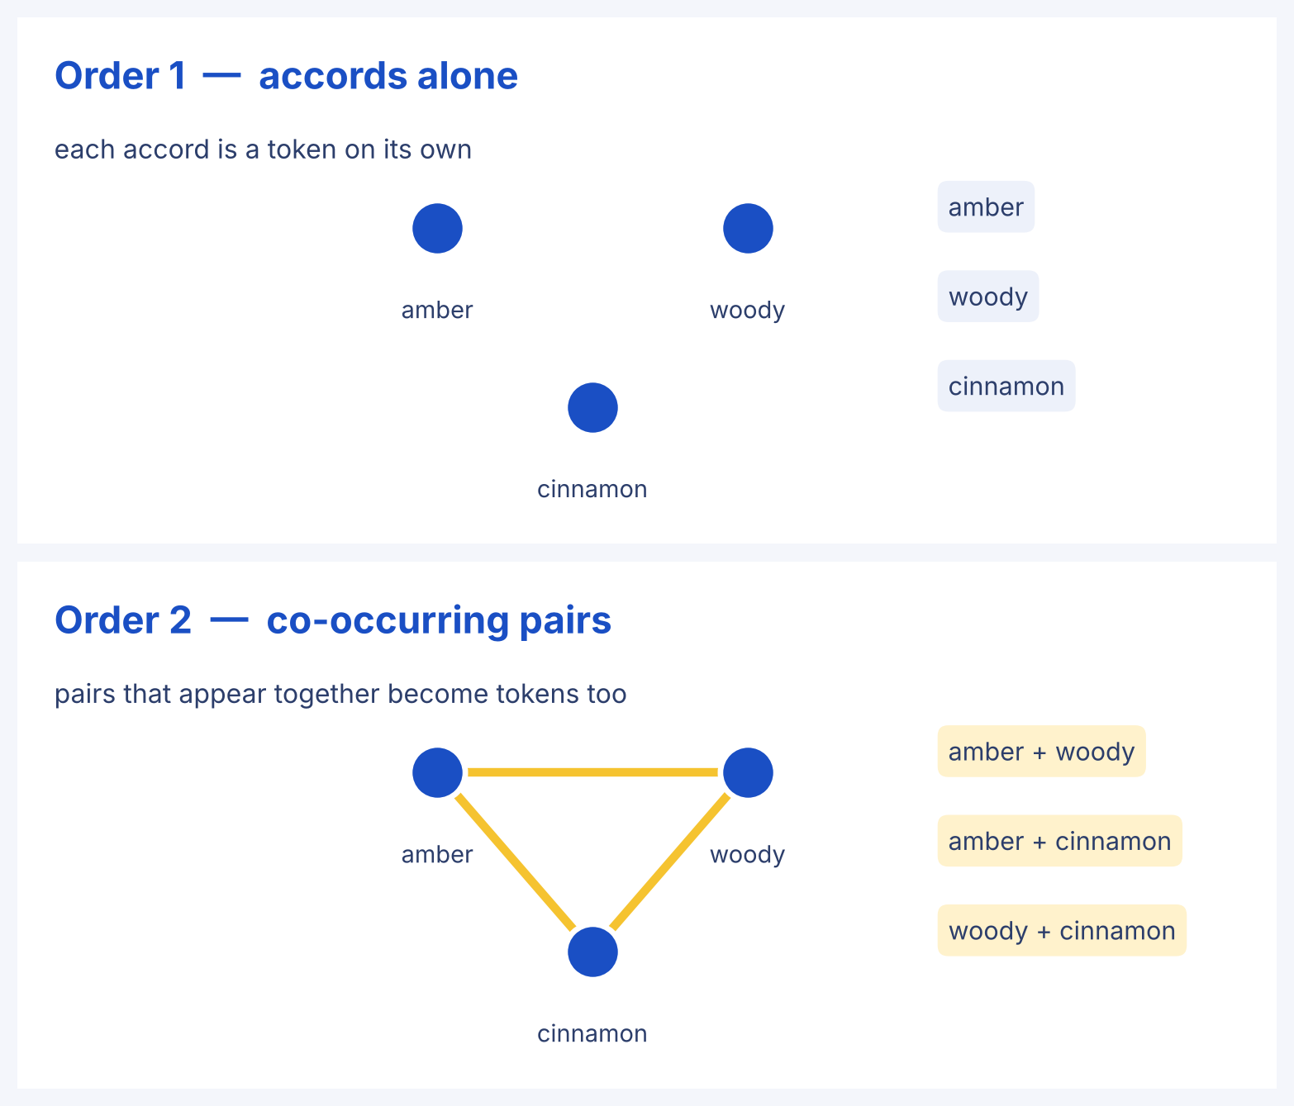
The Idea: Score Accord Pairs,
Not Just Accords
16 - 18 October 2026
ORDER-1 VS ORDER-2
Order 1 :
Each accord is a scoring token on its own — amber, woody and cinnamon are treated as independent terms.
Order 2 :
Accord pairs that occur together in a product become scoring tokens of their own.
Parameters :
None. Rarity weighting (IDF) and cosine similarity only — nothing is learned from data.
Notes:
[4:30-6:00] Here is the idea. At order one, amber, woody and cinnamon are three independent tokens. At order two, the pairs that occur together inside a product become tokens in their own right. Two products sharing a pair resemble each other more than their separate accords suggest. Crucially, nothing here is learned from data: no trained parameters at all.

Slide 6
How the Matcher Works
1. Expand
2. Weight
3. Rank
IDF over 340 products
Accord set → order-1
accords ∪ order-2
accord pairs.
Cosine similarity,
decomposable by order:
s(q,p) = Σₖ Sₖ(q,p)
Top-3 products returned
with their shared pairs.
Rare pairs weigh high
L₂-normalised vector
Notes:
[6:00-7:30] Three stages. Expand each accord set into order-one accords plus order-two pairs. Weight every token by inverse document frequency over the 340 products, so rare pairs count for a lot and ubiquitous single accords count for little; then L2-normalise. Rank by cosine, which separates additively into per-order contributions, so we can measure exactly what each order contributes.

Slide 7
Experimental Setup
16 - 18 October 2026
Aspect | Description
Catalog | 340 products — 243 imitation-labeled, 97 unlabeled distractors
Vocabulary | 59 accords; 55 shared between products and queries
Protocol | Leave-one-out over 208 reference queries, 210 labeled pairs
Metrics | MRR and Hits@3 — one relevant product per query
Comparators | 14 established methods across 5 paradigms
Significance | Wilcoxon signed-rank + Holm; 95% CI from 10,000 bootstraps; |ΔMRR| ≥ 0.01
Notes:
[7:30-9:00] The setup. 340 products, 243 imitation-labeled, 97 unlabeled distractors. Leave-one-out over 208 reference queries. MRR and Hits@3, since there is exactly one relevant product per query. Fourteen comparators across five paradigms. Significance requires Holm-adjusted p below 0.05, a bootstrap interval excluding zero, and an absolute MRR difference of at least 0.01.

Slide 8
Auditing the Benchmark
16 - 18 October 2026
An imitation product copies the reference it emulates, so its accords may partly
reproduce the label. Fragrantica lists accords in a fixed order, and transcription
would preserve that order — which makes it detectable.
Verdict
The benchmark is partially
derivative.
Results are reported on both
the full set (ALL, 208 queries)
and the subset with no ordered-
transcription signature
(NON-OP, 109 queries).
NON-OP is treated as the
primary evaluation.
Ordered containment | Observed | Null mean
Exact prefix of query | 89 | 0.2
Ordered subsequence | 100 | 3.4
of 210 labeled pairs, against 1,000 random permutations · empirical p = 0.001
Notes:
[9:00-10:00] Before the results, a validity check we think matters. An imitation copies the reference it emulates, so its accords may partly reproduce the label. Fragrantica lists accords in a fixed order, so transcription would preserve that order, and that is detectable. Against 1,000 random permutations we expected 0.2 exact prefixes; we found 89. So the benchmark is partially derivative. We report both sets, and treat the clean subset, NON-OP, as the primary evaluation.

Slide 9
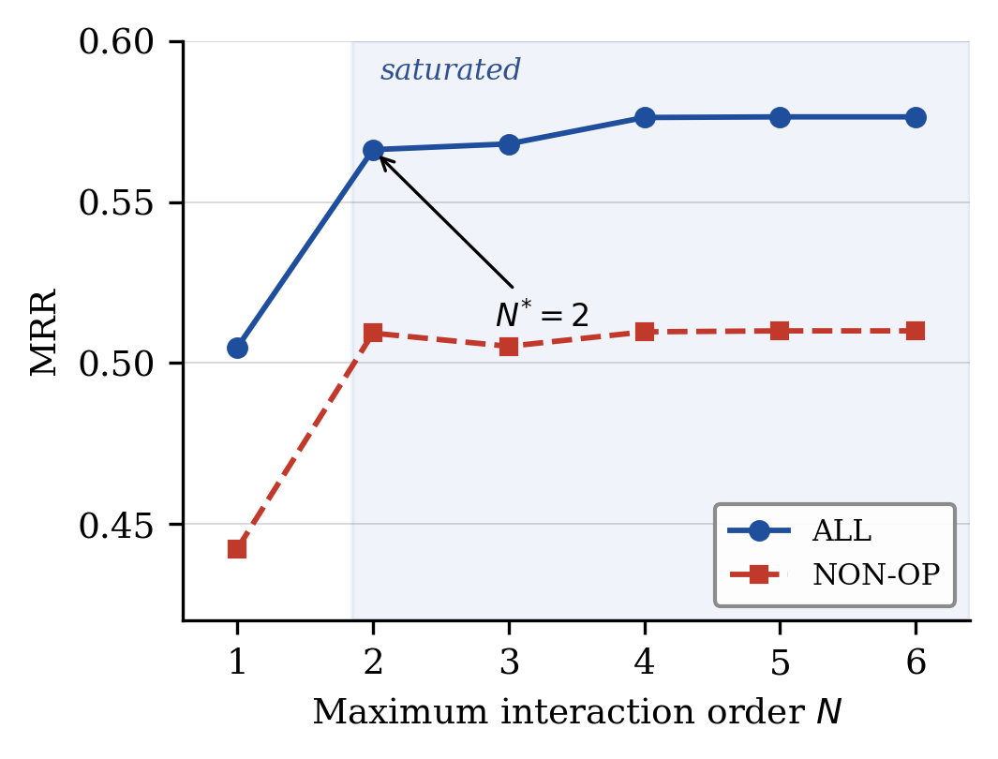
Co-occurrence Helps, Then Saturates
16 - 18 October 2026
RQ1 — order two improves retrieval
Set | Order 1 | Order 2 | ΔMRR | p (Holm)
ALL (208 q) | 0.505 | 0.566 | +0.061 | 1.2 × 10⁻⁷
NON-OP (109 q, primary) | 0.442 | 0.509 | +0.067 | 7.5 × 10⁻⁴
95% CI on ALL: [+0.034, +0.090]
RQ2 — and then it stops
Order 3 vs order 2: ΔMRR = +0.002 (p = 1.00) on ALL and −0.004 on NON-OP.
Higher orders add nothing. The adopted operating order is N* = 2.
Notes:
[10:00-12:00] RQ1: order two raises MRR from 0.505 to 0.566 on the full set, and by 0.067 on the primary NON-OP subset, both strongly significant. RQ2: and then it stops. Order three is not significantly better than order two on either set, and higher orders add nothing. So the operating order is N star equals two. The co-occurrence signal is captured at pairs; triples add no robust benefit on this catalog.

Slide 10
Against Five Paradigms
16 - 18 October 2026
ALL
NON-OP (primary)
 | Method | MRR | H@3 | MRR | H@3
P1 | Order-2 co-occurrence (ours) | 0.566 | 0.649 | 0.509 | 0.569
P2 | Order-2 + learned fusion | 0.567 | 0.647 | 0.511 | 0.562
A3 | Signature LTR | 0.555 | 0.632 | 0.492 | 0.543
B4 | Sentence-BERT | 0.551 | 0.601 | 0.414 | 0.450
A2 | PPMI–SVD | 0.505 | 0.577 | 0.485 | 0.523
B2 | TF-IDF cosine (baseline) | 0.505 | 0.582 | 0.442 | 0.495
A1 | Edwards tree-Wasserstein | 0.303 | 0.337 | 0.266 | 0.312
Two readings
Methods that build a
representation over accord
pairs occupy the top of the
table, however the pairs are
encoded.
Adding a trained fusion (P2)
to the pair representation
gives no significant gain, so
the parameter-free form is
retained.
14 comparators across 5 paradigms — full table in the paper
Notes:
[12:00-13:30] RQ3. Two readings. First, methods that build a representation over accord pairs occupy the top of the table, whatever encoding they use, while methods that never form pair features trail. Second, learning the pair weights does not beat counting them: the learned fusion P2 is statistically indistinguishable from the parameter-free P1, so we retain the simpler form.

Slide 11
Where It Works, and Where It Fails
16 - 18 October 2026
Accord-containment stratum | prefix | subseq | contained | partial
Queries (n) | 88 | 11 | 72 | 37
MRR | 0.629 | 0.631 | 0.699 | 0.140
Is it fixable?
Auditing the 38 partial pairs
with an accord-affinity matrix:
· 17 likely mislinked (label error)
· 14 genuinely far
· only 7 soft-matchable
The ceiling is structural, not a
limitation of the model.
When the product’s accords are contained in the query, order two reaches
MRR 0.63 – 0.70. In the partial stratum it collapses to 0.14, because a product
accord absent from the query has no lexical or co-occurrence bridge to it.
The aggregate figure averages these two regimes.
Notes:
[13:30-14:30] Stratifying by how much of the product's accord set is contained in the query shows two very different regimes. Where the accords are contained, MRR reaches 0.63 to 0.70. In the partial stratum it collapses to 0.14, because an accord absent from the query has no bridge to it. We audited those 38 pairs: 17 are label errors, 14 are genuinely far, and only 7 could be soft-matched. The ceiling there is structural, not a flaw of the model.

Slide 12
Conclusion
16 - 18 October 2026
Future work
Modeling accord co-occurrence at order two significantly improves retrieval over the single-accord baseline, and the gain saturates there.
Methods that represent accord pairs lead across five paradigms, and the parameter-free matcher matches its learned-fusion variant without any trained parameters.
A label-circularity audit shows part of the benchmark is derivative, so both sets are reported.
Intensity-weighted co-occurrence
Replication over more catalogs
Co-occurrence paths as knowledge-graph explanations
Limitations — all data come from a single proprietary catalog in one market; external validity is not established.
Notes:
[14:30-15:00] To summarise: co-occurrence at order two significantly improves interaction-free retrieval and saturates there; pair-based representations lead across five paradigms; and the parameter-free matcher matches its learned variant. All our data come from a single proprietary catalog, so external validity is not established — replication over more catalogs is the next step, along with intensity-weighted co-occurrence and using the exported co-occurrence paths as explanations.

Slide 13
Thank You!
Azam Azri Ahmad · Universitas Gadjah Mada
Notes:
Thank you. Happy to take questions.

