Slide 2



KUMS 总体解决方案
集中统一的财务流程
风险预警
Up-sell/Cross-sell
购买倾向分析
智能驱动
市场营销
集中式财务管控
订单流程
交易历史
商机和客户管理
多渠道销售
前瞻性
销售分析
Customer
效率: 减少处理时间，一次解决
效果: 前瞻性服务, 案例管理
客户
服务
分销代理
管理
产品跟踪: 联系, 信任
盈利分析
销售线索分配和忠诚度工具
佣金管理
Notes:
These are solution sets that we develop to address insurers challenges. This solution sets consist of several product components that I am going to describe in more detail later on.
The first solution set is: intelligence driven marketing solution set. This solution set can be used to drive profitable growth. Insurers can use this solution sets to analyze customer propensity to buy and segment the market and develop product offering to the right segment
The second solution set is: streamlined acquisition and renewal. This solution set can be used to address profitable growth as well. Organization can use streamlined acquisition to analyze sales, do proactive renewals and manage opportunity through out all channels.
The third solution set is used to manage distribution. In this solution set, organization can use siebel to track producer credentials, do profitability analysis, pass leads to producers and keep track the compensation.
The streamlined customer care solution set enables organizations to reduce call handling time and deliver a one and done service
The last solution set is claims management that can be used to reduce claims cost by delivering an end to end claims management
Every solution set utilize siebel workflow and automate manual processes in each area to increase productivity and efficiency

Slide 3
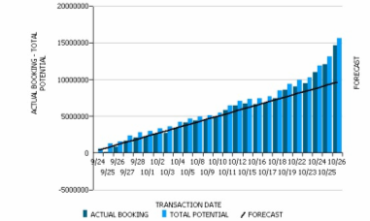
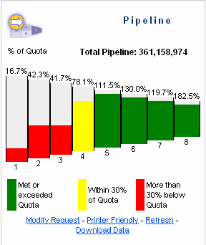
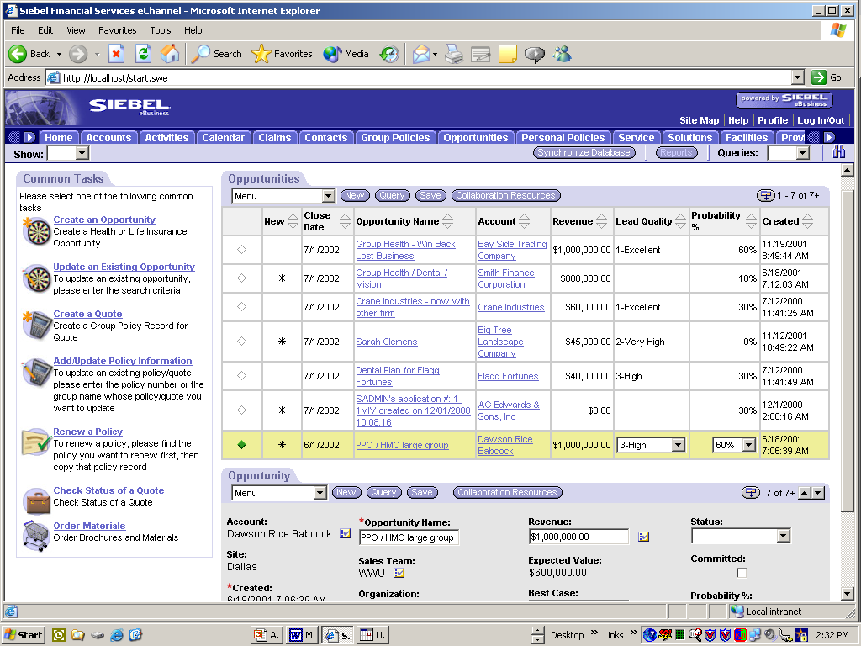
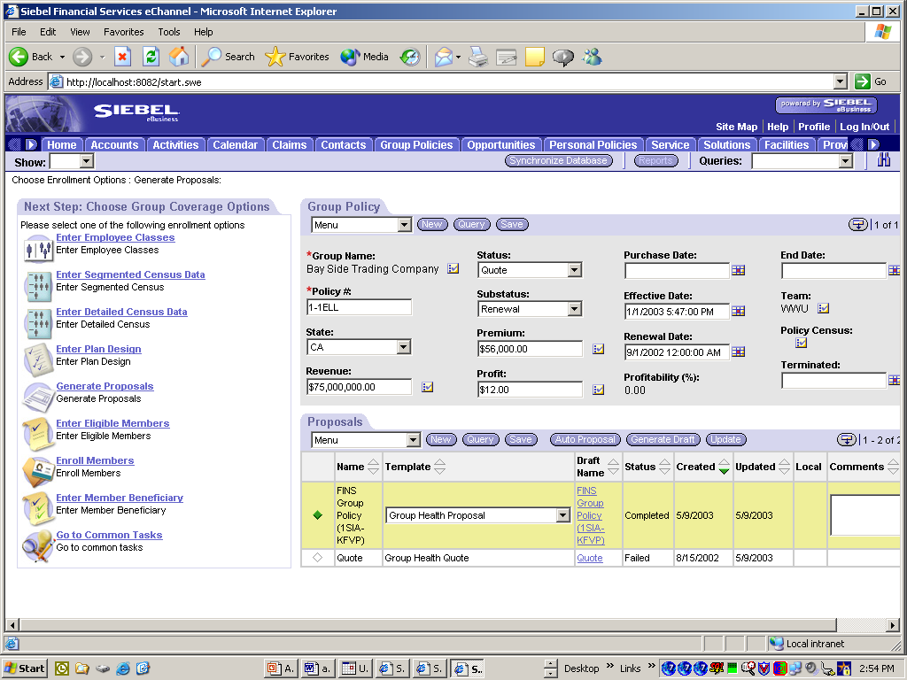


A Kums Solution Platform
Kums Analytics
Kums Executive Dashboards
Kums Sales Dashboards
Kums Service Dashboards
Kums Marketing Dashboards
Kums eCommerce and Self-Service Solutions
KumsAgent/Broker Portal
Kums Customer Portal
Kums Sales Portal
Kums Service Provider Portal
Kums Base Applications
Kums Marketing:
Target Consumers, Agents/Brokers
Kums Sales:
Customer, Agency/ Brokerage, Service Providers
Kums Service:
Customer, Service Providers, Agents/Brokers
Integration
CRM
Products
Policy
Financial
HR
Claims
Notes:
We provide our solution in a componentized manner. Depending on your need, you can choose to implement some components such as siebel call center, siebel agent portal, or siebel analytics. Underlying all of these components are a common set of services for managing data, business rules, security, integration, and administration. These services provide consistent mechanisms for extending, configuring, implementing, and managing these components.
These components can be used to add functionality to an existing system, perform specific business functions in a larger project, or serve as a starting point to accelerate internal development. The component architecture also gives you the option to deploy the entire system using a phased approach.

