Slide 1
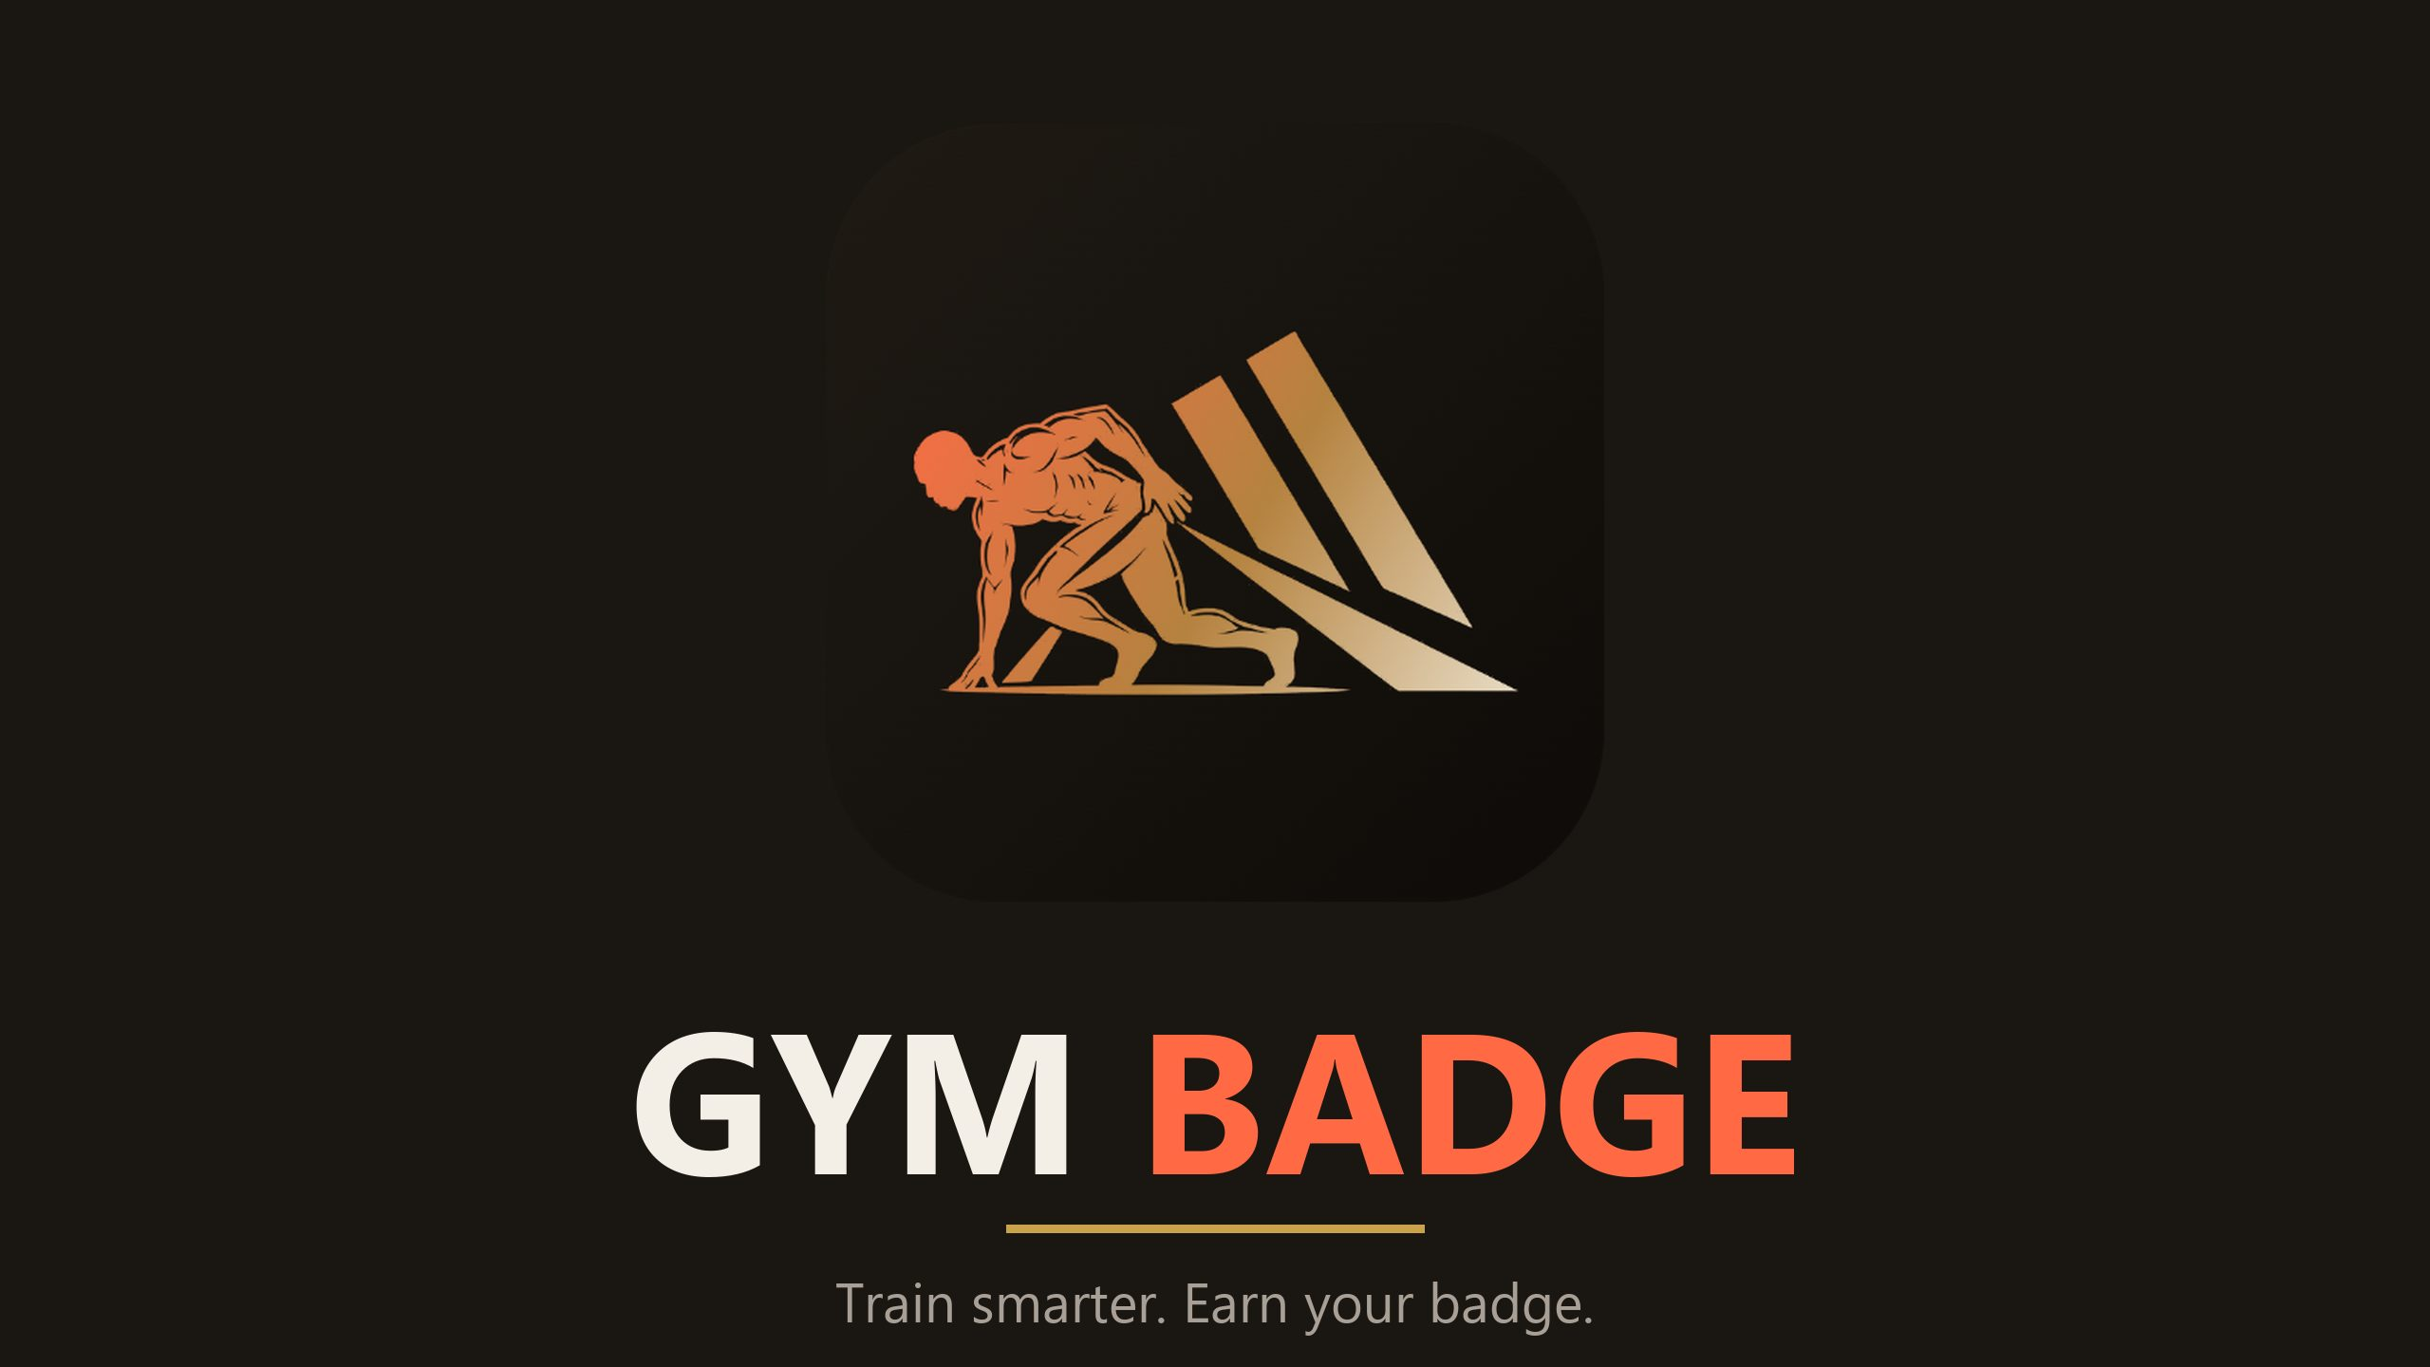
November 2026 · INVESTOR PRESENTATION · CONFIDENTIAL

Slide 2
THE PROBLEM
Fitness apps promised a coach.
They shipped a spreadsheet.
•
Numbers without guidance. A tracker tells you what you ate. It never tells you what to do next.
•
Ghost answers. AI chat with nobody accountable behind it, and no way to reach a human.
•
Ad-funded attention. Free apps monetise members' data and their workout photos.
•
First-week churn. New members quit when nothing explains the plate, the programme, or the progress.
GYM BADGE · INVESTOR PRESENTATION · CONFIDENTIAL
02 / 22

Slide 3
THE SOLUTION
One app: eat. train. badge.
EAT
TRAIN
BADGE
My Plate Truth. Photograph any plate:
148 guided disciplines, a routine built
Every set signed as proof of work.
what it is, what it does for you, and
in four taps, and a log that
Real trainers a tap away. Works
ask it anything right there.
remembers every rep.
offline, anywhere.
GYM BADGE · INVESTOR PRESENTATION · CONFIDENTIAL
03 / 22

Slide 4
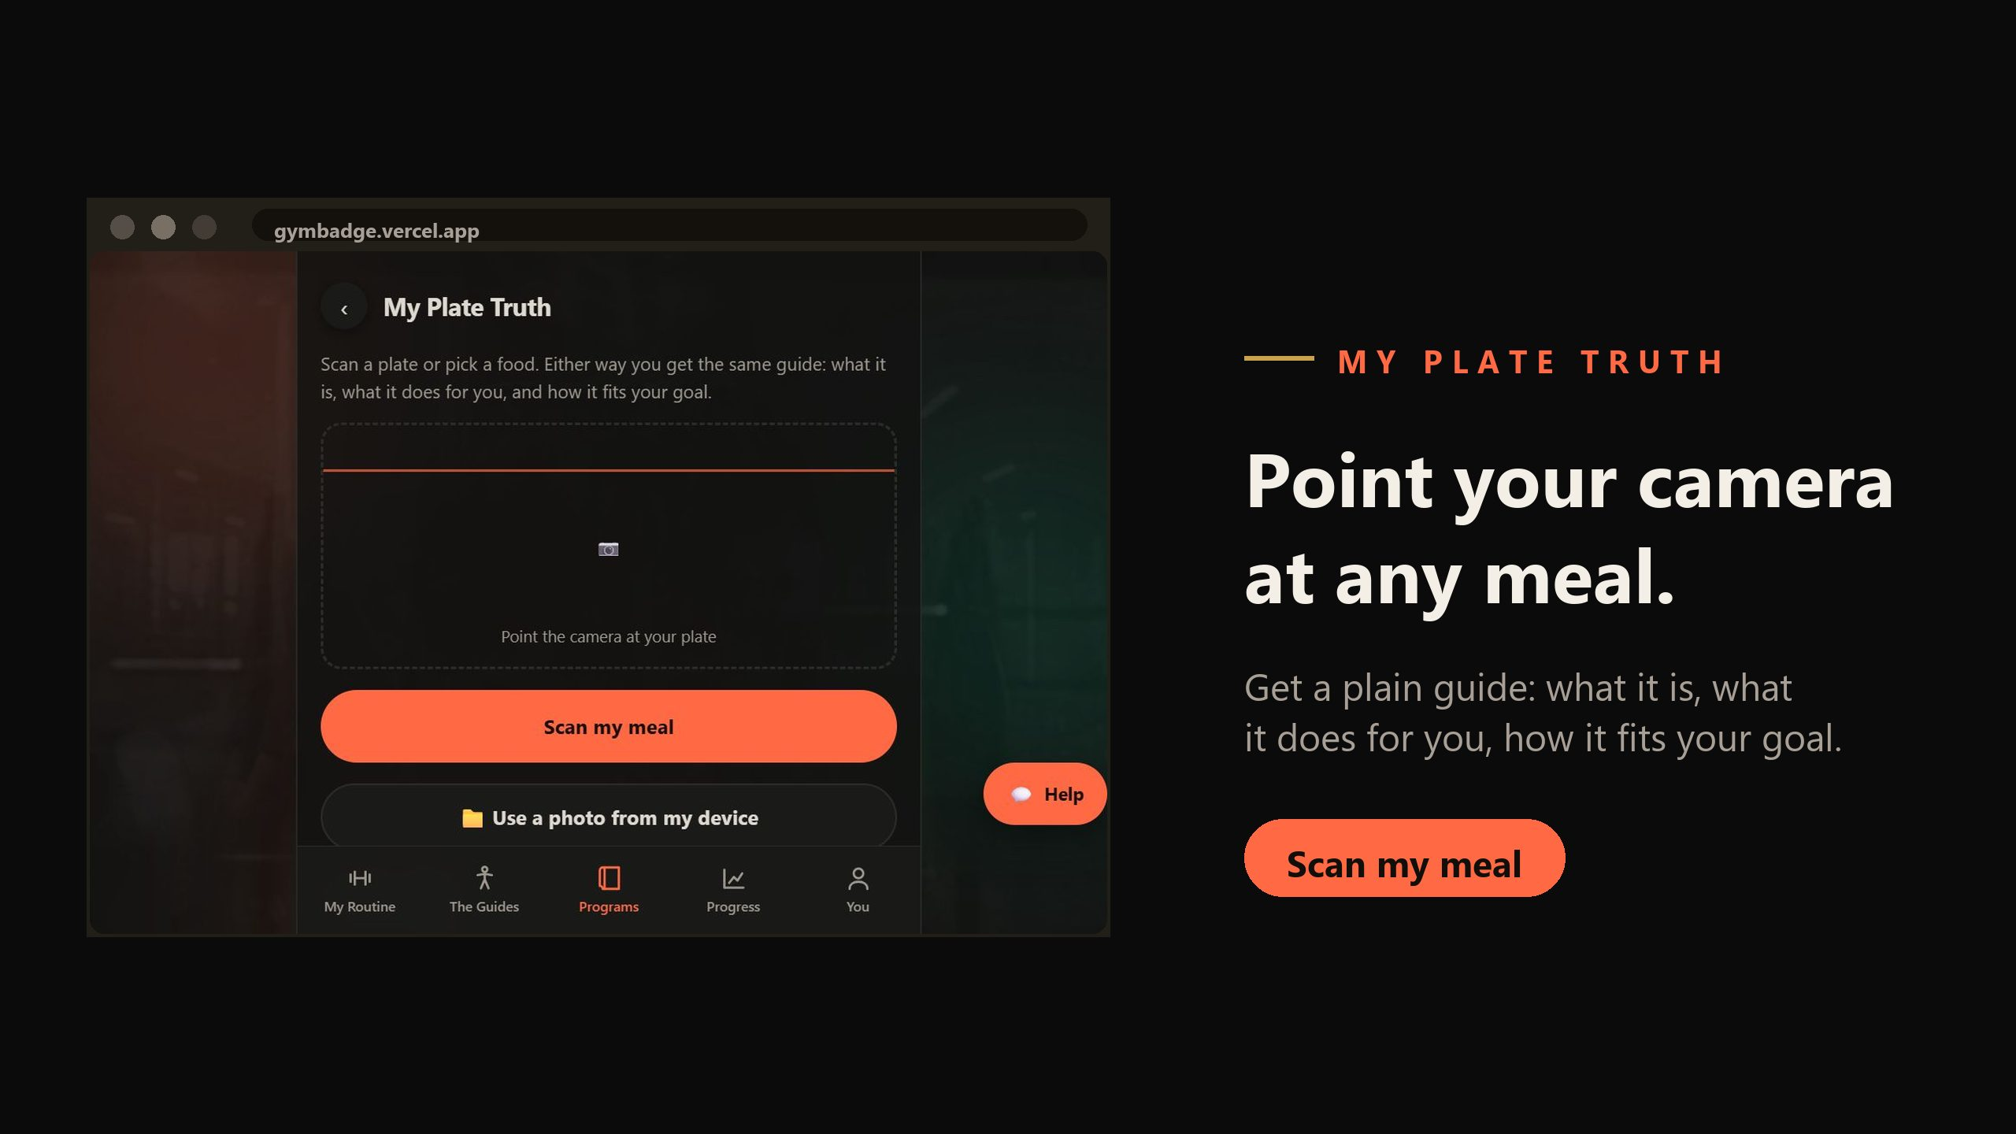
GYM BADGE · INVESTOR PRESENTATION · CONFIDENTIAL
04 / 22

Slide 5
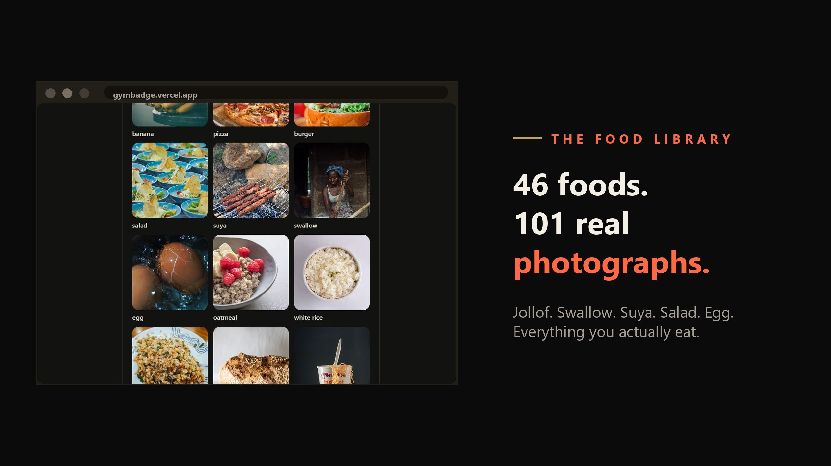
GYM BADGE · INVESTOR PRESENTATION · CONFIDENTIAL
05 / 22

Slide 6
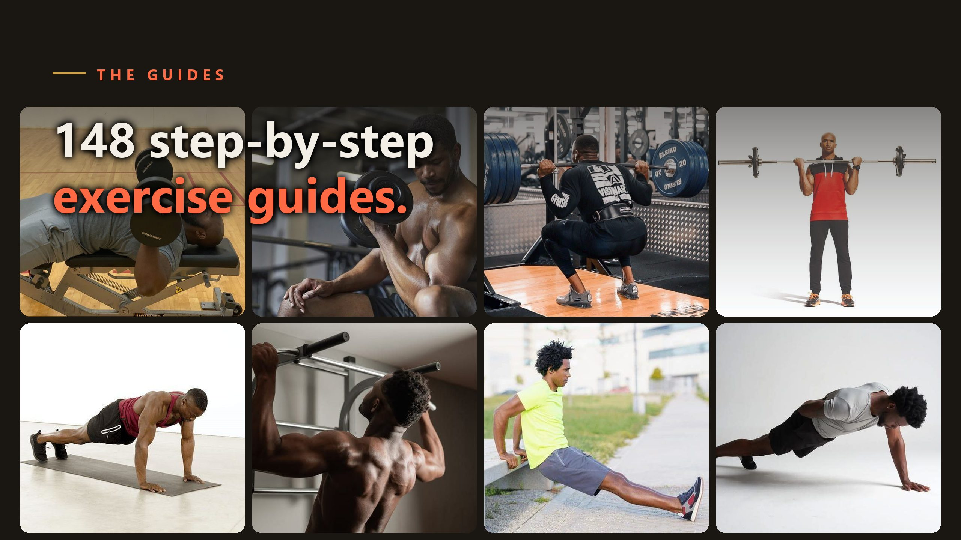
GYM BADGE · INVESTOR PRESENTATION · CONFIDENTIAL
06 / 22

Slide 7
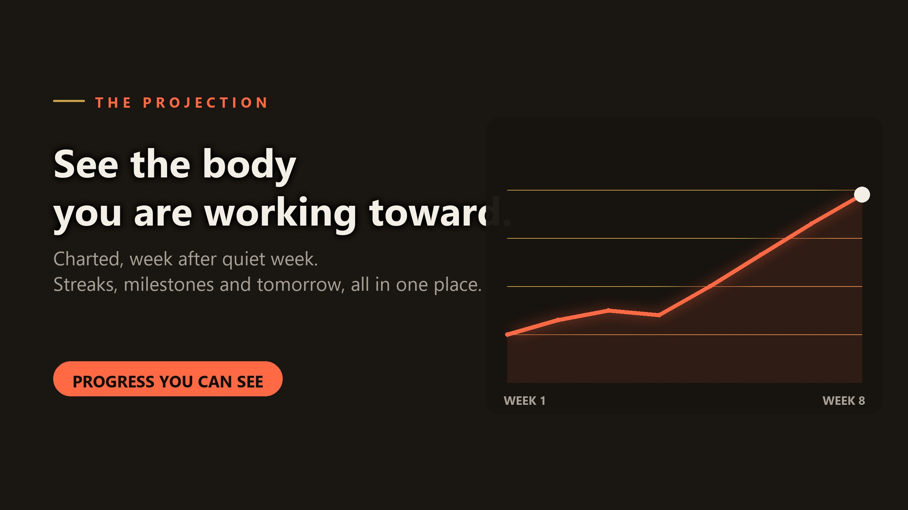
GYM BADGE · INVESTOR PRESENTATION · CONFIDENTIAL
07 / 22

Slide 8
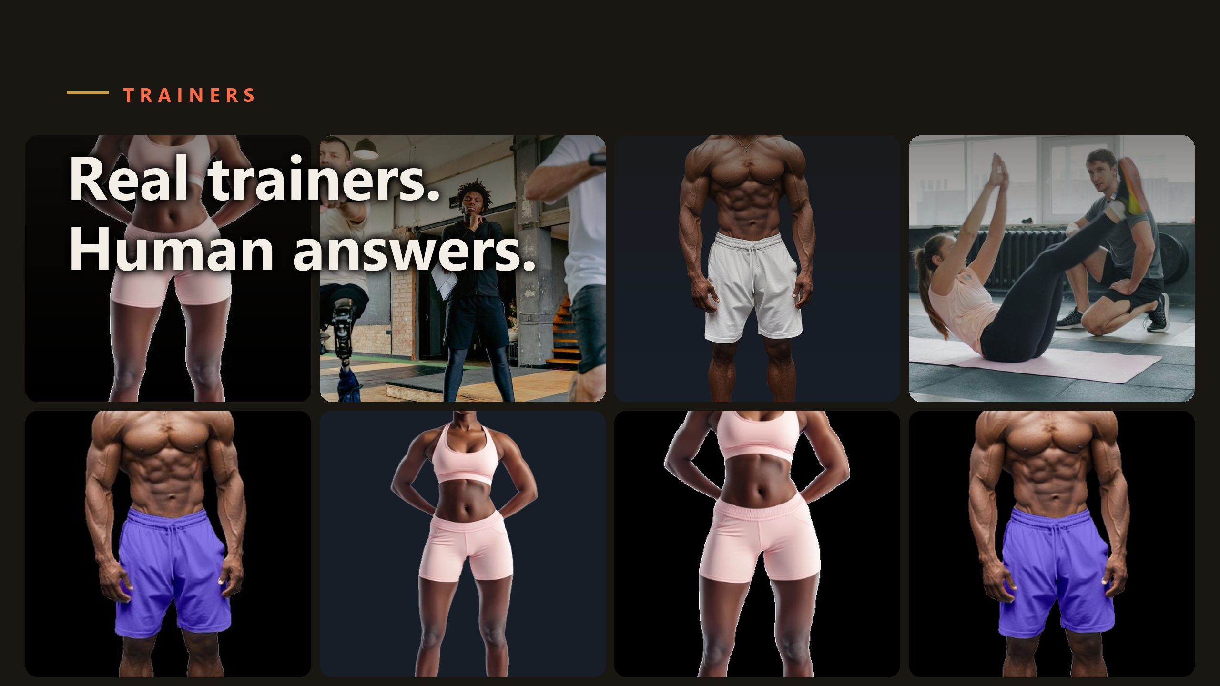
GYM BADGE · INVESTOR PRESENTATION · CONFIDENTIAL
08 / 22

Slide 9
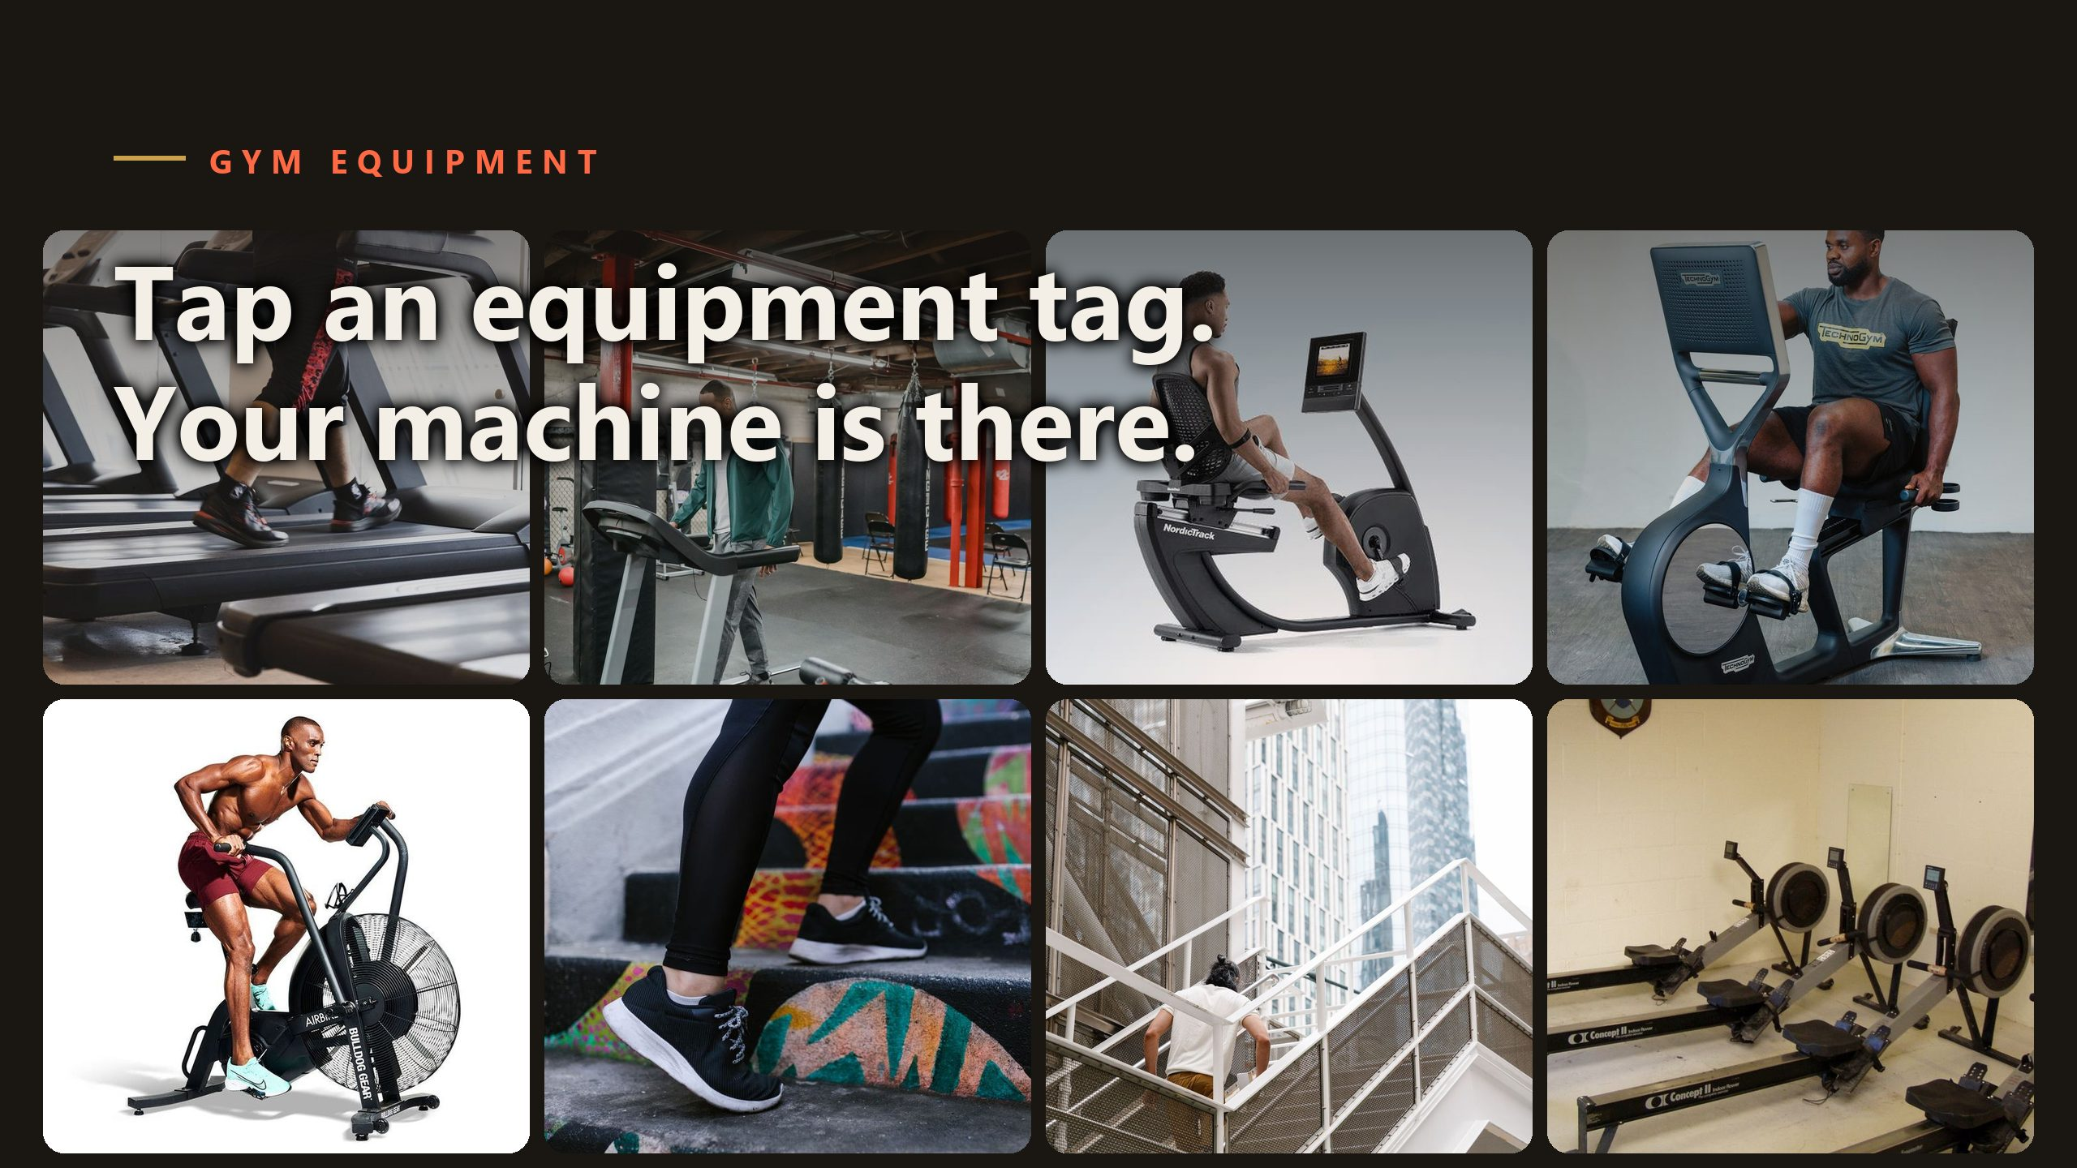
GYM BADGE · INVESTOR PRESENTATION · CONFIDENTIAL
09 / 22

Slide 10
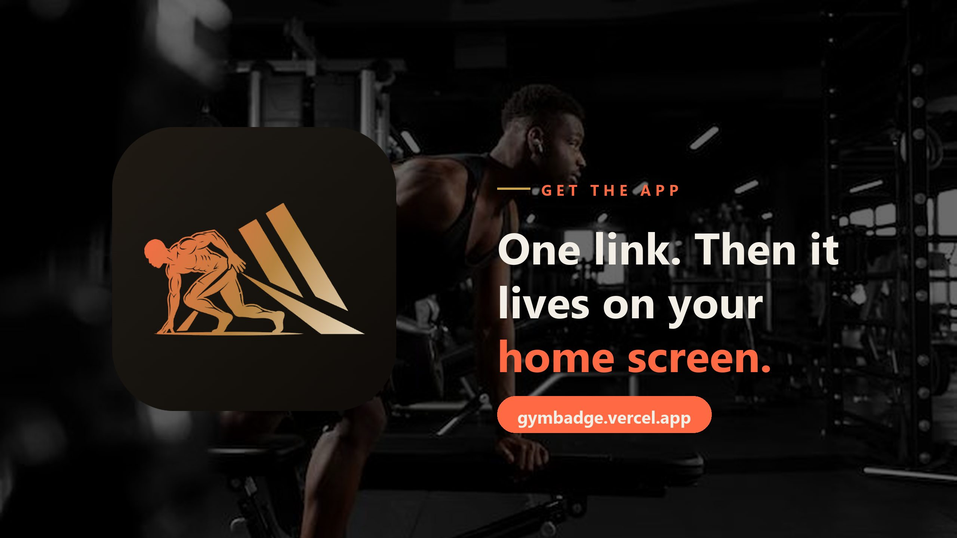
GYM BADGE · INVESTOR PRESENTATION · CONFIDENTIAL
10 / 22

Slide 11
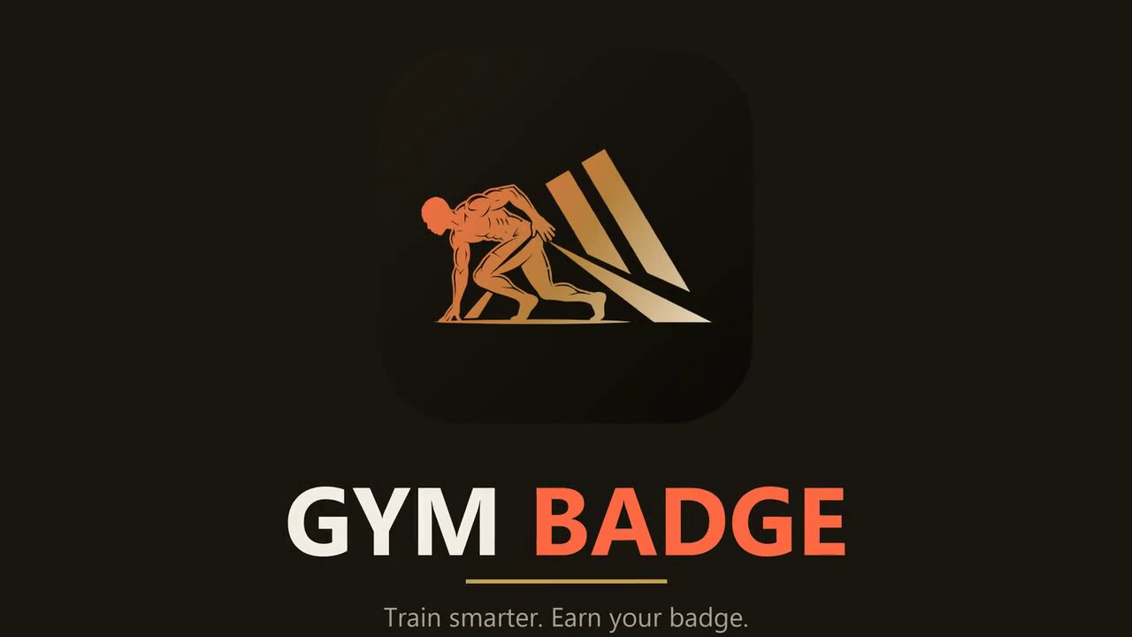
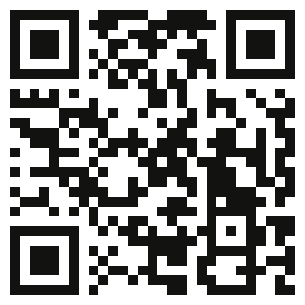
THE DEMO
The full tour in 1:47.
•
Narrated product tour. Every MVP feature,
deep-voice narration, hip-hop score.
•
Live now. gymbadge.vercel.app/demo - scan to
watch.
•
Plays anywhere. Any browser, any phone, no install.
The 1:47 investor cut
Scan to watch
gymbadge.vercel.app/demo
GYM BADGE · INVESTOR PRESENTATION · CONFIDENTIAL
11 / 22

Slide 12
THE MARKET
Nobody bundles the floor
and the plate.
•
The category. Global fitness apps: $12.1B in 2025 , growing 13.4% a year to $33.6B by 2033 (Grand View
Research, Fitness Apps Market, 2026-2033).
•
Our wedge. Food truth plus guided training plus NFC equipment tags - one membership, three jobs.
•
Distribution built in. A link installs the app. No store review, no 30% cut, updates land instantly.
•
Channels are users. Every gym and every trainer in the product is a distribution point, not a cost line.
GYM BADGE · INVESTOR PRESENTATION · CONFIDENTIAL
12 / 22

Slide 13
COMPETITIVE LANDSCAPE
Trackers count. We change the plate.
CAPABILITY
GYM BADGE
FITNESS TRACKERS
AI CHATBOTS
Plate truth from a photo, with follow-up questions
YES
Database logging
Text answers only
148 guided disciplines + routine builder
YES
Running plans only
-
Live gym equipment status (NFC / QR)
YES
-
-
Offline-first, installs from a link, no store cut
YES
Varies
-
No ads, no data sales, human support
YES
Ads / paywalls
Varies
Why now: 858M fitness-app downloads in 2023 (Business of Apps) - none of them own the floor.
GYM BADGE · INVESTOR PRESENTATION · CONFIDENTIAL
13 / 22

Slide 14
THE LOOP
Four engines. One loop.
•
The plate tells the program. My Plate Truth computes today's fuel gap and adjusts tomorrow's session
intensity — food and training stop being separate tabs.
•
The badge is the product. Your QR badge and machine tags tap you in; sets log to you without touching your
phone. NFC wristbands pilot at the flagship house.
•
The floor is live. Member taps feed anonymized machine occupancy — free or in use, right now — the read
side of the gym floor dashboard already in the ask.
•
The proof is signed. Every set can be signed as HMAC proof of work and verified by anyone, no data
fabricated, no PII exposed.
•
Nobody else runs all four in one system. Bundle-level first: token + plate + floor + proof. Buy the loop, not a
tracker.
GYM BADGE · INVESTOR PRESENTATION · CONFIDENTIAL
14 / 22

Slide 15
BUSINESS MODEL
Grow on trust, not traps.
MEMBERS
GYMS
TRAINERS
Free core, premium depth. Premium
Equipment tags and floor analytics.
Bookings and marketplace share.
~$3.23/mo (₦5,000) across 16
Seats from $1.94/seat/mo - Team,
15% at launch, flexed per partner.
currencies; Elite ~$6.13/mo.
Business, Enterprise.
List ARPU ≈$38.71/yr · seats in blocks of 5/10/20 · no ads, no data sales. Ever.
GYM BADGE · INVESTOR PRESENTATION · CONFIDENTIAL
15 / 22

Slide 16
WHERE IT STANDS
Shipped. Not slideware.
•
In production. gymbadge.vercel.app - live, branded, current; offline-first PWA installs from a link.
•
Gated by tests. 194 UI wiring checks and 182 behaviour checks gate every push; human support within one
business day.
•
Traction so far. 3,000+ on the waitlist · 100+ gym trainers in conversation · 2,000 views of the narrated ad in its
first 36 hours.
•
First-12-month targets (targets, not results): flagship gym house open · 10 gyms on NFC tags · weekly
conversion tracking · trainer marketplace beta.
•
Channels are users. Link-install means 0% store cut and instant updates; every gym in the product is a
distribution point.
GYM BADGE · INVESTOR PRESENTATION · CONFIDENTIAL
16 / 22

Slide 17
ROADMAP
Three moves from here.
NOW
NEXT
THEN
Plate to program loop + badge QR
Live floor on the flagship pilot,
Floor dashboard for gyms, B2B pilots.
live. Flagship gym house buildout.
between-set coaching loop, NFC
Months 6-12 post-close.
Gym partnerships for equipment tags.
badge v2 pilot at the house, trainer
marketplace beta.
GYM BADGE · INVESTOR PRESENTATION · CONFIDENTIAL
17 / 22

Slide 18
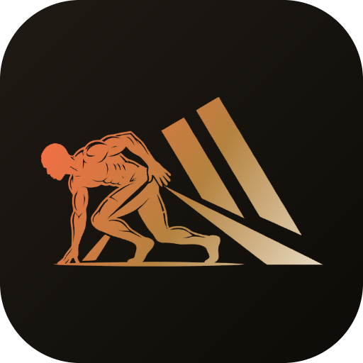
THE TEAM
One founder. Team-grade shipping.
Tearsmith
Founder & CEO
Self-taught engineer and lifelong fitness builder - background across engineering,
hands-on training and prior startup work. Designs, builds and operates Gym Badge end
to end: product, the AI food engine, 148 exercise guides, payments across 16
currencies, and a pipeline that gates every push on 376 automated checks. One person
already ships what normally takes a team.
First hires on this round: two engineers, one growth & partnerships lead, one gym-ops
lead for the flagship house.
GYM BADGE · INVESTOR PRESENTATION · CONFIDENTIAL
18 / 22

Slide 19
THE ASK
$1.5M pre-seed SAFE.
Flagship gym house - buildout & latest equipment
30%
Product & infrastructure
25%
Team
25%
Growth & partnerships
15%
Operations & support
5%
$8M valuation cap · 20% discount · rolling close over 4-6 weeks.
12-month milestones. Flagship gym house open as the pilot floor · 10 gyms on NFC tags · premium conversion tracked weekly · trainer
marketplace beta.
GYM BADGE · INVESTOR PRESENTATION · CONFIDENTIAL
19 / 22

Slide 20
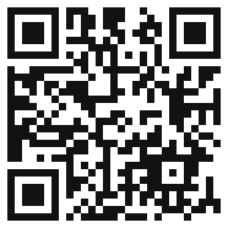
CONTACT
Let's earn the badge together.
gymbadgesupport@gmail.com
gymbadge.vercel.app
Tearsmith - Founder & CEO
Scan to open the app
Gym Badge
GYM BADGE · INVESTOR PRESENTATION · CONFIDENTIAL
20 / 22

Slide 21
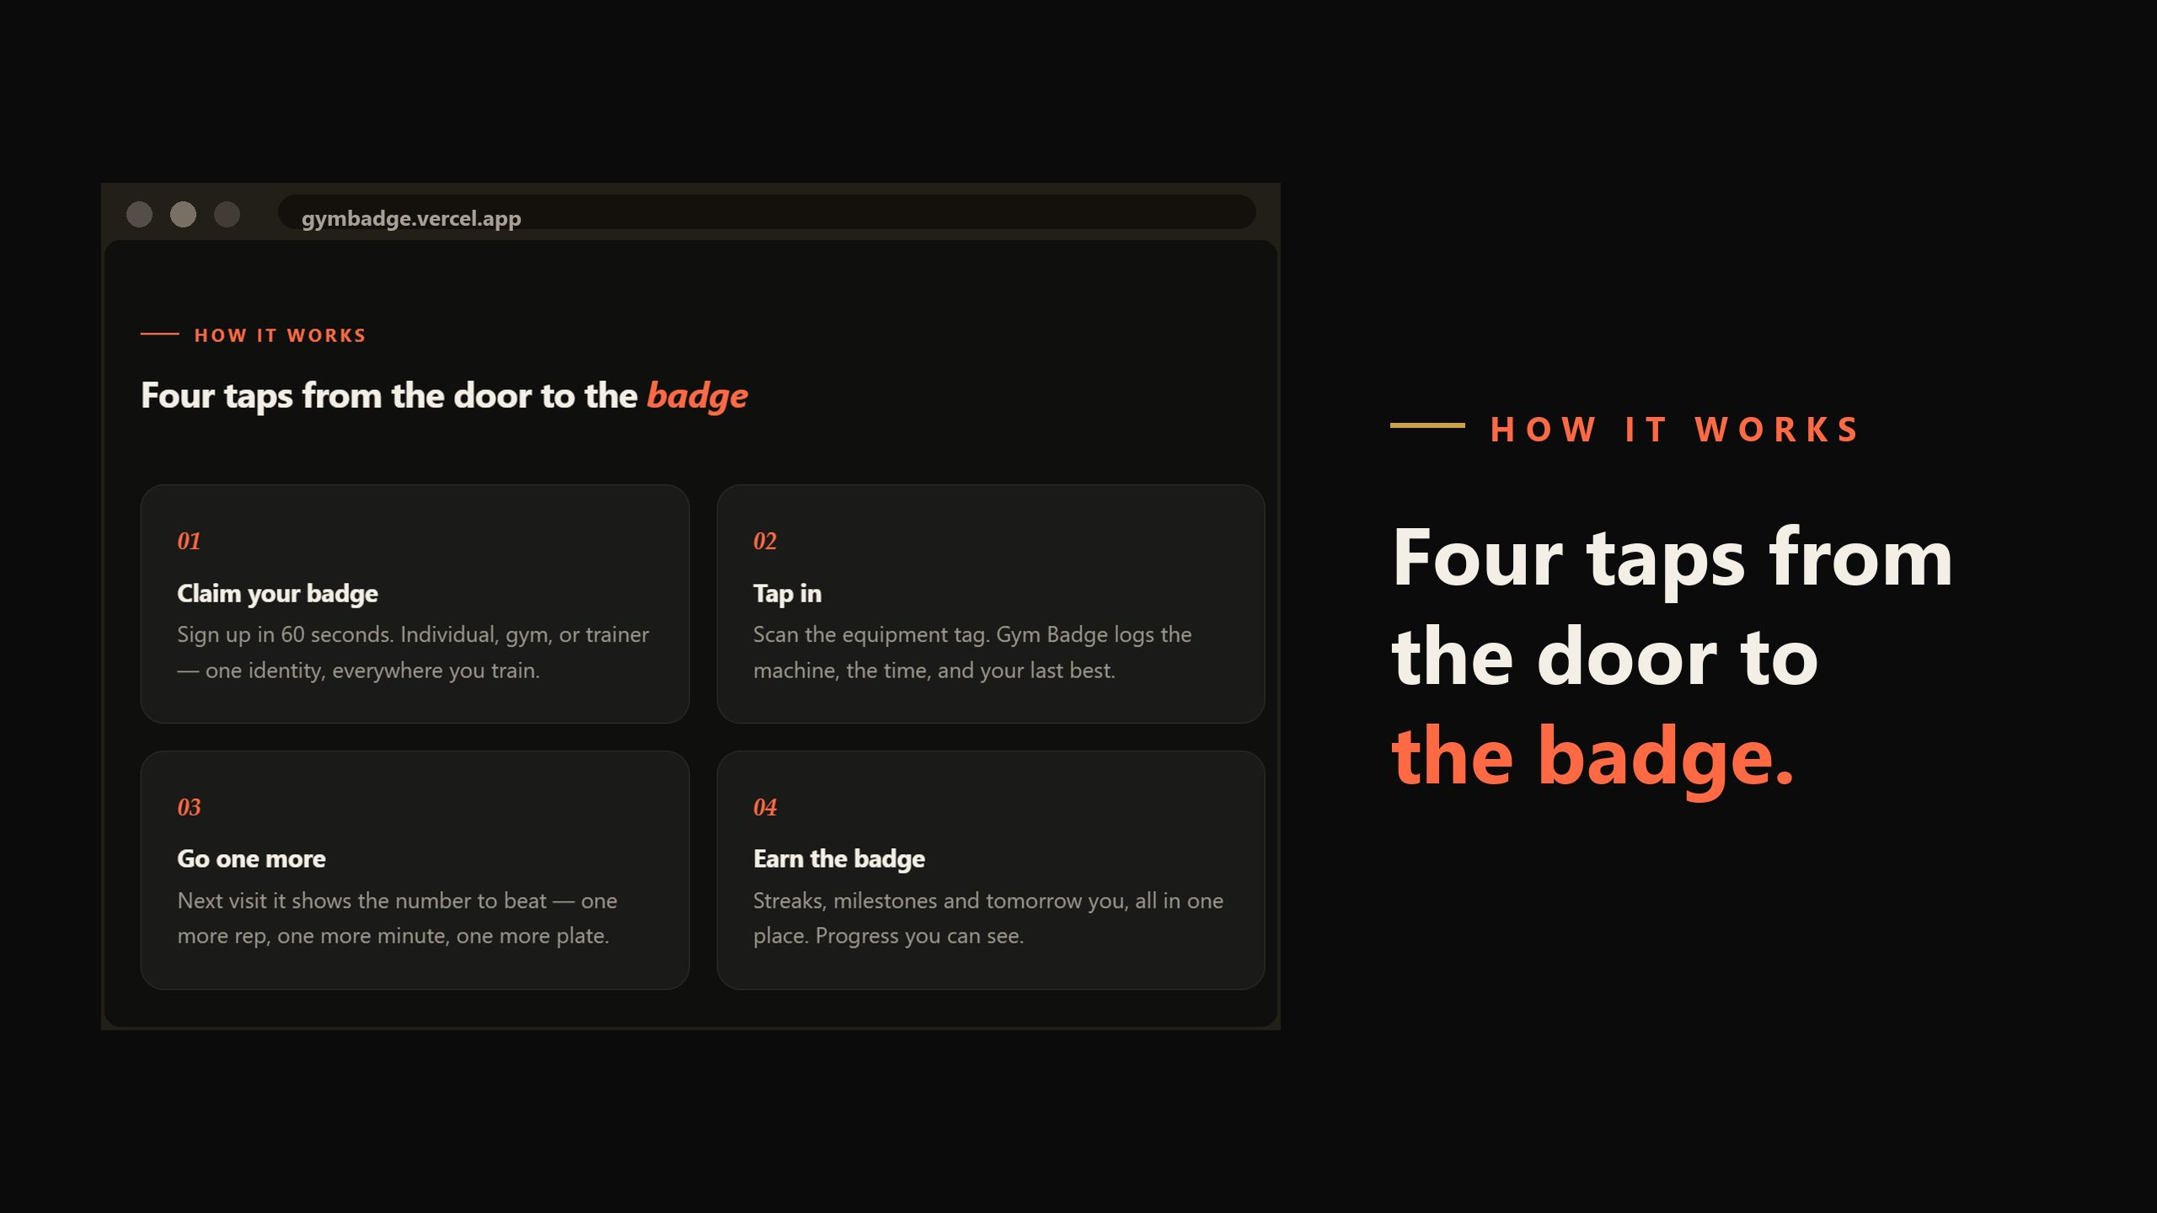
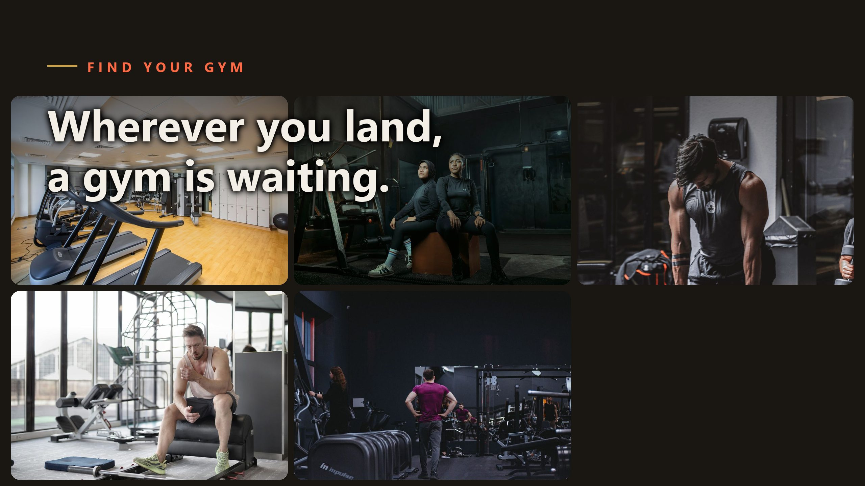
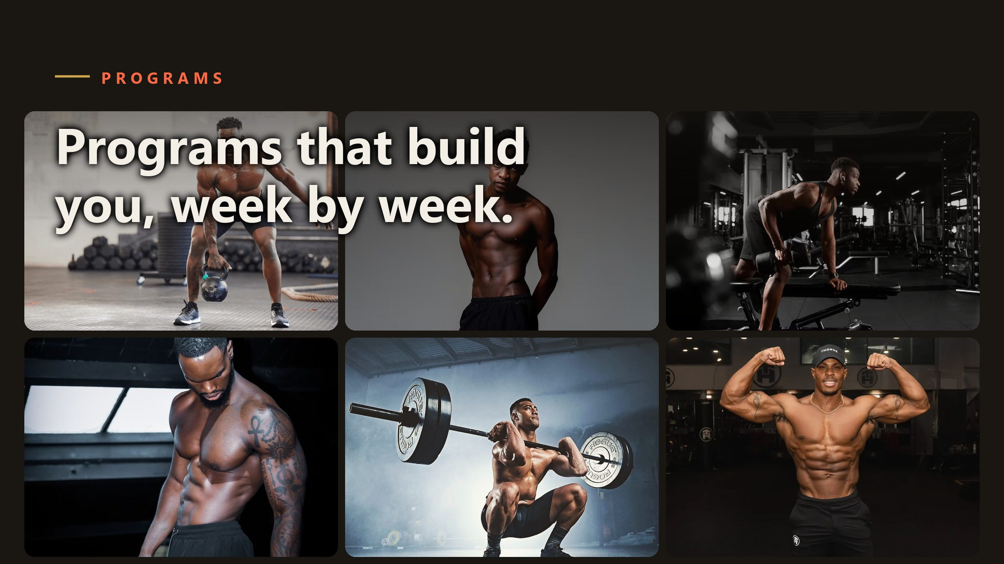
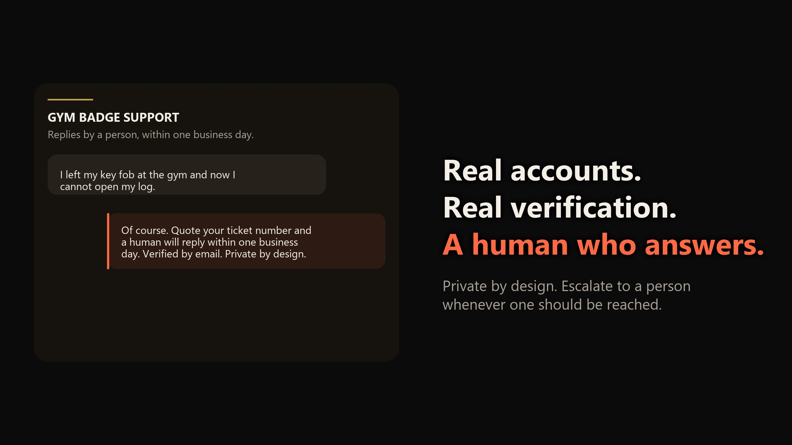
APPENDIX - PRODUCT
More of the product.
GYM BADGE · INVESTOR PRESENTATION · CONFIDENTIAL
21 / 22

Slide 22
APPENDIX - ENGINEERING
Built like it matters.
•
Offline-first PWA. Service worker with versioned caches; every release bump is tested, every asset revalidated.
•
Python API. Rate-limited assistant with safety and escalation handling, verified email flows.
•
Media pipeline. H.264 demos generated and verified in-repo - the same rigour as the app.
•
Brand discipline. Approved artwork and real photography only; nothing reaches the screen untraceable.
•
Green before push. Both suites gate every commit; production is re-verified after every deploy.
GYM BADGE · INVESTOR PRESENTATION · CONFIDENTIAL
22 / 22

