Slide 1

Online School
EterbesX
Team:
Bereznev Max- Manager
Turantaev Nick- Programmer
Gulyaev Villi- Decorator

Slide 2

The problem of lagging behind the curriculum…

Slide 3


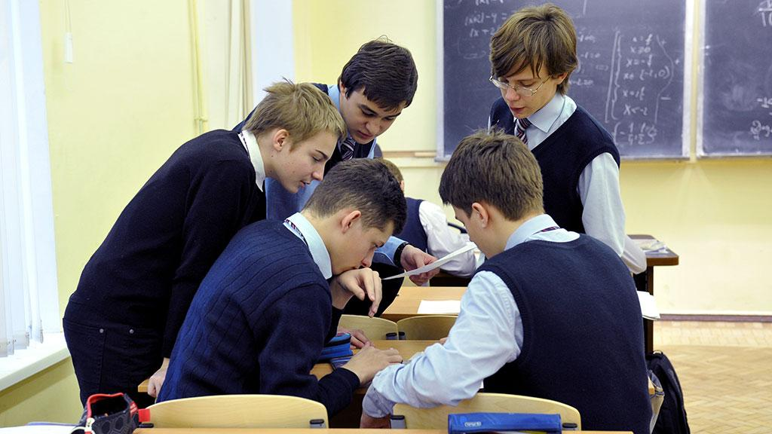
Because students miss classes for different reasons...

Slide 4
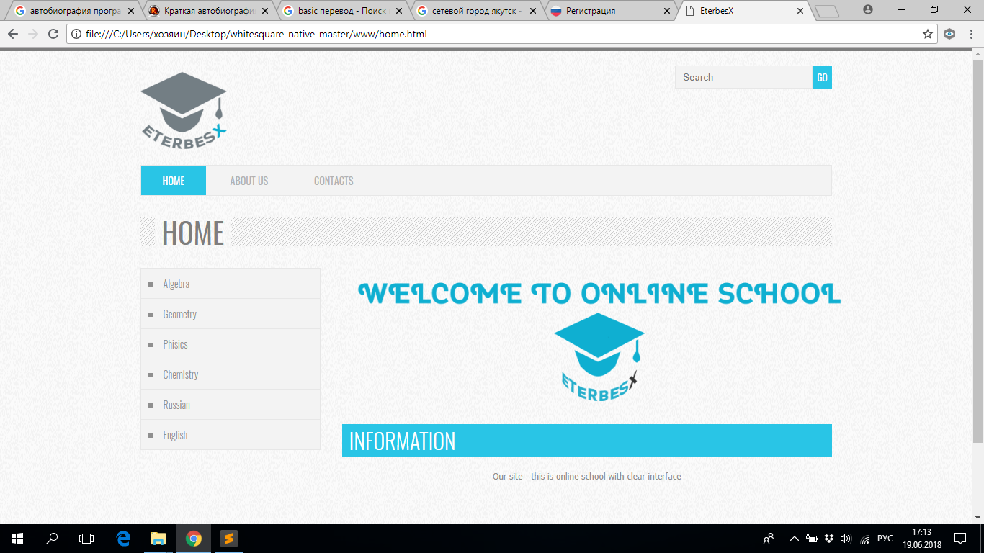
The solution to this problem is our website...
Yakuts

Slide 5


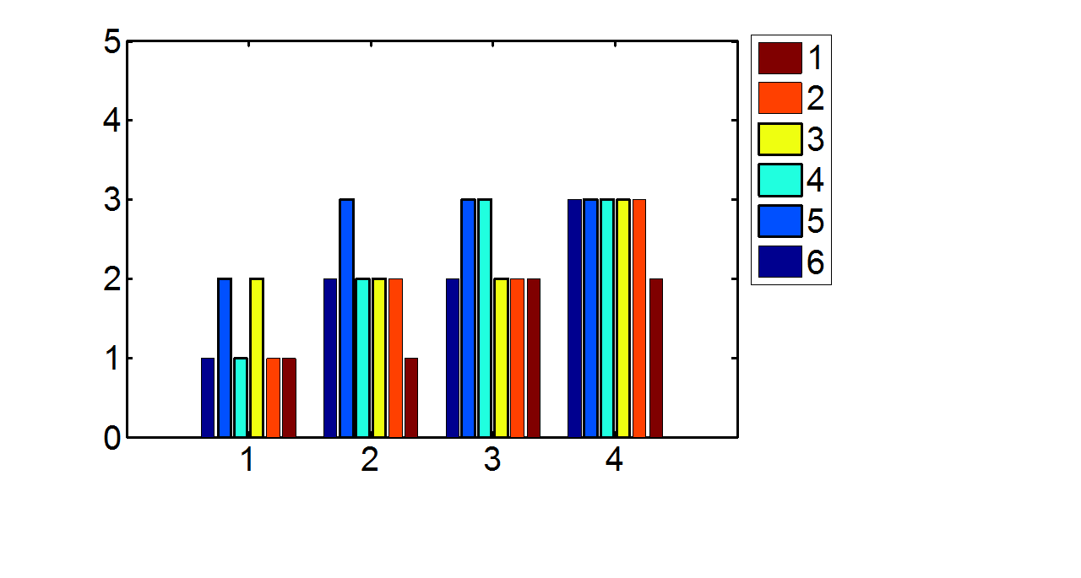

Function: Repetition and study of educational topics.

Slide 6
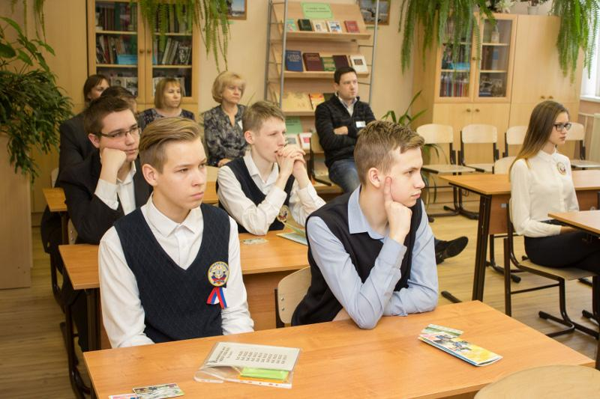
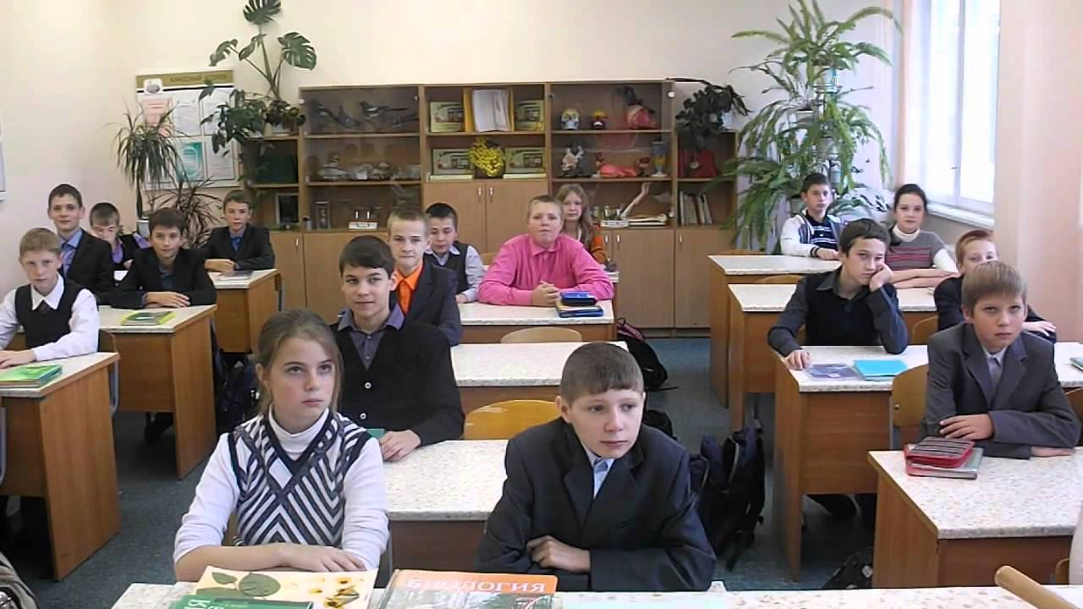
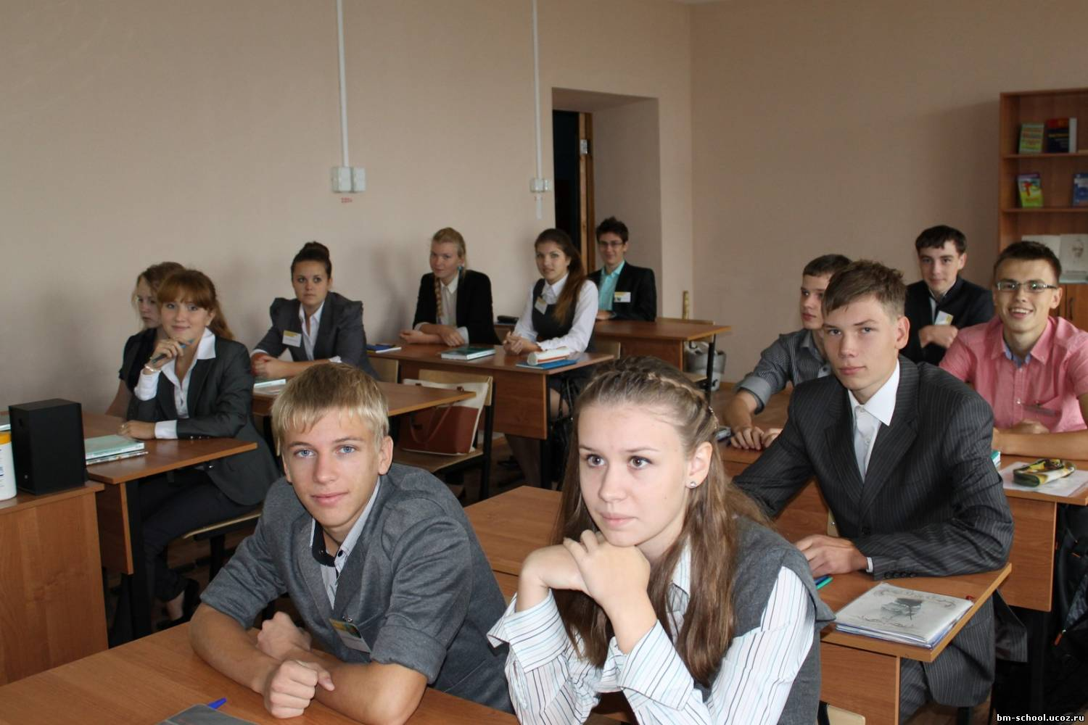
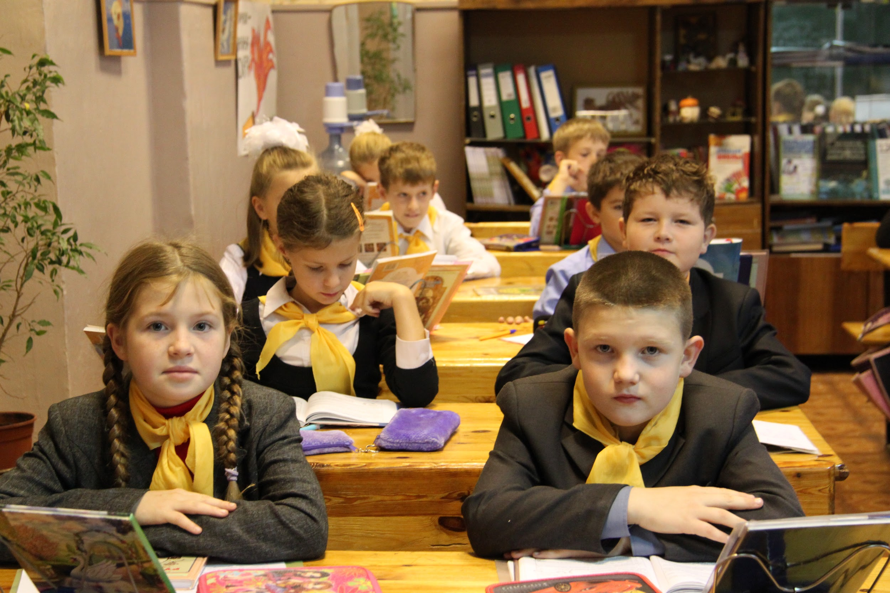
Users: Students of graders 5-11.

Slide 7
Competitors
Network City
Circles

Slide 8
Monetization:
Advertising
Support services quests

