Slide 1
Biomedical Optics Lab Research Presentation
Tommy Eastman

Slide 2
Temporal Focusing Microscopy
Microscopy technique in which two photons arriving at the same instant are required to illuminate a molecule
In order to be able to image a single depth, frequency components must overlap at this depth
Beams must diverge away from the focus so that only the target is illuminated
Provides more penetrating power than a field microscope, and better resolution than imaging techniques such as MRI

Slide 3
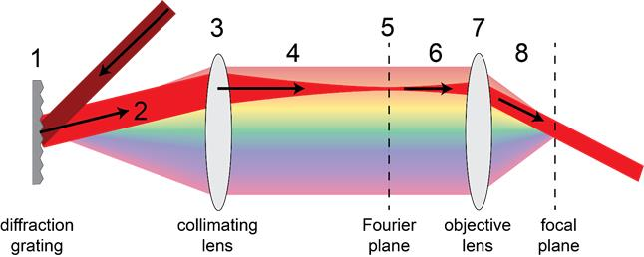
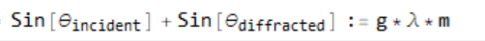
Temporal Focusing Microscopy Model
Analytical solutions aren’t always attainable
Numerical modeling of the propagation allows us to determine how pulse width changes in time and space
Diffraction grating equation:
g = groove density
m = order number

Slide 4
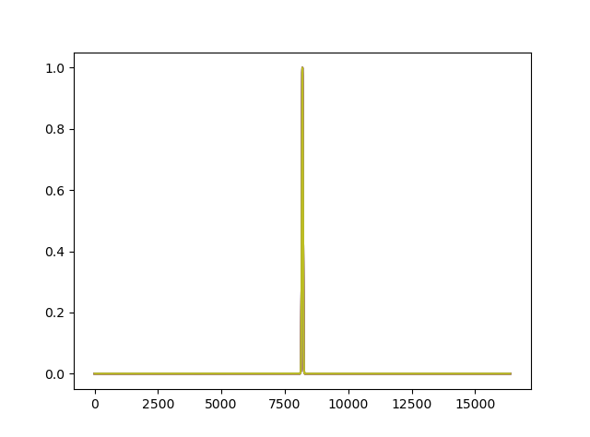
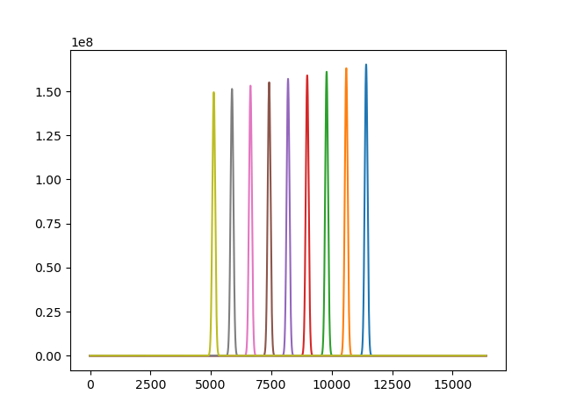
Tasking
Modeled light as it propagates through the microscopy system

Slide 5
Initial Work
Ray tracing program
Addition of diffraction grating
Here it would be good to add a graph created by the python code that shows the ray tracing through a set of lenses
Maybe add the diffraction grating equation

Slide 6
Ports from Matlab to Python
Some important code for fourier optics transformations as they apply to imaging in particular has been written in Matlab
We aim to move this all to python
Began porting matlab functions to python using Voelz Computational Fourier Optics

Slide 7
Making ray tracing multi-dimensional
For temporal focusing, multiple wavelengths of light exist in the beam
We need to be able to map these wavelengths
Parallel programming must be implemented in order to allow for multi-wavelength light propagation
Done using Python Multiprocessing Module

Slide 8
Steps forward
Once I learn more about the end goal of the project this can be beefed up

Slide 9
References
Computational Fourier Optics, Voelz
Modeling the Imaging Chain of Digital Cameras, Fiete

