Slide 1
Kata Containers +UniKernel+WebAssembly-runtime Demo
teawater@antgroup.com

Slide 2
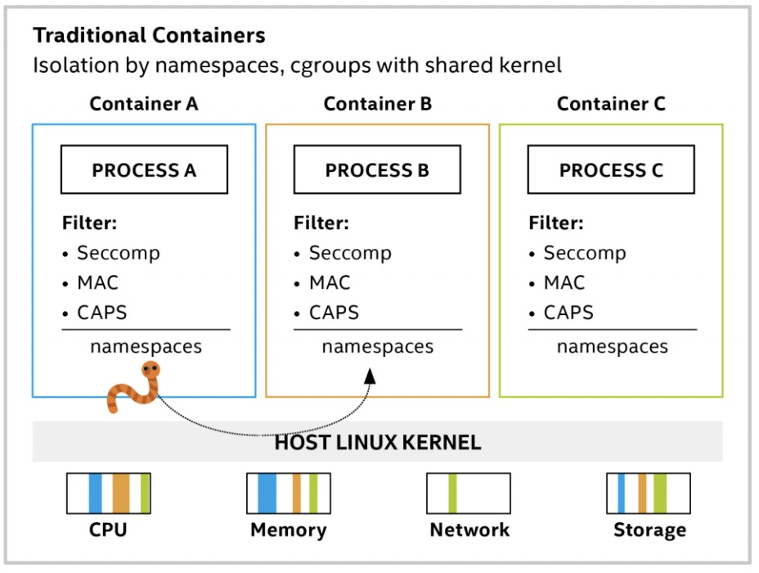
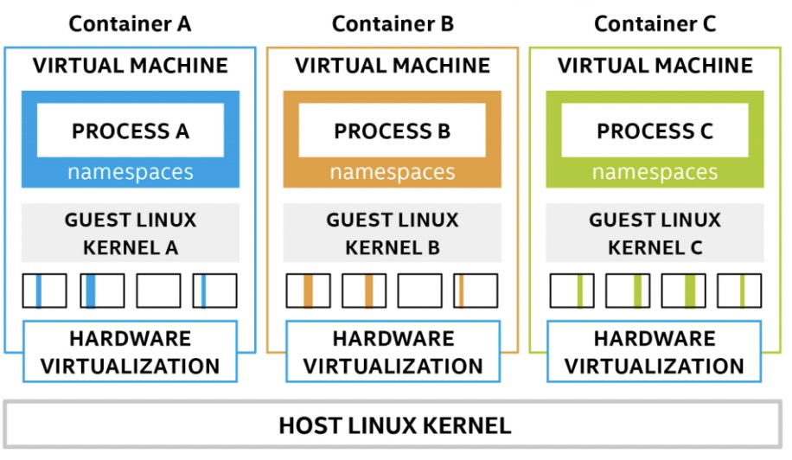
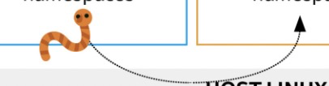
What Is Kata Containers

Slide 3
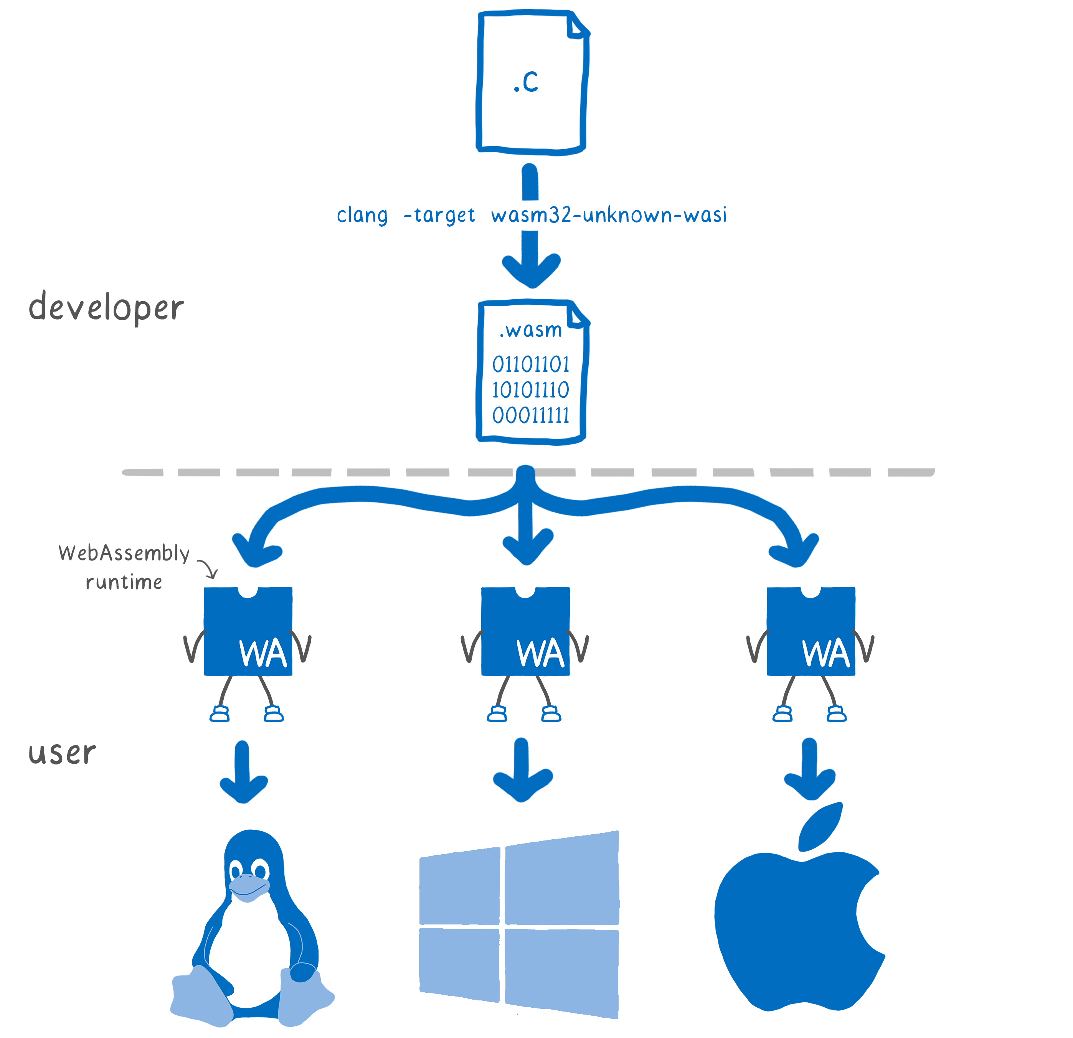
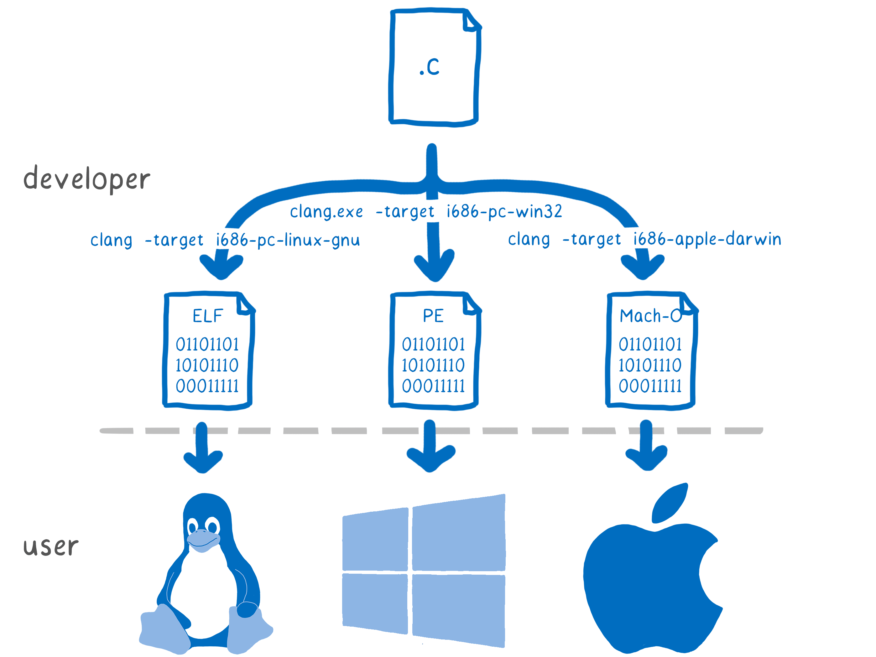
What Is WebAssembly

Slide 4
WebAssembly runtime on guest Linux kernel with namespaces
Kata containers pod
VIRTUAL MACHINE
namespaces A
namespaces B
namespaces C
WebAssembly runtime A
WebAssembly runtime B
WebAssembly runtime C
WASI
WASI
WASI
GUEST LINUX KERNEL
HARDWARE VIRTUALIZATION
Host Linux kernel

Slide 5
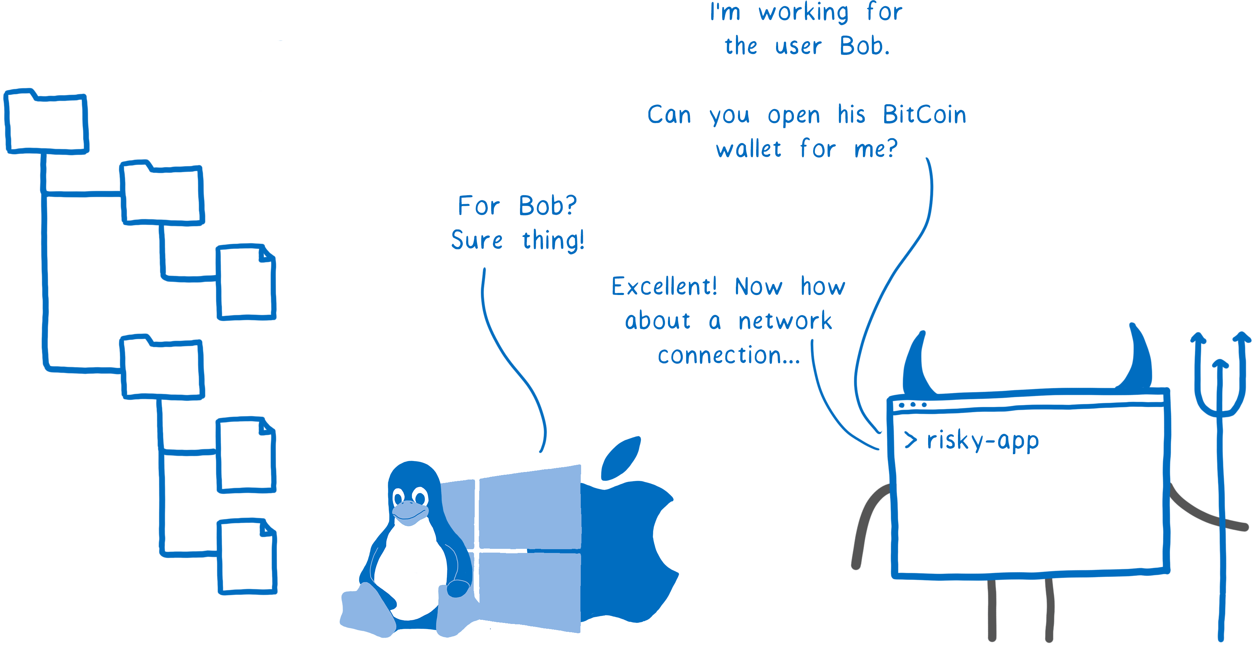
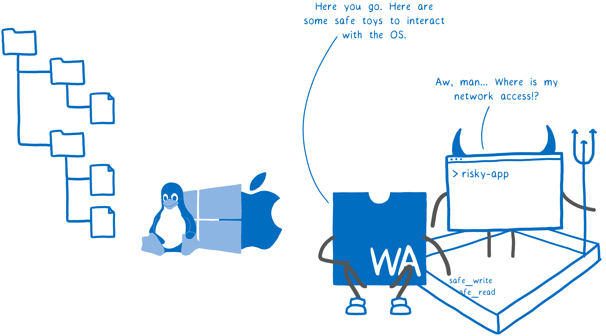
WebAssembly runtime isolation

Slide 6
WebAssembly runtime on guest Linux kernel without namespaces
Kata containers pod
Kata containers pod
VIRTUAL MACHINE
VIRTUAL MACHINE
namespaces A
namespaces B
namespaces C
WebAssembly runtime A
WebAssembly runtime B
WebAssembly runtime C
WebAssembly runtime A
WebAssembly runtime B
WebAssembly runtime C
WASI
WASI
WASI
WASI
WASI
WASI
GUEST LINUX KERNEL
GUEST LINUX KERNEL
HARDWARE VIRTUALIZATION
HARDWARE VIRTUALIZATION
Host Linux kernel
Host Linux kernel

Slide 7
WebAssembly runtime on UniKernel
Kata containers pod
Kata containers pod
VIRTUAL MACHINE
VIRTUAL MACHINE
WebAssembly runtime A
WebAssembly runtime B
WebAssembly runtime C
WebAssembly runtime A
WebAssembly runtime B
WebAssembly runtime C
WASI
WASI
WASI
GUEST LINUX KERNEL
WASI
WASI
WASI
UniKernel
HARDWARE VIRTUALIZATION
HARDWARE VIRTUALIZATION
Host Linux kernel
Host Linux kernel

Slide 8
Why Kata Containers+UniKernel+WebAssembly-runtime?
Because WebAssembly-runtime provides enough application level isolation, UniKernel and WebAssembly-runtime run in kernel mode (ring 0) together. It helps to reduce the overhead of mode switching.
A UniKernel tries to remove some of complexities that modern operating systems bring. It helps decrease the memory usage of Kata Containers.
Specialized implementations: you know what WebAssembly-runtime want and you can tweak and run UniKernel exactly the way you want it.
Kata Containers support ShimV2 can help WebAssembly-runtime more containerized.
Kata Containers support virtio-xxx can help UniKernel better support virtualization.
Kata Containers provides virtualization level isolation for WebAssembly-runtime.
WebAssembly-runtime make UniKernel friendlier to the software ecology.

Slide 9
Links of demo
For Kata Containers: https://github.com/teawater/kata-containers/tree/wasm_demo https://github.com/teawater/libhermit-kata-agent/tree/wasm_demo
For WebAssembly-runtime: https://github.com/teawater/wasm-micro-runtime/tree/wasm_demo
For UniKernel: https://github.com/hermitcore/libhermit https://github.com/teawater/hermit-caves/tree/wasm_demo
Demo: https://github.com/teawater/kata-wasm-demo

Slide 10
Demo & Thanks

