Slide 1

Front End Development workshop
WEEK FOUR: BASIC JAVASCRIPT

Slide 2
Review
Tentative timeline:
HTML – basics
CSS – basics
CSS - intermediate
Javascript (jQuery)
Hosting (Heroku) - basics

Slide 3
Review
Tentative timeline:
HTML – basics
CSS – basics
CSS - intermediate
Javascript (jQuery)
Hosting (Heroku) - basics
Custom fonts
Backgrounds
Media queries

Slide 4
This week
Tentative timeline:
HTML – basics
CSS – basics
CSS - intermediate
Javascript (jQuery)
Hosting (Heroku) - basics
What is Javascript?
What is jQuery?
Animations
Event handling

Slide 5
What is javascript?
Javascript can:
Change the HTML (Document Object Model)
The DOM defines the logical structure of documents and the way a document is accessed and manipulated.
JS can populate HTML with data (Angular, React, etc…)
Access the internet in the background (AJAX)

Slide 6

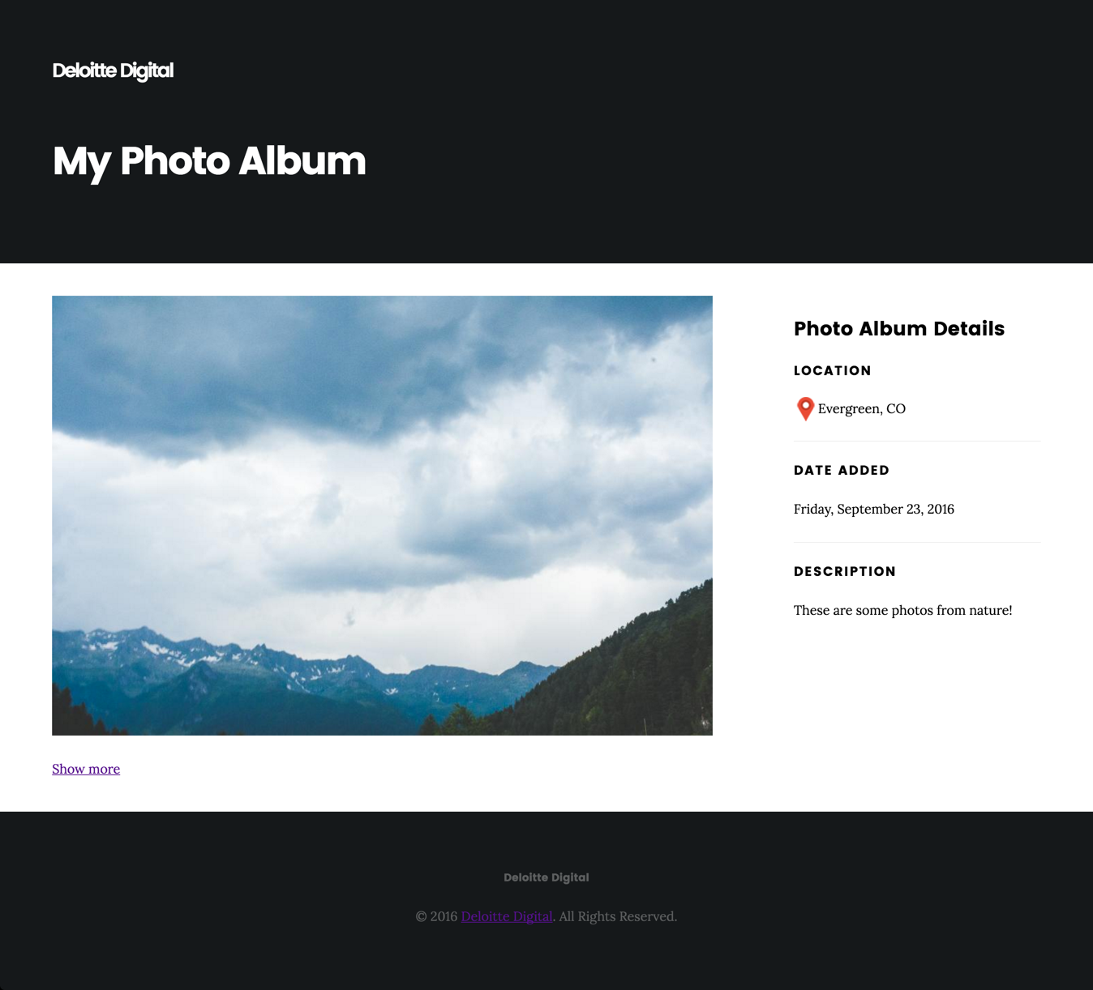
What is javascript?
Exercise:
Using Javascript, let’s show one image at first, and the rest on click.

Slide 7
What is javascript?
Notes:
Load scripts at the end of HTML
document.ready();
console.log();

Slide 8
What is jQuery?
jQuery is a framework that makes writing javascript easier

Slide 9

What is jQuery?
jQuery is a framework that makes writing javascript easier
A collection of pre-built javascript functions

Slide 10

What is jQuery?
jQuery is a framework that makes writing javascript easier
A collection of pre-built javascript functions
Reduces the amount of javascript needed to do common javascripty things

Slide 11
Next Week
Tentative timeline:
HTML – basics
CSS – basics
CSS - intermediate
Javascript (jQuery)
Hosting (Heroku) - basics

Slide 12
References
Browsers
Chrome
Text editors (IDE’s)
Sublime Text (https://www.sublimetext.com/download)
Repositories
Github (https://github.com/glenb0/frontendworkshop)
Local environment
python -m SimpleHTTPServer 8000

