Slide 1

Front End Development workshop
WEEK FIVE: Hosting

Slide 2
Review
Tentative timeline:
HTML – basics
CSS – basics
CSS - intermediate
Javascript (jQuery)
Hosting (Heroku) - basics

Slide 3
Review
Tentative timeline:
HTML – basics
CSS – basics
CSS - intermediate
Javascript (jQuery)
Hosting (Heroku) - basics
What is Javascript?
What is jQuery?
Animations
Event handling

Slide 4
This week
Tentative timeline:
HTML – basics
CSS – basics
CSS - intermediate
Javascript (jQuery)
Hosting (Heroku) - basics
What is hosting?
What is git?
What is Heroku?
Hosting our app

Slide 5
What is HOSTING?
Computers that live in “server farms” that respond to your web browser and “serve” you the website.

Slide 6

What is HOSTING?
Computers that live in “server farms” that respond to your web browser and “serve” you the website.

Slide 7

What is HOSTING?
Computers that live in “server farms” that respond to your web browser and “serve” you the website.

Slide 8
What is HOSTING?
Computers that live in “server farms” that respond to your web browser and “serve” you the website.
http://www.facebook.com

Slide 9

What is HOSTING?
Computers that live in “server farms” that respond to your web browser and “serve” you the website.
http://www.facebook.com
DNS Server

Slide 10
What is HOSTING?
Computers that live in “server farms” that respond to your web browser and “serve” you the website.
http://www.facebook.com
DNS Server
Server farm

Slide 11
What is HOSTING?
Computers that live in “server farms” that respond to your web browser and “serve” you the website.
http://www.facebook.com
DNS Server
Server farm
Facebook

Slide 12
What is Git?
Git is one kind of “source control”
Helps manage, combine and merge code from different places into one version. This is called a “repository.”
Multiple developers can work on the same project, if they’re all combining their code with something like Git.
Github is a company that stores repositories for developers.

Slide 13

What is Git?
Git is one kind of “source control”
Helps manage, combine and merge code from different places into one version. This is called a “repository.”
Multiple developers can work on the same project, if they’re all combining their code with something like Git.
Github is a company that stores repositories for developers.

Slide 14

What is Git?
Git is one kind of “source control”
Helps manage, combine and merge code from different places into one version. This is called a “repository.”
Multiple developers can work on the same project, if they’re all combining their code with something like Git.
Github is a company that stores repositories for developers.

Slide 15
What is Git?
Create a Github account (www.github.com) - it’s free

Slide 16
What is Heroku?
Heroku is a company that owns sever farms and rents space on them.
Create a Heroku account (www.heroku.com) - it’s free

Slide 17
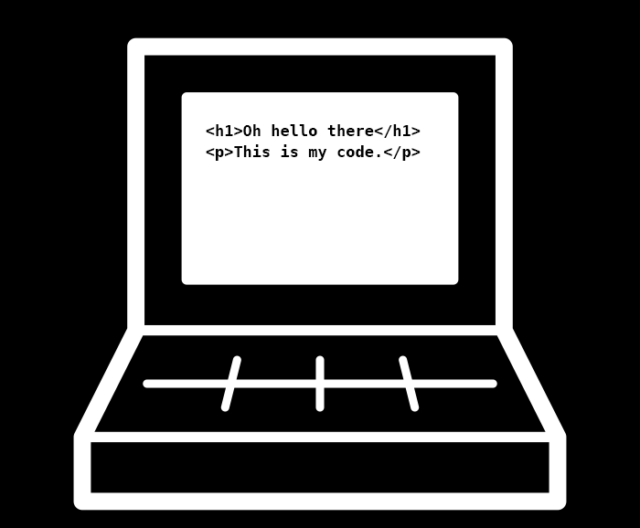

Local Code(s)
Github
Heroku

Slide 18
A quick fix
Rename “index.html” to ”index.php”
Add this to line #1:
<?php $foo = ’bar’; ?>
It means nothing, but tricks Heroku into thinking we’ve built a PHP application, which it can deploy for us.

Slide 19

Create a repo
Download Source Tree: https://www.sourcetreeapp.com/
Open it
Sign in w/ your Github credentials
“New Repository” -> your working folder
Check “Add remote repository”
Make it “public” (“private” isn’t free)
Create a “commit”

Slide 20
Create an app
Go to Heroku.com
Create a “New” application
Select “Github” as the “Deployment Method” – select the repo
Click “Enable Automatic Deploys”

Slide 21
Push the code
In SourceTree, “push” your repository

Slide 22
References
Browsers
Chrome
Text editors (IDE’s)
Sublime Text (https://www.sublimetext.com/download)
Repositories
Github (https://github.com/glenb0/frontendworkshop)
Local environment
python -m SimpleHTTPServer 8000

