Slide 1
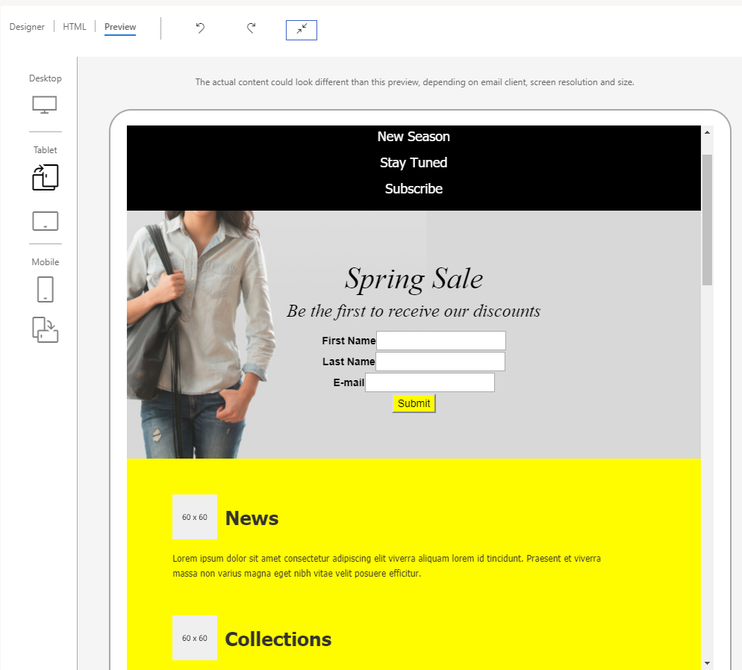
Preview mode selection buttons
Simulated prevew in the selected mode

