Slide 1
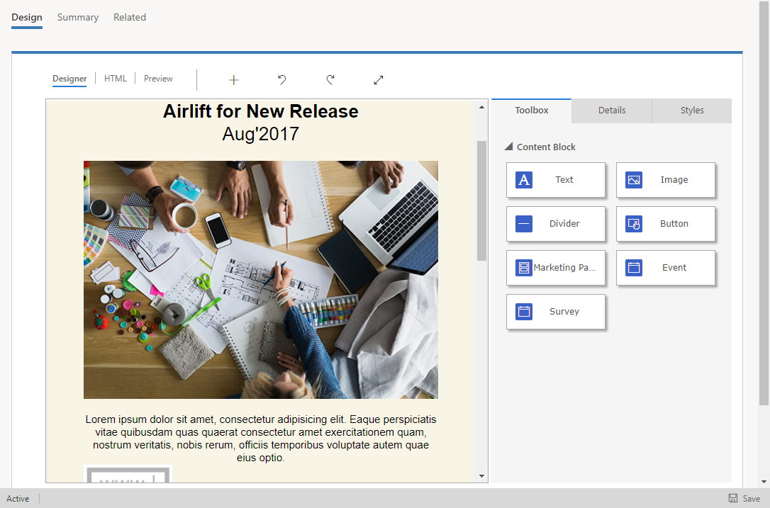
Canvas (editable preview)
Toolbox

