Slide 1
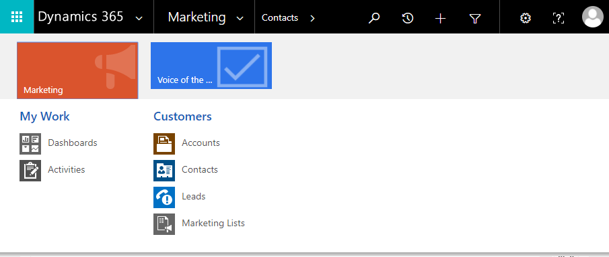
Open the app selector
Open the Surveys navigator (shown)

