Slide 1
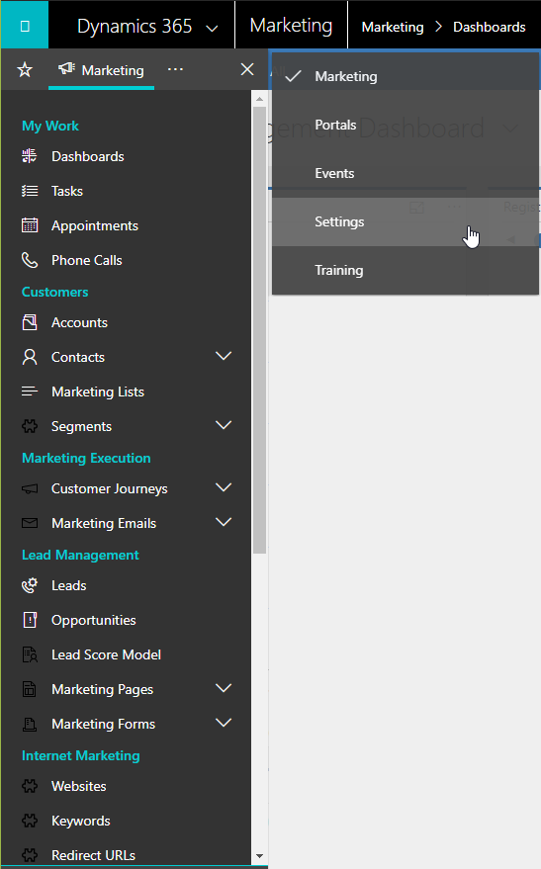
Open favorite entities and recent records
View all entities in the current work area (shown)
Open the work-area menu (shown)
Collapse the navigator to the dock
Navigate to other work areas
Navigate to entites in the current work area (or favorites)
Expand to see recent records for this entity

