Slide 1
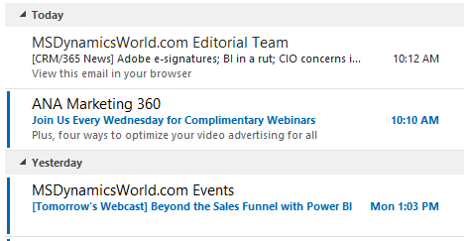
Sender name
Message subject
Preview text

