Slide 1
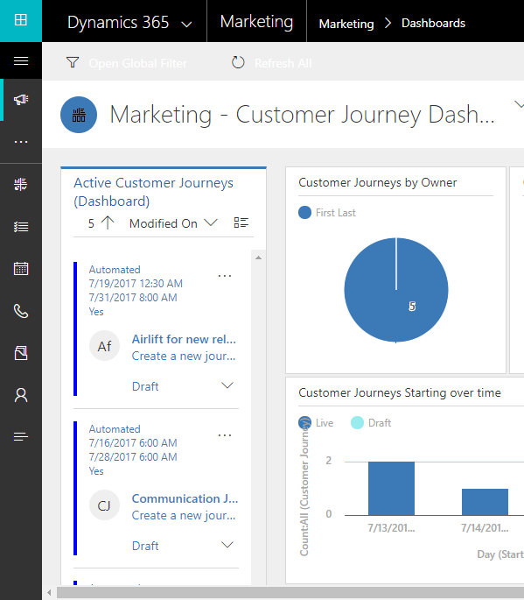
Open the app-selector menu
Expand the navigator
Open the work-area menu
Quick links to most-used features

