Slide 1
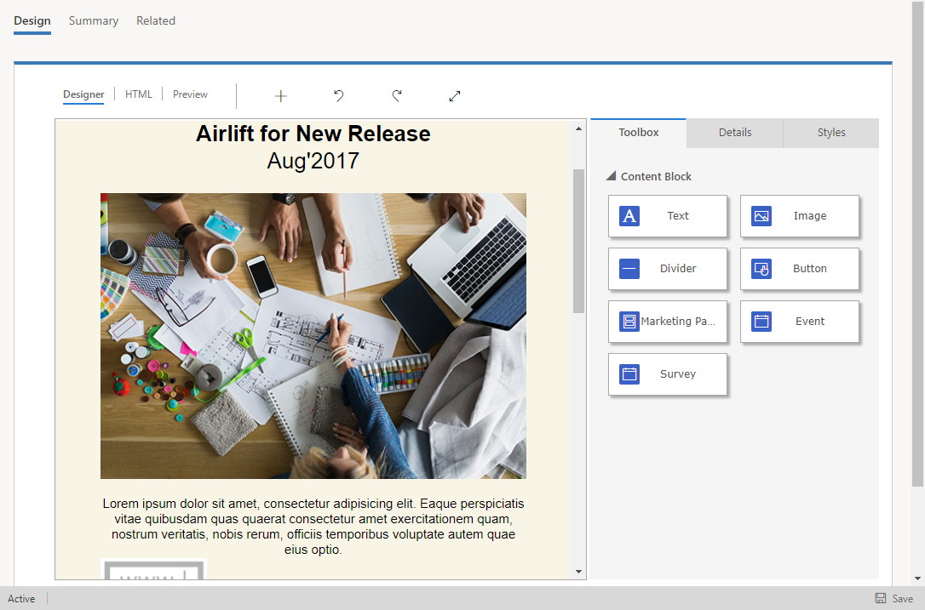
Tabs
Toolbar
Content area

