Slide 1

Unblock Yourself
Miki Tebeka
mtebeka@qualcomm.com

Slide 2
How to overcome a writer’s block

Slide 3
It can happen to anyone

Slide 4
Usually, it looks like

Slide 5
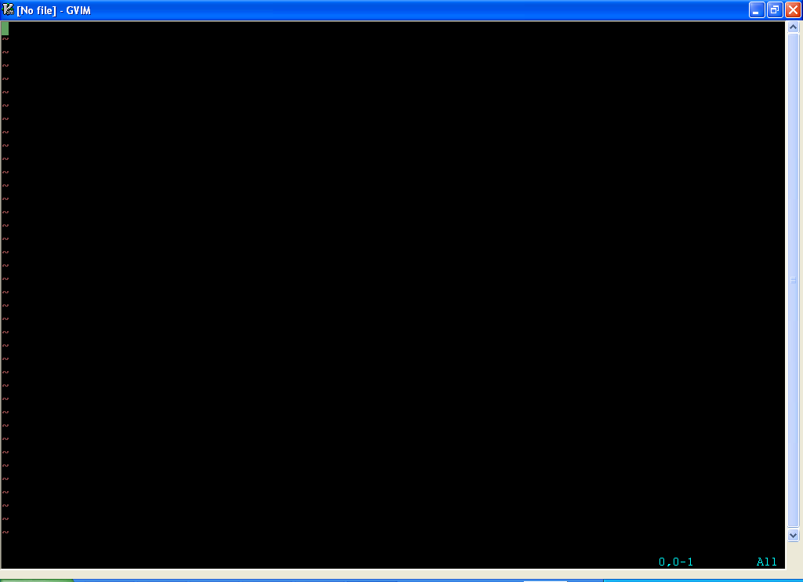

Slide 6
Yes, I work in vi

Slide 7
Actually, it’s VIm

Slide 8
Can’t seem to find a better editor…

Slide 9
However I digress

Slide 10
Back to the issue

Slide 11
We were at

Slide 13
Then you might

Slide 14
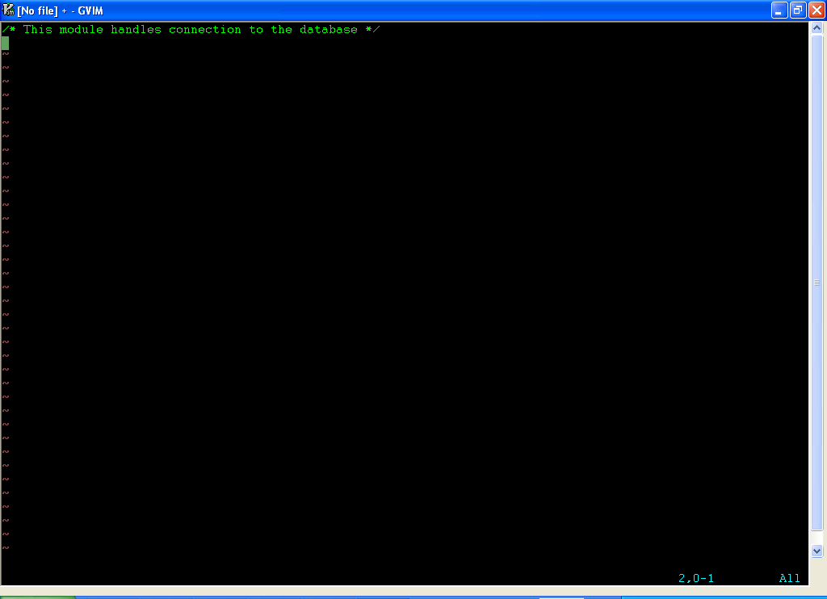

Slide 15
And then even

Slide 16
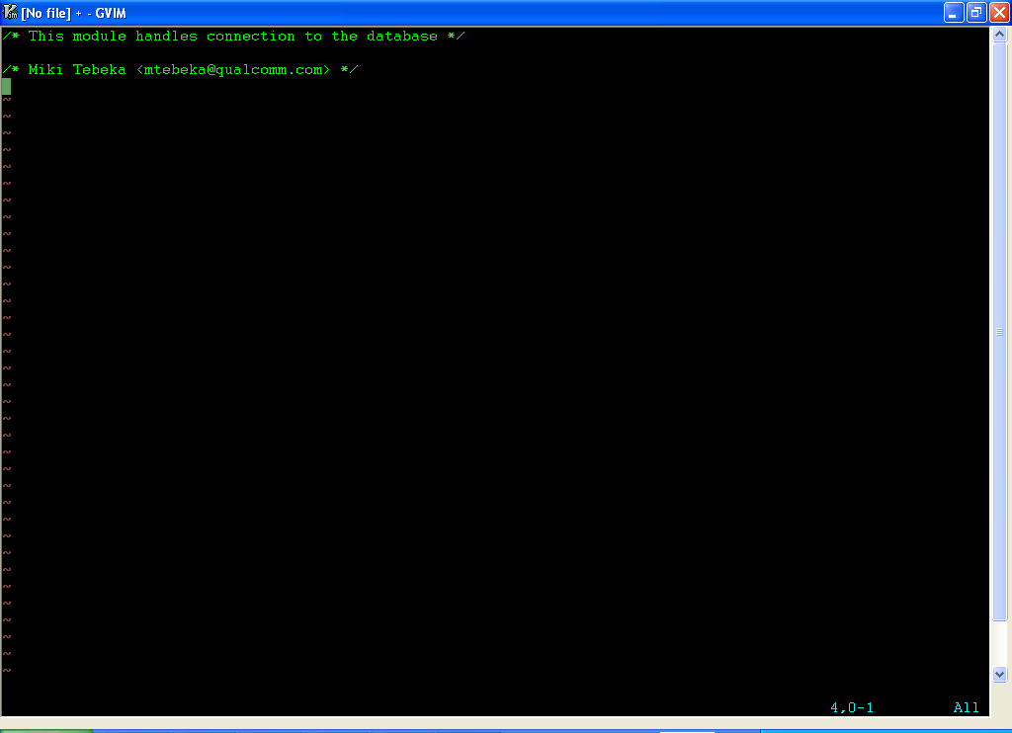

Slide 17
After that, all you can do is

Slide 18
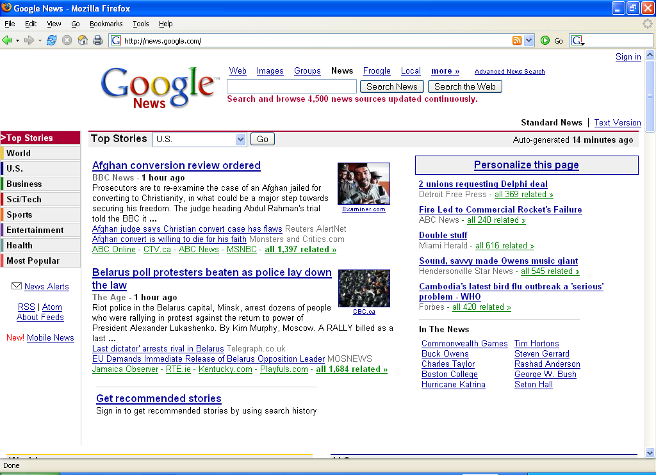

Slide 19
maybe even

Slide 20
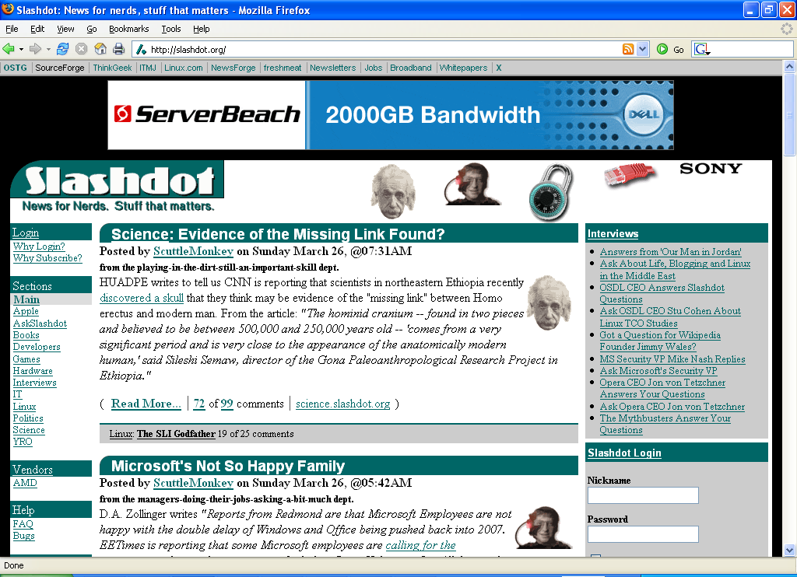

Slide 21
Males can try

Slide 22
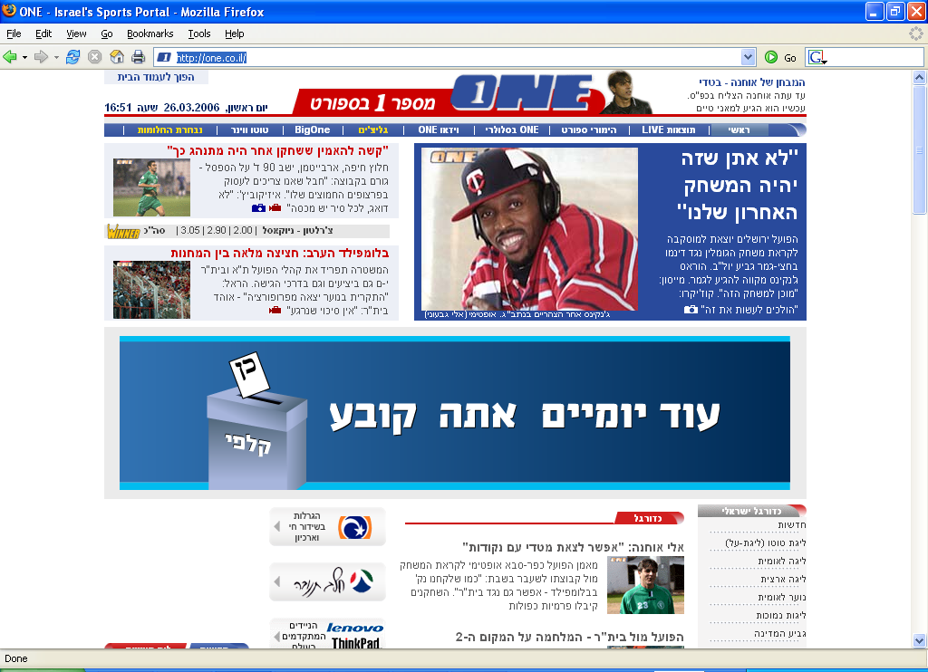

Slide 23
But things can come to

Slide 24
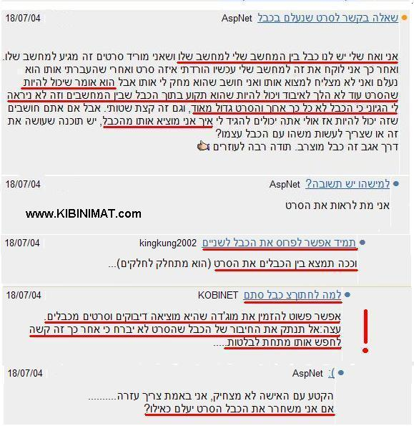

Slide 25
and we don’t want that

Slide 26
Sometimes

Slide 27
it can be a good thing

Slide 28
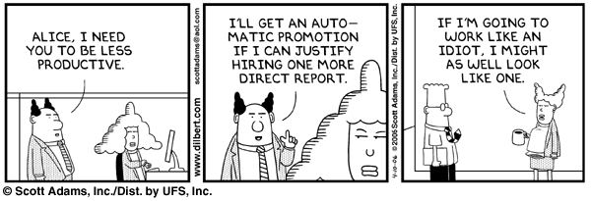

Slide 29
However

Slide 30
Most of the time it’s a problem

Slide 31
So what can we do?

Slide 32
Fools comfort:
You’re not alone

Slide 33
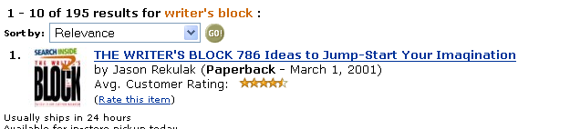

Slide 34


Slide 35


Slide 36


Slide 37


Slide 38
But

Slide 39
Between all these books

Slide 40
And my writer’s block

Slide 41
Not much work is going to happen

Slide 42
So

Slide 43
Solution 1:
Get away for a while

Slide 44
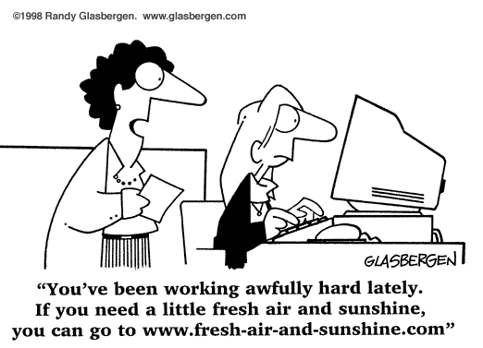

Slide 45
What?
In the middle of work?

Slide 46
Well, you’re not doing anything useful right now

Slide 47
Solution 2:
Write something on the side

Slide 48
A simple test is a good option

Slide 49
Just to get you going

Slide 50
Solution 3:
Find out what is blocking you

Slide 51
Is it bad design?

Slide 52
Is it bad specification?

Slide 53
Is it
…?

Slide 54
When you find the real cause

Slide 55
Fix it first and try again

Slide 56

Solution 4:

Slide 57
A.K.A
“Rubber Ducky”

Slide 58
Just talk to someone

Slide 59
About the problem,
that is

Slide 60
(rubber ducks are great listeners)

Slide 61
Do not call a meeting

Slide 62
This will create more unproductive people

Slide 63
Solution 5:
Work in your active hours

Slide 64
I’m an evening person

Slide 65
I try not to do anything demanding before lunch

Slide 66
(Resting after lunch is also good ☺)

Slide 67
Solution 6:
Divide and conquer

Slide 68
A big task seems daunting

Slide 69
Break it to small chunks

Slide 70
1 hour or less each

Slide 71
Solution 7:
Sketch

Slide 72
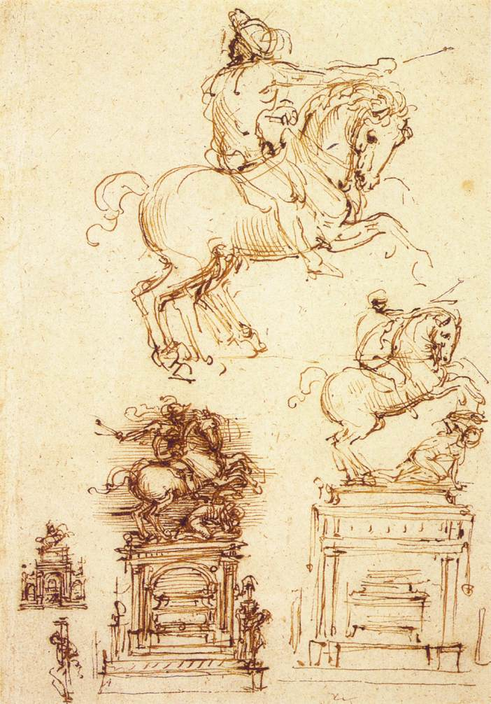

Slide 73
If it was good for Da Vinci …

Slide 74
To overcome the “wrong path” fear

Slide 75
Sketch UI

Slide 76
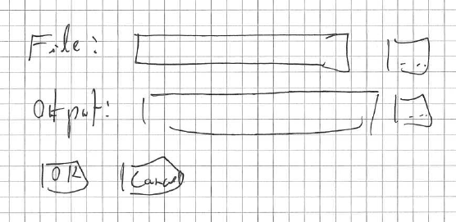

Slide 77
Sketch code in your favorite agile language

Slide 78
{-|
The entry point of Pugs. Uses 'Pugs.Run.runWithArgs' to normalise the command-line
arguments and pass them to 'run'.
-}
pugsMain :: IO ()
pugsMain = mainWith run
…

Slide 79
(Welcome to Perl6)

Slide 80
Personally,
I don’t use Haskell

Slide 81
After the sketch is done

Slide 82
Rewrite in your “production” language

Slide 83
or

Slide 84
Make sketch language your production language

Slide 85
Solution 8:
Brainstorm

Slide 86
Good for group writer’s block

Slide 87
Everyone in same room talking

Slide 88
Almost no tools

Slide 89
Blackboard is usually enough

Slide 90
Solution 9:
Isolate yourself

Slide 91
Close
email client

Slide 92
Close
web browser

Slide 93
Close
IM

Slide 94
Close
the phones

Slide 95
Close
the door

Slide 96
Now focus ☺

Slide 97
That’s about it.

Slide 98
What is your solution?

Slide 99
Resources

Slide 100
The Art in Computer Programming

Slide 101
Fire And Motion

Slide 102
Slashdot discussion

