Slide 1
Uncomment Your Code
Miki Tebeka
miki.tebeka@gmail.com

Slide 2
Only 90 slides!

Slide 3
Relax, it’ll be over faster than you think

Slide 4
I’ve read an article

Slide 5
Yes, at work

Slide 6
Thought it might interest you

Slide 7
It’s about not commenting your code

Slide 8
which will make it better

Slide 9
A quote

Slide 10
“Always write code as if the maintenance programmer were an axe murderer who knows where you live.”
Mike Dunn

Slide 11
He wasn’t joking

Slide 12


Slide 13
Meet Donald E. Knuth

Slide 14
Don’t ask “who is he?”

Slide 15
Another quote

Slide 16
“If something can be described in the language itself, one should do that, and not just mention it in a comment.”

Slide 17
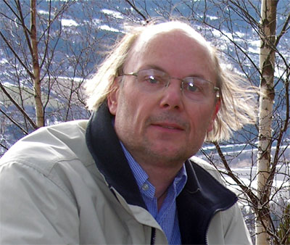

Slide 18
This is Bjarne Stroustrup

Slide 19
Hope you know who he is

Slide 20
Last quote (for now)

Slide 21
“Do not comment bad code, rewrite it”

Slide 22
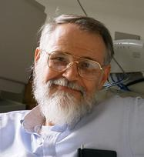

Slide 23
This is Brian W. Kernighan

Slide 24
Not so frightening as the other two

Slide 25
Let’s get dirty

Slide 26
class Badge:
‘’’Stores information printed on person Badge
‘’’
…

Slide 27
Looks OK?

Slide 28
How about…

Slide 29
class InfoOnBadge:
…

Slide 30
Wait, there’s more

Slide 31
class InfoOnBadge: def __init__(self, pid, name): self.pid = pid # Person ID self.name = name # Person Name

Slide 32
can become

Slide 33
class InfoOnBadge: def __init__(self, personID, personFullName): self.personID = personID self.personFullName = personFullName

Slide 34
We can do the same to parameters

Slide 35
def new_badge_info(id):
‘’’Create new badge information
`id’ is the person id’’’
…

Slide 36
will become

Slide 37
def new_badge_info(person_id):
…

Slide 38
Also

Slide 39
def new_badge_info(person_id):
# Load from database db = conect_to_database()
…

Slide 40
Can be improved to

Slide 41
def new_badge_info(person_id): db = load_from_database(person_id)
…

Slide 42
Also delete useless comments

Slide 43
# Open the file infile = open(“some_file”)

Slide 44
turns to

Slide 45
infile = open(“some-file”)

Slide 46
Why delete the comments?

Slide 47
We take shortcuts

Slide 48
and write comments

Slide 49
(which is easy)

Slide 50
to explain unclear code

Slide 51
instead of writing clear code

Slide 52
(which is hard)

Slide 53
Problem is

Slide 54
code always gets updated

Slide 55
but comments only sometimes

Slide 56
So we get unclear code

Slide 57
with outdated comments

Slide 58
Not the place we want to be

Slide 59
However don’t take this extreme

Slide 60
def findStockItemsFromOverseasWithInventoryLessThan10():
…

Slide 61
We can either

Slide 62
def findStockItems( isFromOverseas, maxInventory):
…

Slide 63
or state the reason for the constraints

Slide 64
def findStockItemsToReplenish():
…

Slide 65
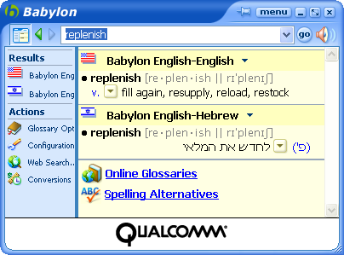

Slide 66
Comments are not all bad

Slide 67
Good for the “big picture”

Slide 68
and

Slide 69
Sometime we do write tricky code

Slide 70
Just make sure it’s absolutely necessary

Slide 71
To quote a wise person

Slide 72
“If the implementation is hard to explain, it's a bad idea.”

Slide 73
“If the implementation is easy to explain, it may be a good idea.”

Slide 74
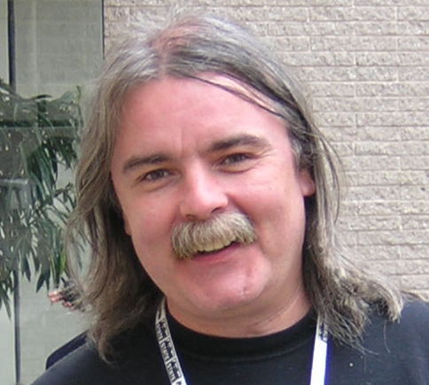

Slide 75
This was
Tim Peters

Slide 76
I don’t expect you to know him

Slide 77
The quote is from the Python Zen

Slide 78
Yes, there is such a thing

Slide 79
Now go and terminate these comments

Slide 80
Or

Slide 81
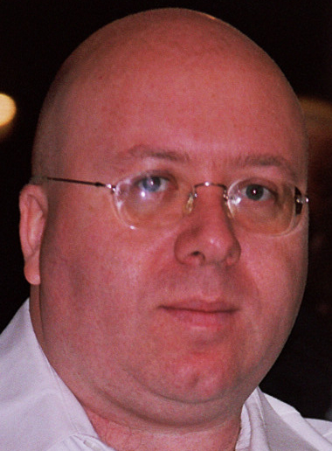

Slide 82
will come after you

Slide 83
with an axe

Slide 84
And he does know where you live

Slide 85
References

Slide 86
C2 Wiki
Treat Comments With Suspicion

Slide 87
“Turning Comment into Code” by Kent Tong
Objective View, 8th edition

Slide 88
Python Zen
(url or import this)

Slide 89
“Programming language inventor or serial killer” test

Slide 90
Thank You

