Slide 1

MOKHELE
IT SOLUTIONS
Reliable technology support for small businesses and the people behind them.
UPDATED BUSINESS PROPOSAL / 2026
Sifiso Mokhele | Founder
18 years of support experience • Remote and on-site delivery • South Africa
01

Slide 2

THE OPPORTUNITY
Small businesses need a dependable IT partner.
Technology problems cost time, revenue, and confidence.
The friction
Slow troubleshooting, unreliable devices, weak backups, and unclear digital processes pull owners away from growth.
The gap
Teams with 1 to 50 employees need support but often cannot justify a full-time IT technician or enterprise contract.
The response
Mokhele IT Solutions packages practical support, cloud guidance, and basic security into an affordable service.
THE CUSTOMER NEED
The promise
Less downtime. More confidence. A clearer way to work.
MOKHELE IT SOLUTIONS / 02

Slide 3

THE BUSINESS
A lean service business built on earned trust.
The founder's existing capability is the first asset.
18 years
R2k–R5k
Support Analyst experience
Lean startup budget
1–50
Remote + on-site
Employee target businesses
Flexible delivery model
Mission
Affordable, reliable IT support that solves problems quickly, improves productivity, and helps clients maintain secure IT environments.
BUILT ON EXPERIENCE
Home-based and remote support from South Africa, with on-site service where the client needs it.
MOKHELE IT SOLUTIONS / 03

Slide 4
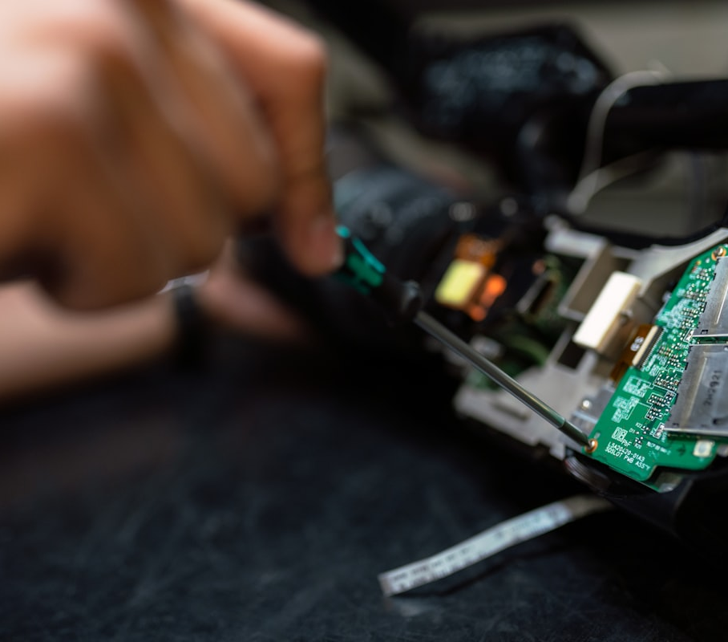
THE OFFER
Practical support across the moments that matter.
A clear service menu makes it easy to buy help and easy to deliver it consistently.
Everyday support
Connected work
Computer and laptop troubleshooting
Performance tune-ups
Virus and malware removal
Wi-Fi and network troubleshooting
Printer and email setup
Remote support
Cloud and continuity
Safer operations
Microsoft 365 setup and administration
Backup and recovery support
User account management
Basic cybersecurity assessments
Phishing and password awareness
Device security checks
PRACTICAL SERVICE DELIVERY
Delivery model
One-off support → Projects → Monthly support plans
MOKHELE IT SOLUTIONS / 04

Slide 5
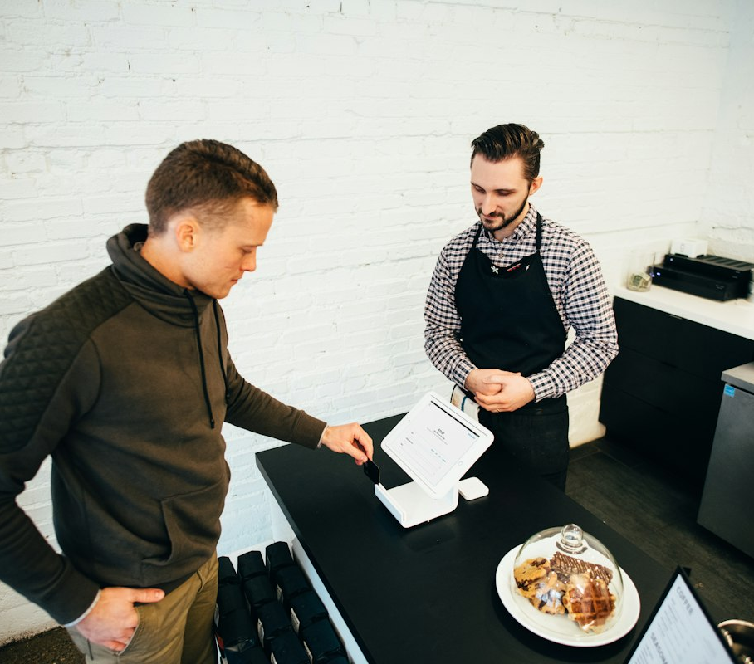
THE MARKET
Start where trust already travels.
A focused local market creates a practical path to the first ten recurring clients.
01
Small businesses
1–50 employees / No in-house IT team
02
Professional offices
Accountants, lawyers / Consultants and practices
03
Community organisations
Churches and NGOs / Local service groups
04
Home users
Remote workers / Families and entrepreneurs
THE PEOPLE WE SERVE
Acquisition starts with the founder's network: former colleagues, church members, friends, family, neighbours, and local business owners.
MOKHELE IT SOLUTIONS / 05

Slide 6
THE MODEL
A price ladder that turns help into continuity.
Accessible entry points create trust; support plans create recurring revenue.
BRONZE
SILVER
GOLD
R500
R1,000
R2,000+
per month
per month
per month
• Remote support
• Everything in Bronze
• Unlimited support
• Monthly health check
• Priority support
• Microsoft 365 administration
• Email assistance
• Backup checks
• Security reviews
• Device management
• Staff assistance
Additional project pricing
Remote support R250–R500/hour • On-site R400–R700/hour • Microsoft 365 setup R1,000–R3,000 • IT audit R1,500–R5,000
MOKHELE IT SOLUTIONS / 06

Slide 7

THE ROUTE TO MARKET
Earn the first five customers, then compound trust.
A simple weekly rhythm keeps the business visible and the pipeline moving.
01
Be findable
WhatsApp Business, LinkedIn, Facebook, a simple website, and business cards.
02
Start warm
Ask the existing network for introductions and share a clear, human service message.
03
Visit locally
Offer a free initial IT health check to professional offices and small businesses.
04
Follow through
Document fixes, check back, request referrals, and invite clients onto a support plan.
TRUST IS THE ADVANTAGE
A free first conversation lowers the barrier; consistent follow-up turns a good first experience into a relationship.
MOKHELE IT SOLUTIONS / 07

Slide 8
THE OPERATING SYSTEM
Small overhead. Repeatable delivery.
The first version of the business can run on tools and habits the founder already understands.
Launch kit
Client workflow
Control points
Reliable laptop
Smartphone and stable internet
Remote-support software
Basic toolkit and documentation
Discover
Diagnose
Resolve
Document
Follow up
Clear quotations
Service records
Backup verification
Invoicing and scheduling
Compliance research
Estimated lean setup
Registration R500–R1,000 • Business cards R300 • Marketing materials R500 • Basic toolkit R500 • Internet and communication: existing
MOKHELE IT SOLUTIONS / 08

Slide 9
THE ECONOMICS
A conservative base case with visible upside.
The business can launch lean, prove demand, and add capacity as recurring revenue grows.
YEAR 1 BASE CASE
GROWTH CASE
10
R10k–R20k
20
R30k
recurring business clients
monthly revenue target
active clients
monthly sales at R1,500 average
Milestones
Growth levers
Months 1–3: register, launch presence, win first 3 customers
Months 4–6: reach 5–10 regular clients, introduce plans
Months 7–12: reach 15–20 clients, add cloud and security services
• More Silver and Gold plans
• Microsoft 365 consulting
• Cybersecurity awareness training
• Computer upgrades and referral partnerships
MOKHELE IT SOLUTIONS / 09

Slide 10

THE ROADMAP
Twelve months from launch to a trusted local partner.
The plan is staged so each milestone funds the next layer of capability.
Q1
Launch
Register the business / Set up digital presence / Win first 3 customers
Q2
Stabilise
Reach 5–10 clients / Introduce support plans / Standardise workflows
Q3
Expand
Add Microsoft 365 / Offer security awareness / Build referral partnerships
Q4
Scale
Reach 15–20 clients / Improve service reliability / Prepare for sustainable growth
THE LONG-TERM VISION
Three-year vision
A trusted, growing IT support business with recurring clients and a strong reputation across local communities and small enterprises.
MOKHELE IT SOLUTIONS / 10

Slide 11

THE NEXT MOVE
Package the expertise.
Prove the value.
Build the relationship.
Mokhele IT Solutions is designed to begin with a low-risk launch and grow through reliable service, recurring support plans, and the trust of every client served.
LET'S BUILD IT
Sifiso Mokhele | +27 64 937 3653 | info@mokheleitsolutions.co.za
www.mokheleitsolutions.co.za
11

