Slide 1
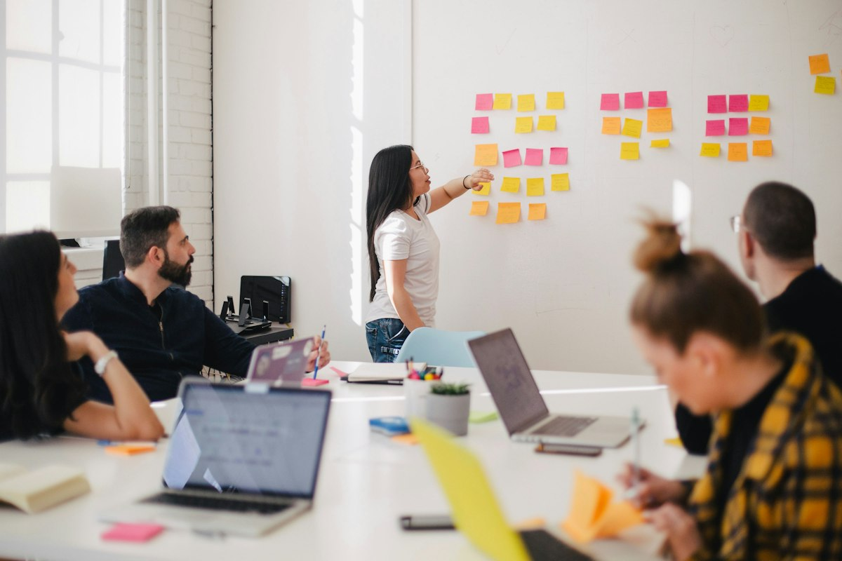
00:20
Sifiso IT Support & Business Solutions
Final Business Presentation | 11 October 2026
• Solving customer problems with dependable IT support
• Building trust, loyalty, and long-term client relationships
• Growing a professional service business with clear systems and value
• Prepared for feedback, Q&A, and the next stage of growth

Slide 2

00:35
1. Customer Need
What problem am I solving?
Small businesses lose time, revenue, and confidence when their devices, systems, or digital processes fail.
Owners often struggle with slow troubleshooting, lack of IT guidance, and poor technology reliability.
The real need is dependable, affordable support that keeps business operations running smoothly.
We solve this by reducing stress, improving productivity, and helping clients focus on growth.

Slide 3
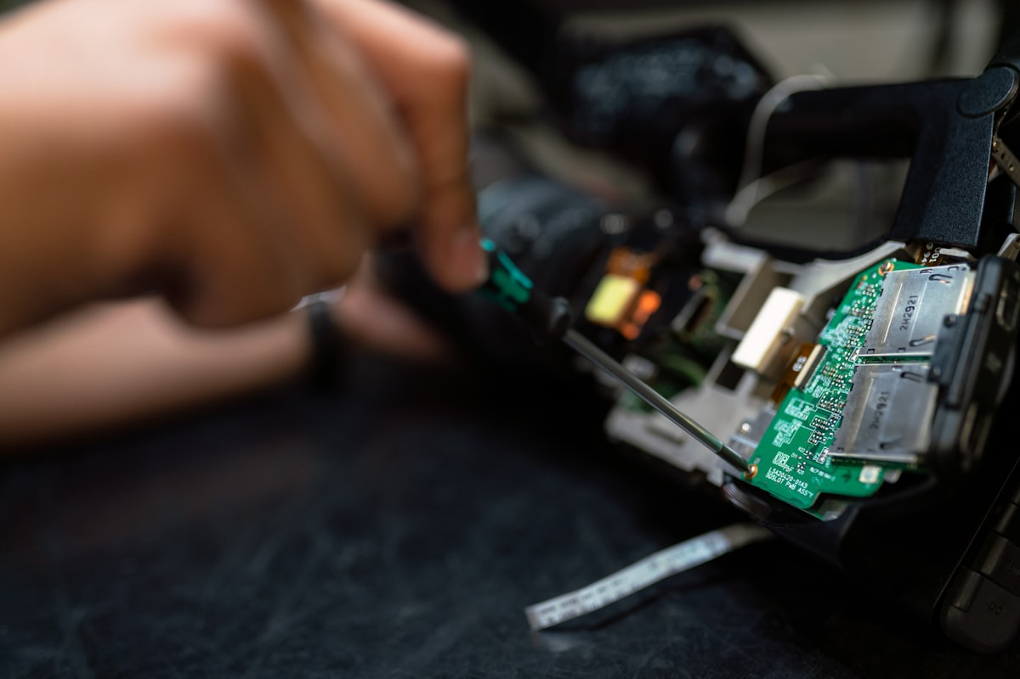
00:45
2. Product / Service
What exactly do I sell?
I provide practical IT support and digital systems assistance for small businesses, entrepreneurs, and home-based operations.
Core services include troubleshooting, setup, maintenance, cloud and file support, digital process guidance, and service follow-up.
Service model: one-off support, monthly retainers, and package-based subscriptions for ongoing reliability.
This gives clients a simple, valuable solution: less downtime and more confidence in how they work.

Slide 4

00:40
3. Competitive Advantage
Why am I different or better?
Customer-first service with clear communication and practical solutions.
Reliable support for non-technical business owners who need simple, effective help.
Flexible packages that match real business needs, not expensive one-size-fits-all plans.
Trust-based relationships create repeat business, referrals, and a lasting reputation.

Slide 5
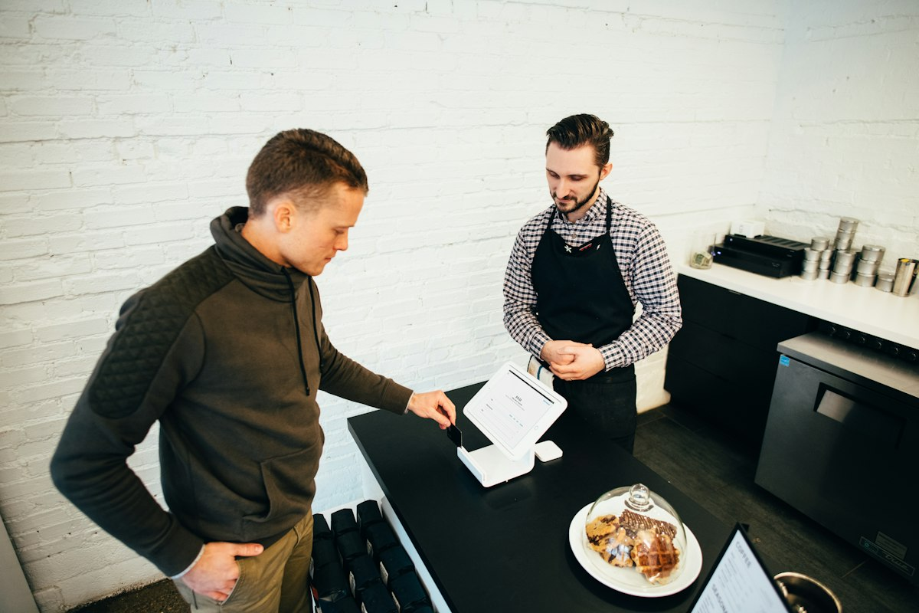
00:35
4. Target Customers
Who do I serve?
Small business owners who are busy and do not have an in-house IT team.
Freelancers, home-based businesses, small offices, and service-driven companies with basic digital needs.
Clients who value professionalism, responsiveness, and clear technical support.
Priority market: local professionals, startups, and growing businesses that need dependable support.

Slide 6
00:45
5. Inclusive Pricing & Access
Affordability is part of the customer need, not an afterthought
Some individuals and micro-businesses need IT help but cannot afford large once-off fees or full monthly retainers.
Offer a low-cost essential support session, clear quotations, and a payment plan where appropriate.
Use remote support, reusable checklists, and group guidance to keep delivery costs low without lowering service quality.
Retainer and premium business clients help subsidise accessible support while referrals build a wider customer base.
Essential session
Starter package
R 350 / 45 min
R 750 / month
Business retainer
Access principle
R 2,500 / month
Value before volume

Slide 7
00:45
6. Acquisition Plan
How will I get attention and make sales?
Use referrals, online visibility, networking, and direct outreach to local businesses.
Create a simple digital presence through social channels, WhatsApp, and a business website.
Offer a free discovery call or quick diagnostic session to build trust and show value.
Turn satisfied clients into advocates through consistent service, follow-up, and repeat support.

Slide 8
00:35
7. Required Resources
What do I need to launch and maintain the business?
Reliable laptop, smartphone, stable internet, and essential productivity tools.
Basic diagnostic software, backup systems, and case management or documentation workflows.
Initial working capital for branding, networking, communication tools, and service delivery costs.
Simple systems for invoicing, scheduling, client communication, and service tracking.

Slide 9
00:40
8. Evidence of Profitability
How will the business make money?
Revenue comes from support fees, monthly retainers, troubleshooting packages, and service subscriptions.
Profitability depends on keeping costs low while delivering dependable value and trusted client service.
Simple pricing model: set fee + hourly support + optional premium maintenance packages.
The goal is steady recurring revenue and a sustainable client base built on trust.

Slide 10
01:00
9. Startup Cost & Operating Cost Model
The business must be realistic, sustainable, and investable
Equipment & tools
Website & branding
Marketing
Software & admin
R 18,000
R 6,500
R 7,000
R 5,000
Owner time cost
Monthly ops
Working capital
R 7,500 / month
R 11,000 / month
R 10,000
Estimated setup cost: R 46,500 | Estimated monthly operating cost: R 18,500 (including owner time equivalent and core business run costs)

Slide 11
01:10
10. Revenue Model & Sales Forecast
How the business creates dependable sales and growth
Clients
Average monthly fee
Monthly sales
Annual revenue target
20 active clients
R 1,500/client
R 30,000
R 360,000
High-value support plan
Service package growth
R 2,500 / client
12-18 clients added
Revenue growth model: steady recurring support fees + premium add-on services + referrals = sustainable monthly income and predictable sales.

Slide 12
01:15
11. One Customer Sale: Unit Economics
A transparent calculation based on Chapter 4 value, costs, pricing, and Chapter 5 customer retention
Customer sale price
Owner time
Time cost
Direct delivery cost
R 3,000
6 hours x R250
R 1,500
R 300
Revenue: R3,000 sale
Less cost of owner time: 6 hours x R250 = R1,500
Less direct delivery, software, data, travel and payment costs: R300 + R200 = R500
Profit per sale: R3,000 - R1,500 - R500 = R1,000 | Profit margin: R1,000 / R3,000 = 33.3%
Monthly fixed overhead
Break-even calculation
Break-even point
R 11,000
R11,000 / R1,000
11 sales / month

Slide 13
01:15
12. Investor Value, Profitability & Reinvestment
A business that can become self-sustaining and scale responsibly
Investment needed
Annual revenue goal
Gross margin
Operating costs
R 75,000
R 540,000
65%
R 195,000
Estimated profit
Investor return
R 156,000
30% equity / profit share
Reinvestment plan: 40% of profits back into sales and service upgrades, 30% reserved for business stability, and 30% distributed to investors or used to expand the client base.

Slide 14

00:45
13. Chapter 11 Focus
Vision, operations, compliance, leadership, and SMART goals
Vision: in three years, I want a trusted, growing IT support business with recurring clients and a strong reputation.
Operations: I will document workflows, service steps, and customer communication systems with consistency.
Compliance: I will research local licensing, registration, and business regulations from the beginning.
SMART goals: establish recurring revenue, increase client base, and improve service reliability by set milestones.

Slide 15

00:30
Final Message
This business is not just about technical support; it is about building trust, reducing operational risk, and creating measurable value for clients.
It is a realistic, investable business model with clear costs, sustainable revenue, and a scalable path to long-term profit.
The business can become self-sustaining through recurring revenue, reinvestment, and disciplined growth, while giving investors both value and return.
Thank you for listening. I welcome your feedback, partnership discussions, and next-stage investment conversations.

