Slide 1
Cyclistic Bike-Share Case Study
Analyzing Member vs Casual Rider Behavior
Prepared for Portfolio Showcase
Prepared by: Muhammad Kamran

Slide 2
Agenda
• Business Task
• Data & Methods
• Key Metrics
• Visual Insights
• Recommendations

Slide 3
Business Task
• Understand how annual members and casual riders use bikes differently
• Develop strategies to convert casual riders into annual members
• Provide data-driven recommendations for marketing campaigns

Slide 4
Data & Methods
• Dataset: 12 months of synthetic trip data (emulating Divvy/Cyclistic)
• Fields engineered: ride_length_min, day_of_week, hour, month
• Filtering: removed non-positive rides and >24h durations
• Analysis: aggregations by user type, day, month, hour

Slide 5
Key Metrics
• Total rides: ~108,000
• Members: ~60% | Casuals: ~40%
• Avg ride length: Members ~12 min | Casuals ~27 min
• Members peak in commute hours; Casuals on weekends & afternoons

Slide 6
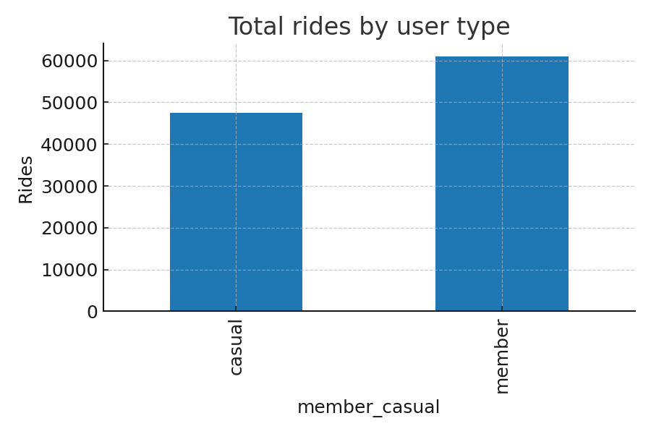
Total Rides by User Type

Slide 7
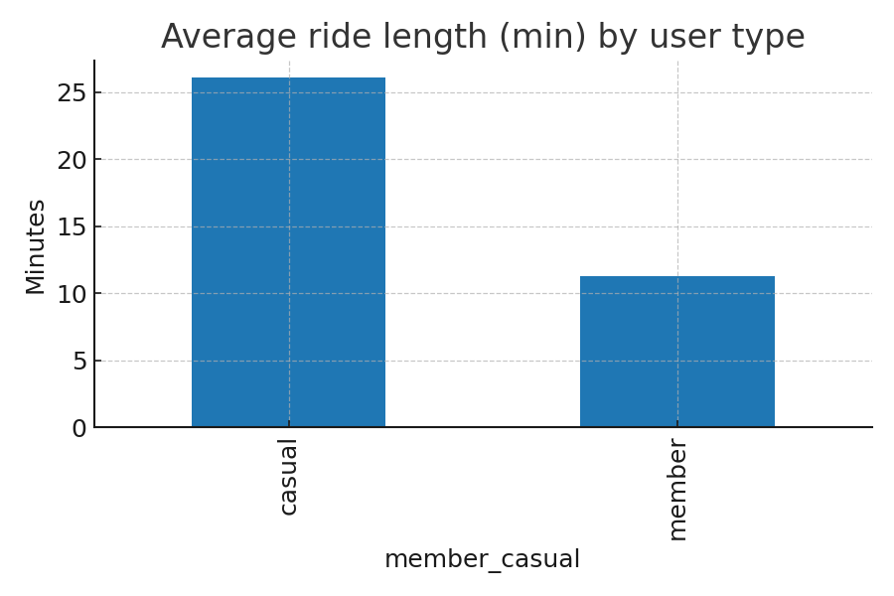
Average Ride Length by User Type

Slide 8
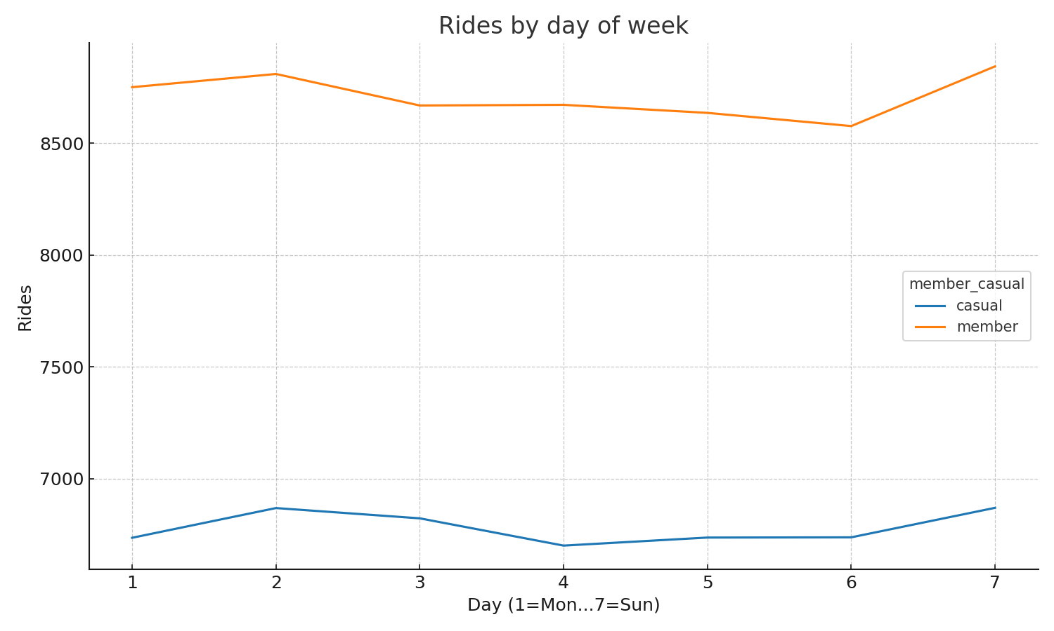
Rides by Day of Week

Slide 9
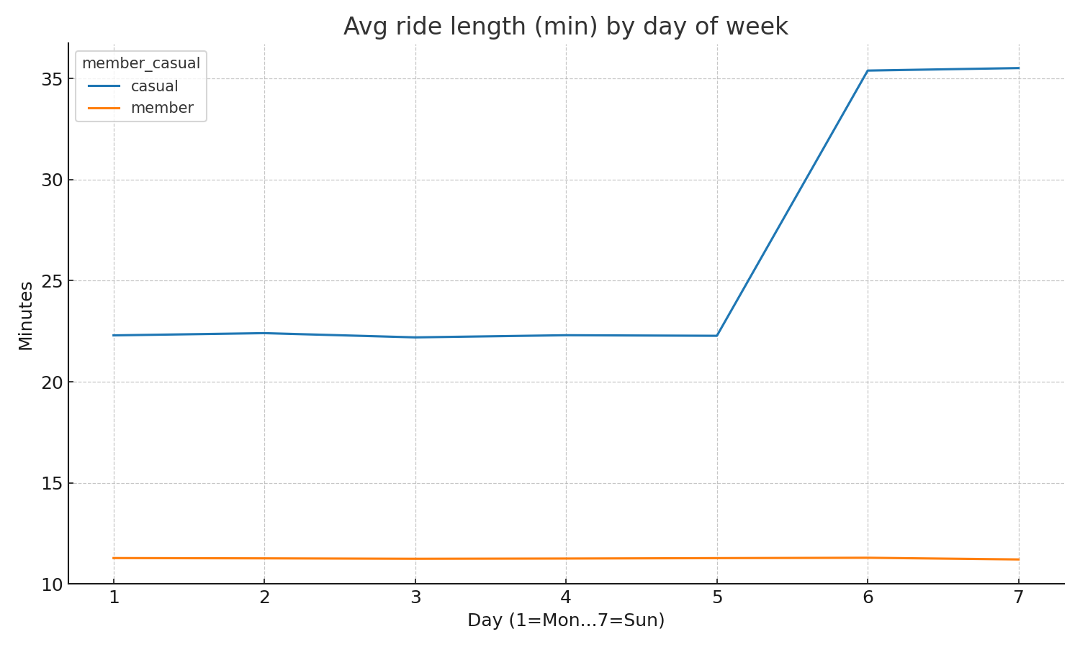
Average Ride Length by Day of Week

Slide 10
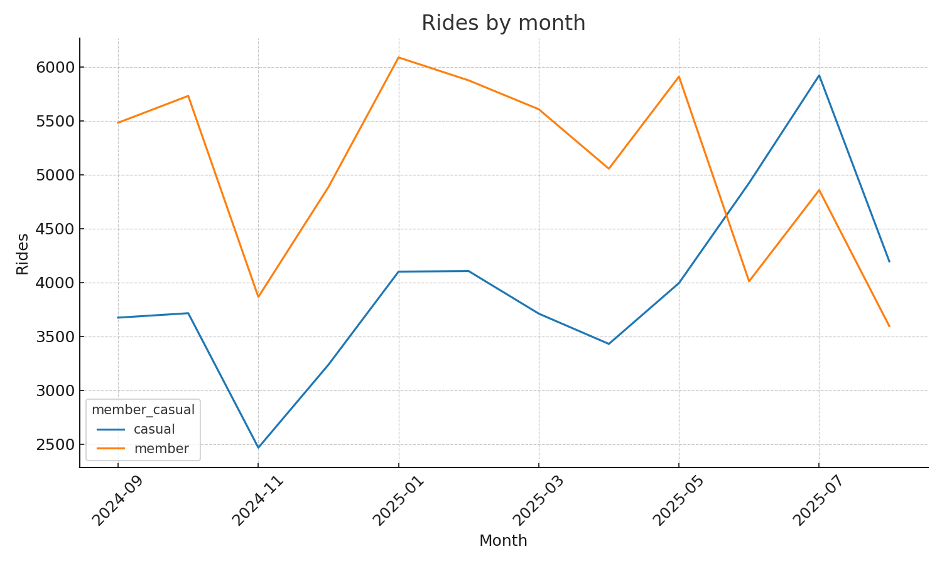
Rides by Month

Slide 11
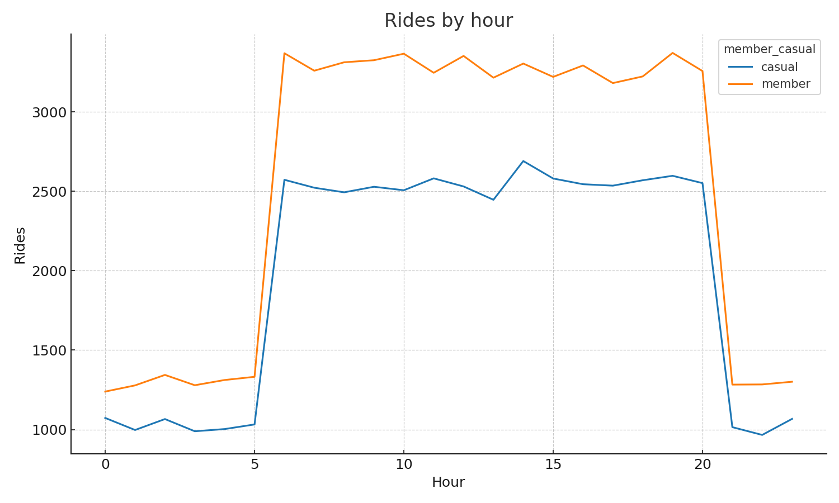
Rides by Hour of Day

Slide 12
Recommendations
1. Weekend-to-Member Trial: Offer weekend casuals a low-cost trial membership
2. In-App Upgrade Nudges: Show savings after long rides to push membership
3. Seasonal Geo-Targeted Campaigns: Target high casual-traffic stations in summer

Slide 13
Conclusion
• Distinct riding patterns between members and casuals provide clear opportunities
• Focused strategies can effectively convert casual riders into long-term members
• Data-driven approach ensures marketing resources are invested where impact is highest

