Slide 1

Statistics Without Borders
(Maximizing Model Performance through Optimization)
Ernesto L. Garcia C., PhD

Slide 2





Model creation process
Data
Data
Pre-processing
Learning
Engine
(“Algo”)
Model
Evaluation
How machine learns to perform tasks from data
@SWBprobono StatisticsWithoutBorders.org
Notes:
Notes: Automated Machine Learning. The ideal.

Slide 3
Notable points
Model ≠ Learning Engine.
The learning engine or “algo” takes data as input and outputs a model.
The model has parameters that control its behavior. These parameters are obtained by the learning engine.
The learning “algo” has hyperparameters. These hyperparameters control the behavior of the leaning engine and are mostly determined by humans.
Learning Engine
Model
Hyperparameters
Parameters
@SWBprobono StatisticsWithoutBorders.org
Notes:
Notes:

Slide 4
Hyperparameters (H) and Parameters (P)
Parameters (P) | Hyperparameters (H)
Required to make predictions with the model | Necessary to estimate model parameters
Estimated by optimization algorithms (e.g., Stochastic Gradient Descent, Batch Gradient Descent, Minibatch Gradient Descent) | Estimated by hyperparameter tuning
Not set “manually” | Set “manually”
The final parameters will decide model’s performance with new data | Choice of H determines how efficient the training is
@SWBprobono StatisticsWithoutBorders.org
Notes:
Notes:

Slide 5
Automated Machine Learning
Human experts perform:
Feature extraction, also called: Feature Engineering
Algorithm selection
Hyperparameter selection
Evaluation, adjustments and maintenance of the model
Automated Machine Learning is the automation of one or more of the activities from the process above.
@SWBprobono StatisticsWithoutBorders.org
Notes:
Notes:

Slide 6
Good Model Performance
The choice of preprocessing tasks (P), learning engine (Le), and hyperparameters (H) are vital for good model performance. We’ll cover the basics of hyperparameter optimization in this presentation and study some python examples.
Performance=f(P, Le, H)
@SWBprobono StatisticsWithoutBorders.org
Notes:
Notes: Evaluation mechanism allows the distinction of good from bad. Search algorithm provides a good trade-off or good solution vs resources. Search space are all the values that the search algorithm can potentially look.

Slide 7
Hyperparameter tuning or optimization
Hyperparameter tuning (or hyperparameter optimization) is the process of finding the combination of hyperparameters that maximizes model performance.
It works by running multiple trials in a single training process. Each trial is a complete execution of the learning engine with hyperparameters set at specific values within selected limits. This process, once finished, provides the set of hyperparameter values that are best suited for optimal model performance.
If you want to know more: https://arxiv.org/pdf/2007.07588.pdf
@SWBprobono StatisticsWithoutBorders.org
Notes:
Notes:

Slide 8
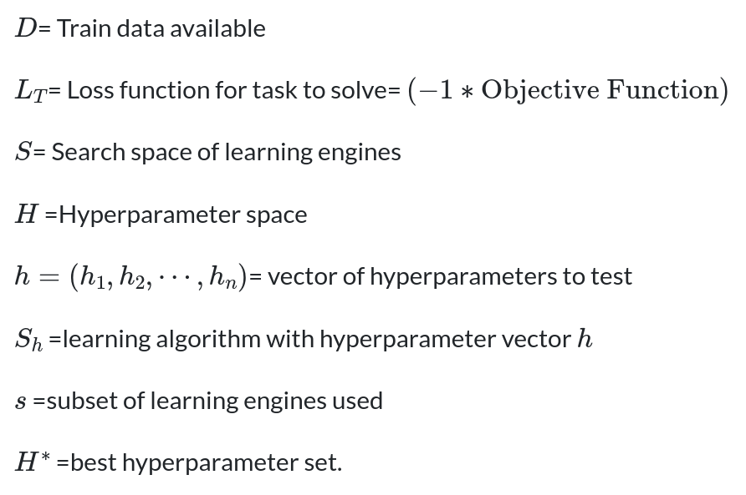

Mathematical representation : CASH
CASH: Combined Algorithm Selection
And Hyperparameter Optimization
@SWBprobono StatisticsWithoutBorders.org
Notes:
Notes:

Slide 9

When the learning “algo” is a hyperparameter: HPO
Evaluation Mechanism
Search Space
Search Algorithm
In this case, the type of machine learning algorithm used is a hyperparameter
HPO: Hyperparameter Optimization
@SWBprobono StatisticsWithoutBorders.org
Notes:
Notes:

Slide 10
Approaches to Hyperparameter tuning

Slide 11


Preliminaries
Chosing the right combination of hyperparameters requires a good understanding of the hyperparameter values that an algorithm engine can have.
It also helps to know the problem or task we are solving.
There are two basic approaches:
Manual tuning
Automated tuning
@SWBprobono StatisticsWithoutBorders.org
Notes:
Notes:

Slide 12
Manual tuning
The person experiments with different sets of H manually, maybe performing an experimental design.
Advantages | Disadvantages
The analyst retains control of the process | It is very tedious, time consuming, and difficult to keep track of all the combinations analyzed
If the analyst is researching the effect of tuning on the model, this might be the way to go | It is not a practical approach. In big data and real-world problems there are too many hyperparameters to consider
Do you want to know more?: https://machinelearningmastery.com/manually-optimize-hyperparameters/
@SWBprobono StatisticsWithoutBorders.org
Notes:
Notes:

Slide 13
Automated tuning
Specify the set of hyperparameters and their range of their values.
An automated method or algorithm selects the best combination using heuristics or specified criteria.
Some of the methods used are:
Random search
Grid search
Tree-structured Parzen Estimator
Successive halving (hyperband)
Bayesian optimization
@SWBprobono StatisticsWithoutBorders.org
Notes:
Notes:

Slide 14
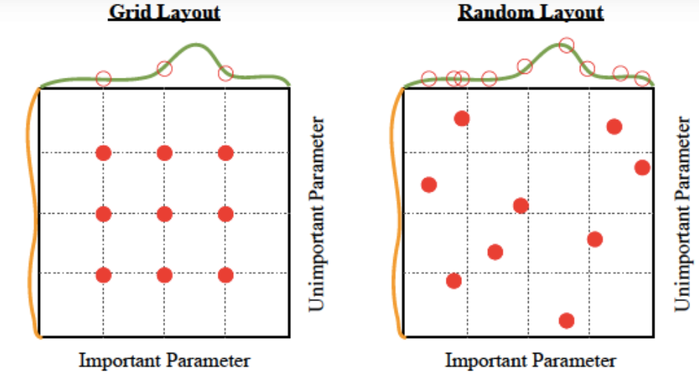
Grid and Random Search
Grid search: brute-force method that exhaustively searches a pre-defined grid of hyperparameter values. It is very thorough, but it is computationally expensive, especially for large hyperparameter spaces.
Random search: Less exhaustive than grid search, also less computationally expensive. Randomly samples hyperparameter values from a pre-defined distribution.
@SWBprobono StatisticsWithoutBorders.org
Notes:
Notes:

Slide 15
Quick description: Bayesian Optimization
It uses a probabilistic model to guide the search for hyperparameter values. More efficient than grid or random search, but it can be more difficult to implement.
Works by first building a probabilistic model of the objective function, typically a Gaussian process. The model is then used to predict the values of the objective function for different hyperparameter configurations. The next hyperparameter configuration to evaluate is chosen by maximizing an acquisition function. The acquisition function is a measure of how likely it is that the next configuration will improve the objective function. The next hyperparameter configuration is repeated until the budget is exhausted or until the desired performance is achieved.
If you want to know more: https://www.nature.com/articles/s41598-023-32027-3
@SWBprobono StatisticsWithoutBorders.org
Notes:
Notes: There are many different acquisition functions that can be used, but some of the most common ones include expected improvement, probability of improvement, and upper confidence bound.

Slide 16
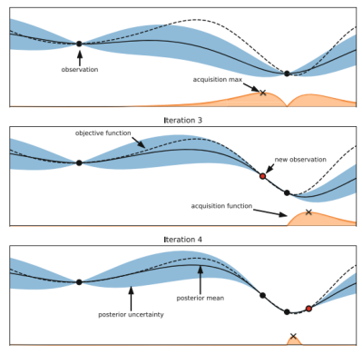
Bayesian Optimization
The graph depicts a Gaussian process approximation of the objective function and an acquisition function in the lower portion.
The mean of the objective function is represented by the solid line and the dashed line represents the actual objective function.
The blue region shows predictive uncertainty. The acquisition function is represented by the orange curve.
@SWBprobono StatisticsWithoutBorders.org
Notes:
Notes:

Slide 17
Tree Structured Parzen Estimator
Bayesian optimization with a twist. Instead of finding the values of p(y|x) where y is the function to be optimized and x is the hyperparameter, TPE models P(x|y) and P(y).
One of the great drawbacks of tree-structured Parzen estimators is that they do not model interactions between the hyper-parameters. That said, TPE works extremely well in practice and was battle-tested across most domains.
If you want to know more: https://www.researchgate.net/publication/216816964_Algorithms_for_Hyper-Parameter_Optimization
@SWBprobono StatisticsWithoutBorders.org
Notes:
Notes:

Slide 18
Hyperband: Bandit based Succesive halving
Hyperband uses a successive halving approach to search the hyperparameter space. The algorithm starts by randomly sampling many hyperparameter configurations. Each configuration is then trained for a fixed number of iterations, and the best-performing configurations are selected to continue training for a longer period. This process is repeated until a maximum budget is reached.
Very efficient algorithm, it can explore a large hyperparameter space with a relatively small number of training runs. It is also very effective algorithm, as it has been shown to outperform other hyperparameter optimization algorithms.
If you want to know more: https://jmlr.org/papers/volume18/16-558/16-558.pdf
@SWBprobono StatisticsWithoutBorders.org
Notes:
Notes:

Slide 19
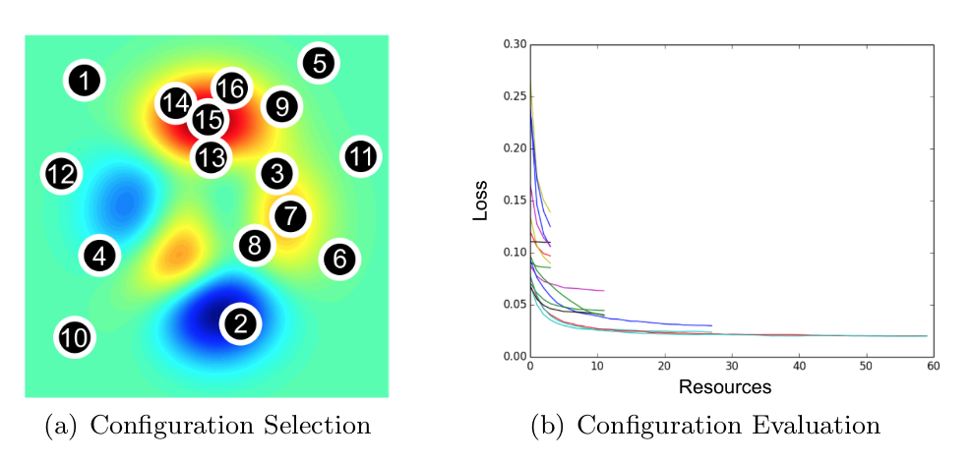
Hyperband: understanding the music
@SWBprobono StatisticsWithoutBorders.org
Notes:
Notes:

Slide 20
Some of the best tools for Hyperparameter tuning
https://neptune.ai/blog/best-tools-for-model-tuning-and-hyperparameter-optimization
https://www.marktechpost.com/2023/07/18/top-tools-platforms-for-hyperparameter-optimization/
@SWBprobono StatisticsWithoutBorders.org
Notes:
Notes:

Slide 21
Examples in Python

Slide 22
Title
Example 1: Multiple regression model with continuous variables
Example 2. Running optimizers
Random search
Grid Search
Hyperband
Bayesian optimization
Example 3. Hyperparameter selection for classification model.
@SWBprobono StatisticsWithoutBorders.org
Notes:
Notes:

Slide 23
References
Aixplained: https://www.youtube.com/@aixplained4763.
Neptune.Ai: https://neptune.ai/blog/hyperparameter-tuning-in-python-complete-guide
@SWBprobono StatisticsWithoutBorders.org
Notes:
Notes:

Slide 24



SWB is grateful for the partnership of [client]
https://StatisticsWithoutBorders.org
Client logo
StatisticsWithoutBorders@gmail.com

