Slide 1
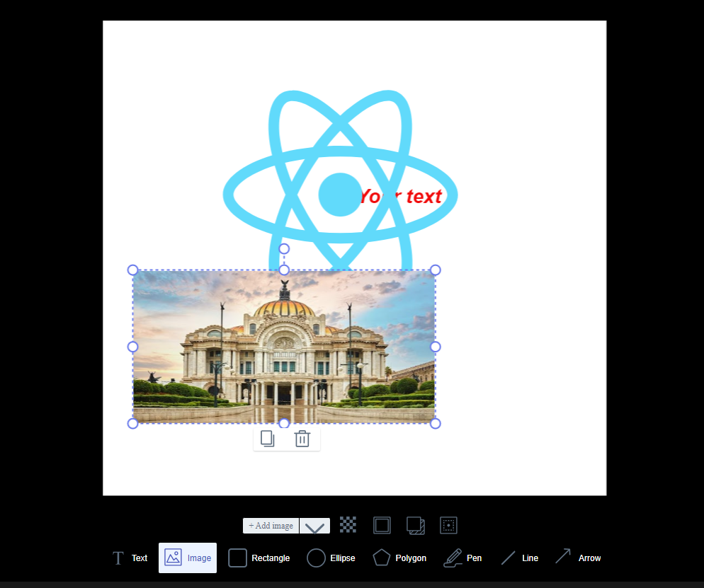
Click to insert text
Click to insert image

Slide 2
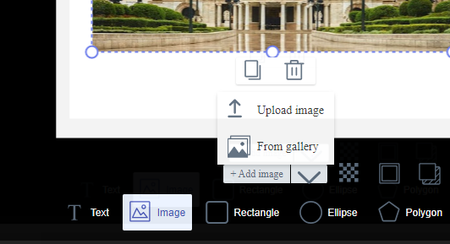
Click to insert image in your local computer
Click to insert image in gallery containing updoaded images

Slide 3
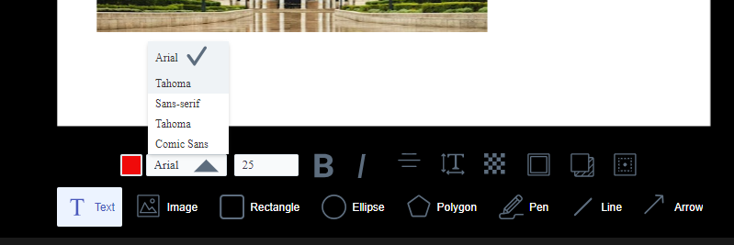
You can set text’s font-family, font-size, color, etc.

Slide 4
I am going to implement follow functionality
-Adjusting image editor’s size to mockup’s size when user selected mockup.
-Uploading images to gallery.
-Display result image when clicked “finalize”.
-Rendering functionality.
-My cover

