Slide 1
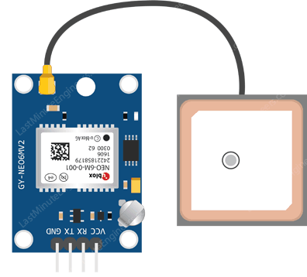
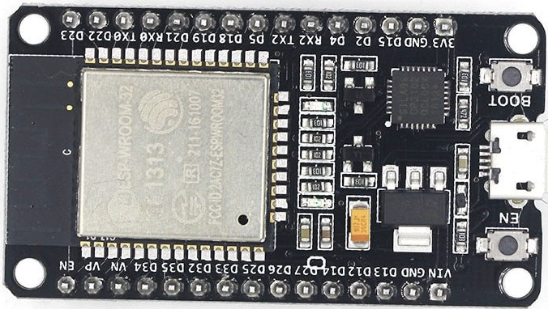
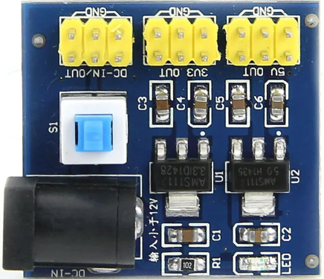
- Ground (GND)
- Input (VCC)
- GPS (TX) – ESP D4
- GPS (RX) – ESP D2

