Slide 1
OPERATING SYSTEM Memory Management

Slide 2
MEMORY MANAGEMENT
Just as processes share the CPU, they also share physical memory. This section is about mechanisms for doing that sharing.
EXAMPLE OF MEMORY USAGE:
Calculation of an effective address
  Fetch from instruction
  Use index offset
Example: ( Here index is a pointer to an address )
loop:
load register, index
add 42, register
store register, index
inc index
skip_equal index, final_address
branch loop
... continue ....

Slide 3
MEMORY MANAGEMENT
Definitions
The concept of a logical address space that is bound to a separate physical address space is central to proper memory management.
  Logical address – generated by the CPU; also referred to as virtual address
  Physical address – address seen by the memory unit
Logical and physical addresses are the same in compile-time and load-time address-binding schemes; logical (virtual) and physical addresses differ in execution-time address-binding scheme

Slide 4
MEMORY MANAGEMENT
Definitions
Relocatable Means that the program image can reside anywhere in physical memory.
Binding Programs need real memory in which to reside. When is the location of that real memory determined?
  This is called mapping logical to physical addresses.
  This binding can be done at compile/link time. Converts symbolic to relocatable. Data used within compiled source is offset within object module.
Compiler: If it’s known where the program will reside, then absolute code is generated. Otherwise compiler produces relocatable code.
Load: Binds relocatable to physical. Can find best physical location.
Execution: The code can be moved around during execution. Means flexible virtual mapping.

Slide 5
MEMORY MANAGEMENT
Binding Logical To Physical
Source
This binding can be done at compile/link time. Converts symbolic to relocatable. Data used within compiled source is offset within object module.
  Can be done at load time. Binds relocatable to physical.
  Can be done at run time. Implies that the code can be moved around during execution.
The next example shows how a compiler and linker actually determine the locations of these effective addresses.
Compiler
Object
Other Objects
Linker
Executable
Libraries
Loader
In-memory Image

Slide 6
MEMORY MANAGEMENT
Binding Logical To Physical
4 void main()
5 {
6 printf( "Hello, from main\n" );
7 b();
8 }
9
10
11 void b()
12 {
13 printf( "Hello, from 'b'\n" );
14 }

Slide 7
MEMORY MANAGEMENT
Binding Logical To Physical
ASSEMBLY LANGUAGE LISTING
000000B0: 6BC23FD9 stw %r2,-20(%sp ; main()
000000B4 37DE0080 ldo 64(%sp),%sp
000000B8 E8200000 bl 0x000000C0,%r1 ; get current addr=BC
000000BC D4201C1E depi 0,31,2,%r1
000000C0 34213E81 ldo -192(%r1),%r1 ; get code start area
000000C4 E8400028 bl 0x000000E0,%r2 ; call printf
000000C8 B43A0040 addi 32,%r1,%r26 ; calc. String loc.
000000CC E8400040 bl 0x000000F4,%r2 ; call b
000000D0 6BC23FD9 stw %r2,-20(%sp) ; store return addr
000000D4 4BC23F59 ldw -84(%sp),%r2
000000D8 E840C000 bv %r0(%r2) ; return from main
000000DC 37DE3F81 ldo -64(%sp),%sp
STUB(S) FROM LINE 6
000000E0: E8200000 bl 0x000000E8,%r1
000000E4 28200000 addil L%0,%r1
000000E8: E020E002 be,n 0x00000000(%sr7,%r1)
000000EC 08000240 nop void b()
000000F0: 6BC23FD9 stw %r2,-20(%sp)
000000F4: 37DE0080 ldo 64(%sp),%sp
000000F8 E8200000 bl 0x00000100,%r1 ; get current addr=F8
000000FC D4201C1E depi 0,31,2,%r1
00000100 34213E01 ldo -256(%r1),%r1 ; get code start area
00000104 E85F1FAD bl 0x000000E0,%r2 ; call printf
00000108 B43A0010 addi 8,%r1,%r26
0000010C 4BC23F59 ldw -84(%sp),%r2
00000110 E840C000 bv %r0(%r2) ; return from b
00000114 37DE3F81 ldo -64(%sp),%sp

Slide 8
MEMORY MANAGEMENT
Binding Logical To Physical
EXECUTABLE IS DISASSEMBLED HERE
00002000 0009000F ; . . . .
00002004 08000240 ; . . . @
00002008 48656C6C ; H e l l
0000200C 6F2C2066 ; o , f
00002010 726F6D20 ; r o m
00002014 620A0001 ; b . . .
00002018 48656C6C ; H e l l
0000201C 6F2C2066 ; o , f
00002020 726F6D20 ; r o m
00002024 6D61696E ; m a i n
000020B0 6BC23FD9 stw %r2,-20(%sp) ; main
000020B4 37DE0080 ldo 64(%sp),%sp
000020B8 E8200000 bl 0x000020C0,%r1
000020BC D4201C1E depi 0,31,2,%r1
000020C0 34213E81 ldo -192(%r1),%r1
000020C4 E84017AC bl 0x00003CA0,%r2
000020C8 B43A0040 addi 32,%r1,%r26
000020CC E8400040 bl 0x000020F4,%r2
000020D0 6BC23FD9 stw %r2,-20(%sp)
000020D4 4BC23F59 ldw -84(%sp),%r2
000020D8 E840C000 bv %r0(%r2)
000020DC 37DE3F81 ldo -64(%sp),%sp
000020E0 E8200000 bl 0x000020E8,%r1 ; stub
000020E4 28203000 addil L%6144,%r1
000020E8 E020E772 be,n 0x000003B8(%sr7,%r1)
000020EC 08000240 nop

Slide 9
MEMORY MANAGEMENT
Binding Logical To Physical
EXECUTABLE IS DISASSEMBLED HERE
000020F0 6BC23FD9 stw %r2,-20(%sp) ; b
000020F4 37DE0080 ldo 64(%sp),%sp
000020F8 E8200000 bl 0x00002100,%r1
000020FC D4201C1E depi 0,31,2,%r1
00002100 34213E01 ldo -256(%r1),%r1
00002104 E840172C bl 0x00003CA0,%r2
00002108 B43A0010 addi 8,%r1,%r26
0000210C 4BC23F59 ldw -84(%sp),%r2
00002110 E840C000 bv %r0(%r2)
00002114 37DE3F81 ldo -64(%sp),%sp
00003CA0 6BC23FD9 stw %r2,-20(%sp) ; printf
00003CA4 37DE0080 ldo 64(%sp),%sp
00003CA8 6BDA3F39 stw %r26,-100(%sp)
00003CAC 2B7CFFFF addil L%-26624,%dp
00003CB0 6BD93F31 stw %r25,-104(%sp)
00003CB4 343301A8 ldo 212(%r1),%r19
00003CB8 6BD83F29 stw %r24,-108(%sp)
00003CBC 37D93F39 ldo -100(%sp),%r25
00003CC0 6BD73F21 stw %r23,-112(%sp)
00003CC4 4A730009 ldw -8188(%r19),%r19
00003CC8 B67700D0 addi 104,%r19,%r23
00003CCC E8400878 bl 0x00004110,%r2
00003CD0 08000258 copy %r0,%r24
00003CD4 4BC23F59 ldw -84(%sp),%r2
00003CD8 E840C000 bv %r0(%r2)
00003CDC 37DE3F81 ldo -64(%sp),%sp
00003CE0 E8200000 bl 0x00003CE8,%r1
00003CE8 E020E852 be,n 0x00000428(%sr7,%r1)

Slide 10
MEMORY MANAGEMENT
More Definitions
Dynamic loading
+ Routine is not loaded until it is called
+ Better memory-space utilization; unused routine is never loaded.
+ Useful when large amounts of code are needed to handle infrequently occurring cases.
+ No special support from the OS is required - implemented through program design.
Dynamic Linking
+ Linking postponed until execution time.
+ Small piece of code, stub, used to locate the appropriate memory-resident library routine.
+ Stub replaces itself with the address of the routine, and executes the routine.
+ Operating system needed to check if routine is in processes’ memory address.
+ Dynamic linking is particularly useful for libraries.
Memory Management Performs the above operations. Usually requires hardware support.

Slide 11
MEMORY MANAGEMENT
SINGLE PARTITION
ALLOCATION
BARE MACHINE:
  No protection, no utilities, no overhead.
  This is the simplest form of memory management.
  Used by hardware diagnostics, by system boot code, real time/dedicated systems.
  logical == physical
  User can have complete control. Commensurably, the operating system has none.
DEFINITION OF PARTITIONS:
  Division of physical memory into fixed sized regions. (Allows addresses spaces to be distinct = one user can't muck with another user, or the system.)
  The number of partitions determines the level of multiprogramming. Partition is given to a process when it's scheduled.
  Protection around each partition determined by
    bounds ( upper, lower )
    base / limit.
  These limits are done in hardware.

Slide 12
MEMORY MANAGEMENT
SINGLE PARTITION
ALLOCATION
RESIDENT MONITOR:
  Primitive Operating System.
  Usually in low memory where interrupt vectors are placed.
  Must check each memory reference against fence ( fixed or variable ) in hardware or register. If user generated address < fence, then illegal.
  User program starts at fence -> fixed for duration of execution. Then user code has fence address built in. But only works for static-sized monitor.
  If monitor can change in size, start user at high end and move back, OR use fence as base register that requires address binding at execution time. Add base register to every generated user address.
  Isolate user from physical address space using logical address space.
  Concept of "mapping addresses” shown on next slide.

Slide 13
MEMORY MANAGEMENT
SINGLE PARTITION
ALLOCATION
Limit
Register
Relocation
Register
MEMORY
CPU
Yes
<
+
Logical
Address
Physical
Address
No

Slide 14
MEMORY MANAGEMENT
CONTIGUOUS
ALLOCATION
All pages for a process are allocated together in one chunk.
JOB SCHEDULING
  Must take into account who wants to run, the memory needs, and partition availability. (This is a combination of short/medium term scheduling.)
  Sequence of events:
  In an empty memory slot, load a program
  THEN it can compete for CPU time.
  Upon job completion, the partition becomes available.
  Can determine memory size required ( either user specified or "automatically" ).

Slide 15
MEMORY MANAGEMENT
CONTIGUOUS
ALLOCATION
DYNAMIC STORAGE
  (Variable sized holes in memory allocated on need.)
  Operating System keeps table of this memory - space allocated based on table.
  Adjacent freed space merged to get largest holes - buddy system.
ALLOCATION PRODUCES HOLES
OS
OS
OS
process 1
process 1
process 1
Process 2
Terminates
process 4
process 2
Process 4
Starts
process 3
process 3
process 3

Slide 16
MEMORY MANAGEMENT
CONTIGUOUS
ALLOCATION
HOW DO YOU ALLOCATE MEMORY TO NEW PROCESSES?
First fit - allocate the first hole that's big enough.
Best fit - allocate smallest hole that's big enough.
Worst fit - allocate largest hole.
(First fit is fastest, worst fit has lowest memory utilization.)
  Avoid small holes (external fragmentation). This occurs when there are many small pieces of free memory.
  What should be the minimum size allocated, allocated in what chunk size?
  Want to also avoid internal fragmentation. This is when memory is handed out in some fixed way (power of 2 for instance) and requesting program doesn't use it all.

Slide 17
MEMORY MANAGEMENT
LONG TERM
SCHEDULING
If a job doesn't fit in memory, the scheduler can
  wait for memory
  skip to next job and see if it fits.
What are the pros and cons of each of these?
There's little or no internal fragmentation (the process uses the memory given to it - the size given to it will be a page.)
But there can be a great deal of external fragmentation. This is because the memory is constantly being handed cycled between the process and free.

Slide 18
MEMORY MANAGEMENT
COMPACTION
Trying to move free memory to one large block.
Only possible if programs linked with dynamic relocation (base and limit.)
There are many ways to move programs in memory.
Swapping: if using static relocation, code/data must return to same place. But if dynamic, can reenter at more advantageous memory.
OS
OS
OS
P1
P1
P1
P2
P3
P3
P2
P2
P3

Slide 19
MEMORY MANAGEMENT
PAGING
New Concept!!
Logical address space of a process can be noncontiguous; process is allocated physical memory whenever that memory is available and the program needs it.
Divide physical memory into fixed-sized blocks called frames (size is power of 2, between 512 bytes and 8192 bytes).
Divide logical memory into blocks of same size called pages.
Keep track of all free frames.
To run a program of size n pages, need to find n free frames and load program.
Set up a page table to translate logical to physical addresses.
Internal fragmentation.

Slide 20
Address Translation Scheme
MEMORY MANAGEMENT
PAGING
Address generated by the CPU is divided into:
  Page number (p) – used as an index into a page table which contains base address of each page in physical memory.
  Page offset (d) – combined with base address to define the physical memory address that is sent to the memory unit.
4096 bytes = 2^12 – it requires 12 bits to contain the Page offset
p
d

Slide 21
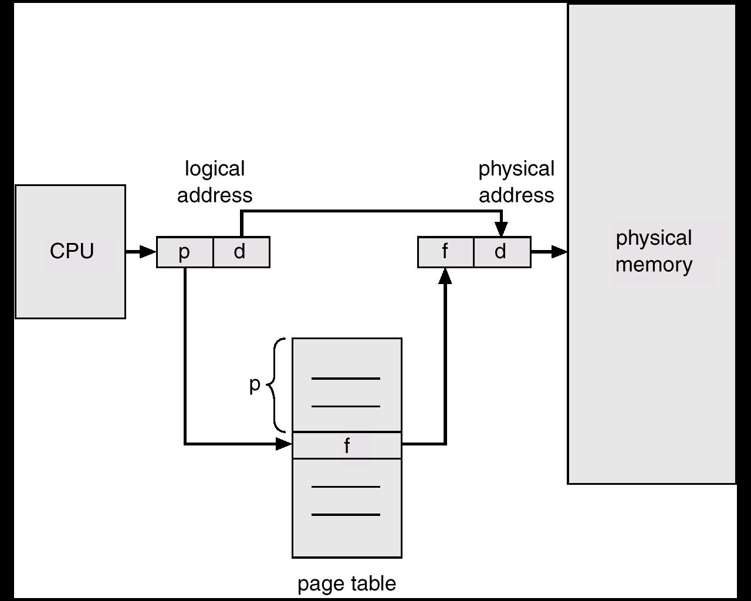
MEMORY MANAGEMENT
PAGING
Permits a program's memory to be physically noncontiguous so it can be allocated from wherever available. This avoids fragmentation and compaction.
Frames = physical blocks
Pages = logical blocks
Size of frames/pages is defined by hardware (power of 2 to ease calculations)
HARDWARE
An address is determined by:
page number ( index into table ) + offset
---> mapping into --->
base address ( from table ) + offset.

Slide 22
PAGING
MEMORY MANAGEMENT
0
Paging Example - 32-byte memory with 4-byte pages
4 I
j
k
l
0 a
1 b
2 c
3 d
8 m
n
o
p
0 5
1 6
2 1
3 2
4 e
5 f
6 g
7 h
12
16
8 I
9 j
10 k
11 l
Page Table
20 a
b
c
d
12 m
13 n
14 o
15 p
24 e
f
g
h
Physical Memory
28
Logical Memory

Slide 23

MEMORY MANAGEMENT
PAGING
  A 32 bit machine can address 4 gigabytes which is 4 million pages (at 1024 bytes/page). WHO says how big a page is, anyway?
  Could use dedicated registers (OK only with small tables.)
  Could use a register pointing to table in memory (slow access.)
  Cache or associative memory
  (TLB = Translation Lookaside Buffer):
  simultaneous search is fast and uses only a few registers.
IMPLEMENTATION OF THE PAGE TABLE
  TLB = Translation Lookaside Buffer

Slide 24
MEMORY MANAGEMENT
PAGING
IMPLEMENTATION OF THE PAGE TABLE
Issues include:
key and value
hit rate 90 - 98% with 100 registers
add entry if not found
Effective access time = %fast * time_fast + %slow * time_slow
Relevant times:
2 nanoseconds to search associative memory – the TLB.
20 nanoseconds to access processor cache and bring it into TLB for next time.
Calculate time of access:
hit = 1 search + 1 memory reference
miss = 1 search + 1 mem reference(of page table) + 1 mem reference.

Slide 25

MEMORY MANAGEMENT
PAGING
SHARED PAGES
Data occupying one physical page, but pointed to by multiple logical pages.
Useful for common code - must be write protected. (NO write-able data mixed with code.)
Extremely useful for read/write communication between processes.

Slide 26

MEMORY MANAGEMENT
PAGING
INVERTED PAGE TABLE:
One entry for each real page of memory.
Entry consists of the virtual address of the page stored in that real memory location, with information about the process that owns that page.
Essential when you need to do work on the page and must find out what process owns it.
Use hash table to limit the search to one - or at most a few - page table entries.

Slide 27
MEMORY MANAGEMENT
PAGING
PROTECTION:
Bits associated with page tables.
Can have read, write, execute, valid bits.
Valid bit says page isn’t in address space.
Write to a write-protected page causes a fault. Touching an invalid page causes a fault.
ADDRESS MAPPING:
Allows physical memory larger than logical memory.
Useful on 32 bit machines with more than 32-bit addressable words of memory.
The operating system keeps a frame containing descriptions of physical pages; if allocated, then to which logical page in which process.

Slide 28


MEMORY MANAGEMENT
PAGING
MULTILEVEL PAGE TABLE
A means of using page tables for large address spaces.

Slide 29
MEMORY MANAGEMENT
Segmentation
USER'S VIEW OF MEMORY
A programmer views a process consisting of unordered segments with various purposes. This view is more useful than thinking of a linear array of words. We really don't care at what address a segment is located.
Typical segments include
global variables
procedure call stack
code for each function
local variables for each
large data structures
Logical address = segment name ( number ) + offset
Memory is addressed by both segment and offset.

Slide 30
MEMORY MANAGEMENT
Segmentation
HARDWARE -- Must map a dyad (segment / offset) into one-dimensional address.
Segment Table
Limit Base
CPU
S D
MEMORY
Logical
Address
Yes
<
+
Physical
Address
No

Slide 31
MEMORY MANAGEMENT
Segmentation
HARDWARE
base / limit pairs in a segment table.
0
1
2
3
4
Limit
1000
400
400
1100
1000
Base
1400
6300
4300
3200
4700
1
1
4
2
0
3
2
4
3
Logical Address Space
Physical Memory

Slide 32
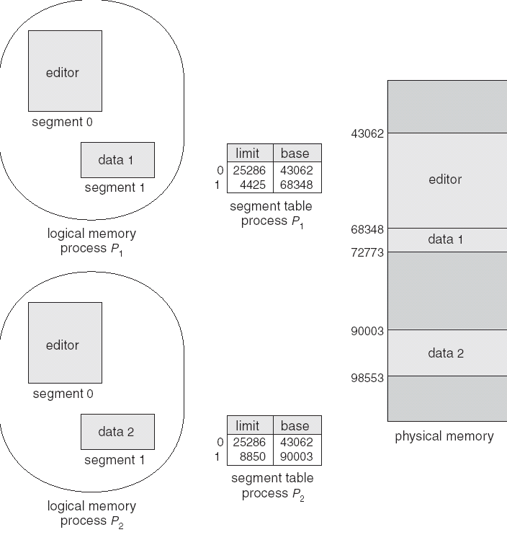
MEMORY MANAGEMENT
Segmentation
PROTECTION AND SHARING
Addresses are associated with a logical unit (like data, code, etc.) so protection is easy.
Can do bounds checking on arrays
Sharing specified at a logical level, a segment has an attribute called "shareable".
Can share some code but not all - for instance a common library of subroutines.
FRAGMENTATION
Use variable allocation since segment lengths vary.
Again have issue of fragmentation; Smaller segments means less fragmentation. Can use compaction since segments are relocatable.

Slide 33

MEMORY MANAGEMENT
Segmentation
PAGED SEGMENTATION
Combination of paging and segmentation.
address =
frame at ( page table base for segment
+ offset into page table )
+ offset into memory
Look at example of Intel architecture.

Slide 34
MEMORY MANAGEMENT
WRAPUP
We’ve looked at how to do paging - associating logical with physical memory.
This subject is at the very heart of what every operating system must do today.

Slide 35
Intel Memory Management
This set of slides is designed to explain the Memory Management Architecture used by Intel Pentium processors.
For these slides we will use the Intel document found at:
  http://www.intel.com/design/processor/manuals/253668.pdf
Intel explains this document as a description of the hardware interface required by an Operating System in order to implement a Memory Management.
It’s assumed that you are familiar with the normal picture of memory management as presented in Chapters 8 & 9 in this course.

Slide 36
How Do Operating Systems Use Memory Management
So I wrote a little program to probe the memory seen by a program. I ran that same program on Windows 2000, Windows XP and RedHat LINUX. I was looking at the addresses that were being used for various kinds of data/code in the program. I probed the addresses by asking for memory continually until something broke. For instance, did continual allocs until an error was returned. Here’s a pseudo code of the program:
#define ONE_MEG 1048576
#define MEM_SIZE 3 * ONE_MEG
char GlobalMemory[MEM_SIZE]; // This is a global/static variable
int main( int argc, char *argv[] )
{
int FirstStackLocation;
int Mode, Temp, *TempPtr;
int Counter = 0;
void *MemPtr, *LastPtr;
printf("Address of main(): %8X\n", (int)(&main) );
while ( TRUE ) // Find highest memory until seg. fault
{
TempPtr = (int *)((int)main + (CODE_JUMP * Counter) ); // Address of location
Temp = *TempPtr;
printf( "Got address %X\n", (int)((int)main + (CODE_JUMP * Counter) ) );
Counter++;
}
Keeps touching memory until it takes a fault

Slide 37
How Do Operating Systems Use Memory Management
printf("Address Start of Global: %8X\n", (int)(&GlobalMemory) );
printf("Address End of Global: %8X\n", (int)(&GlobalMemory) + MEM_SIZE -1);
MemPtr = malloc( ONE_MEG );
printf("First location on heap: %8X\n", (int)MemPtr );
while( (MemPtr = malloc( ONE_MEG )) != NULL )
{
LastPtr = MemPtr;
Counter++;
if ( Counter %100 == 0 )
printf("%5d alloc on heap:%8X\n", Counter, (int)LastPtr +ONE_MEG - 1);
}
printf("Total bytes allocated: %8X (Hex)\n", Counter * ONE_MEG );
printf("Last location on heap: %8X\n", (int)LastPtr );
}
#define STACK_ALLOC ONE_MEG
void RecursiveRoutine( )
{
char Temp[ STACK_ALLOC ];
printf("Begin/End of this allocation: %8X %8X\n",
(int)&(Temp), (int)(&(Temp[STACK_ALLOC])) );
RecursiveRoutine();
}
Iterates on allocs
Iterates using lots of stack

Slide 38
How Do Operating Systems Use Memory Management
So I wrote a little program to probe the memory seen by a program. I ran that same program on Windows 2000, Windows XP and RedHat LINUX. I was looking at the addresses that were being used for various kinds of data/code in the program. I probed the addresses by asking for memory continually until something broke. For instance, did continual allocs until error was returned
Windows XP Memory Usage
Segment | First Address | Last Address | Size
Code | 401000x | 403000x | 002000x ~ 8 Kbytes
Static (Global) Data | 403000x | 703000x | 300000x ~ 3 megabytes
Heap | 760000x | 3A261000x | 39800000x ~ 950 megabytes
Stack | 22EF00x | 16EF00x | 1C0000x ~ 2 megabyte
The file MemoryDemo.exe is about 170Kbytes in size.
Declared a 3 Meg static array!.
Note these addresses grow down!
Note: 100000x == 1 Megabyte

Slide 39
How Do Operating Systems Use Memory Management
So I wrote a little program to probe the memory seen by a program. I ran that same program on Windows 2000, Windows XP and RedHat LINUX. I was looking at the addresses that were being used for various kinds of data/code in the program. I probed the addresses by asking for memory continually until something broke. For instance, did continual allocs until error was returned
LINUX Memory Usage
Segment | First Address | Last Address | Size
Code | 8048400x | 8049900x | 001500x ~ 6 Kbytes
Static (Global) Data | 8049A00x | 8349A00 | 300000x ~ 3 megabytes
Heap | B7EE,B000x | 01CE,4000x | B6000000x ~ 3 gigabytes
Stack | BFFB,7334x | 29BA,91E0x | 9640,0000x ~ 2.5 gigabyte
Declared a 3 Meg static array!.
Note these addresses grow down!
Note: 100000x == 1 Megabyte
How can this sum to more than 4 gigs??
Notes:
The heap measurement and the stack measurement were done separately. If they had been combined in the same run, there would obviously have been less address space available. There are a number of other interesting tests possible here.

Slide 40
How Do Operating Systems Use Memory Management
0x08048368 <main+0>: 55 push %ebp
0x08048369 <main+1>: 89 e5 mov %esp,%ebp
0x0804836b <main+3>: 83 ec 08 sub $0x8,%esp
0x0804836e <main+6>: 83 e4 f0 and $0xfffffff0,%esp
0x08048371 <main+9>: b8 00 00 00 00 mov $0x0,%eax
0x08048376 <main+14>: 83 c0 0f add $0xf,%eax
0x08048379 <main+17>: 83 c0 0f add $0xf,%eax
0x0804837c <main+20>: c1 e8 04 shr $0x4,%eax
0x0804837f <main+23>: c1 e0 04 shl $0x4,%eax
0x08048382 <main+26>: 29 c4 sub %eax,%esp
0x08048384 <main+28>: 83 ec 0c sub $0xc,%esp
0x08048387 <main+31>: 68 c0 84 04 08 push $0x80484c0
0x0804838c <main+36>: e8 1f ff ff ff call 0x80482b0
0x08048391 <main+41>: 83 c4 10 add $0x10,%esp
0x08048394 <main+44>: e8 02 00 00 00 call 0x804839b <b>
0x08048399 <main+49>: c9 leave
0x0804839a <main+50>: c3 ret
1 void b();
2 void c();
3 int main( )
4 {
5 printf( "Hello from main\n");
6 b();
7 }
8 // This routine reads the opcodes from memory and prints them out.
9 void b()
10 {
11 char *moving;
12
13 for ( moving = (char *)(&main); moving < (char *)(&c); moving++ )
14 printf( "Addr = 0x%x, Value = %2x\n", (int)(moving), 255 & (int)*moving );
15 }
16 void c()
17 {
18 }
Notes:
The heap measurement and the stack measurement were done separately. If they had been combined in the same run, there would obviously have been less address space available. There are a number of other interesting tests possible here.

Slide 41
Memory Layout
0x0804839b <b+0>: 55 push %ebp
0x0804839c <b+1>: 89 e5 mov %esp,%ebp
0x0804839e <b+3>: 83 ec 08 sub $0x8,%esp
0x080483a1 <b+6>: c7 45 fc 68 83 04 08 movl $0x8048368,0xfffffffc(%ebp)
0x080483a8 <b+13>: 81 7d fc d9 83 04 08 cmpl $0x80483d9,0xfffffffc(%ebp)
0x080483af <b+20>: 73 26 jae 0x80483d7 <b+60>
0x080483b1 <b+22>: 83 ec 04 sub $0x4,%esp
0x080483b4 <b+25>: 8b 45 fc mov 0xfffffffc(%ebp),%eax
0x080483b7 <b+28>: 0f be 00 movsbl (%eax),%eax
0x080483ba <b+31>: 25 ff 00 00 00 and $0xff,%eax
0x080483bf <b+36>: 50 push %eax
0x080483c0 <b+37>: ff 75 fc pushl 0xfffffffc(%ebp)
0x080483c3 <b+40>: 68 d1 84 04 08 push $0x80484d1
0x080483c8 <b+45>: e8 e3 fe ff ff call 0x80482b0
0x080483cd <b+50>: 83 c4 10 add $0x10,%esp
0x080483d0 <b+53>: 8d 45 fc lea 0xfffffffc(%ebp),%eax
0x080483d3 <b+56>: ff 00 incl (%eax)
0x080483d5 <b+58>: eb d1 jmp 0x80483a8 <b+13>
0x080483d7 <b+60>: c9 leave
0x080483d8 <b+61>: c3 ret
1 void b();
2 void c();
3 int main( )
4 {
5 printf( "Hello from main\n");
6 b();
7 }
8 // This routine reads the opcodes from memory and prints them out.
9 void b()
10 {
11 char *moving;
12
13 for ( moving = (char *)(&main); moving < (char *)(&c); moving++ )
14 printf( "Addr = 0x%x, Value = %2x\n", (int)(moving), 255 & (int)*moving );
15 }
16 void c()
17 {
18 }
Notes:
The heap measurement and the stack measurement were done separately. If they had been combined in the same run, there would obviously have been less address space available. There are a number of other interesting tests possible here.

Slide 42
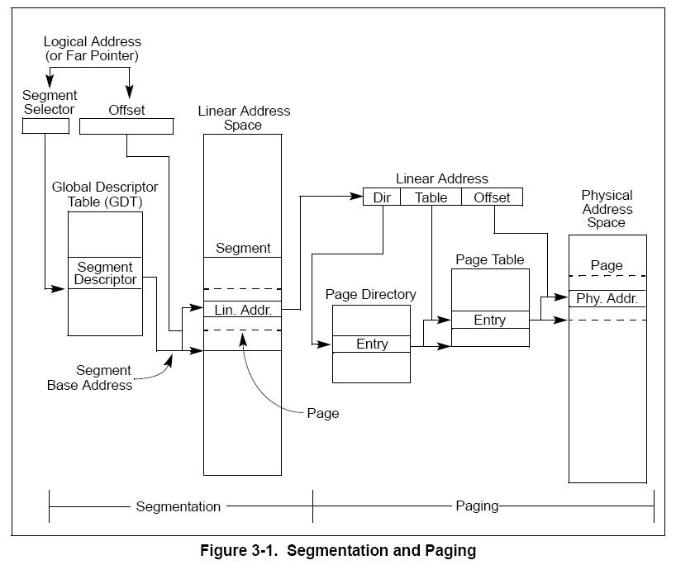
Intel Memory Management
  This is an overview of the hardware pieces provided by Intel. It’s what we have to work with if we’re designing an O.S.

Slide 43
Intel Memory Management
The memory management facilities of the IA-32 architecture are divided into two parts:
Segmentation
Segmentation provides a mechanism of isolating individual code, data, and stack modules so that multiple programs (or tasks) can run on the same processor without interfering with one another.
When operating in protected mode, some form of segmentation must be used.
Paging.
Paging provides a mechanism for implementing a conventional demand-paged, virtual-memory system where sections of a program’s execution environment are mapped into physical memory as needed. Paging can also be used to provide isolation between multiple tasks.
These two mechanisms (segmentation and paging) can be configured to support simple single program (or single-task) systems, multitasking systems, or multiple-processor systems that used shared memory.

Slide 44
Intel Memory Management
See Figure 3-1.
Segmentation gives a mechanism for dividing the processor’s addressable memory space (called the linear address space) into smaller protected address spaces called segments.
Segments are used to hold code, data, and stack for a program andr to hold system data structures (such as a TSS or LDT).
Each program running on a processor, is assigned its own set of segments.
The processor enforces the boundaries between segments and insures that one program doesn’t interfere with the execution of another .
The segmentation mechanism allows typing of segments to restrict operations that can be performed.

Slide 45
Intel Memory Management
See Figure 3-1.
All the segments in a system are contained in the processor’s linear address space.
To locate a byte in a particular segment, a logical address (also called a far pointer) must be provided.
A logical address has :
1. The segment selector – a unique identifier for a segment - provides an offset into a descriptor table (such as the global descriptor table, GDT) to a data structure called a segment descriptor.
This segment descriptor specifies the size of the segment, the access rights and privilege level for the segment, the segment type, and the location of the first byte of the segment in the linear address space (called the base address of the segment).
See 3.4.2 Segment Selectors” for more details.
2. The offset part of the logical address -added to the base address for the segment to locate a byte within the segment. The base address plus the offset thus forms a linear address in the processor’s linear address space.

Slide 46
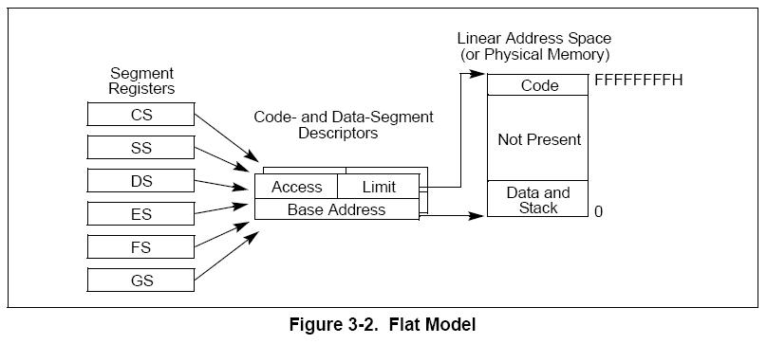
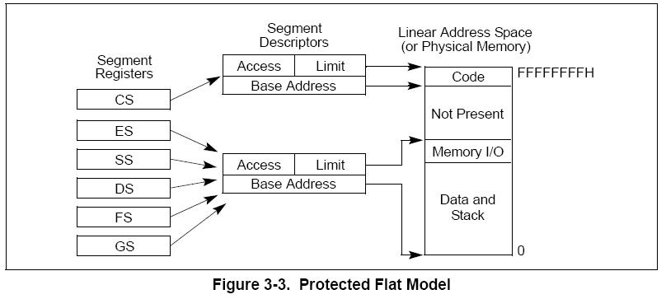
Intel Memory Management
3.2.1 Basic Flat Model
The simplest memory model for a system is the basic “flat model,”
the operating system and application programs have access to a continuous, unsegmented address space.
.
To implement a basic flat memory model with the IA-32 architecture, at least two segment descriptors must be created:
one for referencing a code segment and
one for referencing a data segment (see Figure 3-2).
both segments, however, are mapped to the entire linear address space: that is, both segment descriptors have the same base address value of 0 and the same segment limit of 4 GBytes.

Slide 47
Intel Memory Management
3.2.2 Protected Flat Model
The protected flat model is similar to the basic flat model, except the segment limits are set to include only the range of addresses for which physical memory actually exists (see Figure 3-3).
A protection exception is generated on any attempt to access nonexistent memory. This model provides a minimum level of hardware protection against some kinds of program bugs.
More complexity can be added to this protected flat model to provide more protection.
Example: For the paging mechanism to provide isolation between user and supervisor code and data, four segments need to be defined:
  code and data segments at privilege level 3 for the user,
  and code and data segments at privilege level 0 for the supervisor.

Slide 48
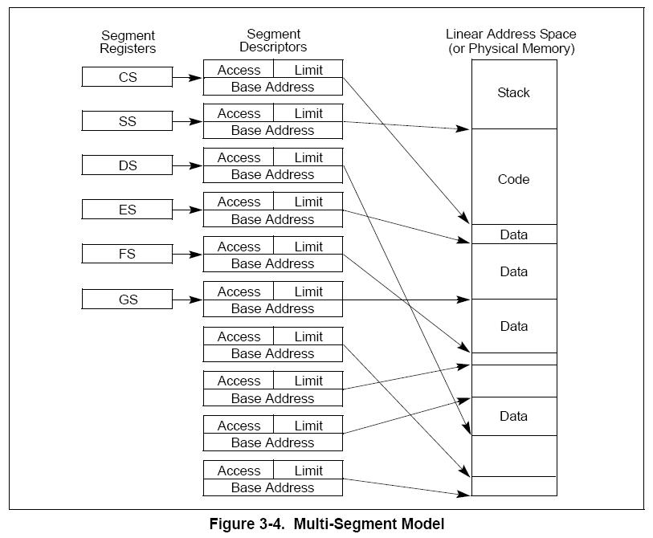
Intel Memory Management
3.2.3 Multi-Segment Model
A multi-segment model (shown here) uses the full capabilities of segmentation to provide hardware enforced protection of code, data structures, and programs and tasks.
each program (or task) has its own table of segment descriptors and its own segments.
segments can be completely private to their programs or shared among programs.
Access to segments and to program environments is controlled by hardware.
Access checks can be used to protect not only against referencing an address outside the limit of a segment, but also against performing disallowed operations in certain segments.
The access rights information created for segments can also be used to set up protection rings or levels.
Protection levels can be used to protect operating system procedures from unauthorized access by application programs.

Slide 49
Intel Memory Management
3.3 PHYSICAL ADDRESS SPACE
In protected mode, the IA-32 architecture provides a normal physical address space of 4 Gbytes (2³² bytes).
This is the address space that the processor can address on its address bus. This address space is flat (unsegmented), with addresses ranging continuously from 0 to FFFF,FFFFH. This physical address space can be mapped to read-write memory, read-only memory, and memory mapped I/O. The memory mapping facilities described in this chapter can be used to divide this physical memory up into segments and/or pages.
The IA-32 architecture also supports an extension of the physical address space to 2³⁶ bytes (64 GBytes); with a maximum physical address of F,FFFF,FFFFH. This extension is invoked
• Using the physical address extension (PAE) flag, located in bit 5 of control register CR4.
-- Talked about later.

Slide 50
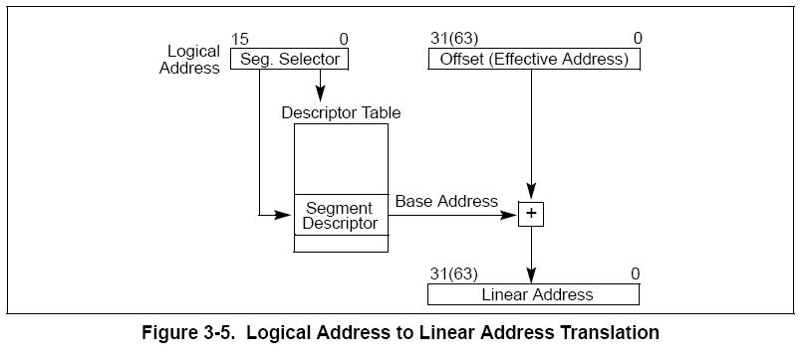
Intel Memory Management
3.4 LOGICAL AND LINEAR ADDRESSES
The processor uses two stages of address translation to arrive at a physical address: logical-address (via segments) translation and linear address space (via paging) translation.

Slide 51
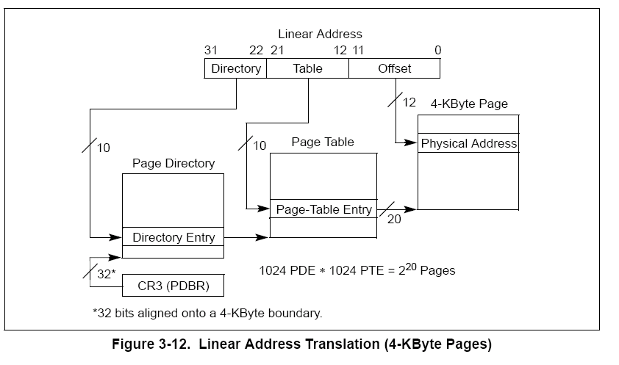
Intel Memory Management
3.4 LOGICAL AND LINEAR ADDRESSES
Every byte in the processor’s address space is accessed with a logical address. A logical address consists of a 16-bit segment selector and a 32-bit offset (see Figure 3-5).
.A linear address is a 32-bit address in the processor’s linear address space. The linear address space is a flat (unsegmented), 2³²-byte address space, with addresses ranging from 0 to FFFF,FFFFH.
The linear address space contains all the segments and system tables defined for a system.
To translate a logical address into a linear address, the processor does the following:
1. Uses the offset in the segment selector to find the descriptor for the segment in the GDT or LDT and reads it into the processor, or uses the appropriate segment register.
2. Examines the segment descriptor to check the access rights and range of the segment – makes sure the segment is accessible and has legal offset.
3. Adds the base address of the segment to the offset to form a linear address.

Slide 52
Intel Memory Management
3.4.2 Segment Selectors
A segment selector is a 16-bit identifier for a segment (see Figure 3-6). It does not point directly to the segment, but instead points to the segment descriptor that defines the segment. A segment selector contains the following items:
Index — Selects one of 8192 descriptors in the GDT or LDT.
TI (table indicator) flag — Specifies the descriptor table to use: GDT or LDT
Requested Privilege Level (RPL) — Specifies the privilege level of the selector. The privilege level can range from 0 to 3, with 0 being the most privileged level.

Slide 53
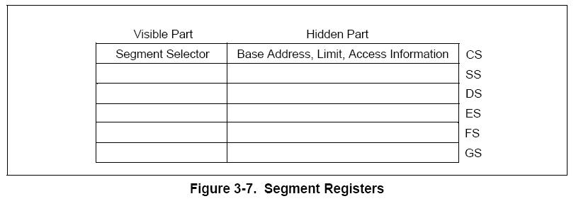
Intel Memory Management
3.4.3 Segment Registers
To reduce address translation time and coding complexity, the processor provides registers for holding up to 6 segment selectors (see Figure 3-7).
Each of these segment registers support a specific kind of memory reference (code, stack, or data).
At least the code-segment, data-segment, and stack-segment registers must be loaded for a program to run..
The processor provides three additional data-segment registers (ES, FS, and GS), which can be used to make other data segments available to the currently executing program (or task).
To access a segment, a program must get to it via a segment register.
Although a system can define thousands of segments, only 6 can be available for immediate use.
There are instructions available so the OS can set up segment registers.
Note how the address translation actually goes through the segment register rather than through the Descriptor Table.

Slide 54
Intel Memory Management
Every segment register has a “visible” part and a “hidden” part.
When a segment selector is loaded, the processor also loads the hidden part of the segment register with the base address, segment limit, and access control information from the descriptor pointed to by the segment selector.
This allows the processor to translate addresses without taking extra bus cycles to read the base address and limit from the segment descriptor.
In systems in which multiple processors have access to the same descriptor tables, it is the responsibility of software to reload the segment registers when the descriptor tables are modified.
If this is not done, an old segment descriptor cached in a segment register might be used after its memory-resident version has been modified.
Two kinds of instructions are provided for loading the segment registers:
Direct load instructions such as the MOV, LES, LGS, and LFS instructions explicitly reference the segment registers.
2. Implied load instructions such as the far pointer versions of the CALL, JMP, and RET instructions, the SYSENTER and SYSEXIT instructions, and the IRET, INTn, INTO and INT3 instructions. These instructions change the contents of the CS register as an incidental part of their operation.

Slide 55
Intel Memory Management
3.5 SYSTEM DESCRIPTOR TYPES
When the S (descriptor type) flag in a segment descriptor is clear, the descriptor type is a system descriptor. The processor recognizes the following types of system descriptors:
• Local descriptor-table (LDT) segment descriptor.
• Task-state segment (TSS) descriptor.
• Call-gate descriptor.
• Interrupt-gate descriptor.
• Trap-gate descriptor.
• Task-gate descriptor.
These descriptor types fall into two categories: system-segment descriptors and gate descriptors.
System-segment descriptors point to system segments (LDT and TSS segments). Gate descriptors are in themselves “gates,” which hold pointers to procedure entry points in code segments (call, interrupt, and trap gates) or which hold segment selectors for TSS’s (task gates).
Table 3-2 shows the encoding of the type field for system-segment descriptors and gate descriptors.

Slide 56
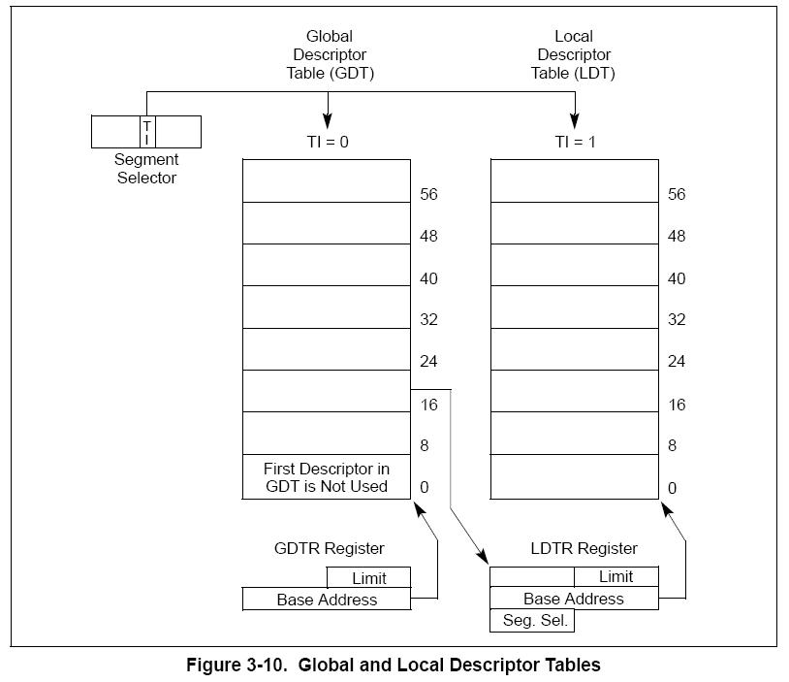
Intel Memory Management
3.5.1 Segment Descriptor Tables
A segment descriptor table is an array of segment descriptors (see Figure 3-10). A descriptor table is variable in length and can contain up to 8192 (213) 8-byte descriptors.
There are two kinds of descriptor tables:
• The global descriptor table (GDT)
• The local descriptor tables (LDT)
Each system must have one GDT defined, which may be used for all programs and tasks in the system.
Optionally, one or more LDTs can be defined. For example, an LDT might be defined for each separate task being run.
The GDT is not a segment itself; instead, it is a data structure in linear address space. The base linear address and limit of the GDT must be loaded into the GDTR register.

Slide 57
Intel Memory Management
3.5.1 Segment Descriptor Tables
The LDT is located in a system segment of the LDT type.
The GDT must contain a segment descriptor for the LDT segment. If the system supports multiple LDTs, each must have a separate segment selector and segment descriptor in the GDT.
An LDT is accessed with its segment selector. To eliminate address translations when accessing the LDT, the segment selector, base linear address, limit, and access rights of the LDT are stored in the LDTR register.
Coming up!! How does the Intel processor do paging?

Slide 58
FILE SYSTEMS
This material covers Silberschatz Chapters 10 and 11.
File System Interface
The user level (more visible) portion of the file system.
Access methods
Directory Structure
Protection
File System Implementation
The OS level (less visible) portion of the file system.
Allocation and Free Space Management
Directory Implementation

Slide 59
FILE SYSTEMS INTERFACE
File Concept
A collection of related bytes having meaning only to the creator. The file can be "free formed", indexed, structured, etc.
The file is an entry in a directory.
The file may have attributes (name, creator, date, type, permissions)
The file may have structure ( O.S. may or may not know about this.) It's a tradeoff of power versus overhead. For example,
  An Operating System understands program image format in order to create a process.
  The UNIX shell understands how directory files look. (In general the UNIX kernel doesn't interpret files.)
  Usually the Operating System understands and interprets file types.

Slide 60
FILE SYSTEMS INTERFACE
File Concept
A file can have various kinds of structure
None - sequence of words, bytes
Simple record structure
    Lines
    Fixed length
    Variable length
Complex Structures
    Formatted document
    Relocatable load file
Who interprets this structure?
    Operating system
    Program

Slide 61
FILE SYSTEMS INTERFACE
File Concept
Attributes of a File
Name – only information kept in human-readable form
Identifier – unique tag (number) identifies file within file system
Type – needed for systems that support different types
Location – pointer to file location on device
Size – current file size
Protection – controls who can do reading, writing, executing
Time, date, and user identification – data for protection, security, and usage monitoring
Information about files is kept in the directory structure, which is maintained on the disk.

Slide 62
FILE SYSTEMS INTERFACE
File Concept
What can we find out about a Linux File?
jbreecher@younger:~$ stat A_File
File: `A_File'
Size: 6491 Blocks: 16 IO Block: 4096 regular file
Device: 14h/20d Inode: 20938754 Links: 1
Access: (0600/-rw-------) Uid: ( 1170/jbreecher) Gid: ( 100/ users)
Access: 2006-11-15 15:38:17.000000000 -0500
Modify: 2006-09-27 17:44:10.000000000 -0400
Change: 2006-09-27 17:44:10.000000000 -0400
jbreecher@younger:~/public/os/Code$ stat protos.h
File: `protos.h'
Size: 2889 Blocks: 8 IO Block: 4096 regular file
Device: 14h/20d Inode: 28442631 Links: 1
Access: (0644/-rw-r--r--) Uid: ( 1170/jbreecher) Gid: ( 100/ users)
Access: 2006-11-16 03:56:17.000000000 -0500
Modify: 2006-08-27 12:45:57.000000000 -0400
Change: 2006-08-27 13:25:24.000000000 -0400

Slide 63
FILE SYSTEMS INTERFACE
File Concept
Note: The command “LDE” – Linux Disk Editor – does amazing things but requires root privilege.
-rw-rw-rw- 1 jbreecherusers 56243 Mon Dec 18 14:25:40 2006
TYPE: regular file LINKS: 1 DIRECT BLOCKS= 0x002462CA
MODE: \0666 FLAGS: \10 0x002462CB
UID: 01170(jbreecher)ID: 00100(users) 0x002462CC
SIZE: 56243 SIZE(BLKS): 128 0x002462CD
0x002462CE
ACCESS TIME: Mon Dec 18 14:35:35 2006 0x002462CF
CREATION TIME: Mon Dec 18 14:25:40 2006 0x002462D0
MODIFICATION TIME: Mon Dec 18 14:25:40 2006 0x002462D1
DELETION TIME: Wed Dec 31 19:00:00 1969 0x002462D2
0x002462D3
0x002462D4
0x002462D5
INDIRECT BLOCK= 0x002462D6
2x INDIRECT BLOCK=
3x INDIRECT BLOCK=
Expanded on next page

Slide 64
FILE SYSTEMS INTERFACE
File Concept
lde v2.6.1 : ext2 : /dev/mapper/VolGroup00-LogVol01
Inode: 1170636 (0x0011DCCC) Block: 2384586 (0x002462CA) 0123456789!@$%^
462CA000 74 68 69 73 20 6D 61 6E : 79 20 6E 6F 74 20 77 6F this many not wo
462CA010 72 6B 20 74 68 69 73 20 : 6D 61 6E 79 20 6E 6F 74 rk this many not
462CA020 20 77 6F 72 6B 20 74 68 : 69 73 20 6D 61 6E 79 20 work this many
462CA030 6E 6F 74 20 77 6F 72 6B : 20 74 68 69 73 20 6D 61 not work this ma
462CA040 6E 79 20 6E 6F 74 20 77 : 6F 72 6B 20 74 68 69 73 ny not work this
462CA050 20 6D 61 6E 79 20 6E 6F : 74 20 77 6F 72 6B 0A 74 many not work.t
462CA060 68 69 73 20 6D 61 6E 79 : 20 6E 6F 74 20 77 6F 72 his many not wor
lde v2.6.1 : ext2 : /dev/mapper/VolGroup00-LogVol01
Inode: 1170636 (0x0011DCCC) Block: 2384598 (0x002462D6) 0123456789!@$%^
462D6000 D7 62 24 00 D8 62 24 00 : 00 00 00 00 00 00 00 00 .b$..b$.........
462D6010 00 00 00 00 00 00 00 00 : 00 00 00 00 00 00 00 00 ................
462D6020 00 00 00 00 00 00 00 00 : 00 00 00 00 00 00 00 00 ................

Slide 65
FILE SYSTEMS INTERFACE
File Concept
Blocking (packing) occurs when some entity, (either the user or the Operating System) must pack bytes into a physical block.
  Block size is fixed for disks, variable for tape
  Size determines maximum internal fragmentation
  We can allow reference to a file as a set of logical records (addressable units) and then divide ( or pack ) logical records into physical blocks.
What does it mean to “open” a file??

Slide 66

FILE SYSTEMS INTERFACE
Access
Methods
If files had only one "chunk" of data, life would be simple. But for large files, the files themselves may contain structure, making access faster.
SEQUENTIAL ACCESS
  Implemented by the filesystem.
  Data is accessed one record right after the last.
  Reads cause a pointer to be moved ahead by one.
  Writes allocate space for the record and move the pointer to the new End Of File.
  Such a method is reasonable for tape

Slide 67
FILE SYSTEMS INTERFACE
Access
Methods
DIRECT ACCESS
  Method useful for disks.
  The file is viewed as a numbered sequence of blocks or records.
  There are no restrictions on which blocks are read/written in any order.
  User now says "read n" rather than "read next".
  "n" is a number relative to the beginning of file, not relative to an absolute physical disk location.

Slide 68
FILE SYSTEMS INTERFACE
Access
Methods
OTHER ACCESS METHODS
Built on top of direct access and often implemented by a user utility.
Indexed ID plus pointer.
  An index block says what's in each remaining block or contains pointers to blocks containing particular items. Suppose a file contains many blocks of data arranged by name alphabetically.
Example 1: Index contains the name appearing as the first record in each block. There are as many index entries as there are blocks.
Example 2: Index contains the block number where "A" begins, where "B" begins, etc. Here there are only 26 index entries.

Slide 69
FILE SYSTEMS INTERFACE
Access
Methods
Adams
Example 1: Index contains the name appearing as the first record in each block. There are as many index entries as there are blocks.
Example 2: Index contains the block number where "A" begins, where "B" begins, etc. Here there are only 26 index entries.
Arthur
Asher
Smith, John | data
Smith
Adams
Adams | Data
Baker
Arthur | Data
Charles
Asher | Data
Baker | Data
Saarnin
Saarnin | data
Smith, John | data

Slide 70
FILE SYSTEMS INTERFACE
Directory
Structure
Directories maintain information about files:
For a large number of files, may want a directory structure - directories under directories.
Information maintained in a directory:
  Name The user visible name.
  Type The file is a directory, a program image, a user file, a link, etc.
  Location Device and location on the device where the file header is located.
  Size Number of bytes/words/blocks in the file.
  Position Current next-read/next-write pointers.
  Protection Access control on read/write/ execute/delete.
  Usage Open count
  Usage time of creation/access, etc.
  Mounting a filesystem occurs when the root of one filesystem is "grafted" into the existing tree of another filesystem.
There is a need to PROTECT files and directories.
Actions that might be protected include: read, write, execute, append, delete, list
In Memory only!

Slide 71
FILE SYSTEMS INTERFACE
Directory
Structure
jbreecher@younger:~/public/os$ stat Code
File: `Code'
Size: 4096 Blocks: 8 IO Block: 4096 directory
Device: 14h/20d Inode: 28606492 Links: 2
Access: (0755/drwxr-xr-x) Uid: ( 1170/jbreecher) Gid: ( 100/ users)
Access: 2006-11-16 14:52:11.000000000 -0500
Modify: 2006-11-16 14:52:01.000000000 -0500
Change: 2006-11-16 14:52:01.000000000 -0500

Slide 72

FILE SYSTEMS INTERFACE
Directory
Structure
Tree-Structured Directory

Slide 73
FILE SYSTEMS INTERFACE
Other Issues
Mounting:
Attaching portions of the file system into a directory structure.
Sharing:
Sharing must be done through a protection scheme
May use networking to allow file system access between systems
  Manually via programs like FTP or SSH
  Automatically, seamlessly using distributed file systems
  Semi automatically via the world wide web
Client-server model allows clients to mount remote file systems from servers
  Server can serve multiple clients
  Client and user-on-client identification is insecure or complicated
  NFS is standard UNIX client-server file sharing protocol
  CIFS is standard Windows protocol
  Standard operating system file calls are translated into remote calls

Slide 74
FILE SYSTEMS INTERFACE
Protection
File owner/creator should be able to control:
  what can be done
  by whom
Types of access
  Read
  Write
  Execute
  Append
  Delete
  List
Mode of access: read, write, execute
Three classes of users
RWX
a) owner access 7 ⇒ 1 1 1
RWX
b) group access 6 ⇒ 1 1 0
RWX
c) public access 1 ⇒ 0 0 1
Ask manager to create a group (unique name), say G, and add some users to the group.
For a particular file (say game) or subdirectory, define an appropriate access.
owner
group
public
chmod
761
game
Attach a group to a file
“chgrp G game”

Slide 75

FILE SYSTEMS INTERFACE
Protection
Example on Windows XP

Slide 76
FILE SYSTEM IMPLEMENTATION
FILE SYSTEM STRUCTURE:
When talking about “the file system”, you are making a statement about both the rules used for file access, and about the algorithms used to implement those rules. Here’s a breakdown of those algorithmic pieces.
Application Programs The code that's making a file request.
Logical File System This is the highest level in the OS; it does protection, and security. Uses the directory structure to do name resolution.
File-organization Module Here we read the file control block maintained in the directory so we know about files and the logical blocks where information about that file is located.
Basic File System Knowing specific blocks to access, we can now make generic requests to the appropriate device driver.
IO Control These are device drivers and interrupt handlers. They cause the device to transfer information between that device and CPU memory.
Devices The disks / tapes / etc.

Slide 77
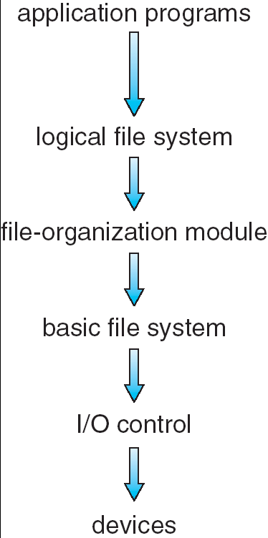
FILE SYSTEM IMPLEMENTATION
Layered File System
Handles the CONTENT of the file. Knows the file’s internal structure.
Handles the OPEN, etc. system calls. Understands paths, directory structure, etc.
Uses directory information to figure out blocks, etc. Implements the READ. POSITION calls.
Determines where on the disk blocks are located.
Interfaces with the devices – handles interrupts.

Slide 78
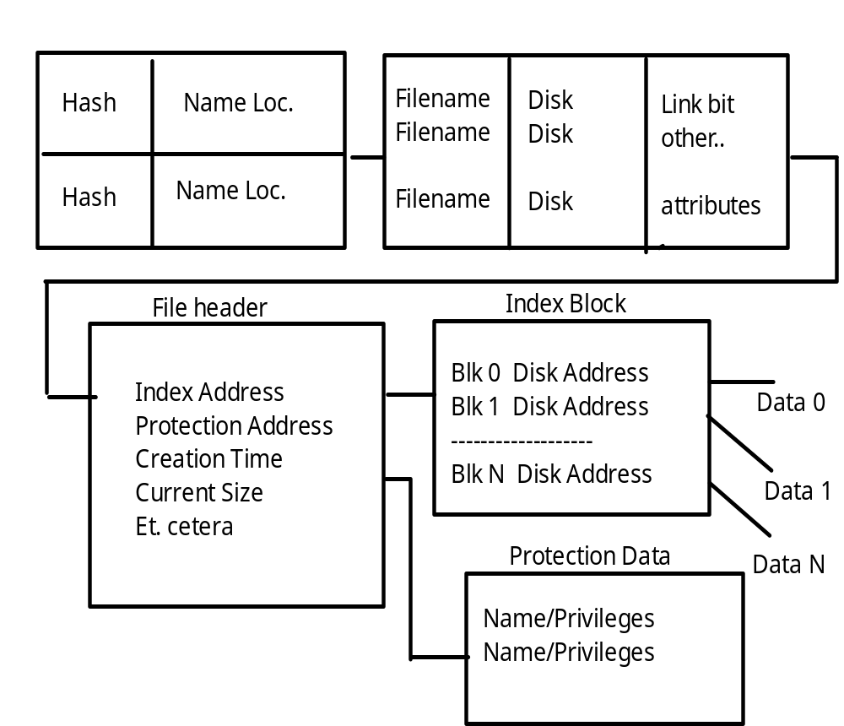
FILE SYSTEM IMPLEMENTATION
Example of
Directory and
File
Structure
Directory Hash Table
Directory Brief Info.

Slide 79

FILE SYSTEM IMPLEMENTATION
Virtual File Systems
Virtual File Systems (VFS) provide an object-oriented way of implementing file systems.
VFS allows the same system call interface (the API) to be used for different types of file systems.
The API is to the VFS interface, rather than any specific type of file system.

Slide 80

FILE SYSTEM IMPLEMENTATION
Allocation Methods
CONTIGUOUS ALLOCATION
Method: Lay down the entire file on contiguous sectors of the disk. Define by a dyad <first block location, length >.
  Accessing the file requires a minimum of head movement.
  Easy to calculate block location: block i of a file, starting at disk address b, is b + i.
  Difficulty is in finding the contiguous space, especially for a large file. Problem is one of dynamic allocation (first fit, best fit, etc.) which has external fragmentation. If many files are created/deleted, compaction will be necessary.
It's hard to estimate at create time what the size of the file will ultimately be. What happens when we want to extend the file --- we must either terminate the owner of the file, or try to find a bigger hole.

Slide 81

FILE SYSTEM IMPLEMENTATION
Allocation Methods
LINKED ALLOCATION
Each file is a linked list of disk blocks, scattered anywhere on the disk.
At file creation time, simply tell the directory about the file. When writing, get a free block and write to it, enqueueing it to the file header.
There's no external fragmentation since each request is for one block.
Method can only be effectively used for sequential files.

Slide 82

FILE SYSTEM IMPLEMENTATION
Allocation Methods
LINKED ALLOCATION
Pointers use up space in each block. Reliability is not high because any loss of a pointer loses the rest of the file.
A File Allocation Table is a variation of this.
It uses a separate disk area to hold the links.
This method doesn't use space in data blocks. Many pointers may remain in memory.
A FAT file system is used by MS-DOS.

Slide 83

FILE SYSTEM IMPLEMENTATION
Allocation Methods
INDEXED ALLOCATION
Each file uses an index block on disk to contain addresses of other disk blocks used by the file.
When the i th block is written, the address of a free block is placed at the i th position in the index block.
Method suffers from wasted space since, for small files, most of the index block is wasted. What is the optimum size of an index block?
If the index block is too small, we can:
  Link several together
  Use a multilevel index
UNIX keeps 12 pointers to blocks in its header. If a file is longer than this, then it uses pointers to single, double, and triple level index blocks.

Slide 84

FILE SYSTEM IMPLEMENTATION
Allocation Methods
UNIX METHOD:
Note that various mechanisms are used here so as to optimize the technique based on the size of the file.

Slide 85
FILE SYSTEM IMPLEMENTATION
Allocation Methods
PERFORMANCE ISSUES FOR THESE METHODS
It's difficult to compare mechanisms because usage is different. Let's calculate, for each method, the number of disk accesses to read block i from a file:
contiguous: 1 access from location start + i.
linked: i + 1 accesses, reading each block in turn. (is this a fair example?)
index: 2 accesses, 1 for index, 1 for data.

Slide 86
FILE SYSTEM IMPLEMENTATION
Free Space
Management
We need a way to keep track of space currently free. This information is needed when we want to create or add (allocate) to a file. When a file is deleted, we need to show what space is freed up.
BIT VECTOR METHOD
Each block is represented by a bit
1 1 0 0 1 1 0 means blocks 2, 3, 6 are free.
This method allows an easy way of finding contiguous free blocks. Requires the overhead of disk space to hold the bitmap.
A block is not REALLY allocated on the disk unless the bitmap is updated.
What operations (disk requests) are required to create and allocate a file using this implementation?

Slide 87
FILE SYSTEM IMPLEMENTATION
Free Space
Management
FREE LIST METHOD
Free blocks are chained together, each holding a pointer to the next one free.
This is very inefficient since a disk access is required to look at each sector.
GROUPING METHOD
In one free block, put lots of pointers to other free blocks. Include a pointer to the next block of pointers.
COUNTING METHOD
Since many free blocks are contiguous, keep a list of dyads holding the starting address of a "chunk", and the number of blocks in that chunk.
Format < disk address, number of free blocks >

Slide 88
FILE SYSTEM IMPLEMENTATION
Directory
Management
The issue here is how to be able to search for information about a file in a directory given its name.
Could have linear list of file names with pointers to the data blocks. This is:
simple to program BUT time consuming to search.
Could use hash table - a linear list with hash data structure.
  Use the filename to produce a value that's used as entry to hash table.
  Hash table contains where in the list the file data is located.
  This decreases the directory search time (file creation and deletion are faster.)
  Must contend with collisions - where two names hash to the same location.
  The number of hashes generally can't be expanded on the fly.

Slide 89
FILE SYSTEM IMPLEMENTATION
Directory/File
Management
GAINING CONSISTENCY
Required when system crashes or data on the disk may be inconsistent:
Consistency checker - compares data in the directory structure with data blocks on disk and tries to fix inconsistencies. For example, What if a file has a pointer to a block, but the bit map for the free-space-management says that block isn't allocated.
Back-up- provides consistency by copying data to a "safe" place.
Recovery - occurs when lost data is retrieved from backup.

Slide 90

FILE SYSTEM IMPLEMENTATION
Efficiency and
Performance
THE DISK CACHE MECHANISM
There are many places to store disk data so the system doesn’t need to get it from the disk again and again.

Slide 91
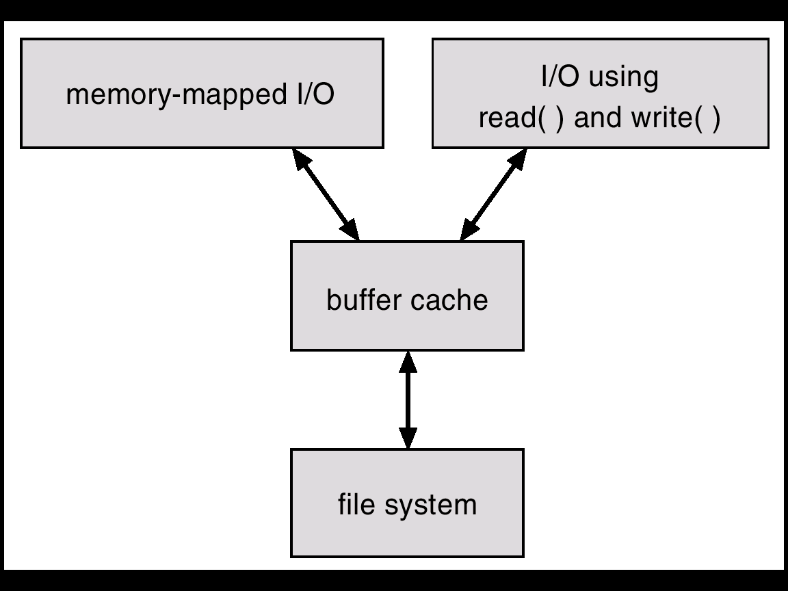
FILE SYSTEM IMPLEMENTATION
Efficiency and
Performance
THE DISK CACHE MECHANISM
This is an essential part of any well-performing Operating System.
The goal is to ensure that the disk is accessed as seldom as possible.
Keep previously read data in memory so that it might be read again.
They also hold on to written data, hoping to aggregate several writes from a process.
Can also be “smart” and do things like read-ahead. Anticipate what will be needed.

Slide 92
DISTRIBUTED FILE SYSTEMS
SUN Network File System
OVERVIEW:
Runs on SUNOS - NFS is both an implementation and a specification of how to access remote files. It's both a definition and a specific instance.
The goal: to share a file system in a transparent way.
Uses client-server model ( for NFS, a node can be both simultaneously.) Can act between any two nodes ( no dedicated server. ) Mount makes a server file-system visible from a client.
mount server:/usr/shared client:/usr/local
Then, transparently, a request for /usr/local/dir-server accesses a file that is on the server.
Can use heterogeneous machines - different hardware, operating systems, network protocols.
Uses RPC for isolation - thus all implementations must have the same RPC calls. These RPC's implement the mount protocol and the NFS protocol.

Slide 93
DISTRIBUTED FILE SYSTEMS
SUN Network File System
THE MOUNT PROTOCOL:
The following operations occur:
  1. The client's request is sent via RPC to the mount server ( on server machine.)
  2. Mount server checks export list containing
    file systems that can be exported,
    legal requesting clients.
    It's legitimate to mount any directory within the legal filesystem.
  3. Server returns "file handle" to client.
  4. Server maintains list of clients and mounted directories -- this is state information! But this data is only a "hint" and isn't treated as essential.
  5. Mounting often occurs automatically when client or server boots.

Slide 94
DISTRIBUTED FILE SYSTEMS
SUN Network File System
THE NFS PROTOCOL:
RPC’s support these remote file operations:
  Search for file within directory.
  Read a set of directory entries.
  Manipulate links and directories.
  Read/write file attributes.
  Read/write file data.
Note:
  Open and close are absent from this list. NFS servers are stateless. Each request must provide all information. With a server crash, no information is lost.
  Modified data must actually get to server disk before client is informed the action is complete. Using a cache would imply state information.
  A single NFS write is atomic. A client write request may be broken into several atomic RPC calls, so the whole thing is NOT atomic. Since lock management is stateful, NFS doesn't do it. A higher level must provide this service.

Slide 95
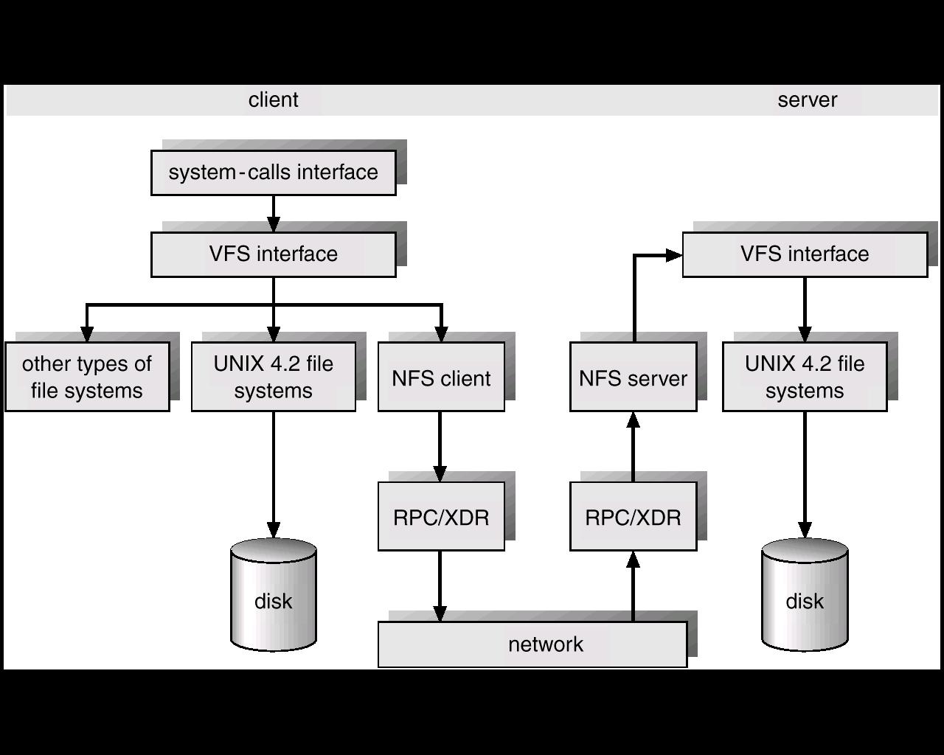
DISTRIBUTED FILE SYSTEMS
SUN Network File System
NFS ARCHITECTURE:
Follow local and remote access through this figure:

Slide 96
DISTRIBUTED FILE SYSTEMS
SUN Network File System
NFS ARCHITECTURE:
1. UNIX filesystem layer - does normal open / read / etc. commands.
2. Virtual file system ( VFS ) layer -
  Gives clean layer between user and filesystem.
  Acts as deflection point by using global vnodes.
  Understands the difference between local and remote names.
  Keeps in memory information about what should be deflected (mounted directories) and how to get to these remote directories.
3. System call interface layer -
  Presents sanitized validated requests in a uniform way to the VFS.

Slide 97
DISTRIBUTED FILE SYSTEMS
SUN Network File System
PATH-NAME TRANSLATION:
Break the complete pathname into components.
For each component, do an NFS lookup using the
component name + directory vnode.
After a mount point is reached, each component piece will cause a server access.
Can't hand the whole operation to server since the client may have a second mount on a subsidiary directory (a mount on a mount ).
A directory name cache on the client speeds up lookups.

Slide 98
DISTRIBUTED FILE SYSTEMS
SUN Network File System
CACHES OF REMOTE DATA:
The client keeps:
  File block cache - ( the contents of a file )
  File attribute cache - ( file header info (inode in UNIX) ).
The local kernel hangs on to the data after getting it the first time.
On an open, local kernel, it checks with server that cached data is still OK.
Cached attributes are thrown away after a few seconds.
Data blocks use read ahead and delayed write.
Mechanism has:
  Server consistency problems.
  Good performance.

Slide 99
FILE SYSTEMS
Wrap Up
In this section we have looked at how the file is put together. What are the components that must be present in the file and implicitly, what procedures must be in the Operating System in order to act on these files.
We’ve also examined the internal structure of files.
This gives a file system knowledge about how to get around in the file – especially how to find the required data block.

Slide 100
Linux Filesystem Features
Evolution of a de facto standard file system for Linux: ‘ext2’

Slide 101
References
Maurice J. Bach, “The Design of the UNIX Operating System,” Prentice-Hall (1986).
Remy Card, Theodore Ts’o, and Stephen Tweedie, “Design and Implementation of the Second Extended Filesystem,” Proc. of First Dutch International Symposium on Linux (1994), ISBN 90-367-0385-9. [This paper is available online at MIT’s website.]

Slide 102
Cross-development
Linux: first developed on a minix system
Both OSs shared space on the same disk
So Linux reimplemented minix file system
Two severe limitations in the minix FS
  Block addresses are 16-bits (64MB limit)
  Directories use fixed-size entries (w/filename)

Slide 103
Extended File System
Originally written by Chris Provenzano
Extensively rewritten by Linux Torvalds
Initially released in 1992
Removed the two big limitations in minix
Used 32-bit file-pointers (filesizes to 2GB)
Allowed long filenames (up to 255 chars)
Question: How to integrate ext into Linux?

Slide 104
The Virtual File System idea
Multiple file systems need to coexist
But filesystems share a core of common concepts and high-level operations
So create a filesystem abstraction
Applications interact with this VFS
Kernel translates abstract-to-actual

Slide 105
Task 1
Task 2
…
Task n
user space
kernel space
VIRTUAL FILE SYSTEM
minix
ext2
msdos
proc
Buffer Cache
device driver
for hard disk
device driver
for floppy disk
Linux Kernel
software
hardware
Hard Disk
Floppy Disk

Slide 106
Limitations in Ext
Some problems with the Ext filesystem
  Lacked support for 3 timestamps
    Accessed, Inode Modified, Data Modified
  Used linked-lists to track free blocks/inodes
    Poor performance over time
    Lists became unsorted
    Files became fragmented
  Did not provide room for future extensibility

Slide 107
Xia and Ext2 filesystems
Two new filesystems introduced in 1993
Both tried to overcome Ext’s limitations
Xia was based on existing minix code
Ext2 was based on Torvalds’ Ext code
Xia was initially more stable (smaller)
But flaws in Ext2 were eventually fixed
Ext2 soon became a ‘de facto’ standard

Slide 108
Filesystem Comparison
Minix
Ext
Xia
Ext2
Maximal FS size
64MB
2GB
2GB
4TB
Maximal filesize
64MB
2GB
64MB
2GB
Maximal filename
14/30 chars
255 chars
248 chars
255 chars
3 timestamps
no
no
yes
yes
Extensible?
no
no
no
yes
Can vary block size?
no
no
no
yes
Code is maintained?
yes
no
?
yes

Slide 109
Common concepts
Files are represented by inodes
Directories are files, too (with dentries)
Devices accessed by I/O on ‘special’ files
UNIX filesystems can implement ‘links’

Slide 110
Inodes
A structure that contains file’s description:
  Type
  Access rights
  Owners
  Timestamps
  Size
  Pointers to data blocks
Kernel keeps the inode in memory (open)

Slide 111
Inode diagram
inode
File info
Direct blocks
Indirect blocks
Double
Indirect
Blocks

Slide 112
Directories
These are structured in a tree hierarchy
Each can contain both files and directories
A directory is just a particular type of file
Special user-functions for directory access
Each dentry contains filename + inode-no
Kernel searches the directory tree, and translates a pathname to an inode-number

Slide 113
Directory diagram
Inode Table
Directory
i1
name1
i2
name2
i3
name3
i4
name4

Slide 114
Links
Multiple names can point to same inode
The inode keeps track of how many links
If a file gets deleted, the inode’s link-count gets decremented by the kernel
File is deallocated if link-count reaches 0
This type of linkage is called a ‘hard’ link
Hard links may exist only within a single FS
Hard links cannot point to directories (cycles)

Slide 115
Symbolic Links
Another type of file linkage (‘soft’ links)
Special file, consisting of just a filename
Kernel uses name-substitution in search
Soft links allow cross-filesystem linkage
But they do consume more disk storage

Slide 116
Filesystem performance
Two predominant performance criteria:
  Speed of access to file’s contents
  Efficiency of disk storage utilization
How can these be meaningfully measured
How do we screen out extraneous factors
  The underlying hardware medium
  The user-interface software, etc

Slide 117
Each task opens its own files
struct task_struct
struct files_struct
files
next_fd
fd[ ]
struct_dentry
struct file
d_name
struct_dentry
d_name

Slide 118
Demo: ‘myfiles.c’
Creates pseudo-file ‘/proc/myfiles’
Shows names for files a process opened
Uses these kernel-object types:
  struct task_struct *task;
  struct files_struct *files;
  struct file *file;
  struct dentry *dentry;

Slide 119
In-class exercises
Write a module similar to ‘myfiles.c’ which will cycle through the kernel’s task-list and show the number of files that each active task has opened (i.e., the ‘next_fd’ value)
Then enhance your module so that it will list the names of each task’s opened files

Slide 120
LINUX FILE SYSTEM

Slide 121
Virtual File System Switch
Supplies applications with the system calls for file system management.
Specific focus on ext2fs and procfs of LINUX.
Different types of files are possible:regular files,directories,device files,fifo’s,pipes,symbolic links,sockets.
Meta data information kept separately.”inodes” are used for describing files.

Slide 122
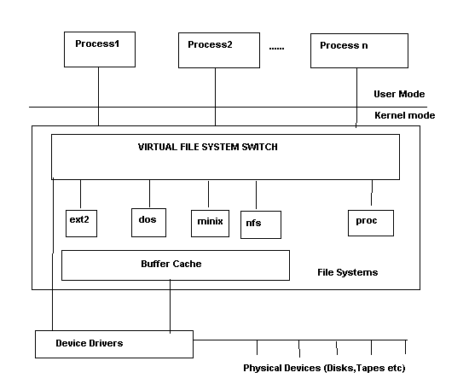
Virtual File System Switch

Slide 123
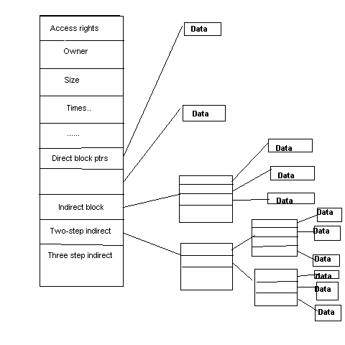
Structure of Inode

Slide 124
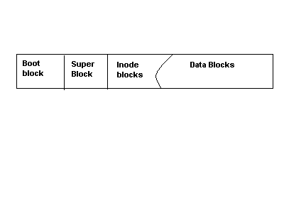
Unix File System

Slide 125
FEATURES OF UNIX FILE SYSTEMS
Boot Block : Will it always be present?
SuperBlock:Information for managing file systems
InodeBlocks:inode structures for the file system.
DataBlocks:blocks for files,directories..etc
Mounting,Unmounting file systems

Slide 126
Representation of File systems
Management structures for file systems is similar to logical structure of UNIX file system.
VFS responsible for calling file-system specific implementations. How does VFS know which filesystems are configured?
Void register_filesystem(struct file_system_type *);
Configured at boot-time and possibly loaded as modules as well.
struct file_system_type {
  Const char *name;
  Int fs_flags;
  Struct super_block *(*read_super)(struct super_block*,void *,int);
  #ifdef VERSION > 2.4
  Struct module *owner;
  Struct vfsmount *kern_mnt;
  #endif
  Struct file_system_type *next;
  };
Notes:
Functions are made known to the VFS via the function “register_filesystem”

Slide 127
Mounting
Any file system in UNIX must be mounted before it can be accessed,either through mount() or mount_root().
What is mount_root() ?
Representation of a mounted file system : struct super_block.Limited to NR_SUPER.
It is initialized by the function “read_super” in the VFS.It interrogates floppy disks,CD-ROM for a change of media,tests if superblock is present and if so returns it.else it calls the fs-specific function to create a superblock.
File system specific Read_super() reads its data from the block device using the LINUX cache functions,bread,brw_page.Processes may be put to sleep when reading/writing or mounting file systems.
Notes:
Sets up the first file system.called by system call setup() after all file systems have been registered.setup() is called after init is created.Why is a system call required here?User mode process.

Slide 128
Superblock
struct super_block {
  kdev_t s_dev;/* device */
  unsigned long s_blocksize;/* block size */
  unsigned char s_blocksize_bits;/* ld(block size) */
  unsigned char s_lock;/* superblock lock */
  unsigned char s_rd_only;
  Unsigned char s_dirt;
  Struct file_system_type *s_type;
  Struct super_operations *s_op;
  Unsigned long s_flags;
  Unsigned long s_magic;
  Unsigned long s_time;
  Struct inode *s_covered;/* mount point */
  Struct inode *s_mounted; /* root inode */
  Struct wait_queue *s_wait;/* s_lock wait queue */
  Union {
    Struct minix_sb_info minix_sb;
    Struct ext2_sb_info ext2_sb;
    ….
    Void *generic_sb;
    }u;

Slide 129
Locking/Unlocking superblock
Lock_super(struct super_block *sb)
{
  If(sb->s_lock) __wait_on_super(sb);
  Sb->s_lock=1;
  }
  unlock_super(struct super_block *sb)
  {
  sb->s_lock=0;
  wake_up(&sb->s_wait);
  }
  The read_super( ) function in the file system specific implementation should also make the root inode available using the function iget( );

Slide 130
Superblock operations
s_op points to a vector of functions for accessing the file system.
struct super_operations {
void (*read_inode)(struct inode *);
Int (*notify_change)(struct inode *,struct iattr *);
Void (*write_inode)(struct inode *);
Void (*put_inode)(struct inode *);
Void (*put_super)(struct super_block *);
Void (*write_super)(struct super_block *);
Void (*statfs)(struct super_block *,struct statfs *);
Void (*remount_fs)(struct super_block *,int *,char *);
};
These functions serve to translate the specific representation of the superblock and inode on data media to their general form in memory and vice-versa.Does every file system have a superblock and inode?
Elaborating a little more…
Notes:
Some of the operations listed in the superblock may be NULL in which case no action will take place.

Slide 131
Write_super(sb) : saves info on super block.Used in synchronising the device.dirty bit is set in buffer.
Put_super(sb) : Called when unmounting file systems.Releases super_block and buffers used.restores consistency if necessary.super_block structure can be reused.
Statfs(sb,statfsbuf) : fills the statfs structure with file system information.
Remount_fs(sb,flags,options) : new attributes for file system and restoring consistency.
Read_inode(inode) : fills in the inode structure.Marks different file types by using different inode_operations struct.for example
If(S_ISREG(inode->I_mode)
Inode->I_op=&ext2_file_inode_operations;
Else if(S_ISDIR(inode->I_mode)
Inode->I_op=&ext2_dir_inode_operations;
Else if(S_ISLNK(inode->I-mode)
Inode->I_op=&ext2_symlink_inode_operations;
…….Similiarly for character devices,block devices,fifos,etc

Slide 132
Notify_change(inode,attr) : changes made to inode are acknowledged by this function.It is of interest only in NFS/Coda etc.Why?Each file on such a system has a local and a remote inode.The remote file system is informed of the change using iattr.
Write_inode(inode) : saves inode structure.
Put_inode(inode) : if inode is no longer required.Called when deleting file and release its blocks.

Slide 133
INODE
Struct inode {
Kdev_t I_dev;
Unsigned long I_ino;
Umode_t I_mode;
Nlink_t I_nlinkl;
Uid,gid etc….
Dev_t I_rdev; /* only if device special file */
Offset,times of modification,access,creation etc
Struct semaphore *I_sem;
Struct inode_operations *I_op;
Struct super_block *I_sb;
Struct wait_queue (I_wait;
Struct file_lock *I_flock;
Struct vm_area_struct *I_mmap;
Struct inode *I_next,*I_prev;
Struct inode *I_hash_next,*I_hash_prev;
Struct inode *I_boundto;

Slide 134
INODE…contd
Struct inode *I_mount;
Struct socket *I_socket;
Reference_counter,flags,lock,bits that denote if this is a pipe,socket.
Union {
Struct pipe_node_info pipe_i;
Struct minix_inode_info minix_i;
….
Void *generic_ip;
}u;
};
Inodes are managed as doubly linked lists as well as a hash table.starts with first_inode(/ inode).iget() function can be used to get the inode specified by the superblock.It uses hints to resolve cross mounted file systems as well.Any access to inode increments a usage counter.Analogous function iput( ).

Slide 135
Inode Operations
Struct inode_operations {
Struct file_operations *default_file_ops;
Int (*create)(struct inode *,const char *,int,int,struct inode **);
Int (*lookup)(struct inode *,const char *,int,struct inode **);
Int (*link)(struct inode *,struct inode *,const char *,int);
Int (*unlink)(struct inode *,const char *,int);
Int (*symlink)(struct inode *,const char *,int);
Int (*mkdir)(struct inode *,const char *,int);
Similiarly we have rmdir,mknod,rename,readlink,follow_link,bmap,truncate,permission,smap.
NOTE :All these functions are directly called from the implementation of the corresponding system call.

Slide 136
File System Calls.
Create(),lookup(),link(),unlink(),symlink(),mkdir(),rmdir(),
mknod(),rename(),readlink(),follow_link()
Bmap() : used for mmap’ing files .This function is called by the function generic_mmap() to map a block of data from file to an address in the user space.
Smap():allows swap files to be created on a UMSDOS file system.
To allow for shared accesses to files,UNIX introduced an extra structure.
Struct file {
Mode_t f_mode;
Loff_t f_pos;
Unsigned short f_flags;
Unsigned short f_count;
Off_t f_reada;/* readahead flag */
Struct file *f_next,*f_prev;
Struct inode *f_inode;
Struct file_operations *f_op;
Void *private_data;
};

Slide 137
File Operations .
General interface to work on files,Has functions to open,close,read,write etc.Why are these isolated from inode_operations?These operations also need to modify struct file.Hence.
Struct file_operations {
Struct module *owner;
Int (*lseek)(…)
Read,write,readdir,select,ioctl,mmap,open,release,fsync,fasync,check_media_change,revalidate..
These are also used by sockets/drivers etc..The inode operations only use the representation of the socket/device .
If any of these functions are not implemented ,it tries to call default file operations function,failing which an error is returned.Certain functions only make sense for drivers,like release,open

Slide 138
Opening Files
Open : most complicated system call. Authorization to open the file is checked,an empty file structure is allocated and entered in file decsriptor table of process and open_namei() is used to retreive the inode for the file.Performs a lot of tests.
Name ends in a /.What should be done?
If O_CREAT is set,What function should this call?
What about symbolic links,directories?
Permission is checked with the inode permission list also.
What about character devices and block devices ?
Directory cache originated in ext2fs.Directory names are cached.It is a 2-level cache with LRU at both levels.Hash key is formed by the dev number and the inode number and the name.Exports dcache_add,dcache_lookup functions
Notes:
Inode operations create.

Slide 139
PROC FILE SYSTEM
Every process has a directory in /proc/pid which contains files relevant to the process.
VFS function read_super( ) is called by do_mount( ) and in turn calls proc_read_super( ) for the proc file system.
Struct super_block *proc_read_super(struct super_block *s,void *data, int silent)
{
Lock_super(s);
Sets some fields in s.
S->s_op=&proc_sops;
Unlock_super(s);
If(!(s->s_mounted=iget(s,PROC_ROOT_INO))) {
S->s_dev=0;/* free the super block */
Return NULL;
}
Parse_options(data,&s->s_mounted->I_uid,s->s_mounted->I_gid);
Return s;
}

Slide 140
PROC FILE SYSTEM…contd
Some of the invariable entries in the root dircetory entry are
. , .. , loadavg,uptime,meminfo,kmsg,version,pci,cpuinfo,self,ioports,profile.

Slide 141
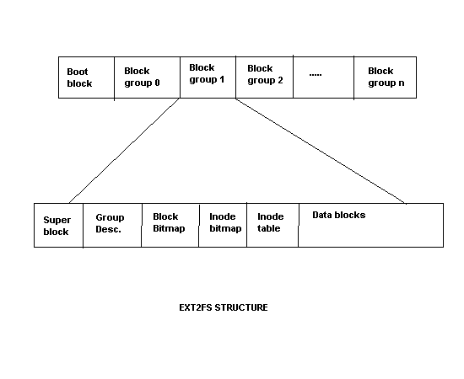
EXT2 File System
Originally used MINIX file system.Serious limitations like partition size,file name size etc.Proposed ext file system which was even worse.Led to excessive fragmentation.Remy Card et’al propose ext2fs which is the LINUX file system.
Influenced by BSD FFS.Every partition is divided into a number of block groups,corresponding to the cylinder groups of FFS,with each block group holding a copy of superblock,inode and data blocks.

Slide 142
STRUCTURE OF E2FS
What is the basic idea of block groups ?
The physical superblock contains information on the number of inodes,blocks per block groups,time of last mount,last write to sb,mount counter,maximum mount operations.Padded to a size of 1k bytes.
Block group descriptors:Information on block groups.Each block group is described by a 32 byte desc.Contains block numbers in the inode bitmap,block bitmap and inode table,number of free inodes,number of free blocks,number of directories in this block group.
Number of directories is made use by allocator to spread files evenly.
Block size=1024bytes => 8192 blocks per block group.
Inode size=128 Bytes.
Notes:
Keep data blocks close to inode,file inodes close to directory inode.

Slide 143
Directories in e2fs
Directories are singly linked lists.
Struct ext2_dir_entry {
Unsigned long inode;
Unsigned short rec_len;
Unsigned short name_len;
Char name[EXT2_NAME_LEN];
};
What happens on a delete?
Notes:
Don’t push/move the buffers around.Just change the value of the previous entry’s reclen to include this entry as well.Zero the inode number also.It can be reclaimed easily as well.

Slide 144
Block allocation in e2fs
Attempts to prevent fragmentation as much as possible.
Target-oriented allocation.
Always look for space in the area of target blocks.If this block is free use that,otherwise look for a block within 32 blocks from this.If not found then try to allocate from the same block group.else go to other block groups.
Pre-allocation:
If a free block is found then upto 8 of the following blocks are reserved if they are free.When a file is closed,the remaining blocks that are reserved are released.Also called clustering of data blocks.
How is target block determined?Let n=logical block #,l=logical block# of the last block allocated.Then l+1 is a possible target block
Notes:
Don’t push/move the buffers around.Just change the value of the previous entry’s reclen to include this entry as well.Zero the inode number also.It can be reclaimed easily as well.

