Slide 1


SEO
Progress Report
November 2023
https://letslearnindia.in/

Slide 2
TABEL OF CONTENT
MONTHLY ON-PAGE WORKS – OVERVIEW
MONTHLY OFF-PAGE WORKS – OVERVIEW
MONTHLY ALL TRAFFIC TO THE WEBSITE – OVERVIEW ( July 2023- Nov 2023 )
MONTHLY ORGANIC TRAFFIC – OVERVIEW ( July 2023- Nov 2023 )
DOMAIN AUTHORITY – OVERVIEW ( July 2023- Nov 2023 )
WEBSITE BACKLINKS – OVERVIEW ( ( July 2023- Nov 2023 )
NEXT MONTH DECEMBER 2023 PLAN

Slide 3

SEO ON-PAGE
(November 2023)

Slide 4
MONTHLY OFF-PAGE WORKS – OVERVIEW (NOVEMBER 2023)
Phases and Activities | Priority | B&P | LLI Tech Team
ALT Tag | Very High | Not Done | Not Done
Website Speed | Very High | Not Done | Not Done
Product Schema | Very High | Not Done | Not Done
Non www. to www. Redirection | Very High | Done | Done
Canonical Tag | Very High | Done | Not Done in a proper way
URL Instruction | Very High | Done | Done
Meta Tags | Very High | Done | This one is missing meta’s (https://letslearnindia.in/cs-professional?cid=23)
Faculty Pages | High | Done | Not Done in a proper way

Slide 5
MONTHLY OFF-PAGE WORKS – OVERVIEW (NOVEMBER 2023)
Phases and Activities | Priority | B&P | LLI Tech Team
Some Pages are Missing Courses | High | Done | Deactivated from backend
404 Page Creation | High | Done | Not Done
Blog Section | High | Done | WIP
H1 Tags | High | Done | Some are Done. Some are Not
Open Graph | High | Done | Not Done
Business Schemas | High | Done | Done
Breadcrumb Schemas | High | Done | Done
Image Alt Tags | High | Done | Need Screenshots
Website Speed | High | Done | Pending

Slide 6
SEO OFF-PAGE
(November 2023)

Slide 7
MONTHLY OFF-PAGE WORKS – OVERVIEW (NOVEMBER 2023)
Sr. No. | SEO Off-Page Activities | Submission Category | Total Submissions
1 | Link Submission | Off-Page | 44
2 | Free Guest Post | Off-Page | 05
3 | Profile Creation | Off-Page | 2
4 | Social Bookmarking | Off-Page | 22
5 | Classified Ads | Off-Page | 10
6 | Quora Answer | Off-Page | 02
7 | SEO Article | Off-Page | 02
TOTAL: |  |  | 87

Slide 8
Monthly All Traffic to the Website
(July 2023- November 2023)

Slide 9
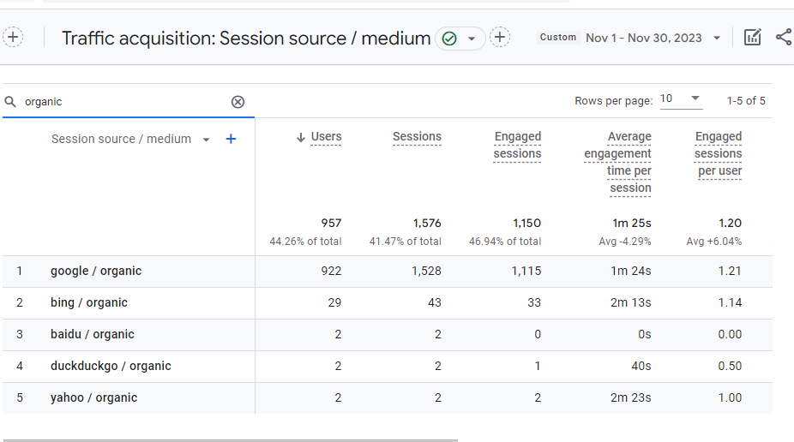
Monthly ORGANIC All traffic – OVERVIEW ( NOVEMBER 2023)
Source: Google Analytics

Slide 10
Monthly All traffic – OVERVIEW (July 2023- Nov 2023)
SEO Result | July 2023 | Aug 2023 | Sep 2023 | Oct 2023 | Nov 2023
Total Session | 1,318 | 5,119 | 5,430 | 4,802 | 3,900
Organic Search | 660 | 2,292 | 2,426 | 1,941 | 1,576
Google Ads | 0 | 0 | 0 | 0 | 0
Direct Session | 380 | 1,176 | 1,659 | 1,891 | 1,197
Referral | 292 | 980 | 1,267 | 969 | 176

Slide 11
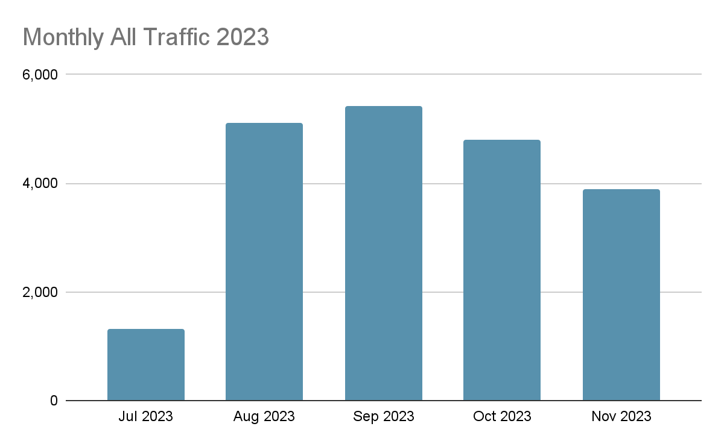
Monthly ALL traffic – July 2023- Nov 2023 OVERVIEW
5,430
5,119
4,802
3,900
1,318

Slide 12
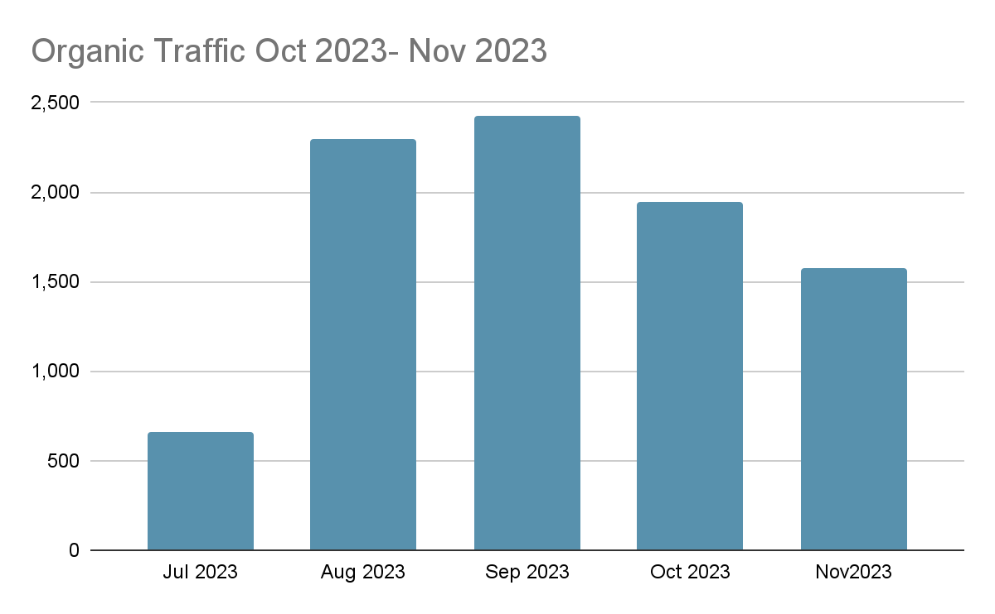
Organic Monthly ALL traffic – Jul 2023- Nov 2023 OVERVIEW
2,426
2,292
1,941
1,576
660

Slide 13
Domain Authority Score
July 2023- NOVEMBER 2023

Slide 14
DOMAIN AUTHORITY – OVERVIEW (July 2023- NOVEMBER 2023)
Month 2023 | Domain Authority Score
July 2023 | 19
Aug 2023 | 21
Sep 2023 | 20
Oct 2023 | 19
Nov 2023 | 20

Slide 15
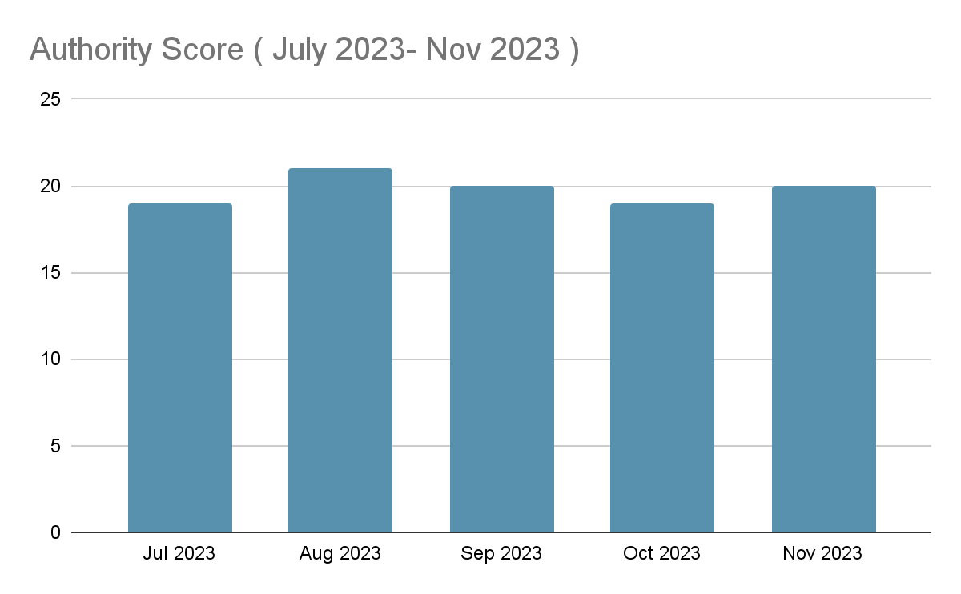
DOMAIN AUTHORITY= July 2023- Nov 2023
21
20
20
19
19

Slide 16
Website Backlinks
July 2023- NOVEMBER 2023

Slide 17
WEBSITE BACKLINKS – OVERVIEW (July 2023 -NOVEMBER 2023)
Month 2023 | No of Backlink
July 2023 | 580
Aug 2023 | 563
Sep 2023 | 523
Oct 2023 | 509
Nov 2023 | 510

Slide 18
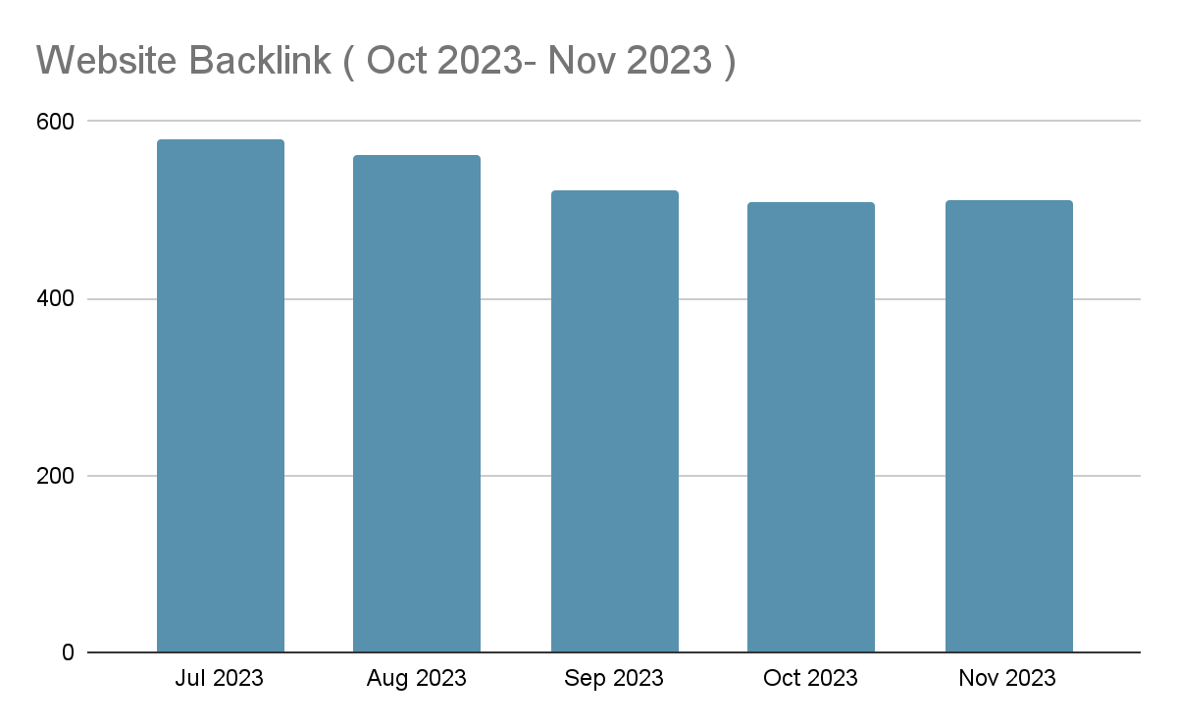
WEBSITE BACKLINKS – OVERVIEW ( October 2023- NOVEMBER 2023)
580
563
523
509
510

Slide 19
WHATS NEXT?
December 2023

Slide 20
Dec 2023 ACTION PLAN
Sr. No. | SEO ACTIVITY PLANS
1 | SEO On-Page: We’ll be doing follow up with the tech team and suggesting implementations for new pages and categories, Website Speed, and Schema Implementation.
2 | Targeting Keywords: All keywords will be our targeting keywords but our primary focus will be on top 5 faculty keywords and top 5 generic keywords.
3 | Content Marketing: We would be required Articles, Quora Answers and Website Blogs.
4 | High DA Sites Submissions: Submitting sites on the High DA sites and creating backlinks from there.
5 | Web 2.0 Submissions: Creating Subdomain Sites and getting backlinks from there.
6 | Broken Backlinks Reach out: Reaching out to the broken links admins.
7 | Keywords Base Competitors Referring Domains Submissions: Spying on the ranking sites and creating backlinks from there too.

Slide 21



