Slide 1
NeuroScience and NeuroComputing Assignment
Wimal Perera
09/10008

Slide 2
My Coding Task
Implementing a feed-forward ANN supporting backpropagation algorithm, where sigmoid function is used as the Activation Function in all perceptrons.

Slide 3
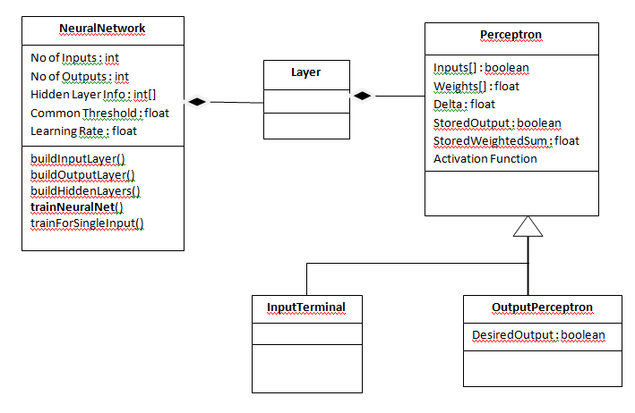
Design - Class Diagram

Slide 4
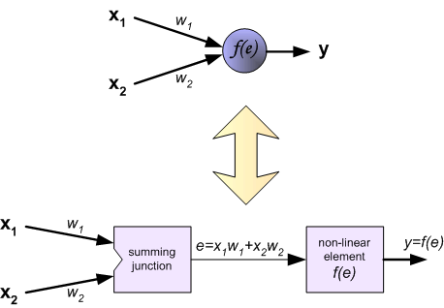
Structure of a Perceptron

Slide 5

Activation Function
Sigmoid Function

Slide 6
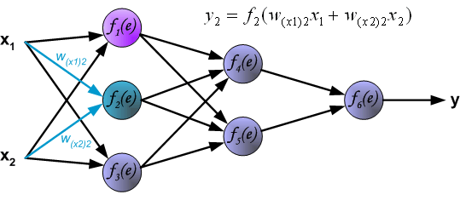
Forward Pass – Calculating Outputs

Slide 7
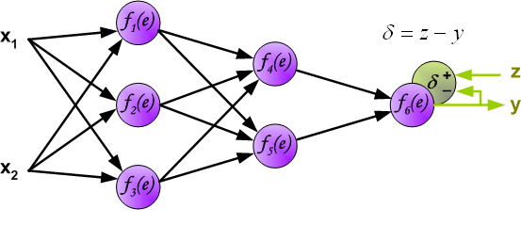
Calculating Delta – In Output Layer

Slide 8
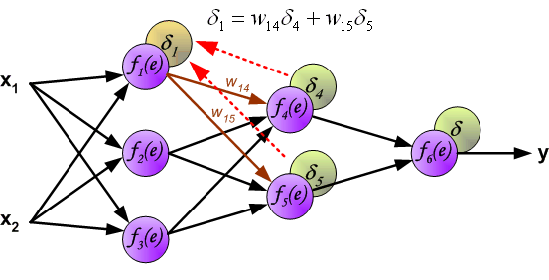
Calculating Delta – In Hidden Layers (Backward Pass)

Slide 9
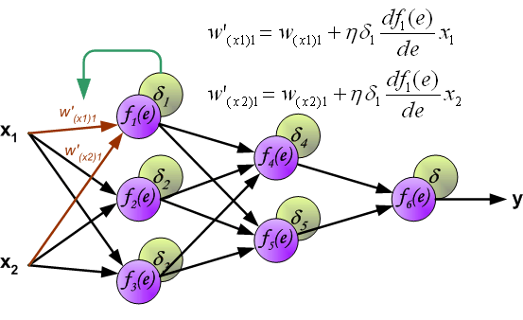
Updating Weights

Slide 10
Sample Usage – Constructing XOR
//parameters for creating the neural network
int inputTerminals = 2;
int outputTerminals = 1;
float learningRate = 0.1f;
float commonThreshold = 0.5f;
int[] hiddenLayerInfo = new int[] {2};
NeuralNetwork neuralNet = new NeuralNetwork(
inputTerminals, outputTerminals,
learningRate, commonThreshold, hiddenLayerInfo);

Slide 11
Sample Usage – XOR Continued
//example data for training the neural network
boolean[][] inputVectors = new boolean[][] {
{false, false},
{false, true},
{true, false},
{true, true}
};
boolean[][] desiredOutputVectors = new boolean[][] {
{false},
{true},
{true},
{false}
};

Slide 12
Sample Usage – XOR Continued
int iterations = 50;
String outputFile = "xor_output.txt";
//we train our neural network for 50 iterations
//the resulting weights of each perceptron in
//each layer is appended to the output file
//xor_output.txt
neuralNet.trainNeuralNet(
outputFile, iterations,
inputVectors, desiredOutputVectors);

Slide 13
Sample Output
============================
2 inputs, 1 outputs, 1 hidden layers
Iteration 6
Layer 1 with 2 perceptrons
Perceptron 0 with 2 inputs.
Current input weights are : 0.67647254 -0.6130594
Perceptron 1 with 2 inputs.
Current input weights are : 0.75545496 -0.68519574
Layer 2 with 1 perceptrons
Perceptron 0 with 2 inputs.
Current input weights are : 0.25466794 0.27075142
=============================

