Slide 1
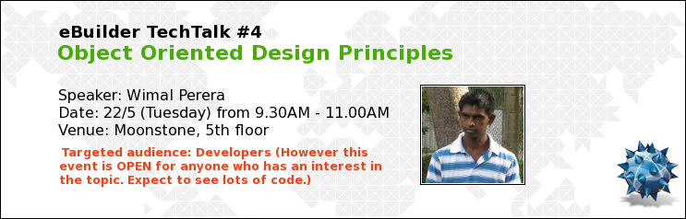

Slide 2
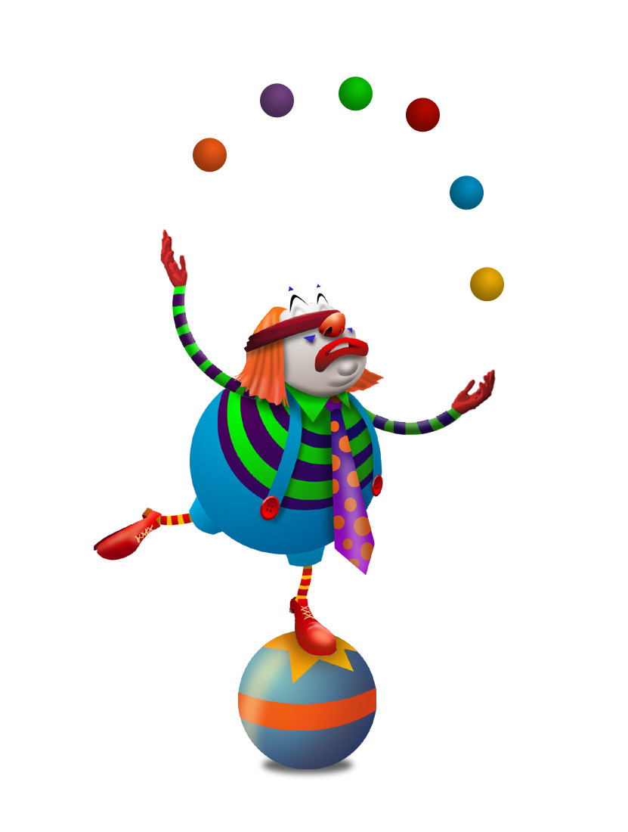
Agenda
UML
OO Design Principles
Agile/Scrum
Refactoring
PUTTING IT ALL TOGETHER
Juggling Code

Slide 3
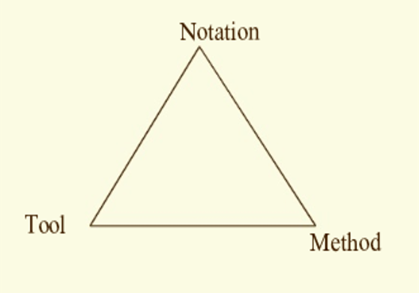
Towards a Successful Software Project
Same idea to be understood by any STAKEHOLDER
(Biz Analyst, PM, Developer, QA)
UML
Software Engineering Process
Astah, Rational Rose
Agile-Scrum Methodology
CASE (Computer Aided Software Engineering) Tool

Slide 4
Software Engineering Process
Defines “Who” is doing “What”,
“When” to do it
“How” to reach a certain goal
Software Engineering Process
New or Changed Requirements
New or Changed System

Slide 5
Software Development Perspective
Scrum:
Most widely used project mgmt approach for Agile Development.
Open Communications
Time Boxing
Priorities Set by Product Owner
Demonstratable Results
Project Management Perspective
Agile:
Promotes iterative and incremental software development

Slide 6
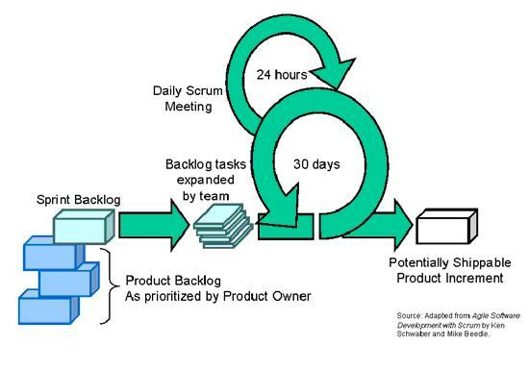
Agile-Scrum Methodology
USER STORIES with HIGHEST priority selected for the next SPRINT, based on team size and skill level
After each SPRINT we deliver a SHIPPABLE PRODUCT INCREMENT

Slide 7
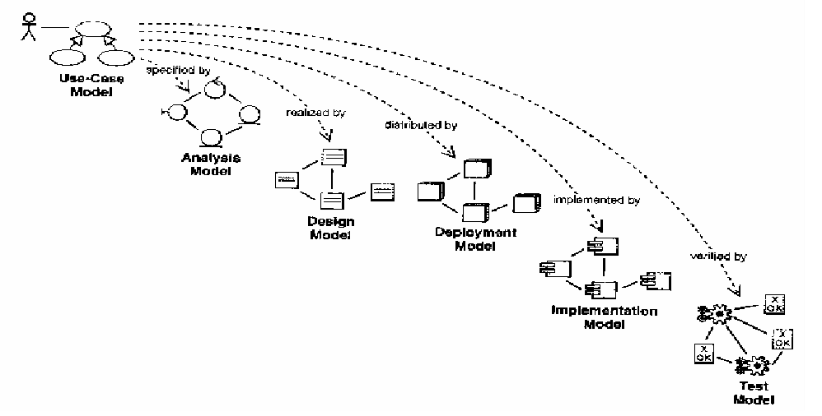
UML (Unified Modeling Language)
Requirement Gathering
Deployment (Login Server, Biz Logic Server, Web Server etc.)
Implementation (Dependencies between jars)
Analysis & Design (Class Diagrams)
Testing (Documenting Test Cases)

Slide 8
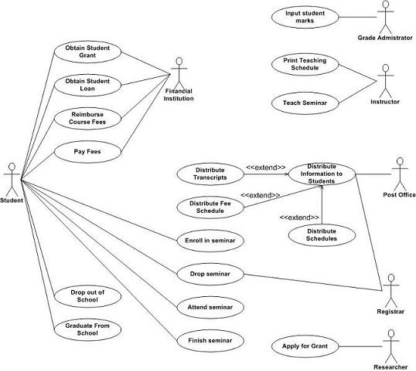
Requirement Gathering with UML
Functional Requirements
as Use Cases
End User(Actor)

Slide 9
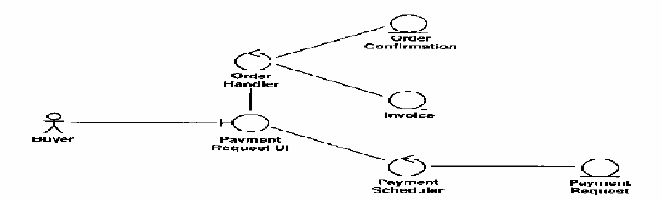
Analysis with UML
Controller Class
(Biz Logic & Related Services)
Entity Class
(to be persisted in DB)
Identifying Classes inside a Use Case
Boundary Class
(End User Interaction)

Slide 10
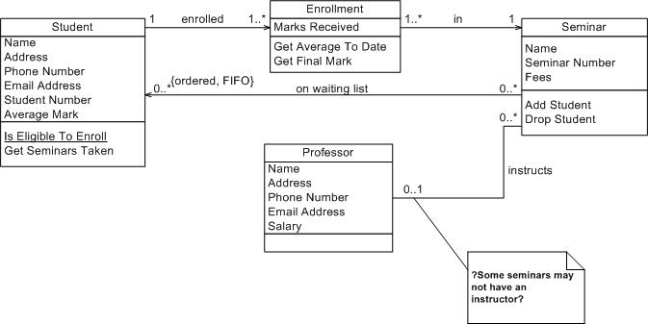
Design with UML
Detail Description of Classes with their Relationships

Slide 11
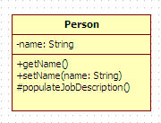
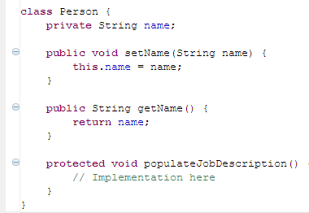
UML Class

Slide 12

Class Diagram Relationships in Detail
Association
Dependency
Generalization
Composition
Aggregation

Slide 13
Class Diagram Relationships in Detail
Dependency
Association
Aggregation
Composition
Generalization
Strength of the relationship increases

Slide 14
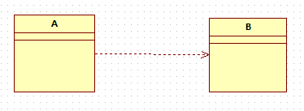
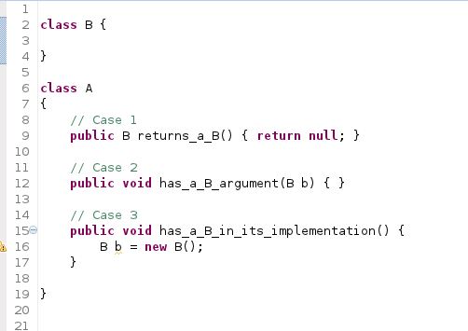
Dependency

Slide 15

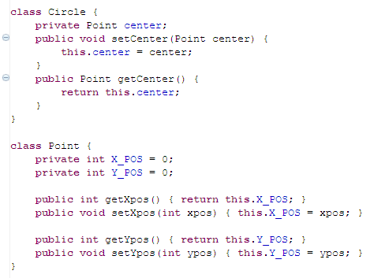
Uni-Directional Association

Slide 16

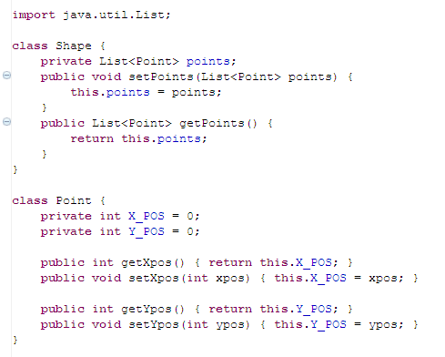
Association with Multiplicity

Slide 17

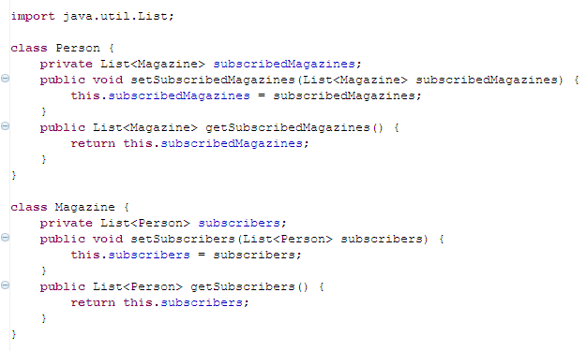
Bi-Directional Association

Slide 18
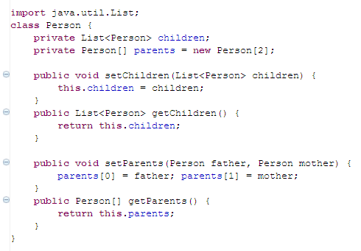
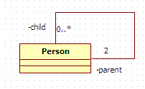
Reflexive Association

Slide 19
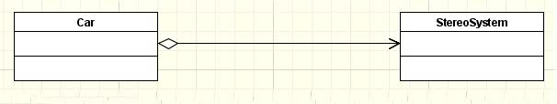
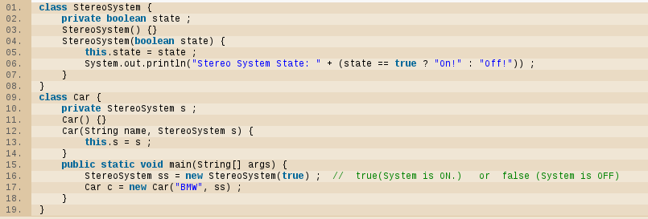
Aggregation

Slide 20
Business Requirements behind Aggregation
A stereo system can be sold separately without a car.
A car can be sold without a stereo system.
If a car is bundled with a stereo system both has to be sold together.

Slide 21
Business Requirements behind Aggregation (contd …)
If a stereo system is broken after the purchase, the car can still be used.
  Customer will purchase a NEW stereo system from us.
If the car is broken after the purchase, the stereo system can still be used.
  Customer might purchase a NEW car from us WITHOUT a stereo system.

Slide 22
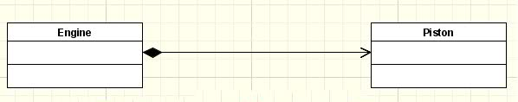
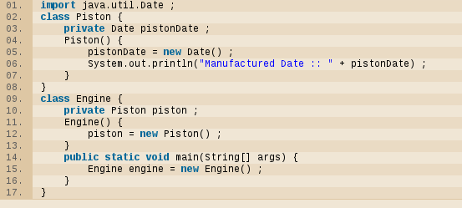
Composition

Slide 23
Business Requirements behind Composition
There can't be an engine without a piston.
We don't sell pistons separately, we sell only engines.
Thus there can't be a piston without an engine.

Slide 24
Business Requirements behind Composition (contd …)
If an engine is broken due to some internal error (even other THAN in the PISTON), then customer has to buy a NEW engine from us.
If the piston is broken and can't be repaired, the customer has to buy a NEW engine from us.

Slide 25
Aggregation vs. Composition vs. Business Domain
In the piston, engine example; if the inventory sells pistons separately, then a piston can exist without an engine
Thus the relationship will become an aggregation, not a composition

Slide 26
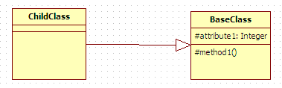
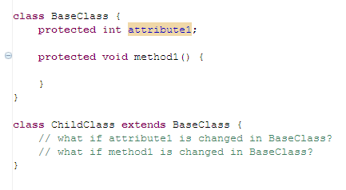
Generalization

Slide 27
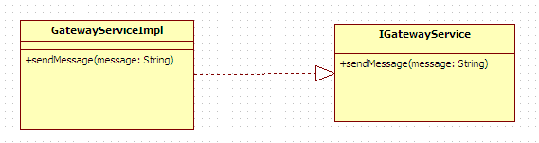
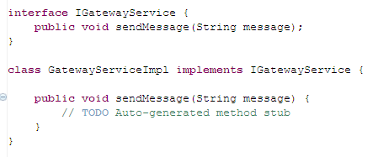
Realization

Slide 28
Forward Engineering vs.
Reverse Engineering
UML Design
Forward Engineering
Java Code
Java Code
Reverse Engineering
UML Design

Slide 29
Where Were We??
Recurring solutions to common software design problems found in real-world application development
OO Design Patterns
Practice
Guidelines to help avoiding a bad OO design (SOLID)
OO Design Principles
Foundation of OO; Abstraction, Encapsulation, Inheritance and Polymorphism
Theory
OO Concepts

Slide 30
What’s Next??
Recurring solutions to common software design problems found in real-world application development
OO Design Patterns
Practice
Guidelines to help avoiding a bad OO design (SOLID)
OO Design Principles
Foundation of OO; Abstraction, Encapsulation, Inheritance and Polymorphism
Theory
OO Concepts

Slide 31
OO Design Principles
SOLID
  Single Responsibility Principle
  Open-close Principle
  Liskov’s Substitution Principle
  Interface Segregation Principle
  Dependency Inversion Principle

Slide 32
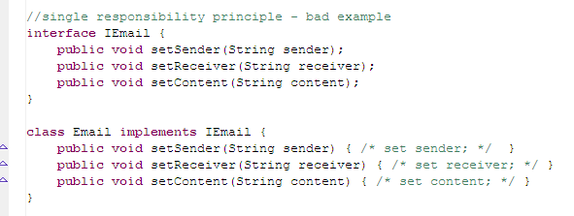
Single Responsibility Principle
Generating Email and Parsing Content are in the same class

Slide 33
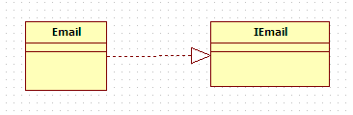
SRP Contd …
A class should have ONLY one reason to change.
Need to change the implementation inside Email class, when you introduce a new content type (like html)
What if there were multiple implementations of IEmail and a new content type is introduced? Change both?

Slide 34
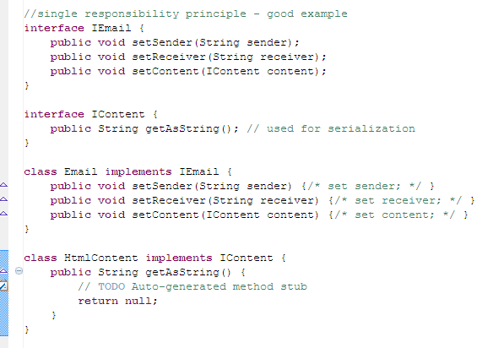
Refactoring with SRP

Slide 35
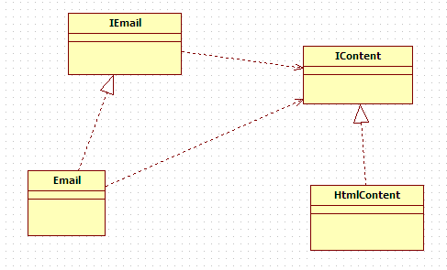
SRP Revised Design

Slide 36
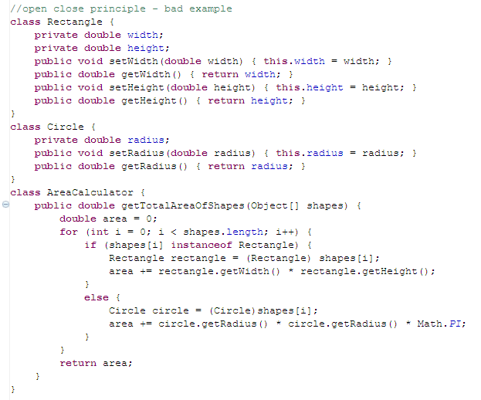
Open Close Principle

Slide 37
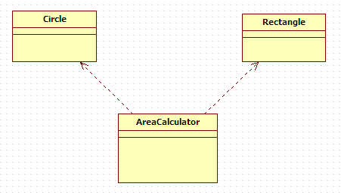
OCP Contd …
Software entities like classes, modules and functions should be open for extension but closed for modifications.
What if you introduce another shape Ellipse?
What will happen to the code inside AreaCalculator?

Slide 38
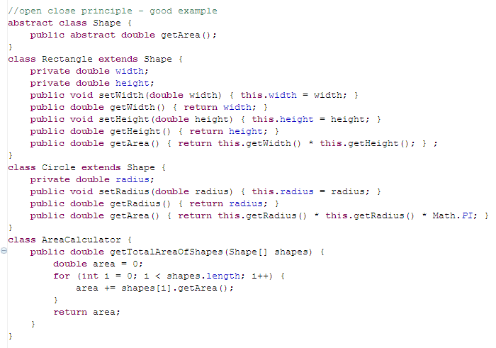
Refactoring with OCP

Slide 39
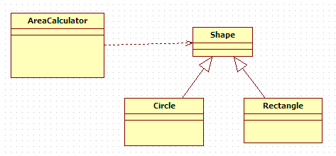
OCP Revised Design

Slide 40
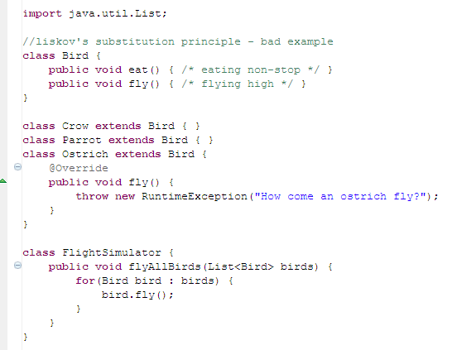
Liskov’s Substitution Principle
Oops!! What if an Ostrich comes here?

Slide 41
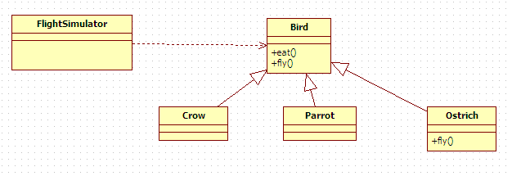
LSP Contd …
Derived types must be completely substitutable for their base types.

Slide 42
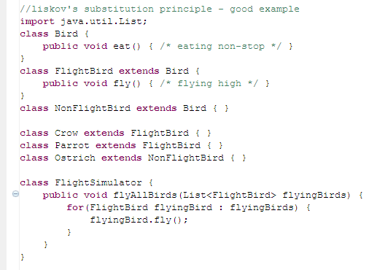
Refactoring with LSP

Slide 43
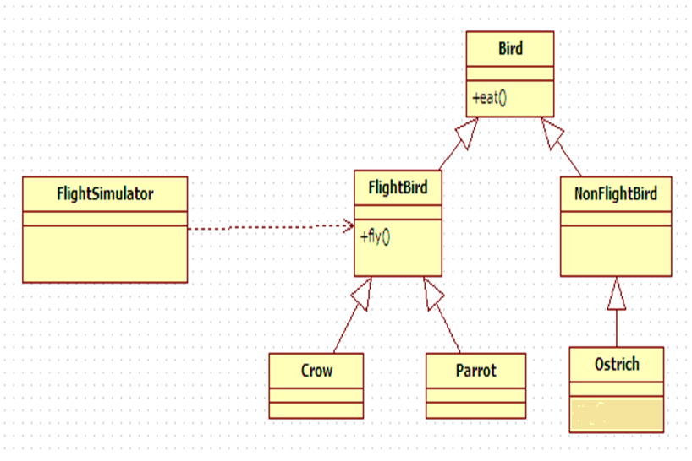
LSP Revised Design
All Birds eat()
Only FlightBirds fly()

Slide 44
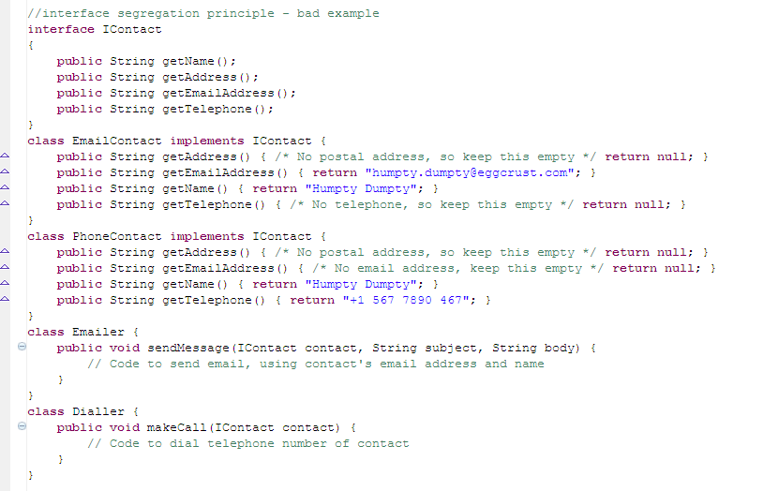
Interface Segregation Principle

Slide 45
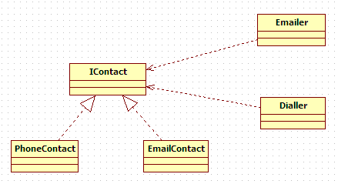
ISP Contd …
Clients should NOT be forced to depend upon interfaces that they DON’T use.

Slide 46
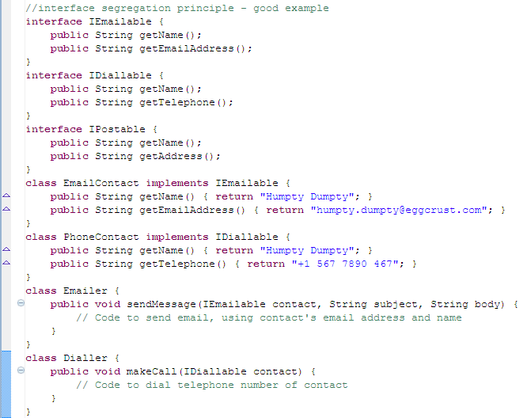
Refactoring with ISP

Slide 47
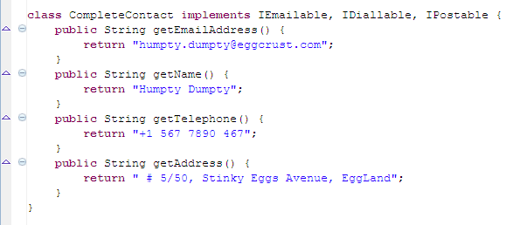
Refactoring with ISP

Slide 48
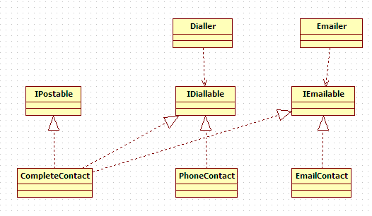
ISP Revised Design

Slide 49
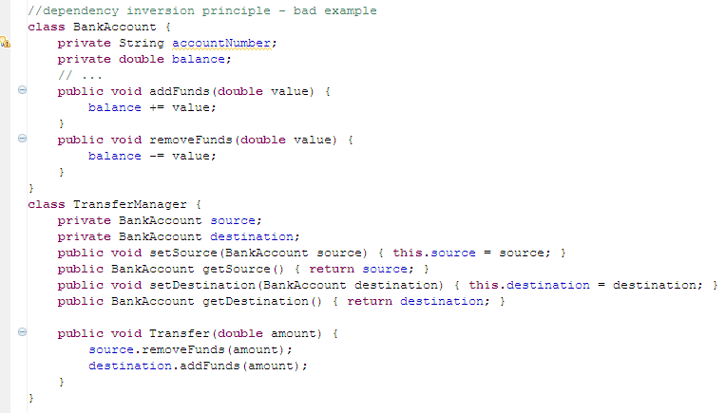
Dependency Inversion Principle

Slide 50
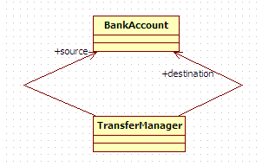
DIP Contd …
High-level modules should not depend on low-level modules. Both should depend on abstractions.
Abstractions should not depend on details. Details should depend on abstractions.

Slide 51
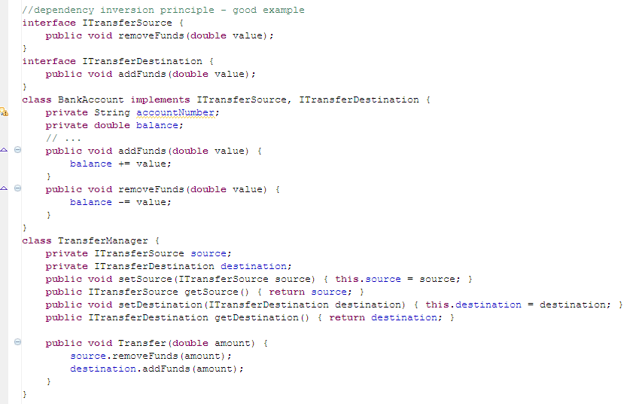
Refactoring with DIP

Slide 52
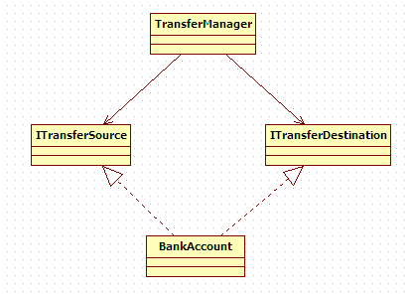
DIP Revised Design
Thanks to DIP, BankAccount and TransferManager can evolve independently from each other …

Slide 53
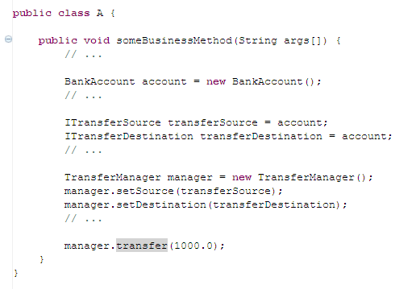
What about Other Connections ???
What if BankAccount class is replaced by a new implementation with a new class name?

Slide 54
About connections contd …
Thanks to DIP, we don’t need to change a single piece of code within TransferManager class …
But still we need to change the place which BankAccount is initialized in someBusinessMethod() in class A

Slide 55
XML vs. DIP
Why not we specify the connections of these objects in an xml file?
Why not write a framework to initialize and connect these objects by reading the XML file?
Then we can straight away call transfer() method on an object created from TransferManager class

Slide 56
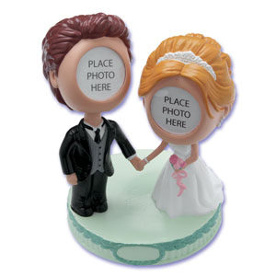
XML vs. DIP Contd …
DIP
XML Wiring
Birth of
Spring Framework

Slide 57
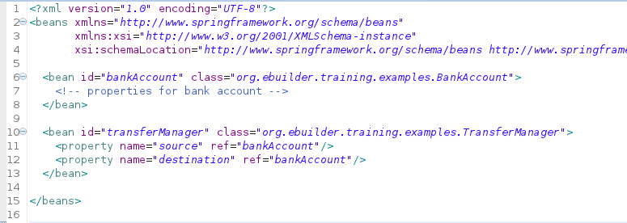
Part of Sample Spring XML File
Implementation Class
Identifier
Reference (XML Wiring)

Slide 58
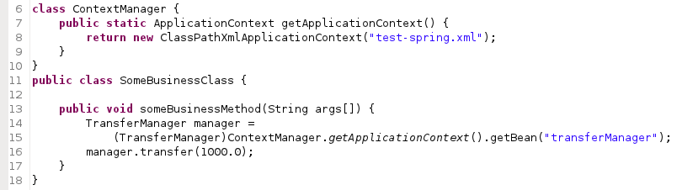
Biz Class Refactored
Spring Config File
Object ID

Slide 59

OO Design Principles
Agile/Scrum
UML

Slide 60

Project “eMystery”
Sprint 1:
  An encryption service, which is able to provide an encrypted file for a given plain file.
  Encryption is done using DES encryption algorithm
Time to get started

Slide 61

Developer: Oops!! Can’t go home today; if I apply OO Design on this. Time to code straight away.
PM: This functionality is critical. We MUST deliver it by EoD today.

Slide 62


Slide 63



Slide 64

SRP is already violated
Encryption Service handles 4 responsibilities …
Expose encryption as a service
Handle data retrieval based on different sources
Handle encryption based on different targets
Handle encryption based on different algorithms

Slide 65

Project “eMystery”
Sprint 2:
  Our encryption service, must support both DES and AES encryption algorithms.
How to survive with JUNK CODE, I wrote during PREVIOUS SPRINT ???

Slide 66

Survival Fix (“Ana” Fix)
Time to survive for this sprint

Slide 67

OCP is violated

Slide 68


Slide 69

Correct Fix with OO Refactoring
SRP partially resolved

Slide 70


Slide 71



Slide 72

Revised Design

Slide 73
OCP violation is resolved
SRP violation is partially resolved

Slide 74

Project “eMystery”
Sprint 3:
  The sources or targets in the encryption service can either be files in the local hard drive, or a data set remotely accessible via a webservice.
It never ends ☹☹☹

Slide 75

Solution with DIP and SRP

Slide 76


Slide 77


Slide 78


Slide 79

Project “eMystery”
Sprint 4:
  Wireless Connections will ONLY act as sources for the encryption service

Slide 80


Slide 81
The previous solution violated ISP

Slide 82


Slide 83


Slide 84



Slide 85

Revised Design

Slide 86

A Developer’s Recipe across multiple Agile Sprints
Ongoing Refactoring
dt
Time
Total Product “built so far”

Slide 87

What’s the reason behind “EncryptionAlgorithm” being an abstract class? Why not use an interface???

Slide 88

In Java JDBC;
Connection, Statement, PreparedStatement, ResultSet are interfaces. None of them are classes. Then where’s the implementation? How java is connected with databases ???

Slide 89
What’s Next??
Recurring solutions to common software design problems found in real-world application development
OO Design Patterns
Practice
Guidelines to help avoiding a bad OO design (SOLID)
OO Design Principles
Foundation of OO; Abstraction, Encapsulation, Inheritance and Polymorphism
Theory
OO Concepts

Slide 90
Q & A

