Slide 1
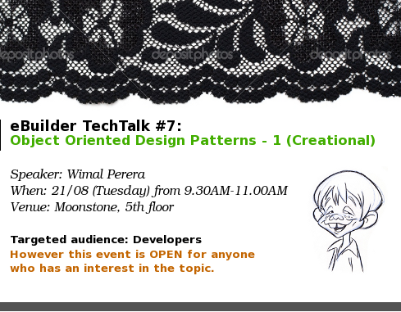

Slide 2
Where were We?
Recurring solutions to common software design problems found in real-world application development
OO Design Patterns
Practice
Guidelines to help avoiding a bad OO design (SOLID)
OO Design Principles
Foundation of OO; Abstraction, Encapsulation, Inheritance and Polymorphism
Theory
OO Concepts

Slide 3

Where were We?
OO Concepts
UML
OO Design Principles
Agile/Scrum
Code Refactoring
Practical Application of OO
PUTTING IT ALL TOGETHER

Slide 4
What’s Next??
Recurring solutions to common software design problems found in real-world application development
OO Design Patterns
Practice
Guidelines to help avoiding a bad OO design (SOLID)
OO Design Principles
Foundation of OO; Abstraction, Encapsulation, Inheritance and Polymorphism
Theory
OO Concepts

Slide 5
OO Design Patterns
5 + 7 + 11 = 23
Creational Patterns
(5)
Structural Patterns
(7)
Behavioural Patterns
(11)

Slide 6

Creational Patterns
CREATE objects for you, RATHER THAN having you instantiate objects directly
Provide your program, with the CAPABILITY to DECIDE which objects to be created based on the GIVEN CASE
1. Factory,
2. Abstract Factory, 3. Builder, 4. Singleton, 5. Prototype

Slide 7

Creational Patterns (e.g.)
We NEVER INSTANTIATE (i.e. use “new” keyword) an object from a SINGLETON class
Instead we “write code within the Singleton class to enable creation of only one object”

Slide 8
Structural Patterns
Focus is on how “CLASSES and OBJECTS are COMPOSED”
EMERGE NEW FEATURES by
ALTERING RELATIONSHIPS between OBJECTS”
1. Adapter, 2. Bridge,
3. Composite, 4. Decorator,
5. Façade, 6. Flyweight,
7. Proxy

Slide 9
Structural Patterns (e.g.)
“110v printer” connects with a “230v power supply” by using 110v~230v ADAPTER
“Power Supply-Adapter-Printer” is COMPOSED into a single system
A NEW FEATURE; “110v Power Supply” is achieved via ADAPTER

Slide 10
Behavioural Patterns
Main Concern is about “COMMUNICATION BETWEEN OBJECTS”
1. Template Method,
2. Iterator, 3. Visitor, 4. Observer, 5. Strategy, 6. Memento,
7. State, 8. Mediator,
9. Command, 10. Interpreter,
11. Chain of Responsibility

Slide 11
Behavioural Patterns (Contd …)
2 Objects COMMUNICATE
with each other by calling a method of one object within a method of the other
NEW FEATURES can be implemented by altering how METHOD INVOCATION happen between objects

Slide 12
Behavioural Patterns (e.g.)
Behavioural Patterns heavily rely on COMBINING polymorphism with Inheritance
Template Method enables
Implementing the CONCEPT of a “Framework”

Slide 13
Framework vs. Library
A Library has a collection of reusable methods. We call these methods from our code.
  Examples in Java;
    System.currentTimeMillis()
    Math.abs(-5.3)
The code written by us are called by a Framework.
  Examples in Java;
    Overriding doGet() method in javax.http.HttpServlet
    Overriding execute() method in org.apache.struts.action.Action

Slide 14
Behavioural Patterns (e.g.)
Template Method Implements the CONCEPT of “Framework” by COMBINING Polymorphism & Inheritance with Open-Close Principle

Slide 15
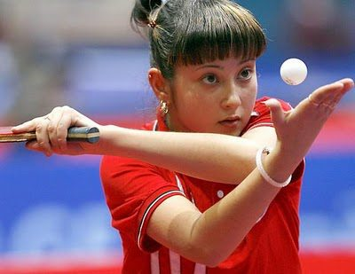
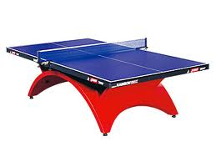

Creational Patterns
1. Factory,
2. Abstract Factory,
3. Builder,
4. Singleton, 5. Prototype

Slide 16

The Story of 4 Musketeers
Once upon a time in eBuilder, there lived 4 Musketeers.
1) SIDA
The “Cleverest
House-builder”
of All
&
“TT Champion” of
All Time

Slide 17

The 4 Musketeers
2) RASI
A friend indeed, founder of
“TT Killer Spin”

Slide 18

The 4 Musketeers
3) WIMA
The humble developer,
founder of
“TT Kurulu” service

Slide 19

The 4 Musketeers
4) ISSA
The “ALMIGHTY” TT Coach, who can lift you from “lowest rank to
2nd RUNNERS UP”

Slide 20
The 4 Musketeers (Contd …)
It all began when SIDA started to build a house on his own.
Unfortunately SIDA couldn’t find all cash needed to build the house and had to buy so many loans from so many places to build his house.
Thus SIDA became “the largest DEBTOR having the largest BUNGLOW” by the time of completing his house.

Slide 21
The 4 Musketeers (Contd …)
Since SIDA couldn’t afford all his DEBTs from eBuilder’s salary, he decided to start a HOUSE BUILDING COMPANY on his own as a part-time business.
SIDA’s company initially supported building houses similar to the bunglow built by SIDA: “SIDA’s MAKABAS MODEL”.
SIDA decided to develop the initial website for his business on his own.

Slide 22
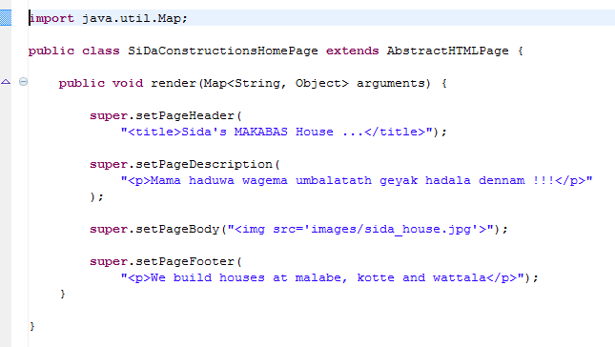

Slide 23
The 4 Musketeers (Contd …)
By the time SIDA was building his house, his fellow friend RASI also started building a house on its own by following SIDA’s strategies.
Thus RASI also became “the largest DEBTOR having the largest BUNGLOW” and had no option other than joining SIDA’s “HOUSE BUILDING COMPANY” for settling his debts.

Slide 24
The 4 Musketeers (Contd …)
But RASI was more interested in selling cars rather than building houses.
The group of companies formed by SIDA and RASI had “2 PRODUCT CATEGORIES”; houses and cars.
SIDA and RASI changed the company website to demonstrate both their PRODUCT CATEGORIES for the customers.

Slide 25
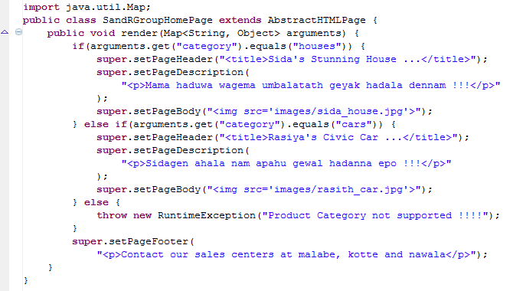

Slide 26
The 4 Musketeers (Contd …)
The business went on.
SIDA and RASI were gradually settling their debts.
However both of them realized that their website will not be maintainable if they try to demonstrate more and more different types of houses and cars in their website.

Slide 27

The 4 Musketeers (Contd …)
SIDA and RASI hired WIMA to fix the source code of the current company website.
With the bird swing of a single TT (Table Tennis) service, WIMA modified the existing source code.

Slide 28
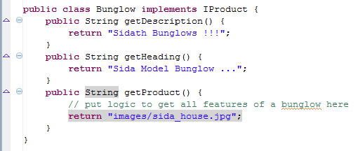
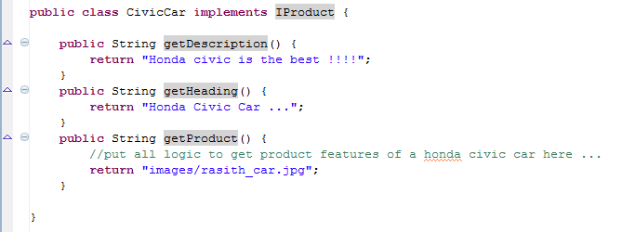

Slide 29
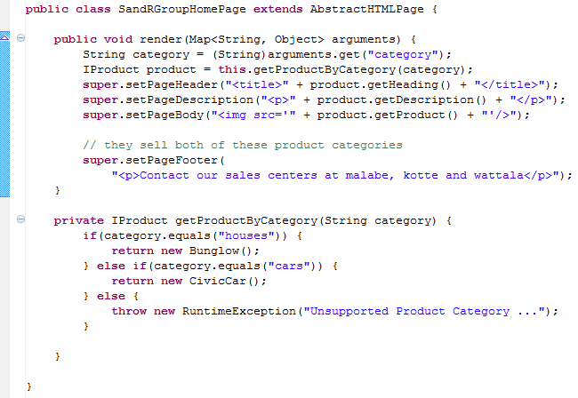

Slide 30
The 4 Musketeers (Contd …)
SIDA and RASI asked “What have you done WIMA?”
This is called the “factory method”
It is NOT the “factory design pattern”
But the code is in a satisfactory state for now

Slide 31
The 4 Musketeers (Contd …)
As the business grew with more opportunities, SIDA and RASI decided to extend their business.
RASI decided to sell “Vitz” cars in addition to “Civic” cars.
SIDA decided to take on “Office Buildings” in addition to “Bunglow” constructions.

Slide 32
The 4 Musketeers (Contd …)
SIDA and RASI consulted WIMA to alter the website based on the new business requirements.
WIMA decided that now it is time to move to “Factory Design Pattern” from the current implementation of “factory method”.

Slide 33

Factory Design Pattern
CREATE objects “WITHOUT specifying the exact class of the object”

Slide 34
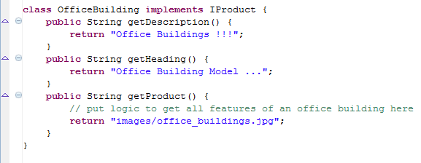
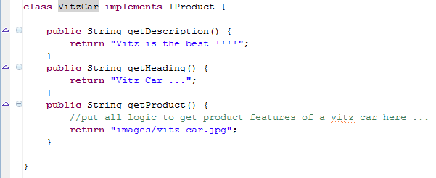

Slide 35

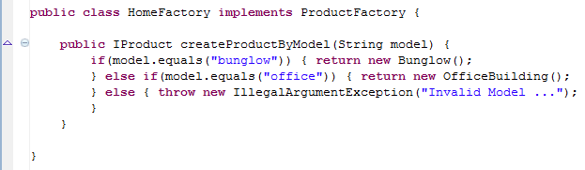
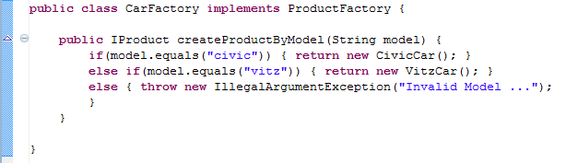

Slide 36
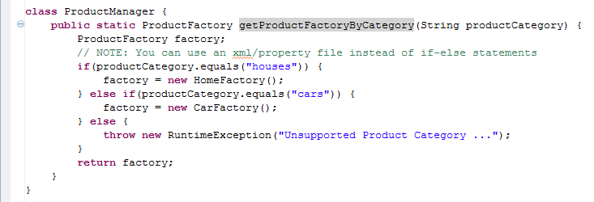
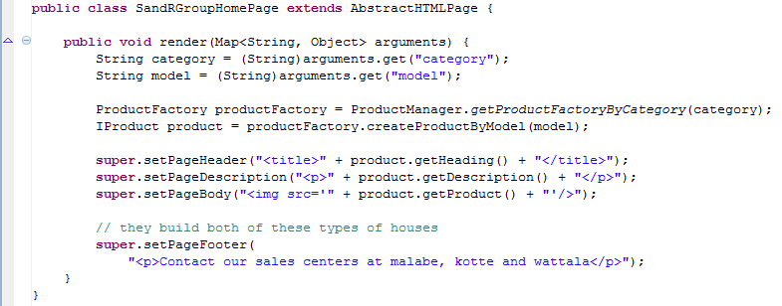

Slide 37
The 4 Musketeers (Contd …)
SIDA decided to stop building houses at Wattala area, since it’s too far for him to go and not much orders are coming.
RASI decided to close the Car Center at Kotte and put remaining cars to Wattala, since Kotte didn’t gave him much sales.

Slide 38
The 4 Musketeers (Contd …)
SIDA and RASI again consulted WIMA, to change the website with these new business requirements.
WIMA noticed that “Products” and “SalesCenters” share some “COMMON THEME” which is based on “Product Category”.
WIMA decided that now it’s time to use “Abstract Factory”.

Slide 39

Abstract Factory
GROUPING of
“object FACTORIES” that have a
“COMMON THEME”
Defines a
“WEB OF INTERFACES”
to represent this “COMMON THEME”

Slide 40

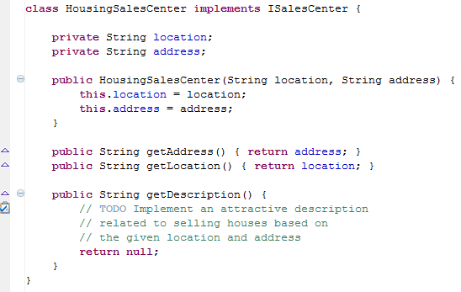

Slide 41
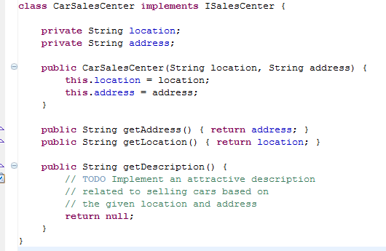

Slide 42

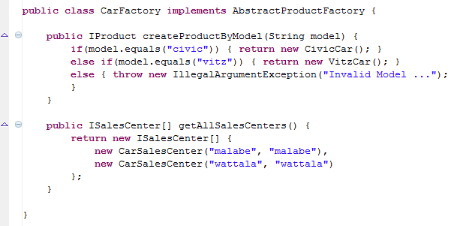

Slide 43
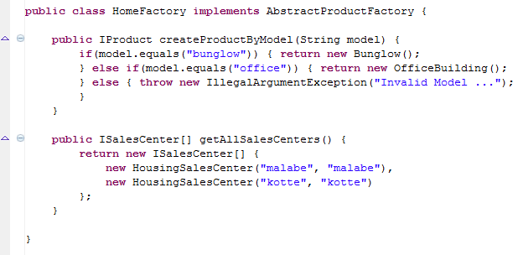

Slide 44
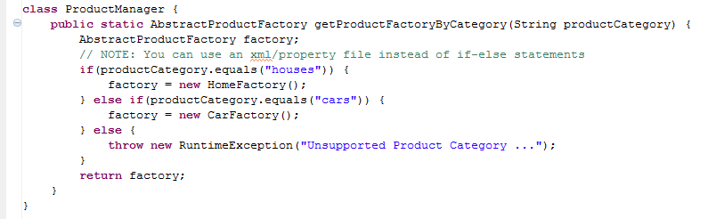

Slide 45
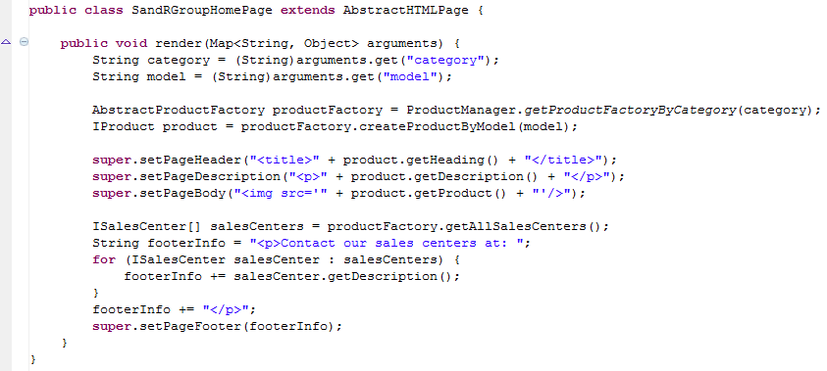

Slide 46
The 4 Musketeers (Contd …)
Suddenly WIMA noticed that some parts of code in HousingSalesCenter and CarSalesCenter are the same.

Slide 49
The 4 Musketeers (Contd …)
WIMA thought why not find a way to reuse the same code, without replicating it.
WIMA decided to refactor ISalesCenter “interface” into an “abstract class”, SalesCenter.

Slide 50
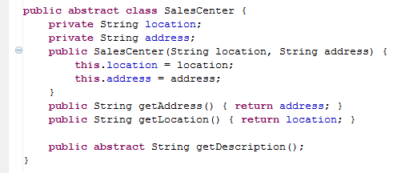

Slide 51
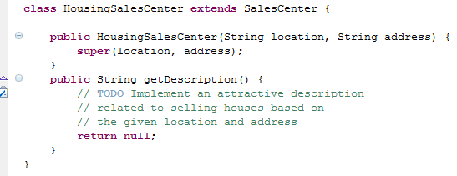
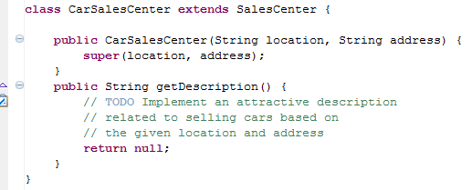

Slide 52
The 4 Musketeers (Contd …)
ISSA (the almighty TT coach), came across SIDA and RASI’s company website.
ISSA contacted SIDA and asked for a housing catalogue on all available housing models, so that he can select a house model based on them.

Slide 53
The 4 Musketeers (Contd …)
SIDA was upset that he didn’t have such a housing catalogue, other than the Bunglow and Office Building, he built.
SIDA decided that it is time to build a housing catalogue with several housing models and introduce this housing catalogue to customers like ISSA.

Slide 54
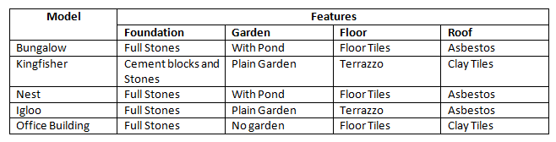
The 4 Musketeers (Contd …)
SIDA defined a house catalog as follows.
SIDA consulted WIMA to include all houses in this catalog in the company website.

Slide 55
The 4 Musketeers (Contd …)
WIMA saw that CONSTRUCTION of a house object is now COMPLEX than previously it was.
WIMA saw that certain features have “repetitive patterns” among different house models.

Slide 56
The 4 Musketeers (Contd …)
Initially WIMA thought why not write 5 classes to represent 5 house models and initialize them via HomeFactory ?
But WIMA realized that in this case, code inside these 5 classes will be repeated again and again.
WIMA decided that it’s time to convert his HomeFactory into a HomeBuilder.

Slide 57

Builder
Construct objects by “SEPERATING between CONSTRUCTION and REPRESENTATION”

Slide 58
The 4 Musketeers (Contd …)
WIMA started by implementing all the features separately.

Slide 59
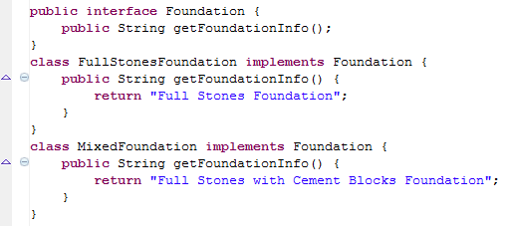

Slide 60
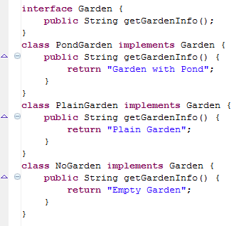

Slide 61
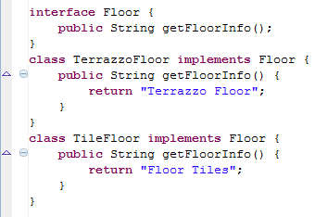

Slide 62
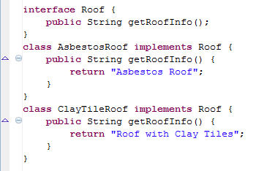

Slide 63
The 4 Musketeers (Contd …)
WIMA created;
  a class called House to hold the REPRESENTATION of a House
  an interface HouseBuilder which is used as guidelines behind CONSTRUCTION of a House
  a class called HouseDirector for building the House based on selected CONSTRUCTION

Slide 64
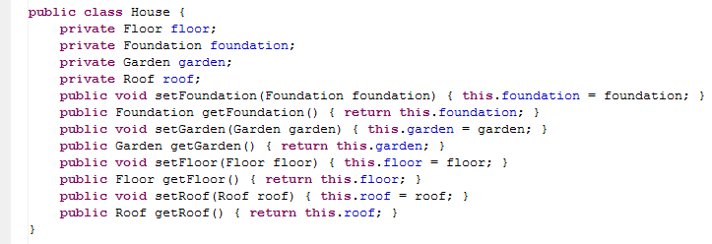

Slide 65
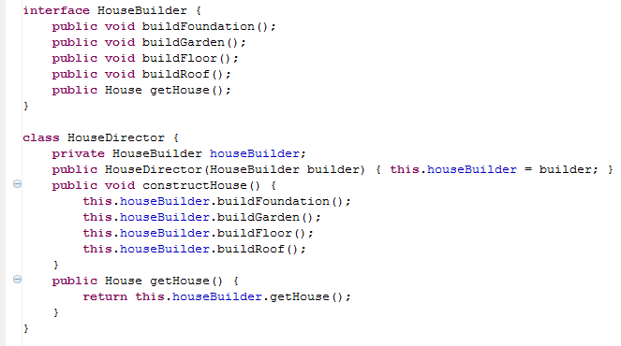

Slide 66
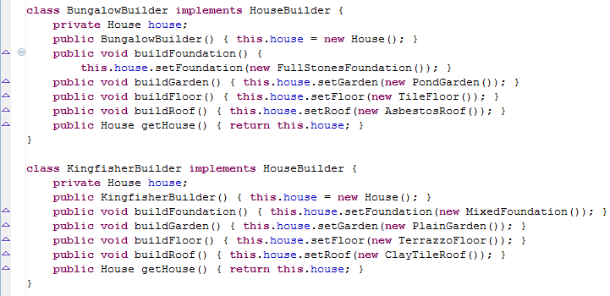

Slide 67
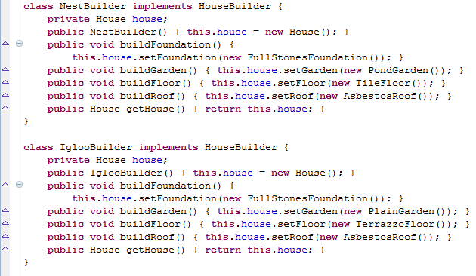

Slide 68
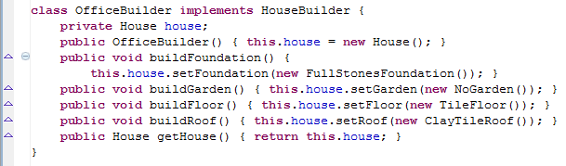

Slide 69
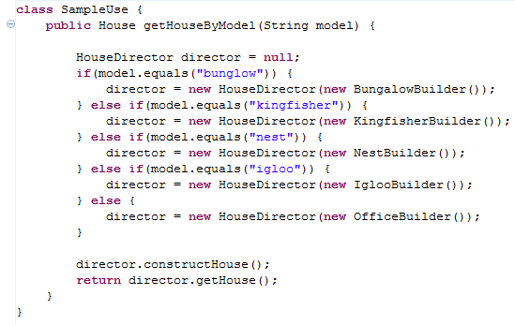
Using Builder to build a House …

Slide 70
The 4 Musketeers (Contd …)
Back to SIDA and RASI’s company website;
  A House is built from scratch, component by component. Therefore CONSTRUCTION of a house is COMPLEX.
  A Car is sold as a whole object. No manufacturing is done such as assembling components inside a car.
Houses need Builder. But for Cars Factory is sufficient.
How to combine HouseBuilder with the already existing AbstractProductFactory?

Slide 71
The 4 Musketeers (Contd …)
WIMA was wondering how to embed “Builder” logic while maintaining “Abstract Factory”.
After the swing of several TT “Kurulu” services, WIMA did the following fix.

Slide 72
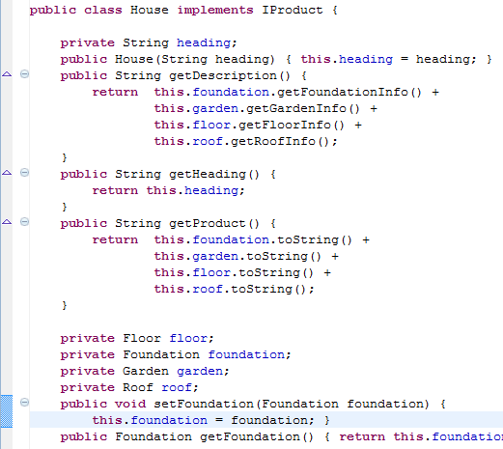

Slide 73
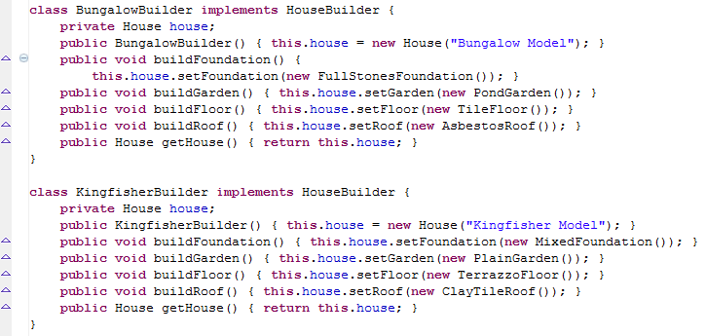

Slide 74
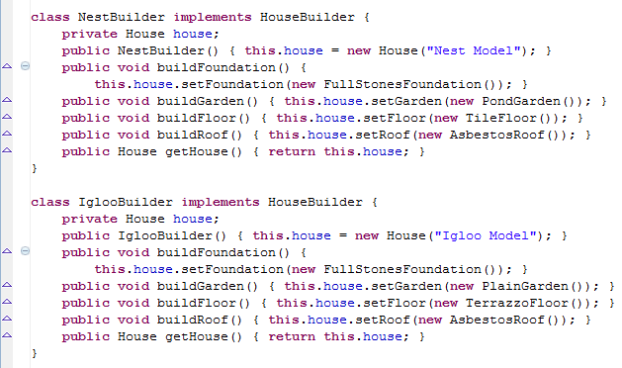

Slide 75
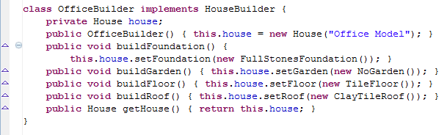

Slide 76
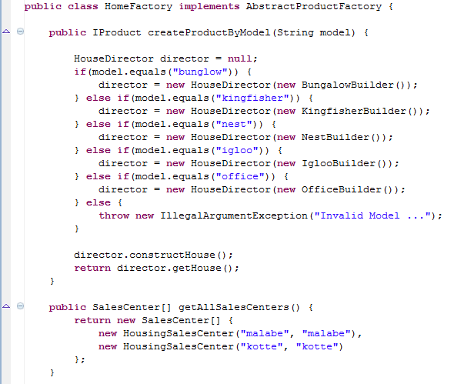

Slide 77
The 4 Musketeers (Contd …)
After having a look at catalog, ISSA was interested about the FEATURES inside all 5 STANDARD HOUSE MODELS in the catalog. But NOT interested in any of the 5 STANDARD HOUSE MODELS.
ISSA inquired from SIDA “Can I preview a CUSTOM house model of my own built from these FEATURES, other than these standard models?”

Slide 78
The 4 Musketeers (Contd …)
SIDA consulted WIMA to change the website to support CUSTOMIZABLE house models.
After having several looks on his 2nd Runner Up Trophy, WIMA did the following fix on top of the existing code base.

Slide 79
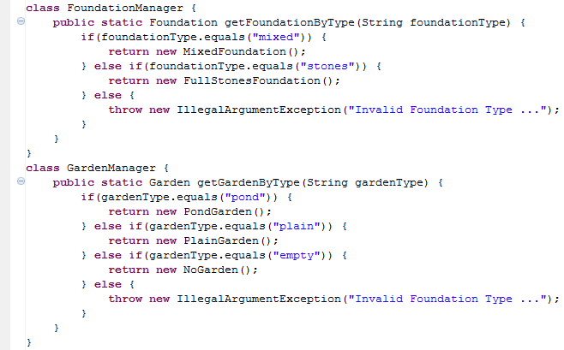

Slide 80
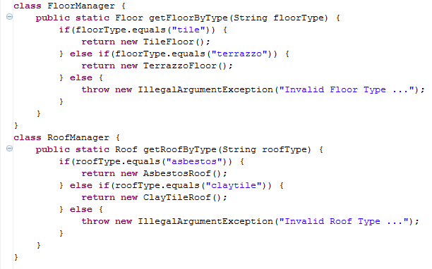

Slide 81
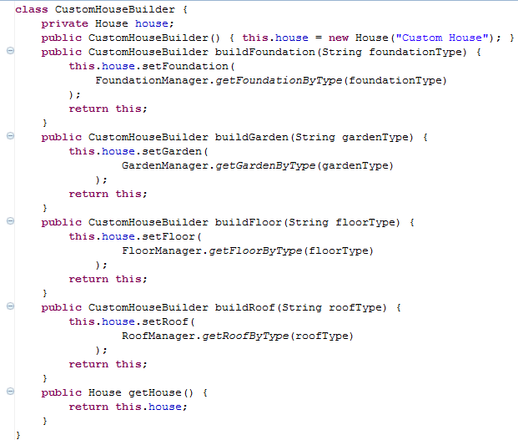

Slide 82
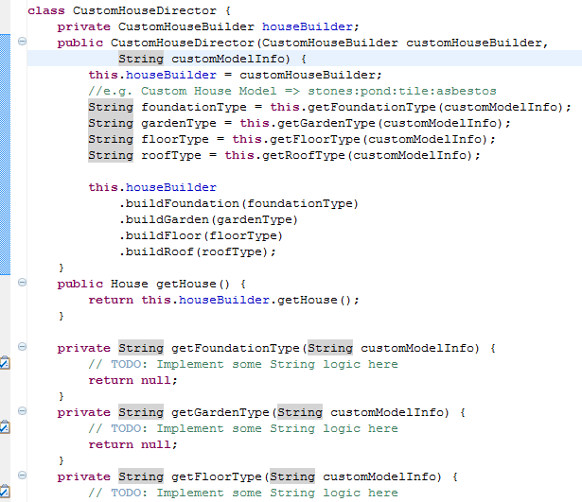

Slide 83
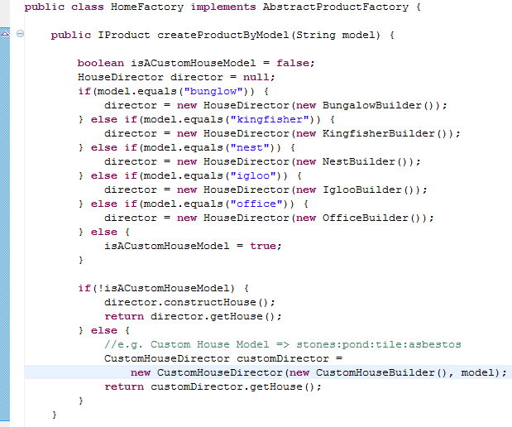

Slide 84
The 4 Musketeers (Contd …)
ISSA managed to come up with a CUSTOMIZED house model at last.
The business went well. SIDA and RASI settled all their debts and became billionaires.
ISSA was satisfied about the house he’s got.
WIMA got well paid for all the work he did.

Slide 85
The 4 Musketeers (Contd …)
And they all lived happily ever after.

Slide 86
Moral of the Story …
When to use design patterns and when not?
What is the difference between factory method and factory design pattern?
What is the difference between factory design pattern and abstract factory design pattern?
Is it necessary to go for a factory design pattern when you have more than one product?

Slide 87
Moral of the Story (Contd …)
Why factory is more suitable than builder based on the given problem?
When to use abstract classes and when to use interfaces within your factories?
Why builder is more suitable than factory based on the given problem?
How to evolve your code with design patterns, according to changing business requirements?
How to come up with a hybrid design by integrating multiple design patterns?

Slide 88
Q & A

Slide 89

Singleton
RESTRICTS “object creation” from a class to “ONLY ONE OBJECT”.

Slide 90
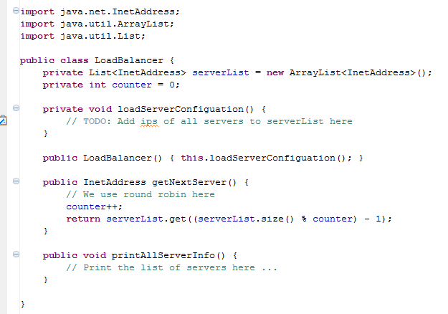
Singleton - Example

Slide 91
Why need a Singleton???
We have an instance variable; “counter” which we use to implement round robin.
We have another instance variable serverList
counter and serverList MUST have SAME VALUE in any LoadBalancer object reference used in any code block of our application
If there aren’t any instance variables no need of Singleton, can have a class with static methods.

Slide 92
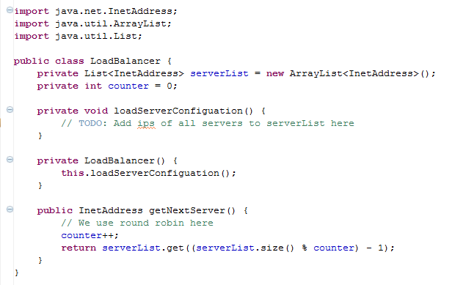
Step 1 – Private Constructor

Slide 93
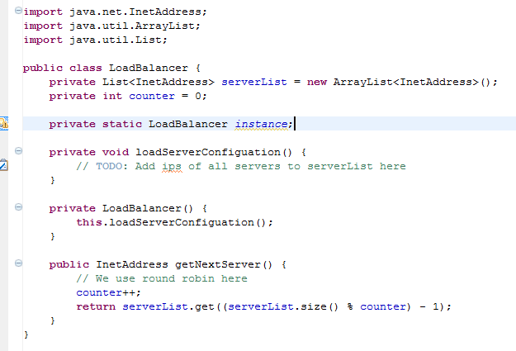
Step 2 – Static Attribute

Slide 94
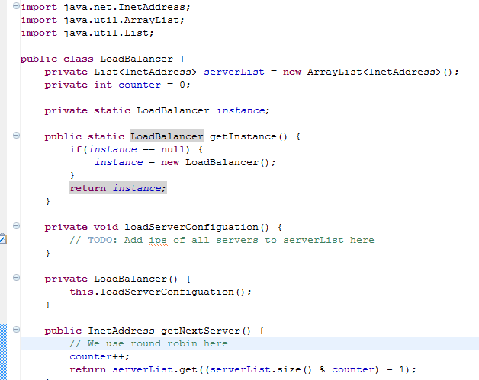
Step 3 - Static Method

Slide 95
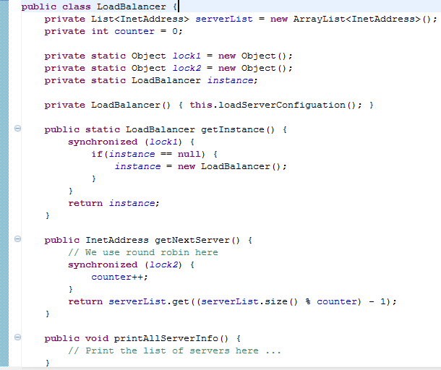
Step 4 – Sync, ONLY if required

Slide 96
Why use lock1 and lock2?
Why not use “static synchronized methods” OR “synchronized(this)” ?????
LoadBalancer class need not to be fully locked, since printAllServerInfo() method don’t need synchronization, even in case of multiple threads.

Slide 97
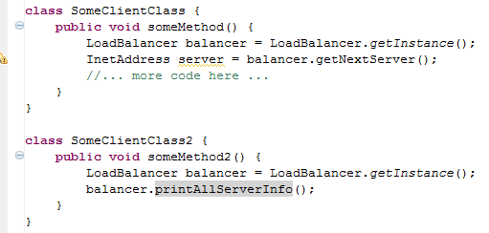
Using Singleton

Slide 98
What if severList changes even after initialization????
Assume you have a public method to setServerList()
2 Options;
  Lock setServerList(), getNextServer() and printAllServerInfo() using lock2
  OR use “static synchronized methods” or “synchronized(this)”
Which is more suitable????

Slide 99


Slide 100


Prototype
CREATE objects by CLONING an existing object
CREATE objects by CLONING an existing object

Slide 101
Why Clone???
JVM’s Perspective
  Higher performance than creating objects via constructors (i.e. with new keyword)
Java Developer’s Perspective
  Can create objects having COMPLEX structures by using already such EXISTING objects; WITHOUT any knowledge about the construction
    E.g. Creating a COMPLEX woman by using another COMPLEX woman, without knowing the COMPLEXITY of woman kind (previous Slide)

Slide 102

Example – Graphics App

Slide 103

Example – Graphics App

Slide 104

Without Cloning …

Slide 105

With Cloning !!!

Slide 106

With Cloning !!!

Slide 107

With Cloning !!!

Slide 108
Is It Correct ????

Slide 109

Problem of Shallow Copies

Slide 110
Problems with Shallow Copies …
Reason
  ColorSettings is a “REFERENCE TYPE” (i.e. not a primitive data type)
  AND
  is “NOT IMMUTABLE”

Slide 111

Deep Copies

Slide 112

Deep Copies

Slide 113
Prototype - Quiz
Why ColorManager need NOT necessarily be a Singleton class?
  In LoadBalancer value of “counter” CHANGED everytime, but in ColorManager standard colors are FIXED after being initialized
Why is factory, abstract factory, builder; NOT suitable for this problem?
  Factories CREATE objects from a SELECTED CLASS based on the GIVEN CASE
  Prototypes are PRE-CREATED objects from the SAME CLASS(i.e. Color), used as TEMPLATES for creating CUSTOMIZED objects (i.e. customRed1)

Slide 114
Q & A

