Slide 1
Model Context Protocol
Manthan Sharma

Slide 2
Agenda
Problem & Solution - Birth of MCP
What is MCP
MCP Architecture
Concepts of MCP Architecture
MCP Protocol Basic Flow in a AI Application
Security & Trust Model
Summary

Slide 3
Problem Layer 1 - AI in Isolation
LLMs are Powerful but they are locked in Conversation Box
They can’t access your files, database, APIs, or tools by default
No standard way for AI to interact with external systems

Slide 4
Partial Fix - Developers built custom Tools
Developers solved this by writing custom integrations/tools for AI
AI could now access files, search the web, query databases… but this created NEW problems

Slide 5
Problem Layer 2 — Tools themselves became a mess
Same tool, different AI apps - Duplicate code everywhere e.g., Web search tool built for Claude has to be rewritten for ChatGPT, Gemini separately
Same type of tool has different implementations across teams - No consistency, no reuse

Slide 6
Solution — MCP
One universal standard that solves both layers
Build a tool once, use it across any AI app
Consistent implementation, no duplication

Slide 7
What is MCP?
An open standard / open source protocol introduced by Anthropic (November 2024)
It is like a universal translator between AI models and external tools/data
Think of it as "USB-C for AI" — one standard plug for everything
Just like HTTP defines how browsers talk to servers, MCP defines how AI talks to tools
It removes the need for custom, one-off integrations — build once, use everywhere

Slide 8
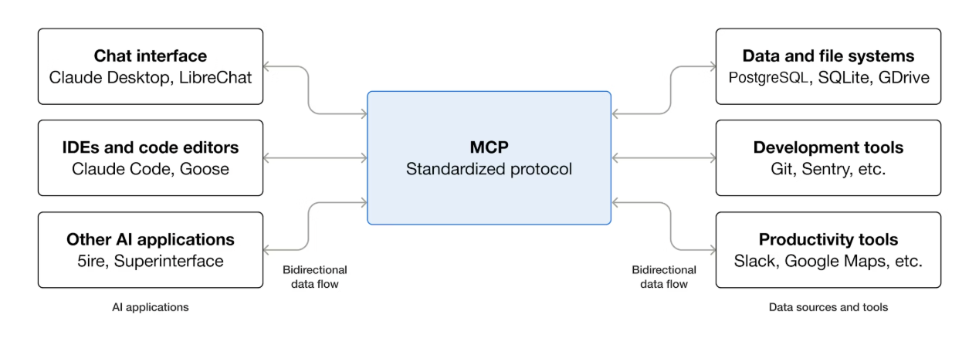
What is MCP?

Slide 9
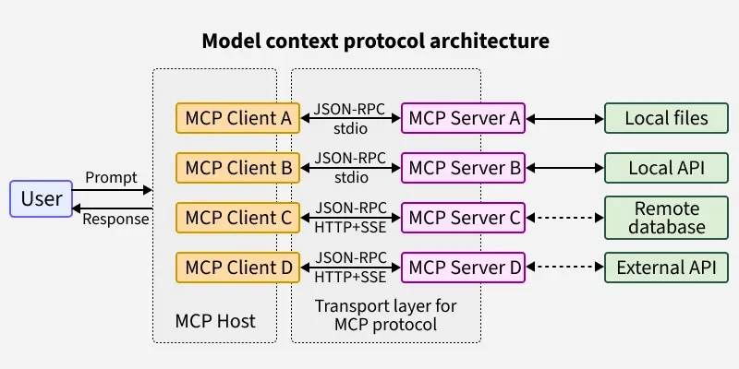
MCP Architecture — How It Works

Slide 10
Concepts of MCP
1. Participants - MCP follows a client-server architecture
MCP Host : The AI application that coordinates and manages one or multiple MCP clients
MCP Client : A component that maintains a connection to an MCP server and obtains context from an MCP server for the MCP host to use
MCP Server : A program that provides context to MCP clients

Slide 11
Concepts of MCP Architecture
2. Layers - MCP Consist of 2 Layers
Data Layer - Defines the JSON-RPC based protocol for client-server communication A. Lifecycle management B. Server features C. Client features D. Utility features
Transport Layer - Defines the communication mechanisms and channels that enable data exchange between clients and servers A. Stdio transport B. Streamable HTTP transport

Slide 12
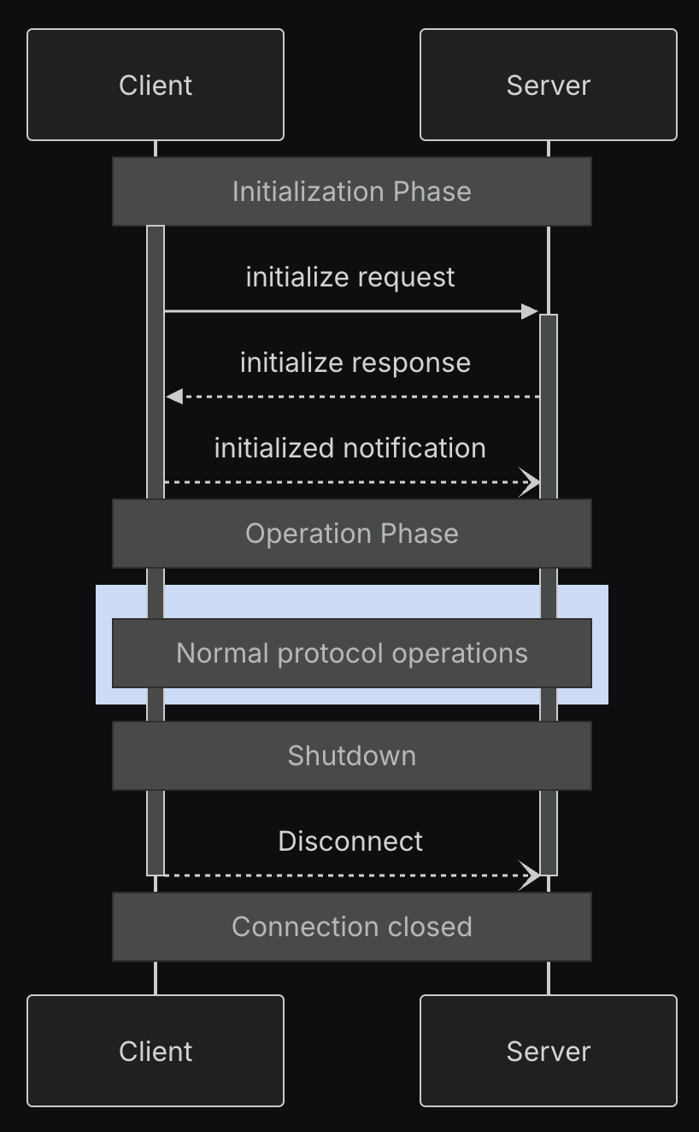
Lifecycle Management
The Model Context Protocol (MCP) defines a rigorous lifecycle for client-server connections that ensures proper capability negotiation and state management.
1. Initialization: Capability negotiation and protocol version agreement
2. Operation: Normal protocol communication
3. Shutdown: Graceful termination of the connection

Slide 13
Primitives
MCP primitives are the most important concept within MCP. They define what clients and servers can offer each other.
MCP defines three core primitives that servers can expose : Tools: Executable functions that AI applications can invoke to perform actions (e.g., file operations, API calls, database queries) Resources: Data sources that provide contextual information to AI applications (e.g., file contents, database records, API responses) Prompts: Reusable templates that help structure interactions with language models (e.g., system prompts, few-shot examples)

Slide 14
Primitives
MCP also defines primitives that client can expose: Roots: Roots define the boundaries of where servers can operate within the filesystem, allowing them to understand which directories and files they have access to. Sampling: Allows servers to request language model completions from the client’s AI application. Elicitation: Allows servers to request additional information from users. This is useful when server authors want to get more information from the user, or ask for confirmation of an action.

Slide 15
Primitives
MCP also defines utilities primitives that client or server can expose: Notifications: The protocol supports real-time notifications to enable dynamic updates between servers and clients. Ping: The Model Context Protocol includes an optional ping mechanism that allows either party to verify that their counterpart is still responsive and the connection is alive. Logging: The Model Context Protocol (MCP) provides a standardized way for servers to send structured log messages to clients.

Slide 16
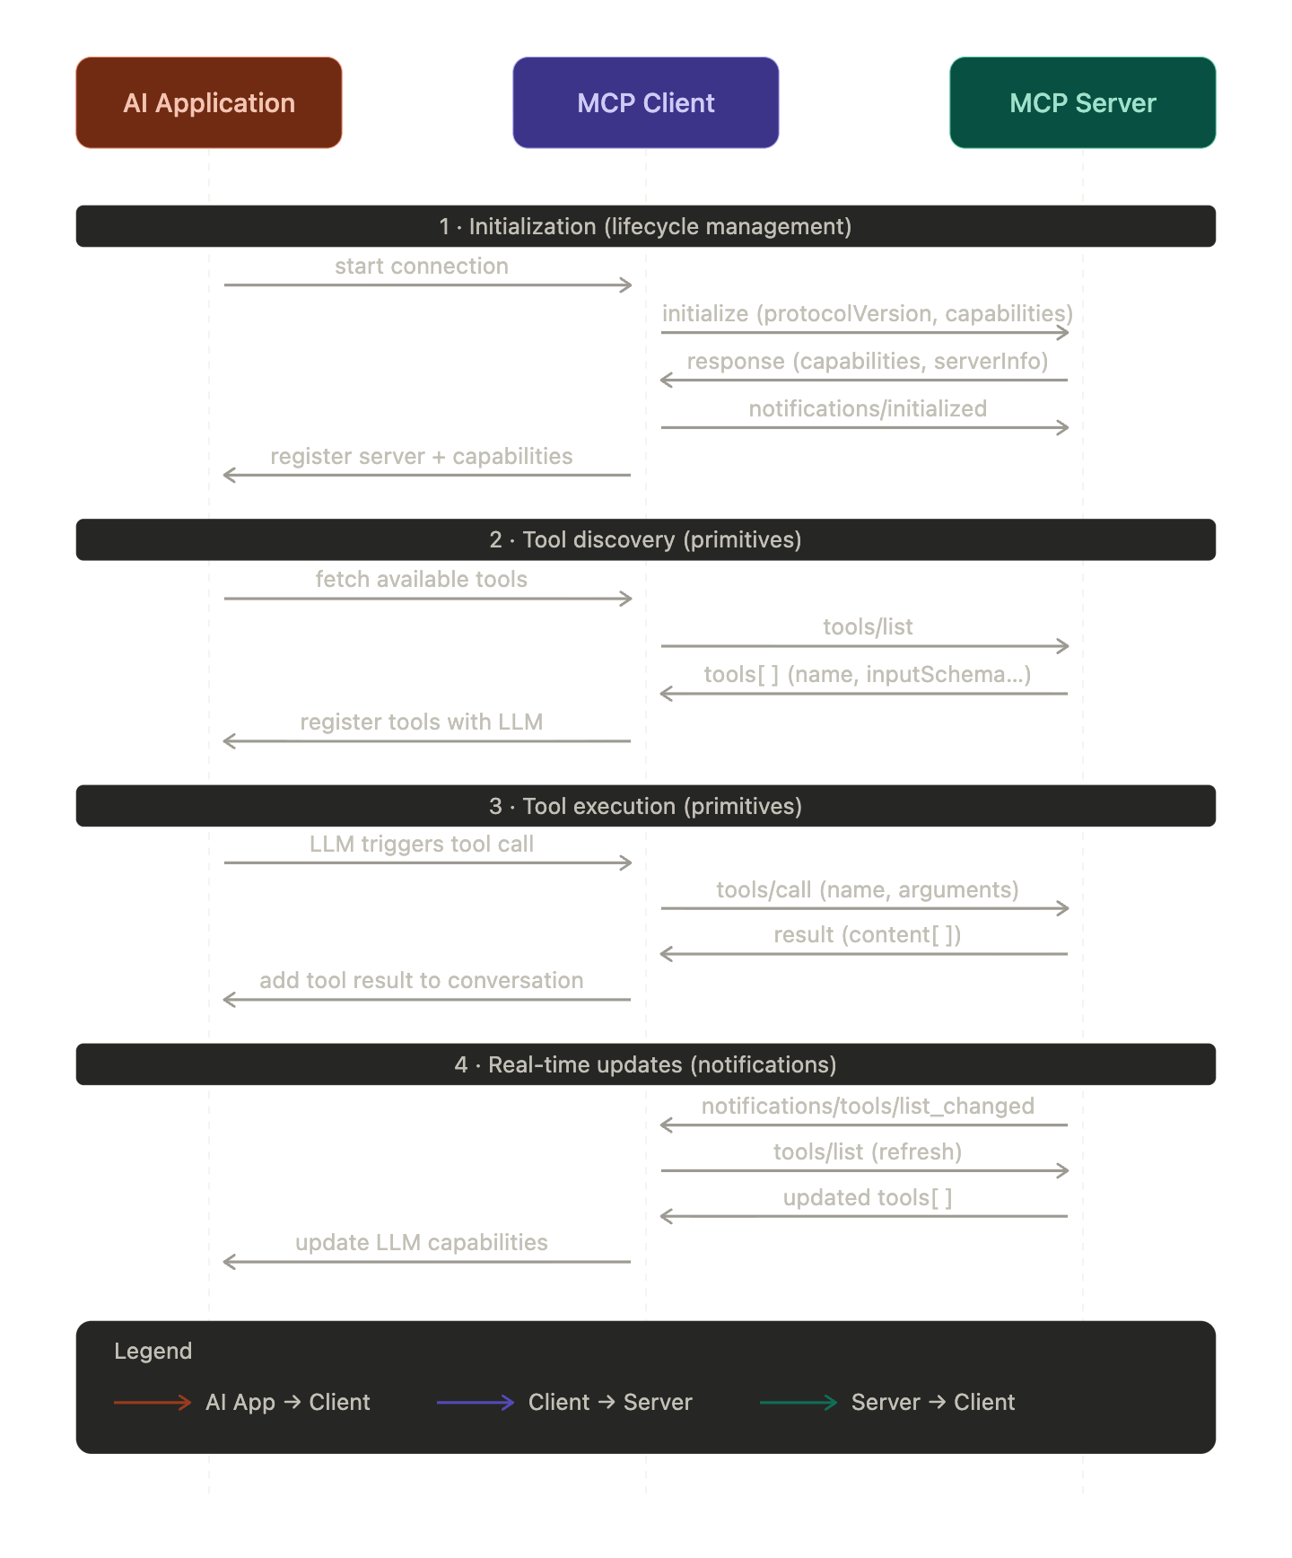

Slide 17
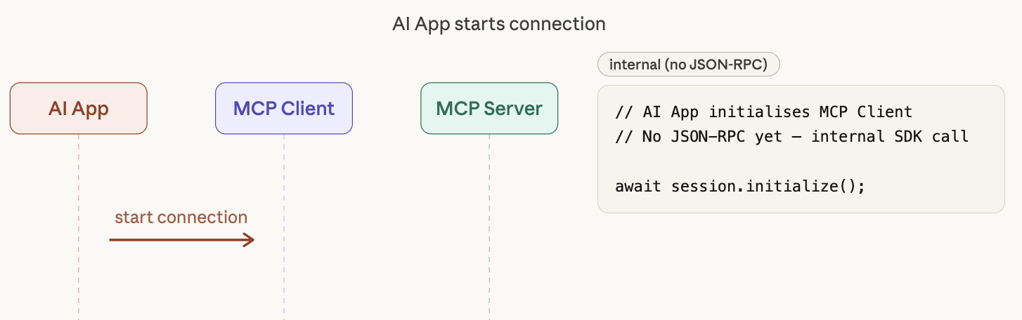
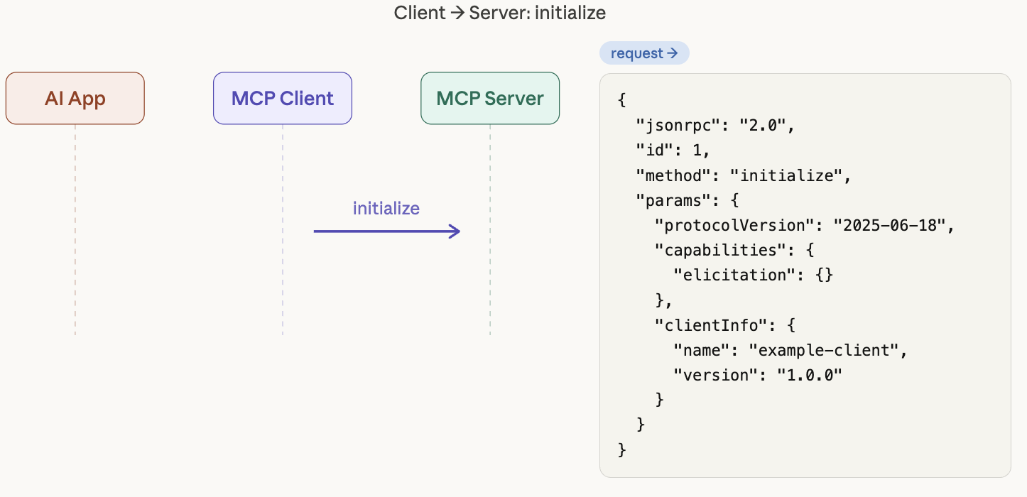
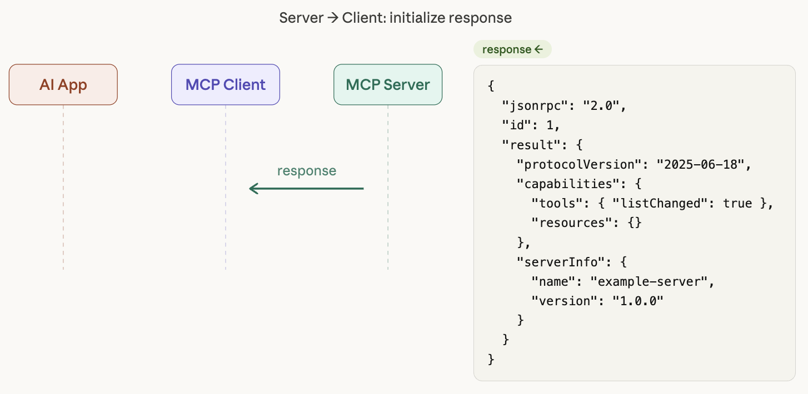
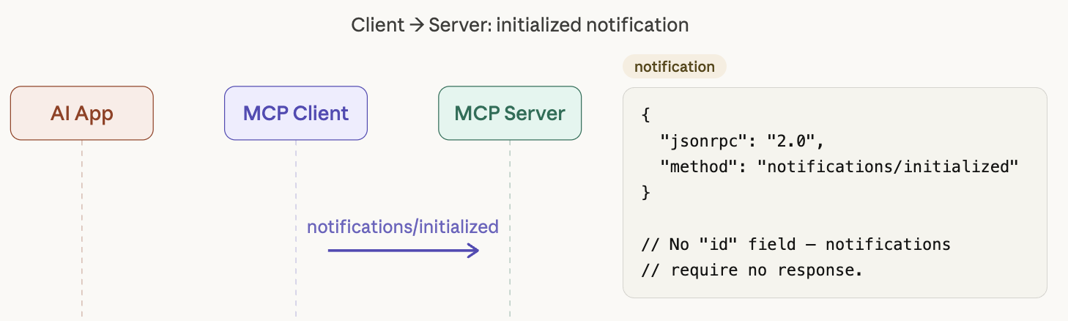
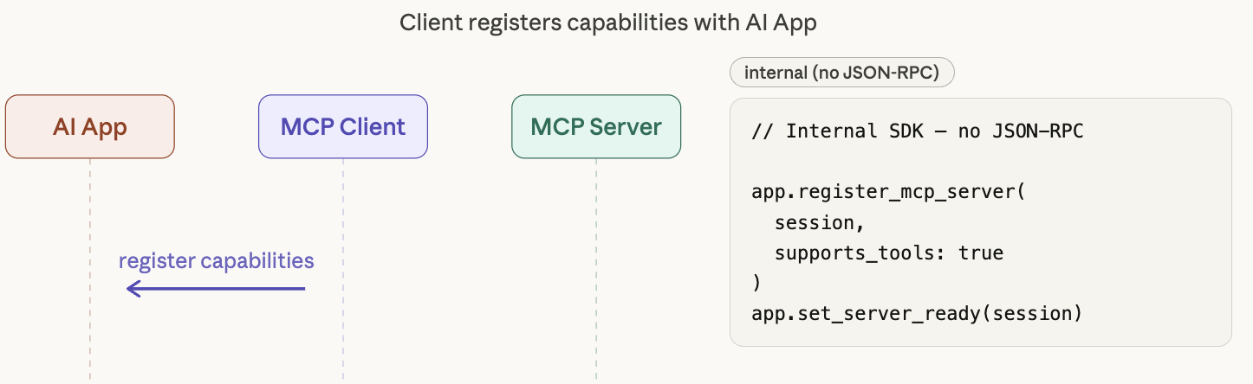
Initialization
1
2
3
4
5

Slide 18
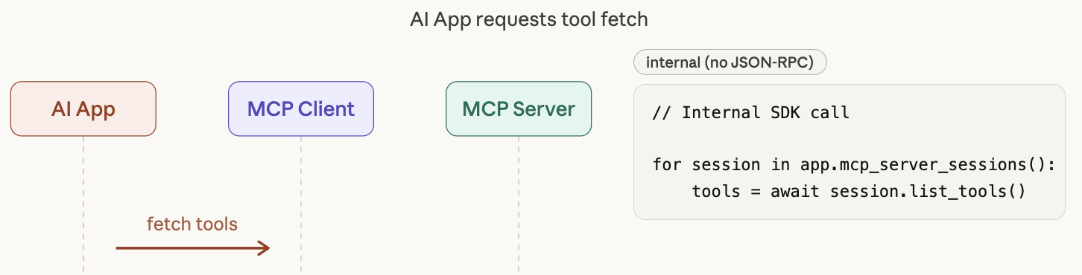
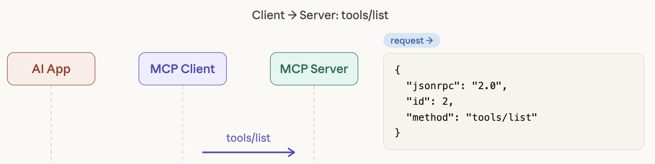
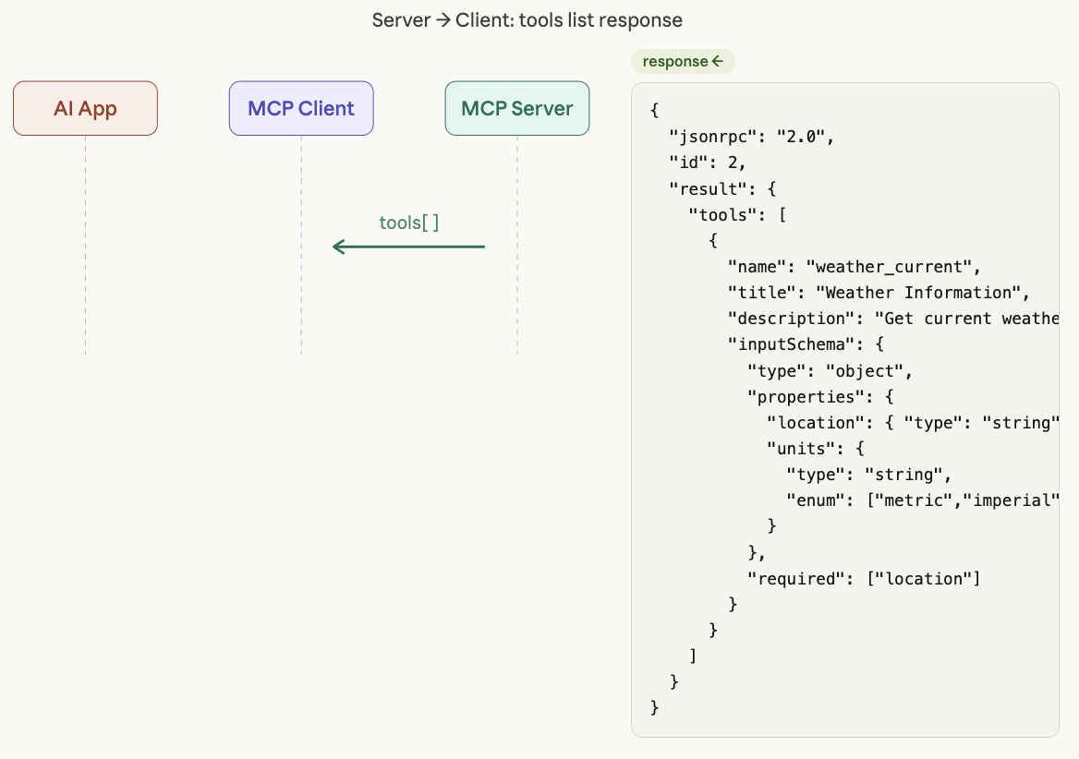
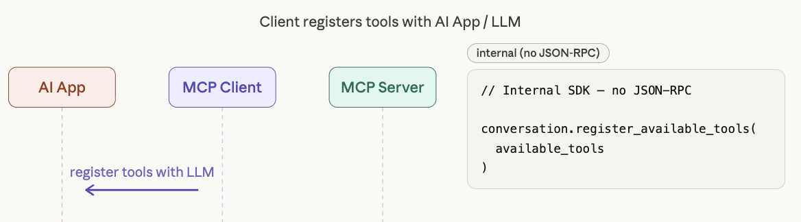
Tool Discovery
1
2
3
4

Slide 19
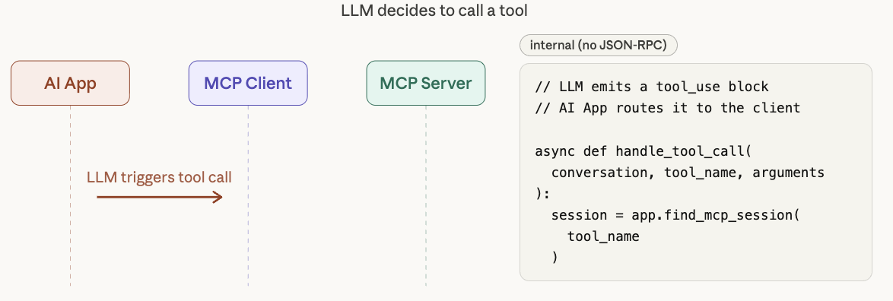
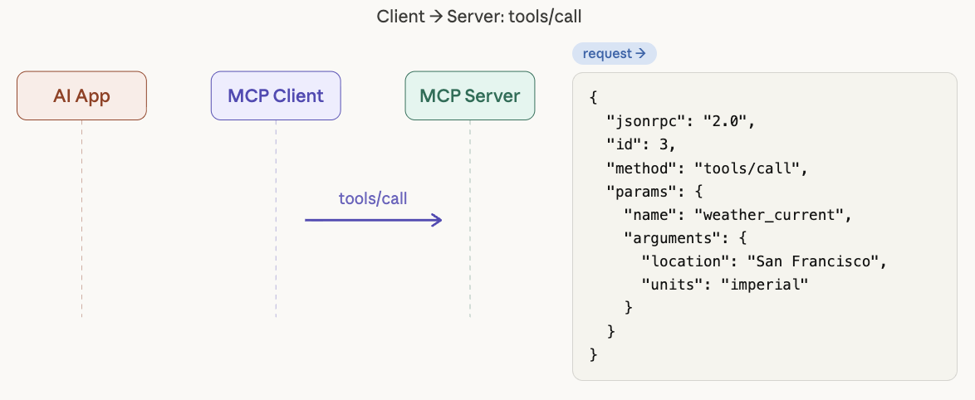
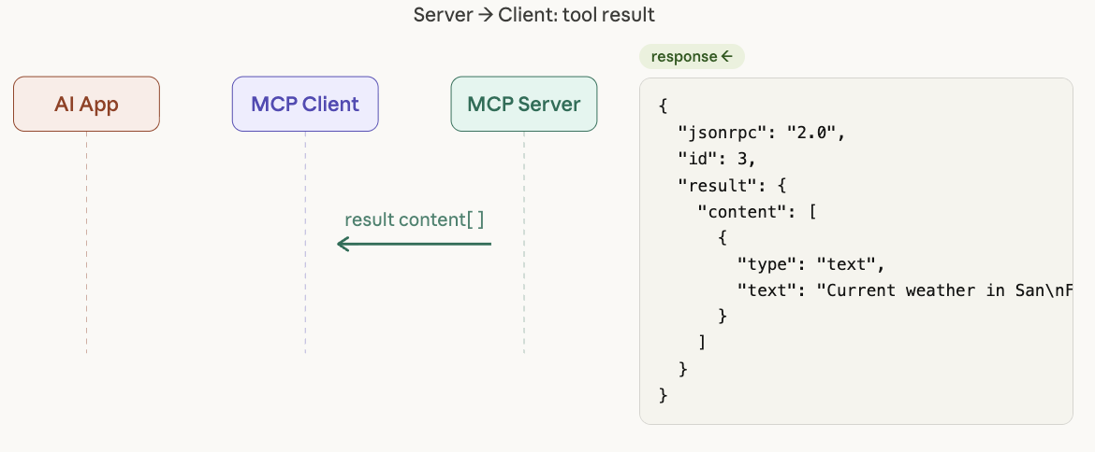
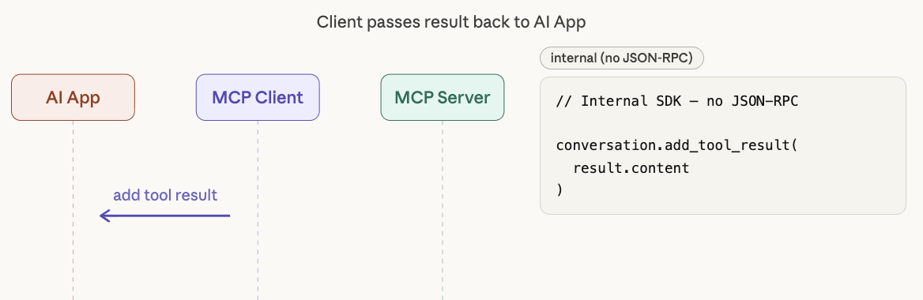
Tool Execution
1
2
3
4

Slide 20
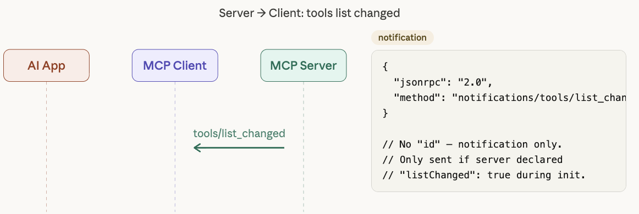
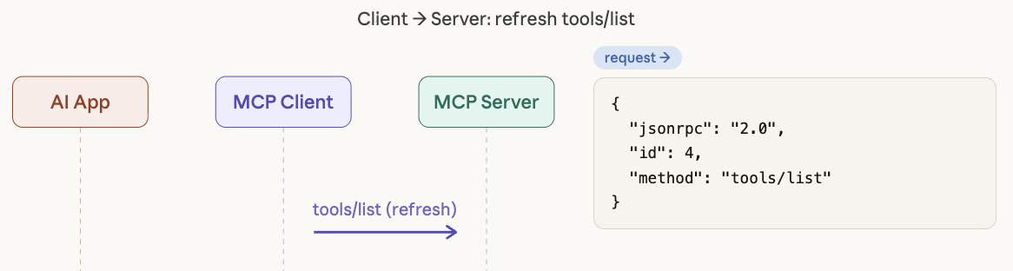
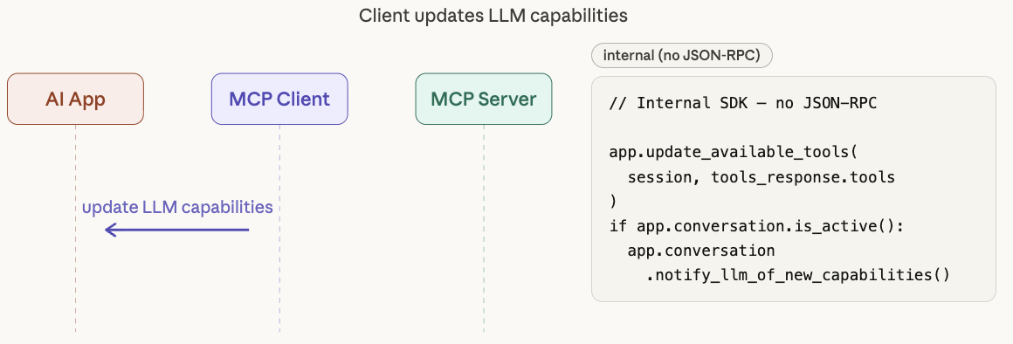
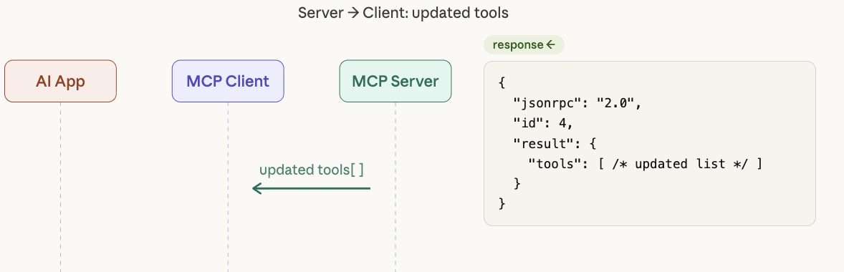
Notification
1
2
4
3

Slide 21
Security & Trust Model
MCP servers run with explicit user permission
AI cannot call a tool unless it is explicitly exposed by a server
Supports OAuth and authentication for remote servers
Users stay in control — MCP is not a backdoor
Sandboxed, auditable, and transparent by design

Slide 22
Summary
MCP is a universal open standard for AI-to-tool connectivity
Built on 3 Main Concepts: Host → Client → Server
Already widely adopted and growing fast
It's the infrastructure layer that makes AI agents possible

Slide 23
Thank You
"MCP is to AI agents what HTTP is to the internet." The protocol that makes everything connect.

