Slide 1
NITHISH T
NMID :EDFD0990FC19F8C87E541276D37DEE6A
Course : Generative AI for Engineering (E2324)
Madras Institute of Technology Campus, Anna University
Heart disease prediction using Machine Learning

Slide 2

PROJECT TITLE
Heart disease prediction using Machine Learning

Slide 3


AGENDA
Problem Statement
Project Overview
Who are the End users?
Solution and value proposition
The wow in the solution
Modelling
Results

Slide 4

PROBLEM STATEMENT
Heart disease remains a leading cause of death globally, emphasizing the need for accurate prediction and early intervention. Traditional risk assessment methods may not fully utilize the available data or provide precise predictions. Hence, there is a necessity to leverage advanced machine learning techniques to enhance heart disease prediction accuracy..

Slide 5

PROJECT OVERVIEW
The project aims to address the significant global health concern of heart disease by leveraging machine learning techniques for accurate prediction.
Various preprocessing techniques and feature extraction methods are employed to effectively utilize available data and enhance prediction accuracy.
Multiple machine learning algorithms are utilized to develop predictive models, enabling comprehensive analysis and comparison.
Evaluation metrics including accuracy, precision, recall, and F2 score are employed to assess the performance of each model, ensuring robustness and reliability.
The ultimate goal is to identify the most effective predictive model for heart disease, which could potentially lead to improved patient outcomes through early detection and intervention.

Slide 6

WHO ARE THE END USERS?
Healthcare Professionals: Physicians, cardiologists, and healthcare providers who can use the predictive models to assist in diagnosing and managing patients at risk of heart disease.
Patients: Individuals concerned about their heart health who may benefit from early detection and intervention facilitated by the predictive models.
Healthcare Institutions: Hospitals, clinics, and medical centers could integrate the predictive models into their existing healthcare systems to enhance patient care and optimize resource allocation.

Slide 7
WHO ARE THE END USERS?
Healthcare Researchers: Researchers in the field of cardiology and preventive medicine could utilize the findings and methodologies from this project to further study and develop heart disease prediction methods.
Health Insurance Companies: Insurers could utilize the predictive models to assess the risk profiles of their policyholders and offer targeted interventions or incentives for healthier lifestyles.
Public Health Authorities: Government health agencies may use the predictive models to identify high-risk populations and allocate resources for preventive measures and public health campaigns aimed at reducing heart disease prevalence.

Slide 8
YOUR SOLUTION AND ITS VALUE PROPOSITION
Accurate Prediction: By leveraging advanced machine learning techniques and comprehensive data analysis, our system provides accurate predictions of heart disease risk, enabling early intervention and treatment.
Personalized Risk Assessment: The predictive models take into account various patient factors and medical data to provide personalized risk assessments, allowing healthcare professionals to tailor interventions and recommendations to individual patients.
Robust Evaluation Metrics: We employ rigorous evaluation metrics such as accuracy, precision, recall, and F2 score to assess the performance of our models, ensuring reliability and robustness in real-world applications.
Flexible Integration: Our solution is designed to be easily integrated into existing healthcare systems, allowing seamless adoption by healthcare institutions, clinics, and medical practices.

Slide 9

THE WOW IN MY SOLUTION
Interpretability and Explainability: In addition to accurate predictions, your solution provides transparent insights into the factors influencing each prediction. Through advanced visualization techniques and model interpretability tools, healthcare professionals and patients can understand why a certain risk level is assigned, empowering them to make informed decisions regarding treatment plans and lifestyle modifications.
Adaptability to Diverse Data Sources: Your solution demonstrates versatility in its ability to integrate and analyze diverse data sources beyond traditional medical records. This includes incorporating data from wearable devices, genetic testing, environmental factors, and even social determinants of health. By harnessing this wealth of information, your system can offer a more holistic view of an individual's health status and tailor predictions accordingly, leading to more personalized and effective interventions.
9

Slide 10
MODELLING
Data Collection and Preprocessing:
Gather relevant datasets containing features such as demographic information, medical history, lifestyle factors, and diagnostic test results.
Preprocess the data by handling missing values, encoding categorical variables, and normalizing or standardizing numerical features to ensure uniformity and compatibility for modeling.
Feature Selection and Engineering:
Conduct feature selection to identify the most informative features for predicting heart disease. This can be done using techniques such as correlation analysis, feature importance scores from tree-based models, or domain knowledge.
Engineer new features that may capture important relationships or interactions within the data, such as derived variables or polynomial features.
10

Slide 11
MODELLING
Model Selection and Training:
Choose appropriate machine learning algorithms for heart disease prediction, considering factors such as interpretability, scalability, and performance.
Train multiple models, such as logistic regression, decision trees, random forests, support vector machines, and gradient boosting machines, to explore different approaches and ensemble techniques.
Utilize techniques like cross-validation to assess model performance and tune hyperparameters to optimize predictive accuracy.
Evaluation and Validation:
Evaluate the trained models using relevant evaluation metrics such as accuracy, precision, recall, F1 score, area under the ROC curve (AUC-ROC), and area under the precision-recall curve (AUC-PR).
Validate the models on separate test datasets or through techniques like nested cross-validation to ensure generalizability and robustness across different data samples.
11

Slide 12
MODELLING
Model Interpretation and Explainability:
Interpret the trained models to gain insights into the factors driving predictions and assess their clinical relevance.
Utilize interpretability techniques such as feature importance plots, partial dependence plots, SHAP (SHapley Additive exPlanations) values, or LIME (Local Interpretable Model-agnostic Explanations) to explain individual predictions and enhance trust in the model's decision-making process.
Deployment and Monitoring:
Deploy the finalized model into production environments, integrating it with healthcare systems or applications for real-time prediction.
Implement monitoring mechanisms to track model performance over time, detect drift or concept shift in the data distribution, and retrain or update the model as needed to maintain accuracy and relevance.
12

Slide 13
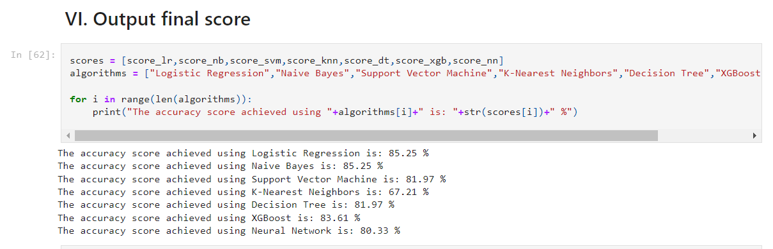
RESULTS
13

Slide 14
RESULTS
14

Slide 15
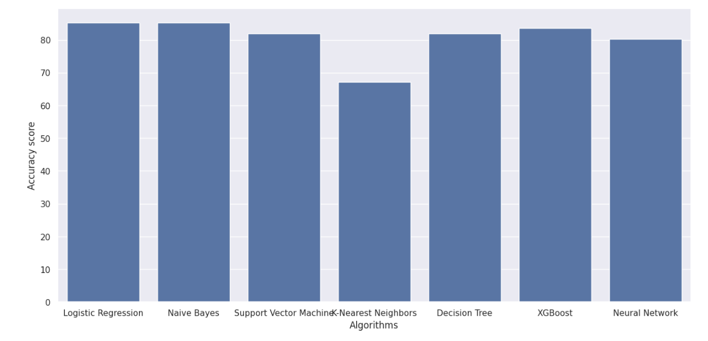
RESULTS(Cont…)
15

Slide 16
THANK YOU
16

