Slide 1
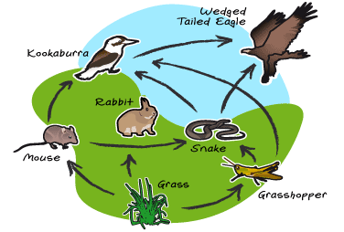
Food web
Intermixing of food chains

Slide 2
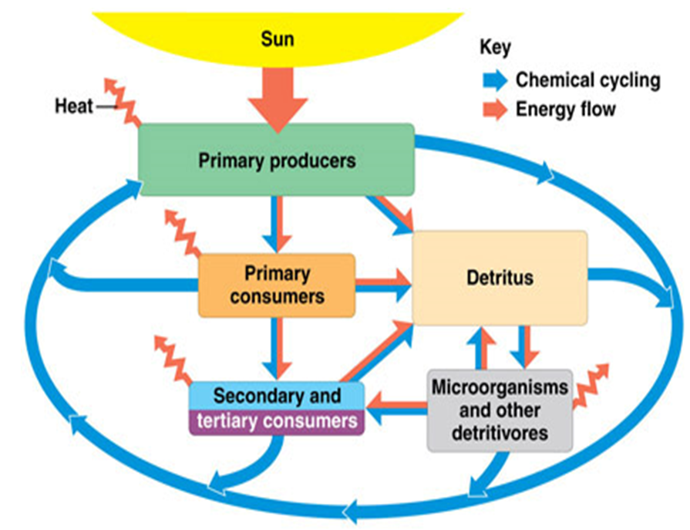
Energy Flow in Ecosystems
First Law of Thermodynamics energy can neither be created nor destroyed but only is transformed from one form to another.
10 Percent Rule of Energy
As a rule of thumb, 90 percent of the energy involved is degraded at each trophic transfer and only 10 percent of the energy is conserved in the organism's tissue.

Slide 3
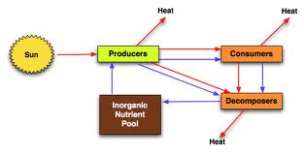
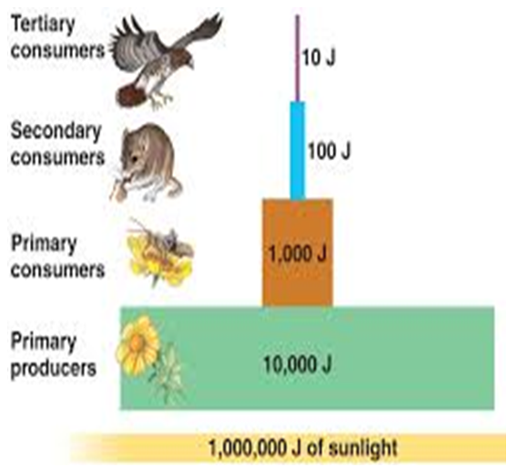
Energy flow in ecosystem and 10% Rule

Slide 4
What is a food chain?
a) A long chain made of food
b) Process of preparing food
c) Food where locked by chain
d) Pathway that energy and nutrients flow through the ecosystem
2. Why organisms in food chains are grouped into categories?
a) To form community
b) To share the energy
c) To form trophic levels
d) To get more energy

Slide 5
1. What is a food chain?
a) A long chain made of food
b) Process of preparing food
c) Food where locked by chain
d) Pathway that energy and nutrients flow through the ecosystem
Answer: d
Explanation: Energy living organisms need food to get energy and thus to survive. The food chain describes who eats whom in the wild. Different habitats and ecosystems provide many possible food chains that make up a food web.
2. Why organisms in food chains are grouped into categories?
a) To form community
b) To share the energy
c) To form trophic levels
d) To get more energy
Answer: c
Explanation: Trophic levels are the levels within the food chain where an organism obtains its energy. This energy depends on whether the organism is producers, consumers or decomposers. The number of trophic levels in food chains varies from three to five.

Slide 6
3. What role human plays in food chains?
a) Producers
b) Consumers
c) Humans do not involve in food chains
d) Decomposers
4. Why do all food chains start with plants?
a) Because plants are easily grown
b) Because plants are nutritious
c) Because plants can produce its own energy
d) Because plants do not require energy

Slide 7
3. What role human plays in food chains?
a) Producers
b) Consumers
c) Humans do not involve in food chains
d) Decomposers
Answer: b
Explanation: Humans are consumers in the food chain. Humans depend on other organisms or plants for energy and they can’t generate own energy. Humans eat both plants and animals. Humans can be classified into both primary and secondary consumers based on food chain.
4. Why do all food chains start with plants?
a) Because plants are easily grown
b) Because plants are nutritious
c) Because plants can produce its own energy
d) Because plants do not require energy
Answer: c
Explanation: The whole food chain depends on the producers. Plants are the only producers. The plants are autotrophs, as they produce their own food by the process of photosynthesis. Food is the source of energy in living being, thus plants are required to start food chains.

Slide 8
5. How many types of ecological models are there?
a) One
b) Two
c) Three
d) Four
6. Food chains are often used in ecological modeling.
a) True
b) False

Slide 9
5. How many types of ecological models are there?
a) One
b) Two
c) Three
d) Four
Answer: b
Explanation: There are two major types of ecological models which are used they are, analytic models and computational models. Analytic models are simple systems where computational models use numerical techniques to solve problems.
6. Food chains are often used in ecological modeling.
a) True
b) False
Answer: a
Explanation: Ecological model is a mathematical representation of an ecological system includes individual population and ecological community which are studied to better understand the real system. Ecosystem models provide a description of climate and stand metrics.

Slide 10
7. Which of the following food chain correctly describes the flow of energy in an ecosystem?
a) Grass->lion->human
b) Cow->grass->lion
c) Grass->goat->human
d) Leaf->bird->lizard
8. If there is a shortage of deer in forest, what tiger might do?
a) Eat grassland leaves
b) Die due to starvation
c) Hunt for other animals
d) Fasting until they find deer

Slide 11
7. Which of the following food chain correctly describes the flow of energy in an ecosystem?
a) Grass->lion->human
b) Cow->grass->lion
c) Grass->goat->human
d) Leaf->bird->lizard
Answer: c
Explanation: Usually energy flows from one trophic level to the next higher trophic level. In the above answer, grass is the lowest trophic level and it is a producer. Goat eats grass to get energy. Goat is a primary consumer. Human eat goat for energy and human belongs to the secondary consumer.
8. If there is a shortage of deer in forest, what tiger might do?
a) Eat grassland leaves
b) Die due to starvation
c) Hunt for other animals
d) Fasting until they find deer
Answer: c
Explanation: In any food chain, one particular animal do not depend on another particular animal. Consumers depend on the producers for energy but that producer may not be particular for consumers all the time.

Slide 12
Ecological Pyramid
The graphical representations of different trophic levels in an ecosystem where producers occupy the base and the top consumer occupy the apex of the pyramid, is known as ecological pyramid .
They are used to illustrate the feeding relationships between organisms.
Food chains and food webs do not give any information about the numbers of organisms involved.
This information can be shown through ecological pyramids.
Types of Ecological Pyramids
  Pyramid of number
  Pyramid of biomass
  Pyramid of energy

Slide 13
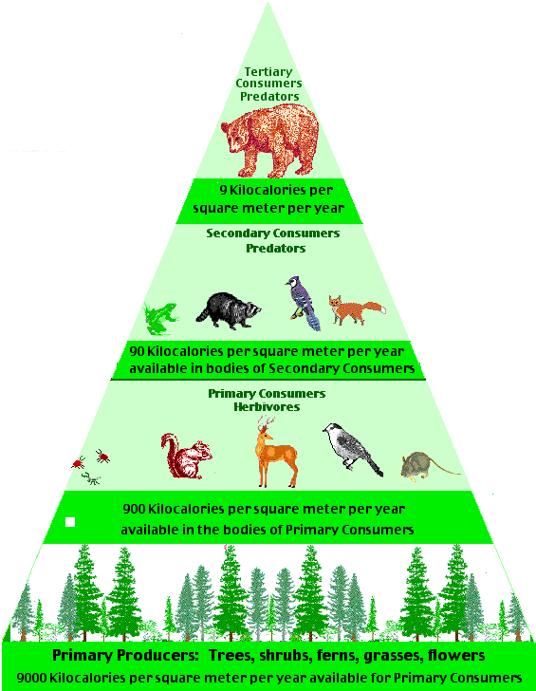
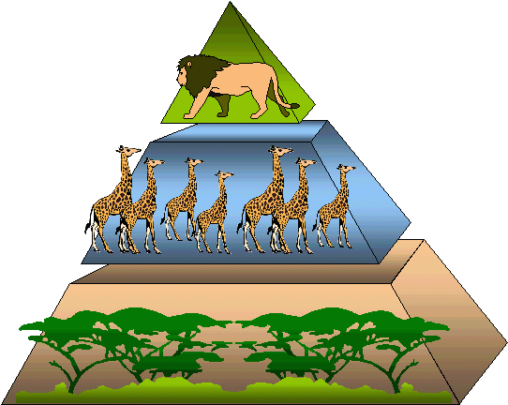
Pyramid of Number
Pyramid of number is used to show the number of individuals in each trophic level.
It is upright in case of grassland and pond ecosystems.

Slide 14
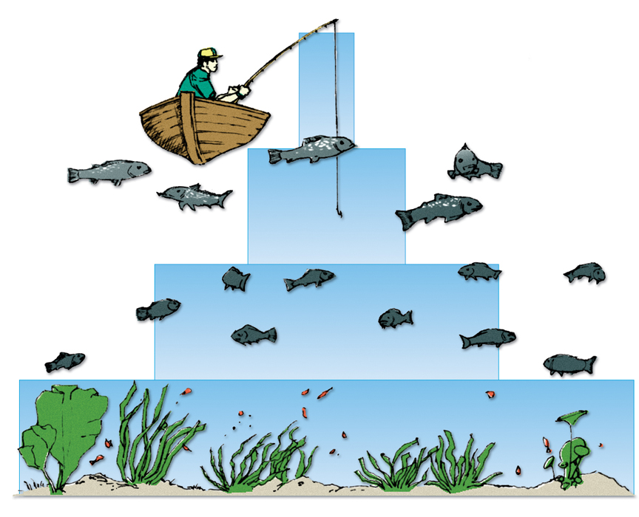
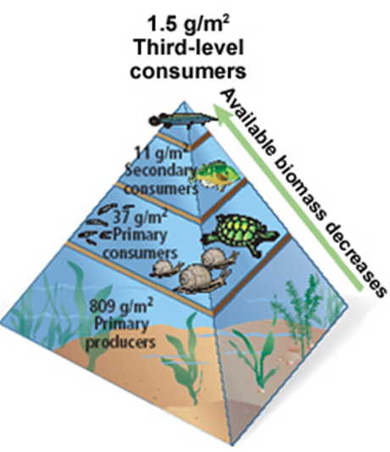
Pyramid of Biomass
tertiary
consumers
75 g/m2
Pyramid of biomass records the total dry organic matter of organisms at each trophic level in a given area of an ecosystem.
The pyramid of biomass is used to show the total biomass of individuals at each trophic level.
It is better than the pyramid of number for showing the relationships between organisms.
secondary
consumers
150g/m2
primary
consumers
675g/m2
producers
2000g/m2

Slide 15
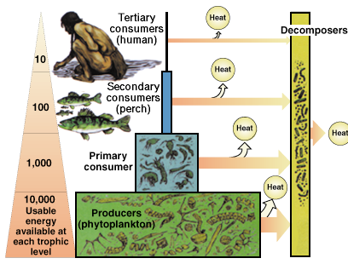
Pyramid of energy
Pyramid of energy is used to show the amount of energy transferred between trophic levels.
It provides the best representation of the overall nature of an ecosystem.
The pyramid of energy flow is always upright because there is always loss of energy while moving from lower trophic level to higher trophic level.
Therefore, the energy reaching the next trophic level is always less compared to that in the previous trophic level.

Slide 16
9. In the food relationship, where the tiger eats the deer and the deer eats plants. Which of the following conditions is true?
a) The tiger is the prey
b) The tiger is the primary consumer
c) The deer is the predator
d) The deer is the prey
10. Which of the following condition is true about food chain?
a) Provide more energy for next trophic level
b) Provides food for succeeding organisms
c) Consume energy from next trophic level
d) Do not pass energy to next trophic level

Slide 17
9. In the food relationship, where the tiger eats the deer and the deer eats plants. Which of the following conditions is true?
a) The tiger is the prey
b) The tiger is the primary consumer
c) The deer is the predator
d) The deer is the prey
Answer: d
Explanation: In the above relationship of food chain of the tiger and deer, the tiger is the predator and the deer is the prey. In other words, the tiger is the secondary consumer and the deer is the primary consumer.
10. Which of the following condition is true about food chain?
a) Provide more energy for next trophic level
b) Provides food for succeeding organisms
c) Consume energy from next trophic level
d) Do not pass energy to next trophic level
Answer: b
Explanation: In a food chain, the organisms provide food for succeeding organisms irrespective whether they are producers or consumers. Plants which are producer gives energy to the primary consumers like deer and this deer gives energy to secondary consumer say carnivores.

Slide 18
12. Which of the following factor diminishing as food chain proceeds?
a) Pressure
b) Energy
c) Nutrition
d) Temperature
13. Which of the following organisms begins marine food chains?
a) Phytoplankton
b) Fishes
c) Zooplankton
d) Corals

Slide 19
12. Which of the following factor diminishing as food chain proceeds?
a) Pressure
b) Energy
c) Nutrition
d) Temperature
Answer: b
Explanation: During the transfer of energy of organic food from one trophic level to the next, only about 10% of the energy from organic matter is stored as flesh. The remaining is lost during transfer, broken down in respiration or due to incomplete digestion by higher trophic levels.
13. Which of the following organisms begins marine food chains?
a) Phytoplankton
b) Fishes
c) Zooplankton
d) Corals
Answer: a
Explanation: Marine food chain begins with phytoplankton. Phytoplankton is microscopic marine algae. Phytoplankton provides the foundation of the sea’s food chain in a balanced system. This phytoplankton captures the sun’s energy through photosynthesis.

Slide 20
Ecological Succession
Ecological succession is the gradual process by which ecosystems change and develop over time. It is therefore a series of predictable temporary communities or stages leading up to a climax community. Each stage/temporary community is called a successional stage. Each step prepares the land for the next successional stage. All habitats are in the state of constant ecological succession.
Environment is always kept on changing over a period of time due to
variations in climatic and physiographic factors, and
the activities of the species of the communities themselves.
Ecological Succession is an orderly sequence of different communities over a period of time.

Slide 21
Types of ecological succession
Primary Succession Secondary Succession
Primary succession is the process by which an area first changes from bare rock into a functioning ecosystem.
Secondary succession is the process by which an already existing plant community is replaced by another plant community.

Slide 22
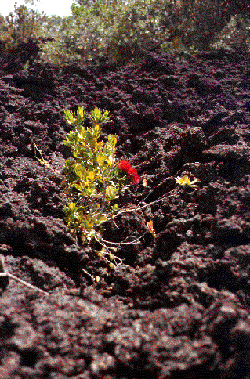
Primary Succession
The development of an ecosystem in an area that has never had a community living within it occurs by a process called PRIMARY SUCCESSION.
An example of an area in which a community has never lived before, would be a new lava or rock from a volcano that makes a new island.

Slide 23
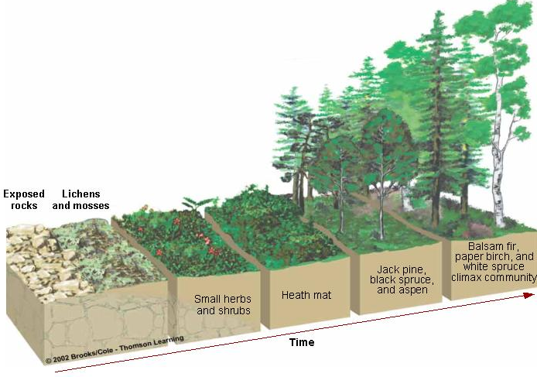
Continue…
Primary succession is the process by which an area first changes from bare rock into a functioning ecosystem.

Slide 24
Secondary Succession
SECONDARY SUCCESSION begins in habitats where communities were entirely or partially destroyed by some kind of damaging event.
When an existing community has been cleared by a disturbance such as a fire, tornado, etc...and the soil remains intact, the area begins to return to its natural community.
Because these habitats previously supported life, secondary succession, unlike primary succession, begins on substrates that already bear soil. In addition, the soil contains a native seed bank.
Since the soil is already in place, secondary succession can take place five to ten times faster than primary succession.

Slide 25
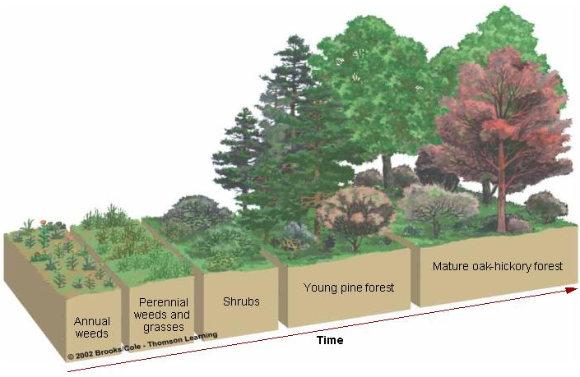
Continue…
Secondary succession is the process by which an ecosystem that has been destroyed gradually returns to its previous state.

Slide 26
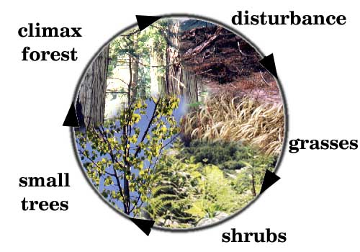
The Circle of Life in Secondary Succession

Slide 27
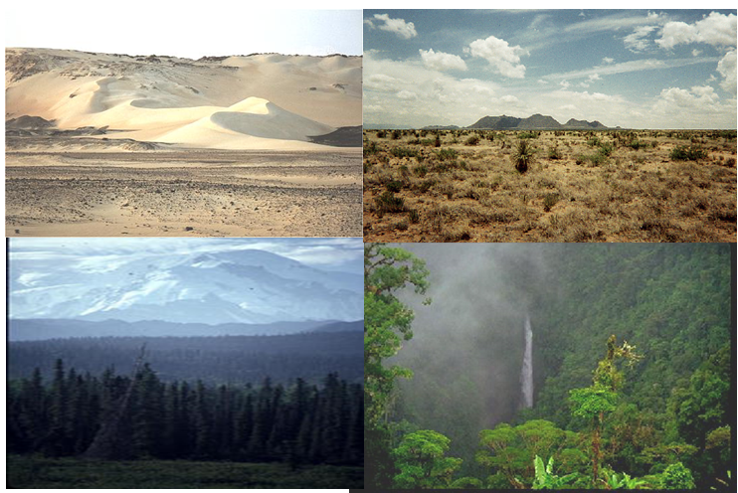
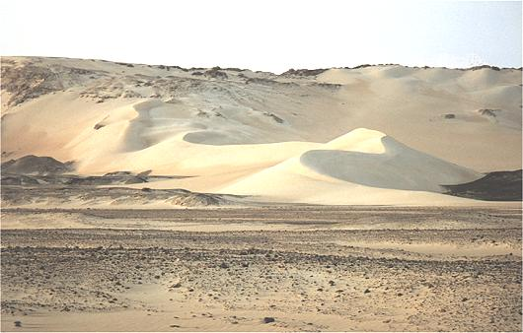
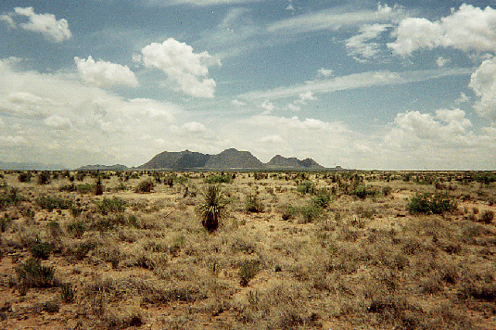
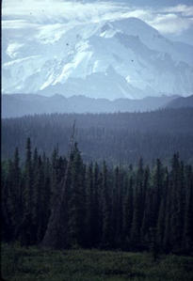
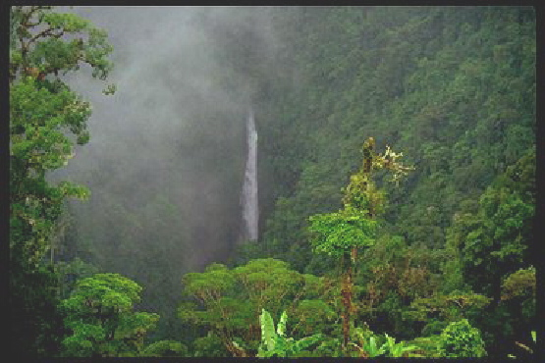
The Climax Community
A climax community is a mature, stable community that is the final stage of ecological succession.
In an ecosystem with a climax community, the conditions continue to be suitable for all the members of the community.
Any particular region has its own set of climax species, which are the plants that are best adapted for the area and will persist after succession has finished, until another disturbance clears the area.

Slide 28
Process / Stages of Ecological Succession
Nudation- Succession begins with the development of a bare site, called Nudation (disturbance).
Invasion
Migration- It refers to arrival of propagules (seeds), dispersion.
Ecesis- It involves establishment and initial growth of vegetation.
Aggregation- It involves increase in number of species.
Competition- As vegetation became well established, grew, and spread, various species began to compete for space, light and nutrients. This phase is called competition.
Stabilization- Reaction phase leads to development of a climax community.

Slide 29
1. In ecological succession, the intermediate developmental phase is known as
(a) ecesis
(b) climax
(c) nudation
(d) sere
2. This is true about secondary succession
(a) follows primary succession
(b) takes place on a deforested site
(c) is similar to primary succession except that it has a relatively slower pace
(d) begins on a bare rock
3. Lithosphere serves as a reservoir for
(a) nitrogen cycles
(b) carbon cycles
(c) oxygen cycles
(d) phosphorus cycles

Slide 30
1. In ecological succession, the intermediate developmental phase is known as
(a) ecesis
(b) climax
(c) nudation
(d) sere
Answer: (d)
2. This is true about secondary succession
(a) follows primary succession
(b) takes place on a deforested site
(c) is similar to primary succession except that it has a relatively slower pace
(d) begins on a bare rock
Answer: (b)
3. Lithosphere serves as a reservoir for
(a) nitrogen cycles
(b) carbon cycles
(c) oxygen cycles
(d) phosphorus cycles
Answer: (d)

Slide 31
Study of some common ecosystems
Terrestrial ecosystem
Grassland ecosystem
Desert ecosystem
Forest ecosystem
Aquatic ecosystem
Pond ecosystem
Ocean ecosystem

Slide 32
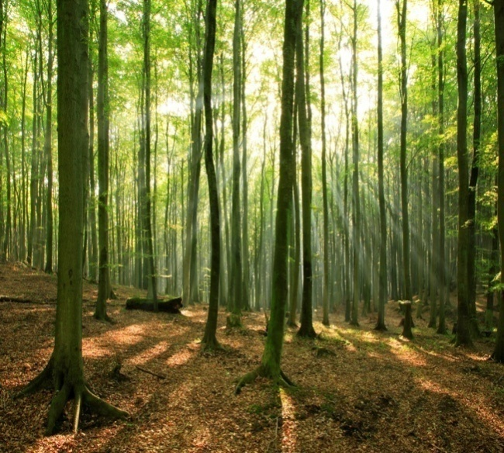
Forest Ecosystem
Abiotic Components
Inorganic and organic substances found in the
soil, climatic factors, e.g., temperature,
humidity, rainfall, and light.
Biotic Components
Producers
Different kinds of trees depending upon the climate
Consumers
Different kinds of primary, secondary, and tertiary consumers, e.g., deer,
elephant, moles, snakes, lizards, lion, and tiger
Decomposers
These are various kinds of bacteria and fungi

Slide 33
Grassland ecosystem
All grasslands in the world are categorize into the following two types:
Tropical grasslands- closets to equator and are hot throughout the year.
Temperate grasslands - farther from the equator and have both hot summers and harsh winters.

Slide 34
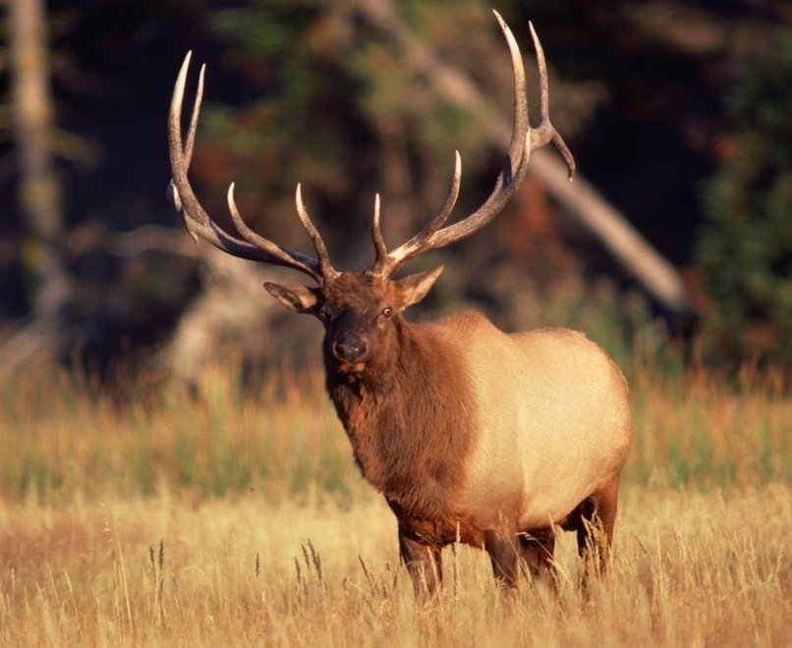
Grassland Ecosystem
Abiotic Components
Inorganic elements (C, H, O, N, P, S), climatic components,
temperature, rainfall, light, etc.
Biotic Components
Producers
Mainly grasses with a few scattered trees
Consumers
Deer, rabbit, giraffe, etc., are herbivores,
while wolf, leopard, etc., are carnivores
Decomposers
Mainly bacteria and fungi

Slide 35
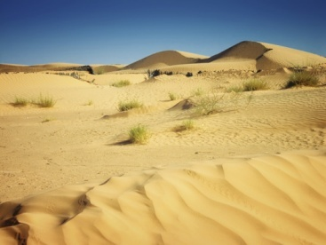
Desert Ecosystem
Abiotic Components
Low rainfall, high temperature, and
sandy soil
Biotic Components
Producers
Predominantly thorny shrubs, cactus, opuntia, etc.
Consumers
Different insects, lizards, reptiles, nocturnal rodents, birds, etc.
Decomposers
Various bacteria and fungi

Slide 36
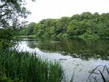
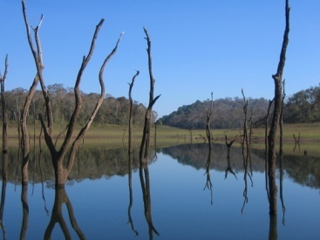
Pond Ecosystem
Abiotic Components
It includes organic and inorganic substances,
atmospheric gases dissolved in water, minerals
found in dissolved state, etc.
Biotic Components
Producers
Submerged floating and emergent aquatic plants
For example, nelumbo, hydrilla, chara, etc.
Consumers
May be primary, secondary, or tertiary, e.g., small fishes, beetles, mollusca, crustaceans, etc.
Decomposers
Chiefly bacteria, actinomycetes, fungi, etc.

Slide 37
Ocean Ecosystem
Abiotic Components
It includes organic and inorganic substances,
atmospheric gases dissolved in water, minerals
found in dissolved state, etc.
Biotic Components
Producers
Submerged floating and emergent aquatic plants
For example, nelumbo, hydrilla, chara, etc.
Consumers
May be primary, secondary, or tertiary, e.g., small fishes, beetles, mollusca, crustaceans, etc.
Decomposers
Chiefly bacteria, actinomycetes, fungi, etc.

Slide 38
4. This is not a climax vegetation
(a) grasses
(b) savannah
(c) forests
(d) hydrophytes
5. This about ecological succession is incorrect
(a) food chain relationships become more complex
(b) species diversity increases as succession proceeds
(c) role of decomposers becomes all the more important
(d) is a random process
6. An example of plants occupying the second stage of hydrosere is
(a) Salix
(b) Vallisneria
(c) Azolla
(d) Typha

Slide 39
4. This is not a climax vegetation
(a) grasses
(b) savannah
(c) forests
(d) hydrophytes
Answer: (d)
5. This about ecological succession is incorrect
(a) food chain relationships become more complex
(b) species diversity increases as succession proceeds
(c) role of decomposers becomes all the more important
(d) is a random process
Answer: (d)
6. An example of plants occupying the second stage of hydrosere is
(a) Salix
(b) Vallisneria
(c) Azolla
(d) Typha
Answer: (b)

Slide 40
7. On the sand, ecological succession is
(a) halosere
(b) xerosere
(c) hydrosere
(d) psammosere
8. Order of basic processes involved in succession is
(a) invasion -> stabilization -> completion and coaction -> reaction -> nudation
(b) nudation -> stabilization -> completion and coaction -> invasion -> reaction
(c) invasion -> nudation -> completion and coaction -> reaction -> stabilization
(d) nudation -> invasion -> completion and coaction -> reaction -> stabilization
9. Process of the successful establishment of species in a new area is known as
(a) climax
(b) sere
(c) ecesis
(d) invasion
10. In ecological succession, the final stable community is known as
(a) climax community
(b) ultimate community
(c) final community
(d) seral community

Slide 41
7. On the sand, ecological succession is
(a) halosere
(b) xerosere
(c) hydrosere
(d) psammosere
Answer: (d)
8. Order of basic processes involved in succession is
(a) invasion -> stabilization -> completion and coaction -> reaction -> nudation
(b) nudation -> stabilization -> completion and coaction -> invasion -> reaction
(c) invasion -> nudation -> completion and coaction -> reaction -> stabilization
(d) nudation -> invasion -> completion and coaction -> reaction -> stabilization
Answer: (d)
9. Process of the successful establishment of species in a new area is known as
(a) climax
(b) sere
(c) ecesis
(d) invasion
Answer: (c)
10. In ecological succession, the final stable community is known as
(a) climax community
(b) ultimate community
(c) final community
(d) seral community
Answer: (a)

