Slide 1
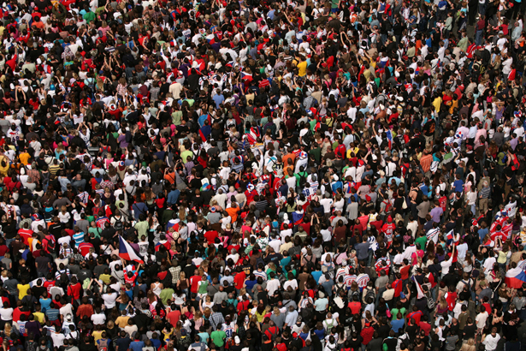
The Human Population and its Impact
Chapter 6
and
Chapter 23-4

Slide 2
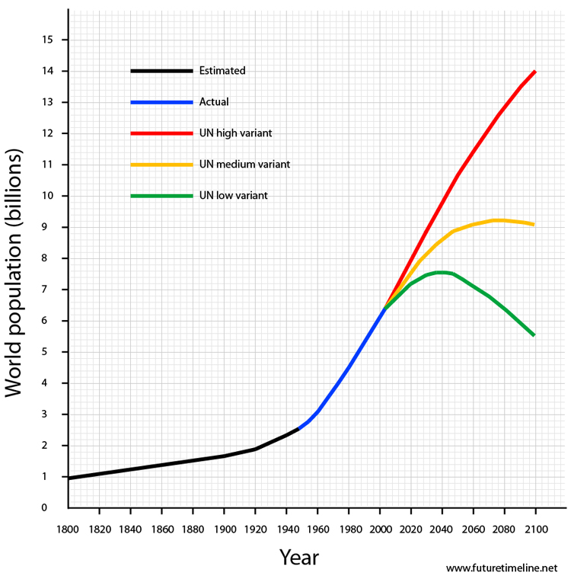
The Human Population Over Time
The time it takes our population to double has decreased sharply.
It only has taken about 12 years to go from 6-7 billion people.
We are projected to hit 9 billion near the year 2050.
Estimates say stabilization around 2100. (10.5 billion)
Notes:
What happened to cause this dramatic increase in exponential growth?

Slide 3
Human Population Over Time
What’s your number?
http://www.bbc.co.uk/news/world-15391515
Population Clock (census)
http://www.census.gov/popclock/
Population growth video
https://www.youtube.com/watch?v=khFjdmp9sZk

Slide 4
Why our population has grown so quickly….
Humans have the ability to expand into all climate zones and habitats
Modern agriculture has allowed us to produce food very efficiently and in large quantities
Death rates decreased because of improved sanitation and healthcare (biggest influence)
The current global population growth rate is around 1.3% per year (and slowing). Most of this growth happens in developing countries.
  If growth rate is slowing…why is our population still growing?

Slide 5
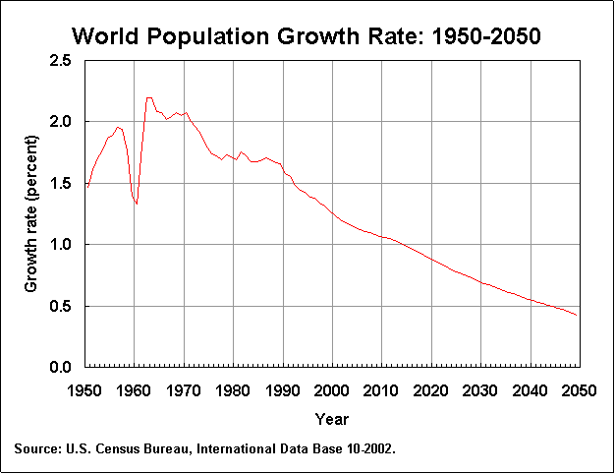
Overall, the world population is growing at a rate of about 1.7 percent; if this rate continues, the population will double in 41 years.
Population growth rate peaked in the 1960s at about 2%

Slide 6
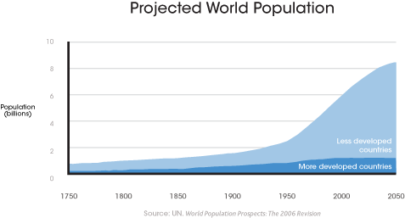
Notes:
What is happening in the developing countries to account for this huge increase in growth?

Slide 7
Carrying Capacity
Under ideal conditions populations will grow exponentially until limiting factors cause growth to slow.
Carrying Capacity: maximum number of individuals an ecosystem can support
  Determined by limiting factors
  Carrying capacity for humans on earth is highly debated.
    Innovation and technology
    Rules other populations follow don’t apply to us
Cultural carrying capacity: the maximum number of people who could live in reasonable freedom and comfort indefinitely without decreasing the ability of the earth to sustain future generations.
  What standard of living are we willing to accept?
Notes:
What are examples of limiting factors?

Slide 8
Factors Affecting Growth
When inputs into a system are larger than the outputs the system will grow
Births, Deaths, Immigration and Emigration
  Crude birth rate: births per 1000
  Crude death rate: deaths per 1000
  Fertility Rates
    Replacement level fertility (number to replace the parents)
      Average 2.1-2.5 (babies dying before reproductive years)
      Gauges changes in population size
    Total fertility (estimate of average number of children born to women)
      Lower in developed countries
        US about 2.1
      On average declining worldwide
      China 1.5 TFR (one child policy)

Slide 9
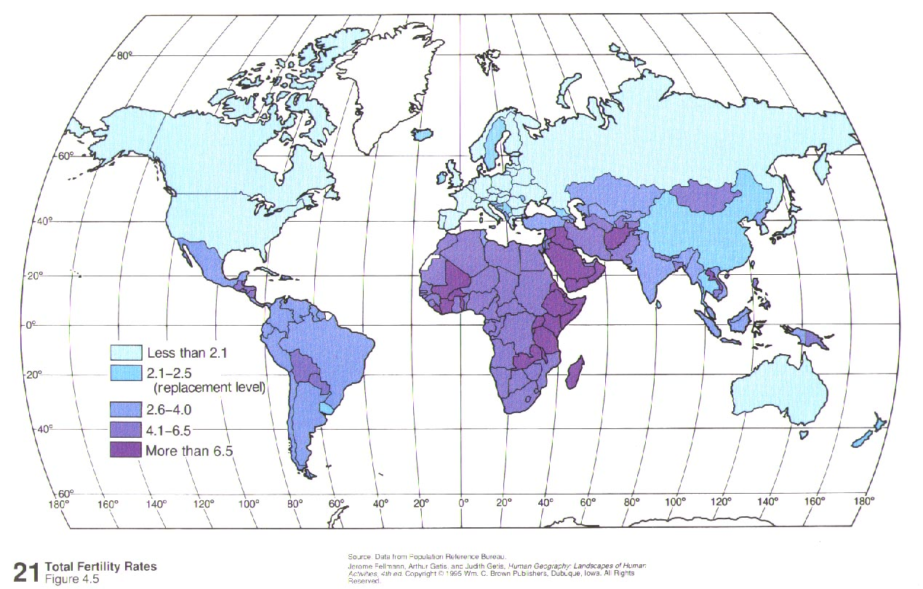
Notes:
Totals Fertility Rate

Slide 10
What factors affect birth and fertility rates?
  Labor force
  Cost of raising and educating children
  Urbanization
  Infant deaths
  Education for women
  Marrying age
  Access to contraceptives
What factors affect death rates?
  Access to nutrition, medical care, clean water
  Community support for elders
  Increased life expectancy
    Usually higher for women
  Decrease in infant mortality

Slide 11
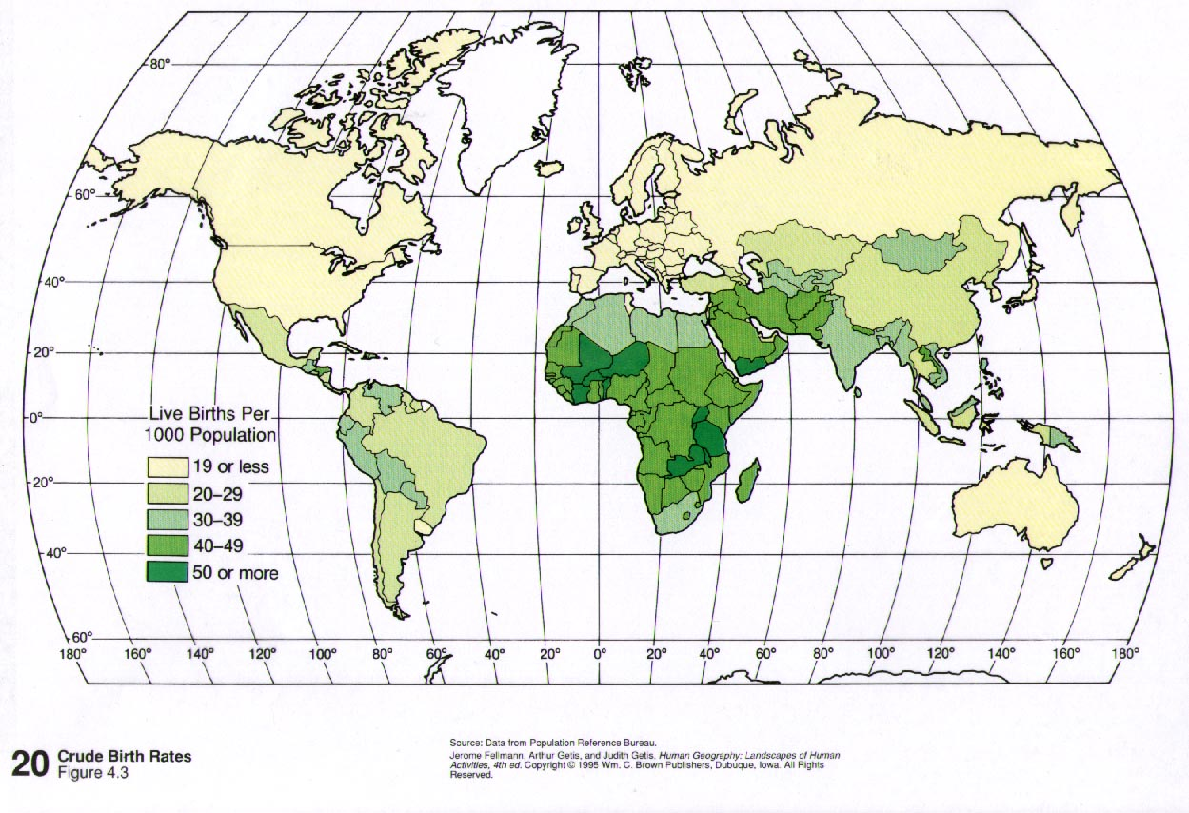
Notes:
World Crude Birth Rates

Slide 12
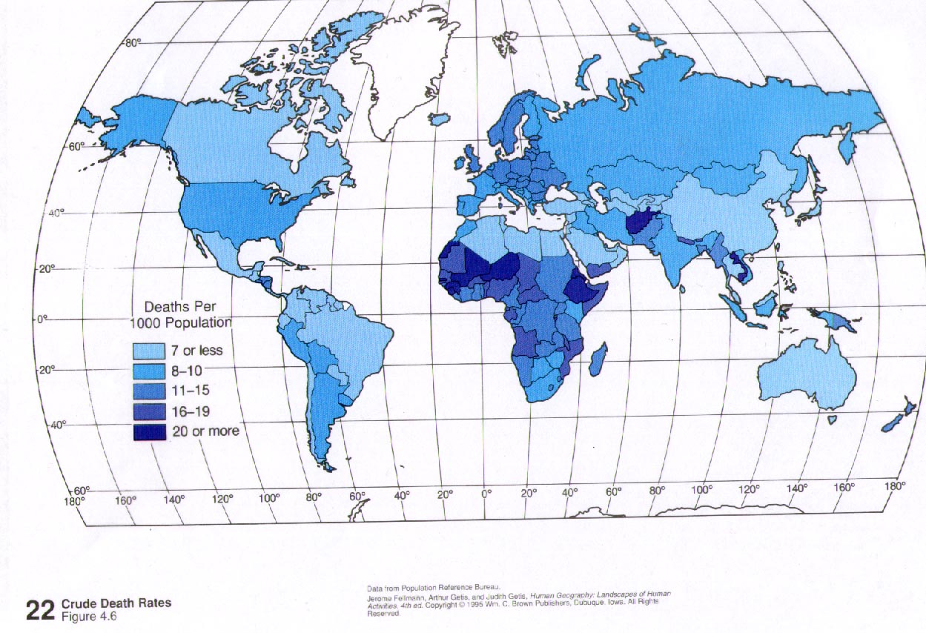
Notes:
World crude Death Rates

Slide 13
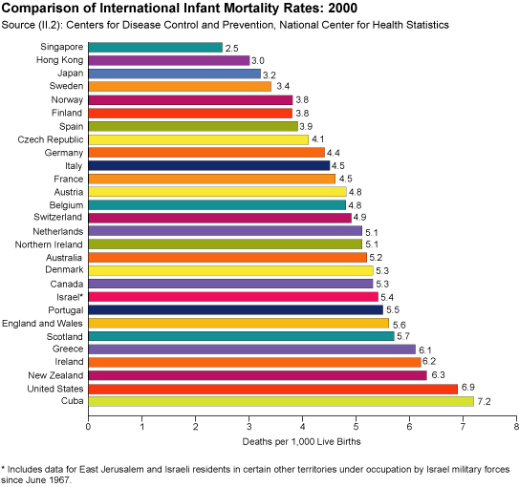
Infant Mortality
Good measure of a nation’s quality of life
Measured as number of infant deaths per 1000 births
  World average is 46
40 countries have a lower IMR than the US. Why?
  Inadequate prenatal care, drug addiction, teenage pregnancies, socioeconomic variances

Slide 14
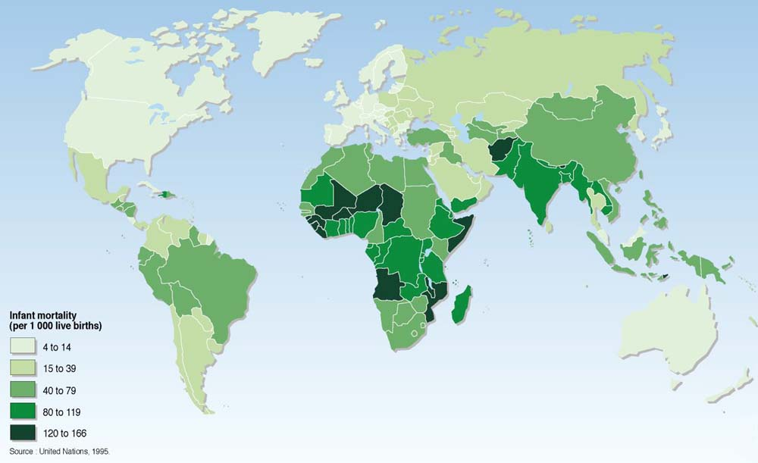
http://www.povertymap.net/pub/mipwa/sections/w-global/health-sanit/infant-mortality-2.htm

Slide 15
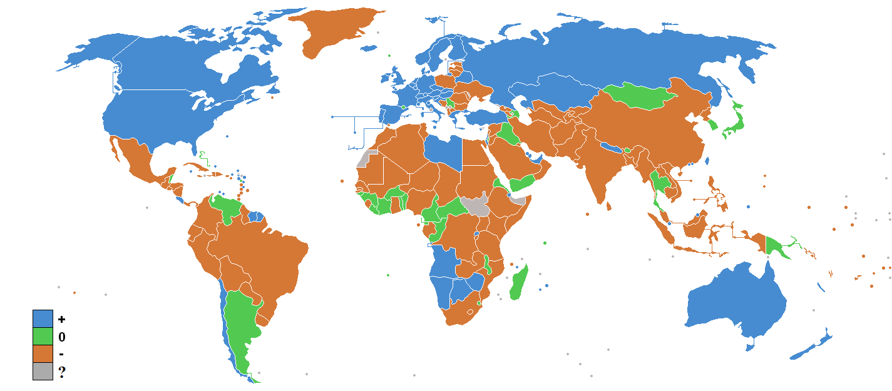
Factors affecting Migration (immigration and emigration)
  Net Migration Rate: difference between immigration and emigration per 1000 people in a given year (only effects individual countries)
    Better jobs and economic improvement
    Religious, ethnic, or political conflicts
    Lack of access to basic needs (food, water, etc.)
      Environmental refugees

Slide 16
Exponential Growth Calculations
Calculating and Predicting Rates of Growth—The Rule of 70
  With populations that are growing exponentially we can use the rule of 70 to predict rates of growth and population doubling times.
  **Assumes growth rate is constant. Estimate only.**
  Doubling time (dt) = 70/ % growth rate
  or
  % growth rate = 70/dt

Slide 17
Practice Problems
If the starting population of 5 rabbits grows at 2% each year, how long will it take the population to double?
If the doubling time for a population is 7 years what is the growth rate over this time period?

Slide 18
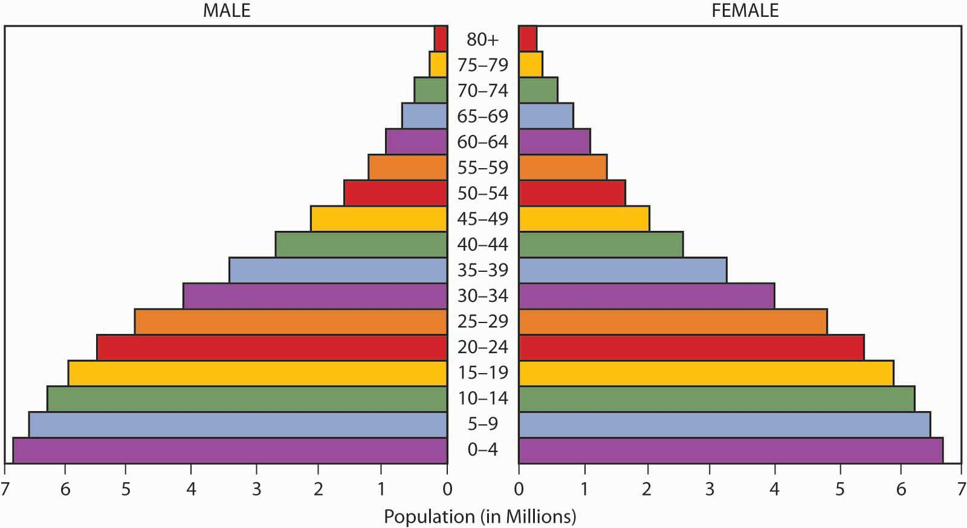
Population Pyramids
Graph (histogram) that allows us to see the population growth within a country broken down by age groups and gender
  horizontal axis: gender
    male: left-hand female: right-hand
    absolute number of people or %
  vertical axis: age
    5-year or 10-year age groups
Ages categorized as…
  Pre-reproductive: ages 0-14
  Reproductive: ages 15-44
  Post-reproductive: ages 44+

Slide 19
Population Pyramids
We classify our pyramids based on the shape they take.
  Rapidly Growing: large amounts of people in the pre-reproductive and reproductive years
    Very large bottom of the pyramid
  Growing Slowly: more individuals in the pre-reproductive and reproductive years
    Bottom of pyramid is slightly larger than the rest
  Stable (zero population growth): population is evenly distributed throughout age groups
    Pyramid is relatively even top to bottom
  Declining (negative growth): more individuals in the post-reproductive age groups
    Bottom of pyramid is smaller than the top

Slide 20
Demographic Transition
Movement of a nation from high population growth to low population as it develops economically (from subsistence economy to affluence).
  Traced through graphs of a population change over time (birth rates and death rates)
  Illustrates how countries will influence the environment as they transition
  most countries will go through this transition in the next few decades due to technological and economic development
Transition as a result of five stages
  Stage 1—Birth and death rates are both high
  Stage 2—Death rates fall; birth rates remain high; growth rate rises
  Stage 3—Birth rates fall as standard of living rises; growth rate falls
  Stage 4 and 5—Growth rate continues to fall to zero or to a negative rate

Slide 21
Solutions for slowing population growth
economic development
  reduction of poverty
  Education
family planning
  reproductive health care
empowering women

Slide 22
economic solutions—get people out of poverty.
“failing states”- rapid population growth, extreme poverty and environmental degradation leads to the government no longer ensuring the personal security of their people and they can’t provide basic services. Leads to people perpetually trapped in poverty.
  civil war and terrorism are common
  low income, less developed
  lack of skilled workers, financial capital
  stuck in stage 2 of transition
  ex. Somalia, Haiti

Slide 23
empowering women
women will have fewer children if they are educated, can control their own fertility, and earn an income of their own
  Microloans for skilled trades (weaving, sewing, etc.) to earn income
in many societies women have fewer rights and educational and economic opportunities
  patriarchal societies (sons valued)--India
  women account for 66% of all hours worked but only 10% of income earned (worldwide)

Slide 24
family planning
helps couples choose how many children to have and when to have them
  educating men and women
birth spacing, birth control, health care for women and infants
  the older a women is when she has her first child will decrease the total number of children
reduces number of pregnancies and abortions (major decrease in TFR)
lack of access to services hinders efforts

Slide 25
Problems with a growing population
“graying of a population” (Japan)
  Characteristic of highly developed countries
    Women choosing not to have children..pursue career instead
  who will care for the elders?
    income to provide for social services
  economic impacts (smaller workforce)
  some countries providing incentives to have more children (Europe)
may be balanced out with a large number of immigrants

Slide 26
Impacts
Developed and Developing countries have different impacts
  most of the world lives in developing countries, but developed countries consume more resources
    ecological footprints and wealth gap
    Affluence
Measure Impact using IPAT equation
  Impact= population x affluence x technology
As a population grows resources need to be available to meet the needs of the people
  land use (housing and agriculture)
  Sanitation and health care
  Access to clean water

