Slide 1
Environmental Movements and Important Case Studies
“A chopped head is cheaper than a felled tree.”
- Amrita Devi

Slide 2
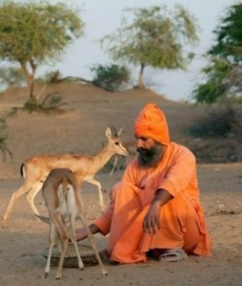
BISHNOI MOVEMENT
The Bishnoi faith is a religious offshoot of Hinduism founded on 29 principles, most of which promote environmental stewardship.
The religion was founded by Guru Maharaj Jambaji in 1485 AD in the Marwar (Jodhpur) desert region of western Rajasthan, India.
He banned cutting down green trees and killing birds or animals.
Bishnois are famous for cultivating lush vegetation, caring for animals, and collecting drinkable water.

Slide 3
BISHNOI MOVEMENT
Principles of Bishnoi philosophy relevant to environmental protection
To be compassionate towards all living beings.
Do not cut the green trees, save the environment.
To provide a common shelter for goat/sheep to avoid them being slaughtered.
Don’t sterilize bulls.
Feed and protect wildlife.

Slide 4
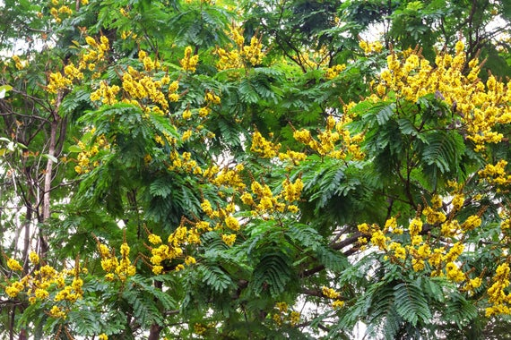
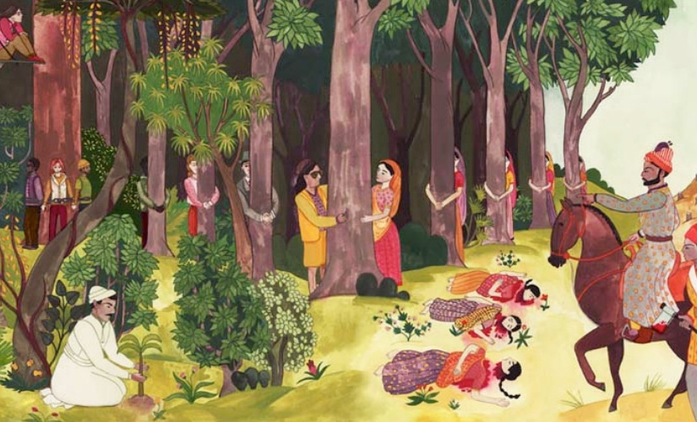
BISHNOI MOVEMENT
In 1730, maharajah (king) of Jodhpur sent soldiers to gather khejri (acacia) wood from the forest region near the village of Khejarli.
Amrita Devi was a female villager who decided to literally hug the trees, and encouraged others to do so too.
As each villager hugged a tree, refusing to let go, they were beheaded by the soldiers.
This voluntary martyrdom continued until 363 Bishnoi villagers were killed in the name of the sacred Khejarli forest.

Slide 5
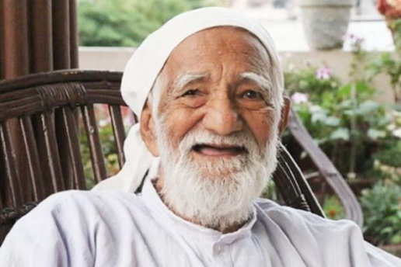
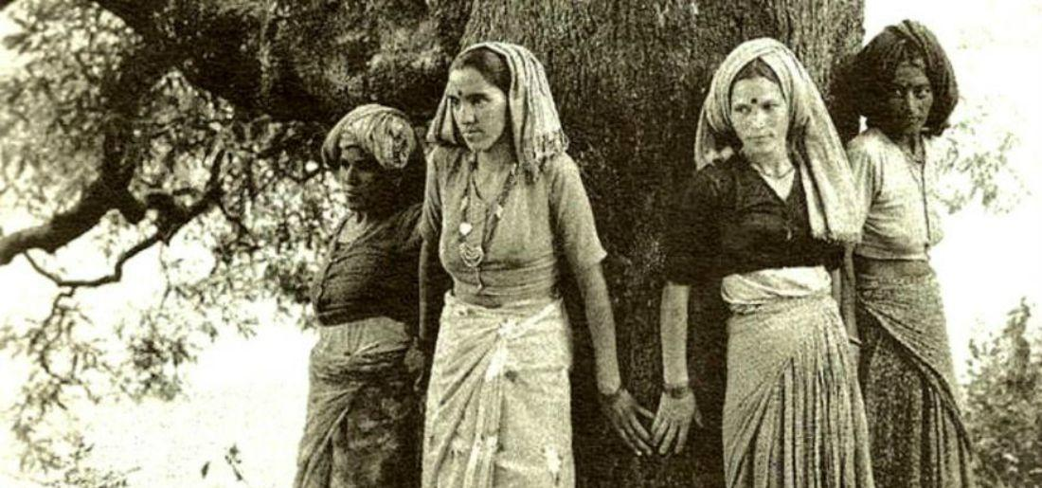
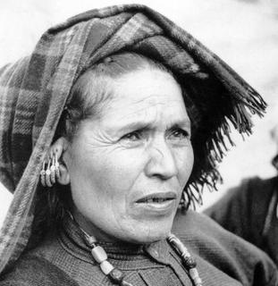
CHIPKO MOVEMENT
Chipko movement (Chipko andolan): A nonviolent social and ecological movement by rural villagers in India in the 1973, aimed at protecting trees and forests slated for government-backed logging.
The movement originated in the Himalayan region of Uttar Pradesh (now Uttarakhand).
Inspired by Bishnoi movement
The main objective was to protect the trees on the Himalayan slopes from the axes of contractors of the forest.
Led by Sundarlal Bahuguna, Gaura Devi, Sudesha Devi

Slide 6

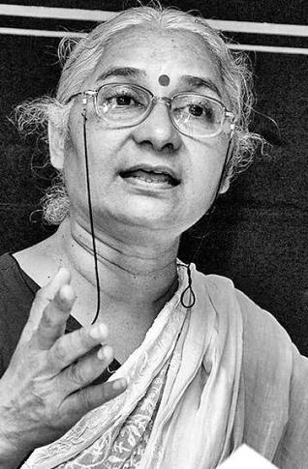
NARMADA BACHAO ANDOLAN
The movement first started in 1985 as a protest for not providing proper rehabilitation and resettlement for the people who have been displaced by the construction of Sardar Sarovar Dam.
Later on, the movement turned its focus on the preservation of the environment and the eco-systems of the valley.
Led by Medha Patekar

Slide 7
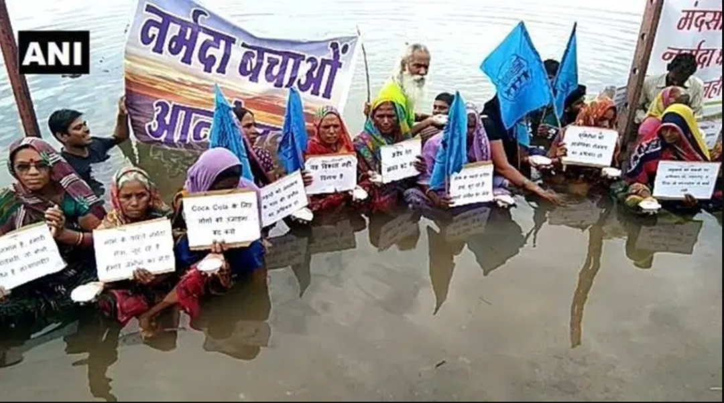
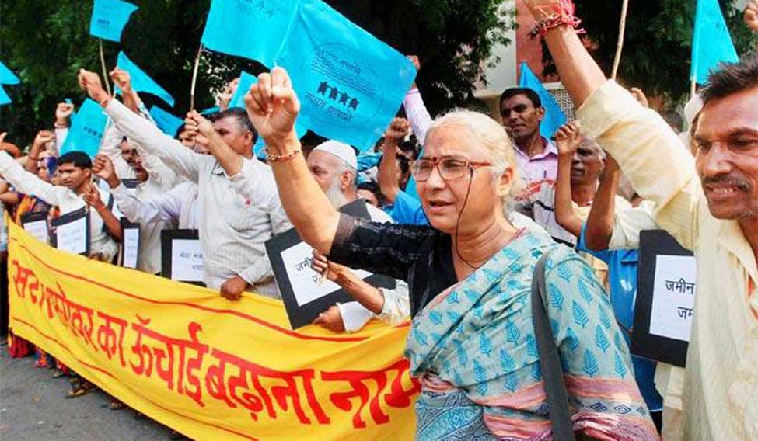
NARMADA BACHAO ANDOLAN
Activists also demanded the height of the dam to be reduced to 88 m from the proposed height of 130m. World Bank withdrew from the project.
In October 2000, the Supreme Court gave a judgment approving the construction of the Sardar Sarovar Dam with a condition that height of the dam could be raised to 90 m.
The project is expected to be fully completed by 2025.

Slide 8
SILENT VALLEY MOVEMENT
Silent Valley National Park located in Nilgiri Hills, Coimbatore – Palakkad District in Kerala is known as “Sairandhrivanam” which means Sairandhri's Forest. Here Sairandhri refers to Draupadi who disguised herself as Sairandhri, queen Sudeshna's assistant during the exile of Pandavas
The first Western investigation of the watersheds of the Silent Valley area was in 1857 by the botanist Robert Wight.
The British named the area Silent Valley because of a perceived absence of noisy cicadas.
Another story attributes the name to the anglicisation of Sairandhri.
A third story refers to the presence of many lion-tailed macaques Macaca silenus.

Slide 9
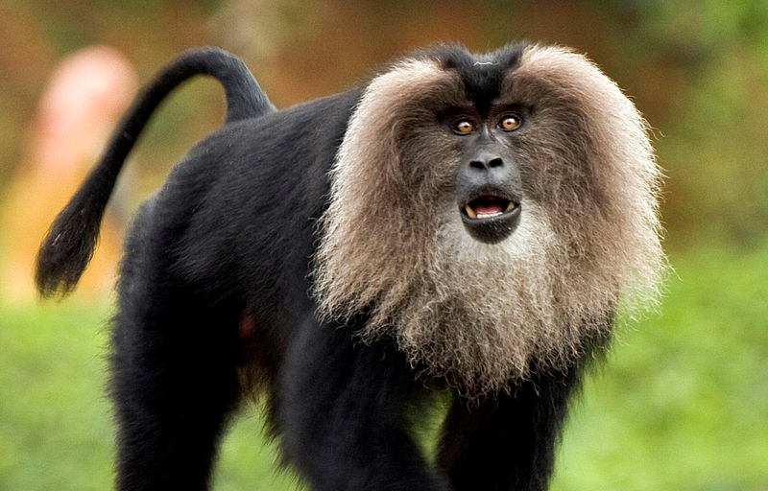
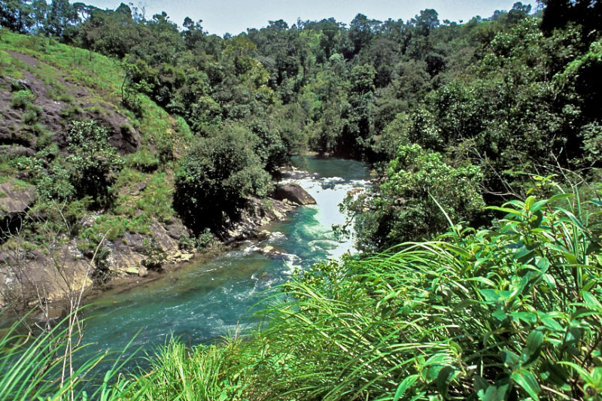
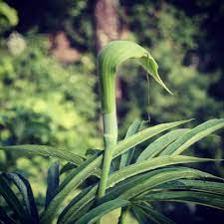
SILENT VALLEY MOVEMENT
The Silent Valley is one of the last undisturbed rain forests and tropical moist evergreen forests in India.
It is located in the Nilgiri Hills, Palakkad District in Kerala, South India.
16 bird species and 34 species of mammals in Silent Valley are threatened.
Over 128 species of butterflies and 400 species of moths live here.

Slide 10
SILENT VALLEY MOVEMENT
The Kerala State Electricity Board (KSEB) proposed a hydroelectric dam across the Kunthipuzha River that runs through Silent Valley.
In February 1973, the Planning Commission approved the project.
Several NGOs strongly opposed the project and urged the government to abandon it.
In January 1981, Indira Gandhi declared that Silent Valley will be protected.
In November 1983 the Silent Valley Hydroelectric Project was called off.
In 1985, Prime Minister Rajiv Gandhi formally inaugurated the Silent Valley National Park.

Slide 11
Role of an individual in conservation of natural resources
Switch off lights, fans and other appliances when not in use.
Use solar heater for cooking your food on sunny days.
Use minimum amount of water for all domestic purposes.
Built rainwater harvesting system in your house.
Grow different types of plants, herbs, trees and grass in your garden and open areas.
Don’t use more fertilizer and pesticides. Use nature manure to the crops.
Don’t waste the food instead give it to someone before getting spoiled.

Slide 12
Who was associated with Bishnoi Movement?
Amrita Devi
Sundarlal Bahuguna
Medha Patkar
Maneka Gandhi

Slide 13
Who was associated with Chipko Movement?
Amrita Devi
Sundarlal Bahuguna
Medha Patkar
Maneka Gandhi

Slide 14
Who made the slogan “A chopped head is cheaper than a felled tree.”
Amrita Devi
Sundarlal Bahuguna
Medha Patkar
Maneka Gandhi

Slide 15
Which river is flowing through the silent valley?
Kaveri
Narmada
Krishna
Kunthi

Slide 16
Which movement forces the prime minister Indra Gandhi to cancel the construction of dam on the Kunthipuzha River
Silent Valley movement
Chipko movement
Bishnoi movement
Narmada Bachao Andolan

