Slide 1
CSE101-Lec 10 and 11
User defined functions(Introduction to Functions)
Parameter Passing mechanisms(Call by value and Call by reference)

Slide 2
Functions

Slide 3
Divide and Conquer
Best way to solve a problem is by dividing the problem and solving it.
Divide and conquer
Construct a program from smaller pieces or components
These smaller pieces are called modules
Each module more manageable than the original program

Slide 4
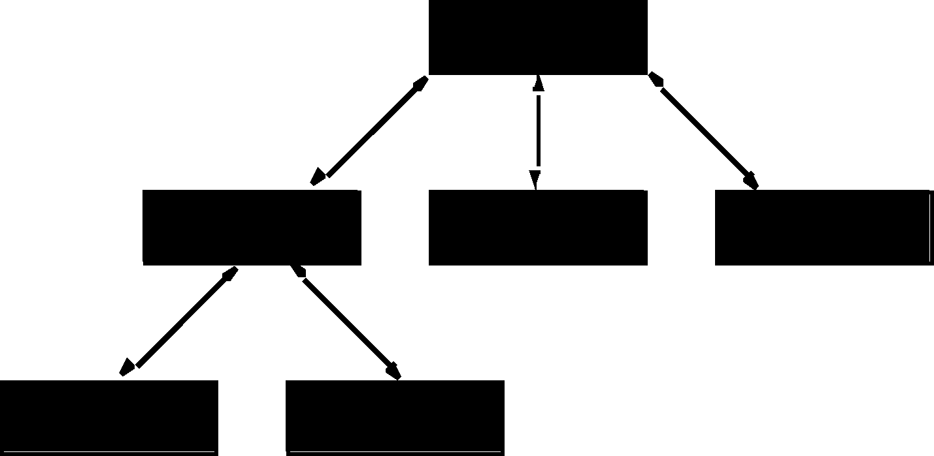
Program Modules in C
Hierarchical boss function/worker function relationship.

Slide 5
Program Modules in C
Functions
Modules in C are called functions.
Two categories of functions: Pre-defined(or library functions) and User defined
Programs combine user-defined functions with library functions
C standard library has a wide variety of functions for performing common mathematical calculations, string manipulations, character manipulations, input/output and many more.
C standard library makes your job easier.
Functions like printf(), scanf(), pow() are standard library functions.
We can also write functions to define some specific task in a program and these functions are called user-defined functions.

Slide 6
What are functions??
Functions
A function is a set of statements that take inputs, do some specific computation and produces output.
The idea is to put some commonly or repeatedly done task together and make a function so that instead of writing the same code again and again for different inputs, we can call the function.

Slide 7
Benefits of functions
Functions help us in reducing code redundancy. If functionality is performed at multiple places in software, then rather than writing the same code, again and again, we create a function and call it everywhere. This also helps in maintenance as we have to change at one place if we make future changes to the functionality.
Functions make code modular. Consider a big file having many lines of codes. It becomes really simple to read and use the code if the code is divided into functions.
Functions provide abstraction. For example, we can use library functions without worrying about their internal working.

Slide 8
Three important parts/ or components of any user defined function
Function declaration/ or Function prototype/ or Function signature
Function definition
Function calling

Slide 9
Function declaration/ or Function prototype/ or Function signature
A function declaration tells the compiler about the number of parameters function takes, data-types of parameters and return type of function. Putting parameter names in function declaration is optional in the function declaration, but it is necessary to put them in the definition. Below are an example of function declarations. (parameter names are not there in below declarations)
Syntax:
return_type function_name( parameter list/or arguments );
Example 1:
int example(int,int);// Here function is returning integer value and accepting two integer arguments
Example 2:
void example();// Here function is returning nothing and it is accepting no argument

Slide 10
Function definition
Function definition consists of the set of statements that are required to be executed when the function is used.
It consists of body of the function along with function header
Function header is same as function declaration but there is no semicolon after it
Function header is followed by function body where actual functionality of the function is placed

Slide 11
Function definition-Example
Syntax:
return_type function_name( parameter list ) //Function Header
{
//body of the function // Function body
}
Example:
int sum(int x,int y) // sum is a user defined function which takes two integer parameters
{
int z;
z=x+y;
return z; //After adding two integers it is returning the result
}

Slide 12
Function Calling
Once the function is declared and defined, we wish to use it. So, for using the function we need to call it
When the function is called in the main() function/ or some other function, the control is transferred to the called function, once the function definition is executed completely, the control will come back to the main()/ or the other function in which the calling statement has been placed, and the execution will resume from the same point where it was halted.
Syntax of function calling:
function_name(<List_of_argument_values>);
Example: function(2,3);

Slide 13
Points to remember during function calling
Function name and the number and type of arguments in the function call must be same as that given in the function declaration and function header of the function definition
Names (and not the types) of variables in function declaration, function call and header of function definition may vary
Arguments may be passed in the form of expressions to the called function. In such a case, arguments are first evaluated and converted to the type of formal parameter and then the body of the function gets executed.
If the return type of the function is not void, then the value returned by the called function may be assigned to some variable as given below.
variable_name = function_name(variable1, variable2, …);

Slide 14
Program example of function
#include<stdio.h>
int sum(int a, int b);// FUNCTION DECLARATION
int main()
{
int num1, num2, total = 0;
printf(“\n Enter the first number : “);
scanf(“%d”, &num1);
printf(“\n Enter the second number : “);
scanf(“%d”, &num2);
total = sum(num1, num2); // FUNCTION CALL
printf(“\n Total = %d”, total);
return 0;
}
// FUNCTION DEFNITION
int sum ( int a, int b)// FUNCTION HEADER
{
// FUNCTION BODY
return (a + b);
}

Slide 15
return statement in functions
The return statement is used to terminate the execution of a function and return control to the calling function. When the return statement is encountered, the program execution resumes in the calling function at the point immediately following the function call.
Calling function is one in which the function is called(usually main()), and the called function is one whose definition is placed outside main() or/ some other function
A return statement returns a value to the calling function. The syntax of return statement can be given as
return <expression> ;
Here expression is placed in between angular brackets because specifying an expression is optional. The value of expression, if present, is returned to the calling function. However, in case expression is omitted, the return value of the function is undefined.
Programmer may or may not place the expression within parentheses.
For functions that has no return statement, the control automatically returns to the calling function after the last statement of the called function is executed.

Slide 16
Types of user defined functions
Function with no argument and no return value :When a function has no arguments, it does not receive any data from the calling function. Similarly when it does not return a value, the calling function does not receive any data from the called function. (input, output statements and actual logic ,all will be placed in the function definition)
Function with arguments but no return value : When a function has arguments, it receive data from the calling function but it returns no values.(input will be taken in the calling function, whereas output statement and logic will be placed in the function definition)
Function with no arguments but returns a value : There could be occasions where we may need to design functions that may not take any arguments but returns a value to the calling function. (input statement and logic will be placed in function definition and output statement will be placed in calling function)
Function with arguments and return value: This kind of function returns a value as well as it can accept arguments also.(input and output statements will be placed in calling function and logic will be placed in function definition)

Slide 17
Program example: Function with no argument and no return value Write a program to add two numbers using function with no argument and no return value
#include<stdio.h>
void add(); //Function declaration
int main()
{
add(); //Function calling
return 0;
}
//Function definition
void add()
{
int a,b,sum;
printf("\n Enter two numbers:");
scanf("%d%d",&a,&b);
sum=a+b;
printf("\n Sum of two numbers is:%d",sum);
}
Here input, output statements and logic all are placed in the function definition

Slide 18
Program example: Function with arguments but no return value Write a program to add two numbers using function with argument but no return value
#include<stdio.h>
void add(int,int); //Function declaration
int main()
{
int a,b;
printf("\n Enter two numbers:");
scanf("%d%d",&a,&b);
add(a,b); //Function calling //a, b are actual arguments
return 0;
}
//Function definition
void add(int x,int y) //x and y are formal arguments
{
int sum;
sum=x+y;
printf("\n Sum of two numbers is:%d",sum);
}
Here input is taken in calling function(i.e. main()) whereas output statement and logic is placed in the function definition
Note: Arguments in function call statements are actual arguments, whereas arguments in function definition are formal arguments

Slide 19
Program example: Function with no arguments but returns a value Write a program to add two numbers using function no arguments but return a value
#include<stdio.h>
int add(); //Function declaration
int main()
{
int result;
result=add(); //Function calling
printf("\n Sum is:%d",result);
return 0;
}
//Function definition
int add()
{
int a,b,sum;
printf("\n Enter two numbers:");
scanf("%d%d",&a,&b);
sum=a+b;
return sum;
}
Here input statement and logic is placed in the function definition and then it returns sum, and output statement is written in the calling function(i.e. main())

Slide 20
Program example: Function with arguments and return value Write a program to add two numbers using function with arguments and return a value
#include<stdio.h>
int add(int,int); //Function declaration
int main()
{
int a,b,result;
printf("\n Enter two numbers:");
scanf("%d%d",&a,&b);
result=add(a,b); //Function calling //a, b are actual arguments
printf("\n Sum is:%d",result);
return 0;
}
//Function definition
int add(int x,int y) //x and y are formal arguments
{
int sum;
sum=x+y;
return sum;
}
Here input and output statements are placed in the calling function (i.e. main()) and logic is placed in the function definition
Note: Arguments in function call statements are actual arguments, whereas arguments in function definition are formal arguments

Slide 21
Parameter Passing mechanisms in C/ or Argument Passing techniques in C/ or Calling mechanisms in C
There are two ways in which arguments or parameters can be passed to the called function.
Call by value in which values of the variables are passed by the calling function to the called function.
Call by reference in which address of the variables are passed by the calling function to the called function

Slide 22
Call by value
In the Call by Value method, the called function creates new variables to store the value of the arguments passed to it. Therefore, the called function uses a copy of the actual arguments to perform its intended task.
If the called function is supposed to modify the value of the parameters passed to it, then the change will be reflected only in the called function. In the calling function no change will be made to the value of the variables.
#include<stdio.h>
void add( int n);
int main()
{
int num = 2;
printf("\n The value of num before calling the function = %d", num);
add(num);
printf("\n The value of num after calling the function = %d", num);
return 0;
}
void add(int n)
{
n = n + 10;
printf("\n The value of num in the called function = %d", n);
}
The output of this program is:
The value of num before calling the function = 2
The value of num in the called function = 12
The value of num after calling the function = 2

Slide 23
Advantages and Disadvantages of Call by value
Advantages:
The method doesn't change the original variable, so it is preserving data.
Whenever a function is called it, never affect the actual contents of the actual arguments.
The other advantage could be arguments can be variables(e.g. x), literals(e.g. 6,0…), or expressions(e.g. x+1)
Disadvantages:
Copy of the variable is created hence it can consume additional storage space
Along with more space, it can take a lot of time to copy, thereby resulting in performance penalty, especially if the function is called many times

Slide 24
Call by reference
When the calling function passes arguments to the called function using call by value method, the only way to return the modified value of the argument to the caller is explicitly using the return statement. The better option when a function can modify the value of the argument is to pass arguments using call by reference technique.
In call by reference, we declare the function parameters as pointers rather than normal variables. When this is done, any changes made by the function to the arguments ,are visible to the calling program.
To indicate that an argument is passed using call by reference, address of the variable is passed as an actual argument during function calling, and pointers will act as formal arguments in the function definition to which the addresses will be assigned

Slide 25
Call by reference(Program example)
#include<stdio.h>
void add( int *n);
int main()
{
int num = 2;
printf("\n The value of num before calling the function = %d", num);
add(&num);
printf("\n The value of num after calling the function = %d", num);
return 0;
}
void add( int *n)
{
*n = *n + 10;
printf("\n The value of num in the called function = %d", *n);
}
The output of this program is:
The value of num before calling the function = 2
The value of num in the called function = 12
The value of num after calling the function = 12

Slide 26
Advantages and Disadvantages of Call by reference
Advantages:
It provides greater time and space efficiency as duplicate copies of the arguments are not created
In this method, there is no copy of the argument made. Therefore it is processed very fast.
Disadvantages:
Original values are not safe, as they can be modified
We can only pass addresses as actual arguments(we cannot pass: literals(1,2,3…) / or expressions(x+1,y+2..) as actual arguments

Slide 27
Call by value vs Call by reference
Parameters | Call by value | Call by reference
Definition | While calling a function, when you pass values by copying variables, it is known as "Call By Values." | While calling a function, in programming language instead of copying the values of variables, the address of the variables is used it is known as "Call By References.
Arguments | In this method, a copy of the variable is passed. | In this method, address of the variable is passed.
Effect | Changes made in a copy of variable never modify the value of variable outside the function. | Change in the variable also affects the value of the variable outside the function.
Alteration of value | Does not allow you to make any changes in the actual variables. | Allows you to make changes in the values of variables by using function calls.
Passing of variable | Values of variables are passed using a straightforward method. | Pointer variables are required to store the address of variables.
Value modification | Original value not modified. | The original value is modified.

Slide 28
Q1
Which of the following is a correct format for declaration of function?
A. return-type function-name(argument type);
B. return-type function-name(argument type){}
C. return-type (argument type)function-name;
D. all of the mentioned
Notes:
A

Slide 29
Q2
Which function definition will run correctly?
a) int sum(int a, int b)
return (a + b);
b) int sum(int a, int b)
{return (a + b);}
c) int sum(a, b)
return (a + b);
d) none of the mentioned
Notes:
b

Slide 30
Q3
Which of the following is a valid function declaration statement?
A.function1(int,int);
B.void function1(a,b);
C.void 1function(int,int);
D.void function1(int,int);
Notes:
D

Slide 31
Q4
Which of the following is a valid function call statement for user defined function: abc
a) abc(int);
b) void abc();
c) abc();
d) int abc(int);
Notes:
C

Slide 32
Q5
What will be the output of the following C code?
#include <stdio.h>
void m()
{
printf("hi");
}
int main()
{
m();
return 0;
}
A. hi
B. Run time error
C. Nothing will be displayed
D. Compile time error
Notes:
A

Slide 33
Q6
What will be the output of the following C code?
#include <stdio.h>
void m();
int main()
{
m();
return 0;
}
void m()
{
printf("hi");
m();
}
A. Compile time error
B. hi
C. Infinite hi
D. Nothing
Notes:
C

