Slide 1
INHERITANCE

Slide 2
Syllabus
Inheritance Basics – derived class and base class,
Modes (private, protected, public inheritance),
Types (simple, multi-level, multiple and hierarchical),
Overriding member functions,
Order of execution of constructors and destructors,
Resolving ambiguities in inheritance,
Virtual base class,
Aggregation and Composition.

Slide 3
Inheritance Basics – derived class and base class

Slide 4
Introduction
Reusability is an important feature of object oriented programming(OOP).
Reusing an existing piece of code offers many benefits.
It not only saves the efforts and cost required to build a software product but also enhances its reliability.
Therefore, programmers need not re-write, re-debug, and re-test the code that has already been tested and being used in the existing software.
Inheritance is a method of implementing reusability of Classes.

Slide 5
Inheritance
The mechanism of deriving a new class from an old class is called inheritance.
The old class is referred to as base class and the new one is called the derived class.
The derived class inherits some or all the properties from the base class.
The Class which acts as the source of providing its Members for Inheritance is called the Parent or Base Class. The Class that derives from or acquires the Members of Base Class is called the Child or Derived Class.
The Private members of any Class can Not be Inherited.

Slide 6
Defining Derived classes
Syntax:
class Derived_Class : [access-specifier] Base_Class
{
//body of derived class ...
};
where
access-specifies
private by default, or
Public
Protected

Slide 7
Modes (private, protected, public inheritance)

Slide 8
Access Specifiers/Visibility modes/Visibility labels in C++
private: It is the highest level of data hiding. Private members are accessible inside the same class in which they are defined.
protected: Protected members are accessible inside base and derived class only.
public: It is the lowest and the most open level of data hiding. Public members are accessible everywhere.

Slide 9
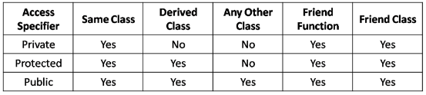
Accessibility modes
Below table specifies the accessibility of the three visibility modes in the same class, derived class and outside class.

Slide 10
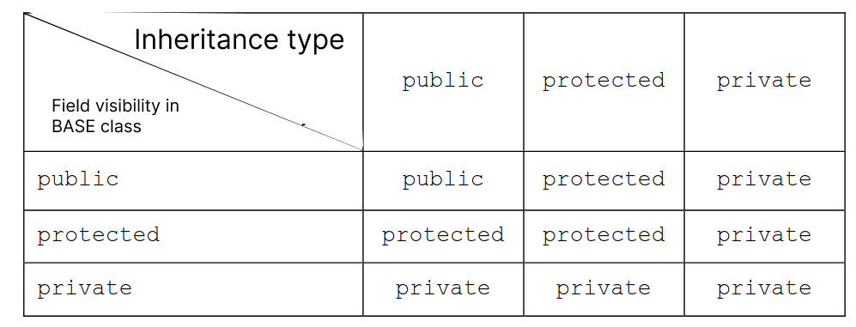
Inheritance type

Slide 11



A class derived in private mode

Slide 12
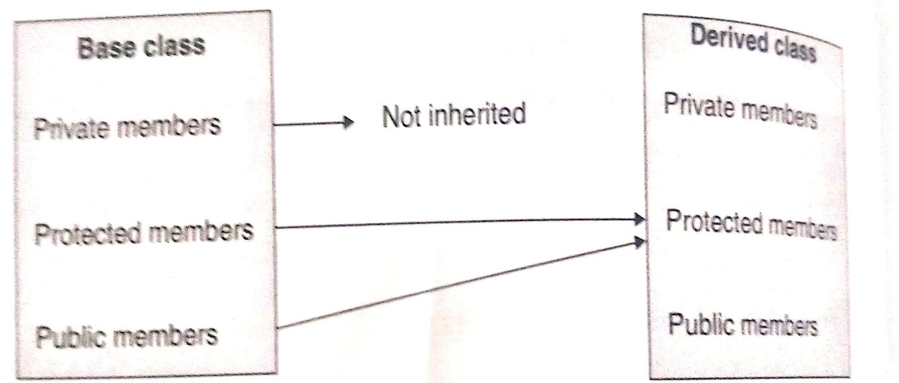

A class derived in protected mode

Slide 13
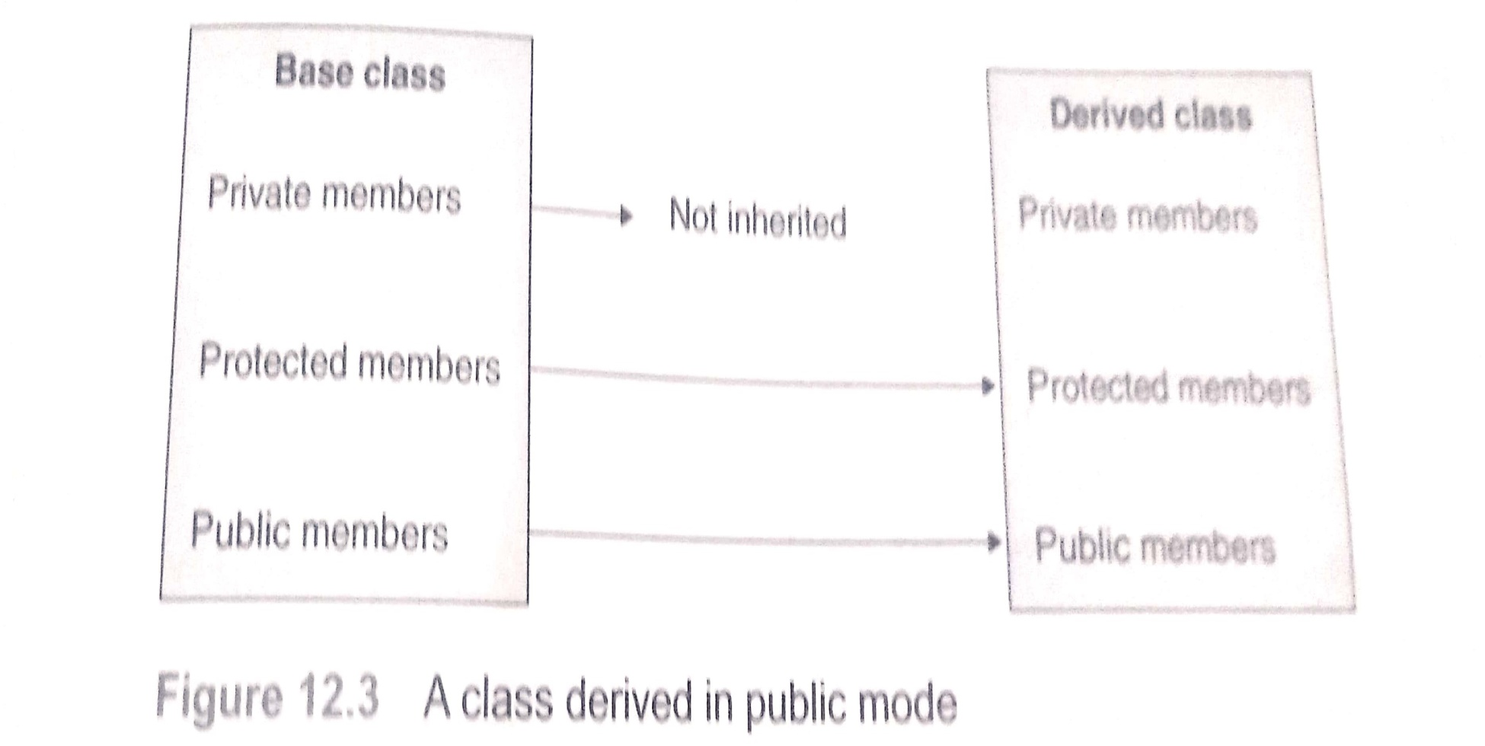

A class derived in public mode

Slide 14
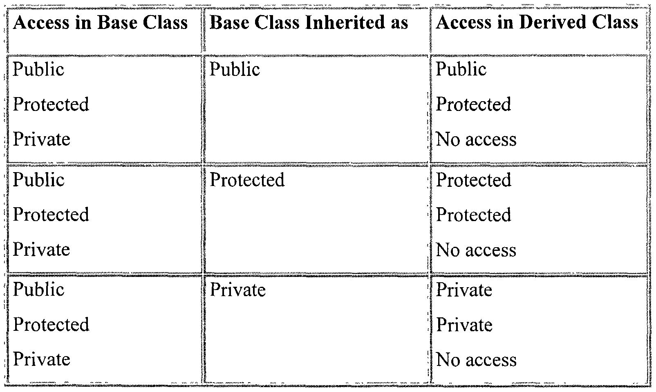
Summary of modes

Slide 15
Understanding Inheritance Restrictions
The following are never inherited:
constructors
destructors
friend functions
overloaded new operators
overloaded = operators
Class friendship is not inherited

Slide 16
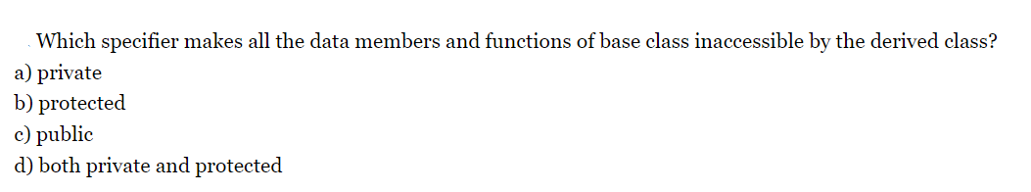
Q1
Solution: Private
Notes:
a

Slide 17
Q2
When the inheritance is private, the private methods in base class are __________ in the derived class (in C++).
A. Inaccessible B. Accessible C. Protected D. Public
Solution: Inaccessible
Notes:
a

Slide 18
Q3
When a protected member is inherited in public mode, it becomes ……….. in the derived class too and therefore is accessible by member functions of the derived class. A) protected B) private C) public D) friend
Solution: Protected
Notes:
A

Slide 19
Q4
When the base class is publicly inherited, public members of the base class become …………. of the derived class. A) private members B) protected members C) Public members D) Not inherited
Solution: Public
Notes:
C

Slide 20
Types (simple, multi-level, multiple and hierarchical)

Slide 21
Types of Inheritance
Single Inheritance(One base and one derived class)
Multiple Inheritance(More than one base classes for one derived class)
Hierarchical Inheritance(More than one derived classes for one base class)
Multilevel Inheritancea (A derived class is created from another derived class)
Hybrid Inheritance(Combination of more than one types of inheritance)

Slide 22
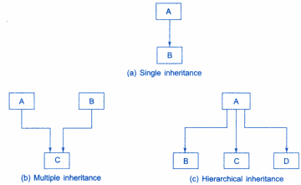
Types of Inheritance

Slide 23
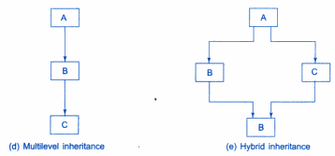
Types of Inheritance

Slide 24
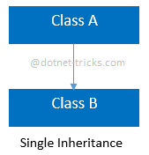
Single Inheritance
In this inheritance, a derived class is created from a single base class.
In the given example, Class A is the parent class and Class B is the child class since Class B inherits the features and behavior of the parent class A.

Slide 25
Single Inheritance: Public derivation
#include<iostream>
#include<string.h>
using namespace std;
class student
{
private:
int roll_no;
protected:
char section[10];
public:
void get_rno()
{
cout<<"\n Enter the roll number:";
cin>>roll_no;
}
void show_rno()
{
cout<<"\n Roll no:"<<roll_no;
}};
class result:public student
{
private:
float fees;
public:
void get_data()
{
get_rno();
cout<<"\n Enter fees:";
cin>>fees;
cout<<"\n Enter section:";
cin>>section;
}
void display()
{
show_rno();
cout<<"\n Fees:"<<fees;
cout<<"\n Section:"<<section;
}} ;

Slide 26
Single Inheritance: Public derivation
int main()
{
result obj1;
obj1.get_data();
obj1.display();
/*obj1.get_rno();//Possible---Public
obj1.show_rno();//Possible--Public
strcpy(obj1.section,"K17TY");//Not Possible--Protected*/
}

Slide 27
Single Inheritance: Protected derivation
#include<iostream>
#include<string.h>
using namespace std;
class student
{
private:
int roll_no;
protected:
char section[10];
public:
void get_rno()
{
cout<<"\n Enter the roll number:";
cin>>roll_no;
}
void show_rno()
{
cout<<"\n Roll no:"<<roll_no;
}};
class result:protected student
{
private:
float fees;
public:
void get_data()
{
get_rno();
cout<<"\n Enter fees:";
cin>>fees;
cout<<"\n Enter section:";
cin>>section;
}
void display()
{
show_rno();
cout<<"\n Fees:"<<fees;
cout<<"\n Section:"<<section;
}} ;

Slide 28
Single Inheritance: Protected derivation
int main()
{
result obj1;
obj1.get_data();
obj1.display();
//obj1.get_rno(); //It not will work
//obj1.roll_no=78;//It will not work(Private data)
//strcpy(obj1.section,"K17MM");//It will not work(Protected data)
}

Slide 29
Single Inheritance: Private derivation
#include<iostream>
#include<string>
using namespace std;
class student
{
private:
int roll_no;
protected:
char section[10];
public:
void get_rno()
{
cout<<"\n Enter the roll number:";
cin>>roll_no;
}
void show_rno()
{
cout<<"\n Roll no:"<<roll_no;
}
};
class result:private student
{
private:
float fees;
public:
void get_data()
{
get_rno();
cout<<"\n Enter fees:";
cin>>fees;
cout<<"\n Enter section:";
cin>>section;
}
void display()
{
show_rno();
cout<<"\n Fees:"<<fees;
cout<<"\n Section:"<<section;
}
} ;

Slide 30
Single Inheritance: Private derivation
int main()
{
result obj1;
obj1.get_data();
obj1.display();
//obj1.get_rno(); //It not will work-Private data
//obj1.show_rno();//It will not work-Private data
//obj1.roll_no=78;//It will not work(Private data)-Not inherited
//strcpy(obj1.section,"K17MM");//It will not work(Private data)
}

Slide 31
Problem
Write a program with two classes: Vehicle as the base class and Car as the derived class, which inherits the properties from the Vehicle class for calculating the speed. The base class fetches the input as a float value, whereas the derived class calculates and prints the output as a float value.
Note: Use public inheritance
The input distance and time should be non-negative floating-point numbers.
Sample Input Sample Output
15.0 5.0 Speed of car: 3 km/hr

Slide 32
Solution
#include <iostream>
using namespace std;
class Vehicle
{
public:
float dist,tim;
void fetchData()
{
cin>>dist>>tim;
}
};
class Car:public Vehicle
{
float spd;
public:
void calc()
{
spd = dist/tim;
}
void display()
{
cout<<"Speed of car: "<<spd<<" km/hr";
}
};
int main()
{
Car c;
c.fetchData();
c.calc();
c.display();
return 0;
}

Slide 33
Multiple Inheritance
Is the phenomenon where a class may inherit from two or more classes
Syntax:
class derived : public base1, public base2
{
//Body of class
};
Base classes are separated by comma
A
B
C
Notes:
33

Slide 34
Multiple Inheritance
#include <iostream>
using namespace std;
class M
{
protected:
int m;
public:
void get_m(int x)
{
m=x;
}};
class N
{
protected:
int n;
public:
void get_n(int y)
{
n= y;
}};
class P:public M, public N
{
public:
void display(void)
{
cout<<"m="<<m<<"\n";
cout<<"n="<<n<<"\n";
cout<<"m*n="<<m*n<<"\n";
}
};
int main()
{
P p;
p.get_m(10); //m=10
p.get_n(20); //n=20
p.display(); //m*n = 200
return 0;
}

Slide 35
Multilevel Inheritance
It is also possible to derive a class from an existing derived class.
It is implemented by defining atleast three classes.
Each derived class must have a kind of relationship with its immediate base class.
A
B
C

Slide 36
Multilevel Inheritance
class Car: public fourWheeler{
public:
Car()
{
cout<<"Car has 4 Wheels"<<endl;
}
};
int main()
{
Car obj;
return 0;
}
#include <iostream>
using namespace std;
class Vehicle
{
public:
Vehicle()
{
cout << "This is a Vehicle" << endl;
}
};
class fourWheeler: public Vehicle
{ public:
fourWheeler()
{
cout<<"Objects with 4 wheels are vehicles"<<endl;
}
};

Slide 37
Problem
Create a class X with data member ‘a’, derived class Y from X with data member ‘b’ and derived class Z from Y with data member c. find the sum of a,b and c and display the result.

Slide 38
Solution
#include<iostream>
using namespace std;
class X
{
protected:
int a;
public:
void getdataX()
{
cout<<"\n Enter value of a:";
cin>>a;
}
};
class Y:public X
{
protected:
int b;
public:
void getdataY()
{
cout<<"\n Enter value of b:";
cin>>b;
}
};
class Z:public Y
{
private:
int c,result;
public:
void getdataZ()
{
cout<<"\n Enter value of c:";
cin>>c;
}

Slide 39
Solution
void sum()
{
result=a+b+c;
cout<<"\n Final result is:"<<result;
}
};
int main()
{
Z obj1;
obj1.getdataX();
obj1.getdataY();
obj1.getdataZ();
obj1.sum();
return 0;
}

Slide 40
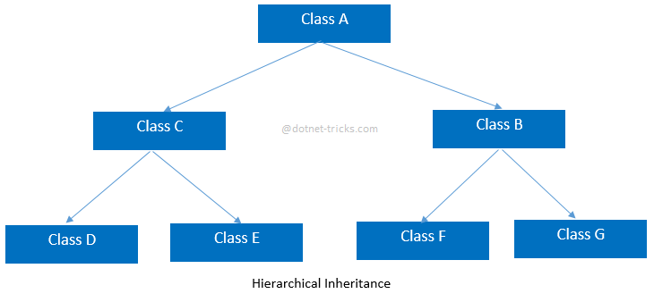
Hierarchical Inheritance
In this inheritance, more than one derived classes are created from a single base class and further child classes act as parent classes for more than one child classes.

Slide 41
Hierarchical Inheritance
#include <iostream>
using namespace std;
class Vehicle
{
public:
Vehicle()
{
cout << "This is a Vehicle" << endl;
}
};
class Car: public Vehicle
{
};
class Bus: public Vehicle
{
};
int main()
{
Car obj1;
Bus obj2;
}

Slide 42
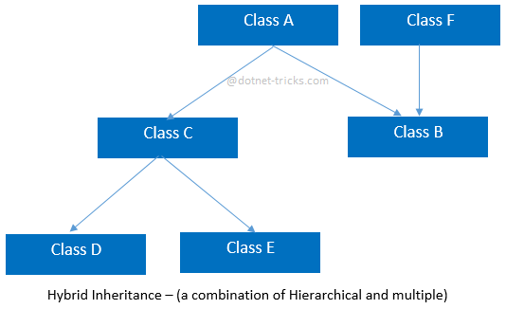
Hybrid Inheritance
This is combination of more than one inheritance. Hence, it may be a combination of Multilevel and Multiple inheritance or Hierarchical and Multilevel inheritance or Hierarchical and Multipath inheritance or Hierarchical, Multilevel and Multiple inheritance.

Slide 43
Problem
Create below inheritance, create one data member in A and one data member in B and one member in C. find the sum and average of all three data in D class.
A
C
B
D

Slide 44
Hybrid Inheritance
#include <iostream>
using namespace std;
class Vehicle
{
public:
Vehicle()
{
cout << "This is a Vehicle" << endl;
}
};
class Fare
{
public:
Fare()
{
cout<<"Fare of Vehicle\n";
}
};
class Car: public Vehicle
{
};
class Bus: public Vehicle, public Fare
{
};
int main()
{
Bus obj2;
return 0;
}

Slide 45
Q1
What is inheritance in C++?
a) A way to achieve multiple inheritance b) A way to reuse code and create a new class from an existing class c) A way to hide the implementation details of a class d) A way to implement encapsulation
Solution: b) A way to reuse code and create a new class from an existing class
Notes:
D

Slide 46
Q2
Which access specifier in C++ allows the derived class to access the public members of the base class?
a) public b) private c) protected d) friend
Solution: a) public

Slide 47
Q3
Which type of inheritance allows a class to inherit from more than one base class?
a) Single inheritance b) Multiple inheritance c) Multilevel inheritance d) Hierarchical inheritance
Solution: b) Multiple inheritance
Notes:
A

Slide 48
Q4
Which type of inheritance involves creating a chain of derived classes where one class inherits from another and so on?
a) Single inheritance
b) Multiple inheritance
c) Multilevel inheritance
d) Hybrid inheritance
Solution: c) Multilevel inheritance
Notes:
B

Slide 49
Write a program
1. Create two classes named Mammals and MarineAnimals. Create another class named BlueWhale which inherits both the above classes. Now, create a function in each of these classes which prints "I am mammal", "I am a marine animal" and "I belong to both the categories: Mammals as well as Marine Animals" respectively. Now, create an object for each of the above class and try calling
a - function of Mammals by the object of Mammal
b - function of MarineAnimal by the object of MarineAnimal
c - function of BlueWhale by the object of BlueWhale
d - function of each of its parent by the object of BlueWhale

Slide 50
Write a program
2. Make a class named Fruit with a data member to calculate the number of fruits in a basket. Create two other class named Apples and Mangoes to calculate the number of apples and mangoes in the basket. Print the number of fruits of each type and the total number of fruits in the basket.

Slide 51
Solution
class Mangoes:public Fruit{
public:
int z;
void mangoes(){
cout<<"Enter the number of mangoes";
cin>>z;
}
void displayMang(){
cout<<"Number of mangoes are:"<< z;
}
};
int main(){
Fruit a;
Apples b;
Mangoes c;
b.apples();
c.mangoes();
b.displayAppl(); cout<<endl;
c.displayMang(); cout<<endl;
cout<<"Total no. of fruits are:"<<a.sum(b.y,c.z);
}
#include<iostream>
using namespace std;
class Fruit{
public:
int a,b;
int sum(int a,int b){
return a+b;
}};
class Apples:public Fruit{
public:
int y;
void apples(){
cout<<"Enter the number of apples";
cin>>y;
}
void displayAppl(){
cout<<"Number of Apples are:"<< y;
}};

Slide 52
Syllabus for CA:-
Unit 2
Pointer to objects, this pointer, Array of objects, The Standard C++ string class-defining and assigning string objects, Member functions, Modifiers of string class, Differences between pointer and reference variables, Array declaration and processing of multidimensional arrays (inside main and inside class),Pointer to data member
Unit 3
Data File operations : Opening and closing of files, Modes of file, File stream functions, Reading/Writing of files, Sequential access and random access file processing, Binary file operations, Classes and file operations, Structures and file operation Constructors, Destructors and File Handling : Manager functions (constructors and destructor), Default constructor, Constructor with default arguments, Destructors, Parameterized constructor, Copy constructor , Initializer lists
Unit 4
Operator Overloading (unary operator, binary operator overloading)

Slide 53
Resolving ambiguities in inheritance

Slide 54
Ambiguity problem in multiple inheritance
When function with same signatures(or prototypes) appear in multiple base classes , then on accessing the same function with the help of the object of derived class, ambiguity may arise, as compiler cannot decide which base class function to call.
Can be resolved by accessing the function with class name and scope resolution operator along with the object of derived class
<derived_object>.<base_Class_name>::<function_name>(<parameters if required>);

Slide 55
Ambiguity
#include<iostream>
using namespace std;
class B1
{
public:
void display()
{
cout<<"\n In the Base class 1";
}
};
class B2
{
public:
void display()
{
cout<<"\n In the Base class 2";
}
};
class D:public B1,public B2
{
public:
D(){
cout<<"\nObject of derived class is created";
}
};
int main()
{
D obj;
obj.display();//Ambiguity(Compile time error)
}

Slide 56
Solution 1
class D:public B1,public B2
{
public:
D(){
cout<<"\nObject of derived class is created";
}
};
int main()
{
D obj;
//obj.display();//Ambiguity(Compile time error)
Obj. B1::display();
Obj. B2::display();
obj.call();
}
#include<iostream>
using namespace std;
class B1
{
public:
void display()
{
cout<<"\n In the Base class 1";
}
};
class B2
{
public:
void display()
{
cout<<"\n In the Base class 2";
}
};

Slide 57
Solution 2
class D:public B1,public B2
{
public:
D(){
cout<<"\nObject of derived class is created";
}
void call()
{
B1::display();
B2::display();
}
};
int main()
{
D obj;
//obj.display();//Ambiguity(Compile time error)
obj.call();
}
#include<iostream>
using namespace std;
class B1
{
public:
void display()
{
cout<<"\n In the Base class 1";
}
};
class B2
{
public:
void display()
{
cout<<"\n In the Base class 2";
}
};

Slide 58
Ambiguity problem in hybrid inheritance
Also known as diamond problem
Situation may arise when multiple copies of the grandparent’s class member is available in the child via multiple paths offered by parents classes. Hence ambiguity arises
Path 1:B→B1→D
Path 2:B→B2→D
B
B1
B2
D

Slide 59
Program-Ambiguity problem in hybrid inheritance
#include<iostream>
using namespace std;
class B
{
protected:
int x;
public:
void get_dataB()
{
cout<<"\n Enter value of x:";
cin>>x;
}
};
class DB1:public B
{
protected:
int y;
public:
void get_dataDB1()
{
cout<<"\n Enter value of y:";
cin>>y;
}
};

Slide 60
Continued…..
class DB2: public B
{
protected:
int z;
public:
void get_dataDB2()
{
cout<<"\n Enter value of z:";
cin>>z;
}
};
class D:public DB1,public DB2
{
public:
void sum()
{
int result;
result=x+y+z;
cout<<"\n Result is:"<<result;
}
};
int main()
{
D obj1;
obj1.get_dataB(); //will give error
obj1.get_dataDB1();
obj1.get_dataDB2();
obj1.sum();
return 0;
}

Slide 61
Solution is Virtual base class

Slide 62
Virtual base class
Virtual base classes are used to prevent multiple instances of a given class from appearing in an inheritance hierarchy when using multiple inheritances.

Slide 63
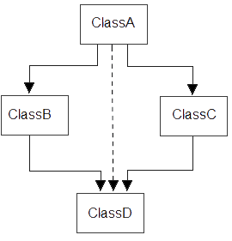
Solution to ambiguity problem in hybrid (Virtual Base Class)
Virtual base class can be used to remove the ambiguity problem
It will create a virtual path from grandparent class to the child class, so that only one copy of grandparent’s member is available in the child class, hence ambiguity is resolved.
In the following diagram we have a virtual path from Class A to Class D, hence single copies of Class A members will be available in Class D.

Slide 64
Virtual Base Class(Solution)-Ambiguity problem in hybrid inheritance
#include<iostream>
using namespace std;
class B
{
protected:
int x;
public:
void get_dataB()
{
cout<<"\n Enter value of x:";
cin>>x;
}
};
class DB1:public virtual B
{
protected:
int y;
public:
void get_dataDB1()
{
cout<<"\n Enter value of y:";
cin>>y;
}
};

Slide 65
Continued…..
class DB2: public virtual B
{
protected:
int z;
public:
void get_dataDB2()
{
cout<<"\n Enter value of z:";
cin>>z;
}
};
class D:public DB1,public DB2
{
public:
void sum()
{
int result;
result=x+y+z;
cout<<"\n Result is:"<<result;
}
};
int main()
{
D obj1;
obj1.get_dataB();
obj1.get_dataDB1();
obj1.get_dataDB2();
obj1.sum();
return 0;
}

Slide 66
Overriding member functions

Slide 67
Function Overriding
When function with same signature(or prototype) is redefined in the derived class [i.e. Base and derived class have same function], then on accessing the same function with the object of derived class, always derived class version of that function will be called, as it will override( or hide) the base class function.
If we want to access the base class version of that function, then it can be accessed with the help of base class name and scope resolution operator used with the derived class object.
<derived_object>.<base_Class_name>::<function_name>(<parameters if required>);

Slide 68
Program: Function overriding
#include<iostream>
using namespace std;
class A
{
public:
void show()
{
cout<<"\nIn Base Class A";
}
};
class B:public A
{
public:
void show()
{
cout<<"\nIn Derived Class B";
//A::show(); //first solution
}
};
int main()
{
B obj1;
obj1.show(); //Derived class show() will be called
//obj1.A::show();
return 0;
}

Slide 69
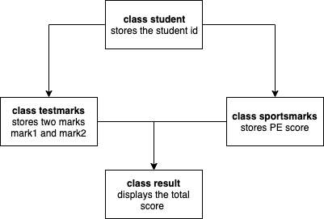
Write a Program
Use virtual base classes to aid you with the design. The class names to be used and the data to be stored are provided in the below diagram.

Slide 70
Write a Program
Input Format
The first line consists of the student ID, which is an integer.
The second line and third line consist of mark1 followed by mark2, both of which have decimal values.
The third line consists of a score, which also has a decimal value.
Output Format
The first line of the output displays the student ID.
The second line displays the mark1.
The third line displays the mark2.
The fourth line displays the score.
The last line displays the total score.
If the given mark or score is not within the range, it displays the corresponding message.

Slide 71
Solution
#include <iostream>
using namespace std;
class student
{
protected:
int id;
public:
void getID(){
cout<<"enter id";
cin>>id;
}
void printID(){
cout<<"ID: "<<id<<endl;
}
};

Slide 72
Continued….
class testmarks: public virtual student{
protected:
float mark1, mark2;
public:
void getMarks(){
cout<<"Enter mark1";
cin>>mark1;
if(mark1 < 0 || mark1 > 100){
cout<<"Invalid mark 1. Only enter values between 0 and 100"<<endl;
}
cout<<"Enter mark2";
cin>>mark2;
if(mark2 < 0 || mark2 > 100){
cout<<"Invalid mark 2. Only enter values between 0 and 100"<<endl;
} }
void printMarks(){
cout<<"Mark 1: "<<mark1<<endl<<"Mark 2: "<<mark2<<endl;
}};

Slide 73
Continued….
class sportsmarks: public virtual student
{
protected:
float score;
public:
void getScore(){
cout<<"Enter score";
cin>>score;
if(score < 0 || score > 100){
cout<<"Invalid score. Only enter values between 0 and 100"<<endl;
}
}
void printScore(){
cout<<"Score: "<<score<<endl;
}
};

Slide 74
Continued….
class result: public testmarks, public sportsmarks
{
float total;
public:
void display(){
total = mark1+mark2+score;
printID();
printMarks();
printScore();
cout<<"Total score: "<<total;
}
};

Slide 75
Continued….
int main()
{
result s1;
s1.getID();
s1.getScore();
s1.getMarks();
s1.display();
return 0;
}

Slide 76
Order of execution of constructors and destructors

Slide 77
Order of execution of constructor and destructor during inheritance
If a constructor is defined in the base class and derived class, then on creating the object of derived class, base class constructor will be executed first, then derived class constructor will be called.
Order of execution of destructor will be in reverse order as that of the order of execution of constructor.
If a base class is having default constructor, then it is optional for derived class to have a default constructor.
If a base class is having parameterized constructor, then it is mandatory for derived class to have a parameterized constructor which will pass the parameters to the base class constructor through initializer list.

Slide 78
Order of execution of constructor and destructor during single inheritance[Default constructor in both classes]
class B:public A
{
public:
B()
{
cout<<"\n Calling default derived constructor";
}
~B()
{
cout<<"\nCalling derived class destructor";
}
};
int main()
{
B obj1;
return 0;
}
#include<iostream>
using namespace std;
class A
{
public:
A()
{
cout<<"\nCalling default base class constructor";
}
~A()
{
cout<<"\nCalling base class destructor";
}
};

Slide 79
Output
Calling default base class constructor
Calling default derived constructor
Calling derived class destructor
Calling base class destructor

Slide 80
Order of execution of constructor and destructor during single inheritance[Parameterized constructor in both classes]
#include<iostream>
using namespace std;
class A
{
int x;
public:
A(int a)
{
x=a;
cout<<"\nCalling base class parameterized "<<x;
}
~A()
{
cout<<"\nCalling base class destructor";
}
};
class B:public A
{
int m;
public:
B(int p):A(p)
{
m=p;
cout<<"\nCalling derived class parameterized:"<<m;
}
~B()
{
cout<<"\nCalling derived class destructor";
}};
int main()
{
B obj2(1);
}

Slide 81
Output
Calling base class parameterized 1
Calling derived class parameterized: 1
Calling derived class destructor
Calling base class destructor

Slide 82
Order of execution of constructor and destructor during single inheritance[Parameterized and default constructor in both classes]
class B:public A
{
int l;
public:
B()
{
cout<<"\nCalling derived class default";
}
B(int p):A(p)
{
l=p;
cout<<"\nCalling derived class parameterized constructor";
}
~B()
{
cout<<"\nCalling derived class destructor";
}};
#include<iostream>
using namespace std;
class A{
int x;
public:
A(){
cout<<"\nCalling base class default";}
A(int a){
x=a;
cout<<"\nCalling base class parameterized constructor "<<x;}
~A()
{
cout<<"\nCalling base class destructor";
}};

Slide 83
Continued…..
int main()
{
B obj1;
B obj2(1);
return 0;
}
Output:
Calling base class default
Calling derived class default
Calling base class parameterized constructor 1
Calling derived class parameterized constructor
Calling derived class destructor
Calling base class destructor
Calling derived class destructor
Calling base class destructor

Slide 84
Q1
In case of inheritance where both base and derived class are having constructors, when an object of derived class is created then___________ .
A. constructor of derived class will be invoked first
B. constructor of base class will be invoked first
C. constructor of derived class will be executed first followed by base class
D. constructor of base class will be executed first followed by derived class
Notes:
D

Slide 85
Solution
In case of inheritance where both base and derived class are having constructors, when an object of derived class is created then___________ .
A. constructor of derived class will be invoked first
B. constructor of base class will be invoked first
C. constructor of derived class will be executed first followed by base class
D. constructor of base class will be executed first followed by derived class
Notes:
D

Slide 86
Q2
If base class has constructor with arguments, then it will be ________________ for the derived class to have constructor and pass the arguments to base class constructor.
A. Optional
B. Mandatory
C. Compiler dependent
D. Compiler Error Situation
Notes:
B

Slide 87
Solution
If base class has constructor with arguments, then it will be ________________ for the derived class to have constructor and pass the arguments to base class constructor.
A. Optional
B. Mandatory
C. Compiler dependent
D. Compiler Error Situation
Notes:
B

Slide 88
Q3
In case of inheritance where both base and derived class are having constructor and destructor, then which if the following are true ?
1. Constructors are executed in their order of derivation
2. Constructors are executed in reverse order of derivation
3. Destructors are executed in their order of derivation
4. Destructors are executed in reverse order of derivation
A. Only 2 ,4
B. Only 1 , 3
C. Only 1 , 4
D. Only 2, 3
Notes:
C

Slide 89
Solution
In case of inheritance where both base and derived class are having constructor and destructor, then which if the following are true ?
1. Constructors are executed in their order of derivation
2. Constructors are executed in reverse order of derivation
3. Destructors are executed in their order of derivation
4. Destructors are executed in reverse order of derivation
A. Only 2 ,4
B. Only 1 , 3
C. Only 1 , 4
D. Only 2, 3
Notes:
C

Slide 90
Q4
What is the output?
#include <iostream>
using namespace std;
class Base
{
public:
Base()
{ cout << "Base";
}
};
class Derived : public Base
{
public:
Derived(int i)
{ cout << i; }
};
int main()
{
Derived d2(10);
}
Base10
10Base
Base
10
Notes:
A

Slide 91
Solution
#include <iostream>
using namespace std;
class Base
{
public:
Base() { cout << "Base"; }
};
class Derived : public Base
{
public:
Derived(int i) { cout << i; }
};
int main()
{
Derived d2(10);
return 0;
}
Base10
10Base
Base
10
Notes:
A

Slide 92
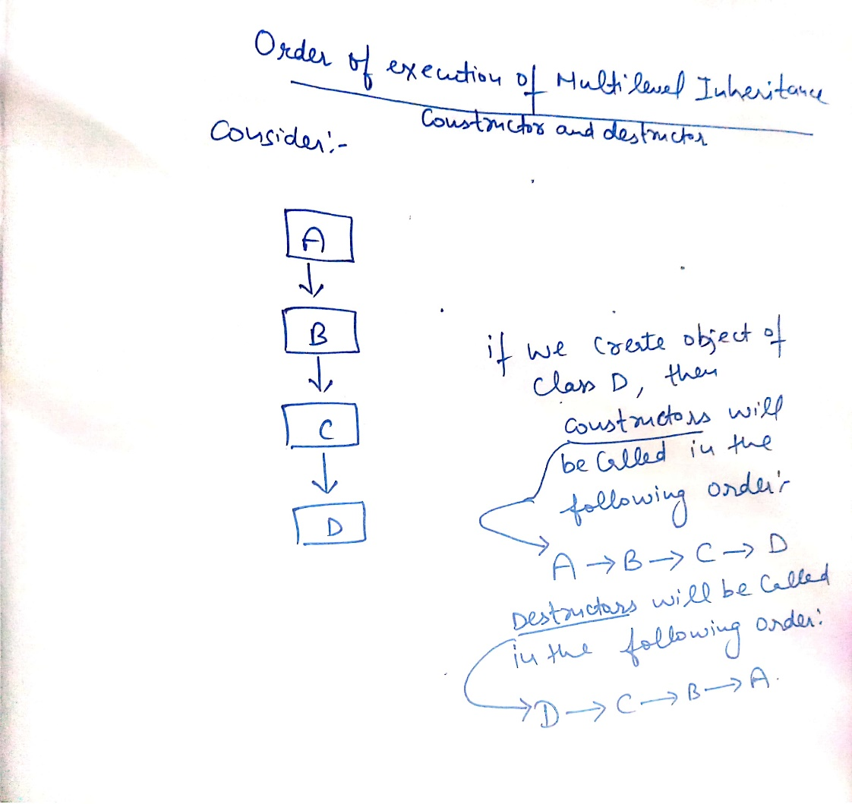
Order of execution of constructor and destructor during Multilevel inheritance

Slide 93
Example
#include<iostream>
using namespace std;
class A
{
int x,y;
public:
A(int r,int s)
{
x=r;
y=s;
cout<<"\nCalling base class constructor:"<<x<<" "<<y;
}
~A()
{
cout<<"\nCalling base class destructor";
}
};
class B:public A
{
int l,m;
public:
B(int p,int q,int r,int s):A(r,s)
{
l=p;
m=q;
cout<<"\nCalling derived class B constructor:"<<l<<" "<<m;
}
~B()
{
cout<<"\nCalling derived B class destructor";
}
};

Slide 94
Continued……..
class C:public B
{
int n,m;
public:
C(int u,int v,int p,int q,int r,int s):B(p,q,r,s)
{
n=u;
m=v;
cout<<"\nCalling derived class C constructor with values:"<<n<<" "<<m;
}
~C()
{
cout<<"\nCalling derived class C destructor";
}
};
int main()
{
C obj1(1,2,3,4,5,6);
return 0;
}
Output:
Calling base class constructor:5 6
Calling derived class B constructor:3 4
Calling derived class C constructor with values:1 2
Calling derived class C destructor
Calling derived B class destructor
Calling base class destructor

Slide 95
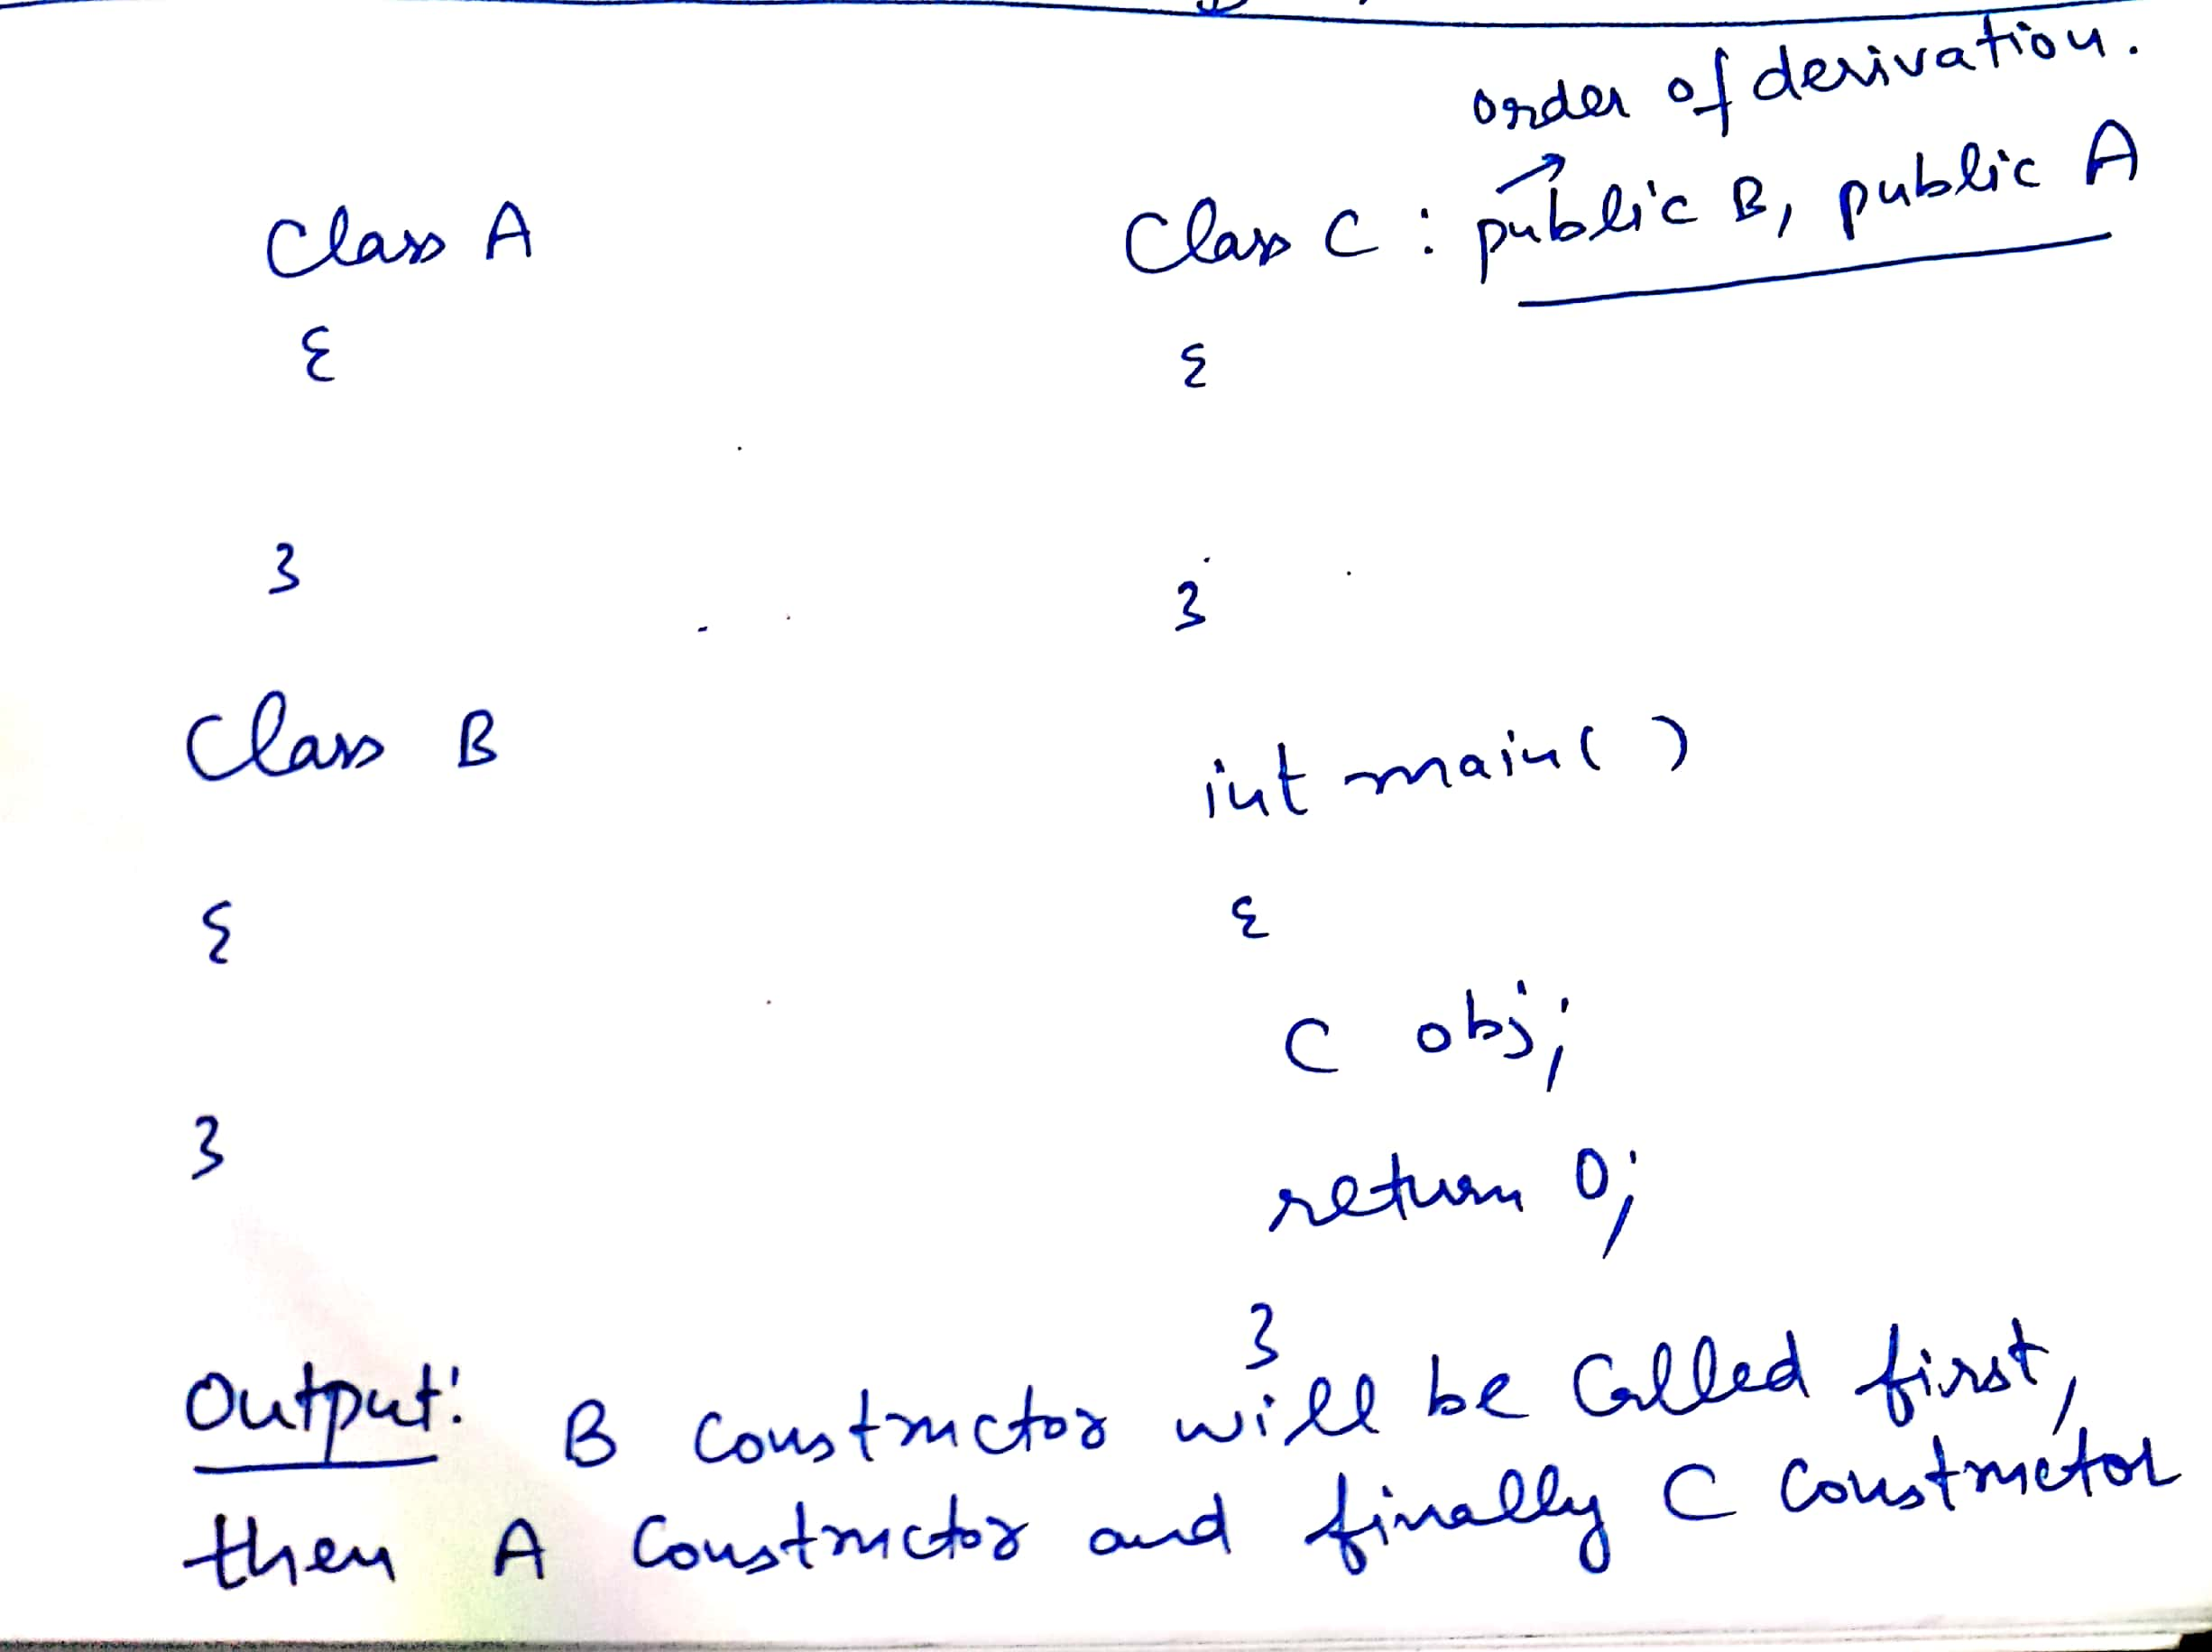
Order of execution of constructor and destructor during Multiple inheritance
Order of execution of constructor during multiple inheritance is dependent upon the order of derivation(or order of inheritance).
Order of execution of destructor will be reverse as that of order of execution of constructor

Slide 96
Example
#include<iostream>
using namespace std;
class M
{
protected:
int m;
public:
M(int x)
{
m=x;
cout<<"\nIn M";
}
};
class N
{
protected:
int n;
public:
N(int y)
{
n=y;
cout<<"\nIn N";
}
};

Slide 97
Continued….
class P:public M,public N
{
int l;
public:
P(int p,int q,int r):M(r),N(q)
{
l=p;
cout<<"\n In P";
}
void display()
{
cout<<“\n”<<"m="<<m<<" "<<"n="<<n<<" "<<"l="<<l;
}
};
int main()
{
P obj1(3,2,1);
obj1.display();
return 0;
}
Output:
In M
In N
In P
m=1 n=2 l=3

Slide 98
MCQ 1
//Output??
#include<iostream>
using namespace std;
class Base1 {
public:
Base1()
{ cout << " Base1's constructor called" << endl; }
};
class Base2 {
public:
Base2()
{ cout << "Base2's constructor called" << endl; }
};
class Derived: public Base1, public Base2 {
public:
Derived(){ cout << "Derived's constructor called" << endl; }};
int main()
{
Derived d;
return 0;
}
Options
A. Compiler Dependent
B. Base1′s constructor called
Base2′s constructor called
Derived’s constructor called
C. Base2′s constructor called
Base1′s constructor called
Derived’s constructor called
D. Compiler Error
Notes:
B

Slide 99
Solution
//Output??
#include<iostream>
using namespace std;
class Base1 {
public:
Base1()
{ cout << " Base1's constructor called" << endl; }
};
class Base2 {
public:
Base2()
{ cout << "Base2's constructor called" << endl; }
};
class Derived: public Base1, public Base2 {
public:
Derived(){ cout << "Derived's constructor called" << endl; }};
int main()
{
Derived d;
return 0;
}
Output:
A. Compiler Dependent
B. Base1′s constructor called
Base2′s constructor called
Derived’s constructor called
C. Base2′s constructor called
Base1′s constructor called
Derived’s constructor called
D. Compiler Error
Notes:
B

Slide 100
MCQ 2
//Output?
#include <iostream>
using namespace std;
class Base1 {
public:
~Base1() { cout << " Base1's destructor" << endl; }
};
class Base2 {
public:
~Base2() { cout << " Base2's destructor" << endl; }
};
class Derived: public Base1, public Base2 {
public:
~Derived() { cout << " Derived's destructor" << endl; }
};
int main()
{
Derived d;
return 0;
}
A. Base1's destructor
Base2's destructor
Derived's destructor
B. Derived's destructor
Base2's destructor
Base1's destructor
C. Derived's destructor
D. Compiler Dependent
Notes:
B

Slide 101
Solution
//Output?
#include <iostream>
using namespace std;
class Base1 {
public:
~Base1() { cout << " Base1's destructor" << endl; }
};
class Base2 {
public:
~Base2() { cout << " Base2's destructor" << endl; }
};
class Derived: public Base1, public Base2 {
public:
~Derived() { cout << " Derived's destructor" << endl; }
};
int main()
{
Derived d;
return 0;
}
A. Base1's destructor
Base2's destructor
Derived's destructor
B. Derived's destructor
Base2's destructor
Base1's destructor
C. Derived's destructor
D. Compiler Dependent
Notes:
B

Slide 102
Order of execution of constructor and destructor during hierarchical inheritance
#include<iostream>
using namespace std;
class M
{
protected:
int m;
public:
M(int x)
{
m=x;
cout<<"\nIn M";
}
};
class N:public M
{
protected:
int n;
public:
N(int y):M(y)
{
n=y;
cout<<"\n In N";
}
};

Slide 103
Continued…
class P:public M
{
int l;
public:
P(int p):M(p)
{
l=p;
cout<<"\nIn P";
}
};
int main()
{
N obj1(1);//Output In M,In N
P obj2(2);//Output In M,In P
return 0;
}
Output:
In M
In N
In M
In P

Slide 104
Problem
Create below inheritance, create one data member in A and one data member in B and one member in C. find the sum and average of all three data in D class.
A
C
B
D

Slide 105
Program
A
B
C
D
E
F

Slide 106
Aggregation and Composition

Slide 107
Aggregation
In scenarios where one class uses another class as the data type of its attributes, aggregation as a construct is involved.
Aggregation represents a whole-part relationship between objects in OOP. It is often referred to as a “has-a” relationship, as one object has another object as a part of its state.
Unlike inheritance, where objects are related through a parent-child relationship, objects in an aggregation relationship are loosely coupled and have no inherent hierarchical relationship.
So, aggregation allows objects to share information and operations, but they can still be used independently.

Slide 108
Example
#include <iostream>
using namespace std;
class employee {
public:
employee()
{
cout<<"I am employee"<<endl;
}
~employee()
{
cout<<"Employee destroyed"<<endl;
}
};
class company
{ public:
employee *emp;
//company HAS-A employee
company(employee *emp)
{
this->emp=emp;
cout<<"this is company"<<endl;
cout<<this->emp;
}
~company()
{
cout<<"company destroyed"<<endl;
}};
int main()
{
employee *e1=new employee;
{
company c1(e1);
}
// delete e1;
}

Slide 109
#include <iostream>
using namespace std;
class Address {
public:
string addressLine, city, state;
Address(string addressLine, string city, string state)
{
this->addressLine = addressLine;
this->city = city;
this->state = state;
} };
class Employee
{ private:
Address* address; //Employee HAS-A Address
public:
int id;
string name;
Employee(int id, string name, Address* address)
{
this->id = id;
this->name = name;
this->address = address;
}
void display()
{
cout<<id <<" "<<name<< " "<<address->addressLine<< " "<< address->city<< " "<<address->state<<endl;
}
};
int main(void) {
Address a1= Address("C-146, Sec-15","Noida","UP");
Employee e1 = Employee(101,"Nakul",&a1);
e1.display();
return 0;
}

Slide 110
Composition
Object composition refers to combining two or more different classes with purpose of creating new, more complex class.
In case of composition, an object "owns" another object, rather than just use it, which means if main object will be destroyed, all internal objects should be destroyed as well.
The use of object in a class as data member is referred as “object composition”.
Object composition is an alternative to class inheritance. Here new functionality is obtained by arranging or composing objects to support more powerful functionality.
In this an object can be a collection of many other objects and the relationship is called a has-a relationship or containership. The has-a relationship occurs when an object of one class is contained in another class as a data member.

Slide 111
class car
{ public:
engine eng; //Engine is the part-of car
car()
{
cout<<"this is car"<<endl;
}
~car()
{
cout<<"car destroyed"<<endl;
}};
int main()
{
car c;
}
#include <iostream>
using namespace std;
class engine {
public:
engine()
{
cout<<"I am engine"<<endl;
}
~engine()
{
cout<<"Engine destroyed"<<endl;
}
};

Slide 112
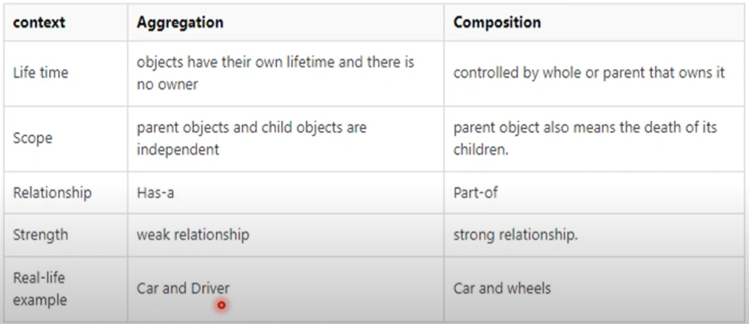

Slide 113
Example
class B
{
…..
…..
};
class D
{
….…
B objb
};

Slide 114
#include<iostream>
using namespace std;
class B{
public:
int num;
B(){
num=0;}
B(int a) {
cout<<"constructor B(int a) is invoked"<<endl;
num=a;
}};
class D{
int data1;
B objb;
public:
D(int a): objb(a)
{ data1=a;}
void output()
{ cout<<"data in object of class D="<<data1<<endl;
cout<<"data in member object of class B in class D="<<objb.num; }};
int main()
{
D objd(10);
objd.output();
return 0;
}
Output:
constructor B(int a) is invoked
data in object of class D=10
data in member object of class B in class D=10

Slide 115
WAP
Write a program that takes the obtained marks as input and calculates the percentage based on the given marks and a total mark value. Using the percentage, determine the grade according to the following criteria:
Percentage >= 90: Grade A+
Percentage >= 80: Grade A
Percentage >= 70: Grade B
Percentage >= 60: Grade C
Percentage >= 50: Grade D
Percentage < 50: Grade F
The program should create a Grade object with the obtained marks and the determined grade. It should then convert the Grade object to two basic types: an int for the marks and a string for the grade: int marks = studentGrade; . Finally, the program should display the marks and grades.

Slide 116
Solution
operator string() {
return grade;
}
};
int main() {
int obtainedMarks;
int totalMarks = 500;
cput<<"Enter obtained marks";
cin >> obtainedMarks;
int percentage = (obtainedMarks * 100) / totalMarks;
string grade;
if (percentage >= 90) {
grade = "A+";
} else if (percentage >= 80) {
grade = "A";
} else if (percentage >= 70) {
grade = "B";
} else if (percentage >= 60) {
grade = "C";
} else if (percentage >= 50) {
grade = "D";
} else {
grade = "F";
}
Grade studentGrade(obtainedMarks, grade);
int marks = studentGrade;
string finalGrade = studentGrade;
cout << "Marks: " << marks << endl;
cout << "Grade: " << finalGrade;}
#include <iostream>
#include <string>
using namespace std;
class Grade {
private:
int marks;
string grade;
public:
Grade(int m,string g)
{
marks=m;
grade=g;
}
void display() {
cout << "Marks: " << marks << endl;
cout << "Grade: " << grade;
}
operator int() {
return marks;
}

Slide 117
WAP
You are tasked with developing a program to process and display full names. The program should accept user input for the first name and last name, create a FullName class using the provided names, and convert the FullName class to a basic-type string FullName fullName(firstName, lastName). Finally, the converted full name should be displayed on the console.
Input Format The first line of input consists of the first name (a string).
The second line of input consists of the last name (a string).
Output Format The output is a single line displaying the user's full name in the format "First Name Last Name".

Slide 118
Solution
#include <iostream>
#include <string>
using namespace std;
class FullName {
private:
string firstName;
string lastName;
public:
FullName(string first, string last)
{
firstName=first;
lastName=last;
}
void display()
{
cout << firstName << " " << lastName;
}
operator string()
{
return firstName + " " + lastName;
}
};
int main() {
string firstName;
string lastName;
getline(cin, firstName);
getline(cin, lastName);
FullName fullName(firstName, lastName);
string fullNameString = fullName;
cout << fullNameString;
}

