Slide 1
Memory Organization 1 Lecture 40
Overview
Memory Hierarchy
Main Memory
Auxiliary Memory
Associative Memory
Cache Memory
Virtual Memory

Slide 2
Memory Organization 2 Lecture 40
Memory Hierarchy
Memory Hierarchy is to obtain the highest possible access speed while minimizing the total cost of the memory system
Magnetic
tapes
I/O
Main
processor
memory
Magnetic
disks
CPU
Cache
memory
Register
Cache
Main Memory
Magnetic Disk
Magnetic Tape

Slide 3
Memory Organization 3 Lecture 40
Main Memory
RAM and ROM Chips
Typical RAM chip
Chip select 1
CS1
Chip select 2
CS2
128 x 8
Read
RD
RAM
8-bit data bus
Write
WR
7-bit address
AD 7
CS1 CS2 RD WR
Memory function
State of data bus
0 0 x x
Inhibit
High-impedence
0 1 x x
Inhibit
High-impedence
1 0 0 0
Inhibit
High-impedence
1 0 0 1
Write
Input data to RAM
1 0 1 x
Read
Output data from RAM
1 1 x x
Inhibit
High-impedence
Typical ROM chip
Chip select 1
CS1
Chip select 2
CS2
512 x 8
8-bit data bus
ROM
9-bit address
AD 9

Slide 4
Memory Organization 4 Lecture 40
Memory Address Map
Address space assignment to each memory chip
Example: 512 bytes RAM and 512 bytes ROM
Hexa
address
Address bus
Component
10 9 8 7 6 5 4 3 2 1
RAM 1
RAM 2
RAM 3
RAM 4
ROM
0000 - 007F
0080 - 00FF
0100 - 017F
0180 - 01FF
0200 - 03FF
0 0 0 x x x x x x x
0 0 1 x x x x x x x
0 1 0 x x x x x x x
0 1 1 x x x x x x x
1 x x x x x x x x x
Memory Connection to CPU
RAM and ROM chips are connected to a CPU through the data and address buses
- The low-order lines in the address bus select the byte within the chips and other lines in the address bus select a particular chip through its chip select inputs

Slide 5
Memory Organization 5 Lecture 40
Connection of Memory to CPU
Address bus
CPU
16-11
10
9
8
7-1
RD
WR
Data bus
Decoder
3
2
1
0
CS1
CS2
128 x 8
Data
RD
RAM 1
WR
AD7
CS1
CS2
128 x 8
Data
RD
RAM 2
WR
AD7
CS1
CS2
128 x 8
Data
RD
RAM 3
WR
AD7
CS1
CS2
128 x 8
RD
RAM 4
Data
WR
AD7
CS1
1- 7
CS2
512 x 8
8
ROM
Data
9
AD9

Slide 6
Memory Organization 6 Lecture 41
Auxiliary Memory
Information Organization on Magnetic Tapes
file i
block 1 block 2
block 3
EOF
R1
R2 R3 R4
R5
block 3
IRG
R6
EOF
R1
R5 R4
R3 R2
block 1
block 2
Organization of Disk Hardware
Moving Head Disk Fixed Head Disk
Track

Slide 7
Auxiliary Memory
An Auxiliary memory is known as the lowest-cost, highest-capacity and slowest-access storage in a computer system. It is where programs and data are kept for long-term storage or when not in immediate use. The most common examples of auxiliary memories are magnetic tapes and magnetic disks.
Magnetic Disks
A magnetic disk is a type of memory constructed using a circular plate of metal or plastic coated with magnetized materials. Usually, both sides of the disks are used to carry out read/write operations. However, several disks may be stacked on one spindle with read/write head available on each surface.
The following image shows the structural representation for a magnetic disk.

Slide 8
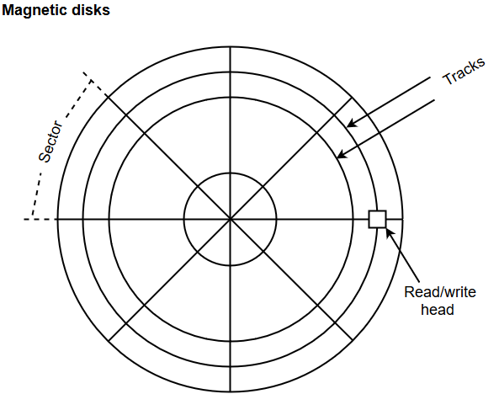
The memory bits are stored in the magnetized surface in spots along the concentric circles called tracks.
The concentric circles (tracks) are commonly divided into sections called sectors.

Slide 9
Magnetic Tape
Magnetic tape is a storage medium that allows data archiving, collection, and backup for different kinds of data. The magnetic tape is constructed using a plastic strip coated with a magnetic recording medium.
The bits are recorded as magnetic spots on the tape along several tracks. Usually, seven or nine bits are recorded simultaneously to form a character together with a parity bit.
Magnetic tape units can be halted, started to move forward or in reverse, or can be rewound. However, they cannot be started or stopped fast enough between individual characters. For this reason, information is recorded in blocks referred to as records.

Slide 10
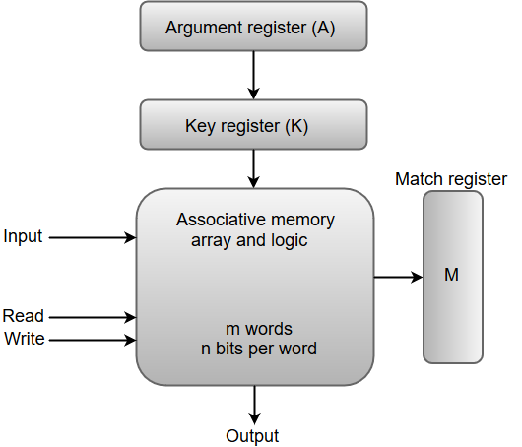
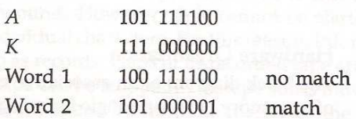
Memory Organization 10 Lecture 41
Associative Memory
- Accessed by the content of the data rather than by an address
- Also called Content Addressable Memory (CAM)

Slide 11
An associative memory can be considered as a memory unit whose stored data can be identified for access by the content of the data itself rather than by an address or memory location.
Associative memory is often referred to as Content Addressable Memory (CAM).
When a write operation is performed on associative memory, no address or memory location is given to the word. The memory itself is capable of finding an empty unused location to store the word.
On the other hand, when the word is to be read from an associative memory, the content of the word, or part of the word, is specified. The words which match the specified content are located by the memory and are marked for reading.

Slide 12
From the block diagram, we can say that an associative memory consists of a memory array and logic for 'm' words with 'n' bits per word.
The functional registers like the argument register A and key register K each have n bits, one for each bit of a word. The match register M consists of m bits, one for each memory word.
The words which are kept in the memory are compared in parallel with the content of the argument register.
The key register (K) provides a mask for choosing a particular field or key in the argument word. If the key register contains a binary value of all 1's, then the entire argument is compared with each memory word. Otherwise, only those bits in the argument that have 1's in their corresponding position of the key register are compared. Thus, the key provides a mask for identifying a piece of information which specifies how the reference to memory is made.
The following diagram can represent the relation between the memory array and the external registers in an associative memory.

Slide 13
Memory Organization 13 Lecture 41
Organization of CAM
A₁
A_{j}
A_{n}
K₁
K_{j}
K_{n}
i= word
j-= bit in word
Word 1
C₁₁
C_{1j}
C_{1n}
M₁
Word i
C_{i1}
C_{ij}
C_{in}
M_{i}
Word m
C_{m1}
C_{mj}
C_{mn}
M_{m}
Bit 1
Bit j
Bit n
Internal organization of a typical cell C_{ij}
Input
A_{j}
K_{j}
Write
R
S
F
Match
To
M
Read
ij
logic
i
Output

Slide 14
The cells present inside the memory array are marked by the letter C with two subscripts. The first subscript gives the word number and the second specifies the bit position in the word. For instance, the cell C_{ij} is the cell for bit j in word i.
A bit A_{j} in the argument register is compared with all the bits in column j of the array provided that K_{j} = 1. This process is done for all columns j = 1, 2, 3......, n.
If a match occurs between all the unmasked bits of the argument and the bits in word i, the corresponding bit M_{i} in the match register is set to 1. If one or more unmasked bits of the argument and the word do not match, M_{i} is cleared to 0.

Slide 15


Memory Organization 15 Lecture 41
Match Logic
K
A
K
A
K
A
1
1
2
2
n
n
F'
F
F'
F
. . . .
F'
F
i1
i1
i2
i2
in
in
M
i

Slide 16
Cache Memory is a special very high-speed memory. The cache is a smaller and faster memory that stores copies of the data from frequently used main memory locations.
There are various different independent caches in a CPU, which store instructions and data. The most important use of cache memory is that it is used to reduce the average time to access data from the main memory.
Characteristics of Cache Memory
Cache memory is an extremely fast memory type that acts as a buffer between RAM and the CPU.
Cache Memory holds frequently requested data and instructions so that they are immediately available to the CPU when needed.
Cache memory is costlier than main memory or disk memory but more economical than CPU registers.
Cache Memory is used to speed up and synchronize with a high-speed CPU.

Slide 17
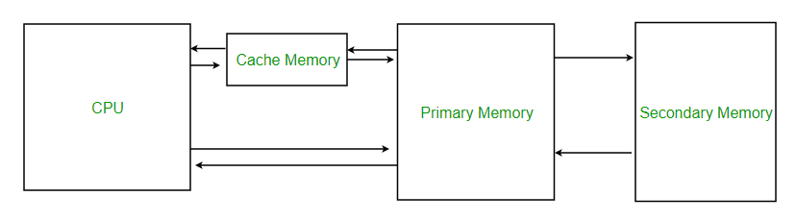

Slide 18
Levels of Memory
Level 1 or Register: It is a type of memory in which data is stored and accepted that are immediately stored in the CPU. The most commonly used register is Accumulator, Program counter, Address Register, etc.
Level 2 or Cache memory: It is the fastest memory that has faster access time where data is temporarily stored for faster access.
Level 3 or Main Memory: It is the memory on which the computer works currently. It is small in size and once power is off data no longer stays in this memory.
Level 4 or Secondary Memory: It is external memory that is not as fast as the main memory but data stays permanently in this memory.

Slide 19
Cache Performance
When the processor needs to read or write a location in the main memory, it first checks for a corresponding entry in the cache.
If the processor finds that the memory location is in the cache, a Cache Hit has occurred and data is read from the cache.
If the processor does not find the memory location in the cache, a cache miss has occurred. For a cache miss, the cache allocates a new entry and copies in data from the main memory, then the request is fulfilled from the contents of the cache.
The performance of cache memory is frequently measured in terms of a quantity called Hit ratio.
Hit Ratio(H) = hit / (hit + miss) = no. of hits/total accesses Miss Ratio = miss / (hit + miss) = no. of miss/total accesses = 1 - hit ratio(H)
We can improve Cache performance using higher cache block size, and higher associativity, reduce miss rate, reduce miss penalty, and reduce the time to hit in the cache.

Slide 20
Cache Mapping:
There are three different types of mapping used for the purpose of cache memory which are as follows:
Direct mapping,
Associative mapping
Set-Associative mapping
Direct Mapping -
In direct mapping, the cache consists of normal high-speed random-access memory. Each location in the cache holds the data, at a specific address in the cache. This address is given by the lower significant bits of the main memory address. This enables the block to be selected directly from the lower significant bit of the memory address. The remaining higher significant bits of the address are stored in the cache with the data to complete the identification of the cached data.

Slide 21
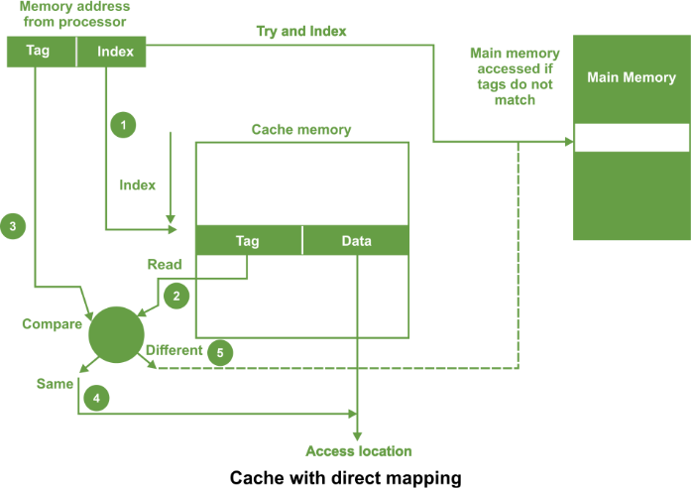

Slide 22
The address from processor is divided into two field a tag and an index.
The tag consists of the higher significant bits of the address and these bits are stored with the data in cache. The index consists of the lower significant b of the address. Whenever the memory is referenced, the following sequence of events occurs
The index is first used to access a word in the cache.
The tag stored in the accessed word is read.
This tag is then compared with the tag in the address.
If two tags are same this indicates cache hit and required data is read from the cache word.
If the two tags are not same, this indicates a cache miss. Then the reference is made to the main memory to find it.
For a memory read operation, the word is then transferred into the cache. It is possible to pass the information to the cache and the process simultaneously.

Slide 23
Memory Organization 23 Lecture 42
Cache Memory
Locality of Reference
- The references to memory at any given time interval tend to be confined within a localized areas
- This area contains a set of information and the membership changes gradually as time goes by
- Temporal Locality
The information which will be used in near future is likely to be in use already( e.g. Reuse of information in loops)
- Spatial Locality
If a word is accessed, adjacent(near) words are likely accessed soon
(e.g. Related data items (arrays) are usually stored together;
instructions are executed sequentially)
Cache
- The property of Locality of Reference makes the cache memory systems work
- Cache is a fast small capacity memory that should hold those information
which are most likely to be accessed
Main memory
CPU
Cache memory

Slide 24
Memory Organization 24 Lecture 42
Performance of Cache
Memory Access
All the memory accesses are directed first to Cache
If the word is in Cache; Access cache to provide it to CPU
If the word is not in Cache; Bring a block (or a line) including
that word to replace a block now in Cache
- How can we know if the word that is required is there ?
- If a new block is to replace one of the old blocks, which one should we choose ?
Performance of Cache Memory System
Hit Ratio - % of memory accesses satisfied by Cache memory system
Te: Effective memory access time in Cache memory system
Tc: Cache access time
Tm: Main memory access time
Te = Tc + (1 - h) Tm
Example: Tc = 0.4 μs, Tm = 1.2μs, h = 0.85%
Te = 0.4 + (1 - 0.85) * 1.2 = 0.58μs

Slide 25
Memory Organization 25 Lecture 42
Memory and Cache Mapping – (Associative Mapping)
Mapping Function
Specification of correspondence between main memory blocks and cache blocks
Associative mapping
Direct mapping
Set-associative mapping
Associative Mapping
- Any block location in Cache can store any block in memory
-> Most flexible
- Mapping Table is implemented in an associative memory
-> Fast, very Expensive
- Mapping Table
Stores both address and the content of the memory word
address (15 bits)
Argument register
Address
Data
CAM
0 1 0 0 0
3 4 5 0
0 2 7 7 7
6 7 1 0
2 2 2 3 5
1 2 3 4

Slide 26
Memory Organization 26 Lecture 42
Cache Mapping – direct mapping
- Each memory block has only one place to load in Cache
- Mapping Table is made of RAM instead of CAM
- n-bit memory address consists of 2 parts; k bits of Index field and n-k bits of Tag field
- n-bit addresses are used to access main memory and k-bit Index is used to access the Cache
n -k
k
Addressing Relationships
Tag(6) Index(9)
00 000
32K x 12
000
Main memory
512 x 12
Cache memory
Address = 15 bits
Address = 9 bits
Data = 12 bits
Data = 12 bits
77 777
777
Direct Mapping Cache Organization
Memory
Memory data
address
Cache memory
00000
1 2 2 0
Index
address
Tag
Data
00777
2 3 4 0
000
0 0
1 2 2 0
01000
3 4 5 0
01777
4 5 6 0
02000
5 6 7 0
02777
6 7 1 0
777
0 2
6 7 1 0

Slide 27
Addressing Relationships
Tag(6) Index(9)
00 000
32K x 12
000
512 x 12
Main memory
Cache memory
Address = 15 bits
Address = 9 bits
Data = 12 bits
Data = 12 bits
77 777
777
Direct Mapping Cache Organization
Memory
address
Memory data
00000
1 2 2 0
Cache memory
Index
address
Tag
Data
00777
2 3 4 0
000
0 0
1 2 2 0
01000
3 4 5 0
01777
4 5 6 0
02000
5 6 7 0
02777
777
0 2
6 7 1 0
6 7 1 0

Slide 28
Memory Organization 28 Lecture 42
Cache Mapping – direct mapping
Operation
- CPU generates a memory request with (TAG;INDEX)
- Access Cache using INDEX ; (tag; data)
Compare TAG and tag
- If matches -> Hit
Provide Cache(data) to CPU
- If not match -> Miss
Search main memory and replace the block from cache memory
Direct Mapping with block size of 8 words
Block 0
000
0 1
3 4 5 0
Tag Block Word
007
0 1
6 5 7 8
010
INDEX
Block 1
017
Block 63
770
0 2
777
0 2
6 7 1 0

Slide 29
Memory Organization 29 Lecture 42
Cache Mapping – Set Associative Mapping
- Each memory block has a set of locations in the Cache to load
Set Associative Mapping Cache with set size of two
Index
Tag
Data
Tag
Data
000
0 1
3 4 5 0
0 2
5 6 7 0
777
0 2
6 7 1 0
0 0
2 3 4 0

Slide 30
Memory Organization 30 Lecture 42
Cache Write
Write Through
When writing into memory
If Hit, both Cache and memory is written in parallel
If Miss, Memory is written
For a read miss, missing block may be overloaded onto a cache block
Memory is always updated
-> Important when CPU and DMA I/O are both executing
Slow, due to the memory access time
Write-Back (Copy-Back)
When writing into memory
If Hit, only Cache is written
If Miss, missing block is brought to Cache and write into Cache
For a read miss, candidate block must be written back to the memory
Memory is not up-to-date, i.e., the same item in
Cache and memory may have different value

Slide 31
Virtual memory is the partition of logical memory from physical memory. This partition supports large virtual memory for programmers when only limited physical memory is available.
Virtual memory can give programmers the deception that they have a very high memory although the computer has a small main memory. It creates the function of programming easier because the programmer no longer requires to worry about the multiple physical memory available.
Virtual memory works similarly, but at one level up in the memory hierarchy. A memory management unit (MMU) transfers data between physical memory and some gradual storage device, generally a disk. This storage area can be defined as a swap disk or swap file, based on its execution. Retrieving data from physical memory is much faster than accessing data from the swap disk.

Slide 32
Paging is a technique of memory management where small fixed-length pages are allocated instead of a single large variable-length contiguous block in the case of the dynamic allocation technique.
In a paged system, each process is divided into several fixed-size ‘chunks’ called pages, typically 4k bytes in length. The memory space is also divided into blocks of the equal size known as frames.
Advantages of Paging
There are the following advantages of Paging are −
In Paging, there is no requirement for external fragmentation.
In Paging, the swapping among equal-size pages and page frames is clear.
Paging is a simple approach that it can use for memory management.

Slide 33
Memory Organization 33 Lecture 43
Virtual Memory
Give the programmer the illusion that the system has a very large memory, even though the computer actually has a relatively small main memory
Address Space(Logical) and Memory Space(Physical)
address space
memory space
virtual address
(logical address)
Mapping
physical address
address generated by programs actual main memory address
Address Mapping
Memory Mapping Table for Virtual Address -> Physical Address
Virtual address
Virtual
Memory
Main memory
address
mapping
address
Main
register
table
register
memory
Physical
Address
Memory table
Main memory
buffer register
buffer register

Slide 34
Memory Organization 34 Lecture 43
Address Mapping
Address Space and Memory Space are each divided into fixed size group of words called blocks or pages
1K words group
Page 0
Page 1
Address space
N = 8K = 2¹³
Page 2
Block 0
Page 3
Memory space
M = 4K = 2¹²
Block 1
Page 4
Block 2
Page 5
Block 3
Page 6
Page 7
Organization of memory Mapping Table in a paged system
Page no.
Line number
1 0 1
0 1 0 1 0 1 0 0 1 1
Virtual address
Table
Presence
address
bit
000
0
Main memory
001
11
1
Block 0
010
00
1
Block 1
011
0
0 1
0 1 0 1 0 1 0 0 1 1
Block 2
100
0
Main memory
Block 3
101
01
1
address register
Memory page table
110
10
1
111
0
MBR
01
1

Slide 35
Memory Organization 35 Lecture 43
Associative Memory Page Table
Assume that
Number of Blocks in memory = m
Number of Pages in Virtual Address Space = n
Page Table
- Straight forward design -> n entry table in memory Inefficient storage space utilization
<- n-m entries of the table is empty
- More efficient method is m-entry Page Table
Page Table made of an Associative Memory
m words; (Page Number: Block Number)
Virtual address
Page no.
1 0 1
Line number
Argument register
1 0 1 0 0
Key register
0 0 1 1 1
0 1 0 0 0
Associative memory
1 0 1 0 1
1 1 0 1 0
Page no.
Block no.
Page Fault
Page number cannot be found in the Page Table

Slide 36
Memory Organization 36 Lecture 43
Page Replacement
Decision on which page to displace to make room for
an incoming page when no free frame is available
Modified page fault service routine
1. Find the location of the desired page on the backing store
2. Find a free frame
- If there is a free frame, use it
- Otherwise, use a page-replacement algorithm to select a victim frame
- Write the victim page to the backing store
3. Read the desired page into the (newly) free frame
4. Restart the user process
valid/
frame
invalid bit
swap
out
1
victim
2
page
f
0
v
i
change to
victim
invalid
3
v
4
swap
f
reset page
desired
table for
page in
new page
backing store
page table
physical memory

Slide 37
Memory Organization 37 Lecture 43
Page Replacement Algorithms
FIFO
Reference string
7
0
1
2
0
3
0
4
2
3
0
3
2
1
2
0
1
7
0
1
7
7
7
2
2
2
4
4
4
0
0
0
7
7
7
0
0
0
3
3
3
2
2
2
1
1
1
0
0
1
1
1
0
0
0
3
3
3
2
2
2
1
Page frames
FIFO algorithm selects the page that has been in memory the longest time
Using a queue - every time a page is loaded, its
identification is inserted in the queue
Easy to implement
May result in a frequent page fault
-
0
1
2
0
3
0
4
2
3
0
3
2
1
2
0
1
7
0
1
7
7
7
2
2
2
2
2
7
0
0
0
0
4
0
0
0
1
1
3
3
3
1
1
Page frames

Slide 38
Memory Organization 38 Lecture 43
Page Replacement Algorithms
LRU
- LRU uses the recent past as an approximation of near future.
Replace that page which has not been
used for the longest period of time @ least recently used page
Reference string
7
0
1
2
0
3
0
4
2
3
0
3
2
1
2
0
1
7
0
1
7
7
7
2
2
4
4
4
0
1
1
1
0
0
0
0
0
0
3
3
3
0
0
1
1
3
3
2
2
2
2
2
7
Page frames
- LRU may require substantial hardware assistance
- The problem is to determine an order for the frames
defined by the time of last use
2 3 2 1 5 2 4 5 3 2 5 2

Slide 39
Page Replacement Algorithms
A virtual memory organization is a consolidation of hardware and software systems. It can make efficient utilization of memory space all the software operations are handled by the memory management software.
The hardware mapping system and the memory management software together form the structure of virtual memory.
When the program implementation starts, one or more pages are transferred into the main memory and the page table is set to denote their location. The program is implemented from the main memory just before a reference is created for a page that is not in memory. This event is defined as a page fault.

Slide 40
When a page fault appears, the program that is directly in execution is stopped just before the required page is transferred into the main memory. Because the act of loading a page from auxiliary memory to main memory is an I/O operation, the operating framework creates this function for the I/O processor.
In this interval, control is moved to the next program in the main memory that is waiting to be prepared in the CPU. Soon after the memory block is assigned and then moved, the suspended program can resume execution.
If the main memory is full, a new page cannot be moved in. Therefore, it is important to remove a page from a memory block to hold the new page. The decision of removing specific pages from memory is determined by the replacement algorithm.

Slide 41
There are two common replacement algorithms used are the first-in, first-out (FIFO) and least recently used (LRU).
The FIFO algorithm chooses to replace the page that has been in memory for the highest time. Every time a page is weighted into memory, its identification number is pushed into a FIFO stack.
FIFO will be complete whenever memory has no more null blocks. When a new page should be loaded, the page least currently transports in is removed. The page to be removed is simply determined because its identification number is at the high of the FIFO stack.
The FIFO replacement policy has the benefit of being simple to execute. It has the drawback that under specific circumstances pages are removed and loaded from memory too frequently.

Slide 42
The LRU policy is more complex to execute but has been more interesting on the presumption that the least recently used page is an excellent applicant for removal than the least recently loaded page as in FIFO. The LRU algorithm can be executed by relating a counter with each page that is in the main memory.
When a page is referenced, its associated counter is set to zero. At permanent intervals of time, the counters related to all pages directly in memory are incremented by 1.
The least recently used page is the page with the largest count. The counters are known as aging registers, as their count denotes their age, that is, how long ago their related pages have been referenced.

