Slide 1

Grammar Rules

Slide 2
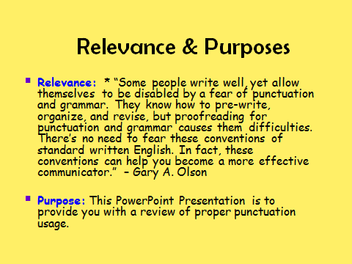

Slide 3
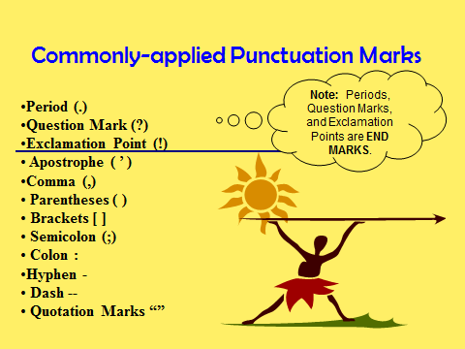

Slide 4
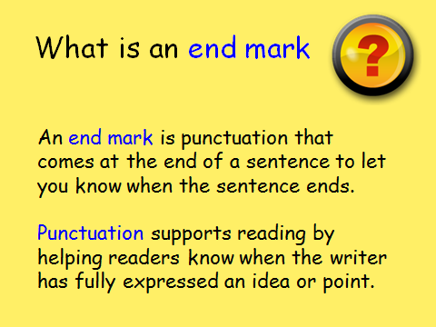

Slide 5
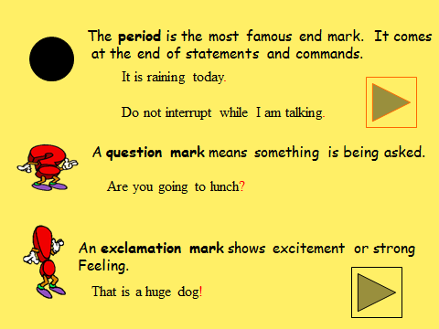

Slide 6
There are four types of sentences:
Declarative
Imperative
Exclamatory
Interrogative

Slide 7
Declarative
A declarative sentence makes a statement.
It is punctuated by a period.
Example: The dog in the neighbor’s yard is barking.

Slide 8
Imperative
An imperative sentence is a command or polite request.
It ends in a period or exclamation mark.
Examples:
Close the door. (command)
Please be quiet.
(polite request)

Slide 9
Exclamatory
An exclamatory sentence expresses great emotion or excitement.
It ends in an exclamation mark.
Example:
The house is on fire!

Slide 10
Interrogative
An interrogative sentence asks a question.
It ends in a ?mark.
Example:
Is it raining?

Slide 11
Now let’s take a pop quiz.
You have an answer sheet on which to record your answers.
You may use these abbreviations: dec.(declarative), imp.(imper-
ative),ex. (exclamatory), int. (interrogative).
Have you made a decision yet?
The girl in the white jacket is lost.
The Bulldogs won the game in the last three minutes!
Give me a piece of pizza.
I did not finish my homework.
Where is my science book?
Please come with me to the movies.
I made a perfect score on this test!
Why is John late for our date?
Open your locker immediately.

Slide 12
Check your answers…
Int
Dec
Ex
Imp
Dec
Int
Imp
Ex
In
Imp
0-1 mistakes EXCELLENT
2-3 mistakes GOOD
4-5 mistakes FAIR
More than 5 mistakes…
view slide show again

Slide 13
By using the four types of sentences in your writing, you can
make your paragraphs more interesting.
Read the sample paragraph below.
My favorite type of fast food is pizza. I could eat pizza
morning, noon, or night. Pepperoni is my number one choice.
I also like double cheese on top. I wish I could order a pizza
right now.
Boring, right? Let’s see how we can use the four types of
sentences and make it more interesting to the reader.

Slide 14
What is your favorite type of fast food? My favorite is pizza. I just love pepperoni and double cheese. Sometimes I think I could eat pizza morning, noon and night! All of this talk about pizza is making me hungry. Let’s order a pizza now.
This is more interesting, right? In this sample we used the four different types of sentences. They provided emotion, excitement, pizzazz to our paragraph.

Slide 15
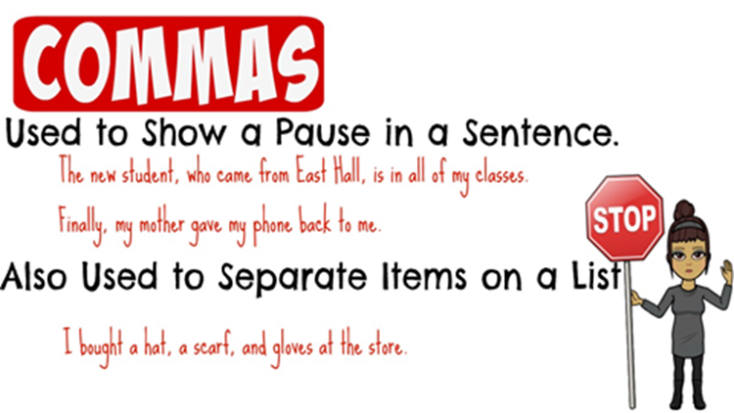

Slide 16
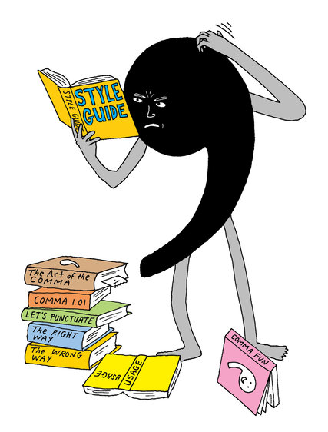
Comma
Use a comma to join 2 independent clauses by a comma and a coordinating conjunction (and, but, or, for, nor, so).
Road construction can be inconvenient, but it is necessary.
The new house has a large fenced backyard, so I am sure our dog will enjoy it.

Slide 17
Use a comma after an introductory phrase, prepositional phrase, or dependent clause.
To get a good grade, you must complete all your assignments.
Because Dad caught the chicken pox, we canceled our vacation.
After the wedding, the guests attended the reception.

Slide 18
Use a comma to separate elements in a series. Although there is no set rule that requires a comma before the last item in a series, it seems to be a general academic convention to include it. The examples below demonstrate this trend.
On her vacation, Lisa visited Greece, Spain, and Italy.
In their speeches, many of the candidates promised to help protect the environment, bring about world peace, and end world hunger.

Slide 19
Use a comma to separate nonessential elements from a sentence. More specifically, when a sentence includes information that is not crucial to the message or intent of the sentence, enclose it in or separate it by commas.
John's truck, a red Chevrolet, needs new tires.
When he realized he had overslept, Matt rushed to his car and hurried to work.
Use a comma between coordinate adjectives (adjectives that are equal and reversible).
The irritable, fidgety crowd waited impatiently for the rally speeches to begin.
The sturdy, compact suitcase made a perfect gift.

Slide 20
Use a comma after a transitional element (however, therefore, nonetheless, also, otherwise, finally, instead, thus, of course, above all, for example, in other words, as a result, on the other hand, in conclusion, in addition).
For example, the Red Sox, Yankees, and Indians are popular baseball teams.
If you really want to get a good grade this semester, however, you must complete all assignments, attend class, and study your notes.

Slide 21
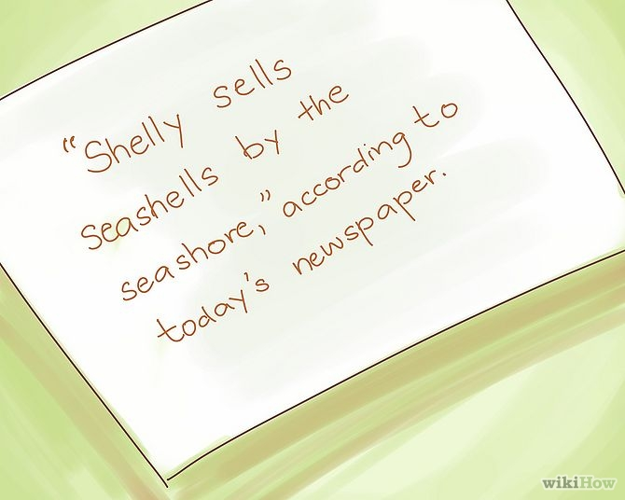
Use a comma with quoted words.
"Yes," she promised. Todd replied, saying, "I will be back this afternoon."

Slide 22
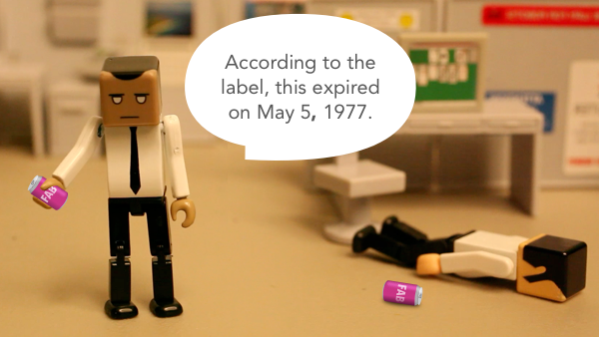
Use a comma in a date.
October 25, 1999
Monday, October 25, 1999
25 October 1999

Slide 23
Use a comma in a number.
15,000,000
1614 High Street

Slide 24
Use a comma in a personal title.
Pam Smith, MD
Mike Rose, Chief Financial Officer for Operations, reported the quarter's earnings.
Use a comma to separate a city name from the state.
West Lafayette, Indiana
Dallas, Texas
Avoid comma splices (two independent clauses joined only by a comma). Instead, separate the clauses with a period, with a comma followed by a coordinating conjunction, or with a semicolon.

Slide 25

When to use periods
.
1. We use a period at the end of sentences that arestatements.
A statement is a sentence that states, or tells, something.
Examples:
•I like to eat pizza.
•School starts on Wednesday.
•The baby's name is Grace.

Slide 26

3. We use a period at the end of sentences that are indirect questions.
An indirect question is a question that is said as a statement. It uses a period instead of a question mark.
Examples:
•She asked me why I didn't go to school yesterday.
•I wondered why Bob wasn't there.
•Tim asked about that book.

Slide 27
2. We use a period at the end of sentences that are commands.
A command is a sentence that tells someone to do something.
Examples:
•Pick up the blue ball.
•Turn left at the next light.
•Hand me the pencil.

Slide 28
4. We use periods in abbreviations.
An abbreviation is a shortened version of a word or words.
Examples:
•United States of America is abbreviated U.S.A.
•Mr. is the abbreviation for Mister.
•Rd. is the abbreviation for road.

Slide 29
5. We use periods in website addresses.
Examples:
•www.dictionary.com
•www.learnersdictionary.com
•www.really-learn-english.com

Slide 30
How to use a period in sentences
1) Do not put a space before a period used to end a sentence.
•Correct: The shirt is blue.
•Incorrect: The shirt is blue.
2) Do put one space after the period if it is followed by another sentence.
•Correct: I am driving to the city. The city is north of here.
•Incorrect: I am driving to the city. The city is north of here.
•Incorrect: I am driving to the city. The city is

Slide 31
Why is the period important?
1) If you do not use a period at the end of a sentence, each sentence will run into the next. That would create confusion for the speaker or reader. The period signals the end of a thought.
Example without periods:
•I visited my friend in the city she lives with her mom they rent an apartment on the south side of town we had a nice visit I hope I can return next year
(You can breath now! :-)

Slide 32
Example with periods:
•I visited my friend in the city. She lives with her mom. They rent an apartment on the south side of town. We had a nice visit. I hope I can return next year.
2) Abbreviations without periods would be random letters placed together without making a word. The period or periods in an abbreviation signal to the reader that it is a shortened form of a word or words.
3) Websites will not work without periods. You must place a period in all correct places for the internet addresses to be correct.

